Slide 1
1.3.1 The Wider Economic Environment
Theme 1: Markets, consumers and firms
1.3 Introducing the market
For more help, please visit www.exampaperspractice.co.uk
© 2025 Exams Papers Practice. All Rights Reserved

Slide 2
Starter
Think about the price you’re willing to pay for good or services
Hands up – how much are you willing to pay for the following
Tesco meal deal
A can of coke
For more help, please visit www.exampaperspractice.co.uk
© 2025 Exams Papers Practice. All Rights Reserved

Slide 3
Demand
Consumer objectives and decisions
The demand curve
The distinction between movements along a demand curve and shifts of a demand curve
The factors that may cause a shift in the demand curve:
Changes in the prices of substitutes and complementary goods
Changes in real incomes
Changes in tastes and fashions
Advertising and branding
Changes in size and age distribution of the population
For more help, please visit www.exampaperspractice.co.uk
© 2025 Exams Papers Practice. All Rights Reserved

Slide 4
Consumer objectives and decisions
The economic objectives of consumers or households might include:
The maximisation of private benefit from consumption
Individuals will seek to attain the highest level of satisfaction available in their consumption of goods and services
The maximisation of private benefit from working
Individuals will seek to attain the highest benefit available in the supply of their labour
This might include higher pay or better working conditions
This will be reflected in the decision making of consumers who are expected to act rationally when making choices
However, as we will see later in the course, this is not always the case
For more help, please visit www.exampaperspractice.co.uk
© 2025 Exams Papers Practice. All Rights Reserved

Slide 5
The demand curve
The demand curve is a graphical representation of the relationship between the price of a good or service and the quantity demanded for a given period of time.
In a typical representation, the price will appear on the left vertical axis, the quantity demanded on the horizontal axis.
For more help, please visit www.exampaperspractice.co.uk
© 2025 Exams Papers Practice. All Rights Reserved

Slide 6
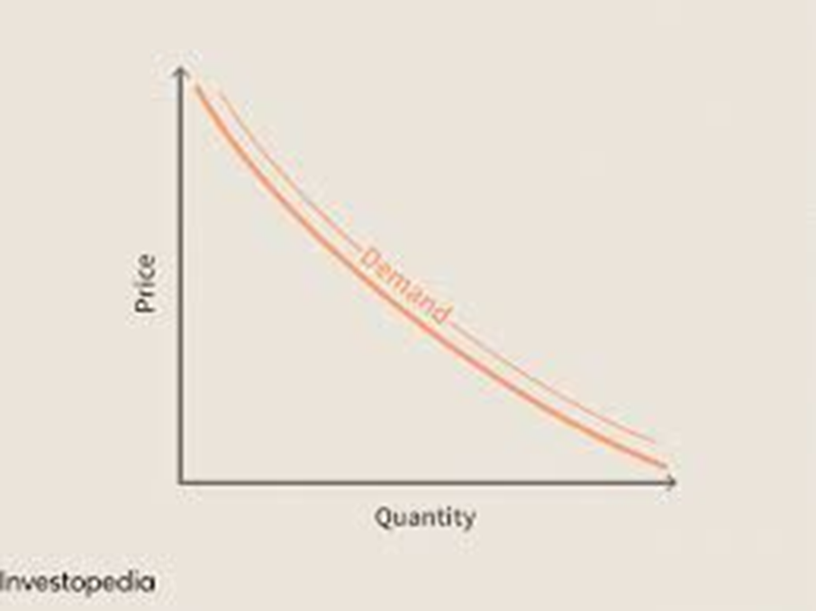
The demand curve
The relationship between price and quantity demanded can be shown using a demand curve
The demand curve shows the quantity demanded for a good, at any given price, over a period of time
As price falls quantity demanded rises
As price rises quantity demanded falls
We plot:
price on the y (vertical) axis quantity on the x (horizontal) axis
A change in price is always shown by a movement along the demand curve
For more help, please visit www.exampaperspractice.co.uk
© 2025 Exams Papers Practice. All Rights Reserved

Slide 7
For more help, please visit www.exampaperspractice.co.uk
© 2025 Exams Papers Practice. All Rights Reserved

Slide 8
The demand curve
A normal good is one where, if price rises, demand will fall and vice versa i.e. a negative correlation.
Rational choice theory makes the assumption that all individuals make logical decisions that will maximise their personal benefit i.e. self-interest.
For more help, please visit www.exampaperspractice.co.uk
© 2025 Exams Papers Practice. All Rights Reserved

Slide 9
The Demand Curve
Rules for drawing a demand curve:
label the y axis price and the x axis quantity
draw the demand curve downward sloping from left to right and label it demand (or D)
to find the quantity demanded at any given price:
a) select a price (P), shown on the y axis
b) draw a dotted line towards the demand curve
c) draw a dotted line down towards the x axis to show quantity (Q)
Price
P
D
0
Q
Quantity
For more help, please visit www.exampaperspractice.co.uk
© 2025 Exams Papers Practice. All Rights Reserved

Slide 10
The Demand Curve
Price
A change in price from £15 to £10 is shown by a movement along the demand curve from 100 to 120 units.
£15
£10
D
100
120
Quantity
For more help, please visit www.exampaperspractice.co.uk
© 2025 Exams Papers Practice. All Rights Reserved

Slide 11
The determinants of demand in a market
Demand can be defined as the amount of a good or service that consumers are willing and able to buy at any given price
There are a number of determinants (influencing factors) of demand:
The price of the good
Consumer income
Prices of other goods and services
Consumer tastes and fashion
Other factors e.g. advertising
Consumers are those people that use goods and services to satisfy their needs and wants.
For more help, please visit www.exampaperspractice.co.uk
© 2025 Exams Papers Practice. All Rights Reserved

Slide 12
The determinants of demand in a market
The quantity demanded of a good or service is said to be a function of (depends upon) all the above factors. This can be shown mathematically:
qd = f (p, y, p of other goods/services, consumer tastes, all other factors)
qd = quantity demanded
f = is a function of
p = price
y = consumer income
For more help, please visit www.exampaperspractice.co.uk
© 2025 Exams Papers Practice. All Rights Reserved

Slide 13
The determinants of demand in a market
In Economics we use the term ceteris paribus meaning all other factors remain the same. The study of Economics is like working in a laboratory.
When Economists raise the price of a good or service they make the assumption that other factors e.g. consumer incomes do not change. This allows us to identify the impact in changes of one factor e.g. price.
For more help, please visit www.exampaperspractice.co.uk
© 2025 Exams Papers Practice. All Rights Reserved

Slide 14
Cause of a movement along a demand curve
The price of the good (p)
Most goods are normal goods
If the price of a normal good or service increases demand for that good or service will decrease
If the price of a normal good or service decreases demand for that good or service will increase
For more help, please visit www.exampaperspractice.co.uk
© 2025 Exams Papers Practice. All Rights Reserved

Slide 15
Cause of a movement along a demand curve
American Economist Thorstein Veblen (1857-1929) identified a ‘snob effect’ where people paid more for certain products as their price increased
He believed that this was due to the increased status that buying higher priced goods conferred on the buyer
A normal good is one where, if price rises, demand will fall and vice versa i.e. a negative correlation.
Veblen goods are a special type of good identified by Veblen. Have you ever bought a Veblen good?
For more help, please visit www.exampaperspractice.co.uk
© 2025 Exams Papers Practice. All Rights Reserved

Slide 16
Factors that cause a shift in the demand curve
Prices of other goods and services
These will have a major impact on the quantity demanded of a product
A substitute product (substitute) acts as an alternative, therefore creating competition
If the price of good A increases, the demand for good B will increase e.g. Coca-Cola and Pepsi Cola
A complementary product (complement) is bought alongside a good or service
If the price of good A increases, the demand for good B will decrease e.g. fish and chips
For more help, please visit www.exampaperspractice.co.uk
© 2025 Exams Papers Practice. All Rights Reserved

Slide 17
Factors that cause a shift in the demand curve
Changes in real incomes (y)
As the income of consumers increases demand for normal goods will increase
This is shown by a shift to the right of the demand curve
An inferior good is one where demand decreases as incomes increase
Scottish Economist Sir Robert Giffen identified certain inferior products where demand rose as consumer incomes increased
Alfred Marshall called these products Giffen goods
For more help, please visit www.exampaperspractice.co.uk
© 2025 Exams Papers Practice. All Rights Reserved

Slide 18
Shifts in the demand curve
Consumer tastes or fashion
People’s tastes change over time and demand for fashionable products changes regularly, often manipulated by advertising
As some products become more fashionable there is an increase in demand
Just as quickly demand can disappear as tastes and fashion change
Advertising and branding
This will increase demand through awareness and loyalty
Size and age distribution of the population
Different demographics will see a change in demand e.g. an increase in those aged over 60 in the UK
For more help, please visit www.exampaperspractice.co.uk
© 2025 Exams Papers Practice. All Rights Reserved

Slide 19
Shifts in the demand curve
If the change in demand is caused by any factor other than price then the demand curve shifts
An increase in demand is shown by a shift to the right
A decrease in demand is shown by a shift to the left
Factors causing a shift in the demand curve include:
Changes in the price or availability of substitutes
Changes in the price or availability of complements
Changes in consumer income
Changes in taste
For more help, please visit www.exampaperspractice.co.uk
© 2025 Exams Papers Practice. All Rights Reserved

Slide 20
Shifts in the demand curve
A substitute product is a competing alternative for another product e.g. Coca-Cola and Pepsi-Cola are substitutes of each other.
Complements are products that are bought alongside another product e.g. tennis balls will be bought as a complement to tennis rackets. These products are consumed together.
For more help, please visit www.exampaperspractice.co.uk
© 2025 Exams Papers Practice. All Rights Reserved

Slide 21
Shifts in the demand curve
A change in any factor other than price e.g. tastes is shown by a shift in the demand curve. An increase in demand can be seen by a shift in the demand curve to the right from D to D1
Price
D
D1
Quantity
For more help, please visit www.exampaperspractice.co.uk
© 2025 Exams Papers Practice. All Rights Reserved

Slide 22
Shifts in the demand curve
What will happen if there is a decrease in demand due to factors other than price e.g. a decline in population?
Draw a new demand curve and label it D1.
Price
D1
D
What other factors would cause the demand curve to shift to the left?
For more help, please visit www.exampaperspractice.co.uk
© 2025 Exams Papers Practice. All Rights Reserved

Slide 23
Quick test
Company A decides to lower prices in order to try and shift surplus stocks. How would this be shown on a demand curve?
A movement along the demand curve to the right
A shift of the demand curve to the right
A movement along the demand curve to the left
A shift of the demand curve to the left
For more help, please visit www.exampaperspractice.co.uk
© 2025 Exams Papers Practice. All Rights Reserved

Slide 24
Quick test
The diagram opposite shows a shift in demand for “Milkit ice cream” from D to D1. What is the most likely cause of this?
A rise in price of “Milkit ice cream”
A fall in price of “Milkit ice cream”
Closure of a competitor of “Milkit ice cream”
Poor weather conditions throughout the summer
Price
D
D1
Quantity
For more help, please visit www.exampaperspractice.co.uk
© 2025 Exams Papers Practice. All Rights Reserved

Slide 25
Quick test
The diagram opposite shows a shift in demand from D to D1. What is the most likely cause of this?
An increase in income tax
An increase in the selling price of a substitute product
Closure of a competitor
A decrease in the selling price of a complementary good
Price
D1
D
Quantity
For more help, please visit www.exampaperspractice.co.uk
© 2025 Exams Papers Practice. All Rights Reserved

Slide 26
Test yourself
Draw 4 demand diagrams to show each of the following changes
A rise in price
A fall in price
An increase in demand caused by a factor other than price e.g. a rise in the price of a substitute product
A decrease in demand caused by a factor other than price e.g. a fall in consumer incomes
For more help, please visit www.exampaperspractice.co.uk
© 2025 Exams Papers Practice. All Rights Reserved

