Slide 1
Production Possibility Frontier
Theme 1: Markets, consumers and firms
For more help, please visit www.exampaperspractice.co.uk
© 2025 Exams Papers Practice. All Rights Reserved

Slide 2
Starter
Gareth and his wife Liz own an allotment. Gareth wants to just grow fruit and veg. Liz wants to also grow flowers.
Can they do both?
How should Gareth and Liz decide how to allocate space in the allotment? Should they grow just fruit and veg, just flowers, or a combination of both?
For more help, please visit www.exampaperspractice.co.uk
© 2025 Exams Papers Practice. All Rights Reserved

Slide 3
What we will cover
What ARE PPF’S?
The distinction between movements along and shifts in
Production possibility curves, considering the possible causes for such changes
The distinction between capital and consumer goods
For more help, please visit www.exampaperspractice.co.uk
© 2025 Exams Papers Practice. All Rights Reserved

Slide 4
Production possibility frontiers
A production possibility frontier (PPF) can be used to show different combinations of output for two products e.g. good x and good y given the resources available
As the output of good x increases that of good y decreases and vice versa
The PPF illustrates the problem of choosing how to use scarce resources when producing goods and services
There is an opportunity cost in deciding what combinations of good x and good y to produce
For more help, please visit www.exampaperspractice.co.uk
© 2025 Exams Papers Practice. All Rights Reserved

Slide 5
Production possibility Diagrams
Wheat
The PPF shows different combinations of output for two products e.g. wheat and hops.
At point A the business can produce 15 units of wheat and 9 units of hops.
The business can produce a combination of wheat and hops anywhere along the PPC e.g. point B.
How many units of wheat and hops can the business produce at point B?
15 units
A
B
9 units
Hops
For more help, please visit www.exampaperspractice.co.uk
© 2025 Exams Papers Practice. All Rights Reserved

Slide 6
Producing anywhere along the PPF shows a full use of resources e.g. points A and B. All factors of production are being used and there is no unemployment of resources. Therefore, there is an efficient allocation of resources.
Producing anywhere within the PPF shows under-use of resources e.g. point C. More resources could be used if there was an increase in efficiency.
At point C we could produce more of both wheat and hops without affecting the current output of these products. Therefore, there is an inefficient allocation of resources.
Production possibility diagrams
Point D is unobtainable as there are not enough resources to produce this level of output. Production at all points on or within the frontier are possible.
Producing at point C shows an inefficiency as not all resources are being used.
Wheat
D
15 units
A
C
B
9 units
Hops
For more help, please visit www.exampaperspractice.co.uk
© 2025 Exams Papers Practice. All Rights Reserved

Slide 7
Production possibility frontiers
The production possibility frontier can be used to show the concepts of scarcity, choice and opportunity cost:
By choosing good X the economic agent sacrifices the benefit of using good Y
There is therefore a choice between two competing resources, this is due to resources being scarce
Remember, the basic economic problem is due to infinite wants but finite resources
For more help, please visit www.exampaperspractice.co.uk
© 2025 Exams Papers Practice. All Rights Reserved

Slide 8
Production possibility frontiers
A trade-off occurs when an economic agent substitutes the production of one good or service for another. This can be seen by a movement along the PPF away from the production of one product and towards the production of another.
The production possibility frontier can be used to show the concepts of trade-offs and conflicting objectives:
Trade-offs between competing uses occurs as there is a choice as to how we utilise resources
Conflicting objectives might arise as there is an opportunity cost as to what goods and services to produce
It might be in the interests of suppliers to produce capital goods whilst consumers might wish to see a greater supply of consumer goods
Future generations will benefit from the production of capital goods whilst the current generation will benefit from the production of consumer goods
Capital goods are those that produce a stream of income in the future e.g. capital goods such as machinery.
Consumption goods are those that produce an immediate benefit to the consumer e.g. a car for personal use.
For more help, please visit www.exampaperspractice.co.uk
© 2025 Exams Papers Practice. All Rights Reserved

Slide 9
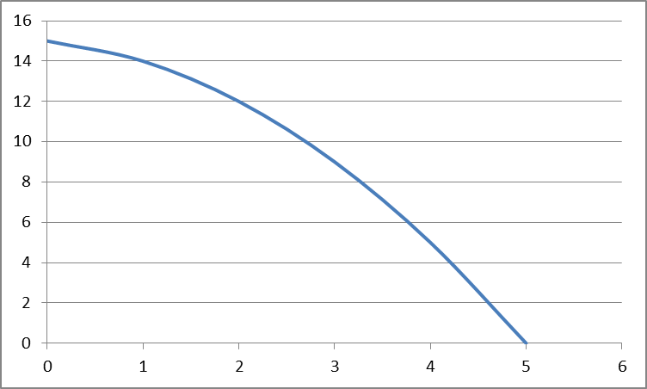
Production possibility frontiers
Motorbikes
A
B
Cars
At A the business can produce 14 motorbikes and 1 car with its resources.
If it were to move to producing at B it would now be producing 12 motorbikes for 2 cars.
The opportunity cost of 1 additional car is therefore the loss of 2 motorbikes.
For more help, please visit www.exampaperspractice.co.uk
© 2025 Exams Papers Practice. All Rights Reserved

Slide 10
Production possibility frontiers and opportunity cost
Wheat
What would be the opportunity cost of shifting from point A on the production possibility curve to point B?
15 units
A
10 units of wheat have been given up to gain 9 units of hops
5 units
B
9 units
18 units
Hops
For more help, please visit www.exampaperspractice.co.uk
© 2025 Exams Papers Practice. All Rights Reserved

Slide 11
Marginal analysis and opportunity cost
We can use marginal analysis to enhance our understanding of the production possibility frontier
Wheat
The opportunity cost of producing one additional unit (the margin) of wheat is 10 units of hops.
10
9
100
110
Hops
For more help, please visit www.exampaperspractice.co.uk
© 2025 Exams Papers Practice. All Rights Reserved

Slide 12
Production possibility diagrams
You have a finite amount of resources in a week.
On the x axis label one other demand on your time.
Add a * on or within the PPF to show how you allocate your resources.
Use this diagram to explain the concept of opportunity cost.
A Levels
For more help, please visit www.exampaperspractice.co.uk
© 2025 Exams Papers Practice. All Rights Reserved

Slide 13
Production possibility diagrams
Economic growth is the percentage change in the total output (GDP) of a country.
An increase in economic growth can be caused by an increase in factor inputs e.g. immigration will see a growth of labour as an input so that we can produce more; increased production of investment goods will allow us to produce more goods and services in the future.
A decline in economic growth can be shown by an inward shift of the PPF e.g. from PPF1 to PPF.
Economic growth caused by an increase in factors of production available in an economy can cause the PPF to shift outwards and to the right.
This will result in an increase in the productive capacity of the economy from PPF to PPF1 i.e. greater output can be produced.
Good y
B
A
PPF
PPF1
Good x
For more help, please visit www.exampaperspractice.co.uk
© 2025 Exams Papers Practice. All Rights Reserved

Slide 14
Production possibility diagrams
Economic shrinkage occurs when there is a reduction in an economy’s production capacity. This will cause the PPF to shift inwards and to the left.
This will result in a decrease in the productive capacity of the economy from PPF to PPF1 i.e. less output can be produced.
Possible causes include:
Natural disasters
Civil unrest
Emigration
Ageing population
Obsolete equipment
Good y
B
A
PPF1
PPF
Good x
For more help, please visit www.exampaperspractice.co.uk
© 2025 Exams Papers Practice. All Rights Reserved

Slide 15
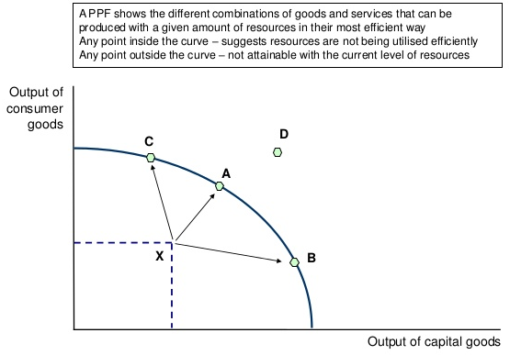
Any point inside the curve indicates resources are not being fully used or not being utilised efficiently.
Any point on the curve shows resources are being fully employed
Any point outside the curve is impossible at the current level of resources.

Slide 16
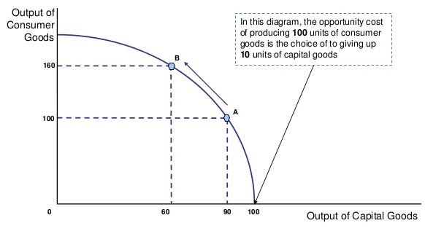
On a curved line the opportunity cost is not constant and we see the influence of the law of diminishing returns.
The opportunity cost of producing 60 more units of consumer good is 30 units of capital good.

Slide 17
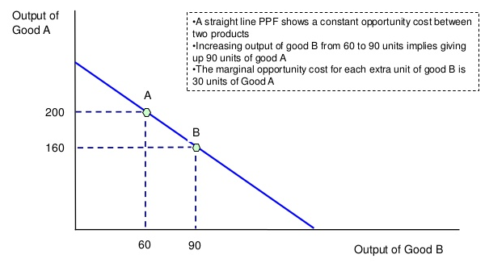
A straight line PPF shows a constant opportunity cost between two products
Increasing output of good B from 60 to 90 units implies giving up 40 units of good A
The opportunity cost of an extra 30 units of good B is 40 units of good A.

Slide 18
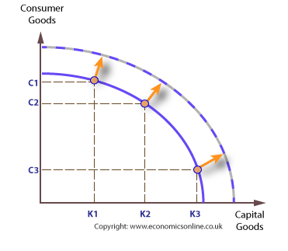
Changing the PPF
The PPF shows the maximum potential output with current resources.
However, if we had a change in our resources (Land, Labour, Capital) it is possible for the PPF to expand.
The new resources are able to be utilised and allow more to be produced.

Slide 19
Efficiency
In economics we like the idea of things being efficient.
We can use a PPF to demonstrate how efficient something is (e.g. an economy or producer).

Slide 20
Any point inside the curve indicates resources are not being fully used or not being utilised efficiently.
Any point on the curve shows resources are being fully employed
Any point outside the curve is impossible at the current level of resources.

Slide 21
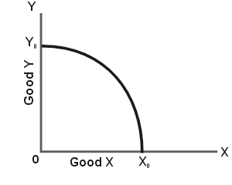
Efficiency
If we are producing anywhere of the boundary we are said to be operating with PRODUCTIVE EFFICIENCY.
It would be impossible for us to produce anymore of one thing without having to give up some of another good

Slide 22
Efficiency
While we can use a PPF to show productive efficiency it is harder to show ALLOCATIVE EFFICIENCY
Allocative efficiency occurs when production of goods best matches peoples tastes and preferences
Allocative efficiency is a point on the PPF but without more information we cannot determine where it is.
Notes:
Remember to point out allocative efficiency does not = maximum welfare
This is dude to the distribution of income, value judgements and externalities

Slide 23
Quick Test
Which of the following is an accurate definition of opportunity cost?
The cost of resources used to meet demand
The cost of one option in terms of the next best option foregone
The cost of advantages offered through specialisation
The cost of combining the factors of production to start a new business

Slide 24
Quick test
A farmer is currently producing OV of crops and OX of dairy. He decides to increase dairy to OY. What is the opportunity cost?
XY
VW
OX
UV
Crops
U
V
W
O
X
Y
Z
Dairy

Slide 25
Quick Test
Describe one economic advantage of concentrating production on one product.
What is shown by a production possibility frontier?
An organic farmer produces apples and pears. Draw a PPC to show how the farmer can increase production of pears. Use your diagram to explain the concept of opportunity cost.
Explain the difference between a movement along and a shift in PPFs.

Slide 26
Opportunity cost
Opportunity cost measures the cost of any choice in terms of the next best alternative foregone.
Work-leisure choices: The opportunity cost of deciding not to work an extra ten hours a week is the lost wages foregone. If you are being paid £7 per hour to work at the local supermarket, if you take a day off from work you might lose over £50 of income
Government spending priorities: The opportunity cost of the government spending nearly £10 billion on investment in National Health Service might be that £10 billion less is available for spending on education or improvements to the transport network.
Investing today for consumption tomorrow: The opportunity cost of an economy investing resources in capital goods is the production of consumer goods given up for today

