Slide 1
1.2.3 Factors of production
Theme 1: Markets, consumers and firms
1.2 Enterprise, business and the economy
For more help, please visit www.exampaperspractice.co.uk
© 2025 Exams Papers Practice. All Rights Reserved

Slide 2
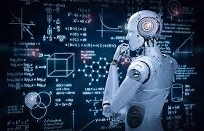
Starter – Solving the economic problem with technology
https://www.bbc.co.uk/news/business-56195288
https://www.wipro.com/holmes/towards-future-farming-how-artificial-intelligence-is-transforming-the-agriculture-industry/
For more help, please visit www.exampaperspractice.co.uk
© 2025 Exams Papers Practice. All Rights Reserved

Slide 3
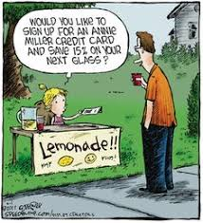
Recall task: Entrepreneurs
Complete the recall activity in your workbook.
For more help, please visit www.exampaperspractice.co.uk
© 2025 Exams Papers Practice. All Rights Reserved

Slide 4
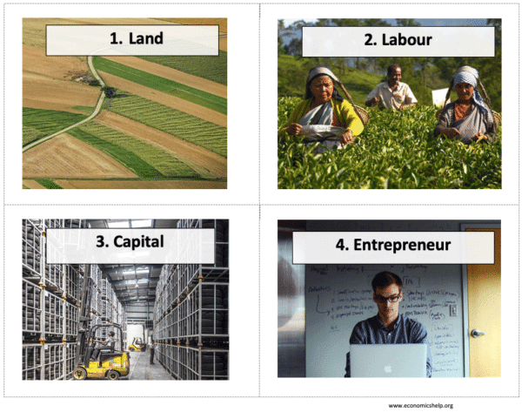
Factors of production
Inputs available in order to supply products and services.
The factors of production are the building blocks of any economy. In other words, they are the inputs that we use to produce goods and services so that we can make an economic profit.
For more help, please visit www.exampaperspractice.co.uk
© 2025 Exams Papers Practice. All Rights Reserved

Slide 5
Factors of production as economic resources
Factors of production are the resources used by firms to produce goods and services
They are called factor inputs
firms input these factors into the production process
The factors of production are known as economic resources as they earn reward for their use in the form of rent, wages, interest and profit
Firms take these resources and turn them into products that they sell for profit
LAND | LABOUR
CAPITAL | ENTERPRISE
For more help, please visit www.exampaperspractice.co.uk
© 2025 Exams Papers Practice. All Rights Reserved

Slide 6
Rewards of production factors
Corporations employ thousands
Make higher profits, increase wages to employees (pay less corporation tax)
Increase innovation/R&D
Expand
Employ more people
More income tax generated from more employed people
Gov pay less benefits because of lower unemployment
Current account surplus
Spend on public services
More educated people/healthier people,
For more help, please visit www.exampaperspractice.co.uk
© 2025 Exams Papers Practice. All Rights Reserved

Slide 7
Enterprise
The entrepreneur takes land, labour and capital and organises them in order to produce products that will be profitable
The skills of the entrepreneur are crucially important to the health of the UK economy
By taking risks the entrepreneur creates wealth and employment in the economy
Today’s small businesses are the large businesses of tomorrow
Profit is the reward for the entrepreneur
For more help, please visit www.exampaperspractice.co.uk
© 2025 Exams Papers Practice. All Rights Reserved

Slide 8
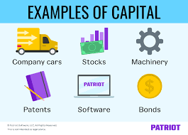
Capital
Capital has a number of meanings e.g. money
As a factor of production it refers to the man-made aids that are used in the production process e.g.
Equipment – machinery and tools
Premises - factories and offices
Capital goods will bring a stream of income in the future rather than being consumed today
e.g. a car used for leisure purposes is a consumption good, but one used as a taxi is a capital good
For more help, please visit www.exampaperspractice.co.uk
© 2025 Exams Papers Practice. All Rights Reserved

Slide 9
Land
Land encompasses all of the natural resources that come from the earth that are used in the production of goods or services
This can include resources:
below the earth e.g. oil
on the earth e.g. crops
above the earth e.g. air
in the sea e.g. fish
These are the raw materials used to generate goods
For more help, please visit www.exampaperspractice.co.uk
© 2025 Exams Papers Practice. All Rights Reserved

Slide 10
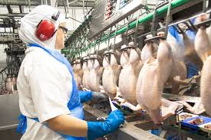
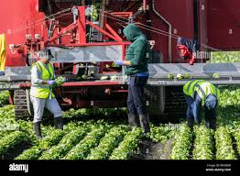
Labour
Labour includes all of the workforce in an economy
Every worker is unique
we all have different skills, qualifications and experience
Job roles differ e.g. a manager or a junior employee
The value of a worker is called its human capital
A worker can be valued by the income they earn
Education and training are likely to increase our human capital
how much are your A Levels worth to you?
For more help, please visit www.exampaperspractice.co.uk
© 2025 Exams Papers Practice. All Rights Reserved

Slide 11
State and explain 2 factors of production that would be used in the production of each of the following examples. Across the examples ensure you cover all 4 factors.
 | State | Explain
Fast food meal 1
Fast food meal 2
Spanish package holiday 1
Spanish package holiday 2
Horse riding school 1
Horse riding school 2
For more help, please visit www.exampaperspractice.co.uk
© 2025 Exams Papers Practice. All Rights Reserved

Slide 12
Quick Test
Which of the following is an example of a factor of production?
Sales revenue enjoyed by a firm
Output by workers
A factory owned by a business
The annual profits achieved by a business
Can you explain your answer?
For more help, please visit www.exampaperspractice.co.uk
© 2025 Exams Papers Practice. All Rights Reserved

Slide 13
Quick Test
Which of the following is an example of an economic resource?
Consumer demand
Factory output
Entrepreneurial skill
Scarcity
Can you explain your answer?
For more help, please visit www.exampaperspractice.co.uk
© 2025 Exams Papers Practice. All Rights Reserved

Slide 14
Quick Test
With the use of relevant examples explain the 4 factors of production.
For more help, please visit www.exampaperspractice.co.uk
© 2025 Exams Papers Practice. All Rights Reserved

