Slide 1


Theme 1: Markets, consumers and firms
1.1.1 The economic problem
1.1 Scarcity, choice and potential conflict
For more help, please visit www.exampaperspractice.co.uk
© 2025 Exams Papers Practice. All Rights Reserved

Slide 2
What we will cover
The problem of scarcity (where there are unlimited wants and finite resources)
Choices and potential trade-offs
The importance of opportunity costs to consumers, producers and government
For more help, please visit www.exampaperspractice.co.uk
© 2025 Exams Papers Practice. All Rights Reserved

Slide 3
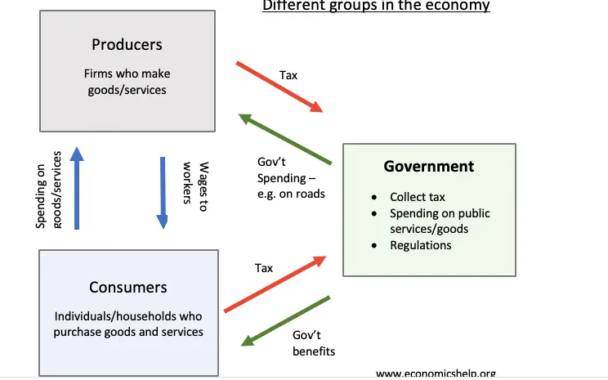
Starter

Slide 4
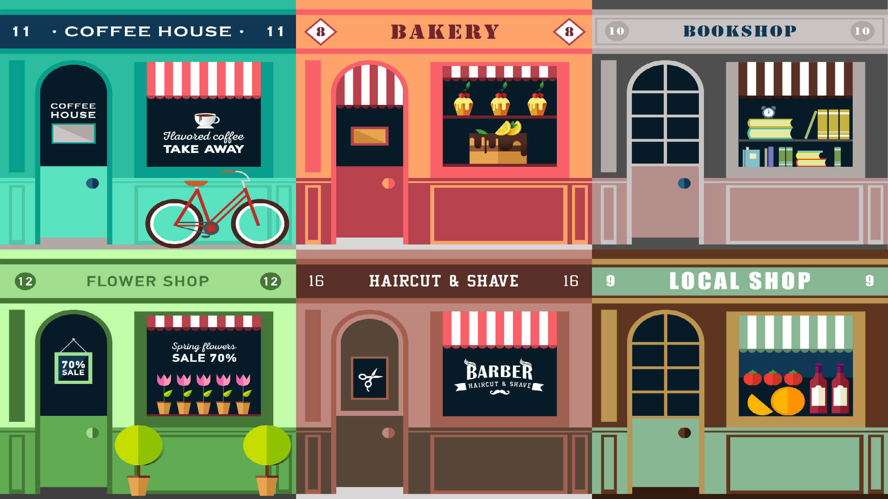

The world
For more help, please visit www.exampaperspractice.co.uk
© 2025 Exams Papers Practice. All Rights Reserved

Slide 5
Recall Activity
Write down the definition of scarcity
Write down two things you need as a consumer and two things you want as a consumer
Challenge: Explain how production of goods is determined in a free market
For more help, please visit www.exampaperspractice.co.uk
© 2025 Exams Papers Practice. All Rights Reserved

Slide 6
What do economists mean by the
‘economic problem’?
People have unlimited wants
However, there aren’t enough resources available to supply all of these wants
This creates the economic problem of scarcity
The ‘economic problem’ occurs when there are finite resources available to supply infinite or unlimited wants i.e. scarcity
Therefore, choices have to be made about how to use these scarce resources
For more help, please visit www.exampaperspractice.co.uk
© 2025 Exams Papers Practice. All Rights Reserved

Slide 7
Economic Activity
The purpose of economic activity is to satisfy the wants and needs of society
  What is the difference between a want and a need?
  Are you ever guilty of using the wrong term?
  Write a list of 4 needs and 4 wants
The economic problem tries to answer 3 basic questions:
  What to produce?
  How to produce?
  Who to produce for?
This problem is faced by consumers, producers and the government.
For more help, please visit www.exampaperspractice.co.uk
© 2025 Exams Papers Practice. All Rights Reserved

Slide 8
Economic Activity
The central purpose of economic activity is the production of goods and services to satisfy needs and wants.
Economic activity will improve economic welfare, the benefit gained by individuals, firms or society in the production of goods and services.
Needs are those things required that are essential to maintain survival.
Wants are those things that are desired but not essential to survival.
For more help, please visit www.exampaperspractice.co.uk
© 2025 Exams Papers Practice. All Rights Reserved

Slide 9
Renewable and non-renewable resources
Renewable resources are ones that can be replenished e.g. trees can be used for wood to generate fuel but they can be replanted
Non-renewable resources are ones that are in finite supply and therefore will run out e.g. oil or natural gas
Sustainable resources are ones that are being used for economic activities in such a manner that they will not run out
However they must be used sensibly e.g. not over fishing and replanting trees
For more help, please visit www.exampaperspractice.co.uk
© 2025 Exams Papers Practice. All Rights Reserved

Slide 10
Renewable resources
In groups complete the table below to show examples of renewable and non-renewable resources
Renewable resources | Non-renewable resources
Wind Solar Tidal Geothermal Biomass Wood Steam | Oil Natural gas Coal Nuclear power Plastic Diamonds
Challenge: Discuss the ethical implications of some renewable resources such as palm oil
For more help, please visit www.exampaperspractice.co.uk
© 2025 Exams Papers Practice. All Rights Reserved

Slide 11
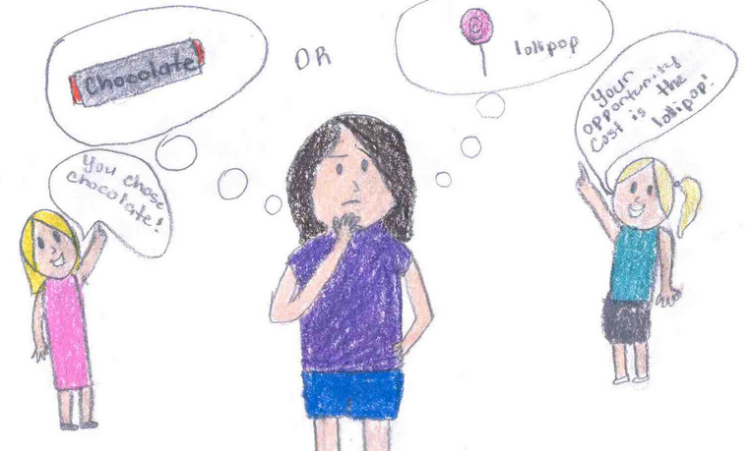
Opportunity cost
What do you think is meant by the term opportunity cost?
Can you write a definition?
For more help, please visit www.exampaperspractice.co.uk
© 2025 Exams Papers Practice. All Rights Reserved

Slide 12
Opportunity Cost
Define the term opportunity cost
Identify 3 economic agents
Define the term trade offs
Challenge: Describe an example of a business making a trade off
For more help, please visit www.exampaperspractice.co.uk
© 2025 Exams Papers Practice. All Rights Reserved

Slide 13
Opportunity cost
Two choices
Petrol Car
Electric Car
If I choose the petrol car that is cheaper to buy outright, the benefit lost of the next best alternative is that I wont pay as little in petrol.
Opportunity cost can be defined as the benefit lost of the next best alternative when making a choice
As all resources are scarce we must make choices in order to allocate these resources
There are always competing alternatives when making choices e.g. should I buy a Pepsi or a Fanta
If I buy a Fanta I have lost the benefit of the closest alternative, a Pepsi
There is an opportunity cost for all decisions made by economic agents
For more help, please visit www.exampaperspractice.co.uk
© 2025 Exams Papers Practice. All Rights Reserved

Slide 14
Opportunity cost
Factor | Opportunity cost
A can of Coca cola | A can of Fanta
An Economics lesson | Sitting in the common room
Getting out of bed | Lying in
Investing in capital goods | Investing in consumer goods
Consumption today | Consumption tomorrow
Going to university | Getting a job
Buying clothes from Ark | Buying clothes from Zara
Watching a live concert | Going to the theatre
Drinking tap water | Time spent
Breathing | No real opportunity cost
For more help, please visit www.exampaperspractice.co.uk
© 2025 Exams Papers Practice. All Rights Reserved

Slide 15
Trade-offs
What are the trade-offs to the Government of student fees?
Opportunity cost is the cost of the next best alternative foregone
However there may be a range of alternatives all of which have been given up
All of these alternatives are referred to as ‘trade-offs’
In pairs:
  Write a definition of the term trade-off
  Support your definition with one example
    From your own experience
    From a government perspective
    From within a business
Why do ‘trade-offs’ exist? Remember to show off your economic terminology
For more help, please visit www.exampaperspractice.co.uk
© 2025 Exams Papers Practice. All Rights Reserved

Slide 16
Opportunity Cost
Identify 3 economic agents
For each of the economic agents you identified above, identify an opportunity cost when setting up a business
For more help, please visit www.exampaperspractice.co.uk
© 2025 Exams Papers Practice. All Rights Reserved

Slide 17
The importance of opportunity costs to economic agents (consumers, producers and government)
What to produce?
  Economic incentives will provide economic agents with the information required to tell them what goods and services to produce
How to produce?
  Firms will combine the factors of production (land, labour, capital and entrepreneurship) in order to produce a good or a service
For whom to produce?
  In a free market economy we produce according to demand and supply
    If there is demand for a product a firm may wish to supply it for a profit
For more help, please visit www.exampaperspractice.co.uk
© 2025 Exams Papers Practice. All Rights Reserved

Slide 18
The importance of opportunity costs to economic agents (consumers, producers and government)
Economic agents are the individuals , firms and governments that partake in economic activity, the demand for and supply of goods and services.
A free market economy is one where firms decide what goods and services to produce with limited intervention from the government.
There is an opportunity cost to all decisions made by economic agents.
For more help, please visit www.exampaperspractice.co.uk
© 2025 Exams Papers Practice. All Rights Reserved

Slide 19
Opportunity Cost
For each answer on the previous slide, explain why the opportunity cost is important to each of the economic agents
Challenge: Identify and explain an opportunity cost that arose from the Covid 19 pandemic
For more help, please visit www.exampaperspractice.co.uk
© 2025 Exams Papers Practice. All Rights Reserved

Slide 20
Quick test
What is the economic problem faced by society?
  How to reduce wants and need
  What, how and for whom to produce goods and services
  How to maximise profits for businesses
  Who to allocate scarce resources to
Can you explain your answer?
For more help, please visit www.exampaperspractice.co.uk
© 2025 Exams Papers Practice. All Rights Reserved

Slide 21
Quick test
The fundamental purpose of economic activity is?
  To increase the supply of renewable resources
  To reduce the use of scarce resources
  Profit maximisation
  The satisfaction of needs and wants
Can you explain your answer?
For more help, please visit www.exampaperspractice.co.uk
© 2025 Exams Papers Practice. All Rights Reserved

Slide 22
The Nature and Purpose of Economic Activity
Finite resources
Infinite wants
Wants
Needs
Economic problem
Scarcity
Choice
Economic activity
Economic welfare
Economic agent
Free market economy
Can you pick any two words and explain the relationship between them?
For more help, please visit www.exampaperspractice.co.uk
© 2025 Exams Papers Practice. All Rights Reserved

