Slide 1

Factors affecting blood pressure
Discuss - fill in mind map with factor and reason why it affects BP
Cardiovascular centre
  Diameter of blood vessels controlled by stimulation of sympathetic and parasympathetic nerves
Smoking
  Nicotine causes vasoconstriction – stimulates the sympathetic nerves
  Build up of fatty deposits in vessels
Diet
  High fat diet leads to build up of fatty deposits in blood vessels
Adrenaline
  Causes selective vasoconstriction & vasodilation
Increase in blood viscosity
  Excess water loss (sweating/excessive urination)
Notes:
What are the Similarities Between Sympathetic and Parasympathetic Nervous System?
Both parts of the autonomic nervous system / involuntary responses
Sympathetic nervous system = fight-or-flight response
Parasympathetic nervous system = control the homeostasis of the body.

Slide 2
Knowledge retrieval question
Read through the following passage on the cardiac cycle, then write on the dotted lines the most appropriate word or words to complete the passage.
The cardiac cycle consists of three stages: atrial systole, ventricular systole and ..................................................................................... .
During atrial systole, the ..................................................................................... contract and the ..................................................................................... are relaxed.
The ..................................................................................... valves are open.
During ventricular systole, the ..................................................................................... open as oxygenated blood is forced out of the heart through the aorta to the body and through the pulmonary ..................................................................................... to the lungs.
diastole
atrium
ventricles
atrioventricular (bicuspid/tricuspid)
semilunar valves
artery

Slide 3
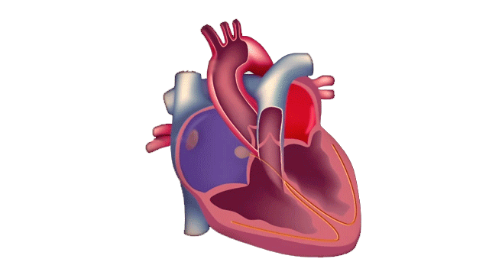
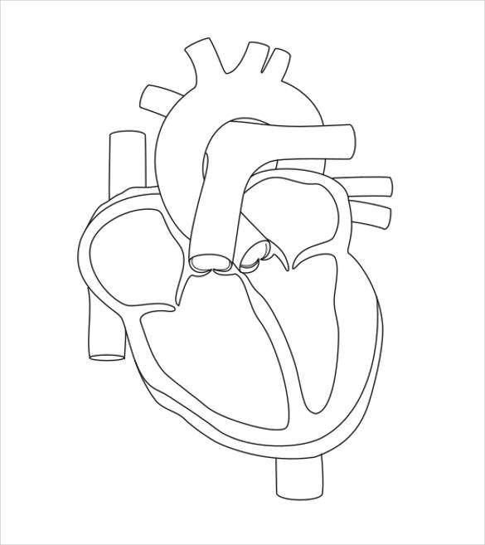
Recap – electrical control
Annotate your diagram

Slide 4
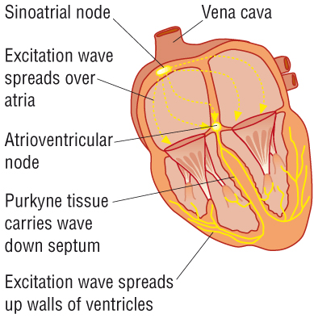
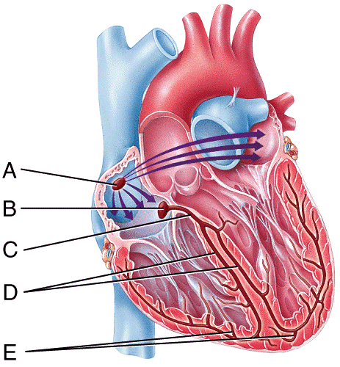
Cardiac muscle is myogenic, meaning it can contract and relax without receiving nerve signals. This pattern controls the heart rate.
A. Sino atrial node (SAN) is found in the wall of the right atrium and acts as a pacemaker. It sends regular waves of electrical activity (waves of excitation) over the atrial walls.
The wave of excitation is passed to the atrio-ventricular node (AVN).
A band of non-conducting tissue prevents this wave passing to the ventricles.
The delay, is in order to allow the atria to have emptied before ventricular contraction begins.
AVN causes a slight delay before passing the wave of excitation down the bundle of His (which is a bundle of conducting tissue containing purkyne fibres).
The Purkyne fibres are muscle fibres which branch upwards, causing the ventricular walls to simultaneously contract, from the bottom (apex) upwards, this allows for a more efficient emptying of the ventricles.
Notes:
How does the SA node create its own signal?
The main function of the SA node is to act as the normal pacemaker of the heart. It initiates an action potential that results in an electrical impulse traveling through the heart’s electrical conduction system to cause myocardial contraction. Unlike atrial and ventricular cells, pacemaker cells in the sinus node do not have a resting phase. Instead, these cells have pacemaker potential, in which they begin to depolarize automatically after an action potential ends.
Action potential : The cell creates a potential difference across the cell membrane that then allows Na and K ions to move through the protein channels creating and impulse .

Slide 5
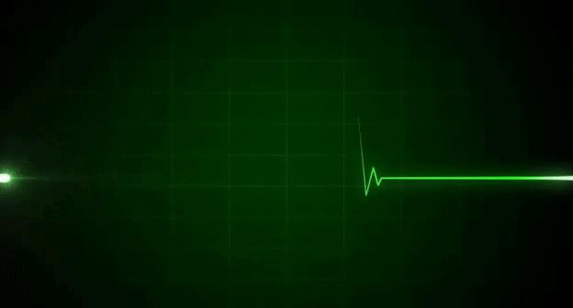

Slide 6
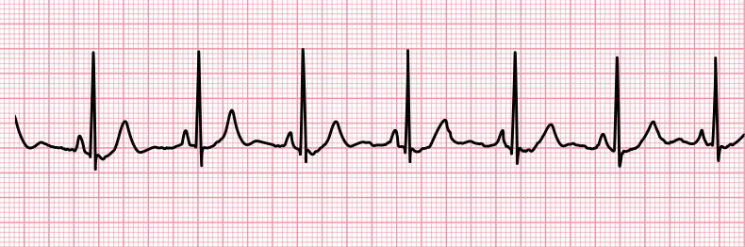
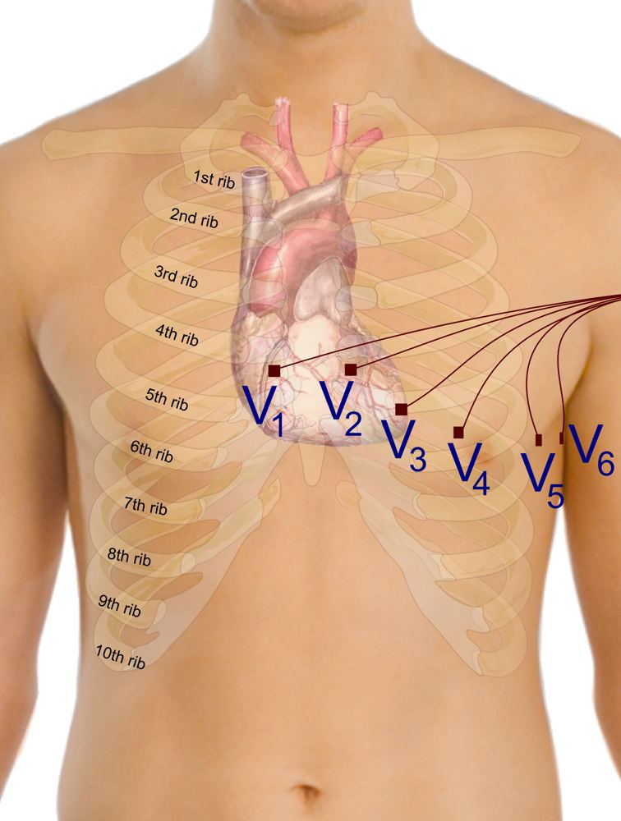
ECG’s
Name?
What do they measure?
How do we take the reading?
What are they used for?
Electrocardiogram (ECG)
Record the spread of electrical excitation in the heart.
Measuring tiny differences in electrical activity on the skin, which have resulted from the electrical activity of the heart.
Electrodes are stuck the skin using gel to help detect the electrical activity. The signal is fed into a machine that produces an ECG trace (See above)
Help doctors diagnose heart problems / or show when someone is having a heart attack.

Slide 7
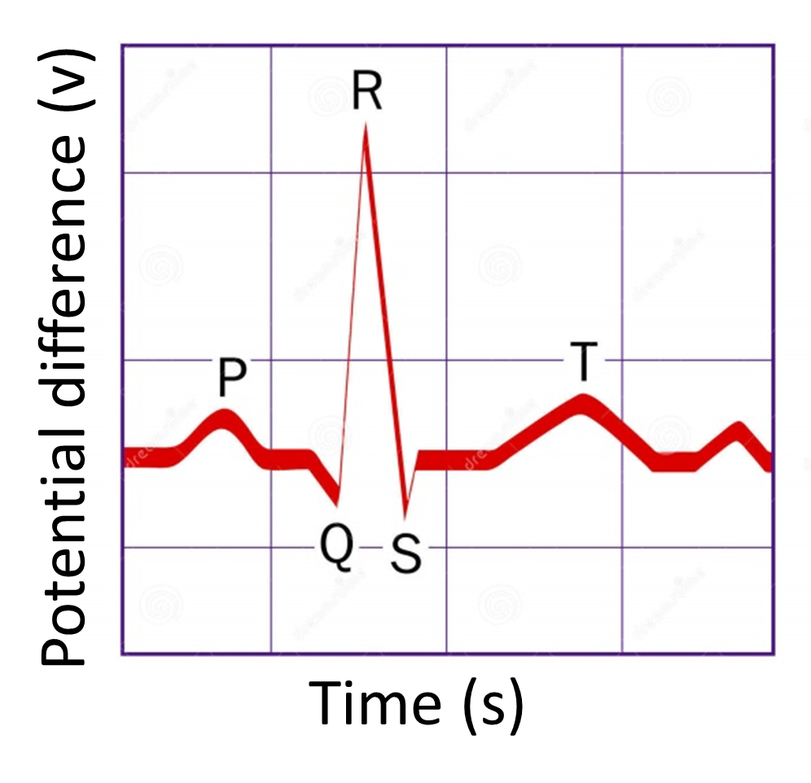
A healthy person has a particular shaped ECG trace.
Why does this second larger peak show?
What could this last wave represent?
Using your knowledge of the heart predict what each letter may represent.
Why does this first peak show?
Why is there a short pause before the QRS?

Slide 8
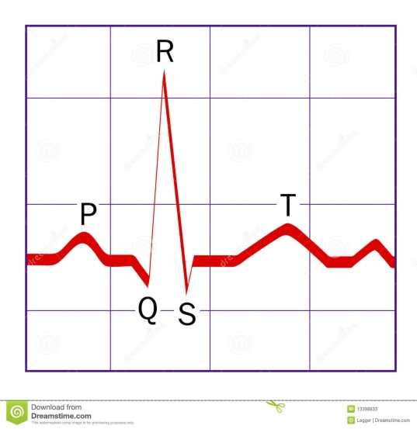
QRS complex – The signal enters the bundle of His and spreads throughout the ventricles walls via the conductive Purkyne fibres. This depolarises the fibres in the ventricle walls inducing ventricular systole. Atrial diastole (repolarisation) is also occurring at this time
P WAVE
The SA node produce the first electrical excitation in the right atrium.
The signal passes across both atria, causing the muscles cells to depolarise and contract.
Atrial systole
The signal passes out of the ventricles, the ventricular walls start to relax. This is called ventricular diastole.
This repolarisation of the ventricles is represented by the T-Wave on the ECG.
P-R segment – the flat line following the P wave. The signal pauses at the non-conductive tissue in the AV node (sometimes call P-Q segment)

Slide 9
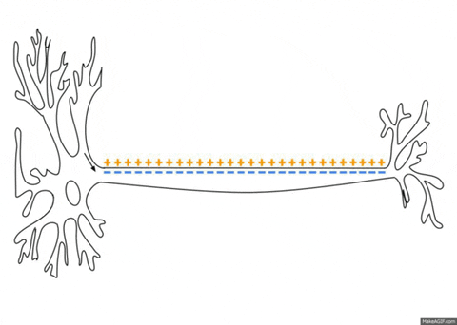
Depolarisation vs repolarisation
Notes:
Resting membrane potential of a cardiac muscles -60millivolts (due to concentration of neg ions)
The excitation of cells causes ion channels to open
Depolarisation of both sides of the cardiac cells occurs when Na ion channels open
This increases the charge to neutral at both sides of the cell
Repolarisation occurs when the sodium ion channels close and the potassium ion channel open and K+ ions move out restoring the -60millivolts in the cell

Slide 10
Ventricular contraction
(ventricular systole)
Atrial diastole occurring at the same time but hidden by QRS
Atrial contraction
(atrial systole)
Ventricles relax
(ventricular diastole)
*Atrial diastole is hidden on an ECG by the QRS complex

Slide 11
S-T section represents the interval between ventricular depolarization and repolarization.
Q-T section – Shows the complete time for the depolarisation and repolarisation on the ventricles

Slide 12
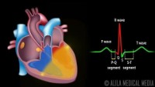

Slide 13
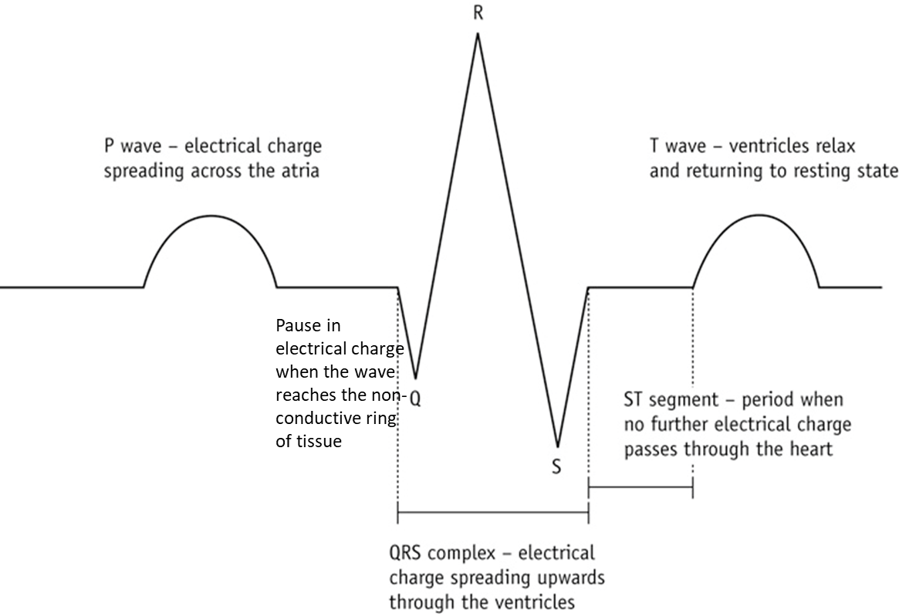
Label your diagram and add what is happening to direction of the blood in the heart at each stage
Extension:
Why is the P wave smaller than the QRS complex on a normal ECG?

Slide 14
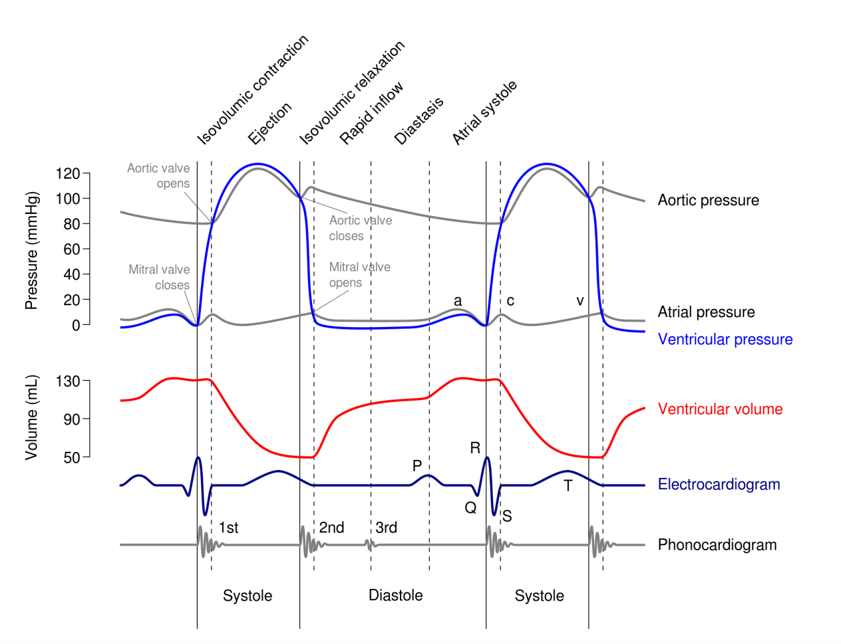
SUMMARY
Repolarisation of ventricles
Depolarisation of ventricles
Depolarisation of SA node
Depolarisation of atria
Depolarisation of AV node

Slide 15
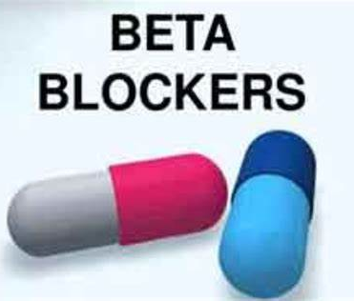

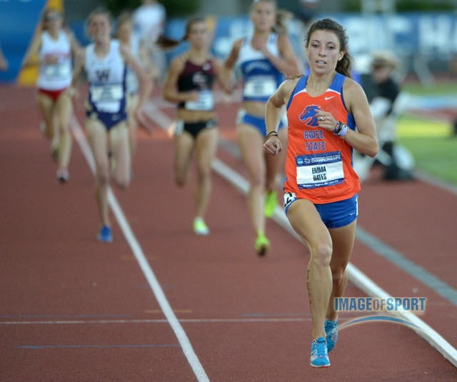
Bradycardia means that your heart beats very slowly
Is this an issue?
Use the images to guide your discussion

Slide 16
Key words
Arrhythmia - abnormal heart rhythm
Fibrillate - irregular and often faster heartbeat.

Slide 17
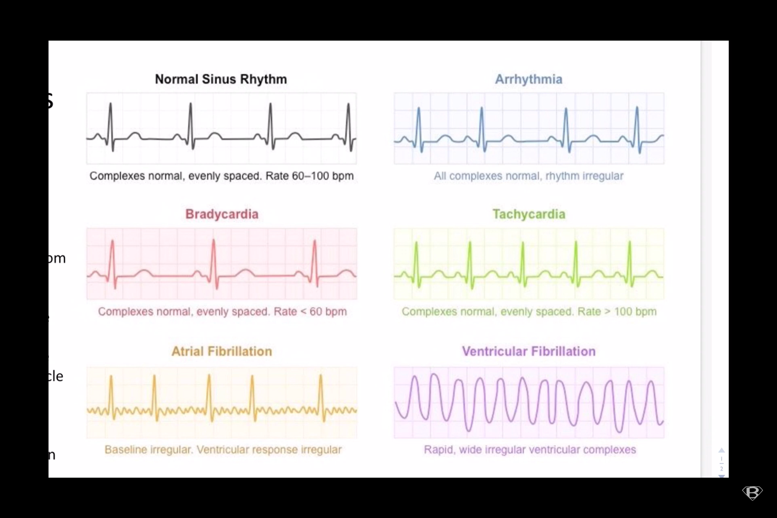
Normal sinus Ventricular fibrillation Tachycardia Arrhythmia Atrial Fibrillation Bradycardia
Match the name to the ECG trace. Use the information below to help you.

Slide 18
Normal sinus Ventricular fibrillation Tachycardia Arrhythmia Atrial Fibrillation Bradycardia
Match the name to the ECG trace. Use the information below to help you.

Slide 19
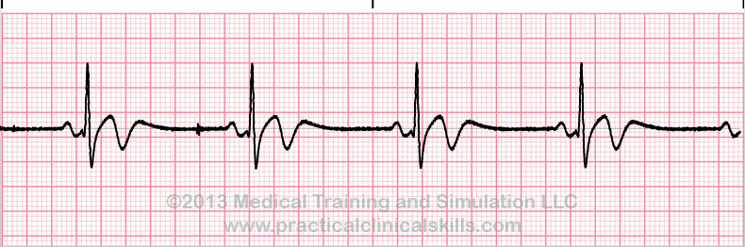
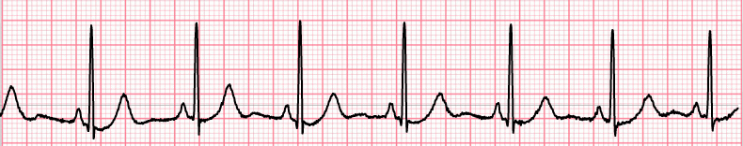
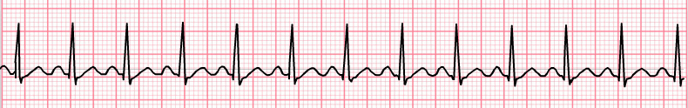
Types of Rhythms
Bradycardia = rate of <60 bpm
Normal = rate of 60 60-100 bpm
Tachycardia = rate of >100 100-160 bpm

Slide 20
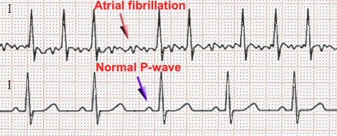
Atrial Fibrillation (arrythmia)
Atria beating more frequently than ventricles so no clear P wave is seen.

Slide 21
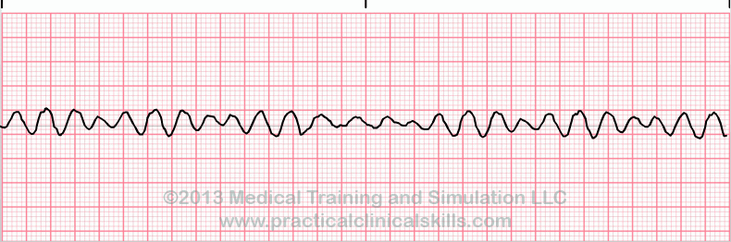
Ventricular Fibrillation (arrythmia)
Impulses originate from several places in the ventricles at a high rate.
No clear P or T wave

Slide 22
Arrythmia
Complex normal. But the rhythm is irregular.

Slide 23
Ectopic heartbeat
Ectopic heartbeats are when either the atria or ventricle has an extra beat. The trace below shows an extra ventricular beat
WE ALL USUALLY HAVE AT LEAST ONE A DAY!!!

Slide 24
END OF LESSON 1

Slide 25


DRAW IT / WRITE IT
TAKE A WHITEBOARD EACH
YOU ARE PLAYING THE AGAINST THE PERSON NEXT TO YOU
YOU WILL SEE AN ECG OR THE NAME OF A TYPE OF HEARTBEAT
YOU NEED TO NAME IT / OR DRAW IT

Slide 30
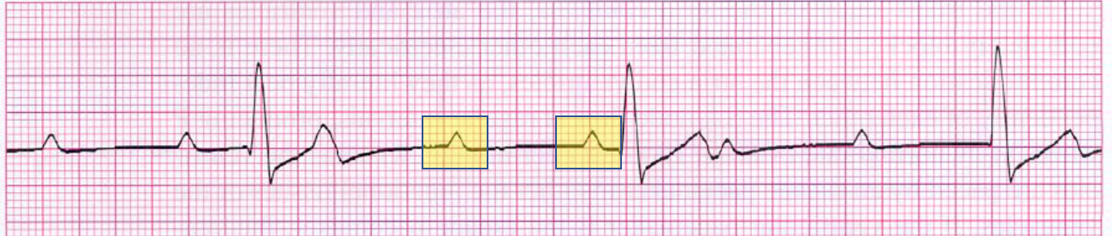
Ectopic heartbeat
Atria or ventricle has an extra beat.

Slide 32
FINAL SLIDE!

Slide 34
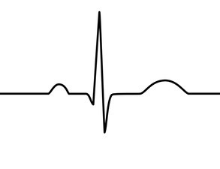
Notes:
PRINT

Slide 35
ANNOTATE – INCLUDE DESCRIPTIONS

Slide 36
QRS complex – The signal enters the bundle of His and spreads throughout the ventricles walls via the conductive Purkyne fibres. This depolarises the fibres in the ventricle walls inducing ventricular systole. Atrial diastole (repolarisation) is also occurring at this time
P WAVE
The SA node produce the first electrical excitation in the right atrium.
The signal passes across both atria, causing the muscles cells to depolarise and contract.
Atrial systole
The signal passes out of the ventricles, the ventricular walls start to relax. This is called ventricular diastole.
This repolarisation of the ventricles is represented by the T-Wave on the ECG.
P-R segment – the flat line following the P wave. The signal pauses at the non-conductive tissue in the AV node (sometimes call P-Q segment)

Slide 37
Heart rate calculations

Slide 38
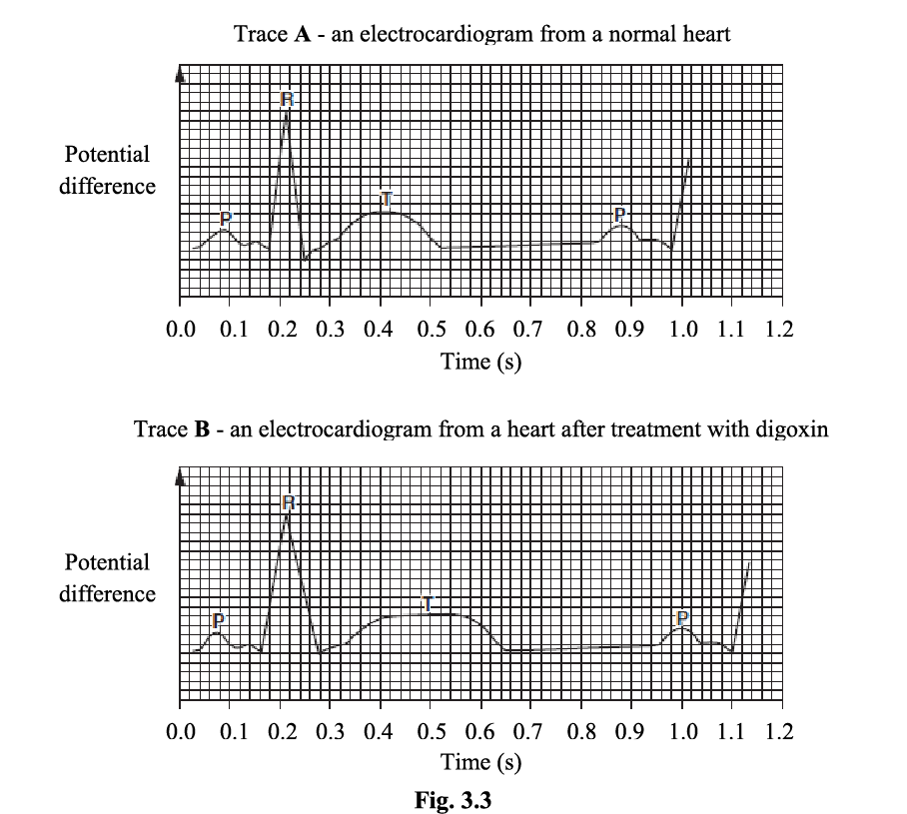
How could I calculate heart rate from an ECG?

Slide 39
Calculating Heart Rate from an ECG
Pick two adjacent points on the waves
Find the time it takes for one cardiac cycle
60 / time for one cycle
Answer in bpm

Slide 40
Calculating Heart Rate from an ECG
Pick two adjacent points on the waves
Find the time it takes for one cardiac cycle
60 / time for one cycle
Answer in bpm
0.18
0.98
Time taken for one cycle = (0.98 – 0.18) = 0.8s
60 / 0.8 = 75bpm

Slide 41
Calculating heart Rate
Now try this one
1) Find out the time each small box represents.
2) Pick two adjacent points from the ECG to measure
(0.04 x number of boxes between two adjacent points on wave)
3) 60s / time for one cardiac cycle
Notes:
6-Second Method: Have a six second strip, count the QRS complexes and multiple by 10 ???

Slide 42
Calculating heart Rate
1) Find out the time each small box represents.
2) Pick two adjacent points from the ECG to measure
(0.04 x number of boxes between two adjacent points on wave)
3) 60s / time for one cardiac cycle
60/0.76 = 79bpm
19 boxes
19x0.04
= 0.76s
1/25=0.04s
Notes:
6-Second Method: Have a six second strip, count the QRS complexes and multiple by 10 ???

Slide 43
Percentage change in HR
Digoxin is a medicine used to treat irregular heart beats.
Trace A is a normal trace
Trace B is from a patient that has been treated with the drug digoxin
Using Trace B in Fig. 3.3, calculate the percentage change in the patient's heart rate after receiving digoxin. (3 marks)
Normal HR: 60/0.8 = 75bpm
Digoxin HR: 60/0.94 = 64bpm
% change: ( change in HR ) x 100 = -14% (13-15% accepted)
initial heart rate
Try additional questions below when done

Slide 44
Common exam questions
Why does our calculation for the time it takes to complete one full cardiac cycle lack accuracy? (1 mark)
How could we improve the accuracy of our answer for the time it takes to complete one full cardiac cycle? (1 marks)
Only one full cardiac cycle shown and used to calculate bpm
Take the mean value (time) for several cardiac cycles to calculate the bpm

Slide 45
Cardiac output
Cardiac output (CO) is the term used to describe the volume of blood that is pumped by the heart (the left and right ventricle) per unit of time
Why do people that are fitter often have higher cardiac outputs?
Why does cardiac output increases when an individual is exercising?
The CO of an individual can be calculated by:

Slide 46
Cardiac output
Cardiac output (CO) is the term used to describe the volume of blood that is pumped by the heart (the left and right ventricle) per unit of time
Why do people that are fitter often have higher cardiac outputs?
Thicker and stronger ventricular muscles in their hearts
Why does cardiac output increases when an individual is exercising?
This is so that the blood supply can match the increased metabolic demands of the cells
The CO of an individual can be calculated by:
Cardiac output = heart rate x stroke volume

Slide 47
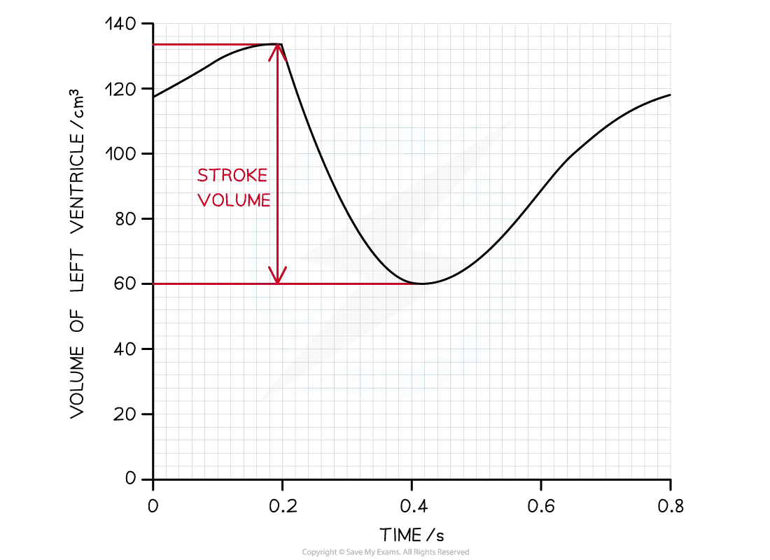
Cardiac output = heart rate x stroke volume
Calculate the cardiac output in dm³ (3 marks)
1 cardiac cycle (atrial systole, ventricular systole and diastole) takes 1 second

Slide 48
Cardiac output = heart rate x stroke volume
Calculate the cardiac output in dm³ (3 marks)
1 cardiac cycle (atrial systole, ventricular systole and diastole) takes 1 second
To find the number of cardiac cycles completed in a minute, multiply by 60
60 x 1 = 60 bpm
Cardiac output = heart rate x stroke volume
Cardiac output = 60 x 74 = 4440 cm³
4440/1000
CO = 4.44 dm³

Slide 50
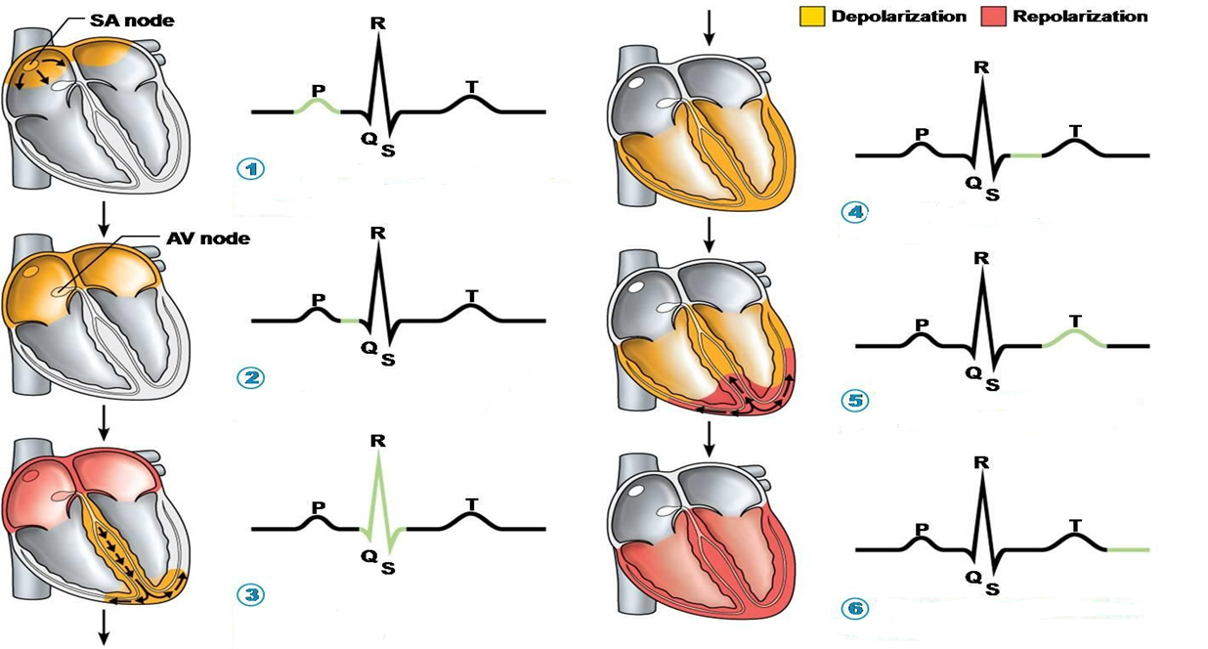
Annotate 1-6 explain each step

Slide 51
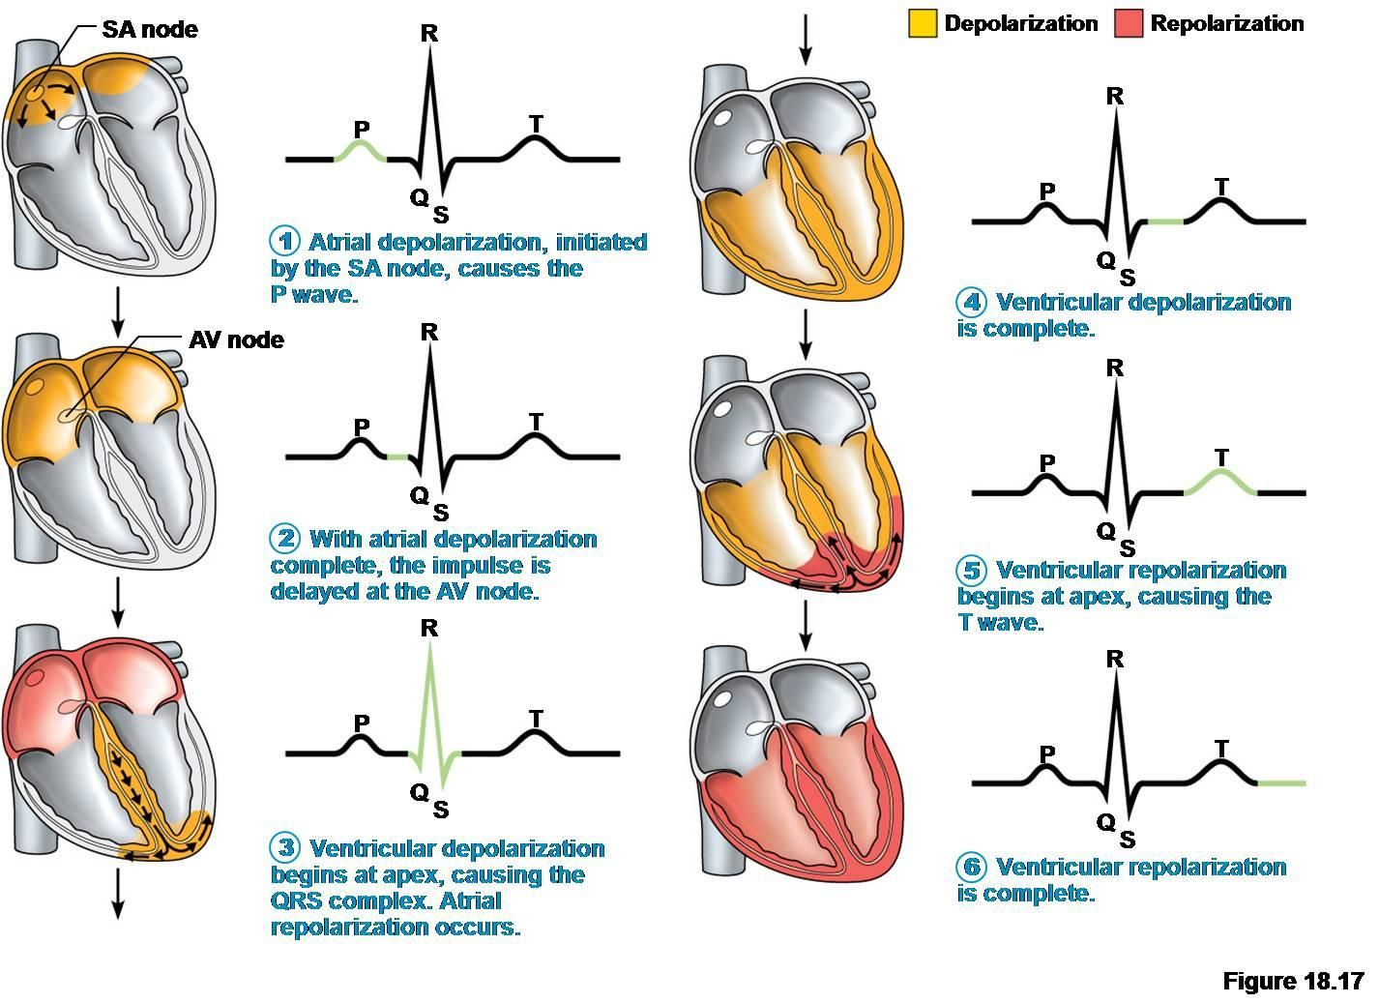

Slide 52
Depolarization
Before stimulation, the cell is in a resting state with a resting membrane potential of around -90 millivolts. When it is excited or stimulated, membrane permeability is changed. The positive ions such as sodium ions begin to diffuse into the cell. These ions tend to rise the potential toward zero. As a result, the new membrane potential is generated called the receptor potential or excitation potential.
Cells have a certain potential limit at which the sodium channels open while the potassium channels are closed. It is called threshold potential and is defined as the potential that must be reached to generate an action potential in the cell.
If the receptor potential is greater than the threshold potential, the efflux of potassium ions stop. Moreover, sodium ions begin to diffuse into the cells via voltage-gated sodium channels. These channels are only opened when the membrane potential becomes greater than a certain value.
Both of these processes result in a net gain in positive ions inside the cell. Eventually, the inside of the cell becomes more positive and the negative membrane potential changes into a positive one.
In this way, the depolarization is completed as the two poles on the sides of the membrane are neutralized.
Repolarization
Depolarization is a momentary change that lasts for only a few milliseconds. Soon after it is over, the negative resting membrane potential is restored by a process called repolarization.
The sodium channels are opened only for a very small fraction of a second. They close soon they are opened. Once the sodium channels are closed, the influx of sodium ions into the cell stops.
In the meantime, the potassium channels are opened again. The potassium ions begin to leave the cell so that a negative potential is created inside the cell.
The sodium-potassium pump also resumes pumping sodium ions out of the cell.
All these processes result in a net loss of positive ions from the cell and the negative resting membrane potential is restored.
Let us now understand how depolarization takes place in different types of cells present in the human body.

Slide 53
Depolarization in SA node
The SA node is the cardiac pacemaker. These specialized cardiac cells can undergo depolarization even in the absence of any stimulus. It is due to the automaticity of these cells.
The resting membrane potential of SA node cells is -60 millivolts. These cells have leaky sodium channels that remain open even in the absence of a stimulus. The sodium ions diffuse into the cell via these channels and cause depolarization to some extent.
The threshold for depolarization in the case of SA nodal cells is -40 millivolts. When the threshold potential is reached, the calcium channels are opened and the membrane potential rapidly increases towards zero. It is due to the influx of calcium ions.
Thus, calcium ions are responsible for the depolarization of the SA node.
However, calcium channels do not remain open for a long time. They soon close and the calcium influx stops. The potassium channels are then opened to cause repolarization by efflux of the potassium ions.
Once the resting membrane potential is restored, the leaky sodium channels continue to operate. Thus, the SA node continues to undergo the cycle of depolarization and repolarization without a break. The action potential thus generated causes contraction of the cardiac muscle and regulates their rhythm.
Depolarization in Cardiac Muscles
Like skeletal and smooth muscles, the depolarization in cardiac muscles is also coupled with their contraction. These muscles are excited by the action potential traveling in the conductive system of the heart.
The cardiac muscles are connected to each other as well as the cells of the heart’s conductive system via gap junctions. These gap junctions serve as electrical synapses allowing the ions to easily flow between the cells.
When these muscles are excited, sodium channels are opened. The influx of sodium ions into the cells causes depolarization spike in these muscles. Once the spike is over, the potassium channels are opened. In the meantime, the calcium channels also open, resulting in the plateau phase of depolarization. This phase is over when the calcium channels close.
Thus, in the case of cardiac muscle, depolarization is caused by the influx of sodium as well as calcium ions. The calcium ions flowing into the cell during the plateau stage are required for the contraction process. In addition, depolarization of the cell also releases calcium ions from the sarcoplasmic reticulum. These calcium ions are also needed for the contraction of cardiac muscles.

Slide 54
Summary
Depolarization is the process by which the electrical potentials on both sides of the plasma membrane are neutralized.
A potential difference exists across the plasma membrane due to selective permeability. The membrane potential when the cell is at rest is called the resting membrane potential. The factors that contribute to the resting membrane potential are:
  Efflux of potassium ions
  Presence of inorganic ions in the cytoplasm
  Influx of small amount of sodium ions
  Sodium-potassium pump
Most of the cells in a resting state have more negativity on the inside as compared to the extracellular fluid. So, the resting membrane potential is negative.
The membrane potential is neutralized in the process of depolarization. It involves the excitation of the cell and the generation of an action potential.
Cells can be excited by an environmental stimulus, a chemical messenger, or via the flow of the ions. Some cells can undergo depolarization in the absence of any stimulus.
The generation of action potential involves the influx of positively charged ions (sodium or calcium) via open channels.
Depolarization of neurons occurs via the opening of the sodium channels.
Depolarization of skeletal muscles also occurs via the influx of sodium ions.
The depolarization of smooth muscles is due to calcium channels.
Cardiac muscles undergo depolarization due to sodium as well as calcium ions influx.
The cells in the SA node reach threshold potential via the influx of sodium ions, while they undergo depolarization via calcium ions influx.
The contraction of muscles is coupled with their depolarization.

