Slide 1
6.1.2 Patterns of inheritance
Specification summary
(a) (i) the contribution of both environmental and genetic factors to phenotypic variation
(a) (ii) how sexual reproduction can lead to genetic variation within a species
(b) (i) genetic diagrams to show patterns of inheritance
(b) (ii) the use of phenotypic ratios to identify linkage (autosomal and sex linkage) and epistasis
(c) using the chi-squared (χ2) test to determine the significance of the difference between observed and expected results
(d) the genetic basis of continuous and discontinuous variation
(e) the factors that can affect the evolution of a species
(f) the use of the Hardy–Weinberg principle to calculate allele frequencies in populations
(g) the role of isolating mechanisms in the evolution of new species
(h) (i) the principles of artificial selection and its uses
(h)(ii) the ethical considerations surrounding the use of artificial selection.

Slide 2
Which is the best statement?
Each characteristic is coded for by a certain gene. You have an allele from each gene from each of your parents. These characteristics can be affected by the environment.
Inheritance depends on your parents and the environment
Inheritance is always a combination of alleles from your parents and the environment that affects your characteristics.
You inherit your characteristics from your parents by inheriting one allele from each parent.
Inheritance comes from your parents

Slide 3

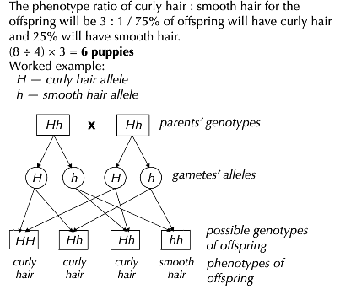
Practice question 1

Slide 4
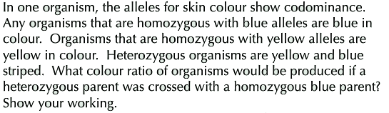
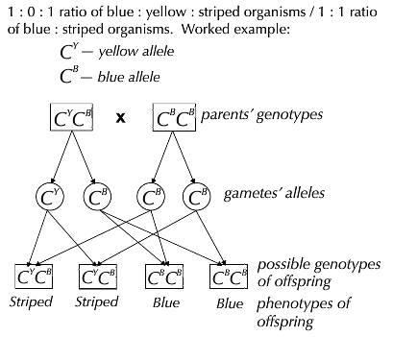
Practice question 2

Slide 5
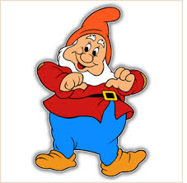
Practice question 3
Multiple alleles
What are the 4 blood groups?
How many alleles are there?
What are the allele combinations of each blood group?
A, B, AB, O
Challenge
What does the I stand for?
3 – I^{A} I^{B} I^{O}
A = I^{A}I^{A} or I^{A}I^{O}
B = I^{B}I^{B} or I^{B}I^{O}
AB = I^{A}I^{B}
O = I^{O}I^{O}

Slide 6
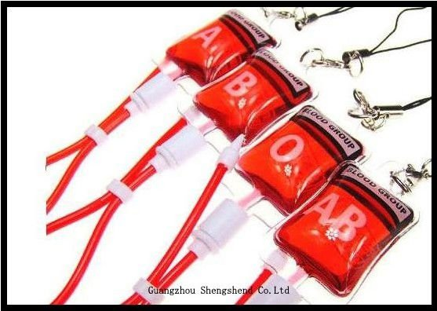
Need to know
I^{A} and I^{B} are co-dominant
Iº is recessive to both.

Slide 7

Draw a genetic cross for a child produced by some one who is blood group AB with someone who is blood group O.
Write the probability of the child having each blood group.
I^{A} I^{B}
I^{O}
I^{O}
I^{A}I^{O}
I^{B}I^{O}
50% group A
50% group B
I^{A}I^{O}
I^{B}I^{O}
Ext. A man claims that he is not the father of a child, he is blood group O. The child has blood group AB, the mother is blood group A. Could he be the father?

Slide 8
Try this question
Human ABO blood groups are determined by the presence or absence of two antigens, A and B, on the plasma membrane of the red blood cells. The inheritance of these blood groups is controlled by three alleles. Allele I^{A} and I^{B} ^{are} co-dominant and I^{O} ^{is} recessive to both.
4 babies were born in the same hospital on the same day to 4 different sets of parents. Owing to a power cut their identities were confused before they were given to their parents. The babies’ blood groups are A, B, AB and O. The blood groups of the parents are:
Mr and Mrs Darwin – A and B
Mr and Mrs Pasteur – B and O
Mr and Mrs Fleming – O and O
Mr and Mrs Mendel – AB and O
Which baby should each couple take home? Explain your answer – 4 marks
AB
B
O
A

Slide 9
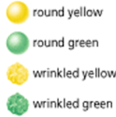

Dihybrid inheritance
The inheritance of two characteristics controlled by different genes.
The classic example uses peas…
Which are dominant?
What are the results if you cross two heterozygous parents?

Slide 10
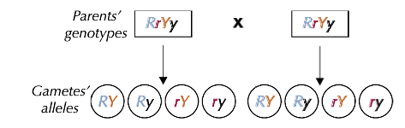
Work out the alleles that the gametes would have
Remember each gamete has two alleles
Ext. Can you predict the outcome of the offspring?

Slide 11
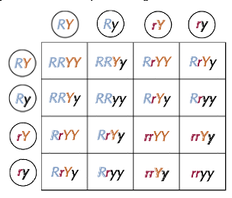
Work out the possible offspring
Ext. What are the phenotypes?

Slide 12
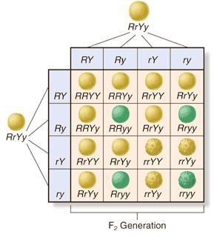
RrYy x RrYy (F₁ cross)
Phenotypes

Slide 13
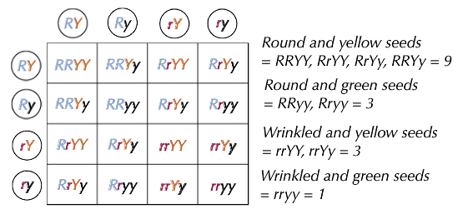
Phenotypes
Ext. What is the phenotypic ratio?

Slide 14
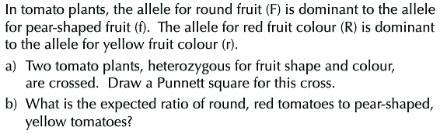
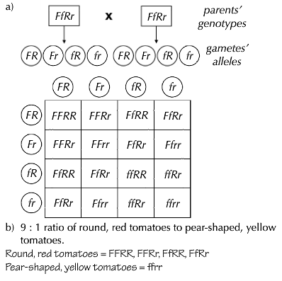
Dihybrid cross practice question

Slide 15
Challenge – polygenic inheritance questions
The colour of a plant’s flowers is controlled by alleles at three loci. The flowers show a range of colours from deep red to white; the larger the number of R alleles inherited, the darker the colour of the flowers.
If a deep red homozygous plant is crossed with a white homozygous plant, it produces plants that are pink. What will the genotypes of the parents and offspring be, assuming that the deep red alleles are R¹, R², and R³, and the white alleles are r¹, r² and r³?
Q2 Deep red alleles R¹, R² and R³
White alleles r¹, r² and r³
Parent phenotypes: Deep red White
Parent genotypes R¹ R¹ R² R² R³ R³ r¹ r¹ r² r² r³r³
Offspring phenotype Pink
Offspring genotype R¹ r¹ R² r² R³ r³

Slide 16
Cross a triple homozygous recessive (aabbcc) animal with a triple homozygous dominant (AABBCC) animal. What is the possible genotype of the next generation?
Now work out the possible gametes for the following individuals Brown eyed man BBBb, and blue eyed female bbbb. What are their chances of having a dark blue eyed baby? BBBB = dark brown eyes, BBBb = brown eyes, BBbb = dark blue eyes, bbbb = blue eyes
50% - two possible genotypes BBbb and Bbbb

