Slide 1
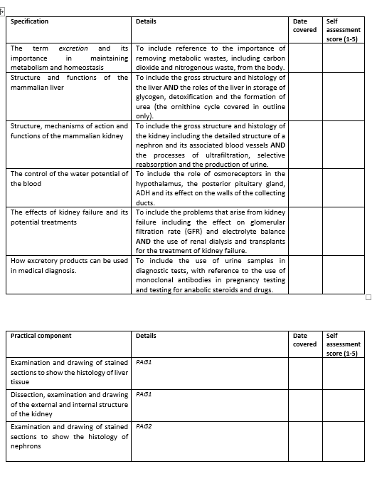
Learning Outcomes
How excretory products can be used in medical diagnosis

Slide 3
Urine and diagnosis

Slide 4
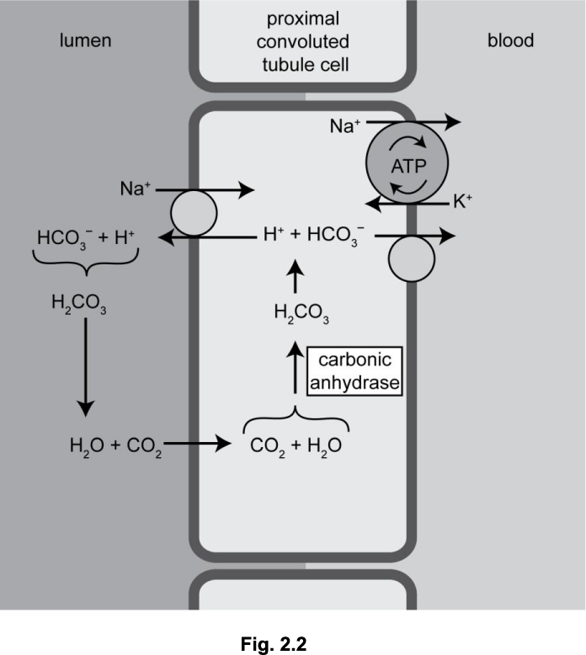
Knowledge retreival question
Excretion is important in both animals and plants.
Sodium ions and glucose are both reabsorbed into the blood from proximal convoluted tubules (PCTs) in the kidney.
A student designed an experiment to investigate the effect of temperature on the rate of glucose diffusion through dialysis tubing.
Q1. State two factors that would need to be controlled in this experiment (2 marks).
initial glucose concentration (on both sides on the membrane)
volume of solution
length / diameter, of dialysis tubing
type / brand, of dialysis tubing
Q2. Sulthiame is a drug that inhibits the enzyme carbonic anhydrase.
Fig. 2.2 shows the role of carbonic anhydrase in the PCT of the kidney.
Using the information in Fig. 2.2, what can you conclude about the likely effect of sulthiame on the reabsorption of sodium ions in the PCT? (4 marks)
less reabsorption because
fewer H+ ions in PCT cells
less / no, co-transport / facilitated diffusion, of Na+ ions, into cells / from lumen (1)
less / no, active transport of Na+ ions into, blood (1)

Slide 5

How did your grandmother find out she was pregnant?

Slide 6
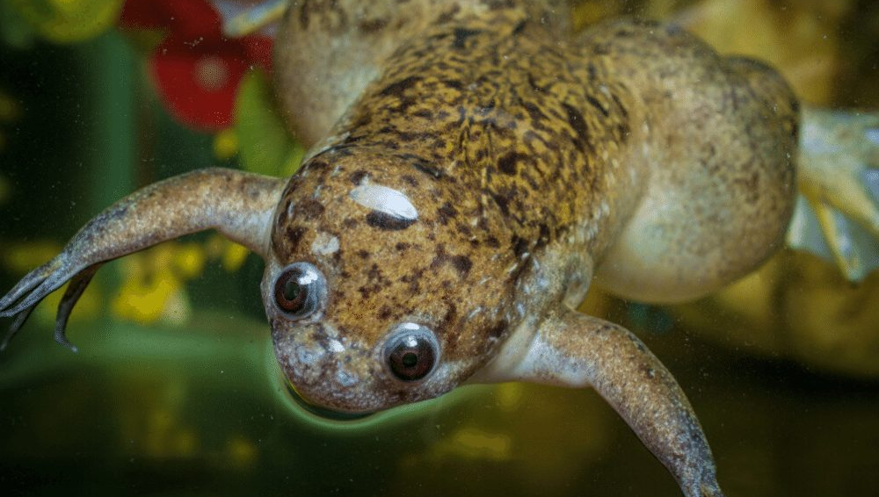

What is the link?
Notes:
Urine from pregnant women was injected into the African clawed toad which triggered rapid egg production after 8 hours if the female was pregnant
Hogben test

Slide 7
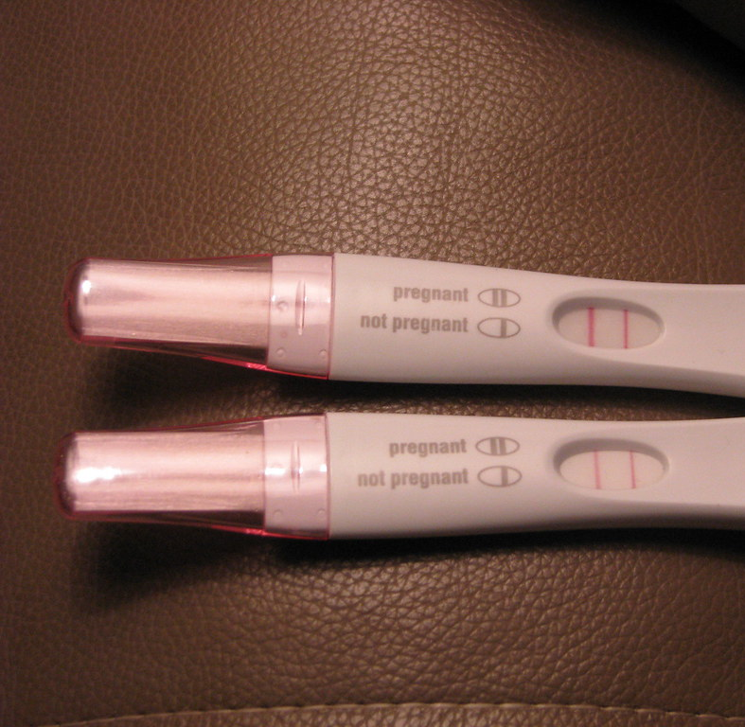
How do todays tests work?

Slide 8
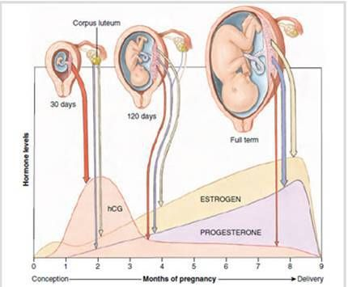
Modern pregnancy tests
Test for hCG (human chorionic gonadotrophin) in urine.
They rely on monoclonal antibodies
They are so sensitive that pregnancy can be detected within hours.
Notes:
*As the placenta develops it releases hCG hormone

Slide 9
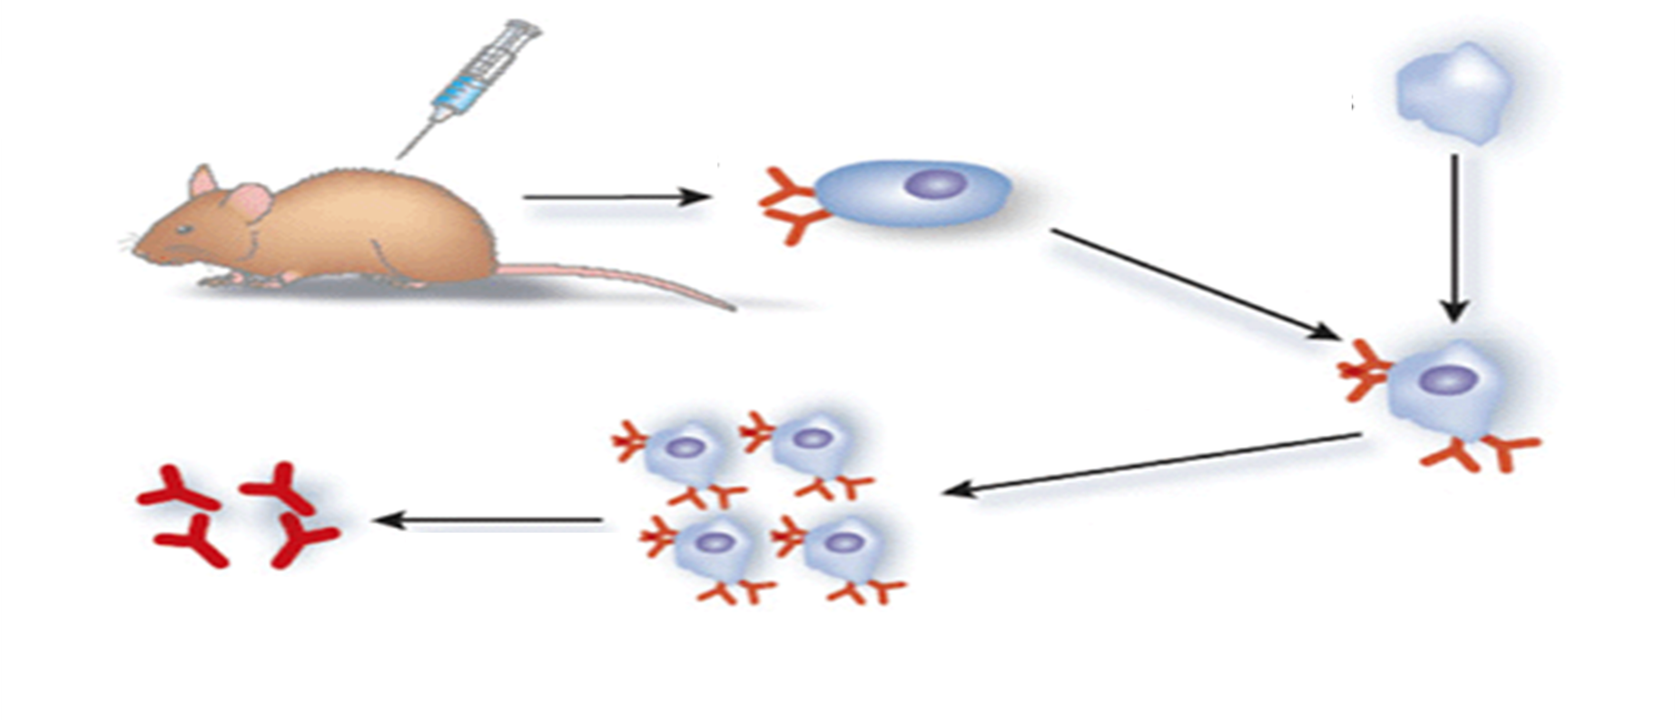
Producing monoclonal antibodies
Notes:
Mono – 1 clonal – cloned into many

Slide 10
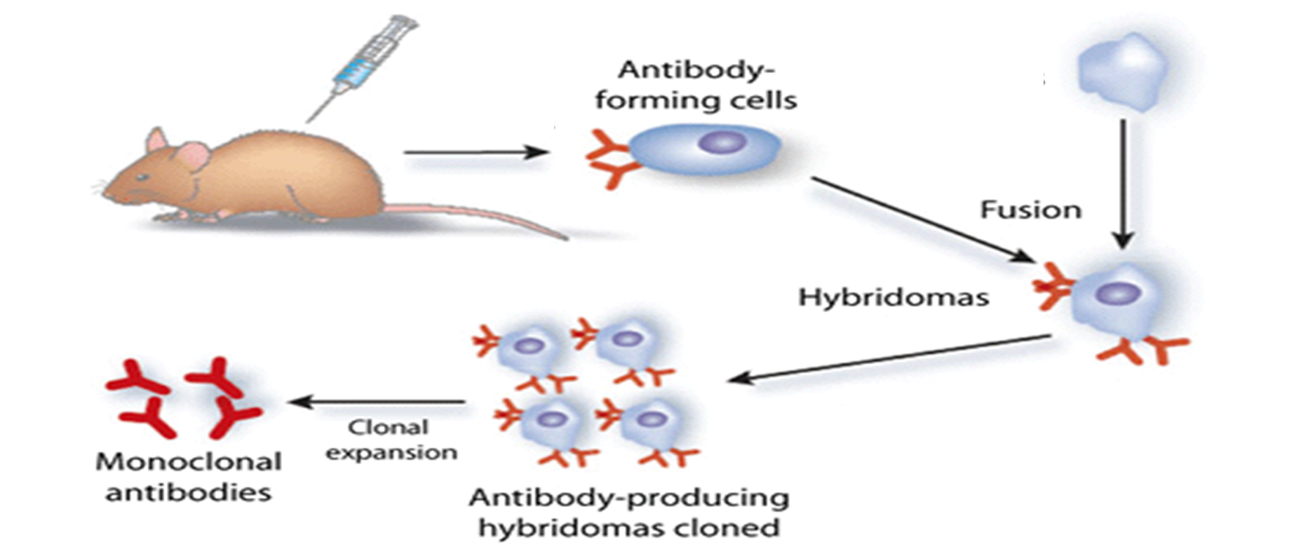
Producing monoclonal antibodies
B-cells fused with myeloma (cancer cell)
Mouse is injected with hCG
Mouse B-cells create appropriate antibodies for hCG
Notes:
Human chorionic gonadotropin hormone (hCG) is injected into the blood of a mouse. Antibodies are produced in the mouse blood in response to this substance.

Slide 11
Organise into the correct order
A myeloma (Cancer cell) is then fused with the B-cells to form a hybridoma
Inject mice with hCG to stimulate B-cells to produce correct antibodies
The hybridoma is then cloned many times and use to produce the correct antibodies
Correct B-cells are extracted from mice, that produce a particular antibody
The hCG antibodies are then separated, purified and ready for use

Slide 12
Inject mice with hCG to stimulate B-cells to produce correct antibodies
Correct B-cells are extracted from mice, that produce a particular antibody
A myeloma (Cancer cell) is then fused with the B-cells to form a hybridoma
The hybridoma is then cloned many times and use to produce the correct antibodies
The hCG antibodies are then separated, purified and ready for use

Slide 13
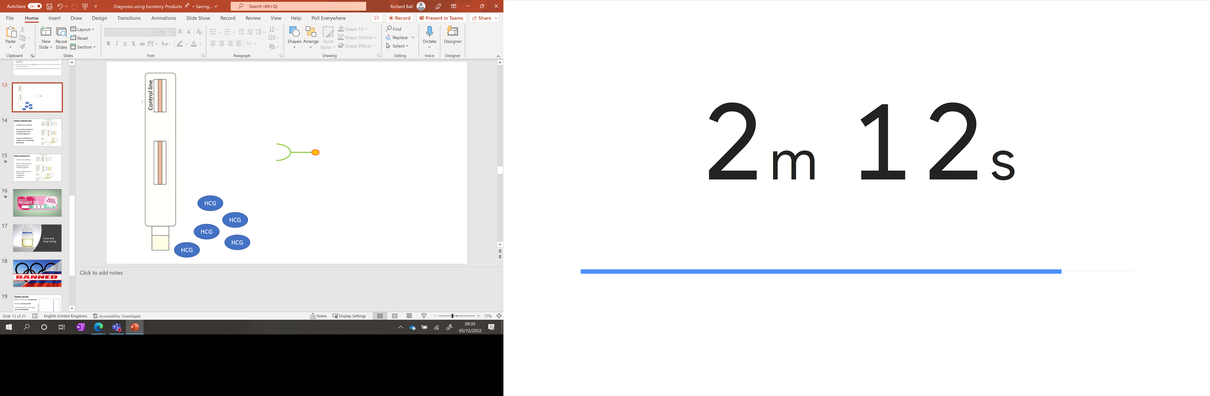
Antibody taken from mouse with coloured particles attached

Slide 14
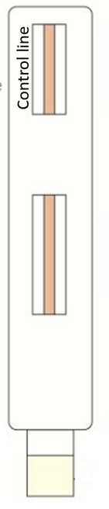
Modified immobilised antibody that can attached to monoclonal antibody
Antibody taken from mouse with coloured particles attached
HCG
HCG
HCG
HCG
HCG

Slide 15
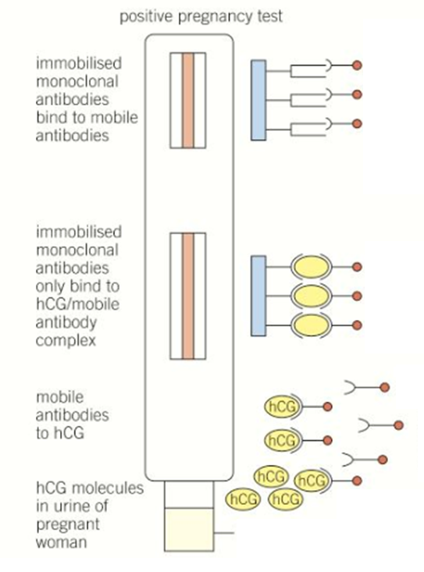
Modern pregnancy test
Contain two windows
One to show the test is working and one to indicate pregnancy
Uses a combination of mobile and immobilised antibodies
Control line

Slide 16


Slide 17
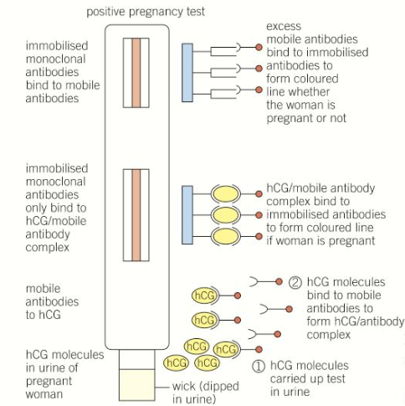
Modern pregnancy test
Contain two windows
One to show the test is working and one to indicate pregnancy
Uses a combination of mobile and immobilised antibodies
Control line
Notes:
Purpose of control line – enough urine used , enough antibodies and you waited enough time

Slide 18
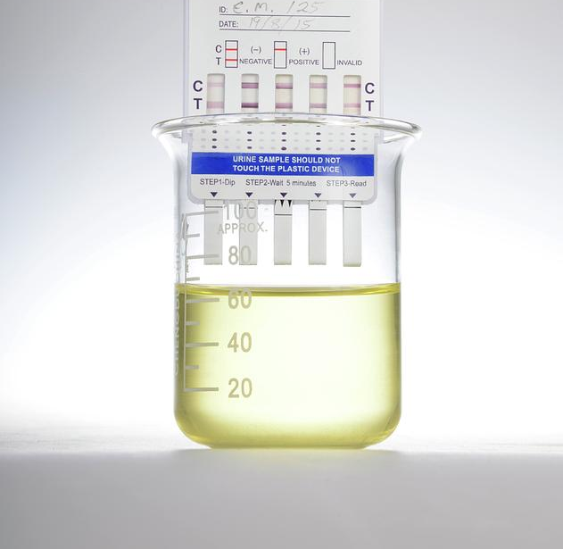
Urine and drug testing

Slide 19


Slide 20


Slide 21
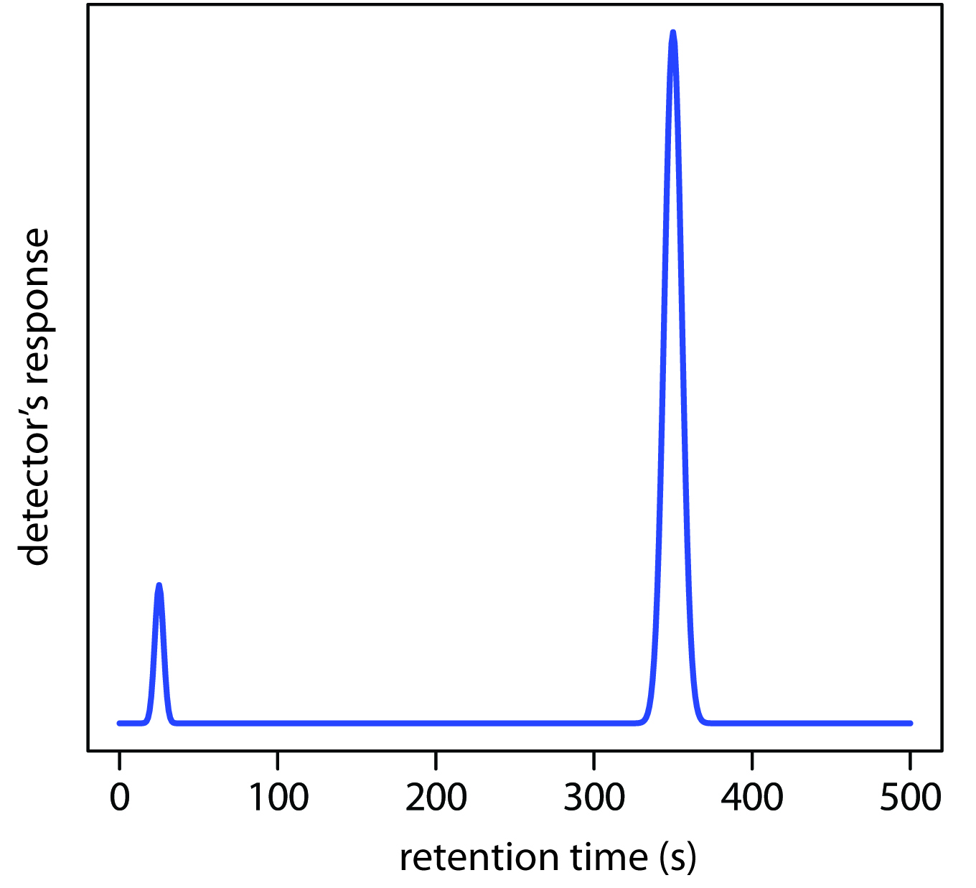
Anabolic steroids
Mimic the hormone testosterone
Promote muscle growth
Can be detected in urine using gas chromatography
Urine is mixed with a know solvent and vaporised, which is then used to produce a chromatogram
Notes:
Anabolic streriods mimic testosterone and cause your body to produce more muscle building proteins

Slide 22

Drug testing continued…
Drugs or metabolites (breakdown of drugs) get filtered through the kidney and stored in the bladder, so it is possible to find drug traces in urine sometime after the drug has been used.
Urine sample of people suspected of taking illegal drugs are split in two.
First sample tested using monoclonal antibodies
Second sample tested using gas chromatography
How long does each remain detectable in your system?
Notes:
Amphetamine is a central nervous system stimulant that affects chemicals in the brain and nerves that contribute to hyperactivity

Slide 23
Additional questions

