Slide 2
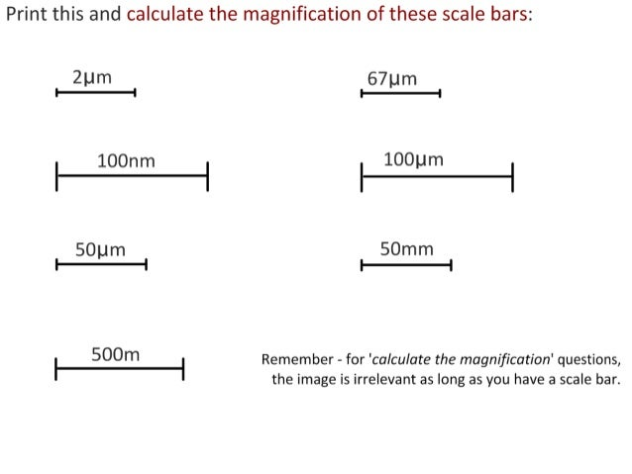
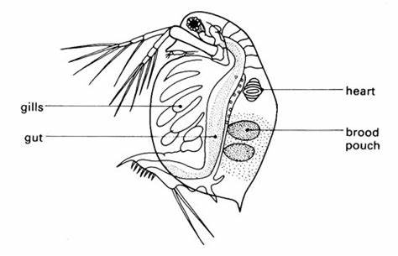
Read through PAG sheet carefully in your pair before you start
Please record x5 heart rates for each temperature and calculate the means
Design an appropriate table (IV left column)
Count for 10 seconds and multiply by 6 to find the heart rate
Use the lowest objective lens
Produce a graph X: Temperature Y:bpm
Produce a scientific drawing and scale bar (you have the calibration calculations in your PAG book for x40)
Complete your extension questions

Slide 3
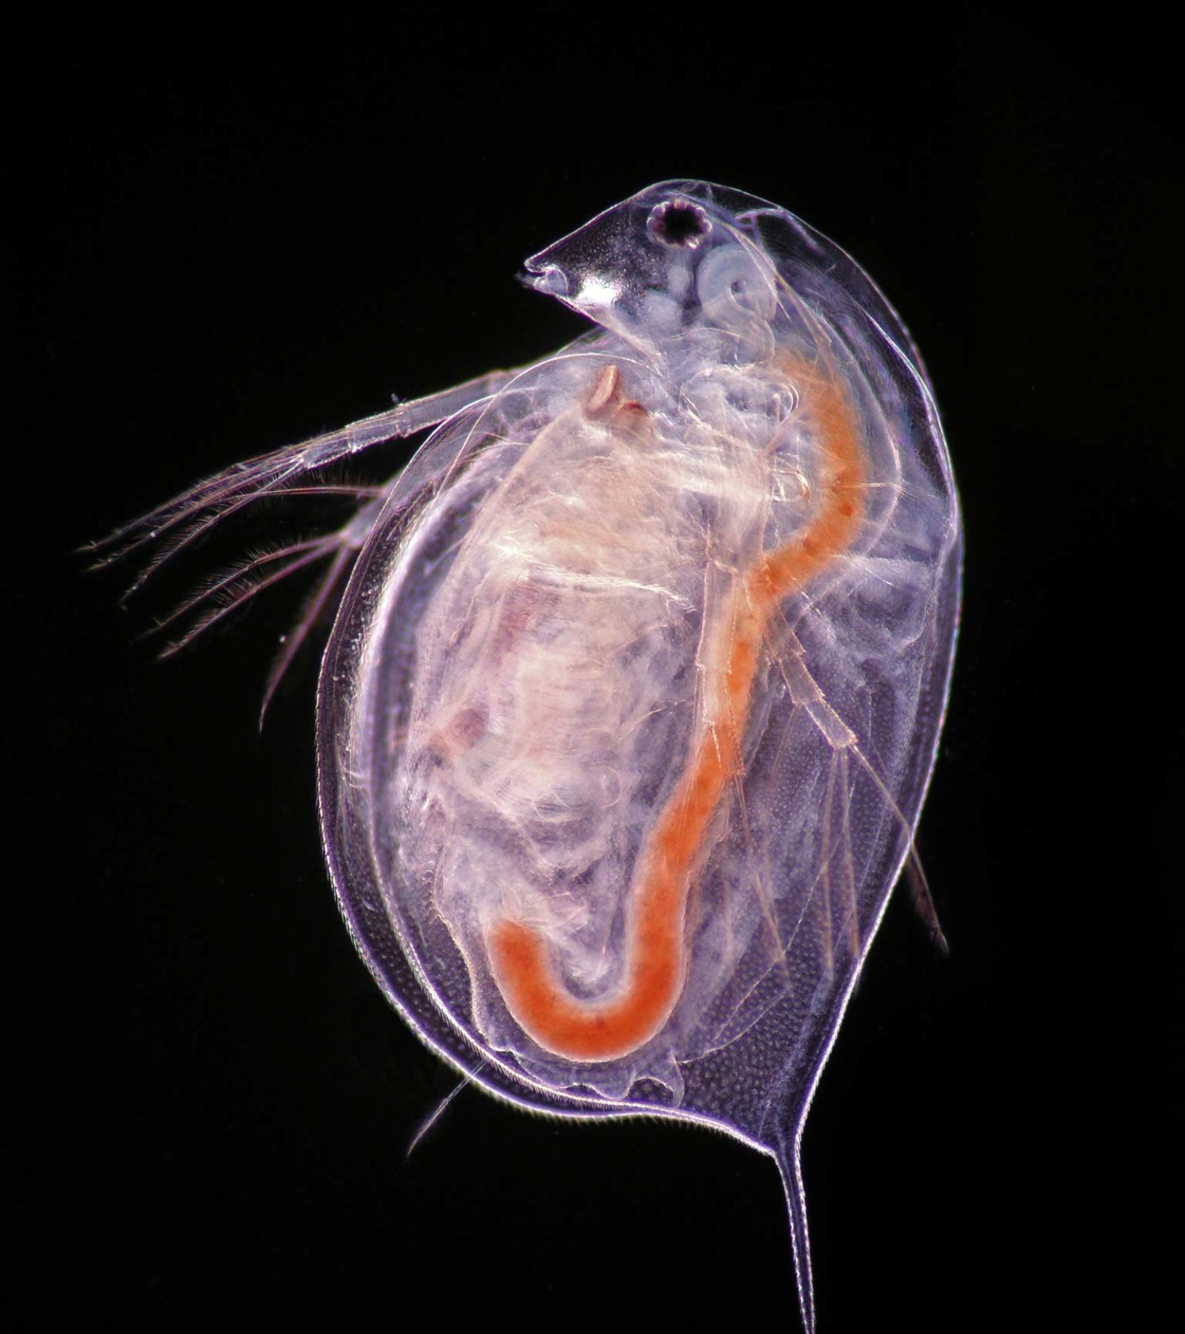
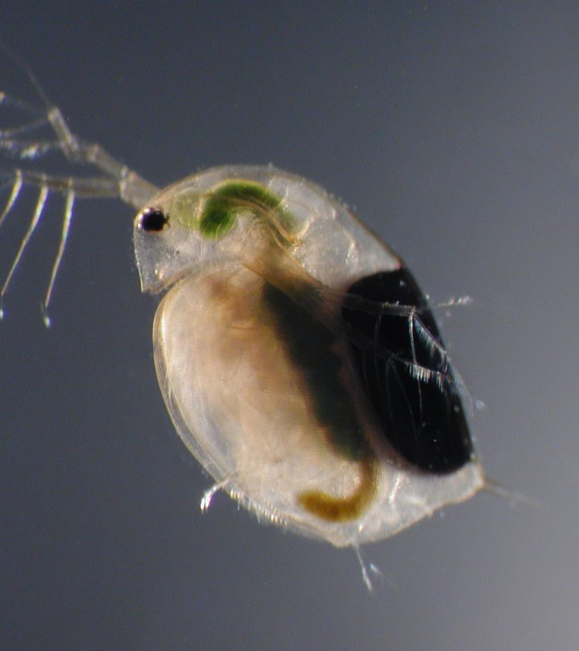
Notes:
a tiny semi-transparent freshwater crustacean with long antennae and a prominent single eye
Excellent for counting their heart rate!

Slide 4


Slide 5
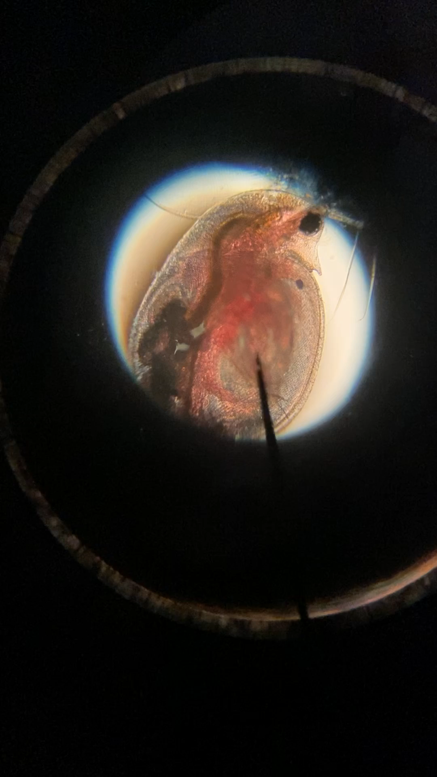
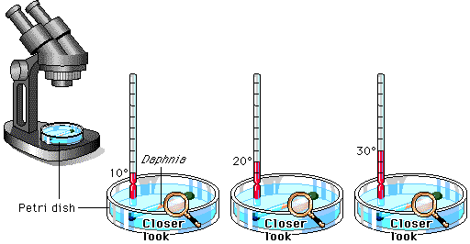
Preparing your daphnia - demo

Slide 6
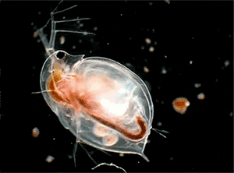
No daphnia will be harmed during this practical!
They will be handled with care
The environments they are exposed to are within their usual temperature ranges

Slide 7
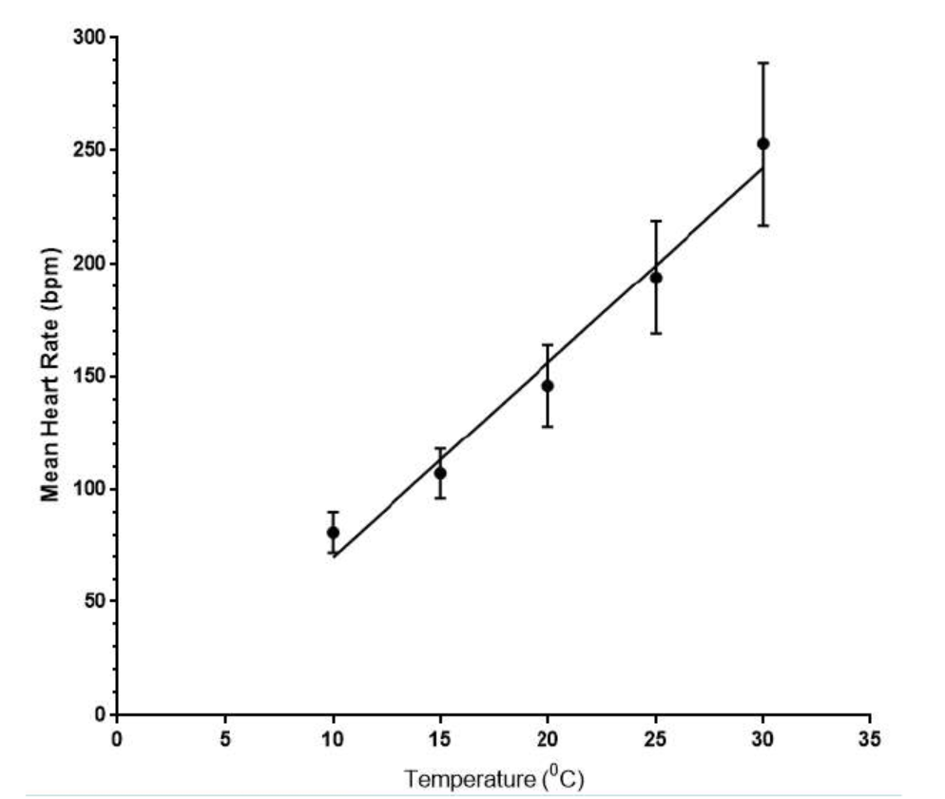

Slide 8
Investigating how caffeine effects the heart rate of daphnia – YouTube
The IV is caffeine here, but much of the method is the same as temp

