Slide 1
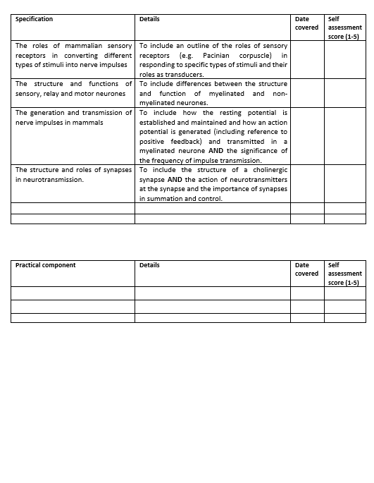
Learning Outcomes
Review the structure and function of sensory, relay and motor neurons.
Describe the role of sensory receptors in generating electrical impulses.

Slide 2
Receptor Cells and Neurones

Slide 3
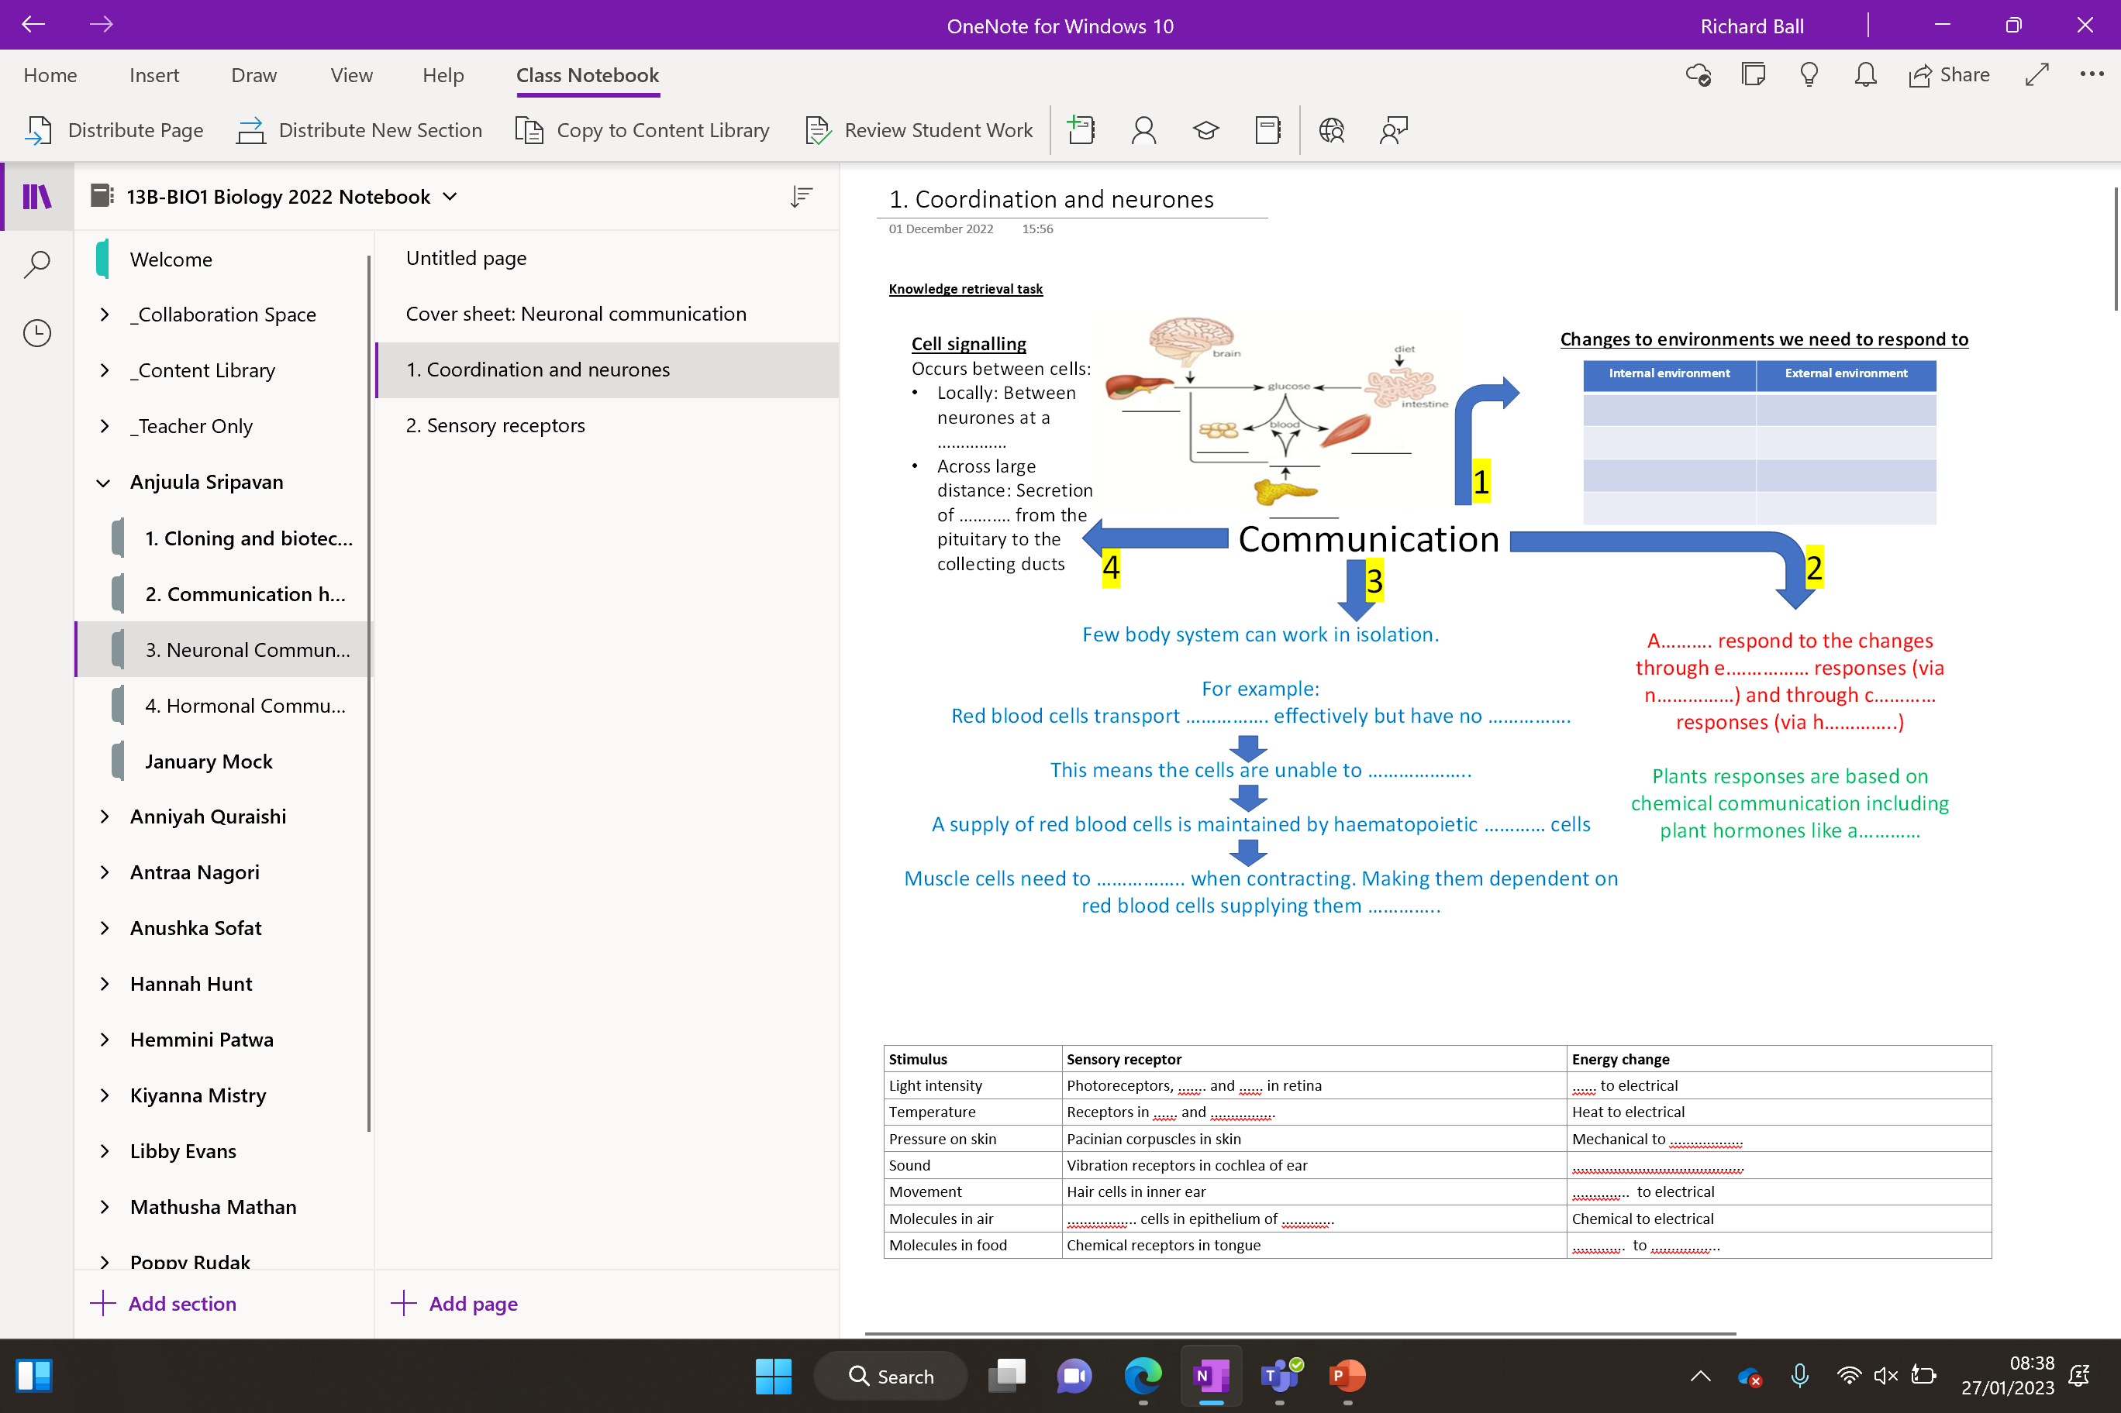

Slide 4
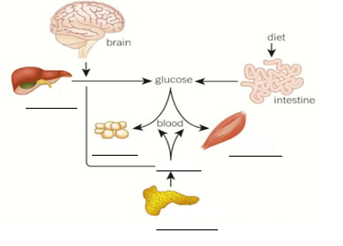
Knowledge retrieval task
Changes to environments we need to respond to
Internal environment | External environment
Cell signalling
Occurs between cells:
Locally: Between neurones at a ……………
Across large distance: Secretion of ……..… from the pituitary to the collecting ducts
1
Communication
4
2
3
Few body system can work in isolation.
For example:
Red blood cells transport ……………. effectively but have no …………….
This means the cells are unable to ………………..
A supply of red blood cells is maintained by haematopoietic ………… cells
Muscle cells need to …………….. when contracting. Making them dependent on red blood cells supplying them …………..
A………. respond to the changes through e.…………… responses (via n……………) and through c………… responses (via h…………..)
Plants responses are based on chemical communication including plant hormones like a…………
Notes:
Haematopoiesis is the formation of blood cellular components

Slide 5
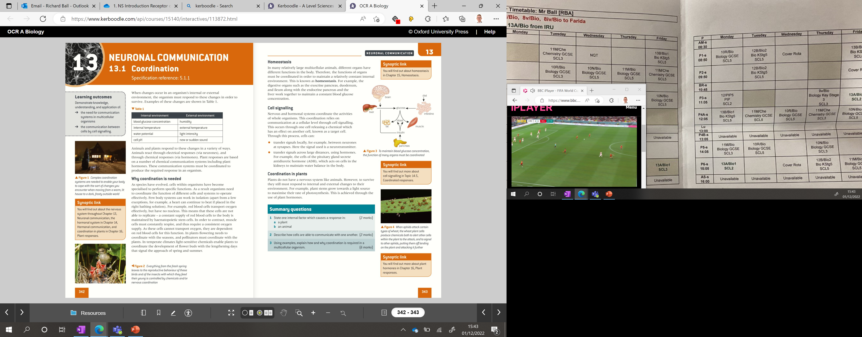
Cell signalling
Occurs between cells:
Locally: Between neurones at a synapse
Across large distance: Secretion of ADH from the pituitary to the collecting ducts
Changes to environments we need to respond to
Internal environment | External environment
Blood glucose
Humidity
Temperature
Temperature
1
Water potential
Light intensity
Cell pH
Sound
Communication
4
2
3
Few body system can work in isolation.
For example:
Red blood cells transport oxygen effectively but have no nucleus
This means the cells are unable to replicate
A supply of red blood cells is maintained by haematopoietic stem cells
Muscle cells need to respire when contracting. Making them dependent on red blood cells supplying them oxygen.
Animals respond to the changes through electrical responses (via neurones) and through chemical responses (via hormones)
Plants responses are based on chemical communication including plant hormones like auxin
Notes:
Haematopoiesis is the formation of blood cellular components

Slide 6
Sensory receptors and effectors
What is a stimuli?
What are sensory cells (sensors)?
What are effector cells (effectors)?
Complete the table to show as many as you can remember!
Stimulus | Sensory receptor | Energy change
Light intensity | Photoreceptors, rods and cones in retina | Light to electrical
Temperature | Receptors in skin and hypothalamus | Heat to electrical
Pressure on skin | Pacinian corpuscles in skin | Mechanical to electrical
Sound | Vibration receptors in cochlea of ear | Mechanical to electrical
Movement | Hair cells in inner ear | Mechanical to electrical
Molecules in air | Olfactory cells in epithelium of nose | Chemical to electrical
Molecules in food | Chemical receptors in tongue | Chemical to electrical
Notes:
Types of photo receptors
Rods monochrome
Cones colours

Slide 7
Sensors and effectors
What is a stimuli?
What are sensory cells (sensors)?
What are effector cells (effectors)?
Complete the table to show as many as you can remember!
Stimulus | Sensory receptor | Energy change
Light intensity | Photoreceptors, rods and cones in retina | Light to electrical
Temperature | Receptors in skin and hypothalamus | Heat to electrical
Pressure on skin | Pacinian corpuscles in skin | Mechanical to electrical
Sound | Vibration receptors in cochlea of ear | Mechanical to electrical
Movement | Hair cells in inner ear | Mechanical to electrical
Molecules in air | Olfactory cells in epithelium of nose | Chemical to electrical
Molecules in food | Chemical receptors in tongue | Chemical to electrical

Slide 8
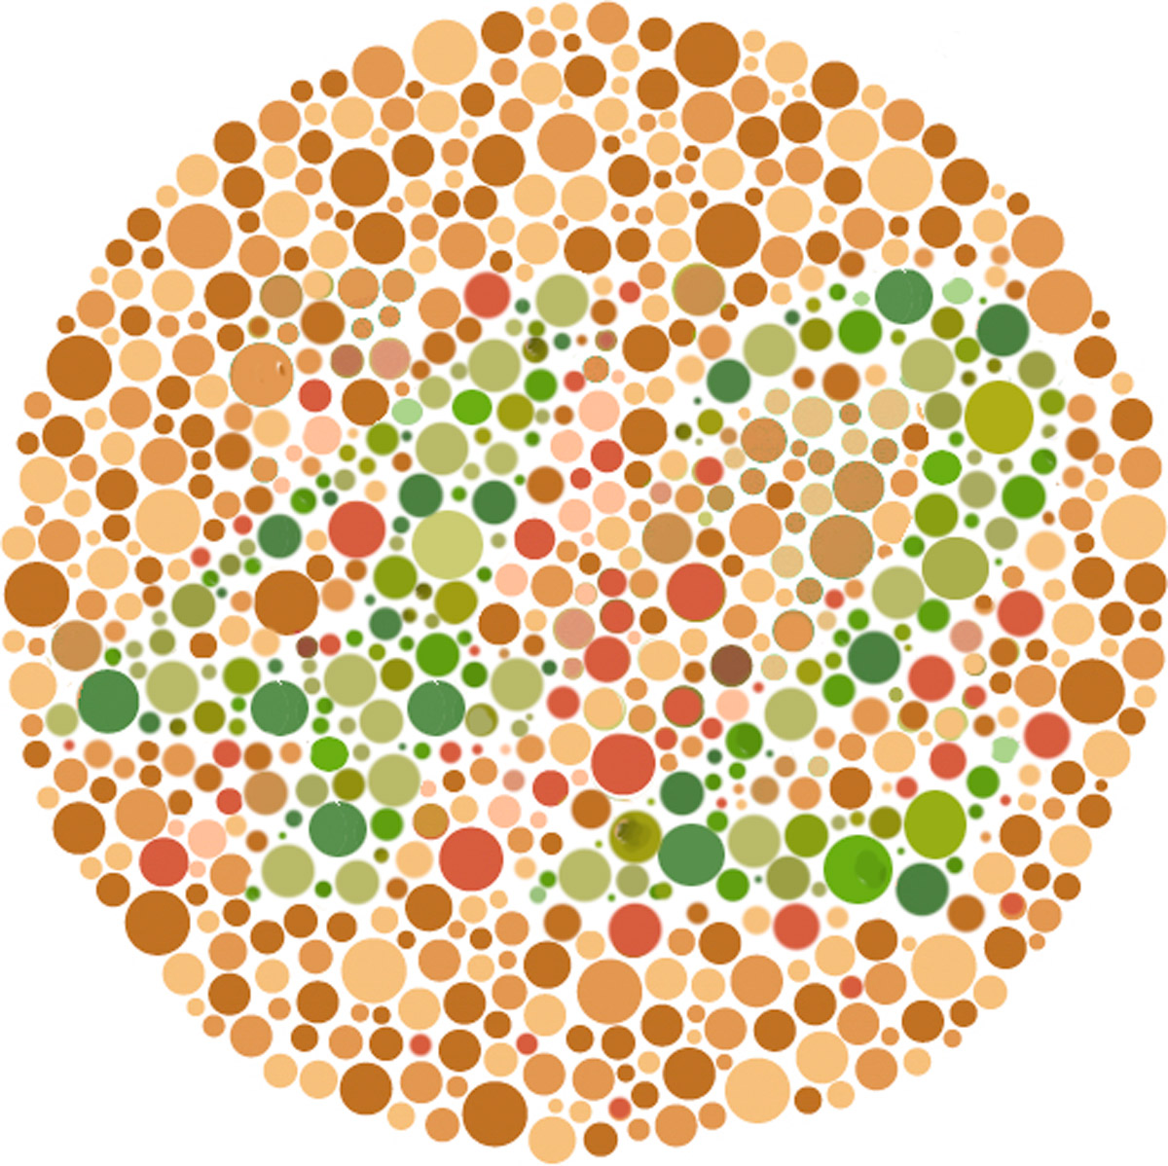

Slide 9
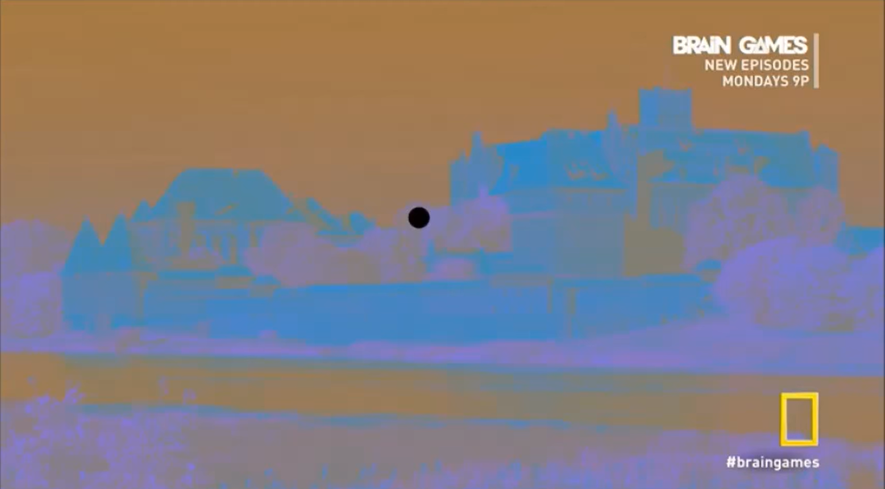

Slide 10
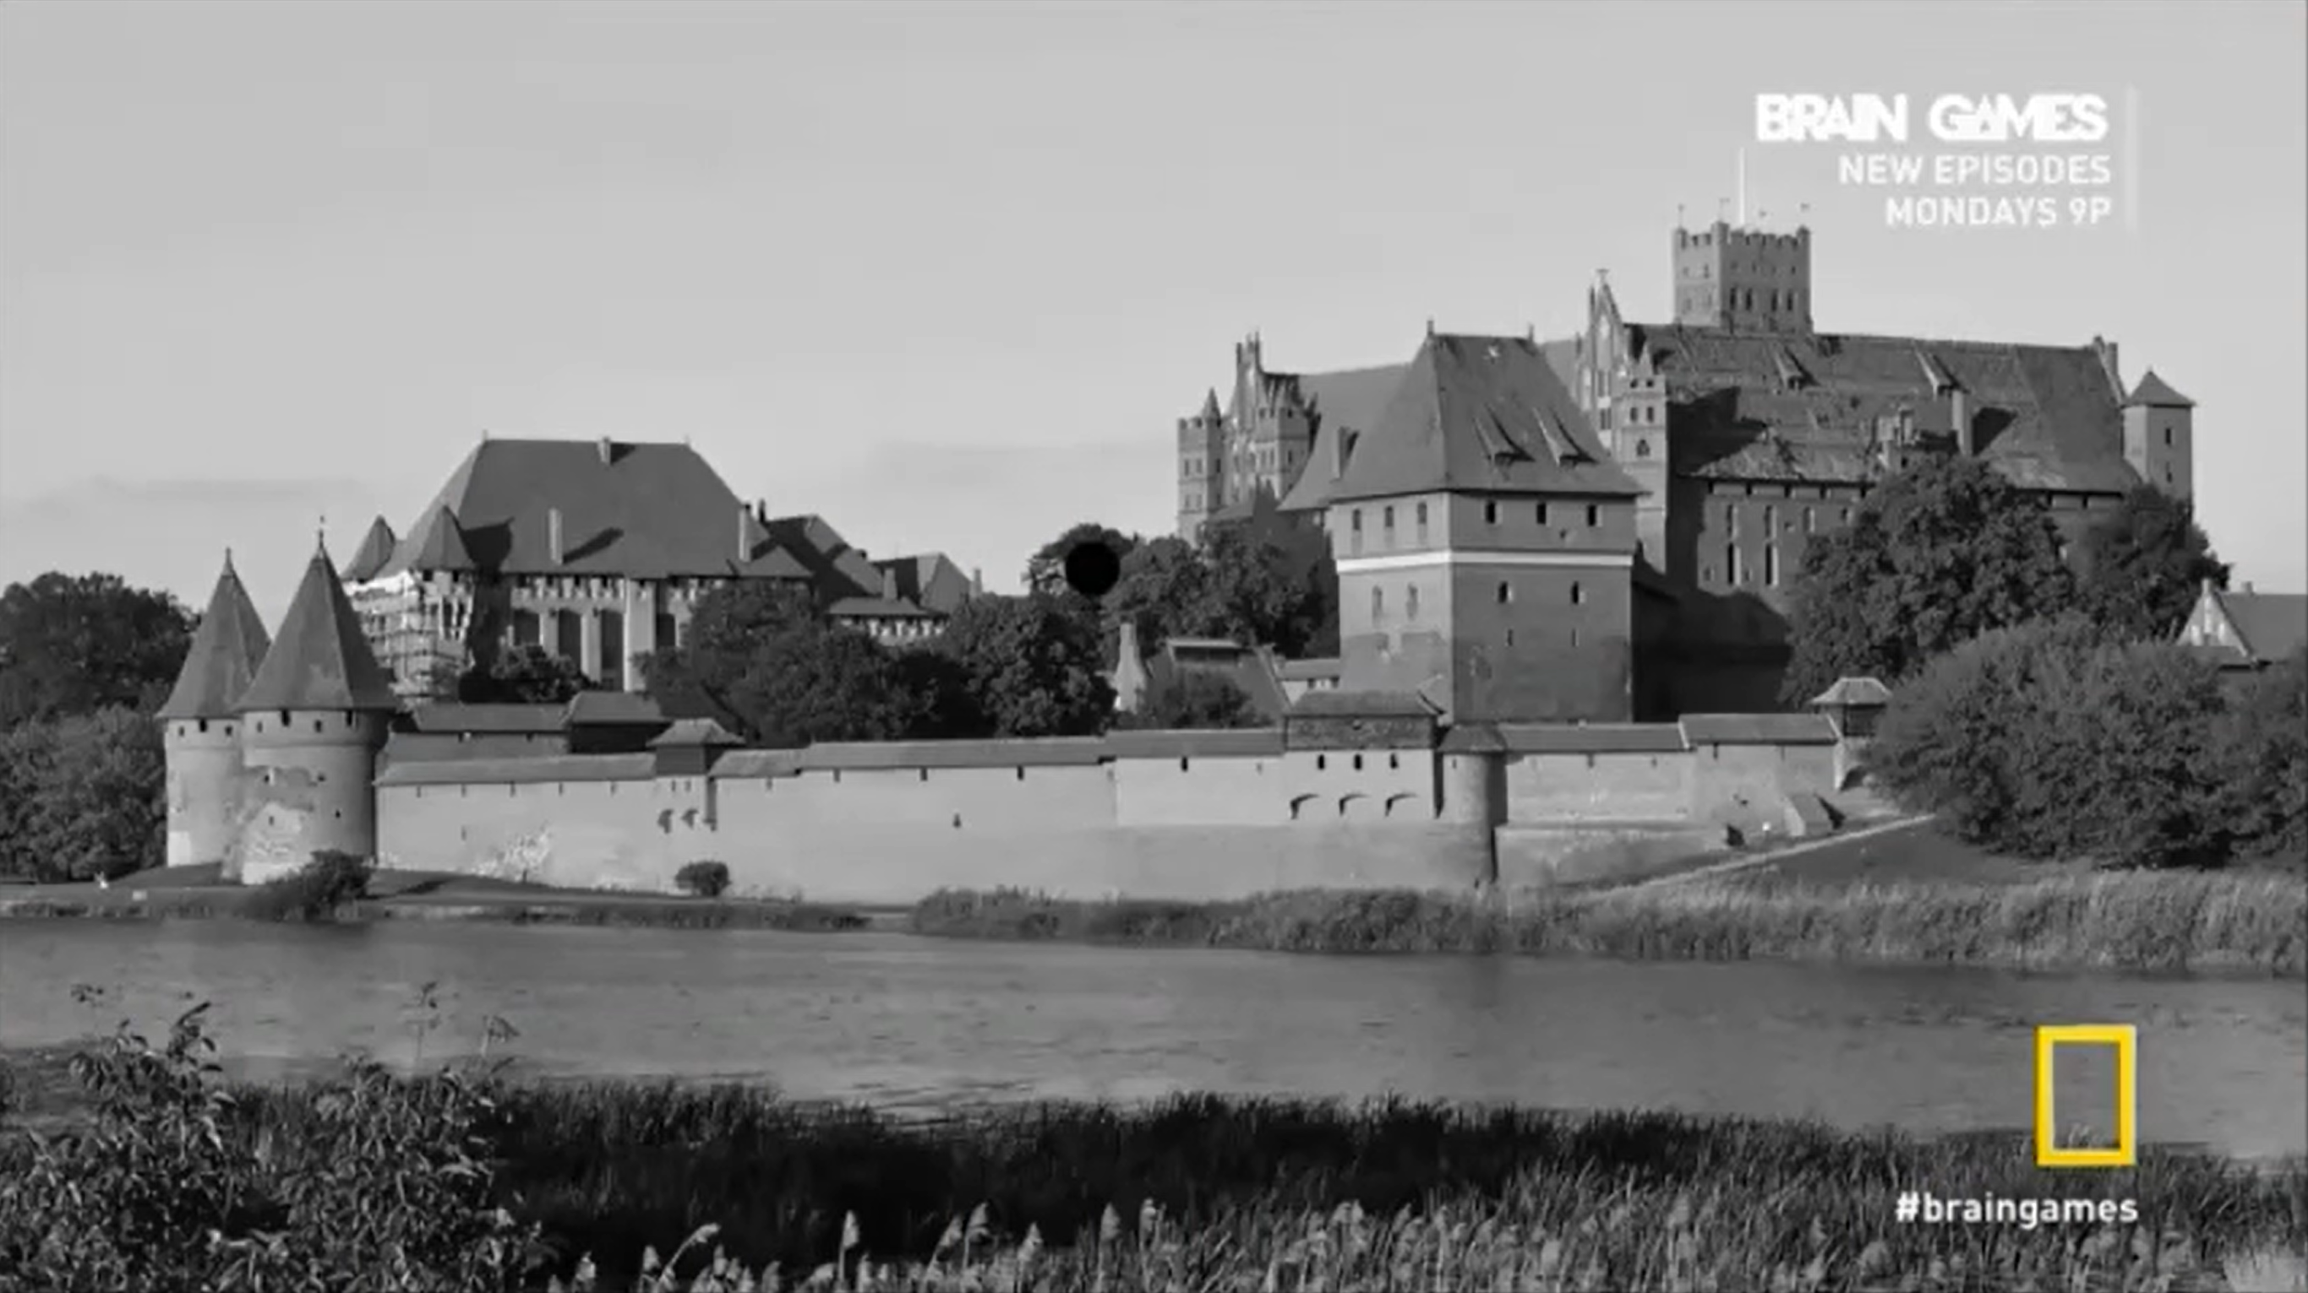

Slide 11
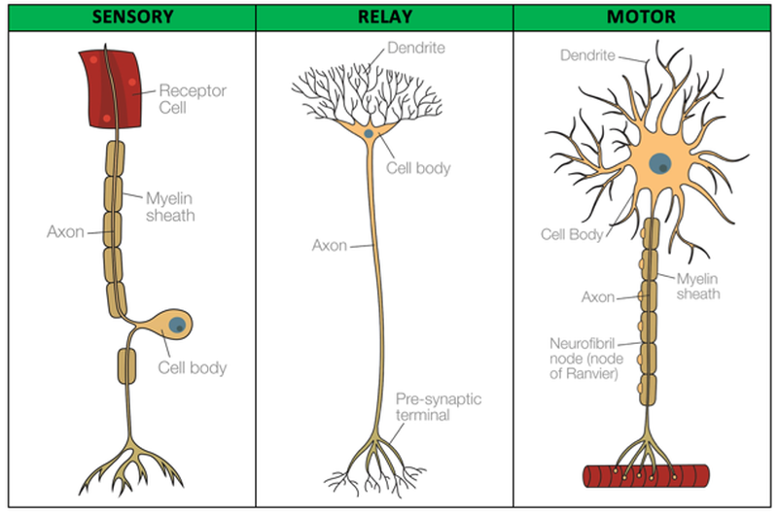
Three types of neurone
Label the three types of neurone sensory, relay and motor
Add an arrow to show the direction of the electrical impulse
Explain what each does, and the differences/similarities?
e.g.
send a signal from where to where
Location of cells body
Myelinated or not

Slide 12
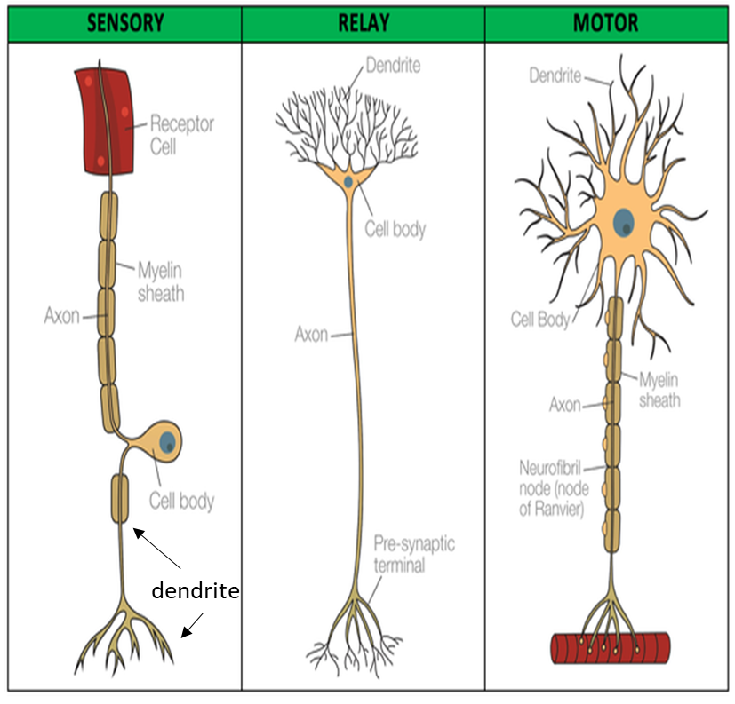
Structure of a neurone
They have three distinct parts:
Cell body – contains nucleus and cytoplasm. Also contains many mitochondria, ribosome and RER to produce neurotransmitters.
Dendron / Dendrites – Extend from the cell body. The electrical impulse travels towards the cell body along these.
Axon – Elongated nerve fibres that transmit impulses away from the cell body to pre-synaptic terminals.
Three types of neurone:
Sensory neurone – Carry the impulse from receptor cells to the relay neurone. Cell body found along the axon.
Relay neurone – Transit impulses between neurones. Have short axons and many dendron. Cell body at the end of axon.
Motor neurone – Carry the impulse from relay neurone to an effector (muscle/gland). Long axon and short dendrites. Cell body found at the end of the axon. Often myelinated.

Slide 13
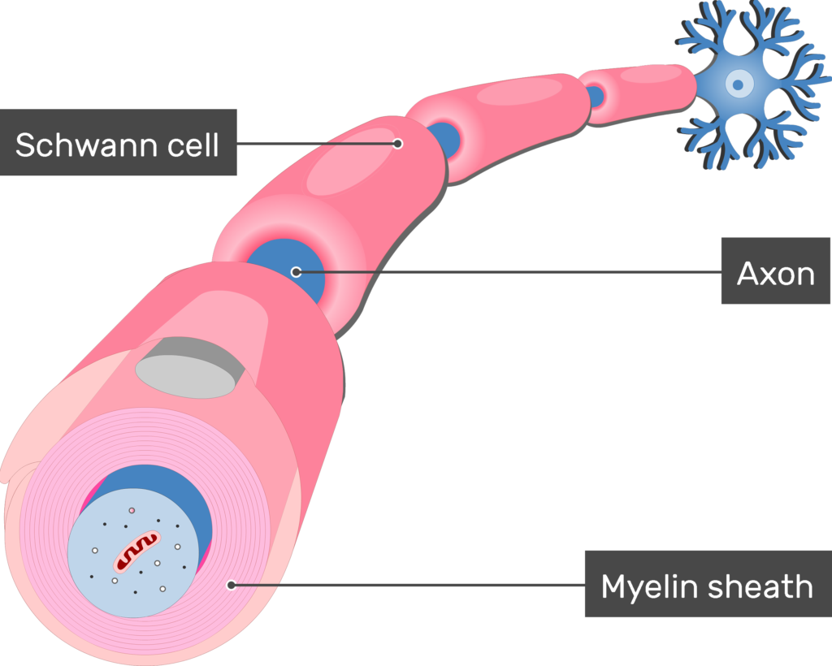
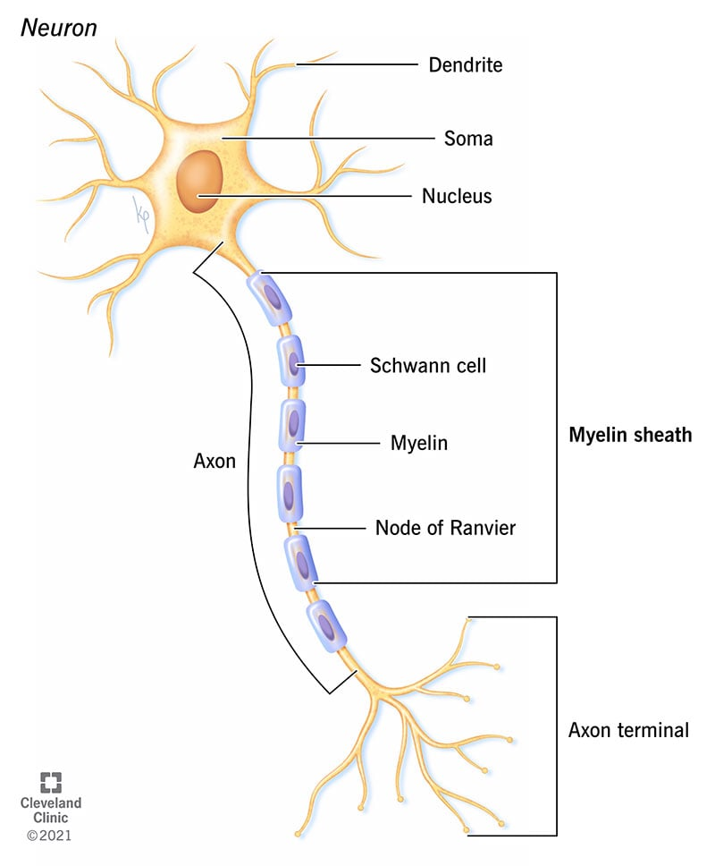
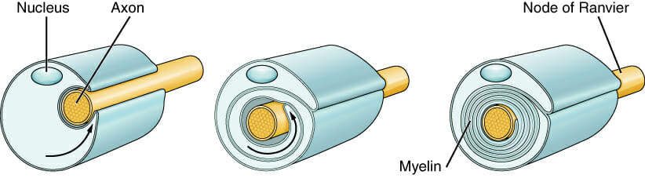

Slide 14
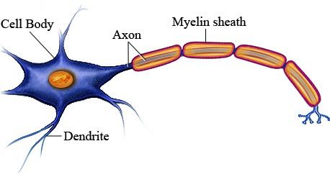
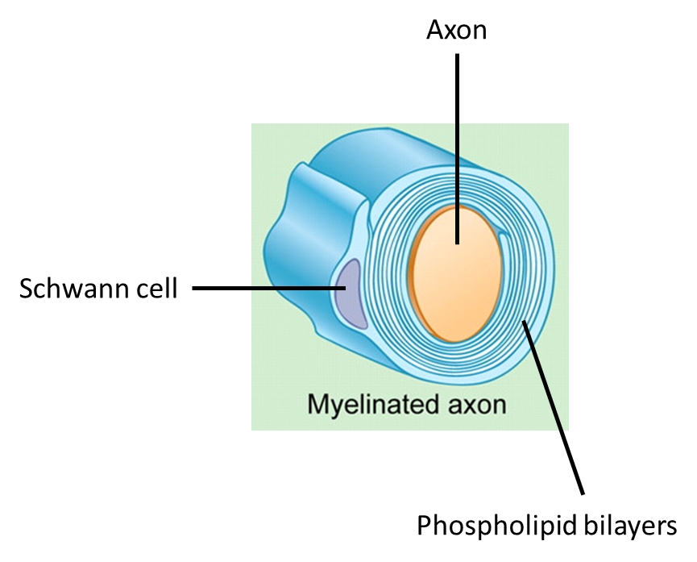
Myelinated Axons
The axons of some neurones are covered in myelin sheath.
Schwann cells surrounding the axon produce many layers of plasma membrane (Up to 20 phospholipid bilayers!)
These layers act as insulation and allow the impulse to travel at much greater speeds.
Myelinated neurone : 100m/s
Unmyelinated neurone: 1m/s

Slide 15
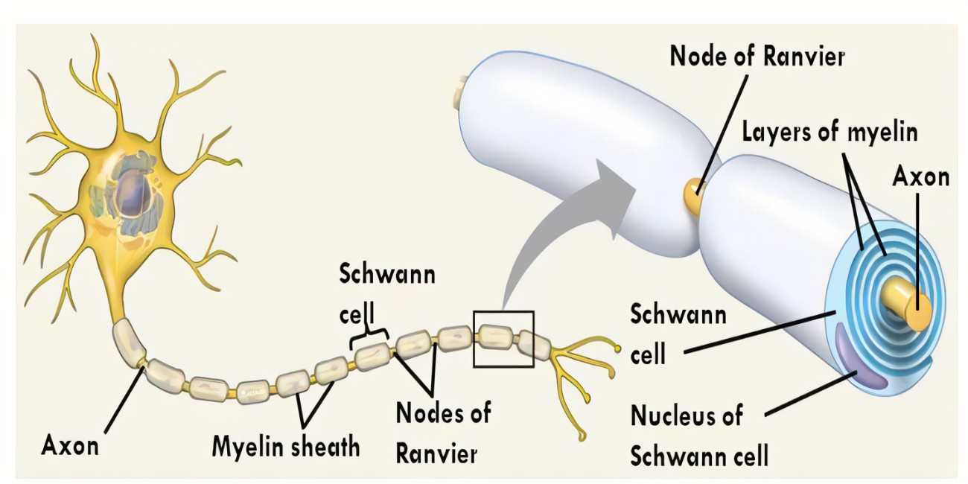
Between each adjacent Schwann cell is a small gap known as the node of Ranvier.
These gaps appear every 1-3mm and help the electrical impulse travel faster as it jumps from one node to the next.
In non-myelinated neurones the impulse does not jump. The continuous transmission along the neuron is much slower
Saltatory conduction
Notes:
Saltatory conduction – depolarisation at the Ranvier – allows action potential to jump from one node to the next

Slide 16
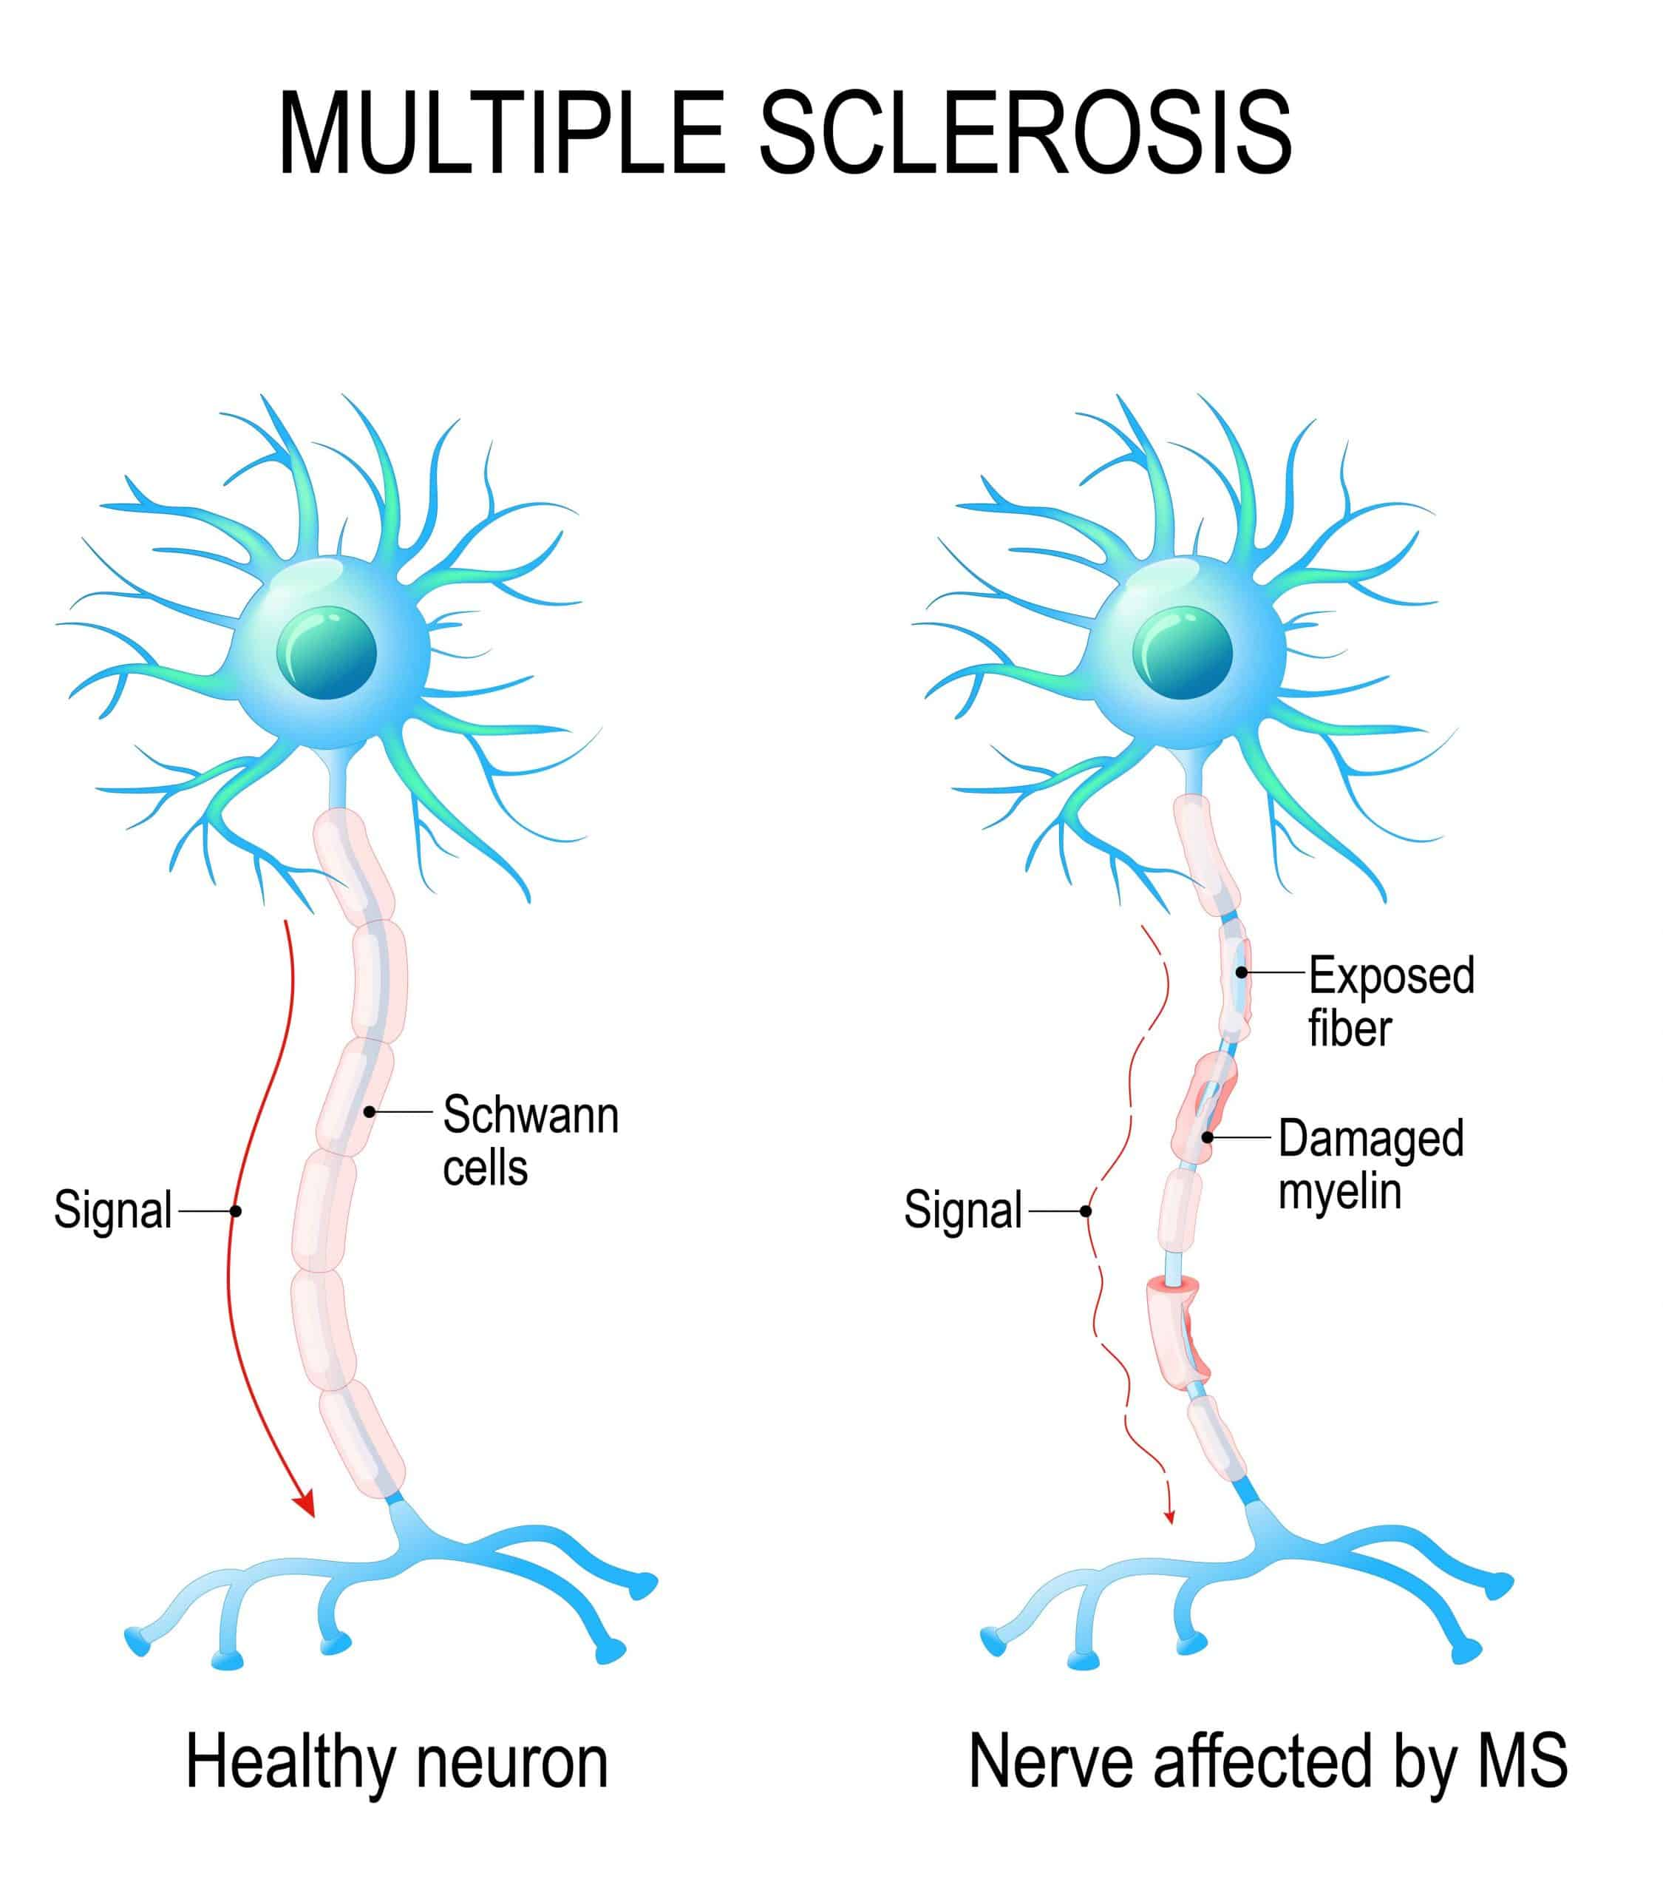

Slide 17
2-Minute Neuroscience: Multiple Sclerosis - YouTube

Slide 18
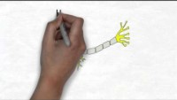

Slide 19
Multiple sclerosis (autoimmune disease)
Immune system attacks healthy tissue
Resulting in thinning/loss of myelin sheath.
Advance stages result in the breakdown of axons within neurones.
Causes (not completely known) but thought to be a combination of genetic and environmental (viral).

Slide 20
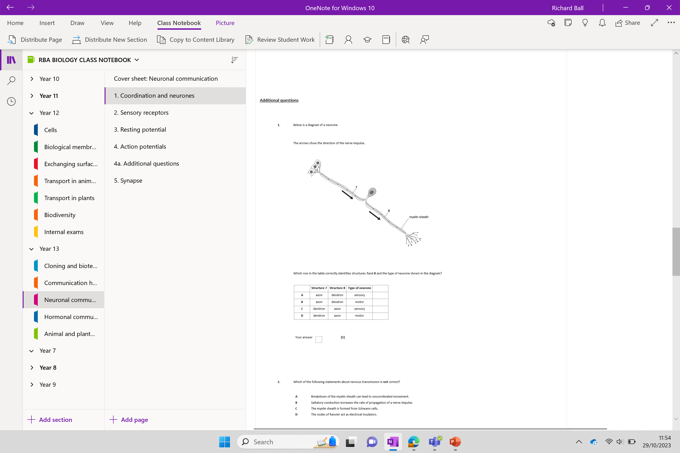
Additional questions

