Slide 1
Revision note
Note: This topic and controlling heart rate (next lesson) sit within the hormonal communication chapter 14 in the textbook

Slide 2
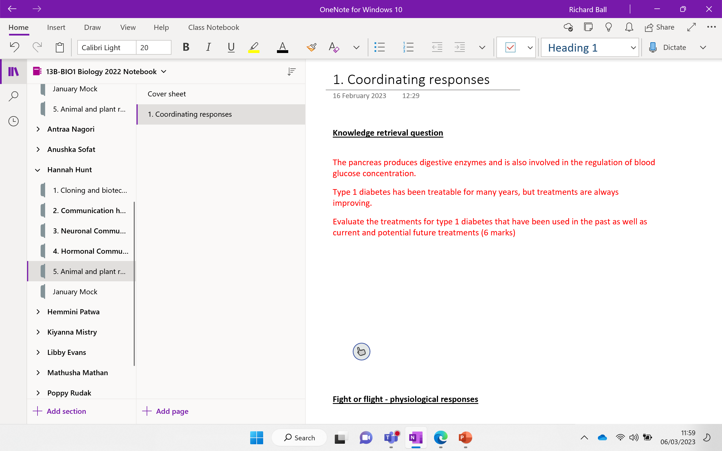

Slide 3
Knowledge retrieval question
The pancreas produces digestive enzymes and is also involved in the regulation of blood glucose concentration.
Type 1 diabetes has been treatable for many years, but treatments are always improving.
Evaluate the treatments for type 1 diabetes that have been used in the past as well as current and potential future treatments (6 marks)
BULLET POINT YOUR ANSWER
Advantages / disadvantages should be linked to treatment being discussed
Level 3 (5–6 marks)
An evaluation that includes treatments with insulin past and current AND includes another treatment (current / future).
Includes advantage and disadvantage statements for insulin and another treatment.

Slide 4
Knowledge retrieval question
The pancreas produces digestive enzymes and is also involved in the regulation of blood glucose concentration.
Type 1 diabetes has been treatable for many years, but treatments are always improving.
Evaluate the treatments for type 1 diabetes that have been used in the past as well as current and potential future treatments (6 marks)
Insulin treatments:
PAST:
from animal pancreas e.g. pig
Current:
GM / recombinant bacteria / Humulin
Other current / potential treatments:
transplant of pancreas / islets
transplant of (pancreatic) stem cells
immunotherapies / gene therapy
Advantages / disadvantages should be linked to treatment being discussed
Advantages of insulin
animal-derived insulin tried and tested method
less risk of allergic reaction
lower production cost
overcomes religious / ethical issues of animal products
use of smart pens / pumps
detail of pump use e.g. monitored by apps
Disadvantages of insulin
animal-derived insulin needs to be purified
risk of allergic reaction
religious / ethical issues of animal products – from pigs
some may not understand technology of injection routine
side effects of pumps e.g. causing lumps to form under skin
Notes:
Humulin is a man-made form of a hormone that is produced in the body. Made from recombinant DNA that is identical to human insulin

Slide 5
Advantages of other treatments
transplants less / no need for insulin injections
more physiological control of blood glucose compared with injection
improved quality of life
stem cells turned into functioning β-cells
Immunotherapies ‘reprogrammes’ immune system and prevents / stops damage to β-cells
Disadvantages of other treatments:
Transplants - requirement for immunosuppression
availability of donor tissue is low
ethical issues associated with stem cells – killing embryos
risk of cancer with stem cells
may still need low dose of insulin
initial high costs
need for clinical trials

Slide 6
How does the following clip make you feel?

Slide 7


Slide 8
Why do some of us enjoy this feeling?
Or is it just the absence of something else?

Slide 9
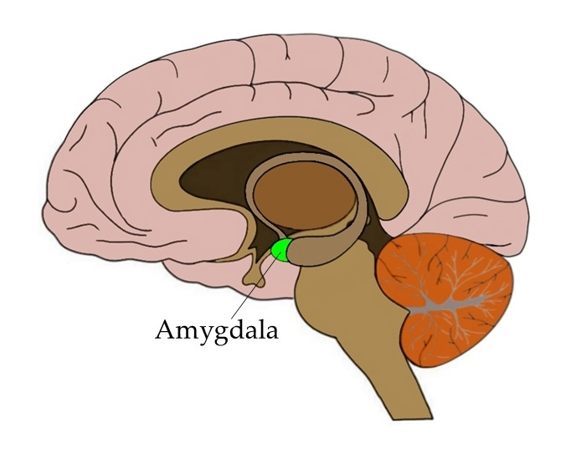
Notes:
Even though the fight or flight response is automatic it is normally triggered by a false alarm, such as sitting an exam or playing this very game – there is no threat to your survival.
The amygdala (part of brain that helps trigger this responses) is unable to distinguish between a real threat or a perceived threat
An exam triggers the same impact on your body as potential sudden death does!! ☹

Slide 10


Slide 11
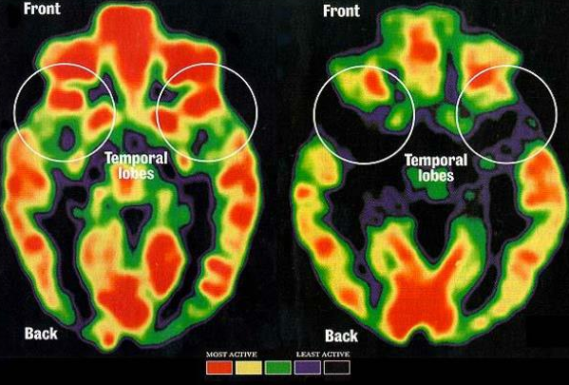
The pre-frontal cortex is at the front of brain, just behind the forehead, and is the part of the brain that governs reasoning, critical thinking, and exercising self-control.
Not a risk taker
Risk taker
Notes:
Psychologists will know this
Less developed in young people – love rollercoasters / flying – take more risks
Becomes more developed as you age and you take fewer risks

Slide 12
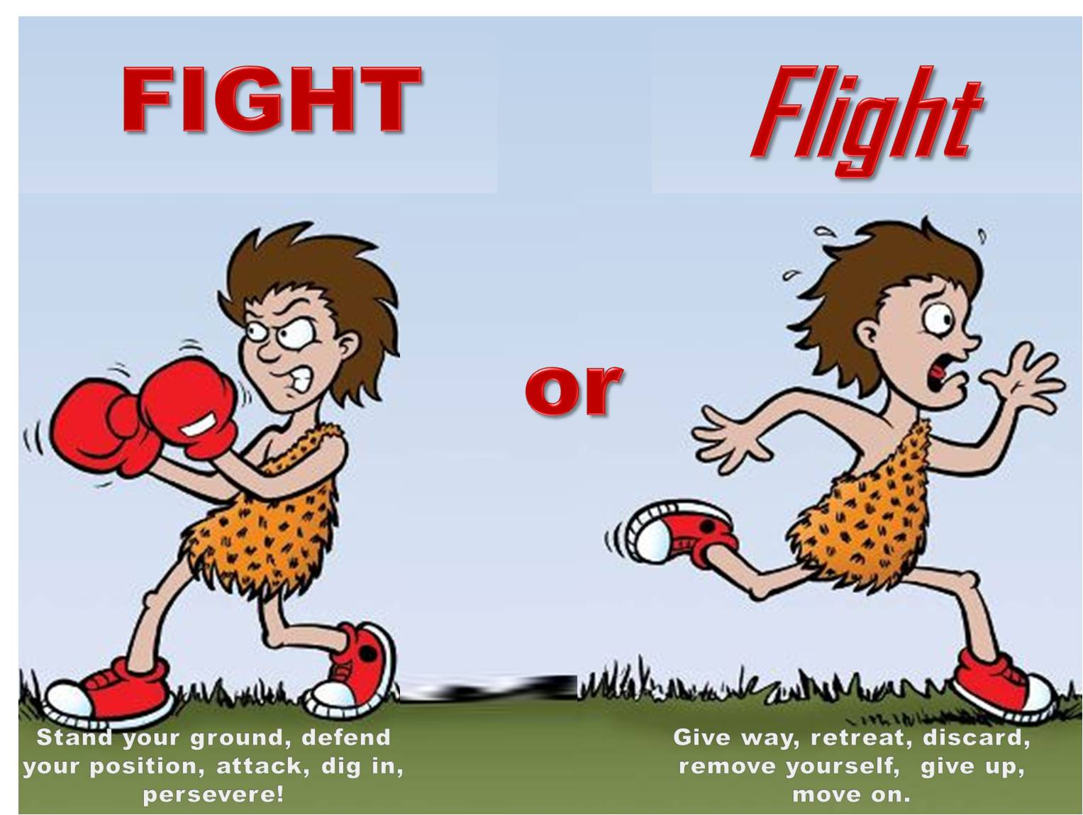
What are the physiological responses

Slide 13
Physiological responses
Complete the table:
Physical responses | Purpose
 | Pump more ………………. blood around the body
Pupils dilate
 | Increase respiration to provide energy for muscular contraction
Smooth muscle of airways relax
 | To focus resources on emergency functions
Add one more of your own

Slide 14
Physiological responses
Complete the table:
Physical responses | Purpose
Heart rate increases | Pump more oxygenated blood around the body
Pupils dilate | To take in as much light as possible for better vision
Blood glucose level increases | Increase respiration to provide energy for muscular contraction
Smooth muscle of airways relax | Allow more oxygen into the lungs
Non-essential system shut down | To focus resources on emergency functions
Arterioles in skin constrict | More blood to major muscle groups, brain, heart and muscles used for ventilation

Slide 15
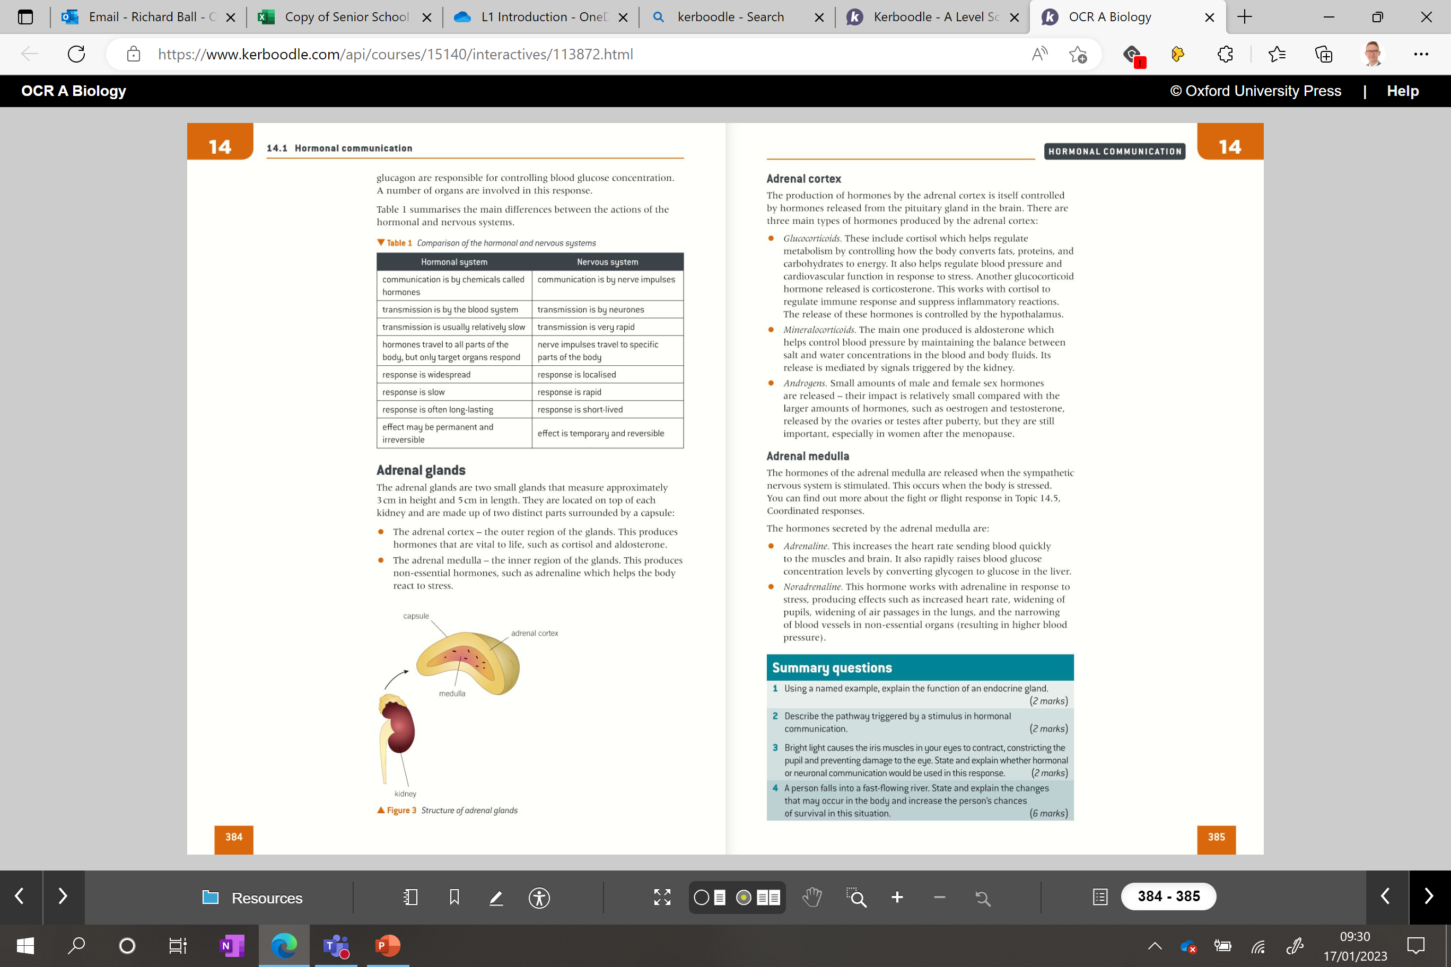
Adrenal glands
(Located above each kidney)
Made up of two parts:
Adrenal cortex – outer region
Adrenal medulla – inner region
QUICK RECAP!

Slide 16
Adrenal cortex
Three main types of hormones produced by the adrenal cortex:
Glucocorticoids – including cortisol, which helps to regulate metabolic rate
Mineralocorticoids – including aldosterone, which helps maintain blood pressure
Androgens –start puberty.
Notes:
Androgens are a group of sex hormones. They help start puberty and play a role in reproductive health and body development
Adrenocorticotropic hormone (ACTH) is produced by the pituitary gland.

Slide 17
Adrenal medulla
Adrenaline – Increases heart rate and blood glucose levels (glycogenolysis)
Noradrenaline – Responds to stress by dilating pupils, widening airways, narrowing non-essential blood vessels and increasing heart rate

Slide 18
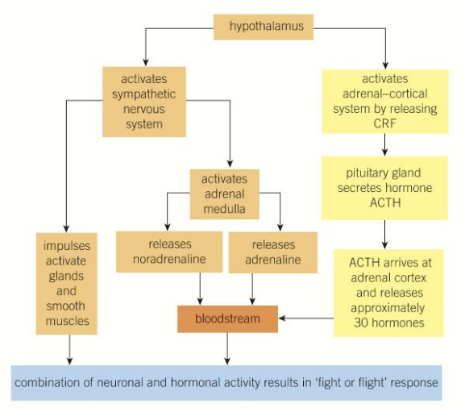
Coordination of fight or flight response
The cerebrum uses sensory input from external threats (detected by eyes, ears e.t.c.) and internal threats e.g. pain.
If a threat is recognised, it stimulates the hypothalamus (autonomic) which activates the:
Neuronal pathway - Sympathetic nervous system
Hormonal pathway - Adrenal-cortical system
*Corticotropin releasing factor / Adrenocorticotropic hormone
Notes:
The cerebellum processes input from other areas of the brain, spinal cord and sensory receptors to provide precise timing for coordinated, smooth movements of the skeletal muscular system.

Slide 19
Summary of coordination of ‘fight or flight’ response
Hormonal pathway via bloodstream to initiate body reactions
Neuronal pathway to initiate body reactions
CRF – a hypothalamic hormone which stimulates the pituitary to secrete ACTH
Stress hormones released cause a number of change e.g. increased heart rate
Smooth muscles relax in airways / pancreas secretes glucagon - glycogenolysis
ACTH target the adrenal cortex to secrete many hormones to prepare the body to deal with the threat
Notes:
Corticotropin releasing factor (CRF) is a hypothalamic hormone, which acts on the anterior pituitary to stimulate the secretion of corticotropin
ACTH – adrenocorticotropic hormone

Slide 20
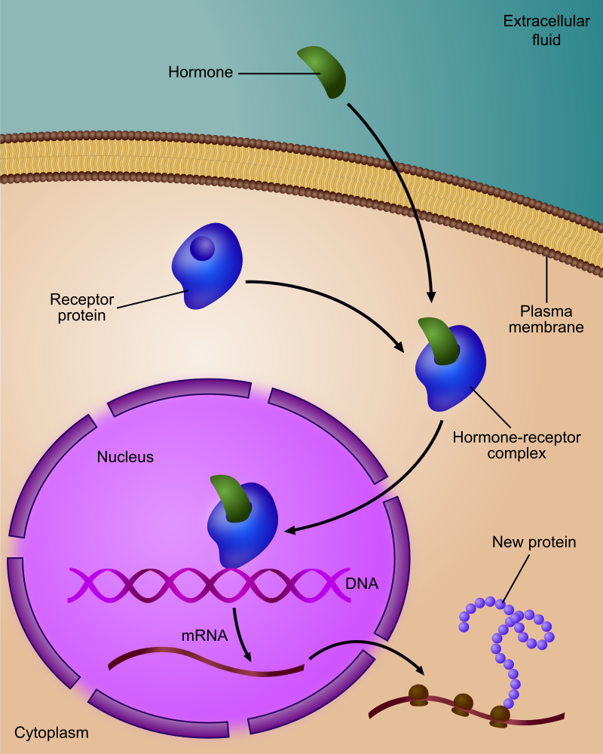
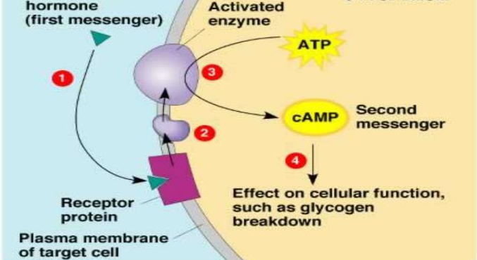
Recap the different types of hormones with the person next to you
Steroid hormone
Non-steroid hormone
Notes:
Non - steroid hormones​
Hydrophilic (do not cross the membrane) ​
Bind to specific receptors on the target cell membrane​
Enzymes convert ATP into cAMP​
This triggers a cascade of reactions, which are mediated by secondary messengers (cAMP)​

Slide 21
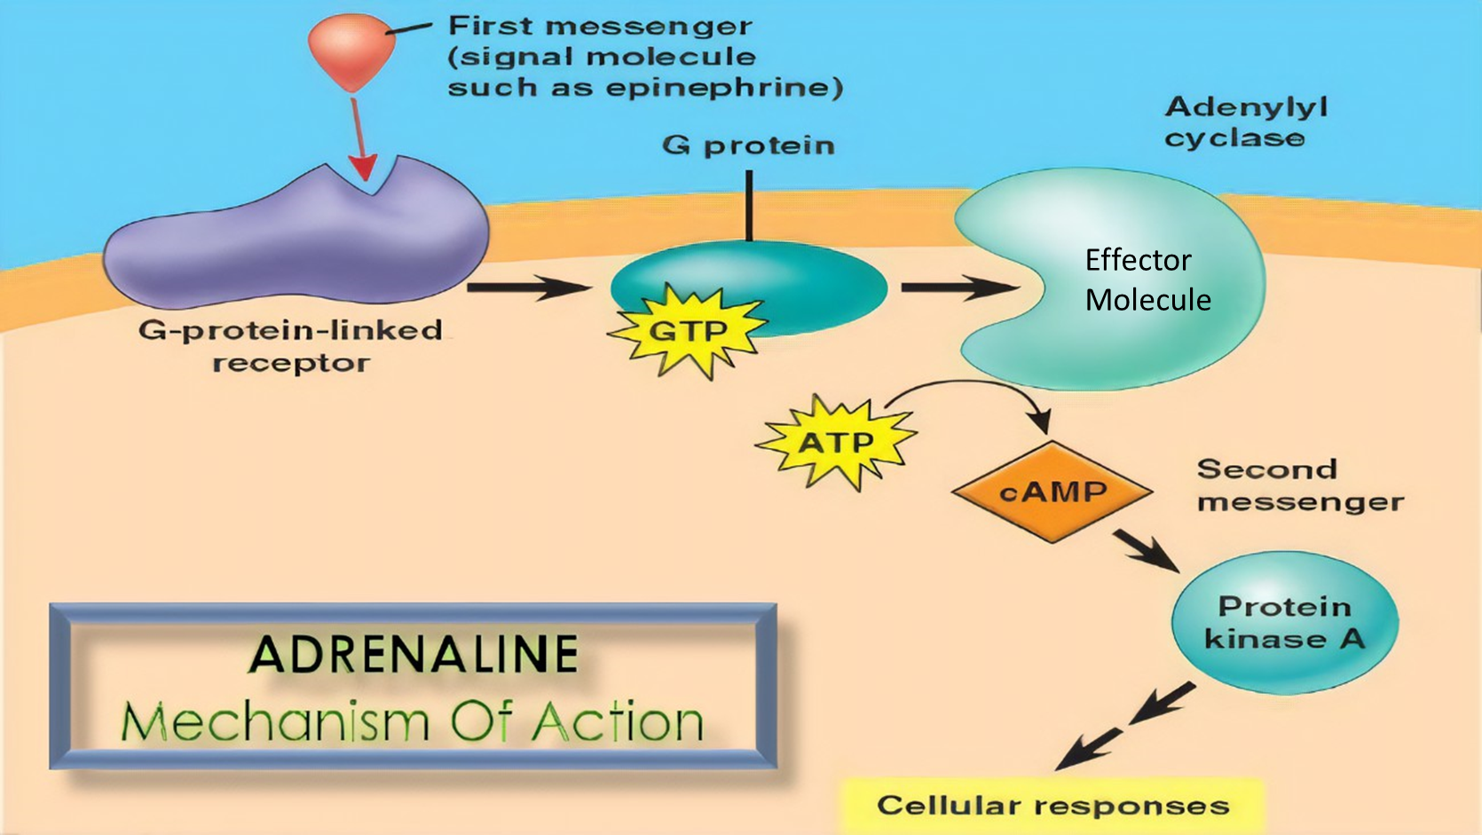
Action of adrenaline
Notes:
Non-steroid hormone
Epinephrine – another name for adrenaline

Slide 22
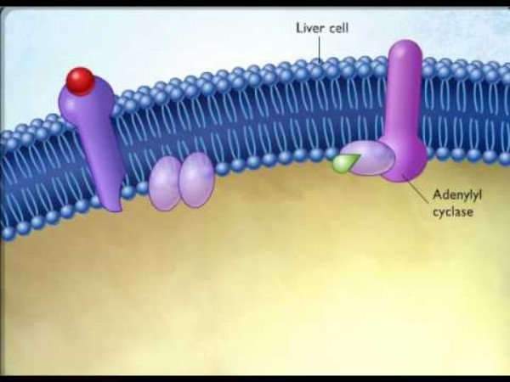

Slide 23
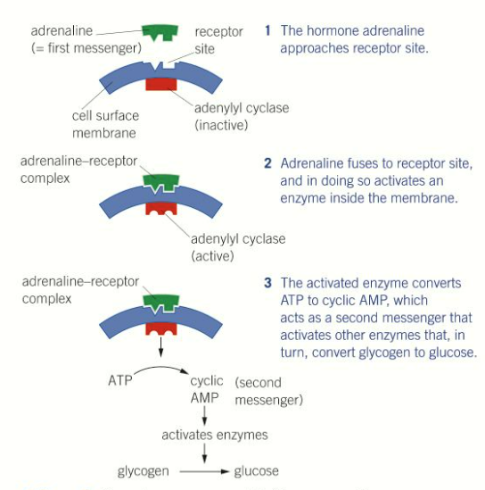
Action of adrenaline action
Type the sentences and fill in the gaps
Adrenaline binds to …………… on the plasma membrane of target cells (e.g liver cells) which activates a G-……………..
The G protein activates enzyme …………. …………. which converts …….. to …………………..
cAMP is the ………… messenger which activates protein kinases
They then phosphorylate (add a phosphate) other enzymes to activate them to convert …………. into ………….
Notes:
Phosphorylate - to cause an organic molecule to combine with phosphoric acid
Protein kinases phosphorylate and activates other enzymes -

Slide 24
Action of adrenaline action
Adrenaline binds to receptors on the plasma membrane of target cells (e.g liver cells) which activates a G protein
The G protein activates enzyme adenylyl cyclase which converts ATP to cyclic AMP (cAMP).
cAMP is the secondary messenger which activates protein kinases
They then phosphorylate (add a phosphate) other enzymes to activate them to convert glycogen into glucose
Notes:
Phosphorylate - to cause an organic molecule to combine with phosphoric acid
Protein kinases phosphorylate and activates other enzymes - Glycogen phosphorylase is the additional enzyme

Slide 25
Key points
When the protein kinase are activated by the cAMP they phosphorylate (release a phosphate)
These (phosphates) then attach to additional enzymes which activate them (eg attaching to phosphorylase in liver cells to convert glycogen into glucose)
(cascade effect)
Notes:
Glycogen phosphorylase is the additional enzyme

Slide 26

Cascade effect
One hormone can cause many cAMP molecules to be formed.
At each stage the number of molecules increases so the process is said to have a cascade effect (see fig 3 right)
Notes:
One hormone can trigger mny cAMP molecules → 2 cAMP molecules can activate 8 enzymes …..

Slide 27
Complete the review questions..
How does the secretion of adrenaline prepare the body for muscular activity?
Adrenaline and cyclic AMP are both messenger molecules. Explain how they perform different but related roles.
Explain how the release of adrenaline from the adrenal gland can bring about responses in a range of tissue types.

Slide 28
Review question answers..
Adrenaline increases the level of glucose in the blood, increases ventilation rate, increases the heart rate and causes arterioles to the muscle to dilate.
Adrenaline binds to a receptor on the surface of a cell causing a response inside the cell, whereas cyclic AMP acts on enzymes inside the cell bringing about a response.
Adrenaline travels through the blood. Blood reaches all cells in the body, where adrenaline binds with receptors on the surface of different tissue types.

Slide 29
Neuronal test – better next lesson if possible
OR additional time – if less than 10 min

Slide 30
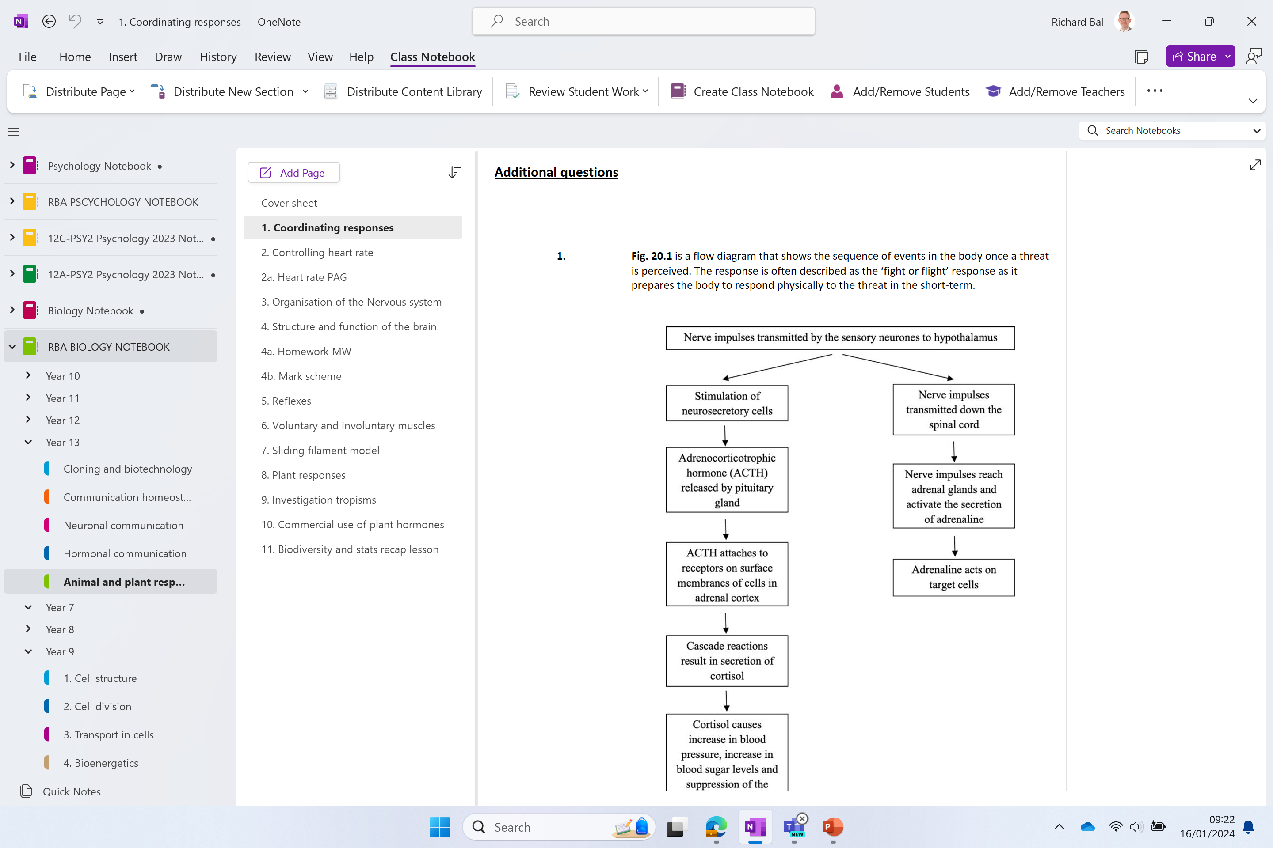
Additional questions

Slide 31
Recap
The Action of Adrenaline - A2 Science - YouTube

Slide 32
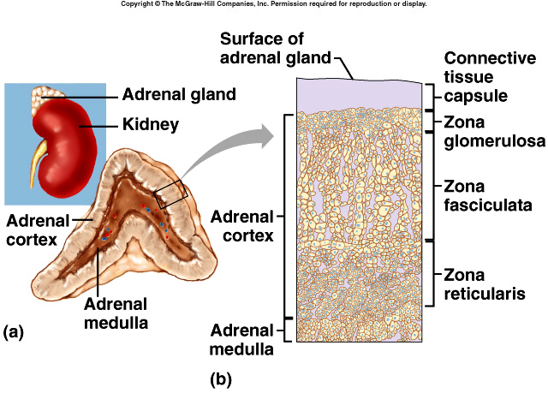
NOT ON SPEC
Adrenal cortex – outer layer of adrenal gland – produces lipid soluble hormones
Zona glomerulosa | Aldosterone | Increases Na⁺ absorption and decreases K⁺ absorption in blood pressure | Distal tubes and collecting duct
Zona fasciculate | glucocorticoids (cortisol) | Released under stress or low [glucose] | Glycogen → glucose
Zona reticularis | molecules used to make sex hormones | Converted into testosterone and oestrogen | Secondary sexual characteristics and gametes
Adrenal medulla – produces polar molecules
Adrenaline | Relaxes smooth muscle; increases heart rate, vasoconstriction; stimulates Glycogen → glucose

