Slide 1
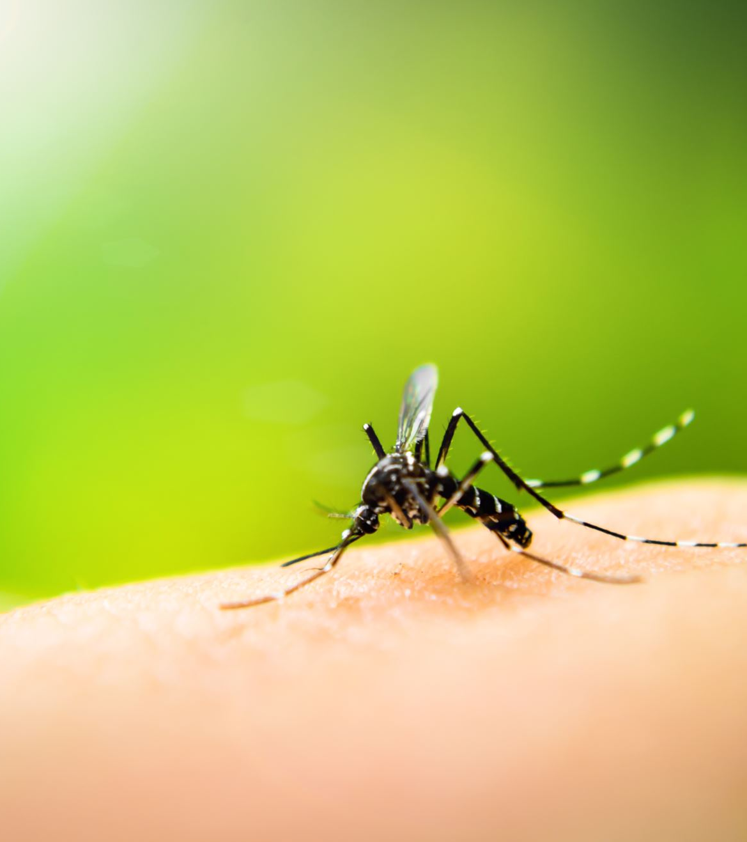
Communicable disease
revision

Slide 2
Tasks:
Complete the revision poster

Slide 3
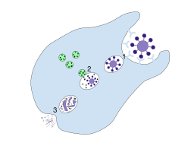
2.Phagocytosis –annotate this diagram make sure you use all key terms
Macrophage attracted to pathogen by chemotaxis
Pathogen adheres to macrophage.
Macrophage develops pseudopodia which engulf the pathogen.
A phagosome is formed inside the macrophage.
Lysosomes containing digestive enzymes fuse with the phagosome.
A phagolysosome is formed.
Digestive enzymes are released which break down the pathogen.
Waste products move towards the cell membrane and fuse with it.
Waste products are expelled from the cell by exocytosis

Slide 4
3. Cell mediated response.
Working in pairs how much of this can you remember from your revision poster?
1. Cell mediated. Start with an infected body cell at the top left corner of the page. You have 2 mins to continue drawing the response. Every two minutes you will swap posters until every poster is complete. You can add or correct any detail on each poster as you come across it. You can use key terms if absolutely necessary, but these must be minimal.

Slide 5
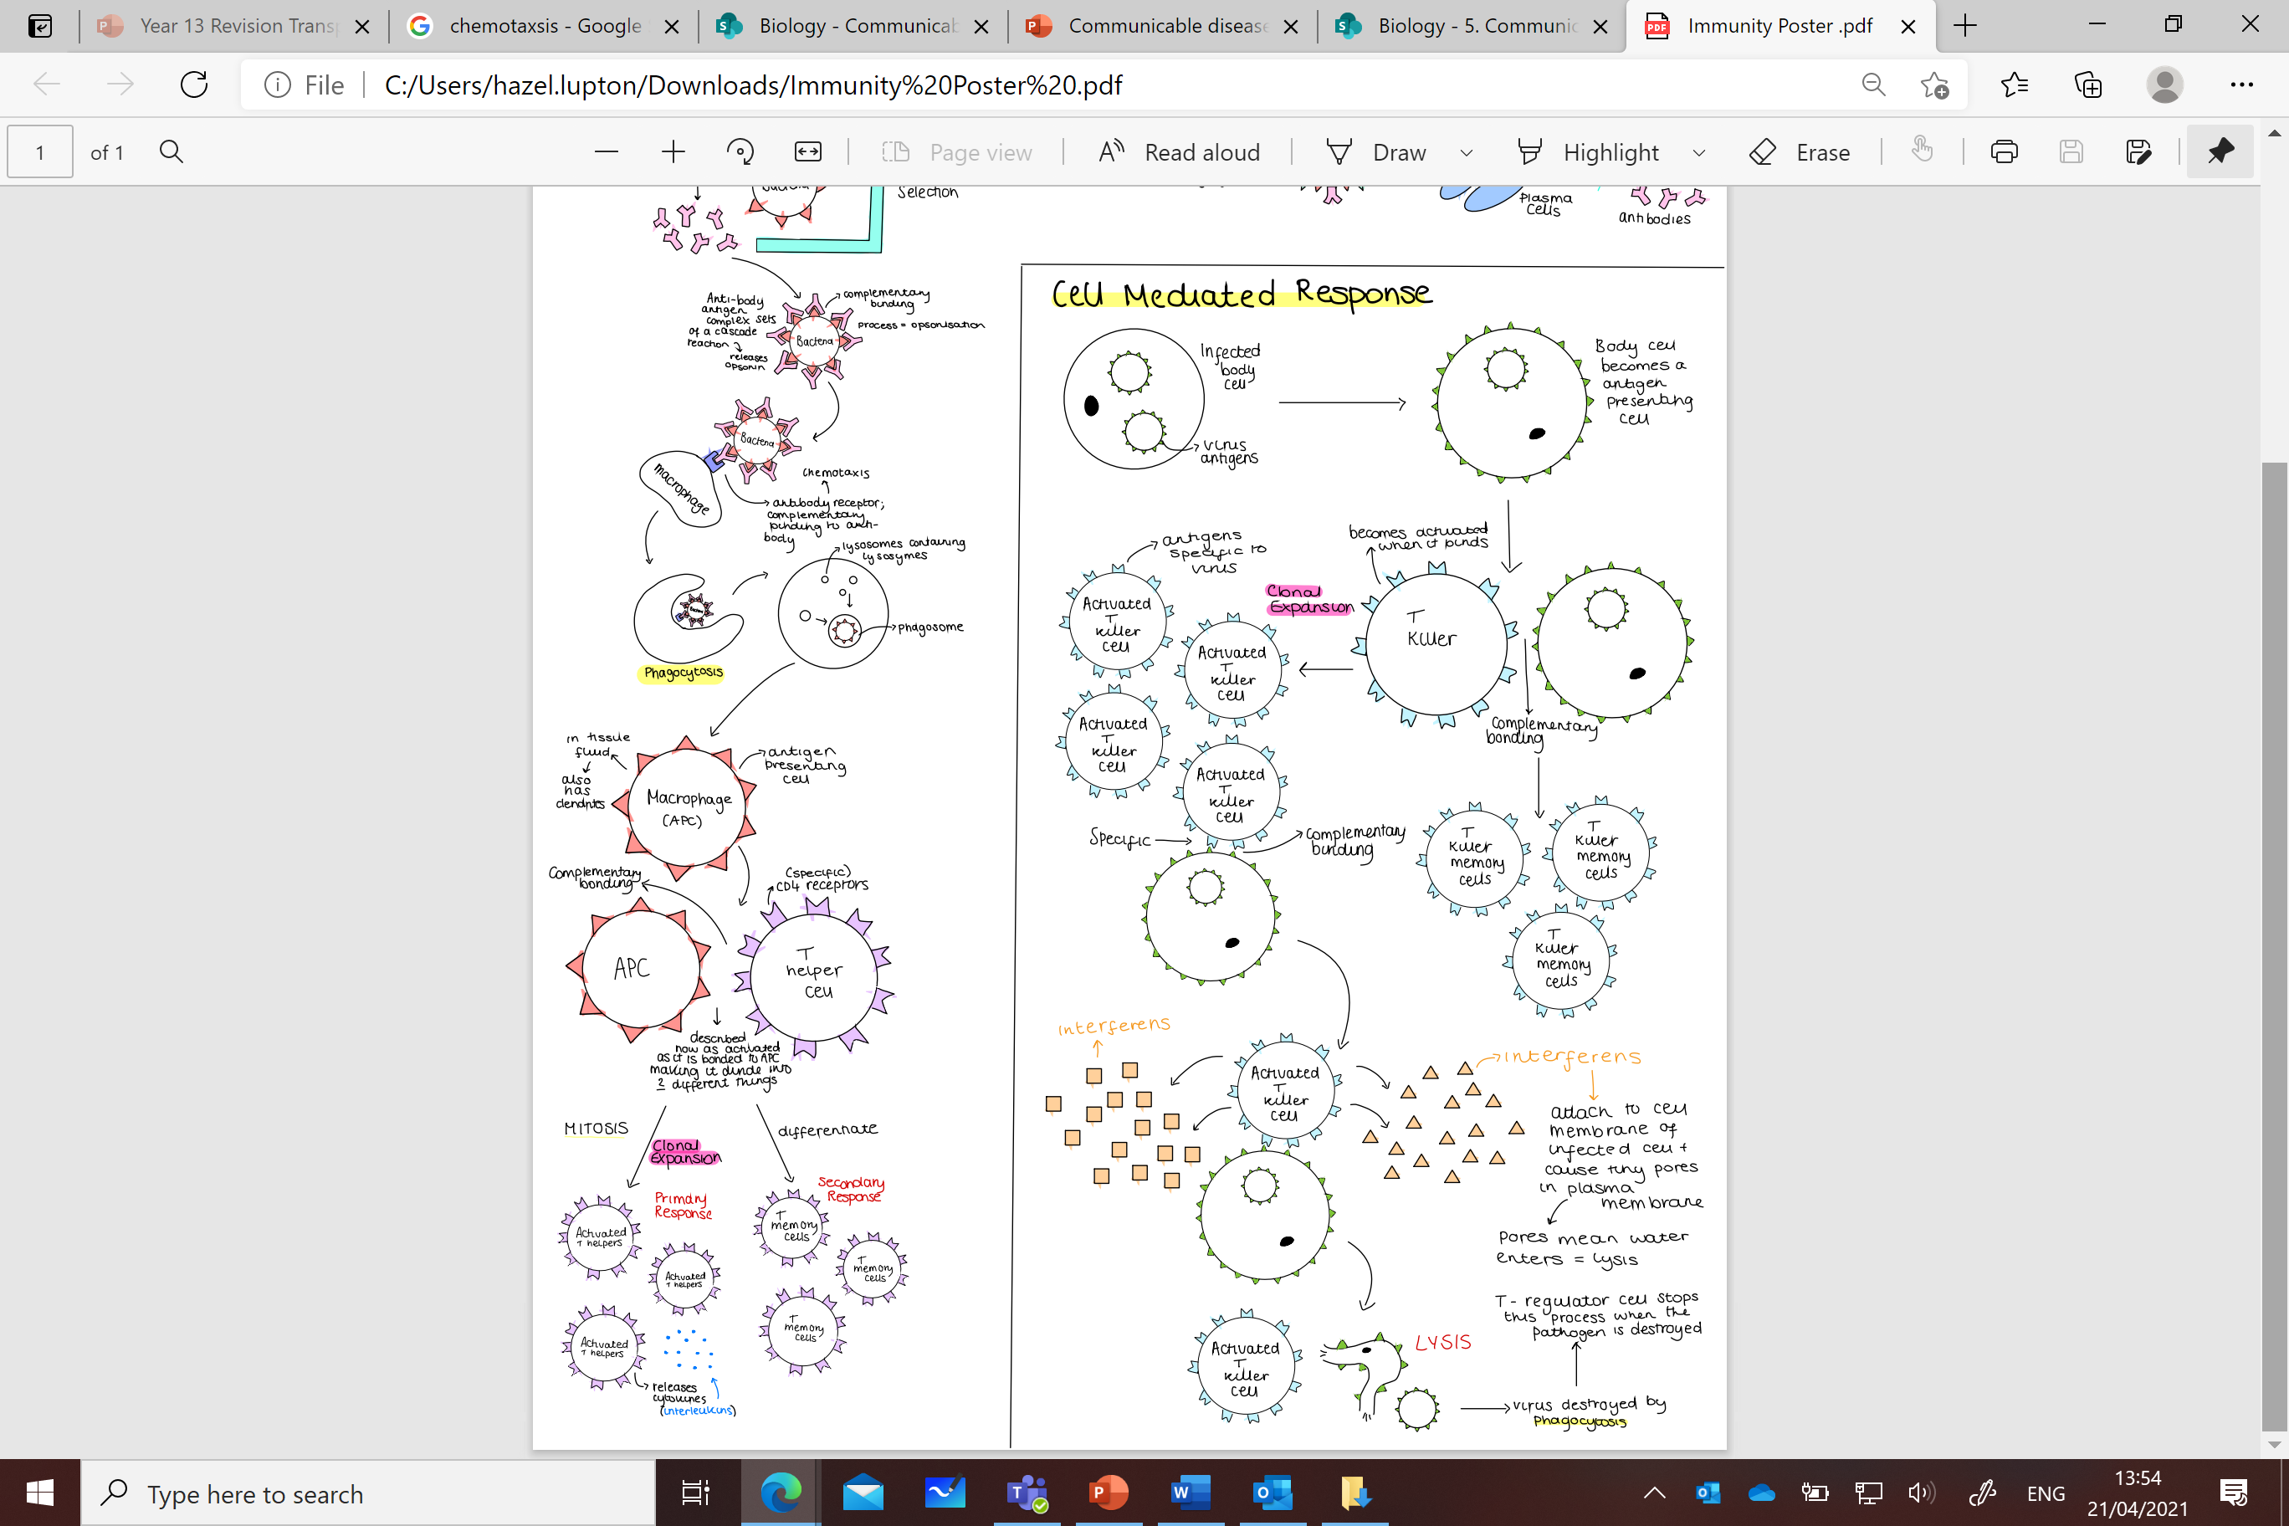

Slide 6
4. Humoral response
Working in pairs how much of this can you remember from your revision poster?
1. Humoral. Start with B cell and a bacteria at the top left corner of the page. You have 2 mins to continue drawing the response. Every two minutes you will swap posters until every poster is complete. You can add or correct any detail on each poster as you come across it. You can use key terms if absolutely necessary, but these must be minimal.

Slide 7
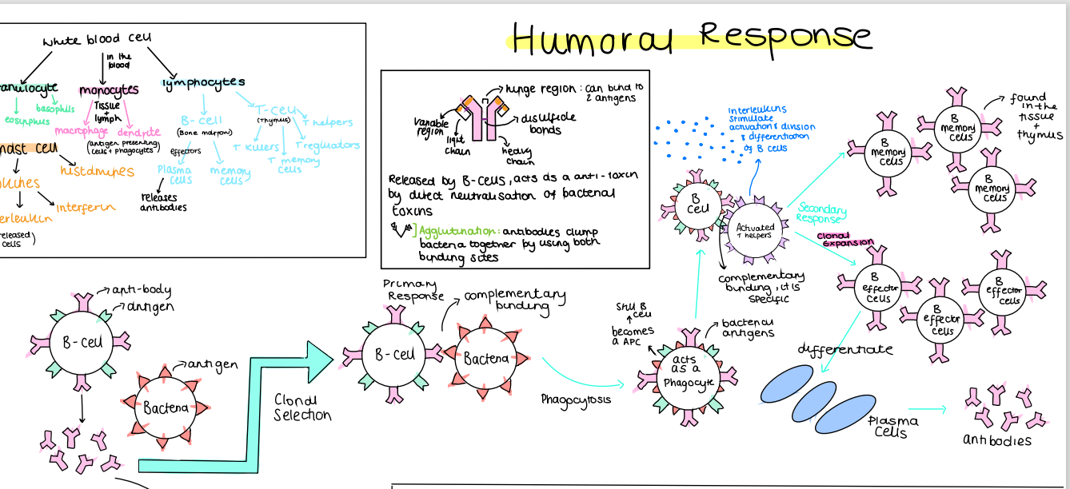

Slide 8
5. Quick 10
1. Name a plant and animal disease caused by a fungus.
2. What are the best conditions for pathogens to thrive in?
3. Name 2 physical defences in plants.
4. Which process dries out surface cells to leave an effective protein barrier?
5. Which soluble protein is found in the blood that is involved in forming a clot in its insoluble form?
6. What signalling substance do mast cells release?
7. Which proteins enhance the ability of phagocytic cells to bind and engulf pathogens?
8. What do monocytes become when they migrate into the body tissues?
9. Which cells release cytokines?
10. Which area of an antibody has a differing order of amino acids to determine its shape?
1. Black sigatoka, athletes foot
2. warm and damp.
3. cellulose, waxy cuticle, stomatal closure, callose.
4. keratinisation.
5.fibrinogen.
6. histamine.
7. opsonin
8. macrophages.
9. T helper
10. Variable region

