Slide 1

Independent exam question
You have 6 minutes
Start straight away
Applies to either nerve
Accelerator nerve
Vagus nerve
Adrenaline
(6 marks)

Slide 2
Applies to either nerve
• nerve impulses are triggered by information from e.g. chemoreceptors
• chemoreceptors detect pH / CO₂ levels
• baroreceptors detect blood pressure
• medulla oblongata (in brain) generates impulse down nerves
Accelerator nerve
• sympathetic nerve increases heart rate
• sympathetic nerve is part of the sympathetic nervous system
• act on SAN / pacemaker
• part of autonomic nervous system
• increase frequency of impulses to SAN
Vagus nerve
• vagus nerve decreases heart rate
• vagus nerve part of the parasympathetic nervous system
• act on SAN / pacemaker
• part of autonomic nervous system
• decrease frequency of impulses to SAN
Adrenaline
• adrenaline is a hormone secreted by (adrenal) gland
• adrenaline is secreted in response to stress / fight and flight
• adrenaline travels in blood stream
• adrenaline binds to receptors on cells of SAN
• adrenaline involves secondary messenger system
• adrenaline enables SAN cells to depolarise more quickly
• adrenaline increases heart rate
• adrenaline is part of endocrine system

Slide 3
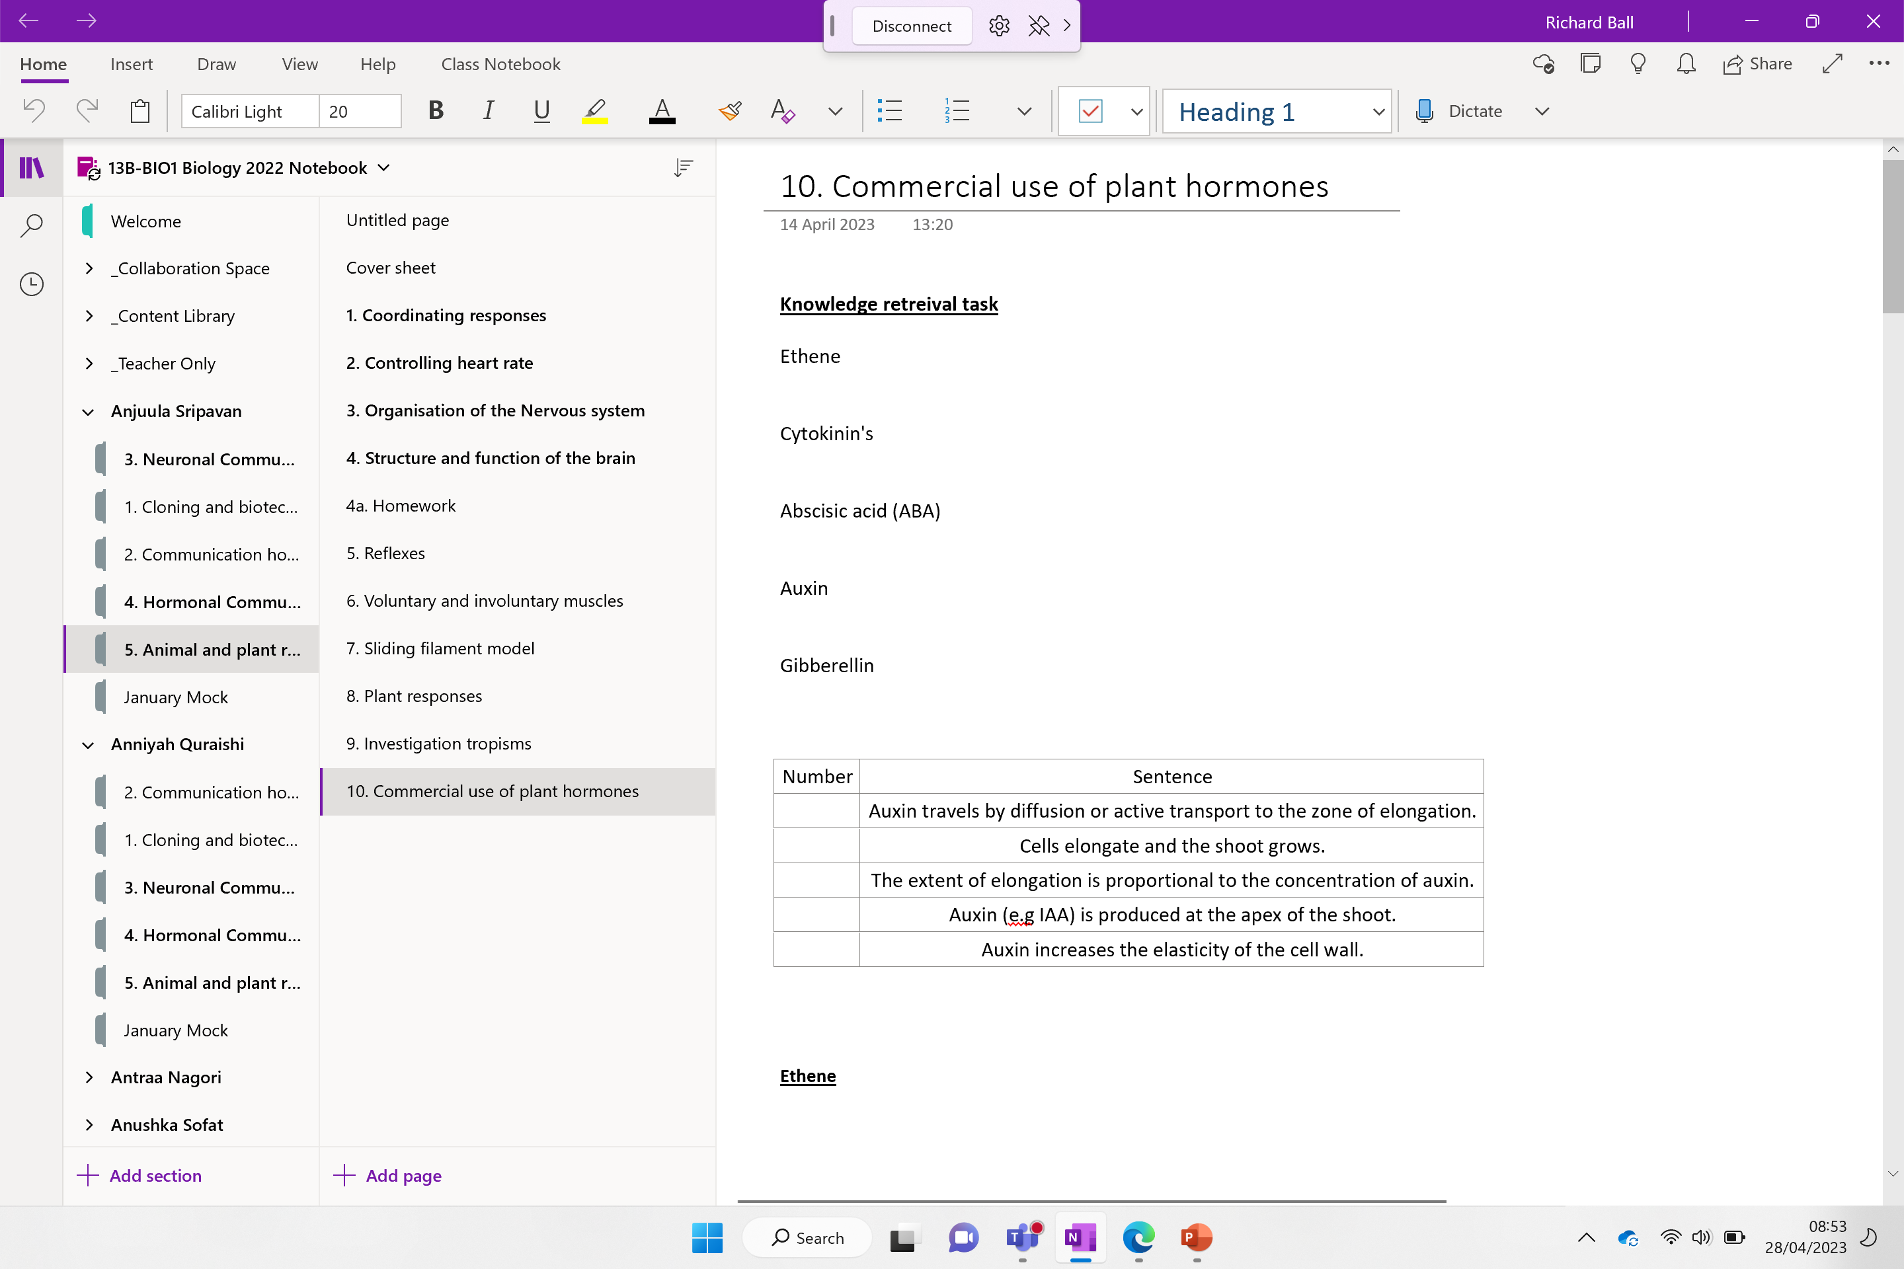

Slide 4
Write one function for each!
Ethene
Speeds up ripening of fruit and thus fruit dropping
Cytokinins
Promote cell division and cell expansion, leaf senescence
Abscisic acid:
Inhibits lateral shoot growth. Auxin keeps absicic acid concentration low. Causes stomatal closure when water availability is limited.
Auxin
Regulates plant growth
Promotes cell elongation
Causes apical dominance: inhibits growth of lateral shoots (lateral shoots do not grow)
Inhibits root growth
Inhibits ethene production, stopping leaf abscission (loss of leaves) and fruit dropping
Gibberellins
Gibberellins promote seed germination by activating genes for amylase and protease enzymes, which break down food stores (Presence of water initiates gibberellin release).
Notes:
Final part of leaf development by redistributing vital resources back in to the plant before the leaf falls.

Slide 5
Answers
Ethene
Speeds up ripening of fruit and thus fruit dropping
Cytokinins
Promote cell division and cell expansion, leaf senescence
Abscisic acid:
Inhibits lateral shoot growth. Auxin keeps absicic acid concentration low. Causes stomatal closure when water availability is limited.
Auxin
Regulates plant growth
Promotes cell elongation
Causes apical dominance: inhibits growth of lateral shoots (lateral shoots do not grow)
Inhibits root growth
Inhibits ethene production, stopping leaf abscission (loss of leaves) and fruit dropping
Gibberellins
Make plants taller by promoting stem elongation, stimulating cell elongation and division
Growth timing
Gibberellins promote seed germination by activating genes for amylase and protease enzymes, which break down food stores (Presence of water initiates gibberellin release).
Notes:
Final part of leaf development by redistributing vital resources back in to the plant before the leaf falls.

Slide 6
Phototropism
How does auxin stimulate growth?
Put these sentences in the correct order.
Number | Sentence
 | Auxin travels by diffusion or active transport to the zone of elongation.
 | Cells elongate and the shoot grows.
 | The extent of elongation is proportional to the concentration of auxin.
 | Auxin (e.g IAA) is produced at the apex of the shoot.
 | Auxin increases the elasticity of the cell wall.
2
4
5
1
3

Slide 7
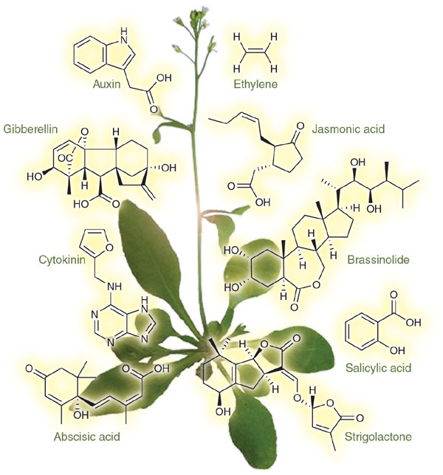
Plant hormones are involved in the control of many different aspects of plant life like:
Germination of seed
Growth of stems
Ripening of fruit
Falling of leaves
As our understanding of these chemicals have advanced, we have developed a number of ways of using plant hormones commercially.

Slide 8
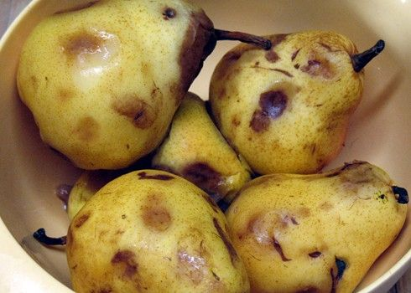
Plants bruise easily when transported.
How could we solve this?

Slide 9
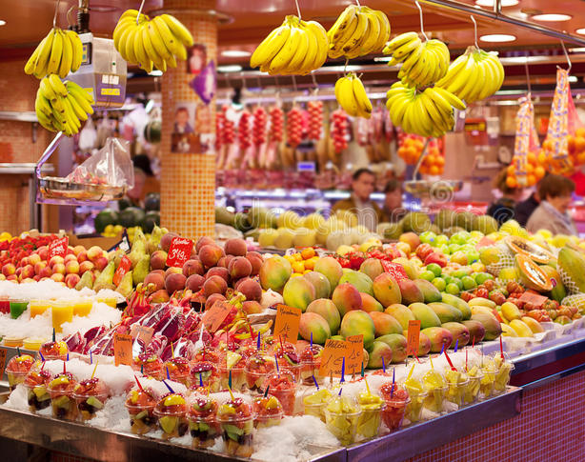
But how do we get it to ripen quickly for sale?

Slide 10
Ethene
Important for cell division and ripening fruits quickly. Fruits produce ethene when they ripen.
How it works:
Unripen fruit is easier to transport as it does not get damaged as easily
It is then stored until required in shops
Ethene is then added to the warm atmosphere around the fruit to quickly ripen, ready for sale.

Slide 11
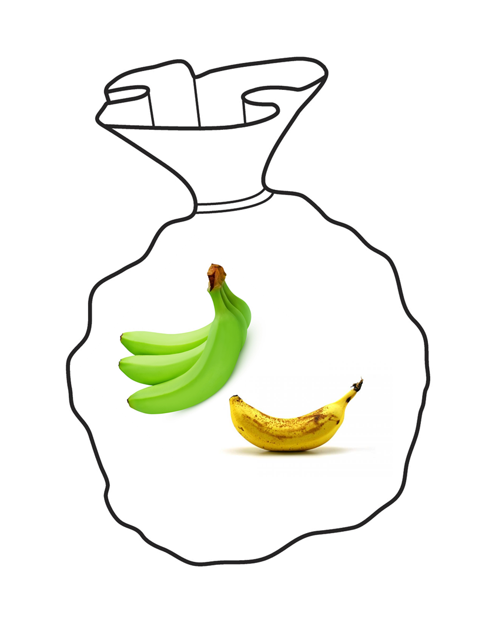
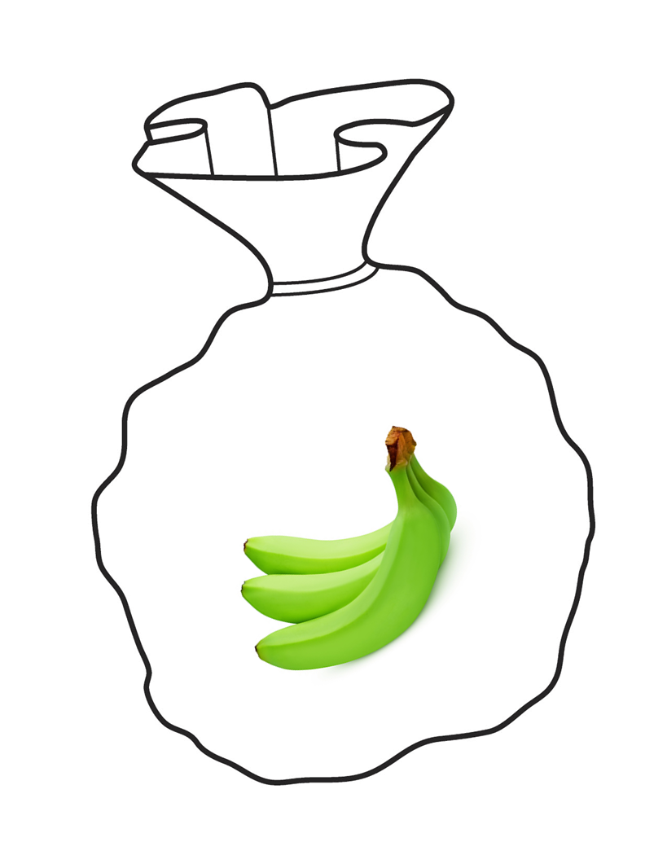
Predict what happens when

Slide 12
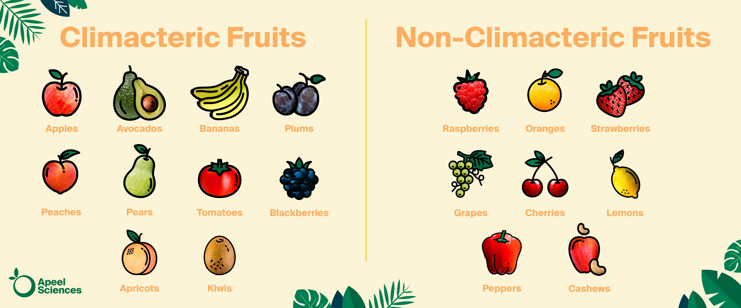
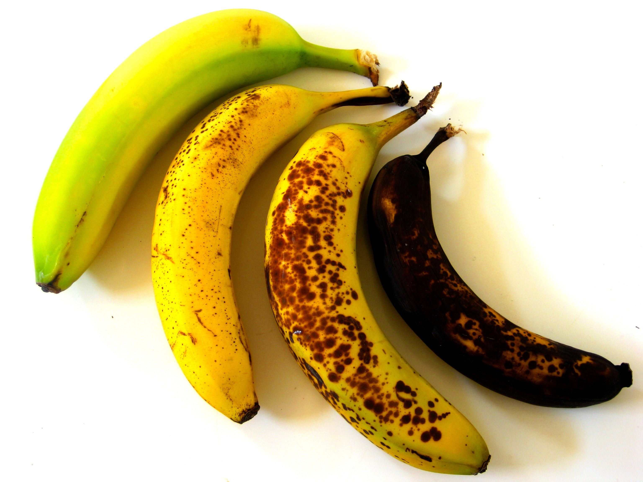
Climacteric fruits
Fruits that continue to ripen after they have been harvested.
They produce large amounts of ethene.
Placing green (not ripe) bananas with a ripe banana in a bag will cause the green banana to ripen faster as the ethene from the ripe banana stimulates rapid ripening of the green ones.

Slide 13
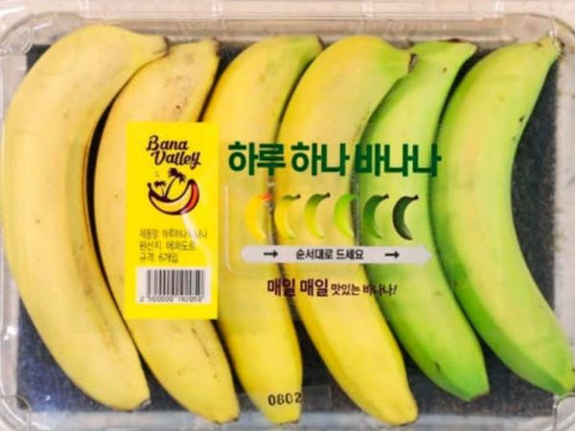

Slide 14
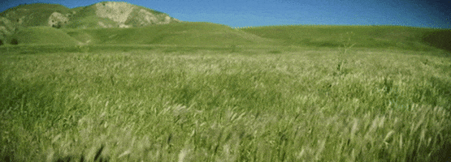
So what did we do with this knowledge?
Notes:
1900’s asia – foolish seedling disease
Later in 1950’s high concentration of these in gibberellins
125 GA 1,2,3, order of discovery

Slide 15
Foolish seedling disease!
Farmers noticed that some rice seedlings in their field grew so tall and spindly that they toppled over before they could mature.
Gibberellins were later discovered in a wide variety of higher plants. One of the first to be isolated in the mid 1950s was named gibberellic acid (GA)
It is now known that there are over 125 different gibberellins (GAs). They are named GA₁, GA₂, GA₃, GA₄…. GA₁₂₅ The numbers roughly refer to the order of discovery.
So what did we do with this knowledge?

Slide 16
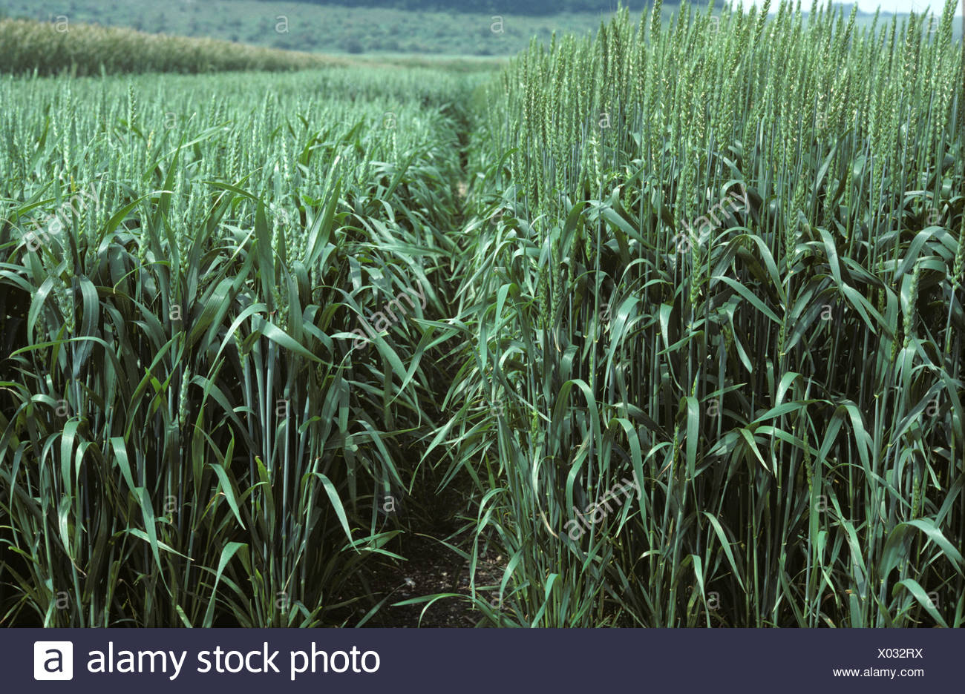
Gibberellins
How does knowledge of gibberellins help farmers?
Try the gap fill!
Plants with s………. stems produce fewer g…………………..
Plant with long stems produce lots of gibberellins.
Scientist have bred many dwarf varieties of plants where the gibberellins synthesis p………. is b………….
Without gibberellins the stems are much s……….. . This reduces w……….. and make them less vulnerable to damage by w……….. and h………….. .

Slide 17

Gibberellins
Fill the gaps!
Plants with short stems produce fewer gibberellins.
Plant with long stems produce lots of gibberellins.
Scientist have bred many dwarf varieties of plants where the gibberellins synthesis pathway is blocked.
Without gibberellins the stems are much shorter. This reduces waste and make them less vulnerable to damage by weather and harvesting.
Notes:
Abscisic acid – block gib pathway

Slide 18
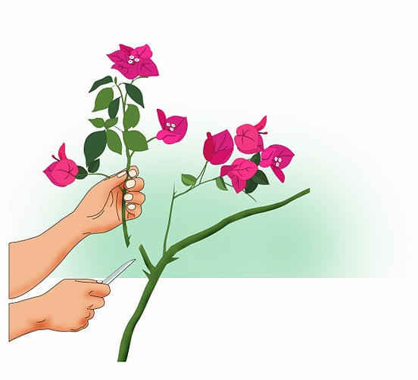
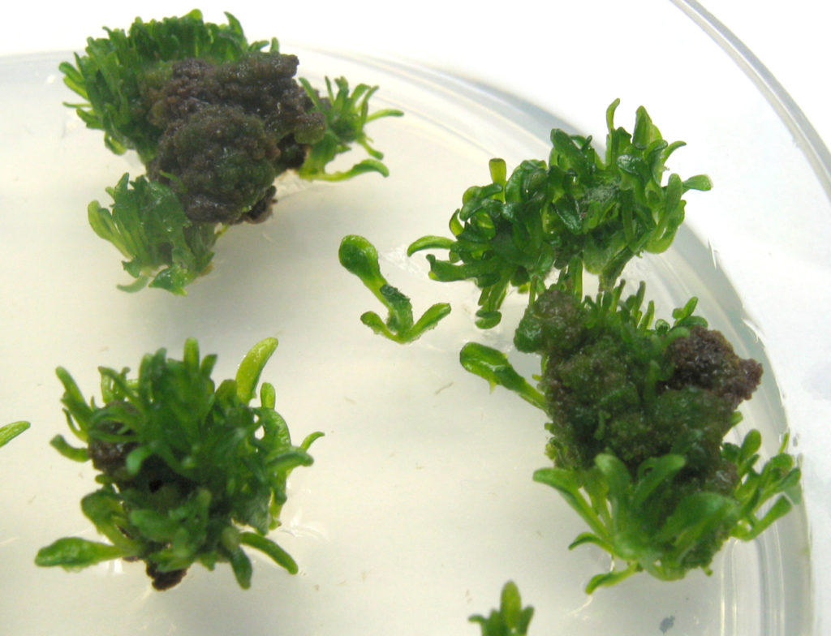
Using hormones recap
Name each method and discuss the differences in each method

Slide 19
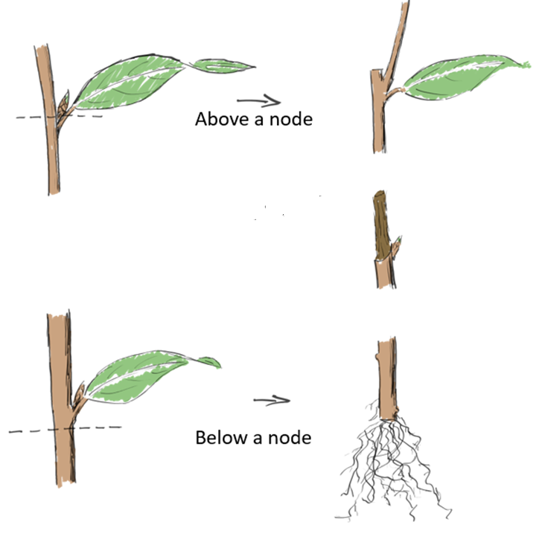
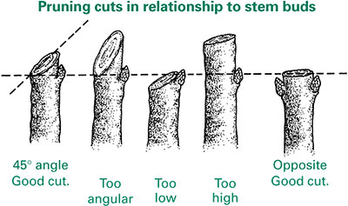
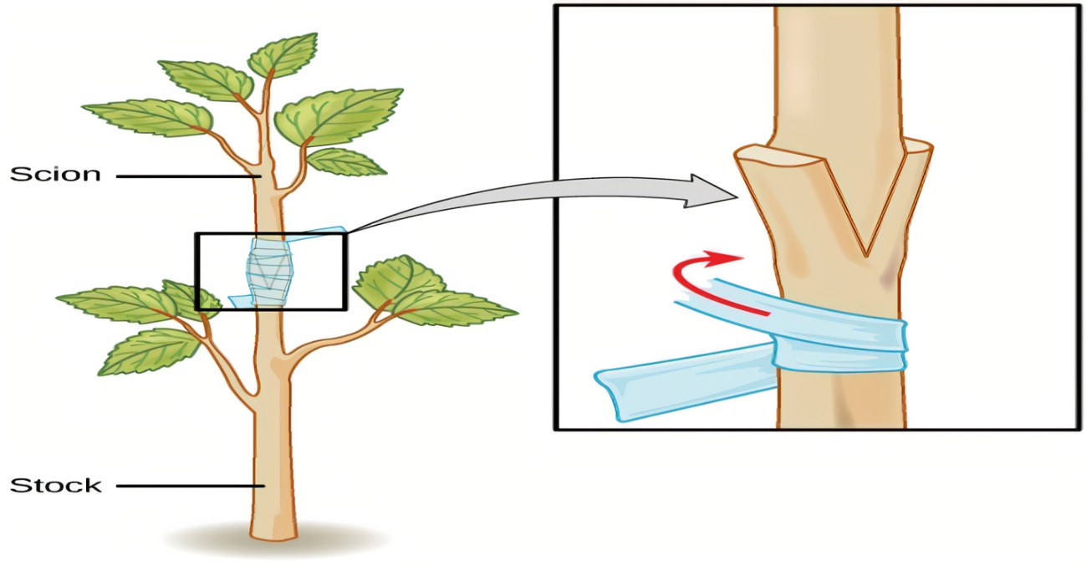
Artificial Vegetative Propagation: Cuttings
To make a cutting, a stem is cut between two leaf joints (nodes)
Cut at an oblique angle
Stem is then dipped in rooting hormone (auxin, cytokinin's) to stimulate growth
The cut end of the stem is then placed in soil and covered with a thin layer
Water the cutting and place by the window for warmth and light

Slide 20
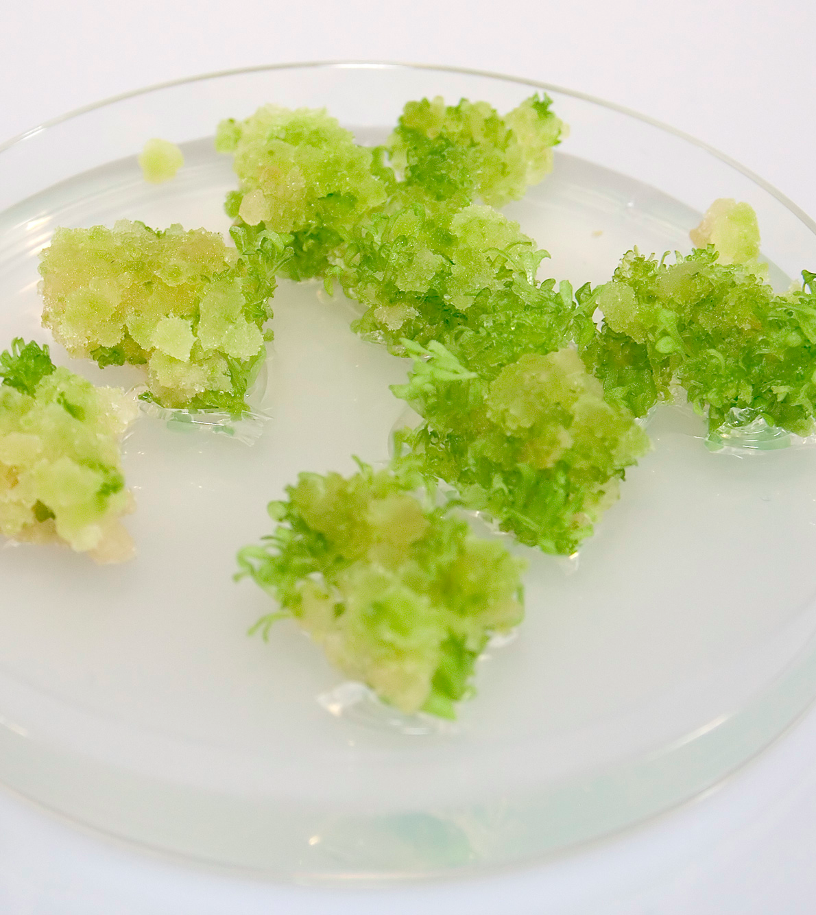
Micropropagation using tissue culture
Arrange the following statements into the correct order:
Disinfect the work area you will be using
Remove the explant from the meristem tissue in the shoots
Immerse the sample in sterilising agent sodium dichloroisocyanurate (Milton), bleach or ethanol.
Place the explant in a sterile culture medium containing plant hormones (auxin, cytokinin's) to stimulate mitosis.
The cells proliferate into a mass of identical cells called a callus
The callus is split up and transferred into new plant growth culture mediums containing a mixture of nutrients and hormones to develop the callus into tiny plantlet's
The plantlets are then potted in compost where they grow into small plants
Young plants are planted out to grow and produce a crop
Key
Explant – the part of the tissue you remove to clone
Cytokinin's – plant hormone that promotes cell division
Callus - a growing mass of unorganized plant parenchyma cells

Slide 21
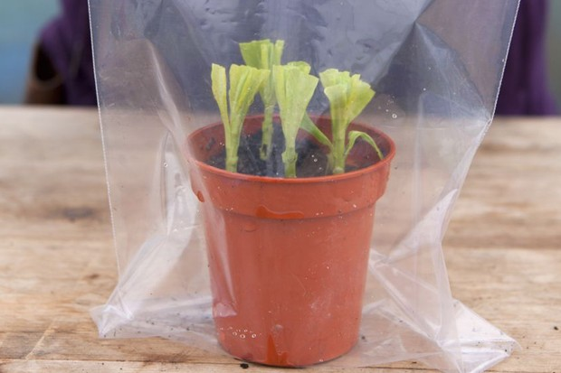
Increasing success of cuttings
Use a n……-f………….. plant
Make an p………. cut in the stem
Use hormone r………… p……………
Reduce l………….. to two or four
Keep cutting well w……………
Cover the cutting with a p…………. b……. for a few days

Slide 22

Increasing success of cuttings
Use a non-flowing plant
Make an oblique cut in the stem
Use hormone rooting powder
Reduce leaves to two or four
Keep cutting well watered
Cover the cutting with a plastic bag for a few days
Notes:
By trapping moisture inside the bag, gardeners can reduce the amount of water lost through evaporation and help prevent the cutting from drying out.

Slide 23
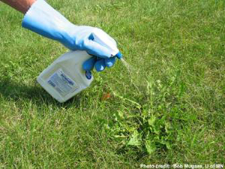
What do weed killers contain?
Weed killer contain auxin!!
WHY?
Hint
Most weed species are dicots with broad leaves

Slide 24
Other uses for auxin
Auxin is used in weed killer
Spray auxin onto the leaves of weeds
Auxin is absorbed
This sends the plant into rapid uncontrolled cell growth
killing the plant
Narrow crops or grasses (monocots) have a small surface area
Do not absorb enough auxin to kill them
Most weeds have broad leaves (dicots) with a large surface area
So absorb lots of auxin, killing them
This is called a selective herbicide, and is the reason why crop yields have increased rapidly in recent years
Doesn’t this kill the grass too?
No, due to the surface area of the plants….huh?

Slide 25
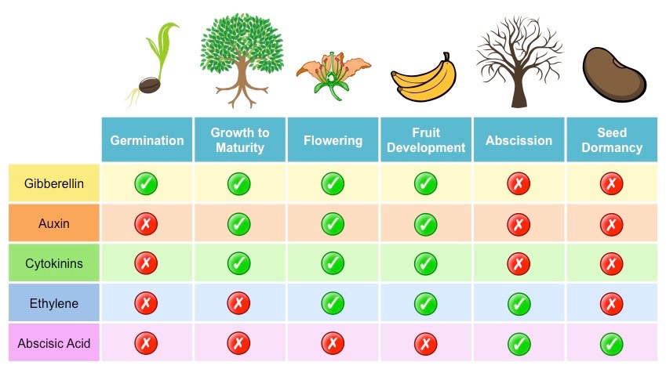
Other notable uses of plant hormones
Auxins used to produce seedless fruits.
Ethene used to speed up fruit dropping (cherries, cotton).
Cytokinin's used to prevent ageing of repined fruit.
Gibberellins can be used to improve the size and shape of fruit. It is also used to speed up the malting process.

Slide 26
REVISION TASKS
Group 1 rotate around each white board and complete each question
Group 2 start the “Plant responses” revision mat
We will switch around in 15-20 minutes

Slide 27
Task 1
Draw a diagram to show the sliding filament theory

Slide 28
Task 2
Draw a diagram to show how hormones cause a seed to germinate

Slide 29
Task 3
Draw a diagram to explain how auxin causes cells to expand

Slide 30
Task 4
Draw diagrams to show how plant respond to light and gravity.
Include:
Normal coleoptile
Tip removed
Agar strip placed between tip and stem
Mic strip halfway through plant
Now draw a diagram to show apical dominance

Slide 31
Experimental data
What experiments could you do to prove these roles of auxin in apical dominance?
Apical bud removed = auxin concentration in tip decreases, lateral shoots grow
Apical bud removed, then auxin pasted onto cut end = lateral shoots do not grow
Auxin transport inhibitor below apex (tip) of shoot = lateral shoots grow
Add to abscission zone of leaf = Inhibits ethene production, stopping leaf abscission (loss of leaves) and fruit dropping.​
What experiments could you do to determine the effects of the two chemicals abscisic acid and cytokinins?
Remove apical bud, then apply abscisic acid to lateral shoots = inhibition of lateral shoot growth should be observed
Addition of excess cytokinin = promote lateral shoot growth
What is the experimental evidence for action of gibberillin
Add gibberellins to dwarf plants, and see if they grow larger (they do)
Compare concentrations of gibberellin in tall and small plants
Genetically modify plants to not produce gibberellins (by turning off expression of a gene which codes for an enzyme to make gibberellins). Then add gibberellin afterwards to a shoot onto GM plant with working gene for enzyme production.
What experiments could you do to prove these roles of ethene?
Apply ethene to unripe fruit = ethene promotes ripening – fruit ripens quickly

Slide 32
Review questions…
In deep-water rice plants, lower oxygen levels stimulate the production of ethene which reduces abscisic acid levels. Abscisic acid is an antagonist of gibberellin. Using this information, explain how deep-water rice plants keep their upper foliage above water.
Describe what happens to the growth of a plant shoot if the apical tip is removed.
Name the hormone that reduces in concentration in the shoot when the apical tip is removed
Experiments show that high levels of this hormone keep abscisic acid levels high in the bud. When the tip is removed, lateral buds start to grow. Use this information to explain how trimming hedge tops can help them to bush out.
The gibberellin responsible for stem elongation is synthesised by an enzyme coded for by the dominant Le allele. Give the genotype for a dwarf pea plant lacking this enzyme.

Slide 33
Review question answers..
1. Abscisic acid reduces gibberellin production so when ethene is produced and reduces abscisic acid, gibberellin production increases which causes stem elongation and enables the floiage to be above the water.
2. Branching/sideways/lateral growth
3. Auxin
4. Trimming hedge tops will remove the apical buds, causing abscisic acid levels to drop. Hedge plants branch out sideways, appearing bushier.
3. Genotype should show homozygous recessive form (lele)

