Slide 1
The chi-squared test
Use the chi-squared (χ²) test to test the significance of the difference between observed and expected results.
You do not need to remember this formula, it will be given to you during the exam.
Key words:
Theory
Expected results
Observed results
Null hypothesis
Task: Write the definition for the following key words.

Slide 2
Definitions
Theory - a possible explanation for something.
Expected result - what should happen according to your theory.
Observed result - what actually happens.
Null hypothesis - always that there is no significant difference between your observed and expected results.
The Chi-squared test is a test to see if the difference between your observed and expected result is significance or just due to chance!

Slide 3
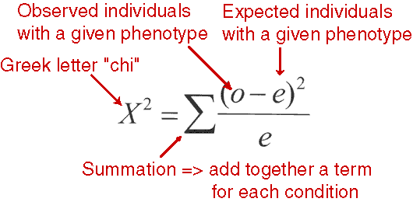
Chi-squared test
The Chi-squared test is a test to see if the difference between your observed and expected result is significance or just due to chance!

Slide 4
Recap
Coat texture and colour in guinea pigs are controlled by different genes:
texture – rough (R) is dominant over smooth (r)
colour – black (B) is dominant over white (b)
Use a genetic diagram to show the result of crossing a rough, black-coated male (heterozygous for both alleles), with a smooth, black-coated female (heterozygous for coat colour):
gametes produced by male (RrBb)
 | RB | Rb | rB | rb
rB | RrBB | RrBb | rrBB | rrBb
rb | RrBb | Rrbb | rrBb | rrbb
rB | RrBB | RrBb | rrBB | rrBb
rb | RrBb | Rrbb | rrBb | rrbb
gametes produced by female (rrBb)
List the phenotypes of the offspring and the ratio they are found in:
rough/ black : rough/ white : smooth/ black : smooth/ white
3 : 1 : 3 : 1

Slide 5
Chi-squared (χ²) test = statistical test used to determine if there is a
significant difference between observed and expected results
when the rough, black-coated male was mated with a smooth, black-coated female the following ratio of offspring was obtained – these are the observed numbers
rough/ black : rough/ white : smooth/ black : smooth/ white
28 : 11 : 31 : 10
28 + 11 + 31 + 10 = 80
1. First work out the expected numbers:
total number of offspring
sum of values in ratio
=
number of offspring represented by a value of 1 in the phenotypic ratio
=
= 10
8
In our example, our expected ratio is:
rough/ black : rough/ white : smooth/ black : smooth/ white
3 : 1 : 3 : 1
=
3 + 1 + 3 + 1 = 8
30 : 10 : 30 : 10
now multiply each number in the ratio by 10
to get the expected number of each phenotype:

Slide 6
Work out χ² using the formula:
(O – E)²
E
where: O = observed number
E = expected number
χ² =
Σ
 | rough/ black | rough/ white | smooth/ black | smooth/ white
O | 28 | 11 | 31 | 10
E | 30 | 10 | 30 | 10
O - E | - 2 | 1 | 1 | 0
(O – E)² | 4 | 1 | 1 | 0
(O - E)² E | 0.13 | 0.10 | 0.03 | 0.00
χ² =
(O – E)²
E
= (0.13 + 0.10 + 0.03) = 0.26
Σ

Slide 7
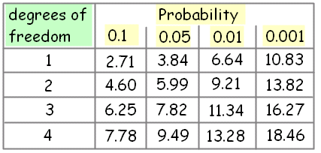
Interpreting the result of the test:
Write the null hypothesis for this investigation:
Null hypothesis = there is not a statistically significant difference between the expected and observed number of offspring of each phenotype
Compare the calculated value of χ² with the critical value for (n - 1) degrees of freedom at a probability level of 0.05 (95%):
n = 4 phenotypes
if χ² > critical value:
reject null hypothesis, less than 5% probability that the difference between observed and expected happened by chance
if χ² < critical value:
accept null hypothesis, more than 95% probability that any difference between observed and expected happened by chance
Write a conclusion for this example.

Slide 8
example 2 – fruit colour
Identify the phenotype of the following:
gene A (pigment)
dominant allele = white
gene B (colour)
in absence of A allele:
- dominant allele = yellow
- homozygous recessive = green
genotype | phenotype
AaBb | white
AAbb | white
aabb | green
aaBb | yellow
Show the result of crossing two double heterozygous plants:
gametes produced by male plant
 | AB | Ab | aB | ab
AB | AABB | AABb | AaBB | AaBb
Ab | AABb | AAbb | AaBb | Aabb
aB | AaBB | AaBb | aaBB | aaBb
ab | AaBb | Aabb | aaBb | aabb
gametes produced by female plant
white : yellow : green
12 : 3 : 1
F₁ ratio of phenotypes:

Slide 9
when two heterozygous (AaBb) plants were crossed, the following F1 offspring were obtained:
white : yellow : green
26 : 5 : 1
Use the χ² test to determine if there is a significant difference between the observed and expected results:
 | white | yellow | green
O | 26 | 5 | 1
E | 24 | 6 | 2
O - E | 2 | - 1 | - 1
(O – E)² | 4 | 1 | 1
(O - E)² E | 0.17 | 0.17 | 0.50
χ2 =
(O – E)²
E
Σ
= (0.17 + 0.17 + 0.58)
= 0.84
The critical value for 2 degrees of freedom at p = 0.05 is 5.99
Write a conclusion for this example, referring to probability and chance:
χ² < critical value, so the null hypothesis is accepted with a probability of more than 95% that the difference between the observed and expected results happened by chance

Slide 10
Past paper questions
Q2 [AQA – BYA5, Jan07 Q8c/d]
(a)
(b)

