Slide 1
9.1 Goal-setting
Skill acquisition and psychology
Chapter 9
Psychology
Learning objectives
1) Understand the principles of SMARTER goal-setting
2) Suggest how to set SMARTER targets appropriate to the
physical activity
3) Explain how goal-setting can control anxiety
For more help, please visit www.exampaperspractice.co.uk
© 2025 Exams Papers Practice. All Rights Reserved

Slide 2
What you need to know
For more help, please visit www.exampaperspractice.co.uk
© 2025 Exams Papers Practice. All Rights Reserved

Slide 3
Goal setting
Goal – a desired aim or outcome; something that you are trying to achieve
Benefits
Having a goal to aim for is motivating
It gives direction to your training
Enables a performer to check their progress
Increases confidence when a target has been achieved
Helps performer feel in control, reducing anxiety
Athletes at every level may want to reach a personal best time or distance
A school cricket player may want to make it into the first team
A professional footballer may want to win the league or cup
Are the above goals likely to provide these benefits?
For more help, please visit www.exampaperspractice.co.uk
© 2025 Exams Papers Practice. All Rights Reserved

Slide 4
The SMARTER principles
Goals work best when they follow these principles
S | Specific | Goal/target must be specific – (‘I will run faster’ is too vague, ‘I will reduce my 100m time by 0.2 s’ is specific)
M | Measureable | Can your goal/target be measured? – (reducing your 100m time by 0.2s can be timed)
A | Agreed | You and your coach must discuss and agree your goals. They must be challenging and achievable for you to make progress
R | Realistic | A goal must be realistic or it can become demotivating – (reducing your 100m time by 5 seconds is not realistic, to reduce your time by 0.2 seconds is)
T | Time-phased | Goals should be planned ahead to give direction over the short, medium and long term – (reduce my 100m time by 0.4 seconds by the end of the year is a time-phased goal)
E | Exciting | Exciting and challenging goals prevent boredom/tedium. As you progress goals should become more challenging and exciting to maintain motivation
R | Recorded | Goals should be written down so that you know what you are aiming for and so that you can check your progress over time
For more help, please visit www.exampaperspractice.co.uk
© 2025 Exams Papers Practice. All Rights Reserved

Slide 5
Task
Long term goals – may last for around a year
Medium term goals – may last for around a month
Short term goals – may last for around a week
Create 3 goals (long/medium/short term) that will aid your development within your chosen sport
Make sure that each of these goals is based on the SMARTER principles
If you finish, attempt the question below
Referring to two principles of goal setting, explain why an athlete may not achieve their goals (2)
See slide 6 for a worked example
See slide 7 for the mark-scheme
For more help, please visit www.exampaperspractice.co.uk
© 2025 Exams Papers Practice. All Rights Reserved

Slide 6
Example
This is an example of a medium term goal for a Netball goal-shooter
S | Specific | I will increase my goal success rate from 6/10 to 7/10
M | Measureable | Yes (number of successful shots can be measured)
A | Agreed | After discussion with coach, we have both agreed that this is challenging and achievable
R | Realistic | Yes (a 10% increase is realistic, a 30% increase may not be)
T | Time-phased | I will increase my goal success rate from 6/10 to 7/10 by the 20th of June (1 month – medium term goal)
E | Exciting | Yes (being more confident and accurate when shooting is an exciting prospect as it will improve both my own and my team’s performance)
R | Recorded | Yes – the goal is written down so that I know what I’m aiming for and can check my progress
For more help, please visit www.exampaperspractice.co.uk
© 2025 Exams Papers Practice. All Rights Reserved

Slide 7
Referring to two principles of goal setting, explain why an athlete may not achieve their goals (2)
Specific (the targets may have been too general/not specific to the sport)
Measurable (there may not have been a way of measuring progress meaning the athlete could become demotivated)
Agreed (the coach and performer may not have been in agreement over the targets leading to confusion)
Realistic (goal may have been too easy or too difficult meaning the performer may lose interest)
Time related (The time set may have been too long or too short preventing the performer from achieving their goals or developing boredom)
Exciting (lack of excitement in training may lead to demotivation)
Recorded (if results are not recorded, performer may not know if they have improved)
For more help, please visit www.exampaperspractice.co.uk
© 2025 Exams Papers Practice. All Rights Reserved

Slide 8
In a named activity choose three goal setting principles. For each principle give an example of how it could be applied to the named activity (3)
e.g. named activity – long distance running
Specific – Set targets that are specific to long distance running (e.g. improving 5000m time by 20 seconds)
Measurable – ensure that all targets can be measured (e.g. improving time)
Agreed – Coach and performer agree the times that should be targeted
Realistic – target time should be realistic based on ability of performer
Time-phased – performer should be given a period of time to complete their goals (e.g. by the end of the year)
Exciting – training should be exciting to avoid demotivation (e.g. could include a combination of continuous, fartlek and interval training)
Recorded – goals and times should be recorded to track progress
For more help, please visit www.exampaperspractice.co.uk
© 2025 Exams Papers Practice. All Rights Reserved

Slide 9
Goal setting and anxiety
Anxiety – a state of nervousness or worry
Over arousal can cause anxiety – this can have a negative affect on performance
Goal setting
Goals can make a performer feel confident as they have know they have trained/prepared properly
They will feel they have control over the situation
Resulting in reduced anxiety
Motivation
Goals
Control
Focus
For more help, please visit www.exampaperspractice.co.uk
© 2025 Exams Papers Practice. All Rights Reserved

Slide 10
9.2 Motivation and mental preparation
Skill acquisition and psychology
Chapter 9
Psychology
Learning objectives
1) Define the term ‘motivation’
2) Explain the terms ‘intrinsic’ and ‘extrinsic motivation’
3) Understand what rewards and incentives are
For more help, please visit www.exampaperspractice.co.uk
© 2025 Exams Papers Practice. All Rights Reserved

Slide 11
What you need to know
For more help, please visit www.exampaperspractice.co.uk
© 2025 Exams Papers Practice. All Rights Reserved

Slide 12
Motivation
To be a successful sports performer, a high level of motivation is required
The desire required to be successful
The driving force that makes you do something
Motivation can be seen by –
The amount of effort applied to a task
How well focus and effort is directed
How long we stick to a task
What we are willing to sacrifice for success
“Obstacles don’t have to stop you. If you run into a wall, don’t turn around and give up. Figure out how to climb it, go through it or work around it” Michael Jordan
For more help, please visit www.exampaperspractice.co.uk
© 2025 Exams Papers Practice. All Rights Reserved

Slide 13
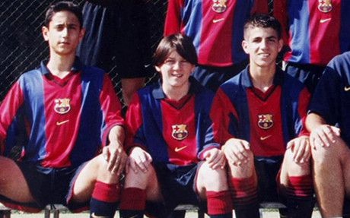
Motivation
Which of the 4 statements about motivation can be seen in these examples?
Lionel Messi – Relocated to Spain to join Barcelona’s youth academy at 13 years old
For more help, please visit www.exampaperspractice.co.uk
© 2025 Exams Papers Practice. All Rights Reserved

Slide 14
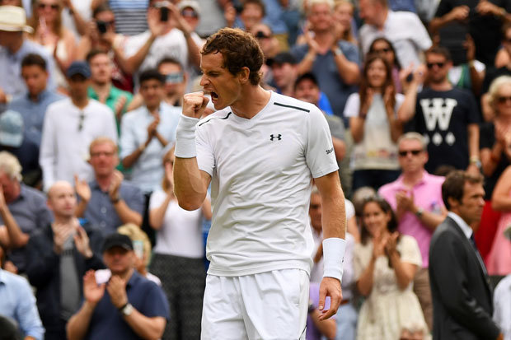
Motivation
Which of the 4 statements about motivation can be seen in these examples?
Andy Murray – Began playing tennis at 3 years old. At 15 he moved (alone) to an academy in Spain
For more help, please visit www.exampaperspractice.co.uk
© 2025 Exams Papers Practice. All Rights Reserved

Slide 15
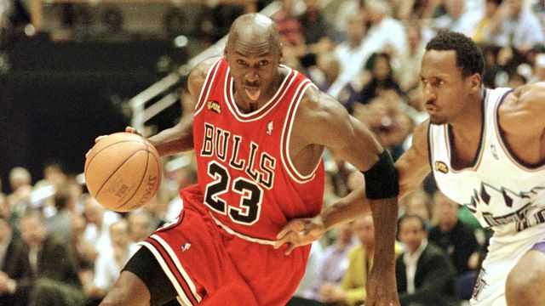
Motivation
Which of the 4 statements about motivation can be seen in these examples?
Michael Jordan – Did not make his high-school varsity squad as he was deemed to be too short. Is now widely recognised as the greatest player of all time
For more help, please visit www.exampaperspractice.co.uk
© 2025 Exams Papers Practice. All Rights Reserved

Slide 16
Intrinsic and extrinsic motivation
Intrinsic motivation | Extrinsic motivation
The desire to do the sport/activity for its own sake Feelings of satisfaction or well-being from doing the activity e.g. improved physical fitness e.g. Social rewards from playing in a team e.g. satisfaction from completing a task | e.g. praise from a parent, coach or the crowd e.g. rewards – money, prizes, medals or trophies e.g. the desire for attention or fame e.g. the search for sponsorship or a better contract (at a professional level)
Intrinsic motivation –
Motivation that comes from simply doing the activity, rather than to gain external rewards or prizes
Extrinsic motivation –
Comes from outside of the individual such as prizes, trophies, praise or fame
For more help, please visit www.exampaperspractice.co.uk
© 2025 Exams Papers Practice. All Rights Reserved

Slide 17
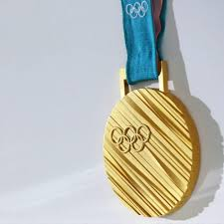
Rewards and Incentives
An Olympic gold medal is given as a reward for winning an event
For someone striving to be the best within their sport, the medal could be one of their main incentives
Are you motivated by rewards in your favourite sport?
What incentives do you have for competing?
What incentives might an elite athlete have?
Reward –
Something given to someone to recognise their achievements
Incentive –
Something that motivates someone to do something
For more help, please visit www.exampaperspractice.co.uk
© 2025 Exams Papers Practice. All Rights Reserved

Slide 18
How can coaches motivate performers
How can a coach encourage intrinsic or extrinsic motivation in an individual or team?
Promoting intrinsic motivation
Ensure that sessions are enjoyable
To ensure that performers continue to gain satisfaction from performing
Promoting extrinsic motivation
Set goals based around achieving rewards (e.g. medals)
Provide incentives to continue working hard such as extrinsic rewards (e.g. most valuable player, regular praise)
Explain how a coach could ensure that their players stay motivated within a sport (4)
For more help, please visit www.exampaperspractice.co.uk
© 2025 Exams Papers Practice. All Rights Reserved

Slide 19
Explain how a coach could ensure that their players stay motivated within a sport (4)
Motivation is the desire needed to be successful. Coaches can promote intrinsic motivation in their performers by ensuring that training sessions are enjoyable. This will ensure they gain satisfaction from the activity and are therefore motivated to improve.
Extrinsic motivation can be developed by setting goals and offering incentives (such as most valuable player awards). This may motivate the player to work hard in an attempt to achieve the award.
Which colour represents which of the following?
Expanding point/linking back to the question
Intro/ definition of key terms
Examples
Basic information/ points
For more help, please visit www.exampaperspractice.co.uk
© 2025 Exams Papers Practice. All Rights Reserved

Slide 20
9.3 Arousal
Skill acquisition and psychology
Chapter 9
Psychology
Learning objectives
1) Give the definition of arousal
2) Know the signs of optimal arousal for different skills
3) Draw and explain the inverted U-theory (Yerkes-Dodson Law)
4) Explain the effects of under-arousal and over-arousal
For more help, please visit www.exampaperspractice.co.uk
© 2025 Exams Papers Practice. All Rights Reserved

Slide 21
What you need to know
For more help, please visit www.exampaperspractice.co.uk
© 2025 Exams Papers Practice. All Rights Reserved

Slide 22
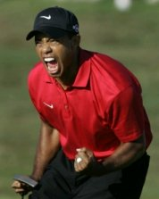
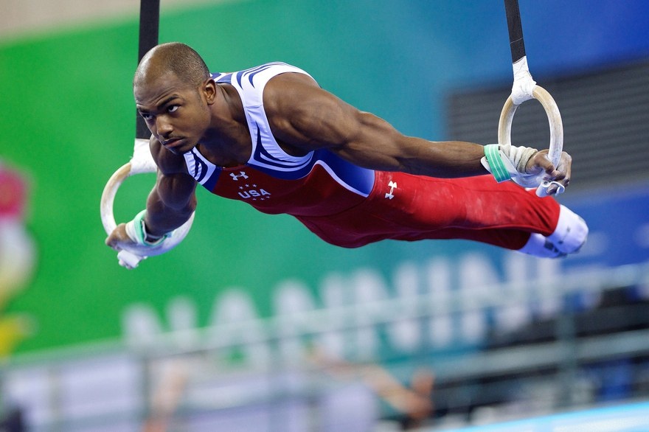
Arousal
Definition – “An increased level of mental excitement and alertness”
An energised state of physiological and psychological readiness to perform a task
Arousal can lead to determination, focus and excitement and can therefore benefit performance
For more help, please visit www.exampaperspractice.co.uk
© 2025 Exams Papers Practice. All Rights Reserved

Slide 23
Increasing arousal
A number of factors can lead to increased levels of arousal
Motivational talk from a coach
Appropriate warm-up
Having a clear goal to work towards
Inspiration from crowd, bright lights, synchronised clapping prior to a jumping event in athletics
The importance of match/trophy/prize
These factors can lead to optimal arousal being reached and improved performance, or over-arousal and decreased level of performance
For more help, please visit www.exampaperspractice.co.uk
© 2025 Exams Papers Practice. All Rights Reserved

Slide 24
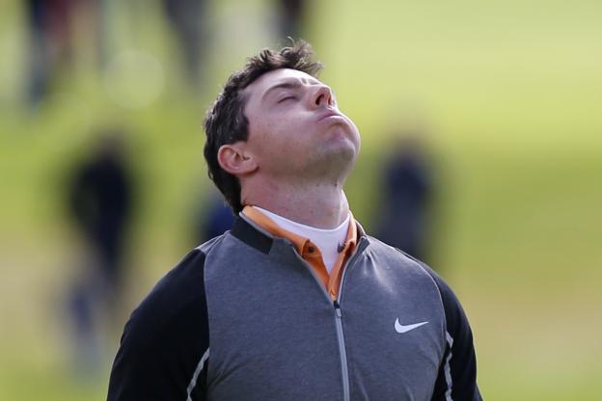
Over-arousal
Too much arousal –
can result in anxiety, nervousness and stress
You could become ‘psyched out’ by the opposition
You may make mistakes and not give your best performance
Physical symptoms
Dry mouth
Increased breathing
Increased heart rate
Nausea
Sweaty palms
Tremor/shakiness
For more help, please visit www.exampaperspractice.co.uk
© 2025 Exams Papers Practice. All Rights Reserved

Slide 25
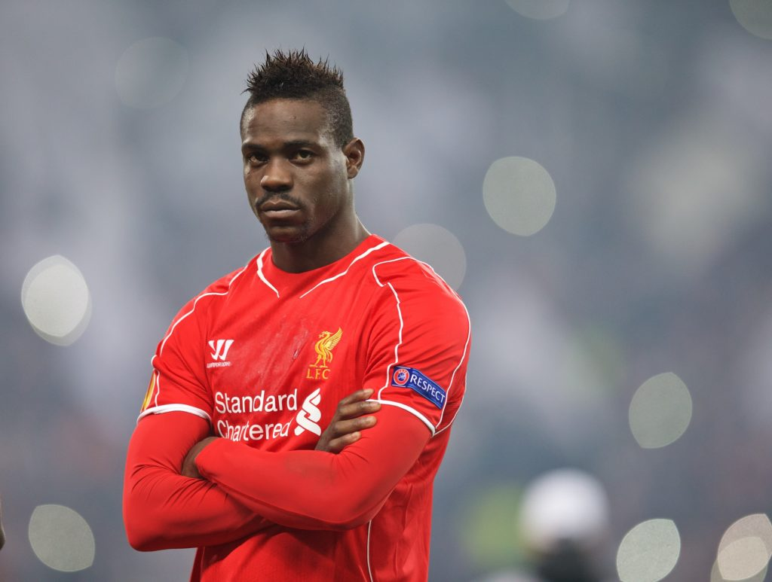
Under-arousal
Too little arousal –
May cause you to under-perform
You may not be excited or focused enough to perform at your best
A lack of drive/determination
However
Fine motor skills such as darts require low levels of arousal to perform well
For more help, please visit www.exampaperspractice.co.uk
© 2025 Exams Papers Practice. All Rights Reserved

Slide 26
The inverted-U theory
Yerkes and Dodson 1908
There is an optimal level of arousal for performance
Too much or too little will cause a reduction in performance
The optimum level is dependent upon:
The nature of the task – (the type of skill and how much pressure is applied)
The skill of the performer
The personality of the performer
The optimal level of arousal therefore changes depending on these three factors
For more help, please visit www.exampaperspractice.co.uk
© 2025 Exams Papers Practice. All Rights Reserved

Slide 27
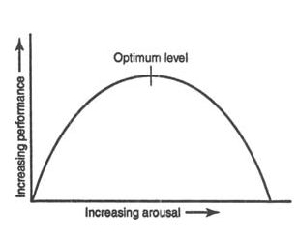
The inverted-U theory
Yerkes and Dodson 1908
A state that allows you to perform well (“in the zone”)
Stress and anxiety
Lack of focus and drive
How do you think the optimal level of arousal changes for fine and gross skills?
Under and over-arousal can both lead to a reduction in performance!
For more help, please visit www.exampaperspractice.co.uk
© 2025 Exams Papers Practice. All Rights Reserved

Slide 28
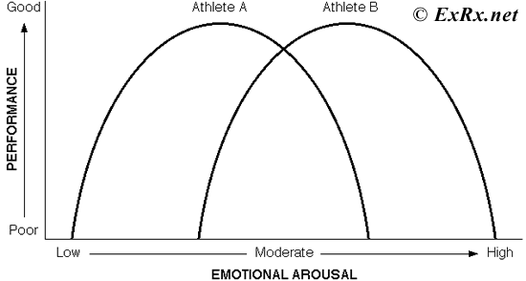
The inverted-U theory
Yerkes and Dodson 1908
Fine skill – e.g. archery
Gross skill – e.g. a rugby tackle
Which curve represents a fine skill and which represents a gross skill?
“Fine skills require lower levels of arousal, gross skills require higher levels of arousal”
For more help, please visit www.exampaperspractice.co.uk
© 2025 Exams Papers Practice. All Rights Reserved

Slide 29
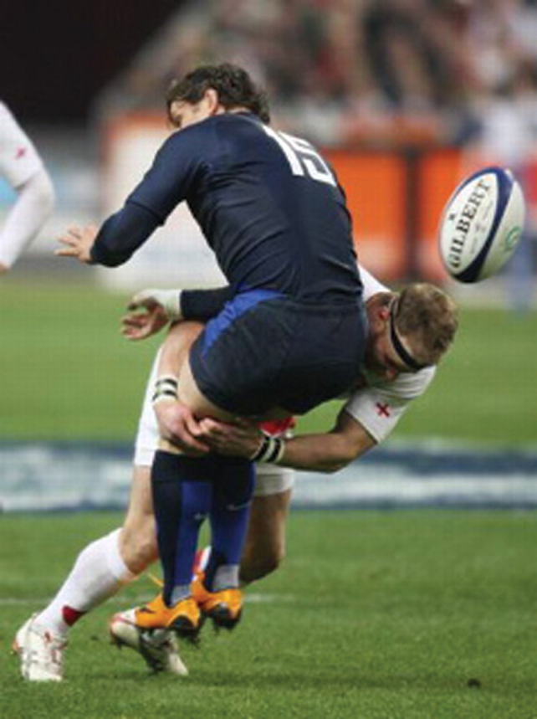
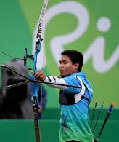
Optimal arousal
Rank the following skills from the lowest level of optimal arousal to the highest
For one of these skills justify your choice
The optimal level of arousal for Rugby is high. This is because tackling is a gross skill and it requires drive, determination and large, powerful movements.
The optimal level of arousal for archery is low. This is because archery is a fine skill that requires precision, accuracy and a calm approach.
For more help, please visit www.exampaperspractice.co.uk
© 2025 Exams Papers Practice. All Rights Reserved

Slide 30
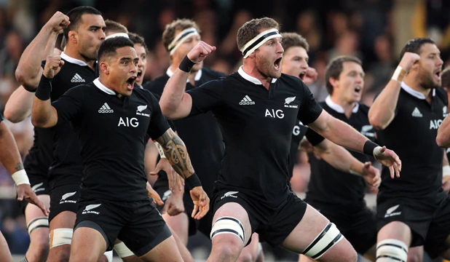
Optimal arousal
Why do you think New Zealand perform the Haka?
Explain with reference to arousal levels
For more help, please visit www.exampaperspractice.co.uk
© 2025 Exams Papers Practice. All Rights Reserved

Slide 31
Explain the impact of arousal on sporting performance with reference to Yerkes and Dodson’s ‘inverted-U theory’ (6)
Arousal is an ‘increased level of mental excitement and alertness’
Inverted U theory suggests that as arousal increases, so does performance up to an optimal point
Too little or too much arousal can lead to a reduction in performance
The optimal level of arousal depends on the skill being performed
Gross skills require high levels of arousal as they require drive, determination and use large, powerful movements
Fine skills require low levels of arousal as they require precision, accuracy and a calm approach
Credit relevant sporting examples
Credit reference to the impact of over/under-arousal on performance
Credit reference to how optimal arousal can be achieved (e.g. use of warm-ups/motivational talks from a coach)
Model answer – slide 32
For more help, please visit www.exampaperspractice.co.uk
© 2025 Exams Papers Practice. All Rights Reserved

Slide 32
Explain the impact of arousal on sporting performance with reference to Yerkes and Dodson’s ‘inverted-U theory’ (6)
Arousal is an ‘increased level of mental excitement and alertness’. Inverted U theory suggests that as arousal increases, so does performance up to an optimal point, after which performance decreases. Under- arousal can lead to a reduction in performance due to a lack of drive and focus, while over arousal can cause stress and anxiety.
The optimal level of arousal depends on the skill being performed however; gross skills such as a rugby tackle have a high optimum level as they require drive, determination and use large, powerful movements. Fine skills have lower optimal levels as they require precision, accuracy and a calm approach.
For more help, please visit www.exampaperspractice.co.uk
© 2025 Exams Papers Practice. All Rights Reserved

Slide 33
9.4 Anxiety
Skill acquisition and psychology
Chapter 9
Psychology
Learning objectives
1) Identify the two types of anxiety (cognitive and somatic)
and describe their symptoms
2) Describe four physiological responses to arousal
3) Explain the causes of anxiety in physical activities
For more help, please visit www.exampaperspractice.co.uk
© 2025 Exams Papers Practice. All Rights Reserved

Slide 34
What you need to know
For more help, please visit www.exampaperspractice.co.uk
© 2025 Exams Papers Practice. All Rights Reserved

Slide 35
Anxiety
Consider the following questions:
What is anxiety?
What sort of situations cause you to feel anxious?
Is there a link between arousal and anxiety?
What effect does anxiety have? (what symptoms might you experience?)
Do you feel anxious before competition? Where would you place yourself on this continuum and why?
Low anxiety
High anxiety
For more help, please visit www.exampaperspractice.co.uk
© 2025 Exams Papers Practice. All Rights Reserved

Slide 36
Anxiety
Definition – “Negative reaction to stress, causing the performer to feel worried, nervous or apprehensive”
Increased arousal = increased likelihood of anxiety
Arousal prior to competition causes a number of responses in the body
If an athlete is unable to control these responses, they may experience anxiety
Which has a negative effect on performance
For more help, please visit www.exampaperspractice.co.uk
© 2025 Exams Papers Practice. All Rights Reserved

Slide 37
What situations cause anxiety?
Discuss– can you explain or provide examples for each of the following causes of anxiety?
Uncertainty
Pressure
Effect on self-esteem
Fear of harm
Frustration
For more help, please visit www.exampaperspractice.co.uk
© 2025 Exams Papers Practice. All Rights Reserved

Slide 38
What situations cause anxiety?
Uncertainty – Not knowing whether you will succeed or not (e.g. when facing an opponent of similar ability)
Pressure – A game of high importance, or taking a crucial penalty
Effect on self-esteem – Other people may have a lower opinion of me if I don't perform well
Fear of harm – I might get hurt or injured (e.g. boxing)
Frustration – I might not win the trophy. I might not make the first team
For more help, please visit www.exampaperspractice.co.uk
© 2025 Exams Papers Practice. All Rights Reserved

Slide 39
The 2 types of anxiety
The symptoms of anxiety can be defined as either cognitive or somatic
Cognitive anxiety – The mental symptoms a performer feels such as fear, worry and doubt
Somatic anxiety – The physical signs of anxiety. Often felt as ‘butterflies in the stomach’
When arousal increases adrenaline is released which can cause the following symptoms of somatic anxiety:
Increased heart rate
Increased respiration
Muscle tension
Do these effects influence cognitive anxiety?
Why these effects?
Can you name/describe any other symptoms of somatic anxiety?
(hint - anxiety is associated with arousal)
For more help, please visit www.exampaperspractice.co.uk
© 2025 Exams Papers Practice. All Rights Reserved

Slide 40
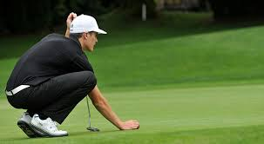
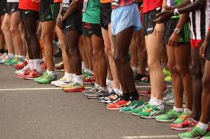
Anxiety
Suggest the possible causes of anxiety in each of the situations below
What somatic symptoms might they experience?
How might these symptoms affect performance?
A golfer lining up a crucial putt to take the lead in a high profile tournament
A marathon runner at the start line before the race
For more help, please visit www.exampaperspractice.co.uk
© 2025 Exams Papers Practice. All Rights Reserved

Slide 41
Task
Draw and annotate the following diagram:
Causes
Anxiety
Signs of somatic anxiety
Cognitive anxiety
Can you include sporting examples? How much detail can you include?
Can you start to think of ways to reduce arousal and anxiety levels?
For more help, please visit www.exampaperspractice.co.uk
© 2025 Exams Papers Practice. All Rights Reserved

Slide 42
9.5 Relaxation techniques
Skill acquisition and psychology
Chapter 9
Psychology
Learning objectives
1) Explain the benefits of relaxation techniques in reducing anxiety
and arousal
2) Describe and use the techniques of mental rehearsal,
visualisation and deep breathing
3) Explain how these techniques control and support the performer
For more help, please visit www.exampaperspractice.co.uk
© 2025 Exams Papers Practice. All Rights Reserved

Slide 43
What you need to know
For more help, please visit www.exampaperspractice.co.uk
© 2025 Exams Papers Practice. All Rights Reserved

Slide 44
Relaxation techniques
Consider the following questions:
Why is it that an athlete might choose to use relaxation techniques?
Do you think elite athletes are likely to be more or less affected by anxiety and arousal then less experienced performers? Why?
What things do you do to keep calm before an event or competition?
For more help, please visit www.exampaperspractice.co.uk
© 2025 Exams Papers Practice. All Rights Reserved

Slide 45
Relaxation techniques – Why?
To control the symptoms of:
Cognitive anxiety (nervousness and worry which could lead to impaired (poor) decision making)
Somatic anxiety (Elevated heart and breathing rate, loss of motor control, shaking, nausea, loss of sleep)
A combination of relaxation techniques may be used to reduce arousal and anxiety both in the short and long term
For more help, please visit www.exampaperspractice.co.uk
© 2025 Exams Papers Practice. All Rights Reserved

Slide 46
Mental rehearsal and visualisation
Mental rehearsal – using the senses to recreate the event mentally. Simulating sights, sounds and sensations such as:
Crowd noise
What the crowd looks like
How to react positively to bad situations
Performing skills perfectly under pressure
The athlete will try to visualise themselves performing well under these conditions
Visualisation – ‘seeing’ the best possible outcome for the skill/technique you are about to perform
Mental rehearsal – running through a skill, sequence or event in your mind, in detail, involving all your senses
For more help, please visit www.exampaperspractice.co.uk
© 2025 Exams Papers Practice. All Rights Reserved

Slide 47
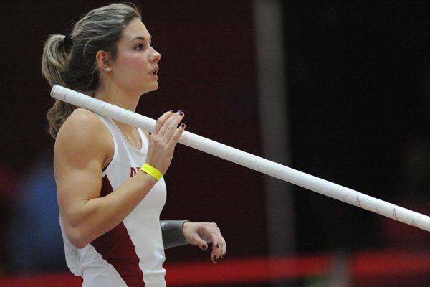
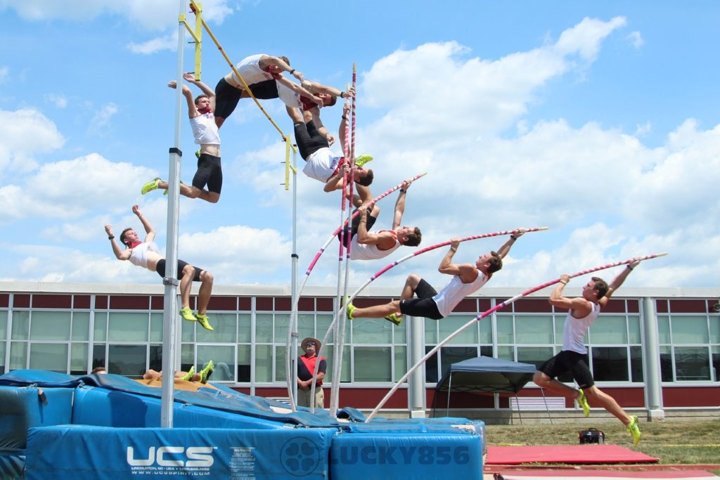
Mental rehearsal and visualisation
Benefits?
Rehearsing mentally
Visualising success
Involving all the senses
Visualisation is when an athlete ‘sees’ themselves succeeding, while mental rehearsal involves mentally running through the whole sequence or skill
For more help, please visit www.exampaperspractice.co.uk
© 2025 Exams Papers Practice. All Rights Reserved
Notes:
Benefits: Improves concentration and confidence. Blocking factors that increase arousal and anxiety (e.g. thoughts about what could go wrong)

Slide 48
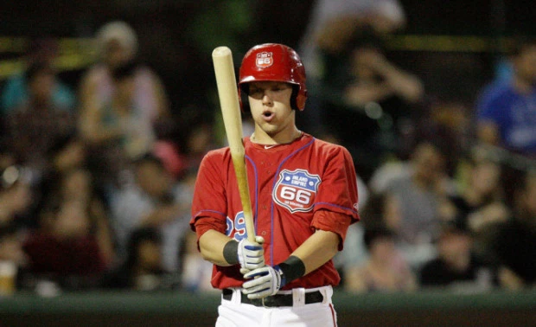
Deep breathing
https://www.youtube.com/watch?v=NtyExtEBF-k
What are the benefits?
Deep breathing – what are the benefits?
Focus on the breath instead of the event, reducing stress
Help the body to take in oxygen efficiently
Focuses the attention
Helps to remove tension from the muscles (relaxation)
Do these benefits help to relieve cognitive or somatic anxiety?
Deep breathing – a learned way of breathing in a deep, calm and focused way to promote relaxation as well as physical well-being
For more help, please visit www.exampaperspractice.co.uk
© 2025 Exams Papers Practice. All Rights Reserved

Slide 49
Task
Draw and annotate the following diagram:
Cognitive
Controlling arousal/ anxiety
Somatic
Which technique(s) could be used? What are their features? What are the benefits?
For more help, please visit www.exampaperspractice.co.uk
© 2025 Exams Papers Practice. All Rights Reserved

Slide 50
9.6 Personality types
Skill acquisition and psychology
Chapter 9
Psychology
Learning objectives
1) Define the two personality types: introvert and extrovert
2) Describe the typical characteristics of introverts and extroverts
3) Suggest physical activities that might be taken up by introvert and
extrovert personality types
For more help, please visit www.exampaperspractice.co.uk
© 2025 Exams Papers Practice. All Rights Reserved

Slide 51
What you need to know
For more help, please visit www.exampaperspractice.co.uk
© 2025 Exams Papers Practice. All Rights Reserved

Slide 52
Which of the following best reflects your preferences?
Select a or b
Quiet, shy and reserved (a) sociable, talkative and outgoing (b)
Prefer taking part in solo activities (a) prefer team sports (b)
Enjoy your own company and like being alone (a) enjoy interacting with others and get bored easily if alone (b)
Enjoy sports that require high levels of accuracy and concentration (a) enjoy sports that require lower levels of concentration (b)
Excel at sports that require fine movement skills (a) prefer sports that require gross motor skills (b)
Perform better with lower levels of arousal (a) Prefer sports that require higher levels of arousal and are played at a fast pace (b)
Prefer to practice alone or with only a few others (a) enjoy team practice sessions (b)
Dislike contact sports (a) prefer contact sports with lots of action (b)
Total the number of a and b answers
For more help, please visit www.exampaperspractice.co.uk
© 2025 Exams Papers Practice. All Rights Reserved

Slide 53
Personality types
There are two main personality types:
Introverts
A quiet, shy, reserved personality. Associated with individual sports
Extroverts
A sociable, lively, optimistic, outgoing personality. More associated with team sports
If you selected more a answers, you have more characteristics associated with introverts
Remember – the characteristics associated with the different personality types are just generalisations; it is possible to be an extrovert that prefers taking part in solo activities that require fine motor skills!
For more help, please visit www.exampaperspractice.co.uk
© 2025 Exams Papers Practice. All Rights Reserved

Slide 54
Personality characteristics
Introvert | Extrovert
Quiet, shy and reserved | Sociable, talkative and outgoing
Prefer taking part in solo activities | Prefer team sports
Enjoy your own company and like being alone | Enjoy interacting with others and get bored easily if alone
Enjoy sports that require high levels of accuracy and concentration | Enjoy sports that require lower levels of concentration
Excel at sports that require fine movement skills | Prefer sports that require gross motor skills
Perform better with lower levels of arousal | Prefer sports that require higher levels of arousal and are played at a fast pace
Prefer to practice alone or with only a few others | Enjoy team practice sessions
Dislike contact sports | Prefer contact sports with lots of action
For more help, please visit www.exampaperspractice.co.uk
© 2025 Exams Papers Practice. All Rights Reserved

Slide 55
The influence of personality
Your personality characteristics can have an effect on the types of sports you decide to take up
“A marathon runner is likely to have a very different personality than a boxer”
And the roles you adopt when participating in team sports
“Extroverts are more likely to adopt leadership roles within their teams”
WHY?
Assessing personality types can be used as a way of identifying talented individuals and nurturing their specific skills
For more help, please visit www.exampaperspractice.co.uk
© 2025 Exams Papers Practice. All Rights Reserved

Slide 56
The influence of personality
Table - The types of sports each personality type would be suited to
Introverts | Agree | Disagree | Extroverts | Agree | Disagree
Marathon running |  |  | Football
Archery |  |  | Boxing
Swimming |  |  | Hockey
Gymnastics |  |  | Rugby
- Do you agree that the sports have been placed in the correct columns?
In each case, discuss with your partner and justify why you agree or disagree
Use the table of personality characteristics to assist you (slide 54)
For more help, please visit www.exampaperspractice.co.uk
© 2025 Exams Papers Practice. All Rights Reserved

Slide 57
Personality theories
“How did my personality come to be?”
There are a number of theories that attempt to answer this question:
Trait theory – people are born with inherited characteristics (personality is determined by genetics)
Social learning theory – behaviours are learned through observation and instruction
Interactionist theory – behaviours/personality are developed through interactions with others
These theories show that many factors may influence our personality and therefore our choice of sport
Which do you most agree with and why?
For more help, please visit www.exampaperspractice.co.uk
© 2025 Exams Papers Practice. All Rights Reserved

Slide 58
Summary
For each of the following characteristics, stand up if you think it is indicative of an extrovert personality
Perform better with lower levels of arousal
Enjoy interacting with others and get bored easily if alone
Prefer contact sports with lots of action
Enjoy sports that require high levels of accuracy and concentration
Prefer team sports
Quiet, shy and reserved
Prefer sports that require gross motor skills
For more help, please visit www.exampaperspractice.co.uk
© 2025 Exams Papers Practice. All Rights Reserved

