Slide 1
8.1 Skill and ability
Chapter 8
Skills and skill acquisition
Skill acquisition and psychology
Learning objectives
1) Define the terms ‘skill’ and ‘ability’
2) Describe the differences between skill and ability
3) Show an awareness of the idea of mastering an ability
against adversity (e.g. Paralympics)
For more help, please visit www.exampaperspractice.co.uk
© 2025 Exams Papers Practice. All Rights Reserved

Slide 2
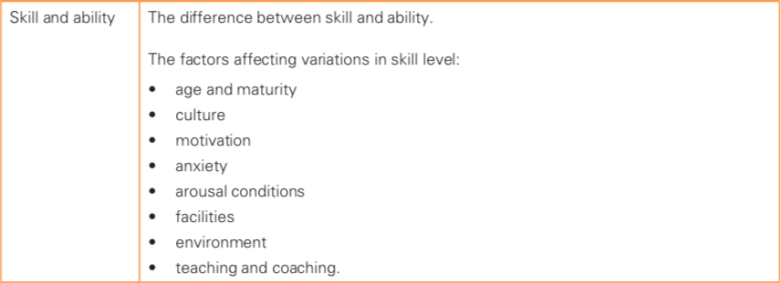
What you need to know
For more help, please visit www.exampaperspractice.co.uk
© 2025 Exams Papers Practice. All Rights Reserved

Slide 3
Skill and ability
Ability – “the qualities and characteristics a person is born with”
Such as speed, agility, balance etc... that enable a person to learn or acquire skills
Skill – “a learned and practiced ability”
It brings about the result that you want to achieve with maximum certainty and efficiency
Some people are born with a natural ability, but they still need to learn or perfect their skills over time
‘It is said to take 10,000 hours of practice to become an expert’
For more help, please visit www.exampaperspractice.co.uk
© 2025 Exams Papers Practice. All Rights Reserved

Slide 4
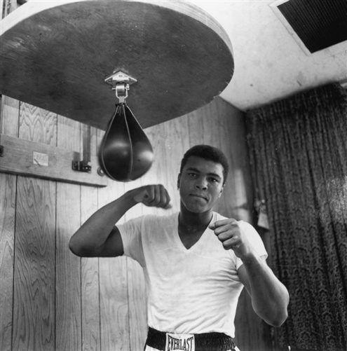
Skill and ability
Muhammad Ali had the ability to punch with speed
But he had to develop his speed punching skills by practicing over and over on the speed bag
A person’s ability will help them learn a skill quickly, but practice is still essential to develop skill
For more help, please visit www.exampaperspractice.co.uk
© 2025 Exams Papers Practice. All Rights Reserved

Slide 5
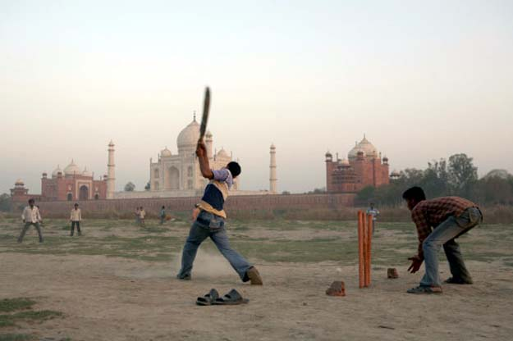
Factors affecting skill level
Why are there so many;
Skilled Footballers in Brazil?
Skilled cross country skiers in Norway?
Skilled Cricketers in India?
For more help, please visit www.exampaperspractice.co.uk
© 2025 Exams Papers Practice. All Rights Reserved

Slide 6
Factors affecting skill level
Culture
Background impacts the skills you learn...
Motivation
A desire to succeed will encourage a performer to practise and become an expert
Anxiety
If you think the skill is too difficult, it may stop you from improving
Teaching and coaching
Someone with the ability to play striking sports is likely to play Cricket if they live in India...
The quality of teaching and coaching will affect skill
Andy Murray moved to a Spanish Tennis academy to
develop his skills
For more help, please visit www.exampaperspractice.co.uk
© 2025 Exams Papers Practice. All Rights Reserved

Slide 7
Environment
Where you live will affect choices
Facilities
Better facilities mean better quality practice
Arousal conditions
Someone who is calm (works well with low arousal) may choose archery which requires fine motor skills
Age and maturity
Expert skiers tend to come from mountainous countries
Facilities offered will impact on the sports available
How young a performer starts may affect how good
they become
They have more time to perfect their skills
For more help, please visit www.exampaperspractice.co.uk
© 2025 Exams Papers Practice. All Rights Reserved

Slide 8
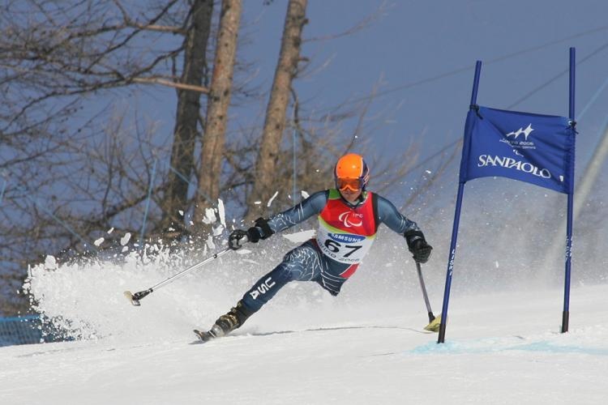
Mastering skills against adversity
Paralympic athletes had to use their abilities to develop a new range of skills
They showed courage to overshadow their disabilities
For more help, please visit www.exampaperspractice.co.uk
© 2025 Exams Papers Practice. All Rights Reserved

Slide 9
Past exam questions
Describe the differences between skill and ability (2)
Skill level is determined by a number of factors.
Describe 4 factors that have an impact on the skill level of a performer (4)
For more help, please visit www.exampaperspractice.co.uk
© 2025 Exams Papers Practice. All Rights Reserved

Slide 10
Mark Scheme
Ability – the qualities and characteristics a performer is born with (such as speed or agility)
Skill – a learned and practiced ability
See slides 6 and 7 to mark your answer.
Answers should include an explanation of the 4 chosen factors
For more help, please visit www.exampaperspractice.co.uk
© 2025 Exams Papers Practice. All Rights Reserved

Slide 11
8.2 Skilled performance
Chapter 8
Skills and skill acquisition
Skill acquisition and psychology
Learning objectives
1) Identify the six main characteristics of a skilled performance
2) Explain the role and importance of these characteristics in
different sports
3) Use these characteristics as a focus for coaching/training and
improvement
For more help, please visit www.exampaperspractice.co.uk
© 2025 Exams Papers Practice. All Rights Reserved

Slide 12
What you need to know
For more help, please visit www.exampaperspractice.co.uk
© 2025 Exams Papers Practice. All Rights Reserved

Slide 13
Skilled performance
What would you look for in a skilled performance?
Discuss – 1 minute
A skilled performance should demonstrate the following 6 characteristics:
Accurate
Consistent
Fluent
Coordinated
Aesthetically pleasing
Goal directed
For more help, please visit www.exampaperspractice.co.uk
© 2025 Exams Papers Practice. All Rights Reserved

Slide 14
The 6 characteristics of skilled performance
Accurate – precise movements
Consistent – performing to a high level every time
Fluent – Using movements that are quick, smooth and flowing
Coordinated – Moving different parts of the body together with efficiency and control
Aesthetically pleasing – A performance that looks good to the eye of the spectator, judge or coach
Goal directed – Focusing performing on a specific target and being determined to achieve that target
Which of the above characteristics of a skilled performance will a centre in netball need?
For more help, please visit www.exampaperspractice.co.uk
© 2025 Exams Papers Practice. All Rights Reserved

Slide 15
Sporting examples
A centre in netball playing skilfully will:
Receive and pass to team-mates with accuracy and consistency
A gymnast performing a floor routine skilfully will:
Require accuracy and fluency of movement which is aesthetically pleasing to watch
A football defender playing skilfully will:
Ensure their actions are goal directed (every action is selected to prevent the opponent from scoring or to help their team to score)
You may be asked to give examples of a skilled performance in a given sport
For more help, please visit www.exampaperspractice.co.uk
© 2025 Exams Papers Practice. All Rights Reserved

Slide 16
The components of fitness
A skilled performer who demonstrates the 6 characteristics will need to use different components of fitness...
Which components of fitness will a fluent performer require?
You may be asked to give examples of a skilled performance in a given sport
For more help, please visit www.exampaperspractice.co.uk
© 2025 Exams Papers Practice. All Rights Reserved

Slide 17
8.3 Skill classification
Chapter 8
Skills and skill acquisition
Skill acquisition and psychology
Learning objectives
1) Identify the different types of skills: basic/complex,
fine/gross, open/closed
2) Understand that these can be placed on a continuum
3) Justify the choice of these skills with sporting examples
For more help, please visit www.exampaperspractice.co.uk
© 2025 Exams Papers Practice. All Rights Reserved

Slide 18
What you need to know
For more help, please visit www.exampaperspractice.co.uk
© 2025 Exams Papers Practice. All Rights Reserved

Slide 19
Classification of skills
Skills can be classified as either:
Basic or complex
Open or closed
Fine or gross
Usually skills are neither one nor the other but somewhere between the two on a continuum
You need to be able to place skills on these continua and justify your choice
For more help, please visit www.exampaperspractice.co.uk
© 2025 Exams Papers Practice. All Rights Reserved

Slide 20
Basic and complex skills
Basic | Complex
“Simple skills such as throwing, running hitting a ball or catching” | “More difficult skills that require a higher level of coordination and concentration”
Need to be mastered first before being able to learn complex skills | Take longer to learn and perfect
Few sub-routines/parts | Have many sub-routines/parts
May involve limited decision making judgements | May involve many decision making judgements
E.g. a chest pass/over-arm throw | E.g. a diving routine
What is meant by the term ‘basic skill’? (1)
Give an example of a ‘complex skill’ and explain your choice (1)
For more help, please visit www.exampaperspractice.co.uk
© 2025 Exams Papers Practice. All Rights Reserved

Slide 21
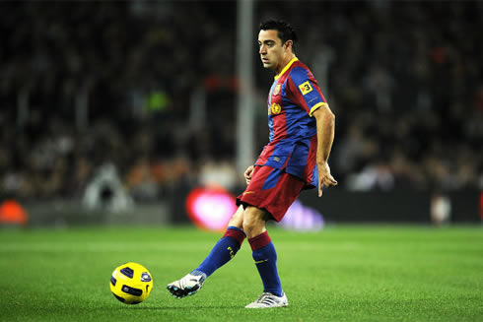
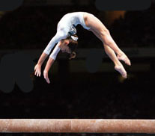
Basic or complex?
Remember to justify your answer!
Basic – skill is simple, has few sub-routines/parts, minimal decision making needed
Complex – a handspring in gymnastics requires higher levels of coordination and concentration, has many sub-routines/parts, involves decision making, takes a long time to learn/perfect
For more help, please visit www.exampaperspractice.co.uk
© 2025 Exams Papers Practice. All Rights Reserved

Slide 22
Open and closed skills
Open | Closed
“Skills that are affected by the environment” | “Skills that are not affected by the environment or the performers in it”
The performer needs to react and adjust to the situation and this will constantly change | Skills are performed in the same way each time (the environment doesn’t change how the skill is performed)
Commonly seen in team games | Typically indoor/individual events…
Environmental changes – weather, pitch surface, actions of team-mates and opponents | Where the environment is stable
E.g. Rugby, football, Netball | E.g. swimming, 100m sprint, gymnastic routine
What is meant by the term ‘closed skill’? (1)
Describe the differences between open and closed skills using sporting examples (2)
For more help, please visit www.exampaperspractice.co.uk
© 2025 Exams Papers Practice. All Rights Reserved

Slide 23
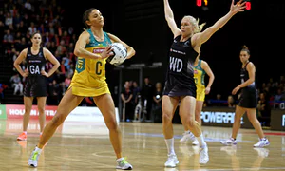
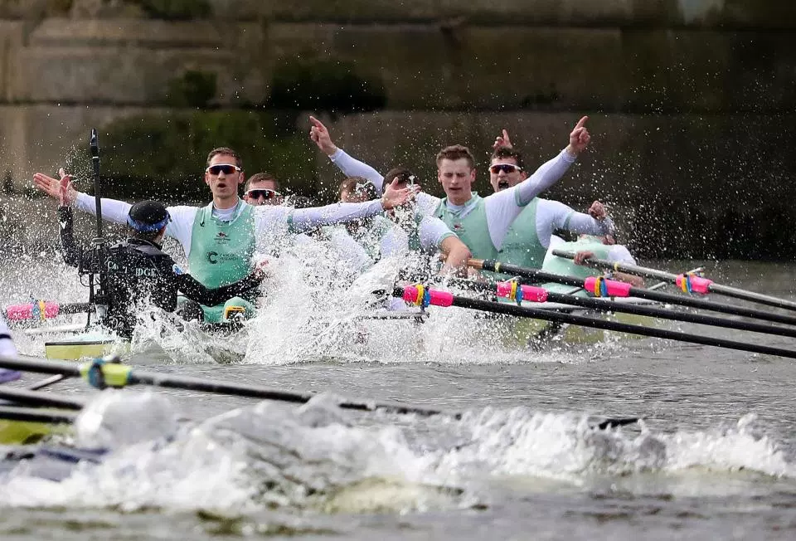
Open or closed?
Remember to justify your answer!
Open – skill is affected by environment so will be performed differently each time. Performer must react to the opponent, the movement of team-mates etc…
Closed – Not impacted by the environment; the skill is performed in the same way each time
For more help, please visit www.exampaperspractice.co.uk
© 2025 Exams Papers Practice. All Rights Reserved

Slide 24
Fine and gross skills
Fine | Gross
“Precise movements that require high levels of accuracy and technique” | “Skills that use large muscle groups to produce large, powerful movements”
Often small movements that require small groups of muscles (e.g. fingers) | Gross skills involve large muscle groups (e.g. arms/legs)
E.g. Archery, snooker | E.g. Shot put, jumping, throwing, running
What is meant by the term ‘fine skill’? (1)
Use a sporting example to define the term ‘gross skill’ (2)
For more help, please visit www.exampaperspractice.co.uk
© 2025 Exams Papers Practice. All Rights Reserved

Slide 25
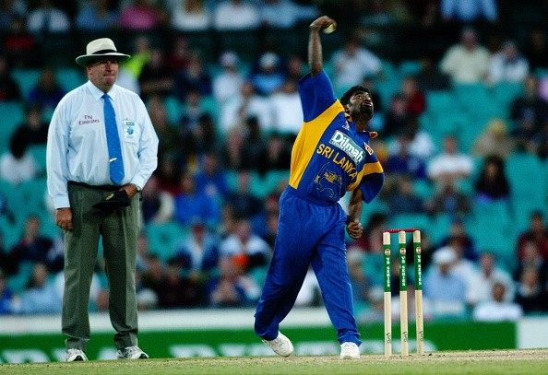
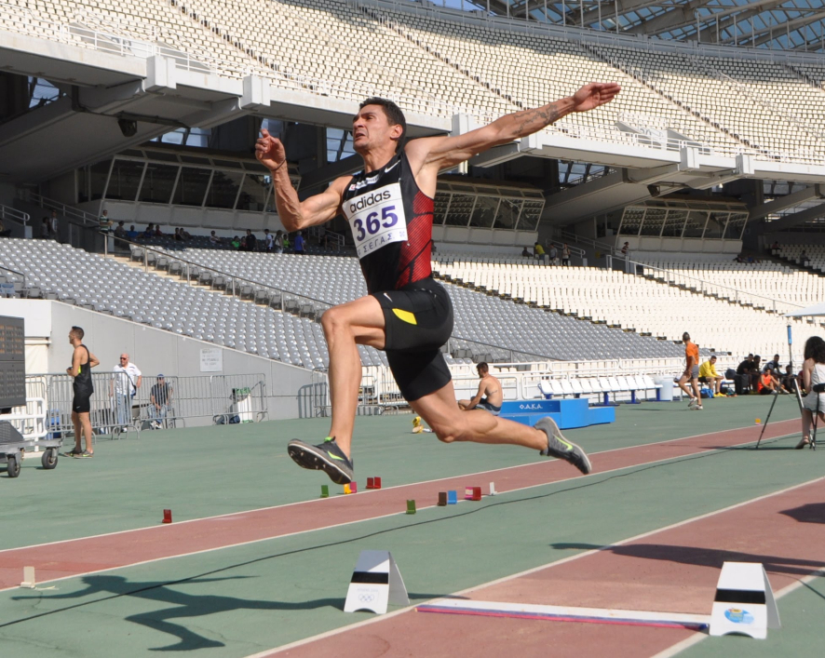
Fine or gross?
Remember to justify your answer!
Fine – spin bowling requires high levels of accuracy and technique. It involves precise movements and small muscle groups (fingers)
Gross – the long jump take-off requires large muscle groups (e.g. the quadriceps) to produce large, powerful movements
For more help, please visit www.exampaperspractice.co.uk
© 2025 Exams Papers Practice. All Rights Reserved

Slide 26
Continua (the plural of continuum)
Basic vs. complex
Open vs. closed
Fine vs. gross
Simple skills
Co-ordination and concentration
Affected by environment
Performed the same each time
Accuracy and technique
Large, powerful movements
No skill fits completely into one category; each pair of skills can be charted on a continuum. You need to be able to place a skill on each continuum and justify your choice using the terminology (words/definitions) on the previous slides
For more help, please visit www.exampaperspractice.co.uk
© 2025 Exams Papers Practice. All Rights Reserved

Slide 27
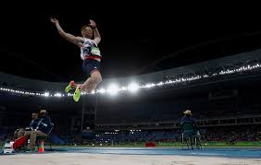
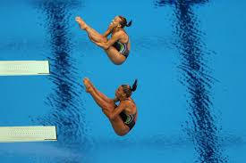
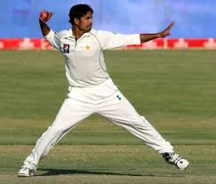
Continua (the plural of continuum)
Basic vs. complex
Simple skills
Co-ordination and concentration
For more help, please visit www.exampaperspractice.co.uk
© 2025 Exams Papers Practice. All Rights Reserved

Slide 28
Question
Where would you place a synchronised diver on the ‘basic vs. complex’ continuum and explain why (2)
-Towards the complex end
-Difficult skill that requires high levels of co-ordination and concentration
-Has many sub-routines/parts
-Involves decision making judgements
For more help, please visit www.exampaperspractice.co.uk
© 2025 Exams Papers Practice. All Rights Reserved

Slide 29
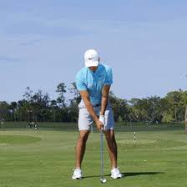
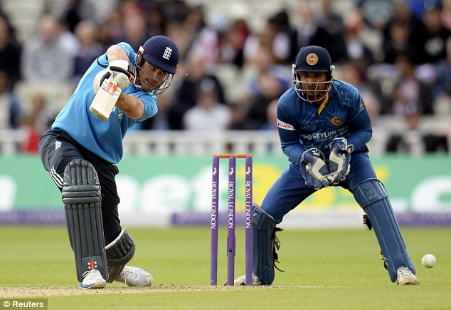
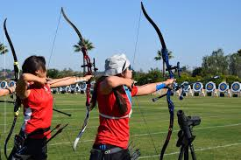
Continua (the plural of continuum)
Open vs. closed
Affected by environment
Performed the same each time
For more help, please visit www.exampaperspractice.co.uk
© 2025 Exams Papers Practice. All Rights Reserved

Slide 30
Question
Where would you place an archer on the ‘open/closed’ continuum and explain why (2)
-Towards the closed end
-As the skill is performed the same way each time
-Minimal environmental influences
-However, environmental changes such as wind may influence the way the skill is performed
For more help, please visit www.exampaperspractice.co.uk
© 2025 Exams Papers Practice. All Rights Reserved

Slide 31
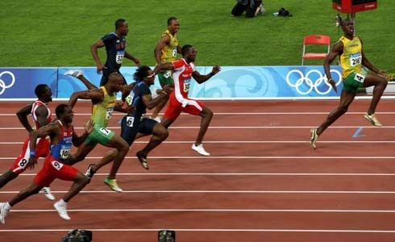
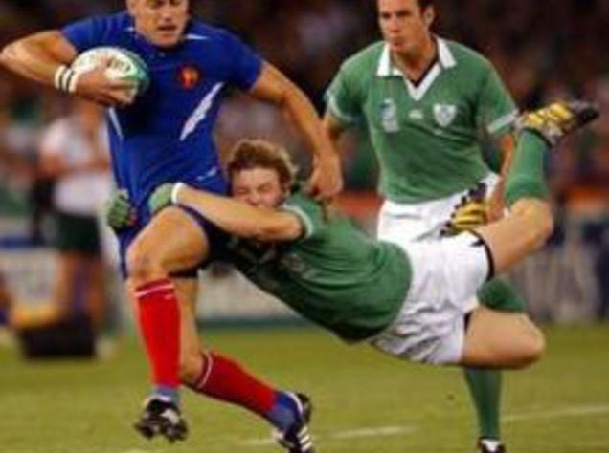
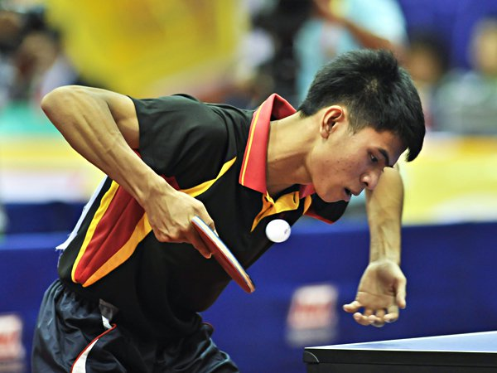
Continua (the plural of continuum)
Fine vs. gross
Accuracy and technique
Large, powerful movements
For more help, please visit www.exampaperspractice.co.uk
© 2025 Exams Papers Practice. All Rights Reserved

Slide 32
Question
Where would you place a table-tennis serve on the ‘fine/gross’ continuum and explain why (2)
-Towards the fine end
-Precise movement that requires high levels of accuracy and technique
-Uses small movements that require small muscle groups
For more help, please visit www.exampaperspractice.co.uk
© 2025 Exams Papers Practice. All Rights Reserved

Slide 33
Summary task
Think of a sport that you regularly play or have an interest in
Draw 3 continua in your books
Place a variety of skills/situations from your sport on each continuum
Make sure you can justify the position of each skill
For more help, please visit www.exampaperspractice.co.uk
© 2025 Exams Papers Practice. All Rights Reserved

Slide 34
8.4 Simple information-processing model
Chapter 8
Skills and skill acquisition
Skill acquisition and psychology
Learning objectives
1) Identify the four stages of the information-processing model
2) Explain the difference between short-term and long-term memory
3) Apply the stages of the information-processing model to a physical
activity
4) Explain what is meant by limited-channel capacity and single-channel
hypothesis
For more help, please visit www.exampaperspractice.co.uk
© 2025 Exams Papers Practice. All Rights Reserved

Slide 35
What you need to know
For more help, please visit www.exampaperspractice.co.uk
© 2025 Exams Papers Practice. All Rights Reserved

Slide 36
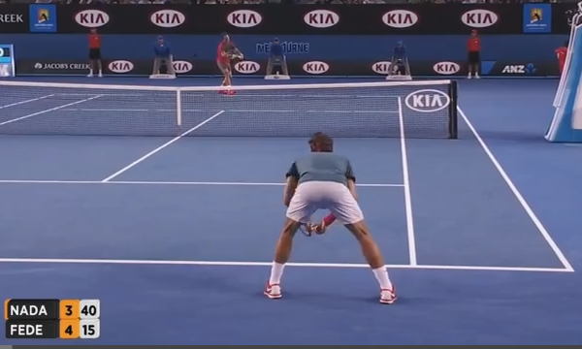
Information processing
How do we process information to allow us to make good decisions?
What information is this player thinking about as his opponent is about to serve?
For more help, please visit www.exampaperspractice.co.uk
© 2025 Exams Papers Practice. All Rights Reserved

Slide 37
Information processing
The brain controls everything you do and is therefore processes information from a number of sources:
Eyes (visual information)
Ears (hearing/auditory information)
Skin (sensory information)
Muscles (which provide action through movement)
The information processing model ‘is a four stage process that a performer goes through to make a decision and act upon it’
For more help, please visit www.exampaperspractice.co.uk
© 2025 Exams Papers Practice. All Rights Reserved

Slide 38
Information processing model
Input
Decision-making
Output
Feedback
Input
- The information that is received
Decision making
Information is analysed by the performer so they can choose the most appropriate response
Output
- The decision is made and then acted upon
Feedback
- Information is also received about the output/outcome (was the action good or bad?)
For more help, please visit www.exampaperspractice.co.uk
© 2025 Exams Papers Practice. All Rights Reserved
Notes:
Tennis serve –
Input: Receiver is standing wide behind the baseline
Decision making: Because the receiver is wide, there is space down the middle (‘T’)
Output: Brain sends signal to muscles which create movement (ball is served)
Feedback: Player was unable to reach the ball – knowledge is stored so that when a player is stood in a similar position in the future a similar decision may be made.

Slide 39
The four stages in detail
Input | Decision making
Information is received via the senses A great deal of information is received so the performer must ‘select’ the most important information to focus on | -The information is analysed and a decision is made If the situation has been experienced many times before, the performer will have information in their long-term memory (LTM), which will help them to make their decision.
Output | Feedback
-The decision is made and acted upon: -The brain sends information to the muscles -The muscles contract creating movement and the skill is performed | -Information is received about the outcome (‘how successful was I?’) -This knowledge will be stored in the short-term memory (STM) at first, but will be moved to the LTM if the skill is practiced many times. - This will help the performer to improve their decision making next time.
For more help, please visit www.exampaperspractice.co.uk
© 2025 Exams Papers Practice. All Rights Reserved

Slide 40
Long-term and short-term memory
Memory store that can hold vast amounts of information for a long period
Experts will have more information stored here as they have rehearsed more
Making decision making easier and more efficient
Because they know what worked well in the past and what didn’t
A system for storing a small amount of information for a brief period
If actions are not rehearsed (practiced), this information is lost
LONG-TERM
SHORT-TERM
For more help, please visit www.exampaperspractice.co.uk
© 2025 Exams Papers Practice. All Rights Reserved

Slide 41
Practical example (Basketball lay-up)
A player has just received the ball near to the basket
Input – The information received could include: the position of defenders/team-mates. The player sees that no defenders are blocking his route to the basket.
Decision making – Based on this information, the player decides that the best option is to lay-up.
Output – Player performs the lay-up and scores.
Feedback – The player receives feedback; (visual – they see that they scored, hearing/auditory – they crowd cheered and the coach congratulated the player, sensory – it felt right when the ball left the hand).
This feedback tells the player that their decision was successful. As a result they will be more likely to make the same decision next time.
If they practice this skill many times, the feedback they receive will be stored in their LTM, helping them to make better and faster decisions in the future. If they don’t practice, the information will only be stored in the STM and will quickly be forgotten.
For more help, please visit www.exampaperspractice.co.uk
© 2025 Exams Papers Practice. All Rights Reserved

Slide 42
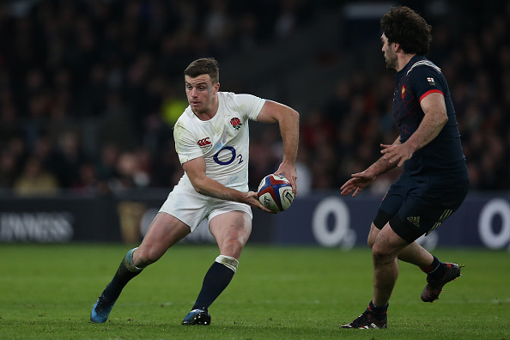
Recap
Think about the situation the player is in and answer the questions below:
(George Ford – England Rugby)
Can you explain:
1) Input - What sort of information is the player receiving?
2) Decision making – What are his options?
3) Other than the input, what might influence the decision he makes?
4) What will he receive once the skill is complete?
5) How might the outcome influence his future decisions?
For more help, please visit www.exampaperspractice.co.uk
© 2025 Exams Papers Practice. All Rights Reserved

Slide 43
Limited-channel capacity
“the idea that our brains can only process a certain amount of information at once; too much information results in overload”
So if we try to do more than one thing at once, our performance suffers as the brain struggles to process all the information
(Too much information processing will cause overload and confusion)
This is known as limited channel capacity

Slide 44
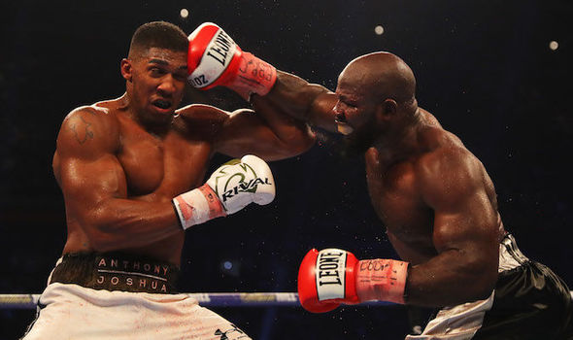
Limited-channel capacity
Q – What information do the boxers need to process?
Q – Could this be an example of LCC in action?
Q – What might the final outcome be?
Anthony Joshua and Carlos Takam
For more help, please visit www.exampaperspractice.co.uk
© 2025 Exams Papers Practice. All Rights Reserved

Slide 45
Single-channel and multi-channel hypotheses
Single channel hypothesis –
The performer can only process one piece of information at a time
Until one has been dealt with, another cannot be acted upon
Can you provide an example to illustrate this?
Multi-channel hypothesis –
The brain has several channels, each dedicated to a different task
Visual information may be processed in one channel
Verbal information may be process through another
Performance suffers only if a channel gets overloaded (e.g. too much verbal information)
For more help, please visit www.exampaperspractice.co.uk
© 2025 Exams Papers Practice. All Rights Reserved

Slide 46
8.5 The stages of learning
Chapter 8
Skills and skill acquisition
Skill acquisition and psychology
Learning objectives
1) Outline the three stages of learning: cognitive, associative,
autonomous
2) Describe the characteristics of a performer at each stage of
learning
3) Apply these characteristics to a physical activity
For more help, please visit www.exampaperspractice.co.uk
© 2025 Exams Papers Practice. All Rights Reserved

Slide 47
What you need to know
For more help, please visit www.exampaperspractice.co.uk
© 2025 Exams Papers Practice. All Rights Reserved

Slide 48
The stages of learning
How does a performer learn a skill or develop from a beginner to a skilled performer?
When learning any skill there are three stages to learning…
1 – Cognitive stage
2 – Associative stage
3 – Autonomous stage
For more help, please visit www.exampaperspractice.co.uk
© 2025 Exams Papers Practice. All Rights Reserved

Slide 49
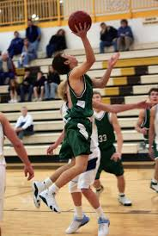
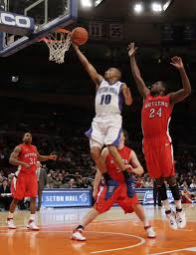
Stage | Mistakes
Cognitive stage - The preparation stage: you start to learn a new skill or technique. You consciously think about what is involved and the actions you need to perform the skill | A large number of mistakes will be made Shooting too far away
Associative stage The practice stage: You continue repeating and practicing skills and techniques so they improve | Skills improve Number of misses gradually decreases
Autonomous stage - The automatic stage: perform the skill naturally and without conscious thought, showing control and accuracy | Mistakes are rare. When you do make mistakes you can analyse what went wrong Scoring every time
For more help, please visit www.exampaperspractice.co.uk
© 2025 Exams Papers Practice. All Rights Reserved

Slide 50
The stages of learning
The stages of learning form a continuum
You gradually progress from one end to the other as your skill level develops
You may sometimes need to move back a stage
E.g. If you find you are using the incorrect technique and need to ‘re-learn’ the correct one
Cognitive stage
Associative stage
Autonomous stage
For more help, please visit www.exampaperspractice.co.uk
© 2025 Exams Papers Practice. All Rights Reserved

Slide 51
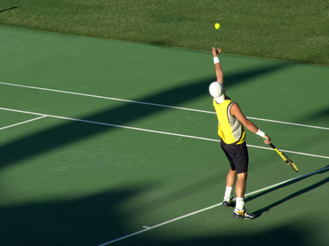
How to learn a skill during each stage
Task – Copy and complete the table (page 160 of the Cambridge GCSE text-book) for a player learning to serve in Tennis
You could use a different sport/skill if you choose
…or move to the next slide to see a worked example (basketball lay-up)
For more help, please visit www.exampaperspractice.co.uk
© 2025 Exams Papers Practice. All Rights Reserved

Slide 52
How to learn a skill during each stage – (cognitive stage)
Basketball – lay-up
- During this stage:
You break down the skill into its’ subroutines
Try to learn each subroutine
Make lots of mistakes and need coaching advice
Demonstrations are useful to show you how the skill should be performed
E.g:
Learning how to release the ball
Learning to hit the back-board in the correct place
Learning how to take two steps and take-off etc…
For more help, please visit www.exampaperspractice.co.uk
© 2025 Exams Papers Practice. All Rights Reserved

Slide 53
How to learn a skill during each stage – (associative stage)
Basketball – lay-up
During this stage:
You combine the subroutines of the skill
You practice, becoming more consistent
You may control/adapt the environment to help you focus on what you need to
You may start to try out more advanced techniques
E.g:
Dribble up, take two steps, and shoot (combining the sub-routines)
Use of a static defender (controlling the environment)
Try varying spin off the back-board (trying more advanced skills/techniques)
For more help, please visit www.exampaperspractice.co.uk
© 2025 Exams Papers Practice. All Rights Reserved

Slide 54
How to learn a skill during each stage – (autonomous stage)
Basketball – lay-up
During this stage:
You can perform the skill without thinking about the technique you are using
You can use the skill in full games
You know what went wrong when you make a mistake and can adapt
You perform the skill with accuracy, consistency and flair
E.g:
Using the skill during competitive games…
i.e. performing lay-ups in changing environments, with defenders present.
For more help, please visit www.exampaperspractice.co.uk
© 2025 Exams Papers Practice. All Rights Reserved

Slide 55
How to practice skills
Practice/rehearsal is essential for a skilled performance
There are many different ways of approaching the task of practice:
Whole practice
Part practice
Whole-part-whole practice
Fixed-variable practice
Make sure you understand each of these forms of practice
Can you remember the 6 components of a skilled performance?
For more help, please visit www.exampaperspractice.co.uk
© 2025 Exams Papers Practice. All Rights Reserved
Notes:
The 6 components of a skilled performance = Accurate, consistent, fluent, coordinated, aesthetically pleasing, goal directed

Slide 56
Practice all the different parts at once (the whole skill – e.g. A defensive shot in cricket)
Break down the skill into smaller parts (e.g. To learn the batting grip and footwork separately)
Skill
Whole
Part
Variable
Fixed
Repeat the technique in one situation over and over again (this is known as a drill)
Repeat the technique in a range of different situations (in isolation or in competition)
For more help, please visit www.exampaperspractice.co.uk
© 2025 Exams Papers Practice. All Rights Reserved

Slide 57
Practicing skills (example)
Whole-part-whole (swimming)
Whole The swimmer does a length of freestyle (front crawl); the coach identifies that they are breathing with every stroke (turning side to side)
Part The swimmer practices breathing every second breath while standing stationary in the pool
Whole The swimmer does a length of freestyle (front crawl) using the correct breathing technique
For more help, please visit www.exampaperspractice.co.uk
© 2025 Exams Papers Practice. All Rights Reserved

Slide 58
Practicing skills (example)
Whole-part-whole (badminton)
Whole The performer plays a singles game; the coach notices that they aren’t moving back to the centre of the court quickly enough after each shot
Part The coach uses a drill to focus on positioning - (e.g. the player has to run to the baseline or either sideline when a call is made, quickly returning to the centre each time).
Whole The performer plays a singles game and their movement and positioning have now improved.
For more help, please visit www.exampaperspractice.co.uk
© 2025 Exams Papers Practice. All Rights Reserved

Slide 59
8.6 Feedback
Chapter 8
Skills and skill acquisition
Skill acquisition and psychology
Learning objectives
1) Identify and outline the four different types of feedback
2) Explain how each type of feedback links to the stages of learning
and can be given to performers at different levels
3) Explain the importance of receiving good feedback and the
impact it can have on performance
For more help, please visit www.exampaperspractice.co.uk
© 2025 Exams Papers Practice. All Rights Reserved

Slide 60
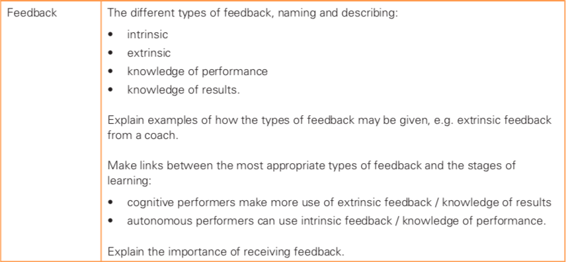
What you need to know
For more help, please visit www.exampaperspractice.co.uk
© 2025 Exams Papers Practice. All Rights Reserved

Slide 61
Feedback
This topic relates to the final stage of the information processing model
Feedback
“The information that a performer receives about their performance”
Question – Give reasons why feedback is important when learning or developing a skill (4)
Identifies strengths so they can be built on
Identifies weaknesses to work on
Stops mistakes being repeated
See if extra training or practice is needed
Set goals or targets for improvement
Motivates performer/develops self-esteem
Allows comparison to the ideal performance
Without feedback you have nothing to compare your performance to – you may regress (get worse at a skill)
For more help, please visit www.exampaperspractice.co.uk
© 2025 Exams Papers Practice. All Rights Reserved

Slide 62
The feedback loop
You need to learn the stages of the feedback loop
Performance
Feedback
Assess performance
Correct, adjust, practice
The diagram shows where feedback fits into the cycle of improving performances
Without feedback, it would be impossible to assess your performance and you wouldn’t know how to improve
For more help, please visit www.exampaperspractice.co.uk
© 2025 Exams Papers Practice. All Rights Reserved

Slide 63
Types of feedback
Extrinsic
Information from an external source (coach, fans)
Intrinsic
Information from within (emotions, thoughts, feel of a movement)
Which type of feedback is most suitable for athletes at the different stages of learning?
Extrinsic feedback –Important for those at the ‘cognitive stage’ of learning (beginners).
As they are yet to develop a ‘feel’ for skills/techniques
Intrinsic feedback – Used by those at the ‘autonomous stage’ of learning (experts).
As they are able to judge the quality of their performance and what needs to be improved through the ‘feel’ of a movement
For more help, please visit www.exampaperspractice.co.uk
© 2025 Exams Papers Practice. All Rights Reserved

Slide 64
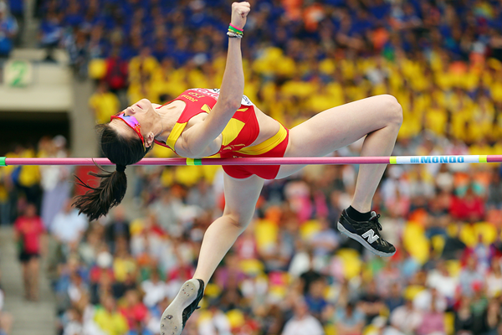
Identify the types of feedback taking place
Spanish high jumper Ruth Beitia at the IAAF World Championships 2017 – receiving intrinsic feedback from the feel of the movement
For more help, please visit www.exampaperspractice.co.uk
© 2025 Exams Papers Practice. All Rights Reserved

Slide 65
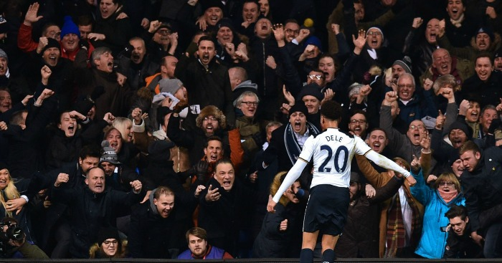
Dele Alli (Tottenham) receiving extrinsic feedback from supporters
For more help, please visit www.exampaperspractice.co.uk
© 2025 Exams Papers Practice. All Rights Reserved

Slide 66
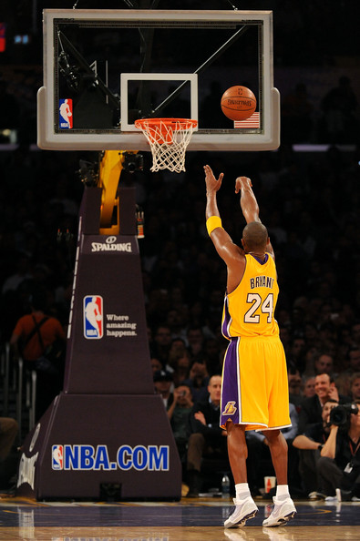
Kobe Bryant (former LA Lakers) receiving intrinsic feedback from the feel of the movement
For more help, please visit www.exampaperspractice.co.uk
© 2025 Exams Papers Practice. All Rights Reserved

Slide 67
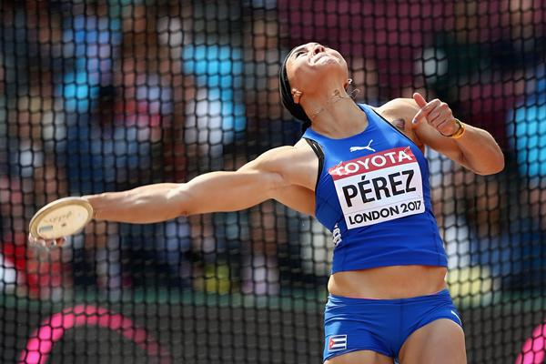
Yaime Perez in the 2017 IAAF World Championships receiving intrinsic feedback from the feel of the movement
For more help, please visit www.exampaperspractice.co.uk
© 2025 Exams Papers Practice. All Rights Reserved

Slide 68
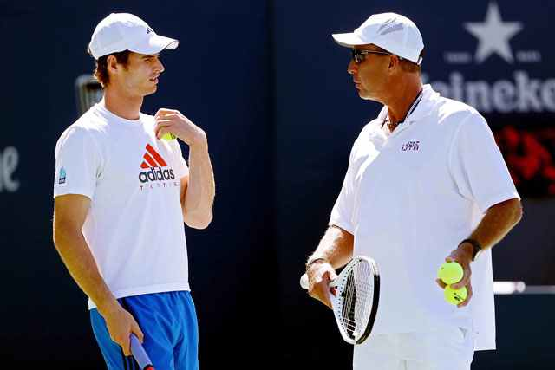
Andy Murray receiving extrinsic feedback from former coach Ivan Lendl
For more help, please visit www.exampaperspractice.co.uk
© 2025 Exams Papers Practice. All Rights Reserved

Slide 69
Types of feedback
Feedback can also come in the form of ‘knowledge of results’ and ‘knowledge of performance’
Knowledge of results
Knowing your score, time, distance or place in the race; this allows you to judge or measure how well you have done
Knowledge of performance
Analysing quality of movement or use of techniques (e.g. whether landing following a gymnastics routine was clean)
Question – Give an example of how ‘knowledge of results’ is used to provide feedback in a named activity (1)
- Athletics – time/distance/position
- Swimming – time/position
- Diving – judges scores
For more help, please visit www.exampaperspractice.co.uk
© 2025 Exams Papers Practice. All Rights Reserved

Slide 70
Types of feedback
Task – Fill in table (page 164 of Cambridge text-book) on the advantages and disadvantages of the four types of feedback
Questions
Explain why ‘knowledge of results’ may be a useful form of feedback for a performer (2)
Describe the term ‘intrinsic feedback’ and explain the disadvantages of this form of feedback (3)
Describe the term ‘extrinsic feedback’ and discuss whether it is a useful form of feedback for someone in the cognitive stage of learning (3)
…or go to the next slide for a summary of the key information
For more help, please visit www.exampaperspractice.co.uk
© 2025 Exams Papers Practice. All Rights Reserved

Slide 71
 | Advantages | Disadvantages
Intrinsic feedback | -Performers can make immediate adjustments to their technique | -Requires a high level of knowledge about the skill (autonomous stage learners) -Beginners (cognitive learners) do not have this knowledge
Extrinsic feedback | -Good for beginners (cognitive stage) as they need constant feedback in order to learn -Autonomous performers can combine intrinsic and extrinsic feedback to get a better picture of their performance | -Needs a qualified coach to give the feedback -Incorrect feedback from a poor-quality coach will cause performances to decline
Knowledge of results | -Gives a quick measure of success -Provides a target for improvement -Helps to show improvement over time if recorded regularly | -Poor results can be demotivating -Improvement might slow down which can be demotivating -Results may not reflect skill or performance (e.g. coming 1st against weak opponents doesn’t tell us much)
Knowledge of performance | -Feedback can be tailored to suit the performer’s ability level -Can be simple feedback on 1 or 2 areas for beginners -Can be specific, complex and detailed for experienced performers | -Can be difficult or time-consuming to analyze performances of experts -There may be many skills and techniques that require feedback which is time consuming -A coach may need to watch videos of the performance first if they are to provide accurate feedback
For more help, please visit www.exampaperspractice.co.uk
© 2025 Exams Papers Practice. All Rights Reserved

Slide 72
Quality feedback
Feedback can be either positive or negative
Positive – focusing on what you did well
Negative – focusing on what you did less well
Good feedback should be –
Positive feedback provides motivation ensuring that the performer builds towards future success
F
Fast – given as soon as possible after the event
Focused – on the key areas for development
Factual – based on evidence of what you did well and what you need to improve
Question – describe the qualities of effective feedback (3)
For more help, please visit www.exampaperspractice.co.uk
© 2025 Exams Papers Practice. All Rights Reserved

Slide 73
Types of feedback
Question
Which types of feedback would benefit each of these performers? Give reasons for your choice
A beginner at hockey
A beginner at trampolining
An advanced triple jumper
An advanced rugby player
Extrinsic, knowledge of performance
Extrinsic, knowledge of results, knowledge of performance
Intrinsic, extrinsic, knowledge of results, knowledge of performance
Intrinsic, extrinsic, knowledge of performance
For more help, please visit www.exampaperspractice.co.uk
© 2025 Exams Papers Practice. All Rights Reserved
Notes:
Knowledge of results may not be relevant as Hockey is a team game and results may not reflect individual performance
Extrinsic as performer is a beginner (and therefore relies on constant feedback to develop performances). Intrinsic is not appropriate since those in the cognitive stage of learning do not yet have the knowledge and experience needed to judge their own performance and make adjustments.

Slide 74
8.7 Guidance
Chapter 8
Skills and skill acquisition
Skill acquisition and psychology
Learning objectives
1) Identify and outline the different types of guidance
2) Summarise the advantages and disadvantages of different types
of guidance
3) Explain how different types of guidance can be used during
different stages of learning
For more help, please visit www.exampaperspractice.co.uk
© 2025 Exams Papers Practice. All Rights Reserved

Slide 75
What you need to know
For more help, please visit www.exampaperspractice.co.uk
© 2025 Exams Papers Practice. All Rights Reserved

Slide 76
Guidance
This topic refers to the ways in which coaches and teachers can help performers to acquire/develop skills and techniques
“Help and instruction given to guide learners through movements, skills and techniques to help them acquire skills”
The forms of guidance
Verbal
In the form of words
Visual
In the form of images, video or demonstration
Mechanical
The use of physical supports such as harnesses
Manual
‘Hands on’ guidance (e.g. showing you how to hold a racquet)
Mechanical and manual guidance are often grouped together as they both refer to physical support
For more help, please visit www.exampaperspractice.co.uk
© 2025 Exams Papers Practice. All Rights Reserved

Slide 77
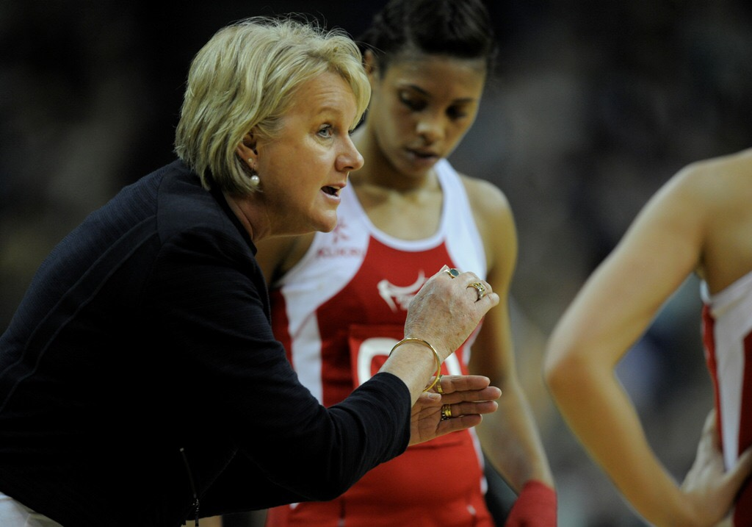
Types of guidance
Which type of guidance is being displayed in each of the following images?
Verbal - The coach is using words to explain movements and techniques
For more help, please visit www.exampaperspractice.co.uk
© 2025 Exams Papers Practice. All Rights Reserved

Slide 78
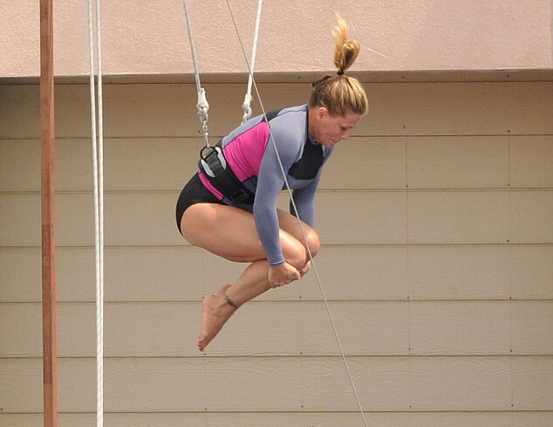
Types of guidance
Mechanical - The harness provides mechanical guidance for the trampolinist.
For more help, please visit www.exampaperspractice.co.uk
© 2025 Exams Papers Practice. All Rights Reserved

Slide 79
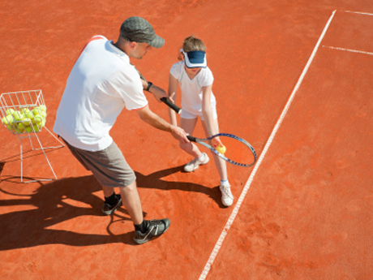
Types of guidance
Manual – the coach physically guides the performer through a movement. This enables the development of ‘muscle memory’
For more help, please visit www.exampaperspractice.co.uk
© 2025 Exams Papers Practice. All Rights Reserved

Slide 80
Types of guidance
At which stage(s) of learning do you think each of these forms of guidance would be appropriate?
Visual – the coach shows the swimmers how to perform a skill/technique through demonstration
For more help, please visit www.exampaperspractice.co.uk
© 2025 Exams Papers Practice. All Rights Reserved
Notes:
Visual – all stages (but most effective at cognitive stage as it provides an overall picture of the skill)
Manual/mechanical – cognitive (enables performers to gain a ‘feel’ for the movement)
Verbal – associative/autonomous (cognitive learners may have limited understanding of terms used. More detailed explanations can be provided for autonomous learners)

Slide 81
Guidance and the stages of learning
At which stage(s) of learning do you think each of these forms of guidance would be appropriate?
Remember – cognitive, associative, autonomous
Visual
Verbal
Mechanical/manual
All stages – but essential at the cognitive stage as beginners need to see an overall picture of the skill so that they understand how it should be performed.
Associative/autonomous as cognitive learners may not understand the terms used. More detailed explanations can be provided for autonomous learners.
Cognitive – as it enables performers to gain a ‘feel’ for the movement. Autonomous learners already have this and can provide their own intrinsic feedback.
For more help, please visit www.exampaperspractice.co.uk
© 2025 Exams Papers Practice. All Rights Reserved

Slide 82
Using guidance
Which type(s) of guidance should be used for learners in each of the three stages of learning?
Visual guidance
Useful at all stages of learning
Most effective at cognitive stage to provide an overall picture of the skill
Verbal guidance
Limited use for cognitive learners as they lack understanding of terms used
More detailed explanations are appropriate for associative and autonomous learners
Manual/mechanical guidance
Useful during the cognitive stage as it helps the learner get a ‘feel’ for the movement
Used to ensure safety in advanced performers (e.g. climbing)
For more help, please visit www.exampaperspractice.co.uk
© 2025 Exams Papers Practice. All Rights Reserved

Slide 83
Advantages and disadvantages
Task – Complete the table (page 168 of the Cambridge GCSE text-book), describing the advantages and disadvantages of the different types of guidance
…or go to the next slide for a summary of the key information
For more help, please visit www.exampaperspractice.co.uk
© 2025 Exams Papers Practice. All Rights Reserved

Slide 84
 | Advantages | Disadvantages
Visual guidance | -Performers can form a mental picture of correct performance -Demonstrations can be repeated if necessary -Slow-motion video can be used to focus on specific sub-routines of a skill -Useful in all stages of learning | -Demonstrations need to be accurately and expertly performed -Poor-quality videos are not helpful
Verbal guidance | -It is immediate. Instructions can be acted upon straight away -Coaches can use questions to assess and check understanding -Verbal and visual guidance can be combined to paint a more accurate picture for the learner | -Long or complicated instructions are hard to take in (see limited channel capacity – topic 8.4) -This can cause issues for beginners taking in lots of new information at once -Some movements cannot be accurately explained using words
Manual/ mechanical guidance | -Useful in the early stages of learning -Helps an individual get a feel for the movement and develop muscle memory -Can provide a safe environment to try out more hazardous activities (e.g. trampolining/gymnastics) -Gives performers a sense of security and helps deal with feelings of anxiety or fear | -Learners can come to depend on support from coach/equipment -Can give learners an unrealistic feeling of the motion (e.g. when they do not support their full body-weight in gymnastics) -Learners may resist having manual/mechanical guidance taken away
For more help, please visit www.exampaperspractice.co.uk
© 2025 Exams Papers Practice. All Rights Reserved

Slide 85
Explain what helps us to learn skills in sport (6)
Guidance:
Visual – Demonstrations or images show us what we need to do
Verbal – Explanations can help to develop understanding
Mechanical/manual – help to give a ‘feel’ for the movement and develop ‘muscle memory’
Feedback:
Knowledge of performance – helps to analyse quality of performance and make adjustments
Knowledge of results – helps to judge how well you have done
Intrinsic – Information from the feel of a movement helps performers make adjustments to their technique
Extrinsic – Provides a picture of what needs to be improved
Type of practice used:
Whole – You practice the whole skill mimicking actual performance
Part – Skills are broken down, practiced and then put back together again
Variable – Skills are practiced in different situations. This is useful for open skills as the environment is constantly changing
Fixed – Skills are practiced in the same conditions. This is appropriate for closed skills such as a set-shot in basketball
For more help, please visit www.exampaperspractice.co.uk
© 2025 Exams Papers Practice. All Rights Reserved

