Slide 1
7.1 Principles of training and overload
Health, fitness and training
Chapter 7
Training
Learning objectives
1) Understand the principles of training known as SPORT
2) Apply these principles to a training programme
3) Provide examples of the principles of overload known as FITT
4) Explain the dangers of overtraining
For more help, please visit www.exampaperspractice.co.uk
© 2025 Exams Papers Practice. All Rights Reserved

Slide 2
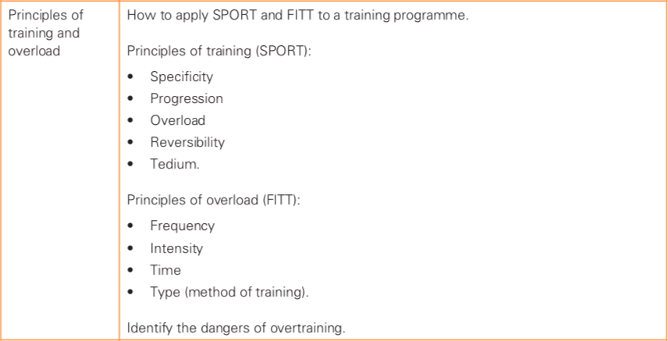
What you need to know
For more help, please visit www.exampaperspractice.co.uk
© 2025 Exams Papers Practice. All Rights Reserved

Slide 3
Principles of training and overload
What is required to create a high quality training programme?
A well designed training programme that follows a clear set of training principles is essential for improving performance
Programmes need to be personalised based on:
Individual needs
Goals or ambitions
Fitness and health status
Gathering information is therefore an important first step
Questionnaires are a convenient way of gathering information
Task – What sort of questions do you think might be useful when designing a personal training programme for someone?
For more help, please visit www.exampaperspractice.co.uk
© 2025 Exams Papers Practice. All Rights Reserved

Slide 4
Principles of training Principles of overload
(SPORT) (FITT)
Specificity Frequency
Progression Intensity
Overload Time
Reversibility Type
Tedium
You need to be able to define each principle, and apply it to a training programme
For more help, please visit www.exampaperspractice.co.uk
© 2025 Exams Papers Practice. All Rights Reserved

Slide 5
S.P.O.R.T
Principles of training
Specificity
Training must focus on specific types of activity to improve:
The components of fitness needed by the individual
The relevant muscle groups
Progression
Occurs when the body adapts to training:
Moving to a new level of fitness
Progress is achieved through overloading the body
Sprinters focus on power and speed
Swimmers exercise muscle groups specific to swimming (e.g. the latissimus dorsi)
Increases in intensity should be gradual
Most progress is made early on
Progress is slower at higher levels of fitness
Why?
For more help, please visit www.exampaperspractice.co.uk
© 2025 Exams Papers Practice. All Rights Reserved

Slide 6
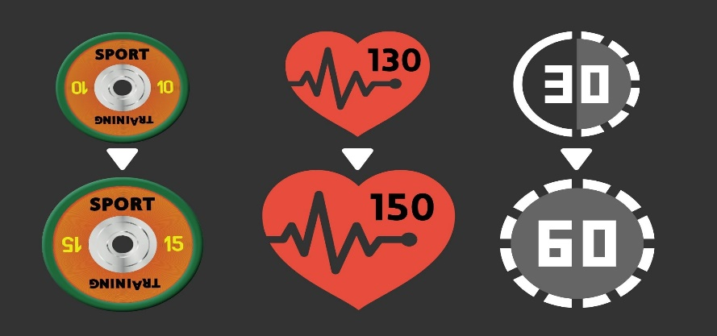
S.P.O.R.T
Principles of training
Overload
Frequency, intensity and time (duration) of training should be increased to ensure fitness gains
Reversibility
Any improvements will be lost (reverse) if you stop training
Tedium
Using a variety of training methods (or exercises) relieves tedium (boredom) in training
By increasing training demands over time, the body is forced to adapt
Caused by injury and excessive fatigue
Muscle atrophy may occur as well as a deterioration of a range of fitness components
Tedium can lead to a loss of motivation
For more help, please visit www.exampaperspractice.co.uk
© 2025 Exams Papers Practice. All Rights Reserved

Slide 7
F.I.T.T
Principles of overload
Frequency
How often you train. Overload can be achieved by adding an additional training session to your weekly schedule
Intensity
How hard you train (e.g. increasing HR during exercise, lifting heavier weights, increasing pace etc…)
How can we apply overload to our training and achieve progression?
For more help, please visit www.exampaperspractice.co.uk
© 2025 Exams Papers Practice. All Rights Reserved

Slide 8
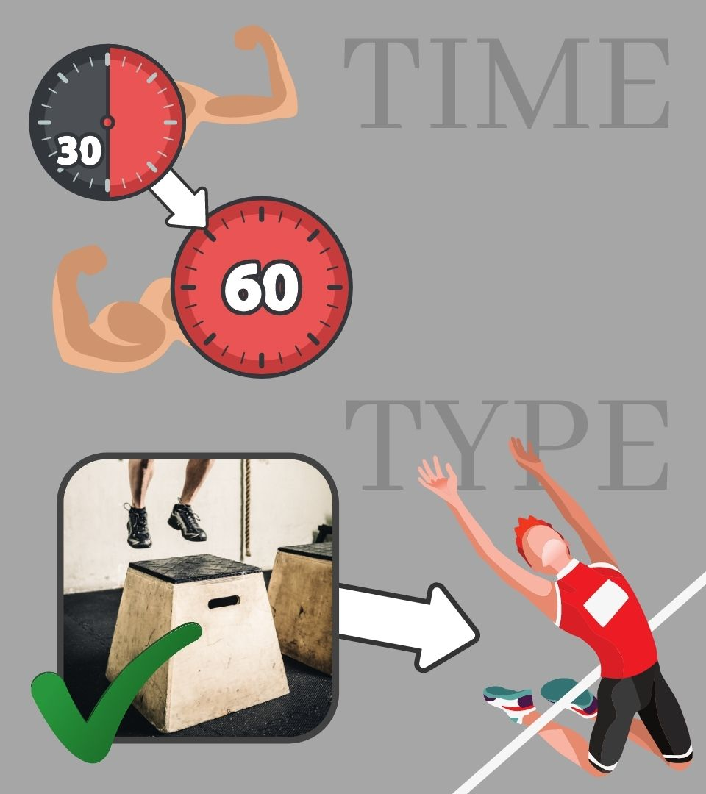
F.I.T.T
Principles of overload
Time
How long you train for. The duration of training sessions can be increased as you adapt to previous training demands
Type
The activities selected must carry you towards your training aim. They should be specific to what you’re trying to achieve and varied/enjoyable to avoid tedium
How can we apply overload to our training and achieve progression?
For more help, please visit www.exampaperspractice.co.uk
© 2025 Exams Papers Practice. All Rights Reserved

Slide 9
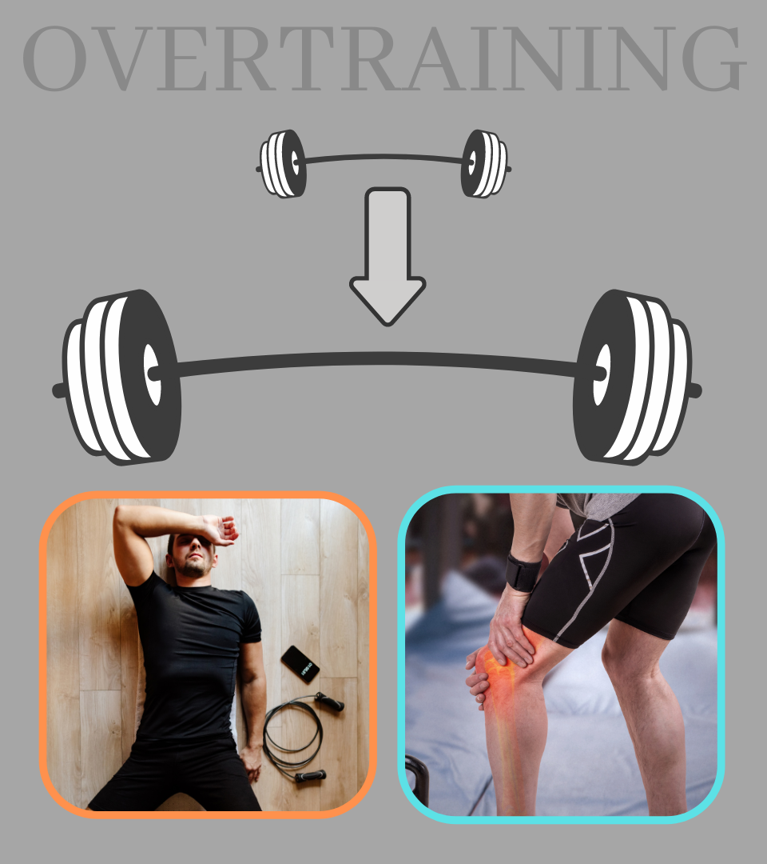
Overtraining
Sudden increases in workload that don’t give the body time to adapt (i.e. when overload is applied to quickly) can lead to a state called overtraining
Overtraining often results in overuse injury or excessive fatigue
Affecting our ability to train effectively, leading to reversibility and a loss of fitness
Overtraining - “Excessive exercise that gives the body more work or stress than it can handle”
For more help, please visit www.exampaperspractice.co.uk
© 2025 Exams Papers Practice. All Rights Reserved

Slide 10
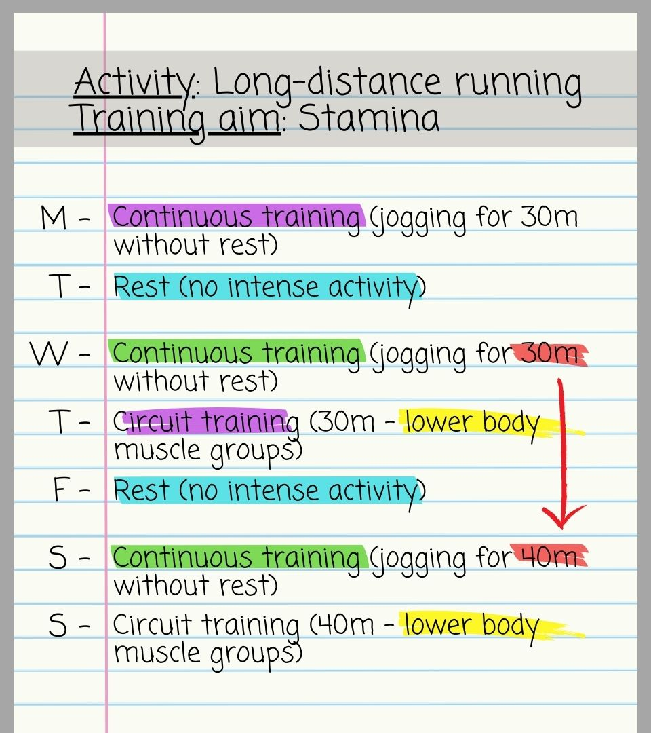
Task – Design a one week training programme for an activity and training aim of your choice.
Try to evidence the principles of training where possible
Progression is achieved by applying overload (increasing time)
Specific to the activity
Specific to the training aim
Variety helps to avoid tedium
Reversibility Rest days help to prevent overtraining and reversibility
For more help, please visit www.exampaperspractice.co.uk
© 2025 Exams Papers Practice. All Rights Reserved

Slide 11
Questions
How might a coach ensure specificity when designing a training programme for a marathon runner looking to develop cardiovascular endurance? (4)
a) Type of training
b) Intensity
c) Duration
d) Muscle groups
e) Individual needs
Continuous training / fartlek training
60-80% of maximum heart rate
Minimum of 20 minutes
Lower body muscle groups (quadriceps, hamstrings, gastrocnemius, gluteals)
Intensity and duration must reflect the current fitness level of the athlete
For more help, please visit www.exampaperspractice.co.uk
© 2025 Exams Papers Practice. All Rights Reserved

Slide 12
Questions
Describe the term progression (2)
Increase in work done should be gradual
An athlete should only progress when the body has adapted to previous demands
This will ensure constant fitness improvements
And will help to reduce chances of injury (through overtraining)
For more help, please visit www.exampaperspractice.co.uk
© 2025 Exams Papers Practice. All Rights Reserved

Slide 13
Questions
How could a coach avoid reversibility when training an athlete? (4)
Overload should be used to ensure that gains are made
Ensure progression is used to prevent injury
Rest periods should be included to avoid injury
Avoid too much emphasis on a single component of fitness as this may lead to reversibility in another
If injuries occur, use alternative training methods (e.g. swimming) to prevent fitness losses
Training should be varied to avoid tedium
Goal-setting should be used to motivate athlete
For more help, please visit www.exampaperspractice.co.uk
© 2025 Exams Papers Practice. All Rights Reserved

Slide 14
Questions
This is all about motivating an athlete
If a training programme isn’t varied, an athlete may get bored and lose motivation
Leading to fitness losses (reversibility)
How might a coach avoid tedium when training an athlete? (2)
Use a range of training methods (e.g. circuits, weight training, continuous training)
Use goal setting to motivate the athlete
For more help, please visit www.exampaperspractice.co.uk
© 2025 Exams Papers Practice. All Rights Reserved

Slide 15
Questions
Using two training principles, describe how a coach could ensure that a performer improves (4 marks)
Specificity – the training should be specific to the activity
Overload – An increase in either time (duration), frequency or intensity
Progression – Increase should be gradual to avoid injury / to ensure athlete increases at a steady level
For more help, please visit www.exampaperspractice.co.uk
© 2025 Exams Papers Practice. All Rights Reserved

Slide 16
7.2 Methods of training
Health, fitness and training
Chapter 7
Training
Learning objectives
1) Outline the six training methods and the activities involved
2) Link each training method to goals for improving specific areas of
fitness
3) Explain the advantages and disadvantages of specialised high
altitude training
For more help, please visit www.exampaperspractice.co.uk
© 2025 Exams Papers Practice. All Rights Reserved

Slide 17
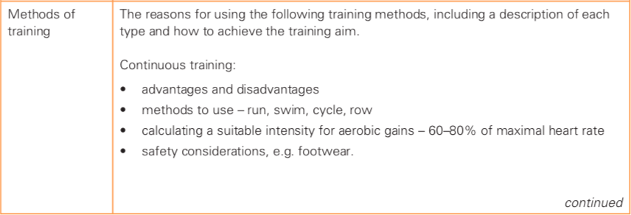
What you need to know
For more help, please visit www.exampaperspractice.co.uk
© 2025 Exams Papers Practice. All Rights Reserved

Slide 18
What you need to know
For more help, please visit www.exampaperspractice.co.uk
© 2025 Exams Papers Practice. All Rights Reserved

Slide 19
Continuous Training
Starter questions
What is continuous training?
Which components of fitness will it develop?
Does continuous training need to take the form of running?
How long should a continuous training session last?
At what intensity should an athlete work?
Are there any safety considerations?
What are the pros and cons of continuous training?
For more help, please visit www.exampaperspractice.co.uk
© 2025 Exams Papers Practice. All Rights Reserved

Slide 20
Continuous Training
“Involves continuous activity without rest intervals”
It is typically used to improve cardio-vascular endurance and muscular endurance
Cycling, running and swimming are common methods of continuous training
Should last for at least 20 minutes
Intensity can be calculated using HR… 60-80% of maximum heart-rate should be maintained in order for the athlete to make aerobic gains
HOW DO WE CALCULATE THIS?
220 – age = HRmax ...then multiply HRmax by 0.6 or 0.8 to calculate 60% or 80%
For more help, please visit www.exampaperspractice.co.uk
© 2025 Exams Papers Practice. All Rights Reserved

Slide 21
Continuous Training
Safety – Inappropriate footwear can lead to injuries such as ‘shin splints’ when running
Advantages | Disadvantages
Can be used for a variety of activities (e.g. running, swimming, cycling) | Little variation can lead to tedium (boredom)
Can be easily adapted to the individual’s needs | Limited specificity for games players due to lack of change in speed/direction
Requires little to no equipment /cheap/can be done almost anywhere
Can reduce the chance of CHD (coronary heart disease)
For more help, please visit www.exampaperspractice.co.uk
© 2025 Exams Papers Practice. All Rights Reserved

Slide 22
Continuous Training
Describe continuous training and explain the benefits of using this training method (4)
Activity is continuous and without rest intervals
It can be used for a variety of activities including running, swimming and cycling
It can be easily adapted to the individual’s needs
It requires little to no equipment and can be done almost anywhere
Helps to improve cardiovascular endurance and muscular endurance
Can help with weight loss and reduces chances of developing coronary heart disease (CHD)
For more help, please visit www.exampaperspractice.co.uk
© 2025 Exams Papers Practice. All Rights Reserved

Slide 23
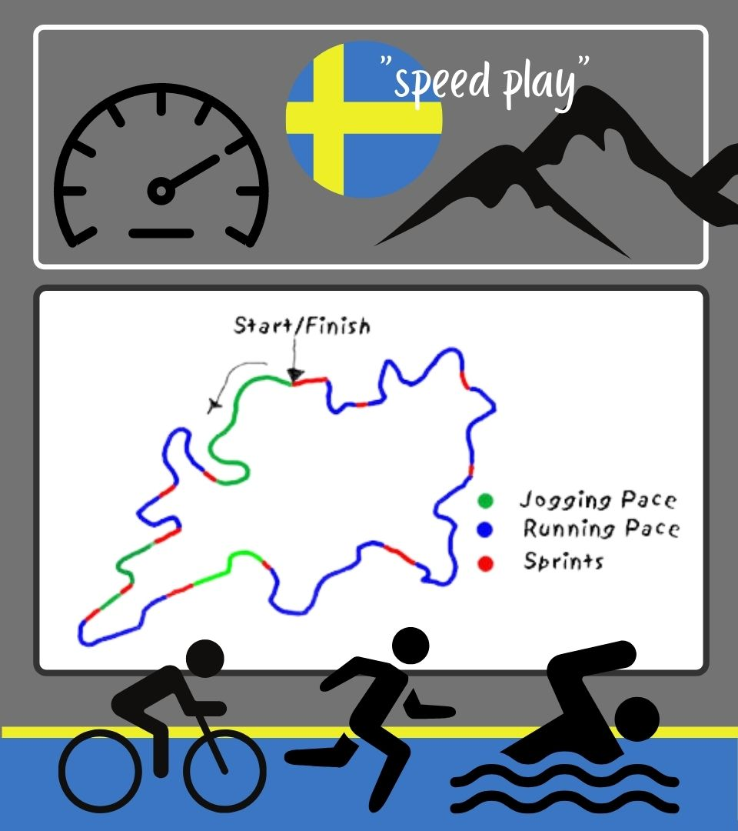
Fartlek Training
What is fartlek training and what are its key features?
Which components of fitness will it develop?
Does fartlek training need to take the form of running?
How do we measure intensity when fartlek training?
Are there any safety considerations?
What are the benefits of fartlek training?
For more help, please visit www.exampaperspractice.co.uk
© 2025 Exams Papers Practice. All Rights Reserved

Slide 24
Fartlek Training
“Fartlek means ‘speed play’ – It is a form of continuous training. Its key characteristics are variations in pace and terrain (or gradient)”
It is used to improve cardio-vascular endurance and muscular endurance (although changes in pace mean that performers can work both aerobically and anaerobically during a session)
Cycling and running are common methods of continuous training
Intensity can be measured using the RPE scale
More details on slide 13
For more help, please visit www.exampaperspractice.co.uk
© 2025 Exams Papers Practice. All Rights Reserved

Slide 25
Fartlek Training
Safety – check equipment (bicycle, footwear etc…) before use
Benefits
Can be used for a variety of activities (e.g. running, swimming, cycling)
Can be easily adapted to the individual’s needs (specificity)
Requires little to no equipment /cheap/can be done almost anywhere
Variation means that tedium is less likely to occur
Enables performers to improve both aerobic and anaerobic fitness
Suitable for games players where sprints are followed by periods of low intensity work (they require both aerobic and anaerobic fitness)
For more help, please visit www.exampaperspractice.co.uk
© 2025 Exams Papers Practice. All Rights Reserved

Slide 26
RPE (Rating of perceived exertion)
Borg’s scale of RPE is used to measure physical activity intensity level
Perceived exertion is ‘how hard you feel your body is working’
This is a more suitable measure of intensity for Fartlek training than heart rate…
…because changes in intensity mean that HR would be constantly changing throughout training…
…and therefore would be difficult to monitor
For more help, please visit www.exampaperspractice.co.uk
© 2025 Exams Papers Practice. All Rights Reserved

Slide 27
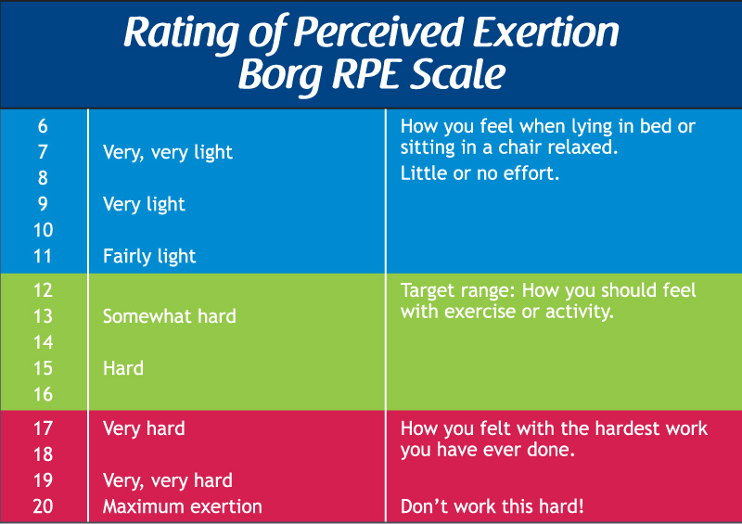
For more help, please visit www.exampaperspractice.co.uk
© 2025 Exams Papers Practice. All Rights Reserved

Slide 28
Fartlek Training
Describe Fartlek training and explain why someone would use this training type (4)
Involves varying the speed/intensity at which you perform
Can involve variations in terrain (e.g. slopes)
Can involve a variety of activities (e.g. swimming, cycling, running)
Helps to improve both aerobic and anaerobic fitness
Useful for games players who require both aerobic and anaerobic fitness
Can be easily adapted to an individual’s needs
Varied/enjoyable – (reduces tedium)
For more help, please visit www.exampaperspractice.co.uk
© 2025 Exams Papers Practice. All Rights Reserved

Slide 29
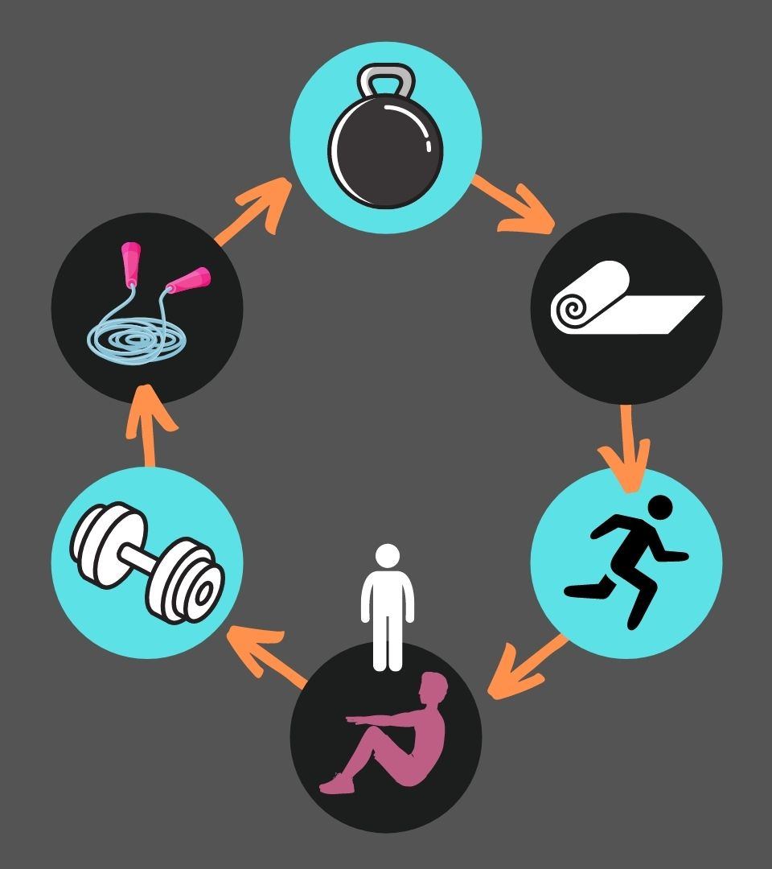
Circuit Training
What is circuit training?
How do we monitor the intensity of a circuit training session?
Are there any safety considerations?
What are the pros and cons of circuit training?
For more help, please visit www.exampaperspractice.co.uk
© 2025 Exams Papers Practice. All Rights Reserved

Slide 30
Circuit Training
“Involves a chain of different activities that can be selected to suit individual or activity requirements”
Intensity can be monitored by:
The time at each station
The number of repetitions at each station
The number of circuits completed
The length of rest periods
The weight or resistance used at a particular station
Ensure that all equipment is in good condition and suitable for the individual (e.g. weights are suitably heavy)
How could the principle of overload be used when planning circuit training?
For more help, please visit www.exampaperspractice.co.uk
© 2025 Exams Papers Practice. All Rights Reserved

Slide 31
Circuit Training
Advantages | Disadvantages
Can be used to develop a range of fitness components depending on the stations included (e.g. sit-ups for muscular endurance) | Rest periods may be too short to enable you to work maximally
Stations can be used to develop either fitness components or skills | Circuit training will not provide you with the long aerobic sessions needed to improve cardiovascular endurance
Variety of stations means that muscle groups can recover – meaning anaerobic work is possible
Intensity can be adapted to focus on anaerobic or aerobic fitness | A variety of equipment and a large work space may be needed
Rest periods can be adapted meaning circuit training can either be continuous or interval | Fatigue can lead to poor technique and increased risk of injury
Variety means tedium is less likely to occur
For more help, please visit www.exampaperspractice.co.uk
© 2025 Exams Papers Practice. All Rights Reserved

Slide 32
Circuit Training
How can circuit training be made more demanding to ensure progression is achieved over time? (2)
Increase the number of circuits
Increase the time spent at each station
Increase the number of repetitions at each station
Increase the weight or resistance used at a particular station
Decrease rest periods
Describe circuit training and outline the advantages of using this training type (4)
Refer to slide 31 and the table on slide 32 to mark your answer
For more help, please visit www.exampaperspractice.co.uk
© 2025 Exams Papers Practice. All Rights Reserved

Slide 33
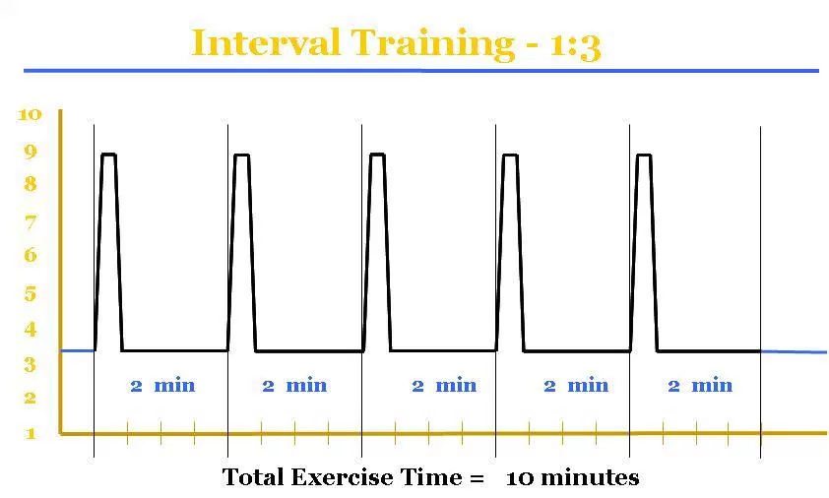
HIIT (High-intensity interval training)
For more help, please visit www.exampaperspractice.co.uk
© 2025 Exams Papers Practice. All Rights Reserved

Slide 34
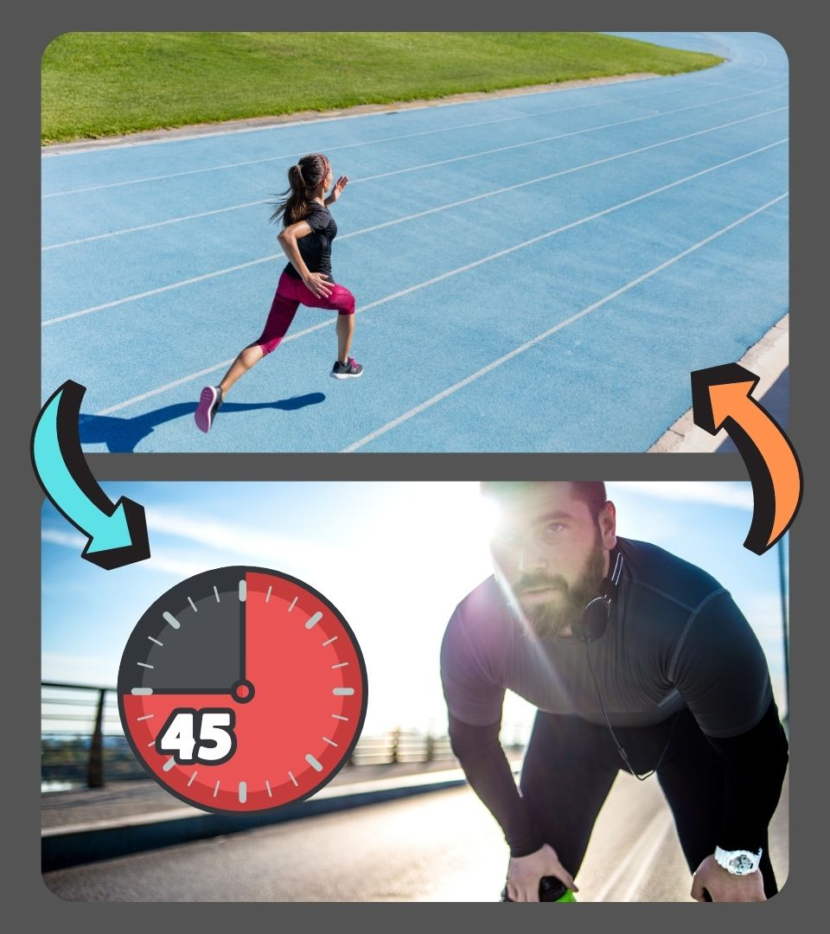
HIIT
What is HIIT?
Why are rest periods so important?
Which components of fitness will it develop?
Which activities can be used during a HIIT session?
What are the advantages and disadvantages of HIIT?
For more help, please visit www.exampaperspractice.co.uk
© 2025 Exams Papers Practice. All Rights Reserved

Slide 35
HIIT
“Involves periods of intense work followed by rest periods”
Rest periods allow waste products (carbon dioxide/ lactic acid to be removed) so that intensity can be maintained
For improvements in speed, power and general anaerobic fitness
Methods include sprinting, cycling and swimming
How could the principle of overload be applied to a HIIT programme?
For more help, please visit www.exampaperspractice.co.uk
© 2025 Exams Papers Practice. All Rights Reserved

Slide 36
HIIT
5.
Advantages | Disadvantages
Benefits games players, as they need to be able to produce repeated, high intensity bursts of activity | HIIT can become boring (tedious) leading to a loss of motivation
Develops anaerobic fitness | High levels of intensity means there is a risk of injury and overtraining
Can be used to build up a tolerance for lactic acid
Can be easily adapted for different activities (e.g. running, cycling, swimming etc…) and fitness levels | Needs to include rest periods
Little or no specialist equipment is required
HIIT can be done almost anywhere
For more help, please visit www.exampaperspractice.co.uk
© 2025 Exams Papers Practice. All Rights Reserved

Slide 37
Weight Training
What is weight training?
How are reps and sets used to conduct a weight training session?
Which components of fitness can be developed?
Are there any safety considerations?
What are the pros and cons of weight training?
For more help, please visit www.exampaperspractice.co.uk
© 2025 Exams Papers Practice. All Rights Reserved

Slide 38
Weight Training
Weight training exercises use external weights (free-weights and machines) as a resistance to work against.
A rep is a single lift (e.g. one bicep curl). A set is a number of reps performed in one go. For a given exercise, several sets are usually performed with rest periods between each.
Strength (higher weight, fewer reps), muscular endurance (lower weight, higher reps).
Lifting heavy weights carries a significant injury risk. A spotter must be present and participants should warm up thoroughly.
How could the principle of overload be applied to a weight training programme?
For more help, please visit www.exampaperspractice.co.uk
© 2025 Exams Papers Practice. All Rights Reserved

Slide 39
Weight Training
Advantages | Disadvantages
Specificity can be easily applied as athletes can adapt their sessions to focus on the components of fitness and muscle groups required by their activity | May not be accessible for all as gym fees can be expensive and specialist equipment may be required
Progression is very easy to monitor | High levels of stress placed on the muscles = high risk of injury
Variety of exercises means tedium is less likely to occur
For more help, please visit www.exampaperspractice.co.uk
© 2025 Exams Papers Practice. All Rights Reserved

Slide 40
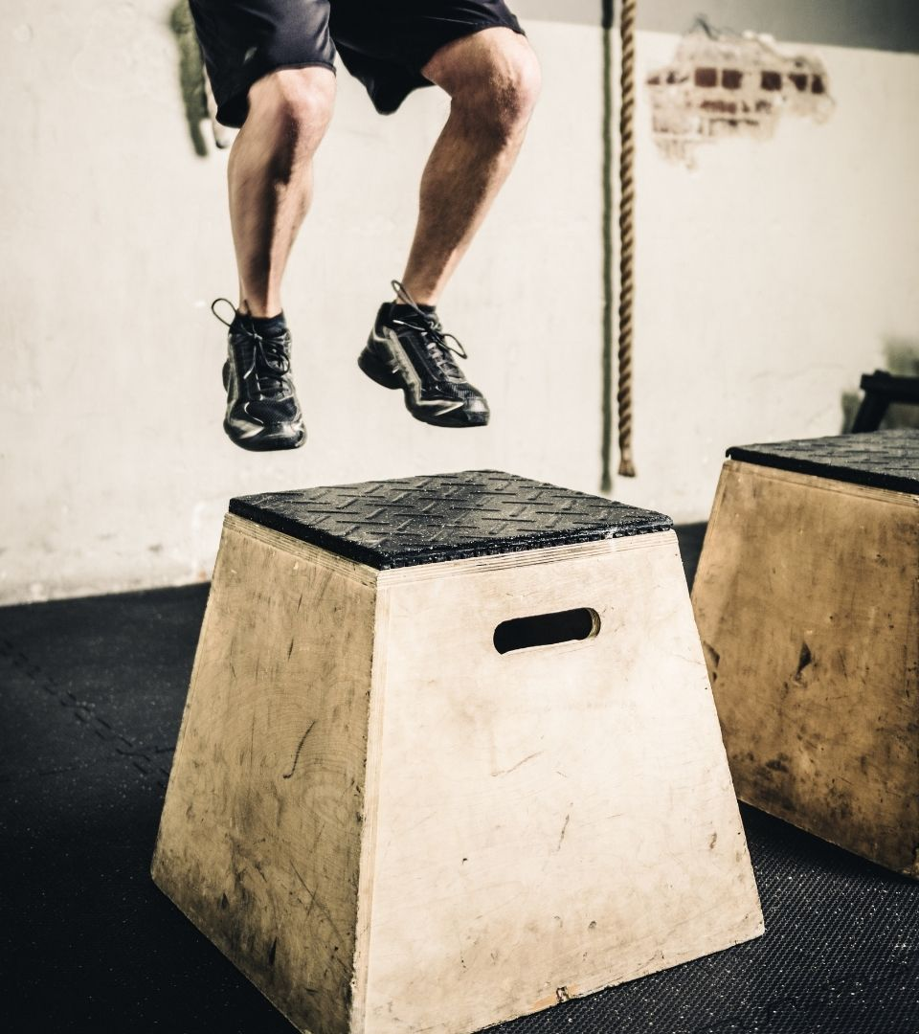
Plyometric Training
What is plyometric training?
How should a plyometric training be structured
Which athletes are likely to benefit?
What are the pros and cons of plyometric training?
For more help, please visit www.exampaperspractice.co.uk
© 2025 Exams Papers Practice. All Rights Reserved

Slide 41
Plyometric Training
Involves explosive exercises such as clap push-ups, squat-jumps and box-jumps to develop power. Exercises should include a short eccentric (or pre-loading) phase
Exercises are performed in sets, with rest periods between each so that high intensities can be maintained
Athletes who rely on producing fast, powerful movements
Long jump, triple jump, high jump
Basketball
Sprinting
Javelin, shot-put, discus
How could the principle of overload be applied to a plyometric training programme?
For more help, please visit www.exampaperspractice.co.uk
© 2025 Exams Papers Practice. All Rights Reserved

Slide 42
Plyometric Training
Advantages | Disadvantages
Over time, a greater force is created when the muscle contracts | High amount of stress placed on the muscles increases the risk of overtraining/injury
Energy is provided more rapidly | No benefits to aerobic fitness
For more help, please visit www.exampaperspractice.co.uk
© 2025 Exams Papers Practice. All Rights Reserved

Slide 43
High Altitude Training
For more help, please visit www.exampaperspractice.co.uk
© 2025 Exams Papers Practice. All Rights Reserved

Slide 44
High Altitude Training
“Specialised training at over 5000 ft above sea level to help the body increase production of red blood cells”
Oxygen levels are lower at altitude, so the working muscles are provided with less oxygen
To compensate, the body produces more red blood cells, increasing the body’s oxygen carrying capacity
This leads to an increase in VO2 max
Which improves performance in endurance events
Benefits last for 2-3 months when the athlete returns to sea-level
For more help, please visit www.exampaperspractice.co.uk
© 2025 Exams Papers Practice. All Rights Reserved

Slide 45
Disadvantages of H.A.T
It places more stress on the body
It’s not possible to train as intensively as at sea-level – this can lead to overtraining
It can have a negative effect on the immune system
There can be a loss of muscle mass as the body uses up energy reserves in the muscles
Some people experience dizziness or nausea and are unable to complete their training
Many people don’t have easy access to high altitude locations
For more help, please visit www.exampaperspractice.co.uk
© 2025 Exams Papers Practice. All Rights Reserved

Slide 46
Question - With reference to a named sporting activity, outline what continuous training is and justify why this training method is relevant to performers in that activity. (4)
1 – knowledge of the training type
Continuous – Designed to improve CV and muscular endurance
Continuous activity with no rest intervals (e.g. running, cycling, swimming)
2 – Application to chosen sporting activity (e.g. netball)
Netball is a sport that requires endurance
3 – Justifications (linked to sporting activity)
Netball players need to continuously move around the court for long periods without tiring
E.g. being able to continuously move into spaces in order to receive a pass
E.g. being able to mark a moving attacker for long periods
However, continuous training involves no rest periods and minimal changes in pace while netball does (lacks specificity)
For more help, please visit www.exampaperspractice.co.uk
© 2025 Exams Papers Practice. All Rights Reserved

Slide 47
7.3 Warming up and cooling down
Health, fitness and training
Chapter 7
Training
Learning objectives
1) Understand the physiological reasons for a warm-up and cool-down
2) Understand the psychological reasons for a warm-up and cool-down
3) Explain the phases required in a warm-up and cool-down
4) Create a warm-up and cool-down for a specific physical activity
For more help, please visit www.exampaperspractice.co.uk
© 2025 Exams Papers Practice. All Rights Reserved

Slide 48
What you need to know
For more help, please visit www.exampaperspractice.co.uk
© 2025 Exams Papers Practice. All Rights Reserved

Slide 49
Warming-up & Cooling-down
Benefits of a warm-up and cool-down can be psychological or physiological
Psychological:
Related to the mind
Activities that stimulate the mind and help the performer prepare mentally for exercise
Or to relax afterwards
Physiological:
Related to the body
Activities that help prepare the body for exercise
Or to wind-down afterwards
For more help, please visit www.exampaperspractice.co.uk
© 2025 Exams Papers Practice. All Rights Reserved

Slide 50
The phases of a warm-up
Pulse raiser
Increases HR, stroke volume & cardiac output
E.g. Running, skipping
Dynamic stretches
Increases flexibility
E.g. Lunges, squats, heel flicks
Skill familiarisation
Imitates actions of the sport
E.g. Dribbling in basketball
For more help, please visit www.exampaperspractice.co.uk
© 2025 Exams Papers Practice. All Rights Reserved

Slide 51
The phases of a cool-down
Light motor activity
5-10 minutes
Static stretches
To help muscles re-establish their normal range of movement
Breathing exercises
To aid relaxation and transition back to daily life
Light jogging/walking
To decrease body temperature and remove waste products from the muscles
5-10 minutes
Optional
For more help, please visit www.exampaperspractice.co.uk
© 2025 Exams Papers Practice. All Rights Reserved

Slide 52
Warming-up
Physiological and psychological benefits of a warm-up
Physiological benefits | Psychological benefits
Raises the body temperature – helps the muscles to become more elastic and reduces injury risk | Focuses the mind on the exercise
Increase in heart rate and breathing rate – allows more oxygen to be delivered to the working muscles via the blood, increasing energy production | Helps prepare mentally for competition
Stretches the muscles and prepares them for action | Part of the build-up to match-readiness
Gets the joints moving and increases their range of motion
Gives practice in the skills and techniques to be used in the session/game
For more help, please visit www.exampaperspractice.co.uk
© 2025 Exams Papers Practice. All Rights Reserved

Slide 53
Cooling-down
Physiological and psychological benefits of a cool-down
Physiological benefits | Psychological benefits
Helps reduce the oxygen debt and clear any lactic acid from the muscles | Gives the performer time to calm down
Allows heart rate and blood flow to reduce gradually to resting levels. This maintains oxygen delivery allowing oxygen debt to be paid back more efficiently | Helps transition to less physical daily activities
Gentle stretching reduced muscle soreness and stiffness later, helps lectic acid to be removed and prevents immediate cramps | Offers a chance to reflect on performance and determine what needs to be done to improve
Stretching helps to reduce risk of injury during the next bout of exercise
For more help, please visit www.exampaperspractice.co.uk
© 2025 Exams Papers Practice. All Rights Reserved

Slide 54
Past exam questions
Explain how a cool down after a rigorous training session can benefit a performer (3 marks)
See slide 53 for physiological and psychological benefits
What are the benefits to a performer taking part in a warm-up? (3 marks)
See slide 52 for physiological and psychological benefits
For more help, please visit www.exampaperspractice.co.uk
© 2025 Exams Papers Practice. All Rights Reserved

