Slide 1
5.1 Principles of force
Chapter 5
Simple biomechanics
Anatomy and Physiology
Learning objectives
1) Identify what is meant by force
2) Understand and apply the equation involving force, mass and
acceleration
3) Describe the effects force has on aspects of sports performance
For more help, please visit www.exampaperspractice.co.uk
© 2025 Exams Papers Practice. All Rights Reserved

Slide 2
What you need to know
For more help, please visit www.exampaperspractice.co.uk
© 2025 Exams Papers Practice. All Rights Reserved

Slide 3
What is force?
Sport employs many different forces. To be successful in sport you need to be able to apply these forces to your advantage in many different ways
Force can be applied in large quantities:
A rugby player making a tackle
A sprinter driving out of the blocks
Force can be used in a more controlled way:
A golfer playing a chip onto the green
A badminton player playing a delicate drop-shot
Force can be a push or a pull:
Pushing against the opposition when scrummaging in rugby
Pulling the oars when rowing
Force – “a push or a pulling action applied upon an object. Measured in Newtons (N)”
Isaac Newton discovered three laws that govern motion and gravity
For more help, please visit www.exampaperspractice.co.uk
© 2025 Exams Papers Practice. All Rights Reserved

Slide 4
Newton’s first law of motion
The law of inertia
“An object in motion stays in motion at the same speed and in the same direction, and an object at rest stays at rest unless acted upon by an external force”
According to the law of inertia, force is required to cause:
A stationary object / body to move
A moving object / body to change direction, accelerate or decelerate
An object / body to change shape
Inertia – “The resistance of an object to changes in motion”
For more help, please visit www.exampaperspractice.co.uk
© 2025 Exams Papers Practice. All Rights Reserved

Slide 5
Effect of force | Example from tennis
A force can cause a stationary object to move | The racquet will remain at rest until the player applies a force to start their back-swing
A force can cause a moving object to change direction | When a shot is played, the racquet exerts a force on the ball, causing it to change direction back towards the opponent
A force can cause a moving object to accelerate | When a player needs to speed up to run across the court to reach the ball, they apply a force against the ground to accelerate
A force can cause a moving object to decelerate | When the player reaches the ball, they apply a force against the ground in the opposite direction to that in which they are running, causing them to decelerate
A force can cause an object to change shape | When the ball hits the racquet, the ball will deform (change shape)
Task – provide examples from a sport of your choice to explain each effect of force
For more help, please visit www.exampaperspractice.co.uk
© 2025 Exams Papers Practice. All Rights Reserved

Slide 6
Newton’s second law of motion
The law of acceleration
“An object will accelerate when acted upon by an external force. The acceleration is proportional to the force and is in the direction by which the force acts”
The law of acceleration can be explained by the formula –
force (N) = mass (kg) x acceleration (m/s²)
The greater the force applied, the greater the acceleration
The greater the mass, the slower the object / body accelerates
F = MA
Mass – “The quantity of matter in a body (kg)”
Acceleration – “The rate at which an object changes speed (m/s²)”
For more help, please visit www.exampaperspractice.co.uk
© 2025 Exams Papers Practice. All Rights Reserved

Slide 7
Newton’s second law of motion
The law of acceleration
Questions
A ball is kicked and accelerates at 10m/s², it has a mass of 0.5kg. How much force is applied to the ball?
A sprinter weighing 90kg accelerates out of the blocks at 3m/s². How much force does the sprinter apply against the starting blocks?
A tennis ball with a mass of 0.1kg is hit with a force of 200N. How quickly does the ball accelerate?
What happens to the body or object if applied force is reduced? (e.g. a 400m runner begins to fatigue on the final straight)
F = MA
For more help, please visit www.exampaperspractice.co.uk
© 2025 Exams Papers Practice. All Rights Reserved

Slide 8
Newton’s third law of motion
The law of action and reaction
“For every action, there exists an equal and opposite reaction”
When a sprinter drives out of the blocks at the start of a race -
Their muscles exert a force of 200N against the starting blocks (downwards and backwards)
The starting blocks exert an equal force of 200N in the opposite direction to the force applied by the sprinter (upwards and forwards)
This reaction force propels the sprinter from the blocks
Question
If the sprinter has a mass of 80kg, how fast to they accelerate from the starting blocks?
For more help, please visit www.exampaperspractice.co.uk
© 2025 Exams Papers Practice. All Rights Reserved

Slide 9
5.2 Applications of force
Chapter 5
Simple biomechanics
Anatomy and Physiology
Learning objectives
1) Identify and explain the forces exerted by gravity, air resistance and
muscular force
2) Define ground resistance force and explain its importance
to sprinters
3) Draw force diagrams to illustrate the forces acting on
performers and objects in sport
For more help, please visit www.exampaperspractice.co.uk
© 2025 Exams Papers Practice. All Rights Reserved

Slide 10
What you need to know
For more help, please visit www.exampaperspractice.co.uk
© 2025 Exams Papers Practice. All Rights Reserved

Slide 11
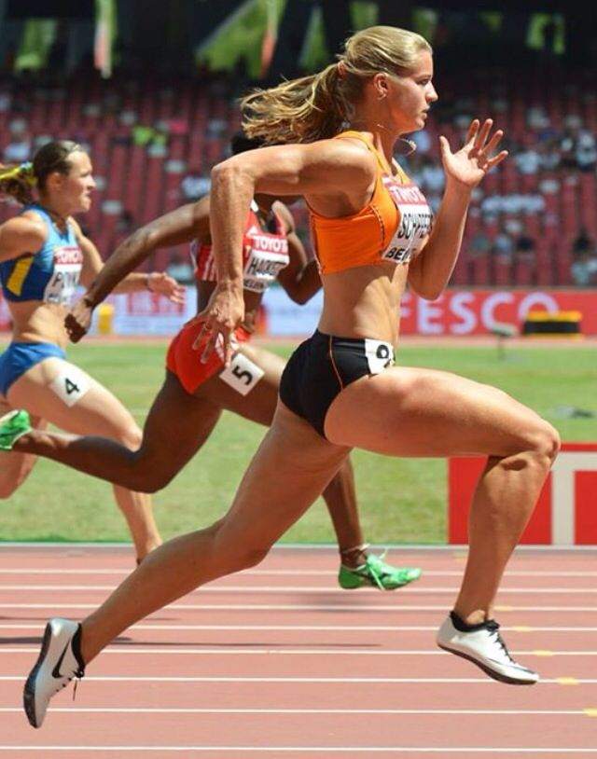
Applications of force
Task
List all the forces acting upon / applied by the sprinter
Gravity
Muscular force
Air resistance
Ground reaction force
-The size of the arrows indicates the magnitude of the force
-In this example, muscular force is greater than air resistance, causing the sprinter to accelerate
-If the forces were balanced, the sprinter would run at a constant pace (or remain stationary)
-What would happen if air resistance exceeded muscular force?
Daphne Schippers – 200m World champion (2017)
For more help, please visit www.exampaperspractice.co.uk
© 2025 Exams Papers Practice. All Rights Reserved

Slide 12
Applications of force
In order to better understand the movement patterns of a body / object, we first need to identify the forces acting in different situations
Gravity
“The force that attracts a body toward the centre of the earth”
Muscular force
“Push or pull applied to an object provided by muscular contraction”
Air resistance
”The frictional force that air applies against a moving object”
Ground reaction force
“The reaction to the force that the body exerts on the ground”
For more help, please visit www.exampaperspractice.co.uk
© 2025 Exams Papers Practice. All Rights Reserved

Slide 13
Applications of force
You need to name and describe the effect of the forces acting in three situations:
A moving performer
A sprinter in the blocks
An object in flight (a projectile)
Muscular force
Air resistance
Gravity
Ground reaction force
Air resistance
Gravity
Muscular force applied at release
Air resistance
Gravity
For more help, please visit www.exampaperspractice.co.uk
© 2025 Exams Papers Practice. All Rights Reserved

Slide 14
Applications of force
1) A moving performer
Muscular force exceeds air resistance, causing the runner to accelerate
Gravity pulls the runner down, but is balanced by an equal and opposite ground reaction force
As the runner speeds up, air-resistance increases
If muscular force and air resistance are balanced, the runner will maintain a constant speed
Muscular force lessens as the runner begins to fatigue
If air resistance exceeds muscular force, the runner will begin to decelerate (slow down)
Which of Newton’s laws can be seen in this example?
For more help, please visit www.exampaperspractice.co.uk
© 2025 Exams Papers Practice. All Rights Reserved

Slide 15
Applications of force
2) A sprinter in the blocks
Muscular force is applied by the sprinter, against the angled starting blocks
An equal and opposite ground reaction force is exerted back against the sprinter, propelling them forwards and upwards
Muscular force (and therefore ground reaction force) needs to be large enough to overcome the force of gravity
As the sprinter leaves the blocks, air resistance is low as they are still moving relatively slowly
As they accelerate, air resistance increases, until a constant pace is achieved (i.e. the forces are balanced)
Which of Newton’s laws can be seen in this example?
For more help, please visit www.exampaperspractice.co.uk
© 2025 Exams Papers Practice. All Rights Reserved

Slide 16
Applications of force
3) An object in flight (projectile)
Gravity will pull the ball towards the pitch
The free-kick taker needs to judge the correct height to clear the wall
Too much height or pace and the ball may not drop in time to hit the target
Air resistance will affect the distance and accuracy of a goal kick
The shape and surface area of an object will influence the air resistance it encounters (e.g. golf balls are less affected due to their small surface area)
Force applied at release (muscular force), will determine the distance of a lofted pass
Too little force and the pass may be intercepted. Too much force and it may run too far for a teammate to chase
For more help, please visit www.exampaperspractice.co.uk
© 2025 Exams Papers Practice. All Rights Reserved

Slide 17
Applications of force - summary
Draw and label the image with arrows to indicate the forces acting upon a performer moving at a constant pace
Muscular force
Gravity
Air resistance
Label the image with arrows to indicate the forces acting upon a performer who is accelerating
Extension task
My minimizing air resistance, the cyclist can achieve higher speeds
What can cyclists do to achieve this?
For more help, please visit www.exampaperspractice.co.uk
© 2025 Exams Papers Practice. All Rights Reserved

Slide 18
5.3 Levers
Chapter 5
Simple biomechanics
Anatomy and Physiology
Learning objectives
1) Identify and draw the three classes of lever
2) State examples of the three classes of lever in the human body
3) Describe how levers help performance in different sporting
situations
For more help, please visit www.exampaperspractice.co.uk
© 2025 Exams Papers Practice. All Rights Reserved

Slide 19
What you need to know
For more help, please visit www.exampaperspractice.co.uk
© 2025 Exams Papers Practice. All Rights Reserved

Slide 20
Levers
All movements that an athlete performs are produced by using levers within the body
A lever consists of three components
Fulcrum – a fixed point about which the lever can turn (also known as an axis or pivot)
Effort – the force required to move the load (applied by the muscles)
Resistance - the load or weight that the lever must move (person’s mass, gravity, air resistance)
Remember – the muscles provide movement at joints, by pulling on the bones to which they are attached
There are three types of lever in the body. Each has a different set of characteristics / function
For more help, please visit www.exampaperspractice.co.uk
© 2025 Exams Papers Practice. All Rights Reserved

Slide 21
Levers
Effort
Legs pushing against the ground
Fulcrum
The point about which the lever turns
Resistance
Mass, gravity, air resistance
The order of these three components determines the characteristics and function of the lever
For more help, please visit www.exampaperspractice.co.uk
© 2025 Exams Papers Practice. All Rights Reserved

Slide 22
First-class levers
E / F / R
‘Nodding the head’ is an example of a first-class lever in action
Task
-Label the diagram with the three components
-Use arrows to indicate the direction in which the force is acting
Fulcrum
Joint where cranium meets the spine
Effort
Force produced by muscles in the neck
Resistance
Weight of the head
For more help, please visit www.exampaperspractice.co.uk
© 2025 Exams Papers Practice. All Rights Reserved

Slide 23
Second-class levers
F / R / E
‘Standing on your toes’ (plantarflexion) is an example of a second-class lever in action
Task
-Label the diagram with the three components
-Use arrows to indicate the direction in which the force is acting
Effort
Force produced by the gastrocnemius muscle
Resistance
The weight of the body going through the foot
Fulcrum
Movement occurs around the joints of the toes
For more help, please visit www.exampaperspractice.co.uk
© 2025 Exams Papers Practice. All Rights Reserved

Slide 24
Third-class levers
F / E / R
A ‘bicep curl’ is an example of a third-class lever in action
Task
-Label the diagram with the three components
-Use arrows to indicate the direction in which the force is acting
Effort
Force produced by the bicep muscle
Resistance
The weight of the dumbbell, the hand and the forearm
Fulcrum
Movement occurs around the elbow joint
For more help, please visit www.exampaperspractice.co.uk
© 2025 Exams Papers Practice. All Rights Reserved

Slide 25
Levers - summary
Task Identify and describe the levers being used in each situation
For more help, please visit www.exampaperspractice.co.uk
© 2025 Exams Papers Practice. All Rights Reserved

Slide 26
Levers - summary
Name the three components of a lever (1)
Draw and label the following classes of lever:
First class lever (1)
Second class lever (1)
Third class lever (1)
Name an example of each of the following levers in the human body:
First class (1)
Second class (1)
Third class (1)
Extension
State where the effort, fulcrum and resistance are located for each of these examples
For more help, please visit www.exampaperspractice.co.uk
© 2025 Exams Papers Practice. All Rights Reserved

