Slide 1
4.1 Aerobic and anaerobic respiration
Chapter 4
Energy supply and the effects of exercise on the body
Anatomy and Physiology
Learning objectives
1) Describe the processes involved in converting food to energy
2) State the equations for both aerobic and anaerobic respiration
3) Link the use of aerobic and anaerobic respiration to different
types of physical activity
For more help, please visit www.exampaperspractice.co.uk
© 2025 Exams Papers Practice. All Rights Reserved

Slide 2
What you need to know
For more help, please visit www.exampaperspractice.co.uk
© 2025 Exams Papers Practice. All Rights Reserved

Slide 3
Energy and respiration
For everything we do we require energy (including muscular contraction / movement)
Food is digested and converted to usable energy (ATP) through a process called respiration
Glucose is one of the most important fuel sources and comes from the digestion of carbohydrates
Excess glucose is stored in the muscles and the liver as a molecule called glycogen
When we exercise, the glycogen is broken down into glucose, which is used to produce energy through respiration
Carbohydrate
Glucose
Energy (ATP)
Digestion
Respiration
For more help, please visit www.exampaperspractice.co.uk
© 2025 Exams Papers Practice. All Rights Reserved

Slide 4
Respiration
There are two main types of respiration that produce energy in different ways
Aerobic respiration
Anaerobically respiration
The type of respiration used during exercise is determined by the nature of the activity or movement being performed
There are two factors to consider -
How long we exercise for (duration)
How hard we exercise (intensity)
For more help, please visit www.exampaperspractice.co.uk
© 2025 Exams Papers Practice. All Rights Reserved

Slide 5
Aerobic respiration
“The process of producing energy involving oxygen”
glucose + oxygen → carbon dioxide + water (+ energy)
Aerobic respiration
Produces energy for long periods of time but,
is a complex process that produces energy slowly
This means that when exercise intensity increases, aerobic respiration can no longer meet the energy demand
Suitable for activities that are –
High duration
Low / moderate intensity
Where does the CO2 go?
For more help, please visit www.exampaperspractice.co.uk
© 2025 Exams Papers Practice. All Rights Reserved

Slide 6
Anaerobic respiration
“The process of producing energy without oxygen”
glucose → lactic acid (+ energy)
Aerobic respiration
Produces energy very quickly so it can meet with the demands of high-intensity exercise
Produces only a small amount of energy, meaning high-intensity activity can only be sustained for short periods
Lactic acid is also produced, which contributes to fatigue
Suitable for activities that are –
High intensity
Low duration
The extra oxygen is needed to break down lactic acid is known as the ‘oxygen debt’. This is only possible by reducing intensity or resting
For more help, please visit www.exampaperspractice.co.uk
© 2025 Exams Papers Practice. All Rights Reserved

Slide 7
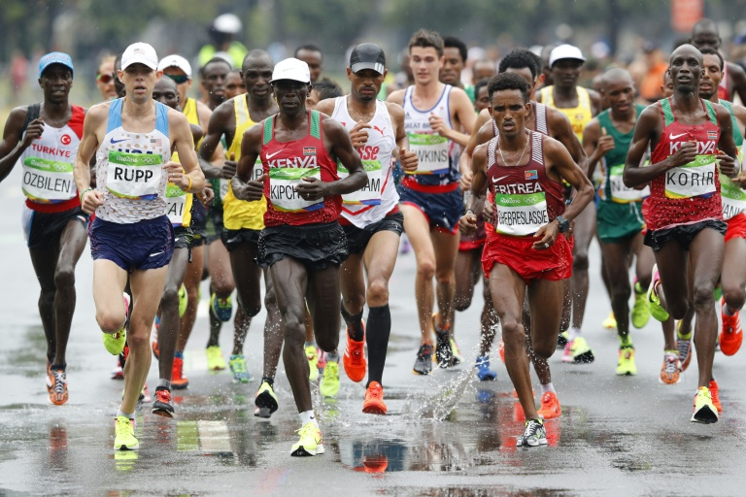
Aerobic? Anaerobic? Why?
For each of the following examples
State whether the activity is more aerobic or anaerobic
Explain why
For more help, please visit www.exampaperspractice.co.uk
© 2025 Exams Papers Practice. All Rights Reserved

Slide 8
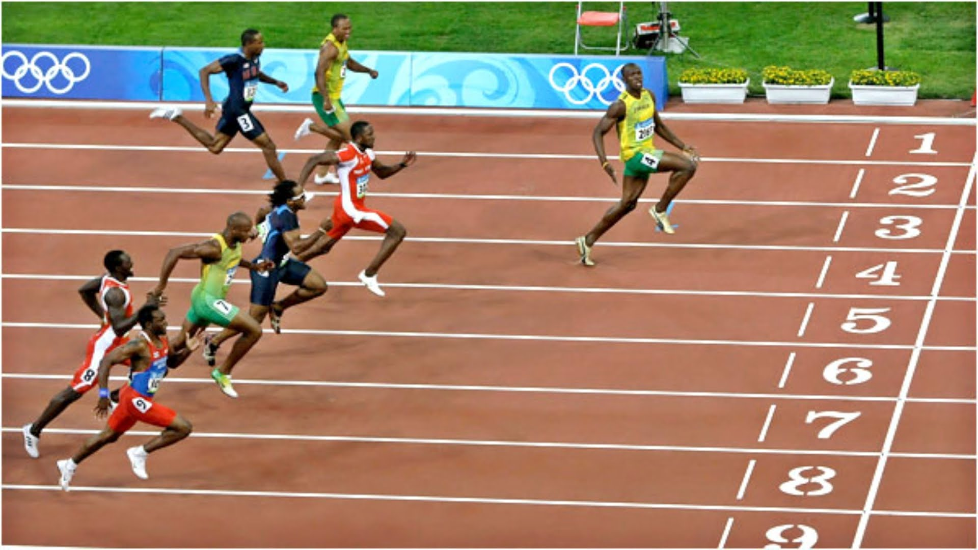
For more help, please visit www.exampaperspractice.co.uk
© 2025 Exams Papers Practice. All Rights Reserved

Slide 9
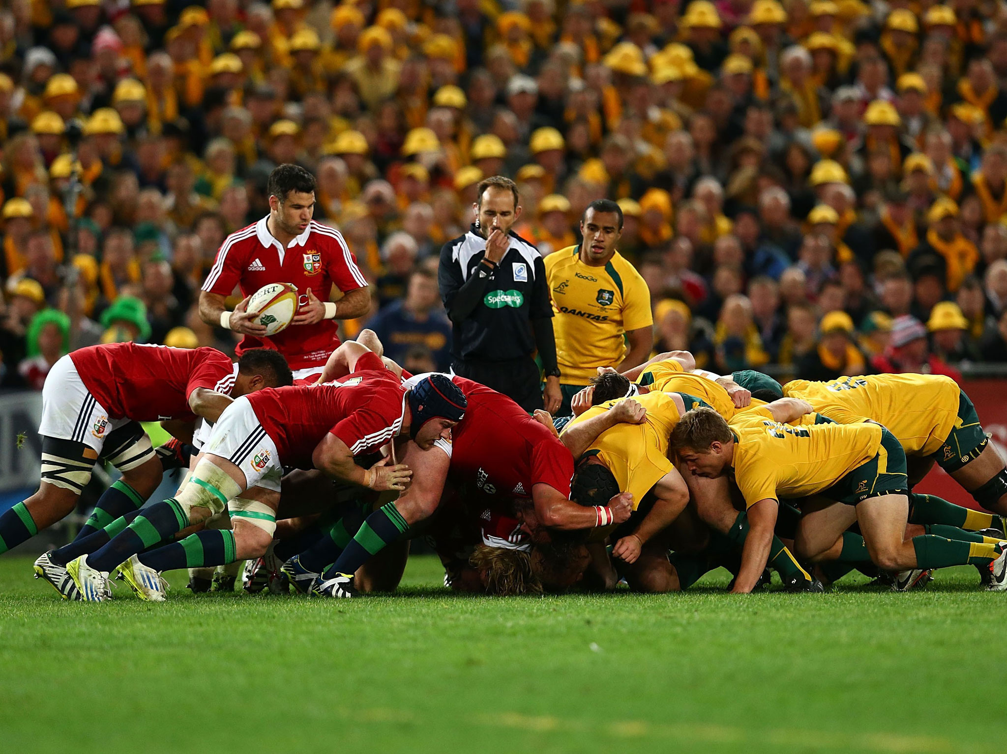

Slide 10
For more help, please visit www.exampaperspractice.co.uk
© 2025 Exams Papers Practice. All Rights Reserved

Slide 11
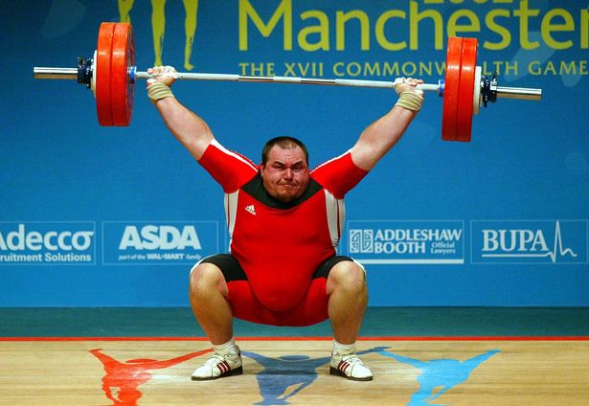
For more help, please visit www.exampaperspractice.co.uk
© 2025 Exams Papers Practice. All Rights Reserved

Slide 12
For more help, please visit www.exampaperspractice.co.uk
© 2025 Exams Papers Practice. All Rights Reserved

Slide 13
For more help, please visit www.exampaperspractice.co.uk
© 2025 Exams Papers Practice. All Rights Reserved

Slide 14
For more help, please visit www.exampaperspractice.co.uk
© 2025 Exams Papers Practice. All Rights Reserved

Slide 15
Aerobic and anaerobic respiration
-Marathon runners may increase their pace for a sprint finish
-The higher intensity demands a faster rate of energy production
-Anaerobic respiration provides the additional energy required
Is Marathon running ever not aerobic?
-Netball involves high intensity movements such as jumping and sprinting into space (anaerobic)
-But netballers constantly move around, adjusting their court position even when not directly involved in the action
-Aerobic respiration provides energy for this lower intensity movement, enabling netballers to stay mobile for the entire game
Is Netball ever not anaerobic?
For more help, please visit www.exampaperspractice.co.uk
© 2025 Exams Papers Practice. All Rights Reserved

Slide 16
True or false
Anaerobic respiration uses oxygen to produce energy
Anaerobic respiration provides energy for low intensity activities
Anaerobic respiration can only provide energy for short durations
Aerobic respiration provides energy for low intensity activities
Anaerobic respiration provides energy for high duration activities
Aerobic respiration provides the majority of the energy for a marathon runner
Lactic acid is produced as a waste product of anaerobic respiration
Anaerobic respiration produces carbon dioxide (CO2) as a waste product
Water is a product of aerobic respiration
Aerobic respiration produces energy very quickly
Anaerobic respiration produces energy slowly
ANSWERS – F / F / T / T / F / T / T / F / T / T / F / F

Slide 17
Past exam questions
State whether marathon runners rely more on aerobic or anaerobic respiration while performing and explain why (3 marks)
Using examples from sport or physical activity, describe the differences between aerobic and anaerobic respiration (6 marks)

Slide 18
Past exam questions Mark scheme
State whether marathon runners rely more on aerobic or anaerobic respiration while performing and explain why (3 marks)
Aerobic respiration
Marathon is a long (high duration) event / aerobic respiration can continue to provide energy for long durations / there are no fatiguing bi-products
Marathon is a low-moderate intensity event / aerobic respiration produces energy slowly
For more help, please visit www.exampaperspractice.co.uk
© 2025 Exams Papers Practice. All Rights Reserved

Slide 19
Past exam questions Mark scheme
Using examples from sport or physical activity, describe the differences between aerobic and anaerobic respiration (6 marks)
Activities that require aerobic respiration
Aerobic respiration (the process of producing energy with oxygen / equation)
E.g. Marathon running (or other relevant examples)
High duration (produces energy for long periods of time)
Low intensity (cannot produce energy quickly)
Activities that require anaerobic respiration =
Anaerobic respiration (the process of producing energy without oxygen / lactic acid is produced as a bi-product / equation)
E.g. Marathon running (or other relevant examples)
High intensity (produces energy quickly)
Low duration (fuel stores are quickly depleted / fatiguing effect of lactic acid)
Ensure you use language that makes a comparison between aerobic and anaerobic (e.g. where as, on the other hand)
The way you structure your answers is important!
For more help, please visit www.exampaperspractice.co.uk
© 2025 Exams Papers Practice. All Rights Reserved

Slide 20
Example answer
Aerobic respiration uses oxygen to produce energy. It is suitable for high duration, low intensity activities such as marathon running. This is because it produces energy slowly, but for long periods of time.
In contrast, anaerobic respiration produces energy without oxygen. It is suitable for high intensity, low duration activities such as the 100m sprint. This is because it produces energy very quickly, but only for short periods of time. It also produces lactic acid as a waste product which causes fatigue.
Core knowledge
Define / describe key term
E.g.
Link to example
For more help, please visit www.exampaperspractice.co.uk
© 2025 Exams Papers Practice. All Rights Reserved

Slide 21
4.2 Recovery
Chapter 4
Energy supply and the effects of exercise on the body
Anatomy and Physiology
Learning objectives
1) Know why the body experiences an oxygen debt after strenuous
exercise
2) Explain how oxygen removes lactic acid from the body
3) Explain how ‘EPOC’ can be achieved
4) Outline the factors affecting recovery time
For more help, please visit www.exampaperspractice.co.uk
© 2025 Exams Papers Practice. All Rights Reserved

Slide 22
What you need to know
For more help, please visit www.exampaperspractice.co.uk
© 2025 Exams Papers Practice. All Rights Reserved

Slide 23
Recovery
Anaerobic respiration
glucose → lactic acid (+ energy)
When exercising at high intensities, lactic acid is produced as a bi-product of anaerobic respiration
The lactic acid builds up causing fatigue and must be removed in order for the muscles to function correctly again

Slide 24
Oxygen debt and ‘EPOC’
After intense exercise, the body requires more oxygen than is normally needed to remove the lactic acid in the cells
Oxygen debt
“A temporary oxygen shortage in the tissues arising from exercise”
The amount of oxygen needed to break down the lactic acid and return the body to normal
Excess post exercise oxygen consumption (EPOC)
“The process of taking in additional oxygen to remove the lactic acid created by anaerobic respiration”
This is achieved by maintaining an elevated cardiac output and minute ventilation after anaerobic exercise
This is why you breathe heavily and have an elevated heart rate after the 100m sprint
Q = HR x SV
MV = breathing rate x tidal volume
For more help, please visit www.exampaperspractice.co.uk
© 2025 Exams Papers Practice. All Rights Reserved

Slide 25
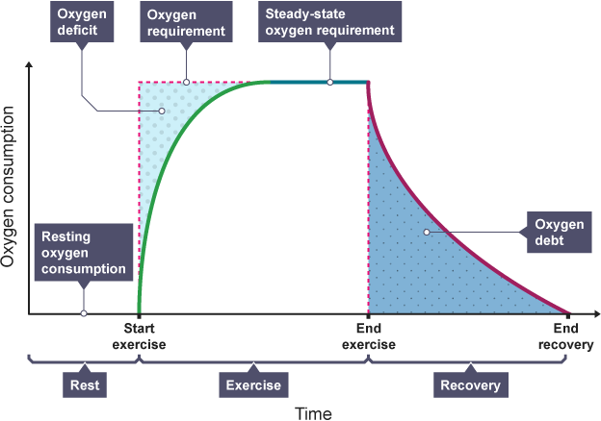
Oxygen debt
The graph demonstrates that O2 consumption remains high during recovery (through EPOC)
The area under the line is the oxygen debt that needs to be repaid.
For more help, please visit www.exampaperspractice.co.uk
© 2025 Exams Papers Practice. All Rights Reserved

Slide 26
Lactic acid removal
The process by which the body uses the additional oxygen provided through EPOC to break down lactic acid and repay the oxygen debt is as follows –
Lactic acid + oxygen → water + carbon dioxide + glucose
Oxygen is used to convert lactic acid into -
Water
Used elsewhere in the body or excreted in urine
Carbon dioxide
Transported to the lungs by the blood and exhaled
Glucose
Can be re-used by the muscles to produce energy
For more help, please visit www.exampaperspractice.co.uk
© 2025 Exams Papers Practice. All Rights Reserved

Slide 27
Past exam question
1) Describe the term ‘oxygen debt’ and explain how the body pays back the oxygen debt after exercise (4 marks)
Describe
Oxygen debt is the amount of oxygen needed to break down lactic acid
Following intense exercise / caused by anaerobic respiration
Explain
The body takes in more oxygen after exercise / EPOC
Elevated cardiac output / heart rate / stroke volume / minute ventilation / breathing rate / minute ventilation
Additional oxygen is used to break down the lactic acid
Lactic acid is broken down into water, carbon dioxide and glucose
For more help, please visit www.exampaperspractice.co.uk
© 2025 Exams Papers Practice. All Rights Reserved

Slide 28
Factors affecting recovery time
Age
Older people tend to take longer to recover after exercise
Overall strength and fitness
The stronger your muscles are, the quicker they will be at absorbing the oxygen needed to remove lactic acid
Genetics
Some people inherit from their parents the ability to recover more quickly from exercise
For more help, please visit www.exampaperspractice.co.uk
© 2025 Exams Papers Practice. All Rights Reserved

Slide 29
Factors affecting recovery time
Gender
There is a gender difference in fatigue and recovery
Studies have shown that fit women tend to have a greater resistance to fatigue than men, especially at low to moderate intensities
Level of aerobic fitness
Stronger cardiovascular and respiratory systems deliver oxygen and remove waste products more efficiently
Sleep
Good sleep helps the body to recover physically and mentally
For more help, please visit www.exampaperspractice.co.uk
© 2025 Exams Papers Practice. All Rights Reserved

Slide 30
Speeding up recovery
Hot and cold contrast therapy
Alternately apply heat (via heat packs or a hot bath) and cold (via ice baths or packs)
Improving blood flow and reducing inflammation
Massage therapy
Massage helps to improve blood flow and relax the muscles
For more help, please visit www.exampaperspractice.co.uk
© 2025 Exams Papers Practice. All Rights Reserved

Slide 31
4.3 Short-term effects of exercise
Chapter 4
Energy supply and the effects of exercise on the body
Anatomy and Physiology
Learning objectives
1) Identify the immediate effects of exercise on the body
2) Describe what happens to the body during exercise
3) Explain the negative effects that impair performance
For more help, please visit www.exampaperspractice.co.uk
© 2025 Exams Papers Practice. All Rights Reserved

Slide 32
What you need to know
For more help, please visit www.exampaperspractice.co.uk
© 2025 Exams Papers Practice. All Rights Reserved

Slide 33
Short term effects of exercise
Starter activity
Complete one minute of intense physical activity (e.g. jumping jacks / rope skipping / shuttle runs)
How did your body respond to the exercise?
Record as many short-term effects as you can think of
Heart rate
Breathing rate
Tidal volume (increased depth of breathing)
Temperature increase
Reddening of skin
Sweating
Fatigue
Lactic acid accumulation
Nausea
Light-headedness
Explain the effects if you can
Oxygen demand increases
Temperature regulation
Fuel depletion
Anaerobic respiration
Changes in blood flow
For more help, please visit www.exampaperspractice.co.uk
For more help, please visit www.exampaperspractice.co.uk
© 2025 Exams Papers Practice. All Rights Reserved
© 2025 Exams Papers Practice. All Rights Reserved

Slide 34
Short term effects of exercise
Heart rate
To deliver more oxygen to the working muscles to turn glucose into energy
Adrenaline is produced, causing the heart to beat faster
Stroke volume also increases leading to a greater cardiac output
Breathing rate
To enable more oxygen to enter the bloodstream via the lungs
To meet the increased energy demand in the muscles
Tidal volume also increases leading to a greater minute ventilation
For more help, please visit www.exampaperspractice.co.uk
© 2025 Exams Papers Practice. All Rights Reserved

Slide 35
Short term effects of exercise
Temperature increase
Temperature increases due to muscular contraction and respiration
Muscles lose their function when the body becomes too hot
Reddening of skin
To control temperature, the blood vessels close to the skin become enlarged
This allows heat to be lost through radiation
Sweating
Sweat evaporates from the skin, taking body heat with it
This is effective, as water is 25 times better at conducting heat than air
For more help, please visit www.exampaperspractice.co.uk
© 2025 Exams Papers Practice. All Rights Reserved

Slide 36
Short term effects of exercise
Fatigue
Occurs quickly during anaerobic activities due to lactic acid production and fuel depletion
Occurs in aerobic activities only when the body begins to run out of glucose, slowing the rate of energy production
Nausea
A feeling of sickness or an inclination to vomit
As blood is diverted away from the digestive system and towards the working muscles where the demand for oxygen is greater
Dehydration or drinking too much can also lead to nausea
For more help, please visit www.exampaperspractice.co.uk
© 2025 Exams Papers Practice. All Rights Reserved

Slide 37
Short term effects of exercise
Light-headedness
During exercise, blood vessels enlarge as the heart works harder to pump blood around the body
After exercise the blood pressure drops as it takes time for the blood vessels to return to their original size
This can affect blood-flow to the brain
Treatment
-Deep breathing to increase oxygen uptake
-Lying down and raising your legs helps
blood to flow back to the heart due to
gravity
-Increasing oxygen delivery to the brain
For more help, please visit www.exampaperspractice.co.uk
© 2025 Exams Papers Practice. All Rights Reserved

Slide 38
Short term effects of exercise - summary
Match each short term effect of exercise with the correct explanation
 | Short-term effect of exercise |  | Explanation
1 | Heart rate increase | a | Lactic acid is produced during anaerobic exercise, affecting muscle function. Glucose starts to run out after long periods of aerobic activity.
2 | Breathing rate increase | b | Blood vessels close to the skin become enlarged, increasing blood flow and therefore heat loss through radiation.
3 | Temperature increase | c | Blood pressure can drop after exercise due to enlarged blood vessels. This can affect oxygen delivery to the brain.
4 | Reddening of skin | d | Muscular contraction and respiration both give off heat as a bi-product.
5 | Sweating | e | Blood is transported to the working muscles at a faster rate, providing more oxygen (in order to produce energy from glucose) and speeding up the removal of waste products.
6 | Fatigue | f | More oxygen enters the bloodstream via the lungs, to be transported to the working muscles.
7 | Nausea | g | Sweat evaporates from the skin, taking body heat with it.
8 | Light headedness | h | Blood is diverted away from the digestive system to deliver more oxygen to the working muscles during exercise.
1-e / 2-f / 3-d / 4-b / 5-g / 6-a / 7-h / 8-c
For more help, please visit www.exampaperspractice.co.uk
© 2025 Exams Papers Practice. All Rights Reserved

Slide 39
4.4 Long-term effects of exercise
Chapter 4
Energy supply and the effects of exercise on the body
Anatomy and Physiology
Learning objectives
1) Identify what happens to the heart after training for a
period of time
2) Understand the effects that changes to the heart have on
the body
3) Understand how blood is able to tolerate lactic acid
For more help, please visit www.exampaperspractice.co.uk
© 2025 Exams Papers Practice. All Rights Reserved

Slide 40
What you need to know
For more help, please visit www.exampaperspractice.co.uk
© 2025 Exams Papers Practice. All Rights Reserved

Slide 41
Long term effects of exercise
People train their bodies to become fitter
Long-term exercise causes changes in the body that lead to improvements in fitness
Long periods of training can have the following effects:
Increased heart size (cardiac hypertrophy)
A lower resting heart rate
An increased stroke volume
A greater tolerance of lactic acid
For more help, please visit www.exampaperspractice.co.uk
© 2025 Exams Papers Practice. All Rights Reserved

Slide 42
Heart size
Long term aerobic exercise
Stresses the heart, causing it to the muscular walls to become thicker
and the chambers to increase in size (particularly the ventricles)
This means that the heart can contract more forcefully
and the heart can hold more blood, leading to an increased stroke volume
Blood is transported to the working muscles more efficiently,
delivering more oxygen and allowing athletes to work harder for longer
Hypertrophy – “increase in size of muscle”
Cardiac hypertrophy – “The process whereby the muscular walls of the heart get thicker and stronger as a result of training”
Why?
For more help, please visit www.exampaperspractice.co.uk
© 2025 Exams Papers Practice. All Rights Reserved

Slide 43
Resting heart rate
Long-term training leads to an increased stroke volume
Cardiac hypertrophy
As the heart is capable of ejecting more blood per beat, it doesn’t need to beat as quickly to achieve the same cardiac output
Q = SV x HR
Trained endurance athletes therefore often have a low resting heart rate
Bradycardia – “A lower than normal resting heart rate (fewer than 60bpm)”
For more help, please visit www.exampaperspractice.co.uk
© 2025 Exams Papers Practice. All Rights Reserved

Slide 44
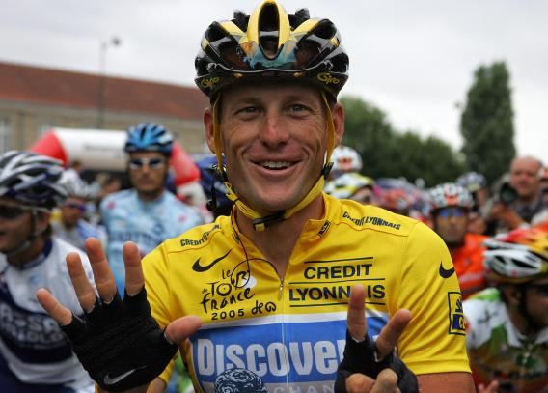
Bradycardia
Lance Armstrong reportedly had a resting HR of 32 BPM when in peak condition
It has been estimated that his heart was up to 40% larger than the average male
Are sprinters and other power athletes likely to develop bradycardia?
For more help, please visit www.exampaperspractice.co.uk
© 2025 Exams Papers Practice. All Rights Reserved

Slide 45
Lactic acid tolerance
Lactic acid is a bi-product of anaerobic respiration
Anaerobic training methods such as high intensity interval training (HIIT) forces athletes to produce lots of lactic acid
Over time, athletes become more tolerant to its fatiguing effects and are able to remove it more quickly
Meaning athletes take longer to fatigue and can recover faster
Which athletes might benefit from this adaptation?
For more help, please visit www.exampaperspractice.co.uk
© 2025 Exams Papers Practice. All Rights Reserved

Slide 46
Past exam question
Explain how an increase in heart size might be beneficial for performance (3 marks)
Muscular walls become thicker / ventricles increase in size
Stroke volume increases / more blood can be ejected from the heart per beat
More blood is transported / cardiac output increases
More oxygen is delivered to the working muscles / waste products are removed more efficiently
Athletes can exercise at higher intensities for longer
Beneficial for aerbic or endurance athletes / relevant example from sport
For more help, please visit www.exampaperspractice.co.uk
© 2025 Exams Papers Practice. All Rights Reserved

