Slide 1
3.1 Components of blood
Chapter 3
The circulatory system
Anatomy and Physiology
Learning objectives
1) Identify the different components of blood
2) Understand the role of haemoglobin
3) Describe the structure of the blood vessels and their
functions
For more help, please visit www.exampaperspractice.co.uk
© 2025 Exams Papers Practice. All Rights Reserved

Slide 2
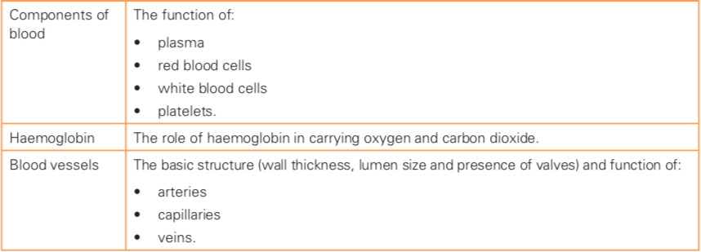
What you need to know
For more help, please visit www.exampaperspractice.co.uk
© 2025 Exams Papers Practice. All Rights Reserved

Slide 3
What is the circulatory system?
Write down everything you can think of that relates to the term
Circulatory system
?
For more help, please visit www.exampaperspractice.co.uk
© 2025 Exams Papers Practice. All Rights Reserved

Slide 4
The circulatory system
“The body’s transport system that consists of the lungs, heart, blood vessels and blood”
The body relies upon the circulatory system to transport oxygen and nutrients (via oxygenated blood) to the tissues,
and to remove waste and carbon dioxide from the cells (via deoxygenated blood)
The blood
plays an essential role in transporting gasses, nutrients and waste products, but also has some other functions
For more help, please visit www.exampaperspractice.co.uk
© 2025 Exams Papers Practice. All Rights Reserved

Slide 5
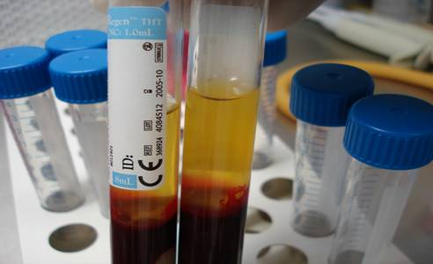
The components of blood
Blood samples spun in a centrifuge machine separate, with the heavier components moving to the bottom
There are 4 main components of the blood
Plasma
Red blood cells
White blood cells
Platelets
For more help, please visit www.exampaperspractice.co.uk
© 2025 Exams Papers Practice. All Rights Reserved

Slide 6
The components of blood
Plasma
-Consists mainly of water
-This allows substances (such as gasses, nutrients, waste products and other blood components) to be easily transported
Red blood cells
-Transport oxygen
-They contain a substance called haemoglobin, which reacts with oxygen to form oxyhaemoglobin
Haemoglobin – a chemical responsible for transporting oxygen in the blood
For more help, please visit www.exampaperspractice.co.uk
© 2025 Exams Papers Practice. All Rights Reserved

Slide 7
The components of blood
White blood cells
-Part of the immune system
-Defend the body against pathogens (disease causing organisms)
Platelets
-Cause the blood to clot
-Preventing excessive bleeding when damage to blood vessels occurs
For more help, please visit www.exampaperspractice.co.uk
© 2025 Exams Papers Practice. All Rights Reserved

Slide 8
Blood transportation
The transportation of oxygenated blood to the cells and waste products away from the cells, is made possible through a network of blood vessels
There are three groups of blood vessels, each designed to perform a specific function -
Arteries
Veins
Capillaries
https://www.youtube.com/watch?v=CsLyOBA2jiU
For more help, please visit www.exampaperspractice.co.uk
© 2025 Exams Papers Practice. All Rights Reserved
Notes:
Video – see ‘lesson resources’

Slide 9
The blood vessels
Lumen – the passageway inside the blood vessel
Arteries
-Transport blood away from the heart (oxygenated blood to the body)
-They have a narrow lumen and thick muscular walls
-Blood pressure in the arteries is high due to the pumping action of the heart
Veins
-Transport blood to the heart (deoxygenated blood)
-Blood pressure is lower
-so veins have thinner walls and a larger lumen
-Veins also contain valves
Valves – prevent the blood from flowing backwards in veins

Slide 10
The blood vessels
Capillaries
-Tiny blood vessels that form a network throughout the body’s tissues
-Blood flows into the capillaries from the arteries, where oxygen and nutrients are extracted
-Deoxygenated blood flows back into the veins carrying waste
-Capillary walls are one cell thick, for efficient gaseous exchange
Capillary walls are one-cell-thick for gaseous exchange
For more help, please visit www.exampaperspractice.co.uk
© 2025 Exams Papers Practice. All Rights Reserved

Slide 11
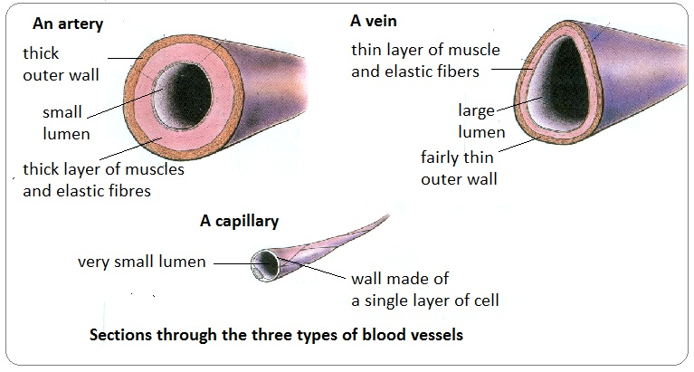
a is for artery that travels away from the heart
veins carry blood into the heart and contain valves
For more help, please visit www.exampaperspractice.co.uk
© 2025 Exams Papers Practice. All Rights Reserved

Slide 12
Blood vessels - summary
 | Artery | Vein | Capillary
Lumen size | Small | Large | Very small
Thickness of walls | Thick | Thin | One cell thick
Where is it taking the blood? | Away from the heart | Toward the heart | To the cells / tissues
Any other features | Blood pressure is high | Contain valves to prevent backflow | Form large networks in tissues
 | Artery | Vein | Capillary
Lumen size | 1 | 2 | 3
Thickness of walls | 4 | 5 | 6
Where is it taking the blood? | 7 | 8 | 9
Any other features | 10 | 11 | 12
Task – In pairs, take it in turns to select a number for each other. Describe and explain according to the number. If correct you gain 1 point. Continue until all boxes are complete.
For more help, please visit www.exampaperspractice.co.uk
© 2025 Exams Papers Practice. All Rights Reserved

Slide 13
3.2 Heart structure and function
Chapter 3
The circulatory system
Anatomy and Physiology
Learning objectives
1) Identify the locations of each section of the heart
2) Describe the functions of the atria, ventricles and valves
3) Describe the pathway of blood through the heart
For more help, please visit www.exampaperspractice.co.uk
© 2025 Exams Papers Practice. All Rights Reserved

Slide 14
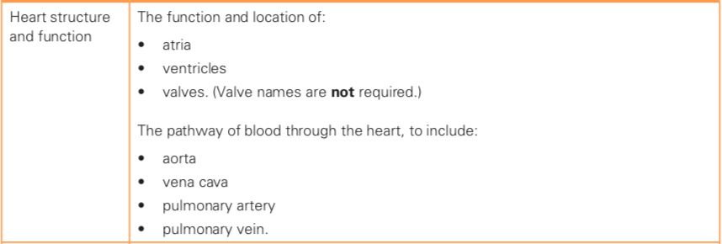
What you need to know

Slide 15
Heart structure and function
Now we understand the function of the blood and the blood vessels
But how does the blood move through the network of blood vessels to its destinations?
The heart
A muscular organ that fills with blood (returning from the body in the veins) and contracts (to force blood away through the arteries)
For more help, please visit www.exampaperspractice.co.uk
© 2025 Exams Papers Practice. All Rights Reserved

Slide 16
The anatomy of the heart
Heart structures
-Atria
-Ventricles
-Valves
-Aorta
-Pulmonary Vein
-Pulmonary Artery
-Vena Cava
Double circulation
-The heart has a double pump
-pulmonary circuit (right side), pumps blood to the lungs and back to the heart
-systemic circuit (left side), pumps blood to the body and back to the heart
For more help, please visit www.exampaperspractice.co.uk
© 2025 Exams Papers Practice. All Rights Reserved

Slide 17
The chambers of the heart
Atria (left and right)
These chambers sit above the ventricles
Receive blood from the body (systemic circuit) and the lungs (pulmonary circuit)
Deliver blood downward, into the ventricles
Ventricles (left and right)
Receive blood from the atria
When they contract, blood is forced to the body (systemic circuit) and lungs (pulmonary circuit)
They have thick muscular walls to force blood away from the heart at high pressure
The heart consists of four chambers (2 atria and 2 ventricles)
For more help, please visit www.exampaperspractice.co.uk
© 2025 Exams Papers Practice. All Rights Reserved

Slide 18
The valves of the heart
Valves are important as they prevent the backflow of blood, ensuring it only moves in the intended direction
Two atrio-ventricular valves
-Sit between the atria and ventricles
-Prevent blood from flowing back into the atria when the ventricles contract
Two semi-lunar valves
-At the entrance to the arteries that transport blood away from the ventricles (the aorta and the pulmonary artery)
-Prevent blood from flowing back into the ventricles
For more help, please visit www.exampaperspractice.co.uk
© 2025 Exams Papers Practice. All Rights Reserved

Slide 19
The blood vessels of the heart
Veins
The Pulmonary Vein
Carries oxygenated blood back from the lungs (pulmonary circuit) to the left atrium
The Vena Cava
Carries deoxygenated blood back from the body (systemic circuit) to the right atrium
Arteries
The Pulmonary Artery
Carries deoxygenated blood away from the right ventricle to the lungs (pulmonary circuit)
The aorta
Carries oxygenated blood away from the left ventricle to the body (systemic circuit)
Two veins transport blood back to the heart and two arteries carry it away
For more help, please visit www.exampaperspractice.co.uk
© 2025 Exams Papers Practice. All Rights Reserved

Slide 20
The pathway of blood
Deoxygenated blood from body (systemic circuit)
Flows through the vena cava (vein)
Into the right atrium
The right atrium contracts
Forcing blood through the valve
Into the right ventricle
The right ventricle contracts
Forcing blood through the valve
Into the pulmonary artery
To the lungs (pulmonary circuit)
Where blood becomes oxygenated (as haemoglobin binds with oxygen forming oxyhaemoglobin)
For more help, please visit www.exampaperspractice.co.uk
© 2025 Exams Papers Practice. All Rights Reserved

Slide 21
The pathway of blood
Oxygenated blood from the lungs (pulmonary circuit)
Flows through the pulmonary vein
Into the left atrium
The left atrium contracts
Forcing blood through the valve
Into the left ventricle
The left ventricle contracts
Forcing blood through the valve
Into the aorta (artery)
To the body (systemic circuit)
Where blood becomes deoxygenated (as oxygen is released from haemoglobin into the cells)

Slide 22
The pathway of blood - summary
Write the statements in
correct order beginning with ‘i’
f) Into left ventricle
Into right atrium
g) To body
b) Through vena cava
i,b,a,c,h,j,d,f,e,g
h) Through pulmonary artery
c) Into right ventricle
i) Deoxygenated blood from the body
d) Into left atrium
j) Through pulmonary vein
e) Through aorta
Can you also identify when the blood passes through the valves?
For more help, please visit www.exampaperspractice.co.uk
© 2025 Exams Papers Practice. All Rights Reserved
Notes:
Can students also add the valves?!

Slide 23
3.3 Cardiac output
Chapter 3
The circulatory system
Anatomy and Physiology
Learning objectives
1) Explain the terms ‘heart rate’, ‘stroke volume’ and ‘cardiac
output’,
2) Identify how cardiac output can be calculated
For more help, please visit www.exampaperspractice.co.uk
© 2025 Exams Papers Practice. All Rights Reserved

Slide 24
What you need to know
For more help, please visit www.exampaperspractice.co.uk
© 2025 Exams Papers Practice. All Rights Reserved

Slide 25
Cardiovascular fitness
Cardiovascular fitness
Otherwise known as stamina
Determined by the amount of oxygen the respiratory and circulatory systems can transport to the working muscles
and how efficiently the muscle cells can use the oxygen
In order to improve cardiovascular fitness, we need an understanding of the following terms:
Heart rate
Stroke volume
Cardiac output
For more help, please visit www.exampaperspractice.co.uk
© 2025 Exams Papers Practice. All Rights Reserved

Slide 26
Heart rate (HR)
Heart rate
“How many times the heart beats per minute (bpm)”
Resting heart rate is typically between 50-80 bpm
To calculate your maximum heart rate, use the equation:
220 – your age
Monitoring heart rate is important
as you need to work at 55-85% of your maximum heart rate to improve cardiovascular fitness
Can you calculate 55-85% of your own maximum heart rate?
For more help, please visit www.exampaperspractice.co.uk
© 2025 Exams Papers Practice. All Rights Reserved

Slide 27
Stroke volume (SV)
Stroke volume
“The volume of blood ejected from the heart (ventricles) per beat (ml)”
Through training, it is possible to increase stroke volume
Training effects
The chambers of the heart become larger (cardiac hypertrophy)
The heart muscle becomes stronger
This means:
More blood can be ejected per beat
More oxygen can be delivered to the working muscles
Cardiovascular fitness improves
For more help, please visit www.exampaperspractice.co.uk
© 2025 Exams Papers Practice. All Rights Reserved

Slide 28
Cardiac output (Q)
Measuring your heart rate and stroke volume, allows you to calculate your cardiac output
Cardiac output
“the volume of blood expelled from the heart per minute (l/min)”
Heart rate (HR) x Stroke volume (SV) = Cardiac output (Q)
70bpm x 70ml = 4.9l/min
A fit athlete has a larger stroke volume and therefore a larger cardiac output
They have high levels of cardiovascular fitness, as they are able to deliver large quantities of oxygenated blood to the muscles
For more help, please visit www.exampaperspractice.co.uk
© 2025 Exams Papers Practice. All Rights Reserved

Slide 29
Cardiac output
At rest an athlete has a resting heart rate of 60 bpm. Their stroke volume is 70ml. Calculate their cardiac output.
During competition their heart rate increases to 180 bpm and their stroke volume increases to 120ml. Calculate their cardiac output.
By how much has their cardiac output increased from rest to exercise?
Show your working!

Slide 30
Circulatory system - summary
Return to your diagram and add everything you now know about the circulatory system
Circulatory system
?
For more help, please visit www.exampaperspractice.co.uk
© 2025 Exams Papers Practice. All Rights Reserved

