Slide 1
2.1 The pathway of air and gaseous exchange
Chapter 2
The respiratory system
Anatomy and Physiology
Learning objectives
1) Identify the different components of the respiratory system
2) Describe the pathway of air into the body
3) Understand the role of alveoli during gaseous exchange
For more help, please visit www.exampaperspractice.co.uk
© 2025 Exams Papers Practice. All Rights Reserved

Slide 2
What you need to know
For more help, please visit www.exampaperspractice.co.uk
© 2025 Exams Papers Practice. All Rights Reserved

Slide 3
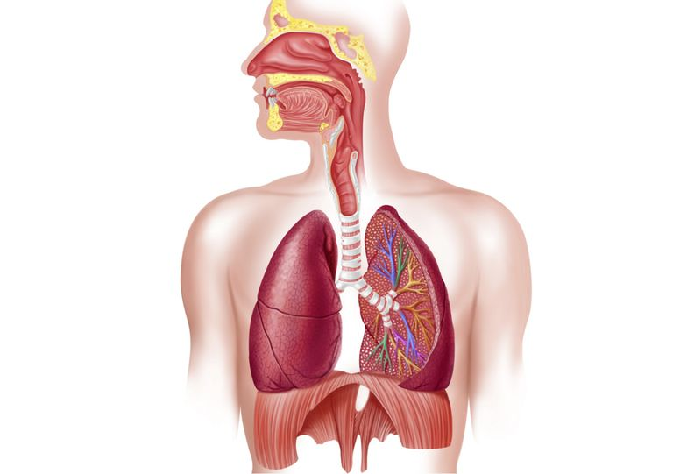
The respiratory system
Respiratory system – the series of organs responsible for taking in oxygen and expelling carbon dioxide
Discuss
Why do you think the respiratory system
is so important?
Why do we need to take oxygen into the
bloodstream and expel carbon dioxide?
This is achieved by bringing air in contact with the blood, so that gaseous exchange can occur
For more help, please visit www.exampaperspractice.co.uk
© 2025 Exams Papers Practice. All Rights Reserved

Slide 4
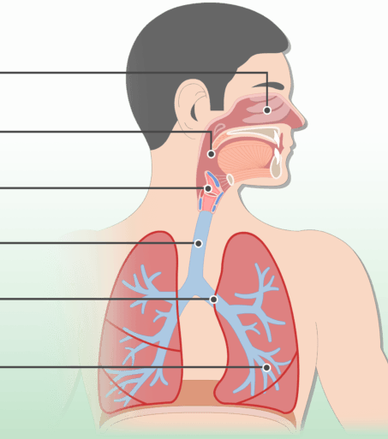
The pathway of air
When we inhale (breathe in), we take air into our lungs. This air includes oxygen, which is taken up by the blood and transported to the working muscles to produce energy
How does the oxygen get there?
Oxygen passes through several structures on its way to the blood-stream
You need to know these structures in order
For more help, please visit www.exampaperspractice.co.uk
© 2025 Exams Papers Practice. All Rights Reserved

Slide 5
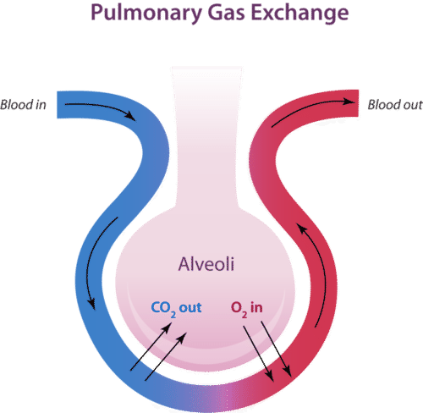
The pathway of air
The structures you need to know -
Mouth/nasal passage
Trachea
Bronchi
Bronchioles
Alveoli
When air reaches the alveoli, gaseous exchange occurs via diffusion
Gaseous exchange – the process in the lungs by which oxygen diffuses into the bloodstream and carbon dioxide is removed from it
For more help, please visit www.exampaperspractice.co.uk
© 2025 Exams Papers Practice. All Rights Reserved

Slide 6
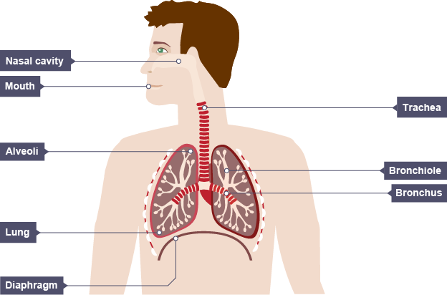
1) Air (containing oxygen), enters the system through the nasal passage and mouth.
2) It travels down the trachea (windpipe),
4) It then moves into smaller airways called bronchioles,
5) before finally reaching the alveoli (millions of air sacs, where gaseous exchange occurs)
3) before branching off into the left and right bronchi.
For more help, please visit www.exampaperspractice.co.uk
© 2025 Exams Papers Practice. All Rights Reserved

Slide 7
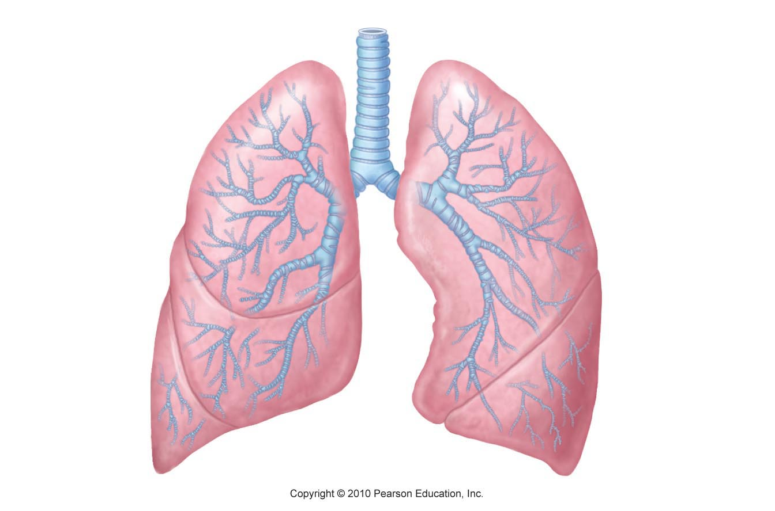
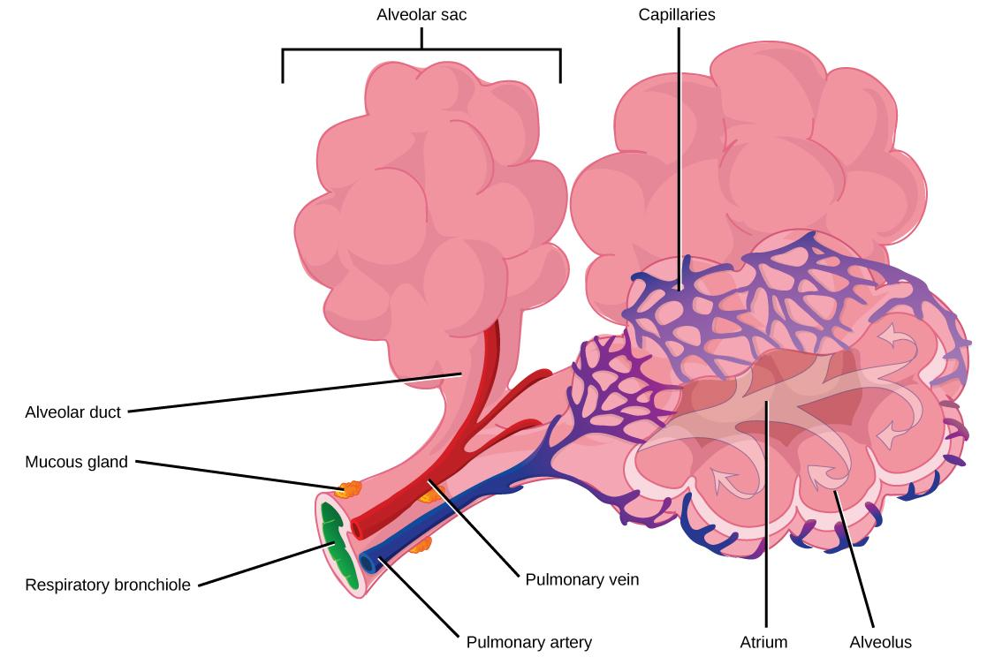
Alveoli – small air sacs in the lungs where gaseous exchange takes place
The alveoli are specially designed for maximum gaseous exchange
For more help, please visit www.exampaperspractice.co.uk
© 2025 Exams Papers Practice. All Rights Reserved

Slide 8
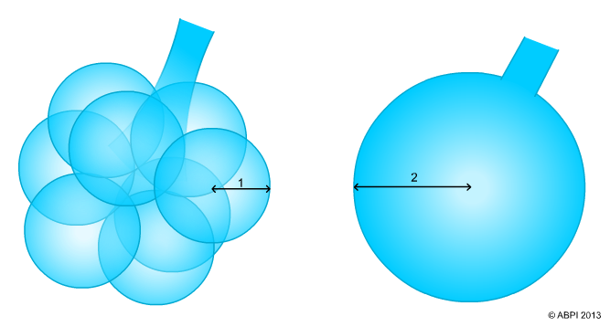
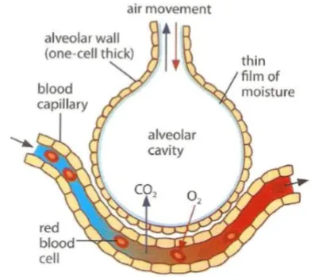
Alveoli – how are they designed for maximum gaseous exchange?
Vast surface area
Alveoli have a specialised shape
There are also millions of them, maximising contact between gasses and the blood
Alveolar walls are one cell thick
Meaning the diffusion distance is short and gasses can pass through easily
A moist lining
Helps gasses to diffuse more freely
For more help, please visit www.exampaperspractice.co.uk
© 2025 Exams Papers Practice. All Rights Reserved
Notes:
3 -

Slide 9
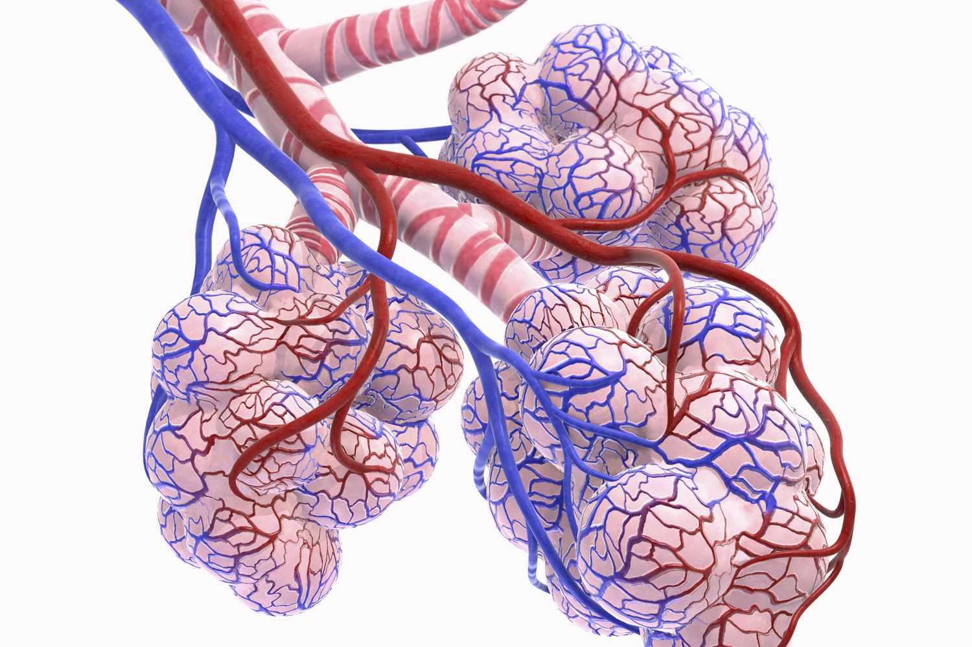
Alveoli – how are they designed for maximum gaseous exchange?
A big network of capillaries
Each alveolus is surrounded by a network of capillaries, ensuring a good blood supply
This means that gases can diffuse to and from the blood with ease
Capillary lining is one cell thick
Meaning the diffusion distance is short and gasses can pass through easily
Alveoli are well ventilated
Meaning air can reach them easily
For more help, please visit www.exampaperspractice.co.uk
© 2025 Exams Papers Practice. All Rights Reserved
Notes:
3 -

Slide 10
Summary quiz
Name the structures that oxygen passes through on the way to the alveoli in order (5 marks)
Name the six features that make the alveoli suitable for gaseous exchange (6 marks)
Describe why each of these features is beneficial for gaseous exchange (6 marks)
For more help, please visit www.exampaperspractice.co.uk
© 2025 Exams Papers Practice. All Rights Reserved

Slide 11
2.2 The mechanics of breathing
Chapter 2
The respiratory system
Anatomy and Physiology
Learning objectives
1) Identify the location of the diaphragm and intercostal muscles
2) Understand the role of these muscles during normal breathing
3) Describe the mechanics of breathing
For more help, please visit www.exampaperspractice.co.uk
© 2025 Exams Papers Practice. All Rights Reserved

Slide 12
What you need to know
For more help, please visit www.exampaperspractice.co.uk
© 2025 Exams Papers Practice. All Rights Reserved

Slide 13
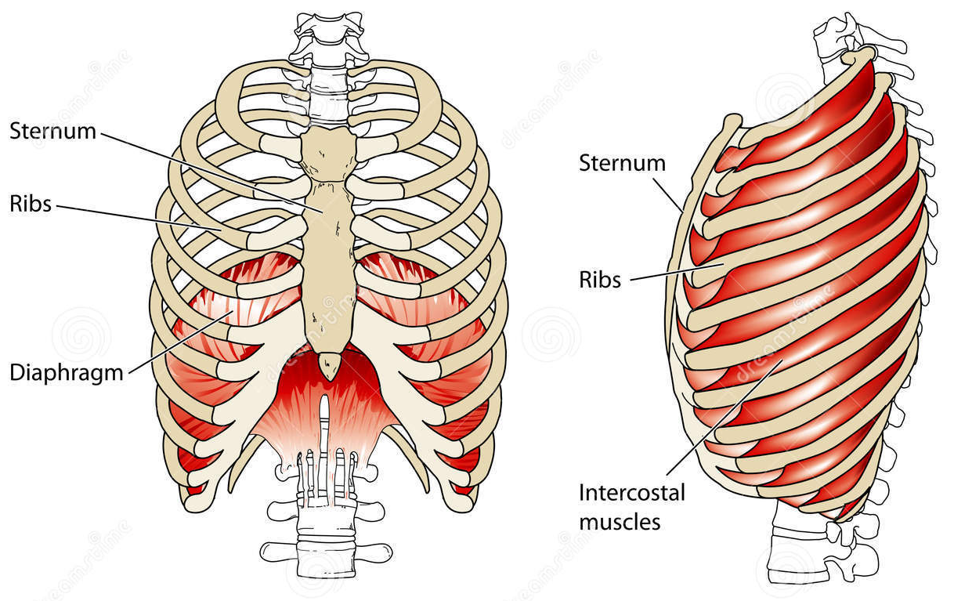
The mechanics of breathing
We now know the pathway of air, but how does the air move into the alveoli for gaseous exchange to occur?
The process of breathing (pulmonary ventilation) is controlled by muscles
These muscles contract or relax forcing air to move into or out of the lungs
Spend 30 seconds to discuss
For more help, please visit www.exampaperspractice.co.uk
© 2025 Exams Papers Practice. All Rights Reserved

Slide 14
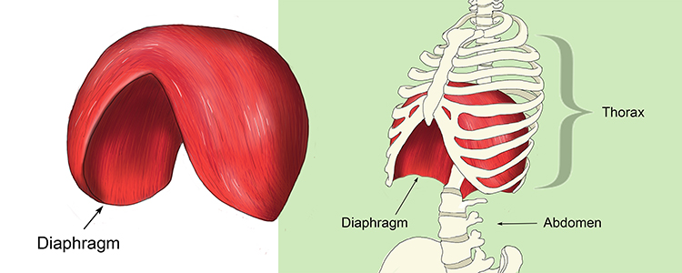
The mechanics of breathing
Muscles
Intercostal muscles
The muscles between the ribs that raise and lower the ribs
Diaphragm
A muscular ‘sheet’ at the base of the chest cavity
The diaphragm moves up and down, changing the volume of the the chest cavity
For more help, please visit www.exampaperspractice.co.uk
© 2025 Exams Papers Practice. All Rights Reserved

Slide 15
Inhalation (breathing in)
Diaphragm – contracts and flattens (moves down)
Intercostal muscles – contract, causing the ribs to move up and out
Lungs – the volume inside the lungs increases
Air pressure - inside the lungs decreases (relative to atmospheric air pressure)
Effect – air containing oxygen moves into the lungs
The effect of training
-Over a sustained period of time, exercise / training can increase the strength of the diaphragm and intercostal muscles
-This enables them to expand further,
-increasing the volume of the lungs, allowing more oxygen to enter
-This enables athletes to compete at higher intensities for longer
Can you remember the pathway of oxygen?
For more help, please visit www.exampaperspractice.co.uk
© 2025 Exams Papers Practice. All Rights Reserved

Slide 16
Exhalation (breathing out)
Diaphragm – relaxes and moves upwards
Intercostal muscles – relax, causing the ribs to move downwards and inwards
Lungs – the volume inside the lungs decreases
Air pressure - inside the lungs increases (relative to atmospheric air pressure)
Effect – air containing carbon dioxide is forced out of the lungs
For more help, please visit www.exampaperspractice.co.uk
© 2025 Exams Papers Practice. All Rights Reserved

Slide 17
The mechanics of breathing
Copy and complete the table
 | Inhalation | Exhalation
Ribcage |  | -Intercostal muscles relax -Ribs move inward and downward
Diaphragm
Lung volume | -Increases
Lung pressure
Effect
For more help, please visit www.exampaperspractice.co.uk
© 2025 Exams Papers Practice. All Rights Reserved

Slide 18
2.3 Breathing volumes and minute ventilation
Chapter 2
The respiratory system
Anatomy and Physiology
Learning objectives
1) Explain the terms ‘tidal volume’, ‘vital capacity’, ‘residual volume’,
‘minute ventilation’
2) Understand the role of each during the mechanics of breathing
3) Describe how exercise effects these volumes
For more help, please visit www.exampaperspractice.co.uk
© 2025 Exams Papers Practice. All Rights Reserved

Slide 19
What you need to know

Slide 20
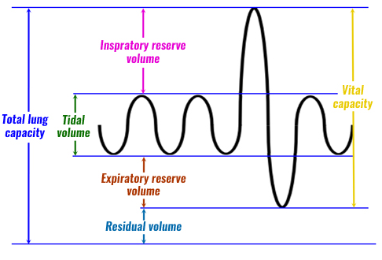
Breathing volumes and minute ventilation
The volume of air we are able to inhale and exhale is an important factor for athletic performance, as it affects how much oxygen diffuses into the bloodstream and transported to the working muscles
There are a number of measurements that can be taken to assess how well the respiratory system is functioning
The terms you need to know:
Tidal volume
Minute ventilation
Vital capacity
Residual volume
For more help, please visit www.exampaperspractice.co.uk
© 2025 Exams Papers Practice. All Rights Reserved

Slide 21
Breathing volumes and minute ventilation
Tidal volume
“The volume of air inhaled during normal breathing”
Tidal volume increases during exercise
Minute ventilation
“The volume of air that you breathe per minute”
Minute ventilation can be calculated by multiplying the tidal volume by the number of breaths taken in one minute
It is expressed in litres per minute (l/min)
Tidal volume (ml) x breaths per minute = Minute ventilation (l/min)
For more help, please visit www.exampaperspractice.co.uk
© 2025 Exams Papers Practice. All Rights Reserved

Slide 22
Breathing volumes and minute ventilation
Vital capacity
“The maximum volume of air you can breathe out”
after breathing in as much as you can
This can be up to ten times as much as you would normally exhale
Residual volume
“The volume of air left in your lungs after breathing out”
There is always some air left in the lungs to prevent them collapsing
Breathe out fully. The air that remains is the residual volume
For more help, please visit www.exampaperspractice.co.uk
© 2025 Exams Papers Practice. All Rights Reserved

Slide 23
Minute ventilation
Always remember to include units when making calculations
- The table compares an athlete exercising at different intensities
- Complete the table using the equation below
Exercise intensity | Tidal volume (ml) | Number of breaths per minute | Minute ventilation (l/min)
Sub-maximal | 500 (0.5l) |  | 8
Maximal | 2,500 (2.5l) | 35
Tidal volume (ml) x breaths per minute = Minute ventilation (l/min)
For more help, please visit www.exampaperspractice.co.uk
© 2025 Exams Papers Practice. All Rights Reserved

Slide 24
What impact do you think exercise has on these volumes and why is it beneficial?
For more help, please visit www.exampaperspractice.co.uk
© 2025 Exams Papers Practice. All Rights Reserved

Slide 25
Exercise effects
Copy and complete the table
What impact do you think exercise has on these volumes and why is it beneficial?
 | Tidal volume | Minute ventilation | Vital capacity | Residual volume
Exercise effect | Increases | Increases (due to increased tidal volume and number of breaths taken per minute) | No change | No change
Benefits | -More oxygen is taken into the lungs -Increased rate of gaseous exchange -More oxygen transported in the blood -More oxygen delivered to the working muscles -Faster removal of carbon dioxide
For more help, please visit www.exampaperspractice.co.uk
© 2025 Exams Papers Practice. All Rights Reserved

