Slide 1
11.1 Performance-enhancing drugs (PEDs)
Chapter 11
Ethics and other issues
Social, cultural and ethical influences
Learning objectives
1) Describe the different types of PEDs and their effects o
performance
2) Understand the reasons why some performers use prohibited
PEDs
3) Explain the disadvantages of using PEDs
4) Describe the negative consequences of drug scandals
For more help, please visit www.exampaperspractice.co.uk
© 2025 Exams Papers Practice. All Rights Reserved

Slide 2
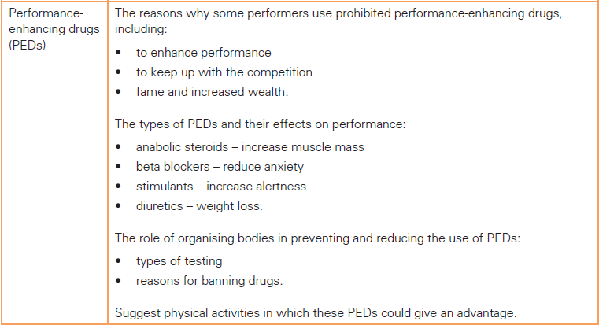
What you need to know
For more help, please visit www.exampaperspractice.co.uk
© 2025 Exams Papers Practice. All Rights Reserved

Slide 3
What you need to know
For more help, please visit www.exampaperspractice.co.uk
© 2025 Exams Papers Practice. All Rights Reserved

Slide 4
Why do some athletes use performance enhancing drugs (PEDs)?
Can you name any cases of PED use in sport?
They may not have the natural ability to compete against the best
Why do athletes use PEDs?
Complete the mind-map
For more help, please visit www.exampaperspractice.co.uk
© 2025 Exams Papers Practice. All Rights Reserved
Notes:
Because of the influence of others (coaches, team-mates, training regime)
To keep up with other athletes already using PEDs
To recover quickly and mask pain (to allow them to continue training and competing)
To calm themselves before or during an event
To achieve success, rewards, sponsorship, new contracts
To build muscle faster than they could through training alone
To improve their performance
To be the best, regardless of morality and ethics (the importance of winning)

Slide 5
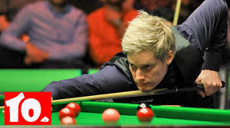
Types of PED
BADS:
Beta blockers
Anabolic steroids
Diuretics
Stimulants
Beta blockers
Prevent adrenaline, reducing heart rate
Has a calming and relaxing effect on the body
Beneficial for sports that require low levels of arousal
E.g. archery and snooker, which involve fine skills that require high levels of precision
Side effects include – a reduced blood pressure and increased risk of heart failure, depression and tiredness
Who could benefit?
For more help, please visit www.exampaperspractice.co.uk
© 2025 Exams Papers Practice. All Rights Reserved

Slide 6
Past exam question
Beta blockers
Describe one type of drug that an archer might use to enhance their performance and explain why (3)
Point; An archer may use beta blockers,
Explain; which prevent adrenaline release and slow down the heart rate
Evidence; This could benefit the archer as the sport involves fine skills that require low levels of arousal
For more help, please visit www.exampaperspractice.co.uk
© 2025 Exams Papers Practice. All Rights Reserved

Slide 7
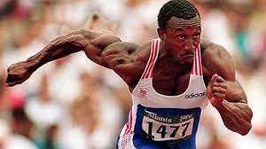
Types of PED
Anabolic steroids
Assist with growth and repair of muscle
Helping athletes increase muscle mass quickly
Leading to increases in power and muscular strength
Making them useful for power athletes such as sprinters and baseball players
They also speed up recovery time, allowing athletes to compete and train more often and at a higher intensity
Making them useful for athletes such as cyclists who compete day after day during races
Side effects include – aggressive behaviour, high blood pressure and heart disease and liver problems. They also affect hormone levels
Who could benefit?
For more help, please visit www.exampaperspractice.co.uk
© 2025 Exams Papers Practice. All Rights Reserved

Slide 8
Past exam question
Anabolic steroids
Name an athlete that might choose to take anabolic steroids and explain why (3)
Point - Sprinters may choose to take anabolic steroids
Explain - As anabolic steroids assist with the growth and repair of muscle fibres, helping to increase muscle mass
Evidence - This could be beneficial to performance as sprinters require high levels of power to finish the race as quickly as possible
For more help, please visit www.exampaperspractice.co.uk
© 2025 Exams Papers Practice. All Rights Reserved

Slide 9
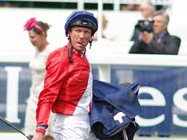
Types of PED
Diuretics
Increase the amount of water removed from the body
Which helps athletes to reduce weight quickly
So used by athletes such as gymnasts and jockeys who benefit from a low body mass and boxers, to help them qualify for a weight category
Also helps to mask other PEDs being used, reducing chances of being caught
Side effects include – Dehydration, weakening of muscles, kidney problems and nausea
Who could benefit?
For more help, please visit www.exampaperspractice.co.uk
© 2025 Exams Papers Practice. All Rights Reserved

Slide 10
Past exam question
Diuretics
Discuss the impact of using diuretics for a boxer on performance and health (4)
Point; Diuretics increase the amount of water removed from the body
Explain; which would help the boxer to lose weight quickly
Evidence; This could help the boxer qualify for their weight category
Evidence; But could lead to dehydration, weakening of muscles and kidney failure
A discussion requires you to consider two sides to an argument (pros and cons)
For more help, please visit www.exampaperspractice.co.uk
© 2025 Exams Papers Practice. All Rights Reserved

Slide 11
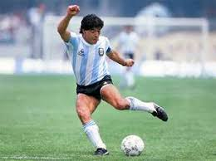
Types of PED
Stimulants – (e.g amphetamines)
Affect the nervous system reducing pain and increasing mental and physical alertness
Can also help to reduce fatigue and improve endurance
Enabling athletes to train and perform at higher intensities for longer
Used by a range of athletes including swimmers and American football players
Side effects include – addiction, high blood pressure and an increased risk of heart failure and strokes and an increased risk of injury as pain is suppressed
Who could benefit?
For more help, please visit www.exampaperspractice.co.uk
© 2025 Exams Papers Practice. All Rights Reserved

Slide 12
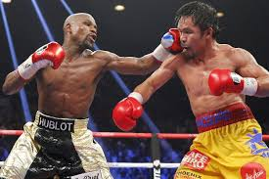
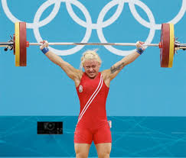
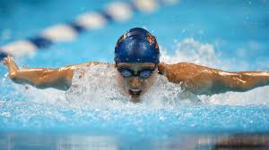
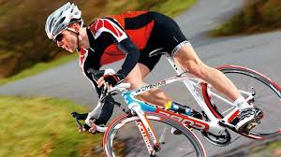
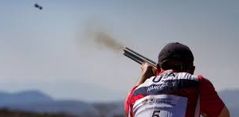
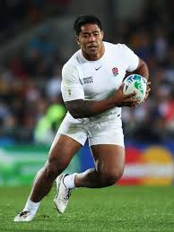
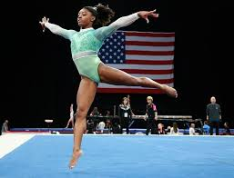
Name a PED that might be used by each of the following:
Justify your answers
For more help, please visit www.exampaperspractice.co.uk
© 2025 Exams Papers Practice. All Rights Reserved

Slide 13
Restriction and prevention
What role do the organising bodies have in preventing and restricting the use of PEDs in sport?
Which types of tests do they use?
Why do organising bodies ban PEDs?
WADA – World Anti-Doping Agency
An agency that monitors sporting activities across the world
Overseeing National Anti-Doping Organisations (NADOs), which are funded and run by the governments of competing nations
Doping – the use of banned PEDs by athletic competitors
For more help, please visit www.exampaperspractice.co.uk
© 2025 Exams Papers Practice. All Rights Reserved

Slide 14
The testing process
Random selection
Athletes are called out for testing at any time (in or out of competition)
Blood testing
Athletes are provided with a sealed kit in which to place two samples (A & B)
Urine sampling
Similar to blood testing, although the sample must be provided in view of an official of the same gender
Sample testing
Samples are sent to a registered laboratory where sample A is tested. If a positive result is found, the athlete is notified before sample B is also tested
Sanctions
If both tests are positive, the relevant sporting organisations are notified; they decide on the penalties or bans to impose
For more help, please visit www.exampaperspractice.co.uk
© 2025 Exams Papers Practice. All Rights Reserved

Slide 15
Why are PEDs banned by the organising bodies?
Discuss your ideas
To prevent athletes from gaining an unfair advantage
Those not using PEDs are unable to compete
May lose motivation
Or drop out of the sport entirely
Banning PEDs ensures every competitor has a fair advantage when competing
PEDs ruin reputations of athletes
E.g. Lance Armstrong’s ruined public image
Role models who use PEDs can have a negative impact on the choices and behaviours of their fans
Sending the message that it’s OK to cheat
How did those cyclists who rode clean feel about their chances of winning the Tour de France?
For more help, please visit www.exampaperspractice.co.uk
© 2025 Exams Papers Practice. All Rights Reserved

Slide 16
Why are PEDs banned by the organising bodies?
Discuss your ideas
PED use can bring the sport into disrepute
Ruining the reputation of the sport
Affecting funding (including sponsorship)
Potentially reducing popularity, spectator attendance and participation
Ethics - the true meaning and value of sport (dedication, respect and fair competition) is damaged by the use of PEDs
Health considerations
PEDs are dangerous and can lead to numerous, often life threatening physical conditions (see ‘side effects’)
And can cause psychological damage including mood swings, aggressive behaviour, depression and anxiety
For more help, please visit www.exampaperspractice.co.uk
© 2025 Exams Papers Practice. All Rights Reserved

Slide 17
Past exam questions
State two reasons why athletes may choose to use performance enhancing drugs (2)
How do anti-doping agencies test for the use of PED’s in sport? (3)
Explain the reasons for banning PEDs in sport (3)
For more help, please visit www.exampaperspractice.co.uk
© 2025 Exams Papers Practice. All Rights Reserved

Slide 18
Disadvantages of using PEDs
Many athletes have been caught by organising bodies (such as WADA), but many more are likely to have avoided punishment
Are there any disadvantages of using PEDs for an athlete who has never been caught?
What are the disadvantages for someone who has?
Major drug scandals such as the Lance Armstrong case can also have a negative impact on the sport as a whole. Can you suggest why?
Watch - https://www.youtube.com/watch?v=Eexfbm73jIQ
For more help, please visit www.exampaperspractice.co.uk
© 2025 Exams Papers Practice. All Rights Reserved

Slide 19
Disadvantages of using PEDs
Public humiliation
Loss of reputation, social media abuse, fears of going out in public
Disadvantages of using PEDs
Complete the mind-map
For more help, please visit www.exampaperspractice.co.uk
© 2025 Exams Papers Practice. All Rights Reserved
Notes:
Health – discuss health risks of each PED and blood doping
Financial penalty – Fines, loss of sponsorship, loss of salary, legal costs (Lance Armstrong paid huge sums to his sponsors for damaging their reputation)
Public humiliation – Loss of reputation, social media abuse, fears of going out in public
Disqualification or ban – May never compete again, loss of livelihood and career, may not perform at same level when returning from a lengthy ban
Effect on other competitors – Loss of medals and winnings for teammates (relays, rowing teams), damaging reputation of sport can lead to reduced sponsorship and popularity/fame of competitors, assumption that the whole sport is dirty – assuming that clean athletes are doping too

Slide 20
Disadvantages of using PEDs
When a performer is caught using PEDs, the most immediate impact may be on them personally or other competitors
Bans or suspensions
Loss of medals and reputation
Loss of financial support or sponsorship
Expensive legal cases
Loss of sponsorship for other competitors as sponsors don’t want to be associated with a tainted sport
British sprinter Dwayne Chambers was banned for life in the 2003 Olympic Games. He had won gold as part of the 4x100m relay. Both he and his teammates (who hadn’t taken drugs) were stripped of their medals
Watch - https://www.youtube.com/watch?v=25JqCbCOi3c
For more help, please visit www.exampaperspractice.co.uk
© 2025 Exams Papers Practice. All Rights Reserved

Slide 21
Disadvantages of using PEDs
Major drug scandals may also affect the credibility of the sport
Drug cheats may affect the reputation of their sport
Attendance, support and participation may all suffer
Sponsors may not want to be associated with sports or events involved in drug scandals, leading to a loss of funding
E.g. The Lance Armstrong scandal gave cycling a bad name. This may have resulted in fewer people becoming interested in the sport and lower attendances at events
E.g. The Russian Winter Olympics team at the Soche Games were found guilty of doping. This damaged the reputation of the competition. Sponsors may be more reluctant to provide funding in the future as they may not want their brand to be associated with the Games
Watch - https://www.youtube.com/watch?v=iYYihLYo2yA
For more help, please visit www.exampaperspractice.co.uk
© 2025 Exams Papers Practice. All Rights Reserved

Slide 22
Summary questions
Can you describe (using examples), the five disadvantages of using PEDs? - choose 1 or 2
Can you discuss in detail the negative consequences that a drug scandal could have on a sport?
Answer one or more of the above without your notes, then check back to ensure all information is accurate and your answer is sufficiently detailed
For more help, please visit www.exampaperspractice.co.uk
© 2025 Exams Papers Practice. All Rights Reserved

Slide 23
11.2 Blood doping
Chapter 11
Ethics and other issues
Social, cultural and ethical influences
Learning objectives
1) Outline the reasons why some performers use blood doping
2) Describe how blood doping is carried out
3) Explain the effects and potential side effects of blood doping
For more help, please visit www.exampaperspractice.co.uk
© 2025 Exams Papers Practice. All Rights Reserved

Slide 24
What you need to know
For more help, please visit www.exampaperspractice.co.uk
© 2025 Exams Papers Practice. All Rights Reserved

Slide 25
Blood doping
A tri-athlete decides to use blood doping to improve their aerobic performance
What might make them decide to use this banned technique?
How does it affect their physiology and what performance benefits can they expect to achieve?
How do they carry out the process?
What side effects might they experience?
Watch - https://www.youtube.com/watch?v=G7KZxIR1t-o
For more help, please visit www.exampaperspractice.co.uk
© 2025 Exams Papers Practice. All Rights Reserved

Slide 26
Blood doping
What is blood doping and why do athletes use this technique?
‘The misuse of techniques and/or substances to increase a performer’s red blood cell count’
E.g. By using the hormone EPO or transfusing oxygenated blood into a performer before an event
More red blood cells = more haemoglobin = more oxygen is transported the working muscles
It therefore helps to improve aerobic fitness, so is beneficial for endurance athletes (long distance cyclists, runners and swimmers), as they need to be able to exercise for long durations without fatiguing
It also improves recovery time, allowing athletes to train harder and more frequently, improving performance
Why would an athlete choose to use blood doping? – See slide 4
For more help, please visit www.exampaperspractice.co.uk
© 2025 Exams Papers Practice. All Rights Reserved

Slide 27
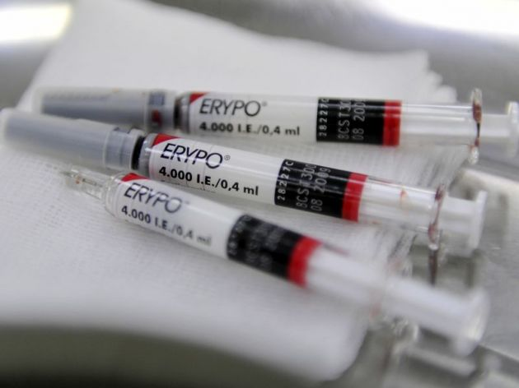
Blood doping - EPO
How is this technique carried out?
EPO (erythropoietin)
Is injected to increase EPO levels in the body
This causes the body to produce far more RBCs that it normally would
Leading to a greater delivery of oxygen to the working muscles
Improving endurance performance and speed of recovery
EPO – a hormone produced in the kidney that can also be artificially produced – it helps to stimulate the production of red blood cells to carry more oxygen to the muscles
For more help, please visit www.exampaperspractice.co.uk
© 2025 Exams Papers Practice. All Rights Reserved

Slide 28
Blood doping
Blood transfusion
The presence of EPO can now be detected through blood tests
While blood transfusions cannot
Many endurance athletes have therefore turned to blood transfusions to boost the oxygen carrying capacity of their blood
Blood transfusions are more time consuming and need to be carefully planned
Oxygen carrying capacity – the amount of oxygen that can be transported in the blood (determined by RBC and haemoglobin levels)
For more help, please visit www.exampaperspractice.co.uk
© 2025 Exams Papers Practice. All Rights Reserved

Slide 29
Blood doping
How is this technique carried out?
Blood transfusion
Blood is taken from the athlete 3-4 weeks before competition
Blood is frozen to maintain the high haemoglobin levels
1-2 days before competition, the blood is thawed and transfused back into the performer
This will increase the number of RBCs in the body increasing the oxygen carrying capacity of the blood
Increasing aerobic fitness, allowing them to perform for longer without fatigue
And improving recovery times
For more help, please visit www.exampaperspractice.co.uk
© 2025 Exams Papers Practice. All Rights Reserved

Slide 30
Blood doping
A number of cyclists died of heart attacks due to excessive EPO use in the 1980s and 1990s
Side effects
The blood becomes thicker (more viscous)
The heart has to work harder to pump the blood around the body
Increasing the risk of heart attacks, strokes, and pulmonary embolism (a blood clot on the lung)
Risk of infection
From injecting other people’s blood
Blood bags can get mixed up, particularly if a ‘doping doctor’ is handling bags from multiple athletes
Kidney disease
Excessive EPO use can cause kidney damage
For more help, please visit www.exampaperspractice.co.uk
© 2025 Exams Papers Practice. All Rights Reserved

Slide 31
Summary questions
Can you provide a range of reasons why athletes may choose to use blood doping?
Can you explain how the two types of blood doping are carried out?
Can you explain the effects of blood doping on performance, state the kind of athletes who would benefit and explain why?
Can you describe the dangers of blood doping?
Answer one or more of the above without your notes, then check back to ensure all information is accurate and your answer is sufficiently detailed
For more help, please visit www.exampaperspractice.co.uk
© 2025 Exams Papers Practice. All Rights Reserved

Slide 32
11.3 Risk and risk assessment
Chapter 11
Ethics and other issues
Social, cultural and ethical influences
Learning objectives
1) Identify and describe the differences between real and perceived
risk
2) Assess risks in different environments
3) Suggest strategies for reducing risk and injury in physical activities
For more help, please visit www.exampaperspractice.co.uk
© 2025 Exams Papers Practice. All Rights Reserved

Slide 33
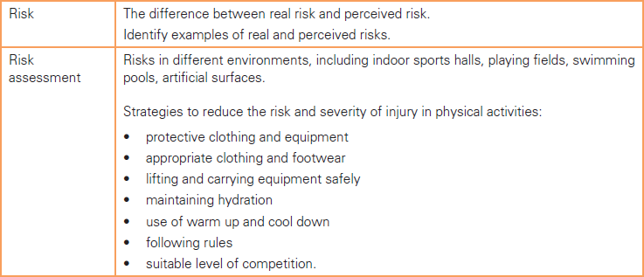
What you need to know
For more help, please visit www.exampaperspractice.co.uk
© 2025 Exams Papers Practice. All Rights Reserved

Slide 34
Introduction
Participating in physical activities has a risk involved. It is important to identify any harm that may occur and to make the activity as safe as possible.
What do you think the differences are between real risk and perceived risk?
Can you think of risk factors that exist in any of the following environments?
Sports halls/gymnasiums
Playing fields
Swimming pools
Artificial surfaces (e.g. Astro turf, 4g pitches)
Can you identify ways in which risk can be reduced in sport/physical activity?
Discuss one or more of these questions in pairs
For more help, please visit www.exampaperspractice.co.uk
© 2025 Exams Papers Practice. All Rights Reserved

Slide 35
Risk – real and perceived
Real risk –
‘The amount of danger that actually exists in the activity’
It’s the level of risk that exists after taking into account safety controls and measures
E.g. Rock climbing may appear to involve a significant level of risk, but taking into account the safety ropes, helmet and experienced guide, the real risk is relatively low
Perceived risk –
‘An individual’s subjective or personal judgement about the dangers of an activity’
It’s an individual’s view of risk – what some people may think of as dangerous, others may not
Risk assessments – are used to calculate the real risk involved in an activity
Perception – the way in which something is interpreted. A perception is not necessarily true
For more help, please visit www.exampaperspractice.co.uk
© 2025 Exams Papers Practice. All Rights Reserved

Slide 36
Risk – real and perceived
Examples
A class is taking part in a climbing wall session. The teacher has conducted a risk assessment and the students are secured to the wall by ropes meaning real risk is low. Many of the parents will perceive the activity as high-risk however (they think their children could fall and injure themselves)
Students are learning to throw a javelin for the first time. They perceive the activity as high-risk as the javelin is a sharp and dangerous object. However, the teacher has completed a risk assessment and has many safety measures in place meaning the real risk is low
Can you identify any other situations where there may be a perceived risk, but not a real risk
For more help, please visit www.exampaperspractice.co.uk
© 2025 Exams Papers Practice. All Rights Reserved

Slide 37
Risk assessment
Risk assessment – a process used to evaluate the real risks involved in an activity
It is important to complete a risk assessment to ensure any potential risks associated with an activity are identified and strategies are put in place to minimise the risks
Risk assessments need to take into account:
Environmental risks (the facility, weather, equipment)
Player risks (player behaviour, nature of the sport, fitness levels, skill levels)
Example | Severity (S) | Likelihood (L) | Risk (S x L) | Rating (1-25)
Stadium collapse | 5 | 1 | 5 | Low
Slipping on the floor | 3 | 4 | 12 | Moderate
Collision with opponent | 3 | 5 | 15 | Moderate
For more help, please visit www.exampaperspractice.co.uk
© 2025 Exams Papers Practice. All Rights Reserved

Slide 38
Risk assessment
Task - Identify risks associated with either: Swimming pool, Indoor sports hall or playing fields
Artificial surfaces (e.g. artificial turf pitches)
Slipping on surface
Ankle injury
Collision with fence/goalposts
Grazes
Ankle sprains
Objects on pitch
Risks
Complete the mind map to identify risks in a range of settings
For more help, please visit www.exampaperspractice.co.uk
© 2025 Exams Papers Practice. All Rights Reserved

Slide 39
Reducing risk
Having identified a range of risks within an environment, we need to identify strategies to reduce those risks:
Strategies include:
Wearing protective equipment and appropriate footwear/clothing
Lifting and carrying equipment safely
Maintaining hydration during an activity
Using a warm-up to prepare the body for exercise and a cool-down to help it recover
Following rules and instructions to encourage safe and fair play
Creating suitable levels of competition (e.g. appropriate age)
Provide examples/further explanation for each of the above points
For more help, please visit www.exampaperspractice.co.uk
© 2025 Exams Papers Practice. All Rights Reserved

Slide 40
Reducing risk
For one of the following situations, identify risks and suggest measures that you could put in place to reduce the risk
A hockey match on an artificial pitch
A long distance running event in the heat
A basketball game in an indoor sports hall
A rugby match on an outdoor pitch
Choose 2 or 3 risk factors and 4 or 5 measures to reduce risk
Which of these examples are player risks and which are environmental risks?
Risks | Measures
Injury due to tackling and contact in the ruck (rugby) | Ensure high tackle rule is explained and upheld Ensure all players wear a gum-shield (mouth-guard) Ensure players are wearing rugby or football boots to prevent slipping Shoulder pads could be worn Ensure players are of a similar age and size Ensure all payers are experienced and understand safe tackle practice
For more help, please visit www.exampaperspractice.co.uk
© 2025 Exams Papers Practice. All Rights Reserved

Slide 41
Summary questions
Can you define the terms real risk and perceived risk? (2)
Can you use examples to explain the differences between real and perceived risk? (4)
Identify three risks associated with a swimming lesson in PE (3)
Can you identify two risks associated with an inter-school football match and suggest strategies to reduce those risks? (4)
Answer one or more of the above without your notes, then check back to ensure all information is accurate and your answer is sufficiently detailed
For more help, please visit www.exampaperspractice.co.uk
© 2025 Exams Papers Practice. All Rights Reserved

Slide 42
11.4 Injuries
Chapter 11
Ethics and other issues
Social, cultural and ethical influences
Learning objectives
1) Describe the causes of and treatments for minor injuries
2) Explain the causes of bruises, muscle, tendon and ligament
injuries
3) Know how to use the RICE method for injuries
For more help, please visit www.exampaperspractice.co.uk
© 2025 Exams Papers Practice. All Rights Reserved

Slide 43
What you need to know
For more help, please visit www.exampaperspractice.co.uk
© 2025 Exams Papers Practice. All Rights Reserved

Slide 44
Introduction
Taking part in physical activity and sport carries risk – injuries may lead to a loss of performance or long-term absence from training and competition.
Common injuries include:
Winding, blisters, cuts and grazes, bruises, muscle, tendon and ligament injuries, dislocation
Pick one of these injuries -
Can you describe it?
Do you know what might have caused it?
Do you know how it could be treated?
For more help, please visit www.exampaperspractice.co.uk
© 2025 Exams Papers Practice. All Rights Reserved

Slide 45
Injuries
Minor injuries (blisters, winding, cuts, grazes)
Other injuries (bruises, muscular, tendon and ligament injuries), dislocation
Blisters
Description | Cause | Treatment
A small pocket of fluid that forms in the upper layers of the skin after it has been damaged Most blisters are filled with a clear fluid (serum) | Repeated rubbing of the skin E.g. where the shoe rubs against the heel while running Burning | If unbroken, don’t pierce Cover with a plaster or dressing If burst, don’t peel of the dead skin covering the blister Allow the fluid to drain and wash with mild soap Cover with a sterile dressing to prevent infection
For more help, please visit www.exampaperspractice.co.uk
© 2025 Exams Papers Practice. All Rights Reserved

Slide 46
Injuries
Bruises
Winding
Description | Cause | Treatment
When capillaries burst under the skin, blood leaks into the soft tissue creating bluish-purple patches | Impact with a hard object | Cold compression such as a cloth soaked in cold water or an ice pack This will help to reduce swelling and internal bleeding
Description | Cause | Treatment
Difficulty in breathing because of exertion or a blow to the stomach | A blow to the abdomen by a ball or hitting action, causing the diaphragm to go into spasm | Loosen the clothing, sit in a crouched position as this helps the muscles to relax Try to stay calm and take deep, controlled breaths
For more help, please visit www.exampaperspractice.co.uk
© 2025 Exams Papers Practice. All Rights Reserved

Slide 47
Injuries
Cuts and grazes
Description | Cause | Treatment
Cuts: When the skin is broken causing damage to the blood vessels beneath Grazes: Where the skin is rubbed off causing damage to blood vessels | Cuts: Contact with a sharp object (e.g. broken glass on a grass pitch) Grazes: Scraping or rubbing against a rough surface (E.g. falling on a rough surface) | Stop any bleeding by applying pressure to the area using a clean, dry absorbent material – such as a bandage or towel When the bleeding has stopped, clean the wound and cover it with a dressing to prevent infection
For more help, please visit www.exampaperspractice.co.uk
© 2025 Exams Papers Practice. All Rights Reserved

Slide 48
Injuries
Muscular injury (strain)
Description | Cause | Treatment
Muscle is overstretched or torn (either partially or fully) | When muscles are overused (e.g. excessive weight training) Sudden, powerful movements such as jumping and throwing Stretching the muscle beyond its normal range of movement | Use the RICE method Limit training to prevent further damage and allow recovery
For more help, please visit www.exampaperspractice.co.uk
© 2025 Exams Papers Practice. All Rights Reserved

Slide 49
Injuries
Tendon injury (strain)
Ligament injury (sprain)
Description | Cause | Treatment
Tendon is overstretched or torn (either partially or fully) | Inflamed tendons (tendonitis) occur through repeated actions like running (e.g. tennis elbow) Activities that involve sudden, sharp movements such as throwing or jumping | Use the RICE method Limit training to prevent further damage and allow recovery
Description | Cause | Treatment
Ligament is overstretched or torn (either partially or fully) | When ligaments are twisted (e.g. twisting the knee when turning with a planted foot), or pulled passed their normal range of movement ACL (anterior cruciate ligament) injuries in the knee occur with sudden changes in direction (e.g. side-stepping in rugby) | Use the RICE method in the first instance More serious injuries may require operation
For more help, please visit www.exampaperspractice.co.uk
© 2025 Exams Papers Practice. All Rights Reserved

Slide 50
Injuries
Dislocation
Description | Cause | Treatment
The bones that form a joint are forced from their normal positions | Sudden forces that move the joint out of position (e.g. a tackle in rugby or an arm-lock in judo) A dislocated shoulder causes swelling and great discomfort | Use the RICE method and go straight to hospital It is sometimes possible to relocate immediately (put the joint back together) An operation may be necessary depending on severity
For more help, please visit www.exampaperspractice.co.uk
© 2025 Exams Papers Practice. All Rights Reserved

Slide 51
Treating injuries - RICE
‘Rest-Ice-Compression-Elevation: a common method of treatment after injury’
It will help to reduce pain and shorten the recovery process
In the case of severe injuries, the individual will require specialist treatment however
Used to treat bruises, muscular, tendon and ligament injuries
Rest | Stop the activity. Rest and protect the injured area.
Ice | Apply an ice pack to reduce pain and swelling. Use a towel to avoid direct contact with the skin.
Compression | Wrap the area with a bandage. Compressing the area will reduce swelling.
Elevation | Keep the injured body part raised (above the heart). This will also help to reduce swelling.
Watch - https://www.youtube.com/watch?v=HimO1Ix8FrM
For more help, please visit www.exampaperspractice.co.uk
© 2025 Exams Papers Practice. All Rights Reserved

Slide 52
Treatment of injuries
Injury | Tendon | Blisters | Bruises | Winding | Ligament
Cause (example) | 1 | 3 | 5 | 7 | 9
Treatment | 2 | 4 | 6 | 8 | 10
Take it in turns to select a number for your partner. They must provide an example of the cause or explain the treatment process.
If you agree they’re correct they gain 1 point. If the answer is incorrect or details are missing they gain nothing.
Then it’s your turn.
First to 4 points.
For more help, please visit www.exampaperspractice.co.uk
© 2025 Exams Papers Practice. All Rights Reserved

Slide 53
RICE
A player ‘sprains’ their ankle during a football match. Place the following actions in the correct order:
Apply an ice pack from the first aid kit to narrow the blood vessels and reduce blood flow
Stop the person from playing and sit them down to prevent any further damage
Raise the ankle above the heart to reduce blood flow and minimise swelling
Bandage the ankle to prevent any further build up of blood and swelling in the injured area
For more help, please visit www.exampaperspractice.co.uk
© 2025 Exams Papers Practice. All Rights Reserved

Slide 54
Summary questions
Can you describe each injury? (choose 1 or 2)
Can you state the cause of each injury using examples to help you? (choose 1 or 2)
Can you explain the treatment process for each injury in detail? (choose 1 or 2)
Can you describe each of the steps of the treatment method ‘RICE’?
Answer one or more of the above without your notes, then check back to ensure all information is accurate and your answer is sufficiently detailed
For more help, please visit www.exampaperspractice.co.uk
© 2025 Exams Papers Practice. All Rights Reserved

