Slide 1
10.1 Leisure, recreation and the growth of leisure activities
Chapter 10
Social and cultural influences
Social, cultural and ethical influences
Learning objectives
1) Explain the terms ‘leisure’, ‘physical recreation’, ‘play’ and ‘sport’
2) Outline the factors that influence the recreational activities
people take part in
3) Describe the factors that have influenced the growth of leisure
activities
For more help, please visit www.exampaperspractice.co.uk
© 2025 Exams Papers Practice. All Rights Reserved

Slide 2
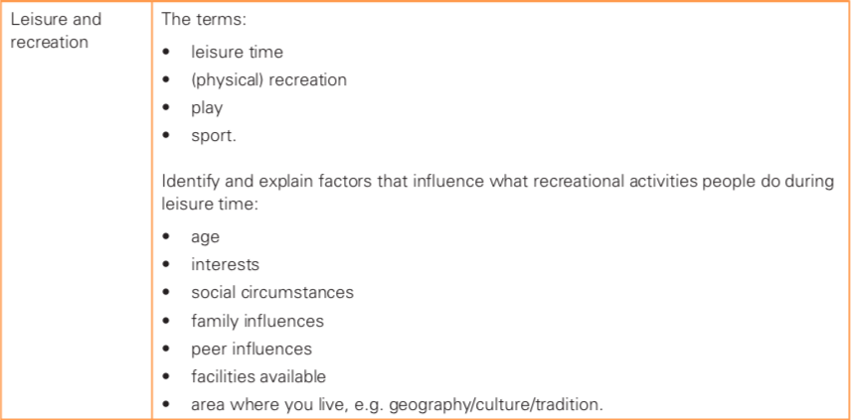
What you need to know
For more help, please visit www.exampaperspractice.co.uk
© 2025 Exams Papers Practice. All Rights Reserved

Slide 3
What you need to know
For more help, please visit www.exampaperspractice.co.uk
© 2025 Exams Papers Practice. All Rights Reserved

Slide 4
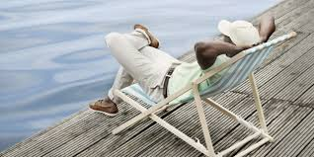
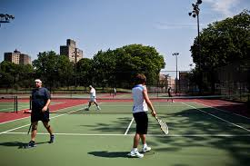
Leisure and physical recreation
What is leisure time?
What is physical recreation?
What are the differences between sport and play?
Name some factors that might influence the activities people choose to take part in during their free time
For more help, please visit www.exampaperspractice.co.uk
© 2025 Exams Papers Practice. All Rights Reserved

Slide 5
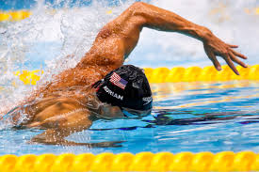
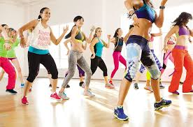
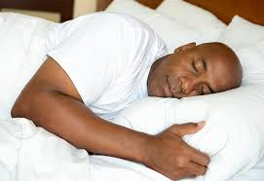
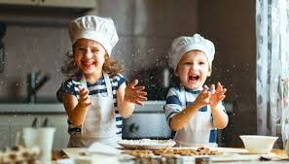
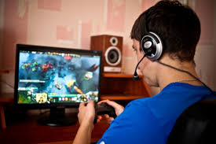
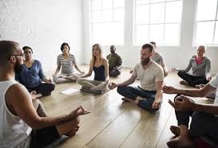
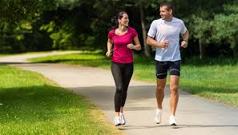
Leisure, physical recreation, sport or play?
Categorise each of the following
1
2
3
4
5
6
7
8
For more help, please visit www.exampaperspractice.co.uk
© 2025 Exams Papers Practice. All Rights Reserved

Slide 6
Leisure and physical recreation
‘People take part in physical recreation for a variety of reasons. For many, this happens during their leisure time’
Leisure and recreation have become a vast industry in recent years. Sport is only a section of it.
What leisure activities (other than sport) might someone be engaged in?
Leisure time– time spent away from work, free of obligations
Physical recreation – a physical activity or pastime that promotes health, relaxation and enjoyment
For more help, please visit www.exampaperspractice.co.uk
© 2025 Exams Papers Practice. All Rights Reserved

Slide 7
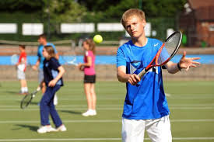
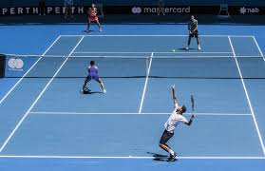
Sport and play
Sport, play and physical recreation may all take place during leisure time
Sports are competitive, they have rules, the aim is to win. Sport includes organised events and competitions
Play is less structured and not as serious
Sport – an activity that involves physical exertion and skill, either as an individual or as part of a team competing against another person or team
Play – To take part in a sport or activity for enjoyment
For more help, please visit www.exampaperspractice.co.uk
© 2025 Exams Papers Practice. All Rights Reserved

Slide 8
Leisure, physical recreation, sport or play?
Has your opinion changed?
1
2
3
4
5
6
7
8
For more help, please visit www.exampaperspractice.co.uk
© 2025 Exams Papers Practice. All Rights Reserved

Slide 9
Physical recreation - influences
There are many reasons why people choose to take part in certain recreational activities
Name a recreational activity that you are regularly involved in
Explain the factors that caused/enabled you to participate in that activity
Age and health Interests Facilities Peer influences
Social circumstances Family influences Where you live
For more help, please visit www.exampaperspractice.co.uk
© 2025 Exams Papers Practice. All Rights Reserved

Slide 10
Physical recreation - influences
Influences | Explanation
Age and health | Older people may choose less physically demanding activities such as walking, golf or bowling
Interests | You are more likely to take part in activities that spark your interest. If you like being outdoors, you may be more likely to take up activities such as hiking
Facilities | Facilities and standard of facilities will influence what you are able to take part in. If you don’t have access to a squash court, you are less likely to take it up.
Peer influences | If your peer group approves of or encourages you to do something, you are more likely to do it.
For more help, please visit www.exampaperspractice.co.uk
© 2025 Exams Papers Practice. All Rights Reserved

Slide 11
Physical recreation - influences
Influences | Explanation
Where you live | Geography, climate and culture all influences the activities you are likely to participate in. Ski jumping is generally only available to those who live in snowy climates
Social circumstances | Activities such as horse riding, sailing and golf can be expensive. Your social circumstances may mean that you cannot afford to participate in such activities
Family influences | If your family shows interest in an activity and encourages you then you are more likely to participate in that activity
Think of a sport that people play a lot of in your country. Can you explain why?
For more help, please visit www.exampaperspractice.co.uk
© 2025 Exams Papers Practice. All Rights Reserved

Slide 12
Questions
What is meant by the term ‘leisure time?’
Explain 2 factors that determine what people do in their leisure time
Name one difference between sport and play
Give one reason why someone who lives in a rural area might find it difficult to perform at the highest level in certain sports
- May not have access to specialist facilities and coaching
- Centres of excellence may be situated in urban areas
- May need to rely on others for transport
- This may be too costly or time consuming
For more help, please visit www.exampaperspractice.co.uk
© 2025 Exams Papers Practice. All Rights Reserved

Slide 13
10.2 The sports development pyramid
Chapter 10
Social and cultural influences
Social, cultural and ethical influences
Learning objectives
1) Define sports development and identify the different levels of the
pyramid
2) Describe the pathways performers take through the pyramid in
different sports
3) Investigate the role of sports development officers
For more help, please visit www.exampaperspractice.co.uk
© 2025 Exams Papers Practice. All Rights Reserved

Slide 14
What you need to know
For more help, please visit www.exampaperspractice.co.uk
© 2025 Exams Papers Practice. All Rights Reserved

Slide 15
The sports development pyramid
The further up the pyramid, the fewer the people who participate
Elite – International and elite club competition (Olympics, world championships...)
Performance – Local and regional coaching, training and competition
Participation – Sports clubs, leisure centres, extracurricular activities
Foundation – PE and recreational sports
Feel Positive about Physical Education
For more help, please visit www.exampaperspractice.co.uk
© 2025 Exams Papers Practice. All Rights Reserved

Slide 16
Stage 1 - foundation
The first stage at which people come into contact with sports
Consists of beginners (often younger people)
Involves mass participation
Is about recreation and having fun
Involves learning the basic skills
Is found in PE lessons
Having a strong foundation in any sport is vital. The more people who take part in sports, the greater the number who will progress to the top of the pyramid
For more help, please visit www.exampaperspractice.co.uk
© 2025 Exams Papers Practice. All Rights Reserved

Slide 17
Stage 2 - participation
The participation stage is about the enjoyment factor of taking part in sports
Taking part in organised sporting activities at clubs or leisure centres
Having a more structured environment than at the foundation stage
Being with friends and like minded individuals who are there to play sport
People at this stage make choices about the sports they want to pursue. Sports clubs are very important at this stage as they bridge the gap to the next stage – ‘performance’
For more help, please visit www.exampaperspractice.co.uk
© 2025 Exams Papers Practice. All Rights Reserved

Slide 18
Stage 3 - Performance
This stage is about competition. Performers have a higher level of skill and are largely at the autonomous stage of learning
The focus is on developing performance toward the elite level
Performers concentrate on one or two sports
Training and competition are regular and more important
Emphasis on professionalism and not just having fun
Coaching will be available to improve tactical and physical skills as they move towards elite level. (Not all performers at this level strive to become elite however)
For more help, please visit www.exampaperspractice.co.uk
© 2025 Exams Papers Practice. All Rights Reserved

Slide 19
Stage 4 - elite
Performance is of the highest level. Very few people reach this stage, hence why it is so narrow at the top
Performers are in regional or national squads
Governing bodies are responsible for the performer’s development. Performers are rarely required to fund their own development
High levels of support are provided, including coaching, medical care and nutrition
Performers are often professional (depending on the sport) and may receive money from sponsorship
Performers make sacrifices to reside at this stage. Their loves tend to revolve around training and competition.
For more help, please visit www.exampaperspractice.co.uk
© 2025 Exams Papers Practice. All Rights Reserved

Slide 20
The sports development pyramid
At which level of the pyramid would you place the following?
A badminton player who meets up every week for a game with her friends
A medal winner at the Paralympic games
A pupil at primary school learning tee-ball
A footballer who plays for their local team in the regional league
Sports development: ‘Promoting sports activities for the community’
Which stage of the pyramid does this target?
How will this influence participation at the other stages?
For more help, please visit www.exampaperspractice.co.uk
© 2025 Exams Papers Practice. All Rights Reserved

Slide 21
Past exam question
Describe the participation level of the sports development pyramid (2)
At the participation level, participants have chosen to take part in the sport by joining clubs or playing with friends. The level is not serious however and having fun is the main objective. The environment tends to be more structured than at the foundation stage.
For more help, please visit www.exampaperspractice.co.uk
© 2025 Exams Papers Practice. All Rights Reserved

Slide 22
10.3 Access and participation in sport
Chapter 10
Social and cultural influences
Social, cultural and ethical influences
Learning objectives
1) Identify the factors that affect access to physical activity
2) Describe the factors that affect participation in sports and
physical activities
3) Explain strategies for increasing access and participation in sports
For more help, please visit www.exampaperspractice.co.uk
© 2025 Exams Papers Practice. All Rights Reserved

Slide 23
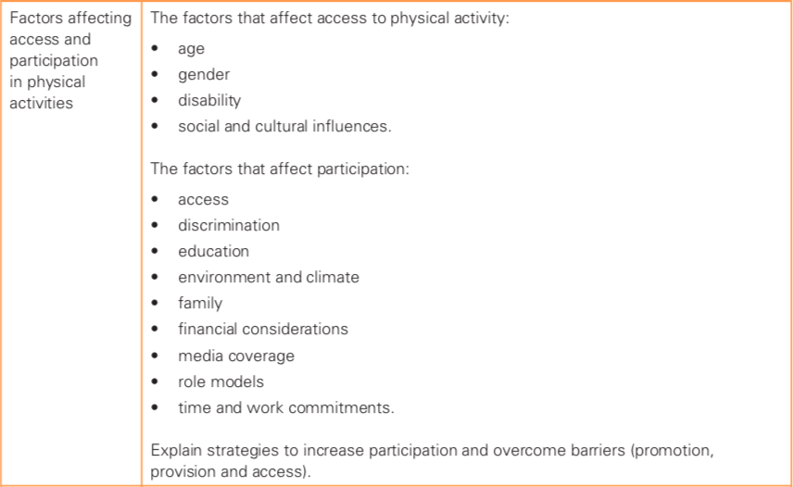
What you need to know
For more help, please visit www.exampaperspractice.co.uk
© 2025 Exams Papers Practice. All Rights Reserved

Slide 24
Access and participation in sport
Accessing sport and physical activity should be an easy decision to make: you simply decide which activity interests you and get involved! There are however many factors that affect which activities you are able to access.
Starter questions
Name and describe factors that could affect your ability to access certain sports or physical activities
Name strategies that could be used to improve participation
For more help, please visit www.exampaperspractice.co.uk
© 2025 Exams Papers Practice. All Rights Reserved

Slide 25
Access and participation in sport
Many people come across obstacles that prevent them from progressing up the sports development pyramid, or even participating at all
These obstacles fall into two main groups:
Factors that affect access (factors that determine whether on not it is possible for an individual to access a certain sport or activity)
Factors that affect participation (factors that influence the likelihood that individuals will participate in a certain sport or activity – provided they have access to it)
Many factors are linked, affecting both access and participation
For more help, please visit www.exampaperspractice.co.uk
© 2025 Exams Papers Practice. All Rights Reserved

Slide 26
Factors that affect access to physical activity
Factor | Group | How it affects access to sport
Age | Young children | Some activities such as weight training are not appropriate as young joints are not fully developed
 | Older people | May not have the physical capabilities to do some sports (less strength, diseases such as arthritis, poor eyesight, poor hearing)
Gender | Females | Some organisations restrict access to men only (e.g. some golf clubs) Women may be made to feel unwelcome even if access is allowed Women’s sports may not have the same levels of finance, facilities and coaching
Often it is not as simple as deciding to take part in an activity that you have an interest in. Many people simply don’t have access!
For more help, please visit www.exampaperspractice.co.uk
© 2025 Exams Papers Practice. All Rights Reserved

Slide 27
Factors that affect access to physical activity
Factor | Group | How it affects access to sport
Disability | Physical | There is a lack of facilities and support for people with disabilities Lack of parking and disabled friendly transport meaning people can’t access facilities
Social influences | Family | Family may not be able to afford equipment, club membership or coaching fees
 | School | Schools may not provide facilities for certain sports, or offer them on the timetable
Cultural influences | Religion | Some faiths won’t allow people to participate on certain (holy) days Some faiths may impose restrictions on sports that can be played or the clothing women can wear (e.g. gymnastics, swimming)
For more help, please visit www.exampaperspractice.co.uk
© 2025 Exams Papers Practice. All Rights Reserved

Slide 28
Access and participation in sport
Using the information provided and your own ideas, write a short article explaining why two of the listed factors can affect access and how access can be improved for those individuals affected
E.g. Those with disabilities may not be able to access certain activities as there may be a lack of specialist facilities and equipment to allow them to participate. Access could be improved by developing local leisure centres to accommodate the disabled (e.g. by installing lifts that enable people to enter and exit swimming pools). Improving disabled parking and public transport links could also help to enable the disabled to access the available facilities.
Alternatively – for each factor, come up with ideas in pairs to improve access (then share with group to create revision mind-map)
For more help, please visit www.exampaperspractice.co.uk
© 2025 Exams Papers Practice. All Rights Reserved

Slide 29
Factors that affect participation in physical activity
Access
Role models
Media coverage
Discrimination
Financial considerations
Factors that affect participation
Time and commitments
Family
Environment/climate
Education
Create a whole page ‘mind-map’ explaining how each of the factors affect participation
For more help, please visit www.exampaperspractice.co.uk
© 2025 Exams Papers Practice. All Rights Reserved

Slide 30
Factors that affect participation in physical activity
Factor | Whom does it affect and why?
Access | People with disabilities, the elderly, women (see slides 26-27)
Discrimination | People of minority ethnic groups / people with disabilities. May be discriminated against, discouraging them from participating
Education | Those educated on the health benefits of physical activity may be more likely to participate
Environment / climate | In mountainous areas, activities such as hiking or skiing may be popular and well supported
Family | Traditionally, in some countries women are expected to look after the family, meaning fewer opportunities to participate in physical activities. Your family’s habits and attitude towards exercise could influence your approach.
Financial considerations | Expensive activities such as golf and horse riding may not be accessible for those from lower socio-economic backgrounds
For more help, please visit www.exampaperspractice.co.uk
© 2025 Exams Papers Practice. All Rights Reserved

Slide 31
Factors that affect participation in physical activity
Factor | Whom does it affect and why?
Media coverage | Very dominated by male sports, meaning males have plenty of inspiration to participate. Little female sport covered in the media means less inspiration to participate.
Role models | Males have many role models due to extensive media coverage in male sport (females have fewer role models) Minority sports are not covered in the media to the same extent, meaning there are fewer role models in such activities
Time and work commitment | People in full-time work may have less time for activities or may feel too tired to take part
For more help, please visit www.exampaperspractice.co.uk
© 2025 Exams Papers Practice. All Rights Reserved

Slide 32
Strategies to increase participation in physical activity
Access
Role models
Media coverage
Discrimination
Financial considerations
Strategies to increase participation
Time and commitments
Family
Environment/climate
Education
Create a whole page ‘mind-map’ describing strategies to increase participation
For more help, please visit www.exampaperspractice.co.uk
© 2025 Exams Papers Practice. All Rights Reserved

Slide 33
Strategies to increase participation in physical activity
Factor | Strategies to increase participation
Access | Disabled-friendly leisure centres (larger doors, access ramps, hoists for swimming pools) Provide specific activities for the elderly and disabled
Discrimination | Promoting tolerance through anti-discrimination initiatives, e.g. ‘kick it out’ (racism in football)
Education | Educational initiatives delivered through schools to improve knowledge of the health benefits of exercise
Environment / climate | Specialist facilities to allow access to activities that would not usually be available in a given environment (e.g. indoor ski centres, rock climbing centres)
Family | Cheaper memberships when enrolling as a family Childcare facilities at leisure centres
For more help, please visit www.exampaperspractice.co.uk
© 2025 Exams Papers Practice. All Rights Reserved

Slide 34
Strategies to increase participation in physical activity
Factor | Strategies to increase participation
Financial considerations | Reducing the cost of memberships through concessions (e.g. for under 16s and pensioners) Local group activities using public spaces to keep costs down and offer easy access (e.g. park runs)
Media coverage | More coverage of female sports Programmes aimed at women with high profile TV presenters, e.g. Sky TV’s ‘Sports Women’
Role models | Greater media attention on female athletes and elite athletes from minority and disability sports
Time and work commitment | Improved access to leisure facilities such as gyms for use during office hours Childcare facilities at leisure centres that allow parents to find the time to exercise
For more help, please visit www.exampaperspractice.co.uk
© 2025 Exams Papers Practice. All Rights Reserved

Slide 35
Past exam questions
Suggest reasons why there has been an increase in the number of disabled athletes taking part in sport (2)
Wider variety of activities available
Greater willingness to adapt sports to people’s needs
Improvement in facilities for performers and spectators
Increasing number of coaches, including coaches specialising in disability sport
Open competitions (enabling anyone to enter)
Disability games alongside able-bodied (Paralympics)
Greater acceptance of disability sport
Increased media coverage and sponsorship
For more help, please visit www.exampaperspractice.co.uk
© 2025 Exams Papers Practice. All Rights Reserved

Slide 36
Past exam questions
Why do some women find it difficult to participate in sport on a regular basis? (2)
Traditional roles of females (housewife role)
Family commitments
Limited transport (use of family car)
Limited child care/cost of child care
Cost of participation (equipment, memberships)
Cultural/religious attitudes and restrictions
Time owing to other commitments
Single parents
Limited opportunities (e.g. some clubs only allow men)
For more help, please visit www.exampaperspractice.co.uk
© 2025 Exams Papers Practice. All Rights Reserved

Slide 37
10.4 Sponsorship
Chapter 10
Social and cultural influences
Social, cultural and ethical influences
Learning objectives
1) Identify the different forms sponsorship can take
2) Describe the role that sponsorship plays in sport
3) Explain the advantages and disadvantages of sponsorship in
sport
For more help, please visit www.exampaperspractice.co.uk
© 2025 Exams Papers Practice. All Rights Reserved

Slide 38
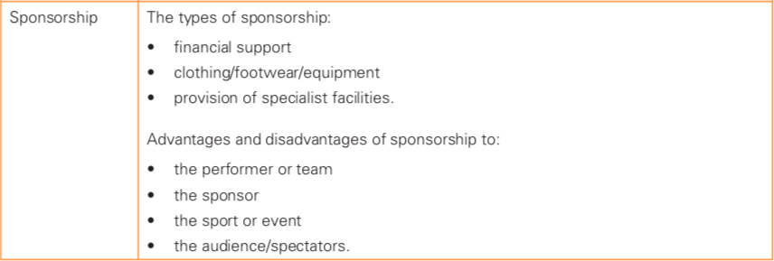
What you need to know
For more help, please visit www.exampaperspractice.co.uk
© 2025 Exams Papers Practice. All Rights Reserved

Slide 39
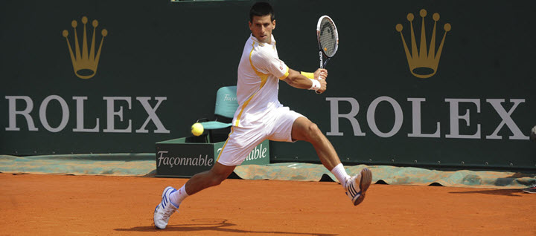
What is sponsorship?
https://www.youtube.com/watch?v=aIHhd4X09og
Sponsorship - the support given to a sport, event, organisation or individual by an outside body for the mutual benefit of both parties
Nike pays Christiano Ronaldo around $20 million a year for him to wear their clothing and represent their brand
Slazenger pay money to Wimbledon for the rights to be affiliated to it
JPMorgan Chase have paid the Golden State Warriors hundreds of millions of dollars to name the team’s new stadium
Rolex sponsor the French Open, enabling them to promote their brand
For more help, please visit www.exampaperspractice.co.uk
© 2025 Exams Papers Practice. All Rights Reserved

Slide 40
The types of sponsorship
Sponsorship can come in the following forms:
Financial support – Funding from the sponsor can help pay for daily living and training costs of a performer or team. In return, the performers will need to promote the business by wearing branded sportswear during competitions or in public
Clothing, footwear, equipment – Head provide tennis racquets to many high profile tennis players. In return the company will receive huge public exposure
Provision of specialist facilities – Emirates partly paid for the construction of Arsenal’s stadium. In return they gained the rights to name it for advertising purposes
For more help, please visit www.exampaperspractice.co.uk
© 2025 Exams Papers Practice. All Rights Reserved

Slide 41
The benefits of sponsorship
There are a number of benefits and drawbacks for each of the parties involved.
Discuss the benefits for each of the following, providing examples where possible
Sponsor
Performer
Sport
Audience and spectators
For more help, please visit www.exampaperspractice.co.uk
© 2025 Exams Papers Practice. All Rights Reserved

Slide 42
The benefits of sponsorship
Sponsor
Being linked to successful sports performers can improve the public image of companies
Displaying the brand helps to increase sales through advertising
Sponsorship money is generally tax free, meaning sponsors can reduce their tax outlay
Performer
Financial support can allow the athlete to compete and train full time
Performers may receive free clothing and equipment
Performers may become extremely wealthy through sponsorship
For more help, please visit www.exampaperspractice.co.uk
© 2025 Exams Papers Practice. All Rights Reserved

Slide 43
The benefits of sponsorship
Sport
Additional funding can be used to develop coaching and community schemes
This can increase the numbers of people playing the sport, improving quality later on
Audience and spectators
Sponsorship money can be used to improve spectator facilities
Sponsors can raise the profile of a sport, increasing the level of media coverage
For more help, please visit www.exampaperspractice.co.uk
© 2025 Exams Papers Practice. All Rights Reserved

Slide 44
Questions
Explain the advantages of sponsorship to the performer and sponsor (3)
Individual:
Helps to pay for living costs including transport, equipment and coaching
Financial support enables performer to train and compete full time
Funds the development of up and coming stars
Sponsor:
Develop a positive image, especially when associated with winning or glamour
Helps to increase sales through advertising
For more help, please visit www.exampaperspractice.co.uk
© 2025 Exams Papers Practice. All Rights Reserved

Slide 45
The disadvantages of sponsorship
There are a number of benefits and drawbacks for each of the parties involved.
Discuss the disadvantages for each of the following, providing examples where possible
Sponsor
Performer
Sport
Audience and spectators
For more help, please visit www.exampaperspractice.co.uk
© 2025 Exams Papers Practice. All Rights Reserved

Slide 46
The disadvantages of sponsorship
Sponsor
Image may be damaged if the performer becomes a negative role model
Performer
Sponsors can go bankrupt causing financial difficulties for the performer or organisation
Sponsors can withdraw support if a performer’s image is damaged
Performers may be required to spend time at a sponsor’s event instead of resting or training
For more help, please visit www.exampaperspractice.co.uk
© 2025 Exams Papers Practice. All Rights Reserved

Slide 47
The disadvantages of sponsorship
Sport
Pressure from sponsors can lead to changes in the rules of the sport (e.g. The introduction of video referees in rugby) which can interfere with the flow of the game
Sponsors prefer high profile sports to promote their brands. Minority sports may find it difficult to find sponsors.
Audience and spectators
Timings of games may change due to sponsors wanting prime-time exposure
Sponsorship deals with media companies may mean coverage changes from free to pay-per-view
For more help, please visit www.exampaperspractice.co.uk
© 2025 Exams Papers Practice. All Rights Reserved

Slide 48
Summary
McDonalds sponsored the 2016 Olympic games
Discuss the effects of this sponsorship with reference to one of the stakeholders (performers, sponsors, sport or audience)
E.g. Sponsor:
McDonalds gained the rights to advertise at the games, meaning they gained massive exposure as the games were viewed by millions worldwide. This can lead to increased sales and revenue.
Their pubic image may also have improved due to associating with such a popular and respected institution.
For more help, please visit www.exampaperspractice.co.uk
© 2025 Exams Papers Practice. All Rights Reserved

Slide 49
10.5 Media
Chapter 10
Social and cultural influences
Social, cultural and ethical influences
Learning objectives
1) Identify the different types of media coverage
2) Explain how the media functions in sport
3) Explain the advantages and disadvantages of media
coverage in sport
For more help, please visit www.exampaperspractice.co.uk
© 2025 Exams Papers Practice. All Rights Reserved

Slide 50
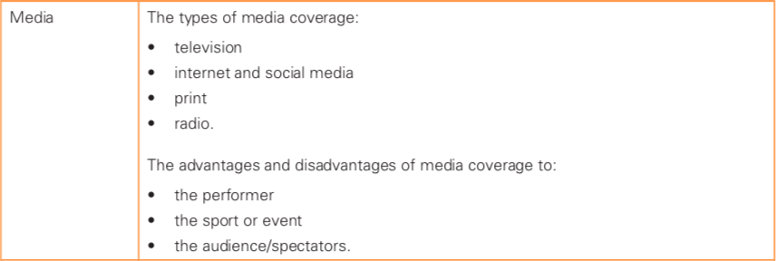
What you need to know
For more help, please visit www.exampaperspractice.co.uk
© 2025 Exams Papers Practice. All Rights Reserved

Slide 51
Media
“the variety of forms of communicating information to an audience”
How many of forms of media can you identify?
Can you identify any positives of the media in sport?
Can you identify any negatives of the media in sport?
Think of your favourite sporting event. In which ways do you think the media has influenced the event?
For more help, please visit www.exampaperspractice.co.uk
© 2025 Exams Papers Practice. All Rights Reserved

Slide 52
Types of media coverage
Media coverage includes print, internet/social media, TV and radio
Print
Newspapers – contain sports sections. There are some sports specific papers e.g. the racing post.
Magazines – Sporting articles, interviews and insight into sport, specific magazines for individual sports (golf, cycling etc…)
Internet and social media
Internet - allows access to radio, TV and print media
Provides up to date and varied information as well as a means to look up past events and statistics
Social media - provides access to ‘behind the scenes’ footage and information from performers and teams
Allows individuals to comment on posts and connect with sports performers
For more help, please visit www.exampaperspractice.co.uk
© 2025 Exams Papers Practice. All Rights Reserved

Slide 53
Types of media coverage
Television
Non-subscription channels deliver free sports coverage
Pay to view channels deliver sport with 24 hour coverage
Channels can bid to show sports or particular events
Subscription services have led to improved quality of broadcasting
Radio
Offers live coverage with up to date information
Sport specific stations (e.g. talkSPORT)
Can be listened to on the move
Allows people to interact and share opinions through phone-ins
For more help, please visit www.exampaperspractice.co.uk
© 2025 Exams Papers Practice. All Rights Reserved

Slide 54
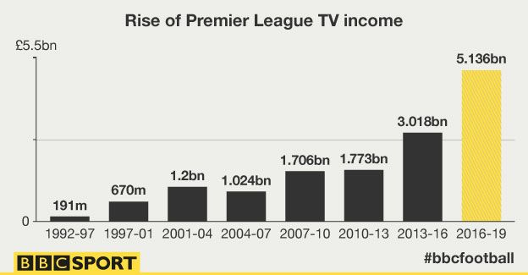
The impact of the media
Media companies (SKY and BT) paid billions of dollars for the rights to broadcast premier league football matches in the UK this year
Each team received over £100 million as a result
What impact does this have?
For more help, please visit www.exampaperspractice.co.uk
© 2025 Exams Papers Practice. All Rights Reserved

Slide 55
The impact of the media
Positive effects of the media | Negative effects of the media
Media coverage makes it easier to attract sponsorship | Some sports get more exposure than others; minority sports lose out
Supporters can get a better view of the action | Media feeds an obsession with statistics and records, rather than the skills of the sport
Supporters gain insider knowledge from expert analysis | Media influence is large, with sports changing formats to suit media needs (e.g. introduction of the tennis tie-break)
Media has influenced positive rule changes (e.g. the use of ‘hawk eye’ in tennis and goal-line technology in football) | People may stay at home to watch sporting events leading to reduced attendances
People become more interested in sports leading to increased attendances | Pay-per-view channels may mean that people can’t afford to access certain events
For more help, please visit www.exampaperspractice.co.uk
© 2025 Exams Papers Practice. All Rights Reserved

Slide 56
The impact of the media
Positive effects of the media | Negative effects of the media
Athlete pay and prize-money increases due to money from the media | Event timings may be altered to suit the media, not the players or the fans
Standards increase due to media money used for facilities and coaching | Increased exposure can lead to a lack of privacy for performers and families
Performers can become role models, developing their reputation, promoting themselves and products | Media scrutiny means that comments and behaviour can lead to fines and loss of sponsorship
Media coverage can increase participation levels and interest in sports | Sensationalisation by the media to promote events can affect people’s views of sports and individuals
 | Over-exposure can lead to a loss of interest in the sport
 | Sports may become dependent on money from the media
Sensationalisation – the reporting of something in a way that arouses curiosity by exaggerating a story or focusing on specific details
For more help, please visit www.exampaperspractice.co.uk
© 2025 Exams Papers Practice. All Rights Reserved

Slide 57
Task – The impact of the media
For each positive and negative effect of the media, state which stakeholder it influences
Select one of thee following scenarios
Discuss the impact on each of the three stakeholders
Scenarios
the influence of extensive television coverage in football
the effect of limited television coverage in minority sports
the effect of multimedia coverage of large global events
from the viewpoint of the different stakeholders:
Performer
Sport/event
Audience/spectators
For more help, please visit www.exampaperspractice.co.uk
© 2025 Exams Papers Practice. All Rights Reserved

Slide 58
Example
Scenario
the effect of multimedia coverage of large global events
Performer: May be required to perform at unfavourable times due to pressure from the media. The injection of funds from the media can lead to increased pay and prize money however.
Sport/event: The media has a large influence over the event in some cases leading to changes in competition times and rules. Supporters may also choose to watch from home leading to a drop in attendance.
Audience/spectators: Supporters can gain more knowledge from expert analysis, although they may not be able to access certain events due to costly ‘pay-per-view’ TV channels.
For more help, please visit www.exampaperspractice.co.uk
© 2025 Exams Papers Practice. All Rights Reserved

Slide 59
Questions
Describe one benefit of the media for sports performers (1)
What advantages are there for a sport when it receives regular television coverage? (4)
Increased popularity leading to increased attendance
and increased levels of participation
Sponsors are more likely to be attracted to the sport
Money from sponsorship can lead to improved facilities
TV deals provide money directly to the sport
This can lead to improved quality of coaching
Overall increase in the quality of performance
Presence of the media can motivate performers
For more help, please visit www.exampaperspractice.co.uk
© 2025 Exams Papers Practice. All Rights Reserved

Slide 60
10.6 Global events
Chapter 10
Social and cultural influences
Social, cultural and ethical influences
Learning objectives
1) Identify the advantages and disadvantages of hosting global sporting
events
2) Understand how global sports events can affect areas of sport and
society
3) Describe the effects of global sports events on different host
cities/countries
For more help, please visit www.exampaperspractice.co.uk
© 2025 Exams Papers Practice. All Rights Reserved

Slide 61
What you need to know
For more help, please visit www.exampaperspractice.co.uk
© 2025 Exams Papers Practice. All Rights Reserved

Slide 62
Global events – why host?
Several years before each major global competition, nations put huge resources into bidding for the rights to host that event
Why do you think a nation would want to host a global event? (take notes in pairs)
Single sport events
Multi sport event
For more help, please visit www.exampaperspractice.co.uk
© 2025 Exams Papers Practice. All Rights Reserved

Slide 63
Advantages of hosting a global competition
https://www.youtube.com/watch?v=UiV_6nAvEFA
Factor | Advantages of hosting a global competition
Stadia and training facilities
Home advantage
National pride
Tourism
Economy and employment
Legacy implications
Infrastructure
Explain how each of the factors could be an advantage for a host nation. You could also provide examples
For more help, please visit www.exampaperspractice.co.uk
© 2025 Exams Papers Practice. All Rights Reserved

Slide 64
Factor | Advantages of hosting a global competition
Stadia and training facilities | Improved sports facilities are built that can be used both before and after the competition.
Home advantage | Hosting an event can give the country home advantage, with more spectators cheering home performers on. Performers can also benefit from competing in a familiar environment and climate.
National pride | Can create a buzz for local residents, improving optimism and a sense of national pride.
Tourism | More visitors in the country spending money on hotels, food, souvenirs, transport etc… This can also lead to improved awareness and status of the city/country increasing visitor numbers in the future
Economy and employment | Increased employment in preparation for and during the event. Extra revenue from visitors during and after the event.
Legacy implications | The event offers a legacy; better facilities will be available for elite training and community use. Increased interest following the event can lead to more participation in sports.
Infrastructure | Improved infrastructure around the venues and main cities such as road, rail and accommodation, offering longer term benefits for the local society
For more help, please visit www.exampaperspractice.co.uk
© 2025 Exams Papers Practice. All Rights Reserved

Slide 65
Benefits for athletes
List benefits and drawbacks for athletes competing in the Olympic games
There are also a number of benefits for the athletes themselves when competing on the biggest stage
High levels of pressure could impact performance
Increased fame/ gaining status as a top-level athlete
Athletes feel proud to represent their nation
Opportunity to compete against the best
Financial rewards for competing
Could be a once in a lifetime opportunity
Pressure to win can lead to cheating (e.g. PED use)
Athletes can become role models for others
Chance to obtain better contracts and sponsorship
For more help, please visit www.exampaperspractice.co.uk
© 2025 Exams Papers Practice. All Rights Reserved

Slide 66
Disadvantages of hosting a global competition
https://www.youtube.com/watch?v=Zh3L1S31WAo
Factor | Advantages of hosting a global competition
Stadia and training facilities
Home advantage
National pride
Tourism
Economy and employment
Legacy implications
Infrastructure
Explain how each of the factors could be an disadvantage for a host nation. You could also provide examples
For more help, please visit www.exampaperspractice.co.uk
© 2025 Exams Papers Practice. All Rights Reserved

Slide 67
Factor | Disadvantages of hosting a global competition
Stadia and training facilities | Sports facilities can be a target for terrorists, or those seeking to make their political views known. A huge amount of money was spent on anti-terrorism security during the Rio 2016 games.
Home advantage | Added pressure on home performers to succeed could have a negative effect on performances
National pride | Negativity or lowering of morale if home team does not perform well
Tourism | Increased tourism can put pressure on facilities (e.g. transport problems). Tourist’s experiences could create bad publicity for the host nation.
Economy and employment | The cost of hosting a global event can be huge. A poorly run competition could give the country a poor image, which could effect future tourism.
Legacy implications | Facilities can quickly become run-down and disused if not maintained and managed properly
Infrastructure | Huge financial cost of investing in new sports facilities
For more help, please visit www.exampaperspractice.co.uk
© 2025 Exams Papers Practice. All Rights Reserved

Slide 68
Summary Questions
Provide an example of a recognised global event (1)
- FIFA world cup
- WRU world cup
- FINA national swimming championships
Describe the advantages of hosting a major global event for the host nation (4)
Hosting a major global event such as the Olympics has many advantages for the host nation. Newly built stadia and training facilities can be used both before and after competition, benefiting both performers and spectators. The event will also provide employment opportunities through increased tourism and preparing and running the event. This can help to develop the economy of the nation. Infrastructure, including transport networks will improve, benefiting the wider society. The event may also leave a positive legacy with greater levels of participation and training facilities for elite development.
For more help, please visit www.exampaperspractice.co.uk
© 2025 Exams Papers Practice. All Rights Reserved

Slide 69
10.7 Professional and amateur performers
Chapter 10
Social and cultural influences
Social, cultural and ethical influences
Learning objectives
1) Identify the differences between professional and amateur
performers
2) Explain the blurred lines between professional and amateur
status
3) Describe how sportsmanship and gamesmanship are displayed in
physical activities
For more help, please visit www.exampaperspractice.co.uk
© 2025 Exams Papers Practice. All Rights Reserved

Slide 70
What you need to know
For more help, please visit www.exampaperspractice.co.uk
© 2025 Exams Papers Practice. All Rights Reserved

Slide 71
Professional and amateur performers
Discuss questions in pairs or record your own notes
What does it mean to be a professional sports performer?
In recent years, more and more athletes have become professional and the majority of top level athletes are now professional.
What do you think caused the rise in numbers of professional athletes?
For more help, please visit www.exampaperspractice.co.uk
© 2025 Exams Papers Practice. All Rights Reserved

Slide 72
Professional and amateur performers
Professional –
Performing a sports activity as a paid occupation, rather than a pastime
Amateur –
Engaging in a sports activity, on an unpaid basis
Most people that take part in sport are amateur; they do so for the enjoyment of performing. Over the years, sponsorship and media became more involved and now the majority of elite sport is now professional
For more help, please visit www.exampaperspractice.co.uk
© 2025 Exams Papers Practice. All Rights Reserved

Slide 73
Professional and amateur performers – traditional differences
Many modern sports can be traced back to British schools in the 1800s attended by the upper classes
It was believed that the purest form of sport was amateur (without payment or reward)
Professional athletes tended to come from the lower classes as they competed for money (often from bets)
Amateurs believed that competing for money was not ‘gentlemanly’
The traditional differences between amateur and professional performers are summarised on the next slide
For more help, please visit www.exampaperspractice.co.uk
© 2025 Exams Papers Practice. All Rights Reserved

Slide 74
Professional and amateur performers – traditional differences
Label the following as either a characteristic of amateur or professional performers
Winning is the main aim as performers often receive more money when they win
They choose when and where to take part
Training and performing is their job and a full-time occupation
Performers take part for enjoyment
Sport is a leisure activity
Training is done in spare time, fitted in around work
Performers take part for money
They perform when they are told to (by clubs, sponsors, managers etc...
Taking part is more important than the result
Sport is their job
For more help, please visit www.exampaperspractice.co.uk
© 2025 Exams Papers Practice. All Rights Reserved

Slide 75
Blurring between professional and amateur status
Read the information then summarise in your own words why the IOC (International Olympic Committee) eventually allowed professionals to compete in the Olympic games.
Over time however, the division between amateur and professional status started to become blurred
For many amateurs, sport was no longer simply a leisure activity where taking part was more important than the result!
Amateurs were gaining funding from a variety of sources, allowing them to dedicate more time and energy to their sport
Funding also helped them to access better quality facilities, coaching and equipment
In some instances, it meant that ‘amateur’ performers were essentially professional
Once exclusively amateur events such as the Olympics, eventually changed their rules to allow professionals to compete
They did this as it became harder to distinguish between professional and amateur competitors
For more help, please visit www.exampaperspractice.co.uk
© 2025 Exams Papers Practice. All Rights Reserved

Slide 76
Blurring between professional and amateur status
Where did funding for performers in the Olympic games come from?
Some countries’ competitors were sponsored by their government to train and compete (e.g. East Germany)
Some athletes were being paid secretly to enable them to train and compete full time
In 1971 the IOC (International Olympic Committee) began providing compensation for missing work or funding
Some athletes made money through sponsorship
Or achieved athletic scholarships to help them train and compete at the highest level
Some were given grants or had trust-funds set up
As a result, in 1986 a rule change meant professionals were allowed to compete in the Olympics (e.g. Basketball stars such as Michael Jordan were able to represent their nation)
For more help, please visit www.exampaperspractice.co.uk
© 2025 Exams Papers Practice. All Rights Reserved

Slide 77
Professional and amateur performers
Today, both amateur and professionals are able to compete at the Olympic Games
Although the vast majority of performers are professional, amateur athletes still have an opportunity to become famous through determination rather than domination
‘Eric the Eel’ (Eric Moussambani) represented Equatorial Guinea in the 2000 Olympic Games in Sydney
He had only learned to swim 8 months before and finished over a minute behind the winner of his semi-final in the 100m freestyle
His determination brought fame, and encapsulated the spirit of the Games
For more help, please visit www.exampaperspractice.co.uk
© 2025 Exams Papers Practice. All Rights Reserved

Slide 78
Questions
Explain how some performers are able to maintain amateur status whilst being able to perform at the highest level (3)
Sponsorship deals
Part time employment
Trust funds
Grants
Prize money
Remember, simply listing points is not sufficient. You need to explain your understanding. E.g. Sponsors pay athletes to endorse/use their products. This money may mean athletes don’t have to work and can focus fully on training and competition.
For more help, please visit www.exampaperspractice.co.uk
© 2025 Exams Papers Practice. All Rights Reserved

Slide 79
Questions
Professional sports people compete in the Olympic Games when there is little financial reward. Give three reasons why they would choose to do so (3)
Pride in representing their country
Olympic Games represents a unique opportunity as it only occurs every 4 years
The chance to win a medal could be a once only opportunity
The history of the games. People want to be involved in such a great and historical event
Opportunity to compete at the highest level (winning at the games is considered to be the pinnacle of sporting achievement)
To enhance reputation and recognition/to gain more opportunities to gain sponsorship
For more help, please visit www.exampaperspractice.co.uk
© 2025 Exams Papers Practice. All Rights Reserved

Slide 80
Questions
Explain why amateur competitions such as the Olympic Games prevented professional athletes from competing for so long (2)
Belief that the purest form of sport was amateur
Belief that competing for money was not ‘gentlemanly’
Beliefs established by the upper classes in the 1800’s
Fairness as an underlying principle; it was thought that training and competing professionally gave athletes an unfair advantage
For more help, please visit www.exampaperspractice.co.uk
© 2025 Exams Papers Practice. All Rights Reserved

Slide 81
Questions
Explain why events such as the Olympic Games made the transition to allow professionals to compete (3)
The division between amateur and professional status started to become blurred
Amateurs began to gain funding from a variety of sources
Funding meant amateurs were able to dedicate more time to their sport
Funding also helped them to access better quality facilities, coaching and equipment
Some athletes were sponsored by their government/secretly paid/gained sponsorships/trust-funds/grants/compensated for missing work
It became harder to distinguish between professional and amateur performers
For more help, please visit www.exampaperspractice.co.uk
© 2025 Exams Papers Practice. All Rights Reserved

Slide 82
Sportsmanship and gamesmanship
What do you know about the terms sportsmanship and gamesmanship?
Can you provide any practical examples of sportsmanship?
Can you provide any practical examples of gamesmanship?
Discuss questions in pairs or record your own notes
For more help, please visit www.exampaperspractice.co.uk
© 2025 Exams Papers Practice. All Rights Reserved

Slide 83
Sportsmanship and gamesmanship
Definitions
Sportsmanship –
‘Upholding the spirit of the game by being honest, playing by the rules and showing respect for your opponents’
This relates to the traditional values of amateur sport; acting with sportsmanlike behaviour was seen as essential to the ‘gentleman amateur’
Gamesmanship –
‘Seeking to gain an advantage in any way you can that is not against the rules’
At times this may seem unfair and treads a fine line between cheating and playing by the rules
Videos – sportsmanship or gamesmanship?
https://www.youtube.com/watch?v=xOZ8VZi6mQs&t=3s
https://www.youtube.com/watch?v=dCVlRFWOjgE
https://www.youtube.com/watch?v=liCRrheKIOI
https://www.youtube.com/watch?v=OiW0IPrv1Ro
https://www.youtube.com/watch?v=5mHjvFpsjLk
For more help, please visit www.exampaperspractice.co.uk
© 2025 Exams Papers Practice. All Rights Reserved
Notes:
Videos not downloaded – find on youtube

Slide 84
Sportsmanship and gamesmanship
Task –
Select a sport that you play regularly or enjoy watching
Note down examples of sportsmanship that exist in that sport
Note down examples of gamesmanship that exist in that sport
Share your answers with a partner and see if they can identify any examples that you missed
Extension – for at least one of the examples you have given, explain why it demonstrates sportsmanship or gamesmanship
For more help, please visit www.exampaperspractice.co.uk
© 2025 Exams Papers Practice. All Rights Reserved

Slide 85
Sportsmanship or gamesmanship?
...or cheating?
For each of the following state whether you think it’s an example of sportsmanship, gamesmanship, or breaking the rules
Football – Shielding the ball by the corner flag to run down the clock
Cricket – Fielding team applauding an outstanding shot
Cricket – Pretending the ball didn’t touch the bat when caught out
Boxing – ‘Psyching out’ the opponent during the fight
Tennis – ‘Grunting’ during a point
Football – Refusing to celebrate when scoring against former club
Boxing – Hitting below the belt
General - Shaking hands/apologising after committing a foul
General – Celebrating in front of the opposition after scoring
Cricket – A batter walking off the field having been caught when they know they touched the ball, even when the umpire has given ‘not out’
Netball – Deliberately using the foot to prevent a bounce-pass
Football – Kicking the ball away to prevent opponent from taking a quick free-kick
G
S
G
G
?
S
?
S
G
S
?
?
For more help, please visit www.exampaperspractice.co.uk
© 2025 Exams Papers Practice. All Rights Reserved
Notes:
5 – Can it be proved that they’re trying to put off their opponent?
7 – They are trying to gain an unfair advantage, but if caught are simply playing outside of the rules
11 – They are trying to gain an unfair advantage, but if caught are simply playing outside of the rules
12 – The extent to which they kick the ball determines whether the referee will penalise the player

Slide 86
Sportsmanship or gamesmanship?
...or cheating?
For each of the following state whether you think it’s an example of sportsmanship, gamesmanship, or breaking the rules
Cricket – ‘Sledging’ from the wicketkeeper towards the batter
Football – Kicking the ball out of play when an opponent is injured
Football – Passing the ball back to the team who kicked it out of play
Football – Goalkeeper holding on to the ball to run down the clock
General – Helping a opponent to their feet
General – Feigning injury to break up the flow of the game
General – Diving (simulation)
Cycling – Allowing a competitor to catch up following a crash
Boxing – ‘Grappling’ to run down the clock and avoid being hit
Rugby – Holding onto the ball after a tackle, but releasing quickly enough to avoid being penalised
Cricket – Bowler runs across the wicket to create rough patches which will give their spin bowlers an advantage
Football – Waving an imaginary card to the referee, encouraging them to book an opponent
G
S
S
G
S
G
?
S
G
G
G
G
For more help, please visit www.exampaperspractice.co.uk
© 2025 Exams Papers Practice. All Rights Reserved
Notes:
19 – It is often difficult to tell whether simulation occurs. A player may make a foul look worse than it is to gain an advantage (this is gamesmanship). A blatant dive in absence of contact is outside the rules and the player should be penalised
23 – The subtlety of the action determines whether it is gamesmanship or outside of the rules

Slide 87
Summary questions
Can you define the terms sportsmanship and gamesmanship?
Can you explain the differences between the two?
Can you use a range of practical examples to help you explain the term sportsmanship? – choose 1 or 2
Can you use a range of practical examples to help you explain the term gamesmanship? – choose 1 or 2
Can you state whether ‘feigning injury to waste time’ is an example of sportsmanship or gamesmanship and explain why?
Answer one or more of the above without your notes, then check back to ensure all information is accurate and your answer is sufficiently detailed
For more help, please visit www.exampaperspractice.co.uk
© 2025 Exams Papers Practice. All Rights Reserved

Slide 88
10.8 Technology in sport
Chapter 10
Social and cultural influences
Social, cultural and ethical influences
Learning objectives
1) Identify the different forms of technology used in sport
2) Understand how technology is used in sport by officials,
improving performance, recording time and distance
3) Describe the positive and negative impact of technology on sport
For more help, please visit www.exampaperspractice.co.uk
© 2025 Exams Papers Practice. All Rights Reserved

Slide 89
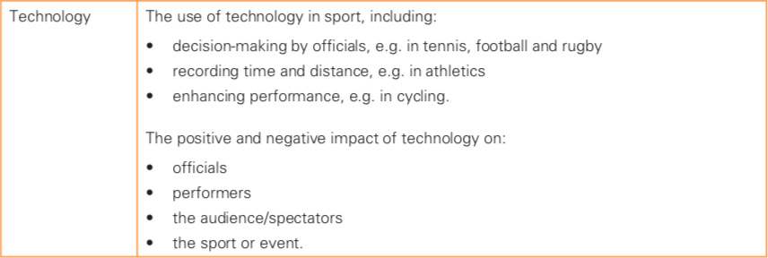
What you need to know
For more help, please visit www.exampaperspractice.co.uk
© 2025 Exams Papers Practice. All Rights Reserved

Slide 90
Technology in sport
https://www.youtube.com/watch?v=dqDZftgB2lw
Technology has had a major impact in the world of sport, affecting almost every area:
How officials make decisions
How performers train for events and deliver their best performance
How performances are measured and recorded
Starter task
Discuss technologies that are used in sport today
Use the categories above to assist
For more help, please visit www.exampaperspractice.co.uk
© 2025 Exams Papers Practice. All Rights Reserved

Slide 91
Technology
Enhancing performance
https://www.youtube.com/watch?v=8COaMKbNrX0
Technological advances are continuing to improve performance
Watch the video and note the technologies that have led to improvements in athletic performance over time
Did you manage to come up with the following?
Starting blocks, synthetic running tracks, faster skis, running shoes, swimming pool guttering, low friction swim suits, aerodynamic bicycles
Equipment has improved over time, but so have technologies associated with training, sports medicine and analysis of performance
For more help, please visit www.exampaperspractice.co.uk
© 2025 Exams Papers Practice. All Rights Reserved

Slide 92
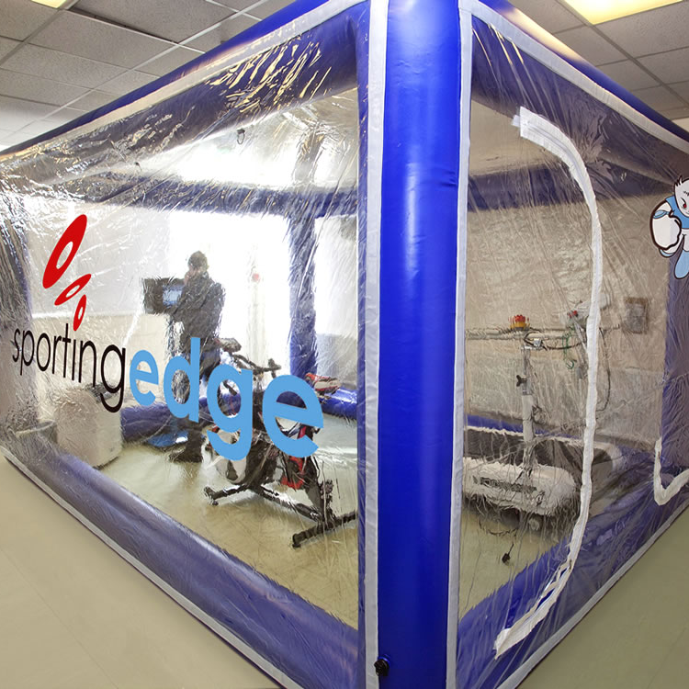
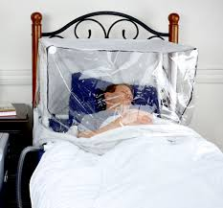
Technology
Enhancing performance
Altitude tents –
Used to enhance performance in endurance athletes
Recreates living and training at altitude
Expose performers to low oxygen (hypoxic) conditions simulating living and training at high altitude
Leads to an increase in red blood cell concentration
Increasing the oxygen carrying capacity of the blood
And improving aerobic performance
Beneficial for marathon runners
The technology is expensive however and therefore may not be available to all giving higher profile/professional athletes an unfair advantage
For more help, please visit www.exampaperspractice.co.uk
© 2025 Exams Papers Practice. All Rights Reserved

Slide 93
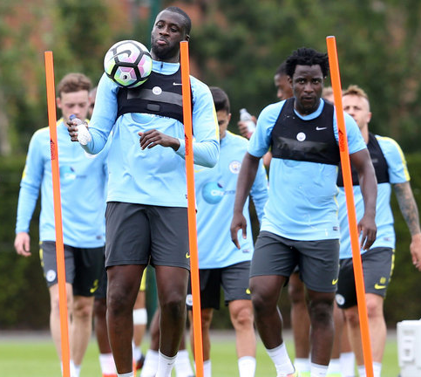
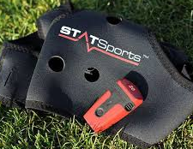
Technology
Enhancing performance
Multisensor monitoring (‘Viper Pod’)
Sensor is worn in a vest and used for data analysis of an athlete’s physical performance
Measures heart rate, distance covered, intensity & speed
Detailed feedback can be provided and training methods adapted to address weaknesses
For more help, please visit www.exampaperspractice.co.uk
© 2025 Exams Papers Practice. All Rights Reserved

Slide 94
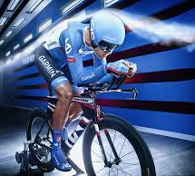
Technology
Enhancing performance
Wind tunnels –
High speed fans are used to show how equipment and body position are affected by air resistance
Techniques and equipment (such as bicycles and helmets) are adapted to reduce the impact of air resistance
For more help, please visit www.exampaperspractice.co.uk
© 2025 Exams Papers Practice. All Rights Reserved

Slide 95
Technology
Enhancing performance
Equipment
New materials and design used in tennis rackets, skis, footballs, javelins and bicycles improving control, speed and distance
Specialist clothing and footwear, including heat-reducing and lightweight materials and hydrodynamic full-body swimming suits improving speed and endurance
Facilities
All-weather surfaces, better drainage and roofed stadiums produce better playing conditions
Safety improvements in gymnastics training, including landing areas and harnesses, encourage greater skill development
ICT in training and coaching
Use of video and statistical analysis helps identify areas for improvement and focuses coaching to improve performance more effectively
Fitness monitoring equipment analyses key physiological factors and helps with the planning of effective training
Are their any downsides of these technologies for performers?
For more help, please visit www.exampaperspractice.co.uk
© 2025 Exams Papers Practice. All Rights Reserved

Slide 96
Technology
Decision making by officials
Correct decision making by officials has become increasingly important with investments from sponsors and the media
A wrong decision in the Championship play-off final could cost a club hundreds of millions, as this is the money clubs receive directly and indirectly for reaching the premier league
Cricket review system - https://www.youtube.com/watch?v=ecjKhf-TC0k
Hawkeye - https://www.youtube.com/watch?v=XhQyVnwBXBs
Goal line technology - https://www.youtube.com/watch?v=qOq0yqzp49E
For more help, please visit www.exampaperspractice.co.uk
© 2025 Exams Papers Practice. All Rights Reserved

Slide 97
Technology
Decision making by officials
Basketball referees use replay systems to make sure players are shooting within the time allotted by the shot clock
In international cricket, the third umpire who has access to TV replays is used to assist with contentious decisions such as disputed catches and boundaries
Goal-line technology in football is used to determine whether the ball has fully crossed the line and a goal can be awarded
Off-field umpires with access to multiple TV replay angles communicate with referees to help them make correct decisions (TMO – television match official in rugby union and VAR – video assistant referee in football)
Are their any downsides of these technologies for officials, performers, the sport and the audience/spectators?
Summarise one of the following technologies: Hawkeye, goal-line technology
For more help, please visit www.exampaperspractice.co.uk
© 2025 Exams Papers Practice. All Rights Reserved

Slide 98
Technology
Recording times and distances
Fully automatic time (FAT)
Time measuring technology is used in swimming, where the clock is activated by the starting buzzer and stopped when the swimmer makes contact with a touch pad on the pool wall
Laser measurement (LaserLynx)
Laser-based distance measurement devices can produce accurate, computer-generated measurements for field events (e.g. long jump)
The accuracy of time and distance measurements are extremely important as margins of victory are often small and new records are at stake
For more help, please visit www.exampaperspractice.co.uk
© 2025 Exams Papers Practice. All Rights Reserved

Slide 99
Technology
Advantages and disadvantages
Task – discuss potential advantages and disadvantages of technology for one of the following parties –
Performers, the sport, audience/spectators, officials
Effect on… | Advantages | Disadvantages
Performer | Improvements in training leading to improved performance Able to review decisions in competition that may go against them unfairly | Not all performers have access to the best technology Gives advantage to performers from wealthier countries Can disrupt or slow down the game
Sport | Fairer decision-making Adds drama and suspense while the decision is made Brings in more investment | Can slow play down if used too often Doesn’t always give the correct decision Media companies may demand more influence in return for their investment
For more help, please visit www.exampaperspractice.co.uk
© 2025 Exams Papers Practice. All Rights Reserved

Slide 100
Technology
Advantages and disadvantages
Effect on… | Advantages | Disadvantages
Audience / spectators | Better informed from replays, expert analysis, different camera angles Can see how decisions are made and trust they are fair Adds excitement when waiting for a decision | May see errors or poor decisions when viewing on platforms with technology that officials don’t have, causing problems for the official and sport To keep plays fast, only a few reviews are allowed, so mistakes are still made if no reviews are left
Officials | Helps to make correct decisions Improved communication with colleagues Reduces pressure of officials from supporters and players | Reversed decisions may lead to officials being undermined May become too reliant on the systems to make decisions
For more help, please visit www.exampaperspractice.co.uk
© 2025 Exams Papers Practice. All Rights Reserved

Slide 101
Past exam questions
Describe technologies that help officials to make decisions in sport (3)
Describe the impact of technological advances for sports performers (3)
Hawkeye is used in tennis to make judgements on whether the ball landed in or out of the court. Explain the advantages and disadvantages of this technology (3)
For more help, please visit www.exampaperspractice.co.uk
© 2025 Exams Papers Practice. All Rights Reserved

