Slide 1


1.1 The skeleton and its functions
Chapter 1
The skeletal and muscular system
Anatomy and Physiology
Learning objectives
1) Outline the four main functions of the skeleton
2) Name and locate the main bones in the skeleton and classify
them according to type
3) Describe the functions of different bones
For more help, please visit www.exampaperspractice.co.uk
© 2025 Exams Papers Practice. All Rights Reserved

Slide 2
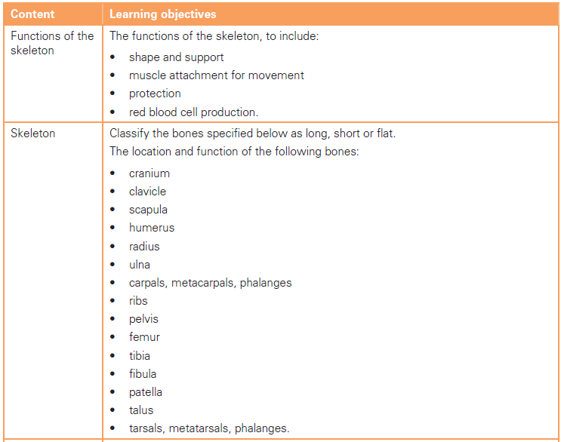
What you need to know
For more help, please visit www.exampaperspractice.co.uk
© 2025 Exams Papers Practice. All Rights Reserved

Slide 3
Functions of the skeletal system
- Task 1 What jobs does the skeleton do (there are 4 in total)?
Shape and Support
Protection
Movement (provides attachments for muscles)
(Red) blood cell production
- Task 2 Discuss what is meant by each of the above
For more help, please visit www.exampaperspractice.co.uk
© 2025 Exams Papers Practice. All Rights Reserved

Slide 4
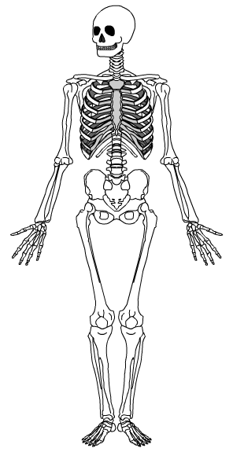
Shape and Support
- What would a human look like without bones to support them?
Support
Bones enable us to stand upright
Bones help to keep organs and tissues in place
Shape
Bones determine height and build
Ligaments join the bones together
Provides a frame to which our muscles can attach
“E.g. The backbone / spine enables us to stay upright”
For more help, please visit www.exampaperspractice.co.uk
© 2025 Exams Papers Practice. All Rights Reserved

Slide 5
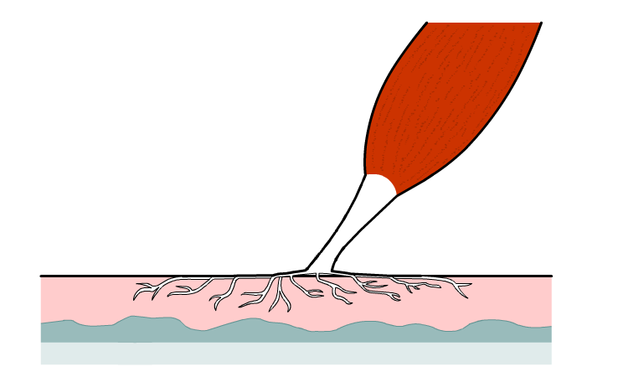
Movement
Muscles are attached to the skeleton by tendons
  Movement occurs when muscles contract,
  Pulling on the bones,
  Creating movement at a joint
E.g. “The bicep connects to the forearm. When it contracts it pulls on the bone, creating movement at the elbow”
For more help, please visit www.exampaperspractice.co.uk
© 2025 Exams Papers Practice. All Rights Reserved

Slide 6
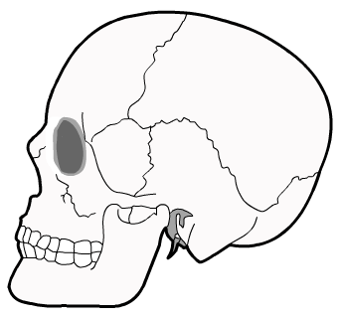
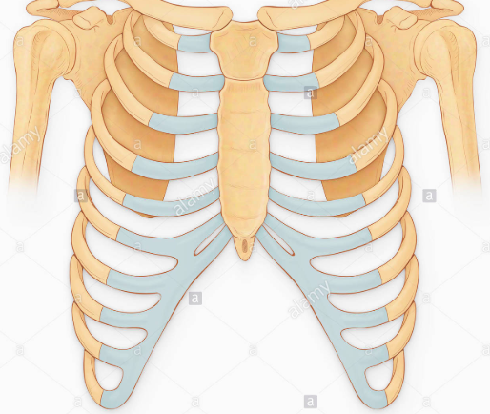
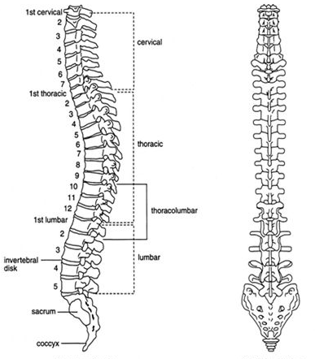
Protection
The internal organs are soft, delicate and easily damaged
  These vital organs are protected by the skeleton
Which organs are protected by each of the following bones?
E.g. “the cranium protects the brain”
For more help, please visit www.exampaperspractice.co.uk
© 2025 Exams Papers Practice. All Rights Reserved

Slide 7
(Red) blood cell production
The centre of some large bones contains red bone marrow
  Red blood cells are produced in the bone marrow
E.g. “The pelvis and the femur contain lots of bone marrow and are important for red blood cell production”
For more help, please visit www.exampaperspractice.co.uk
© 2025 Exams Papers Practice. All Rights Reserved

Slide 8
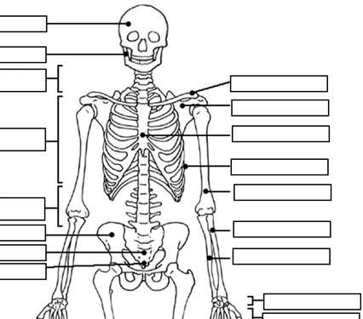
The bones of the skeletal system
- Task Using the work-sheet, label as many bones as you can think of!
Skeletal system worksheet (next slide)
For more help, please visit www.exampaperspractice.co.uk
© 2025 Exams Papers Practice. All Rights Reserved

Slide 9
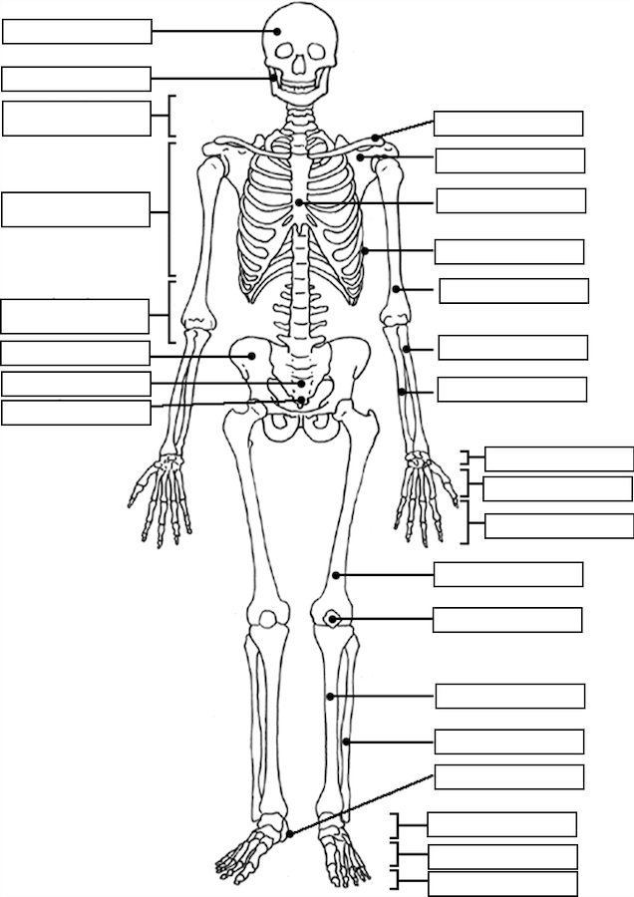
For more help, please visit www.exampaperspractice.co.uk
© 2025 Exams Papers Practice. All Rights Reserved

Slide 10
Bones you need to know:
Cranium
Clavicle
Scapula
Humerus
Radius
Ulna
Carpals, Metacarpals, Phalanges
Ribs
Pelvis
Femur
Tibia
Fibula
Patella
Talus
Tarsals, Metatarsals, Phalanges
Take another work-sheet and correctly fill in all of these bones
For more help, please visit www.exampaperspractice.co.uk
© 2025 Exams Papers Practice. All Rights Reserved

Slide 11
Types of bone
There are 4 types of bone that you need to know:
Long Bones
Are longer than they are wide
Act as levers to produce a large range of movement
They also contain bone marrow for red blood cell production
E.g. Femur, fibula, tibia, humerus, radius, ulna, phalanges, clavicle
Short Bones
Small and squat bones
They enable movement in lots of directions
and provide support
E.g. Carpals, tarsals
For more help, please visit www.exampaperspractice.co.uk
© 2025 Exams Papers Practice. All Rights Reserved

Slide 12
Types of bone
Flat Bones
Provide a large surface area for muscles to attach to
They are therefore important for movement
They also provide protection for organs
E.g. Pelvis, cranium, scapula
Irregular Bones
Provide protection and support
They are shaped to suit their specific job
E.g. Vertebrae
For more help, please visit www.exampaperspractice.co.uk
© 2025 Exams Papers Practice. All Rights Reserved

Slide 13
Types of bone
Task - Copy and complete the table
Bone | Type | Primary function | Location
Cranium Clavicle Scapula Humerus Radius Ulna Carpals Metacarpals Phalanges Ribs Pelvis Femur Tibia Fibula Patella Talus Tarsals Metatarsals Phalanges
For more help, please visit www.exampaperspractice.co.uk
© 2025 Exams Papers Practice. All Rights Reserved

Slide 14
Summary quiz
Name all 4 functions of the skeletal system
Ligaments connect bone to bone. True or false?
How do bones enable movement?
Name the 3 bones located in the arm
Name the 4 bones located in the foot
Where are red blood cells produced?
What is the primary function of the ribs?
Where is the scapula located?
What is the primary function of a long bone?
What is the primary function of a flat bone?
For more help, please visit www.exampaperspractice.co.uk
© 2025 Exams Papers Practice. All Rights Reserved

Slide 15
Summary quiz - answers
Movement, shape / support, red blood cell production, protection
True
Muscles attach to bones, pulling on them when they contract
Ulna, radius, humerus
Tarsals, metatarsals, phalanges, talus
In the (red) bone marrow
Protection
Shoulder
Movement
Protection
For more help, please visit www.exampaperspractice.co.uk
© 2025 Exams Papers Practice. All Rights Reserved

Slide 16
1.2 Joint types, structure and formation
Chapter 1
The skeletal and muscular system
Anatomy and Physiology
Learning objectives
1) Identify the three different types of joint
2) Describe two types of freely movable joint
For more help, please visit www.exampaperspractice.co.uk
© 2025 Exams Papers Practice. All Rights Reserved

Slide 17
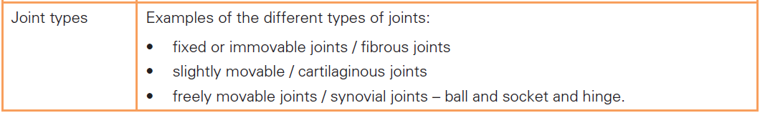
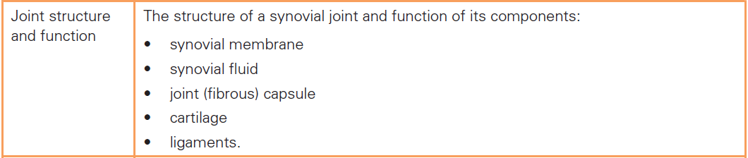
What you need to know
For more help, please visit www.exampaperspractice.co.uk
© 2025 Exams Papers Practice. All Rights Reserved

Slide 18
Types of joints
A joint is the point at which two or more bones meet, allowing movement. The nature of the joint determines the types of movement possible
Fixed/immoveable/fibrous joints
The bones at an immoveable joint cannot move
e.g. the cranium
Slightly moveable/cartilaginous joints
These bones have a small range of movement as they are connected by ligaments and cartilage
e.g. between the vertebrae
Freely moveable/synovial joints
Most joints in the body are freely moving
They have a large range of movement
e.g. hip, shoulder, knee, elbow, ankle
For more help, please visit www.exampaperspractice.co.uk
© 2025 Exams Papers Practice. All Rights Reserved

Slide 19
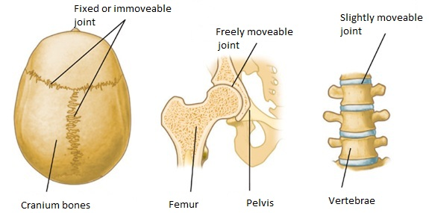
Types of joints
For more help, please visit www.exampaperspractice.co.uk
© 2025 Exams Papers Practice. All Rights Reserved

Slide 20
Synovial Joints
There are different types of synovial joints including hinge and ball and socket joints.
Ball and socket – provide a large range of movement
  Located at the hip and the shoulder
  Enable flexion, extension, adduction, abduction, rotation and circumduction
  E.g. A large range of movement is needed at the shoulder when serving in tennis
Ball and socket joints have a much greater range of movement than hinge joints. They are much less stable however and more prone to injury.
For more help, please visit www.exampaperspractice.co.uk
© 2025 Exams Papers Practice. All Rights Reserved

Slide 21
Synovial Joints
Hinge joints – can only move in 1 direction
  Located at the elbow and knee
  Enable flexion and extension only
  E.g. when bending / straightening the elbow during a jump-shot in basketball
Hinge joints have a much lower range of movement than ball and socket joints. They are much more stable however!
For more help, please visit www.exampaperspractice.co.uk
© 2025 Exams Papers Practice. All Rights Reserved

Slide 22
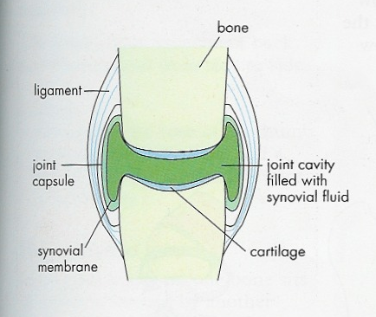
The structure of Synovial Joints
The structures you need to know:
Synovial membrane
Synovial fluid
Joint (fibrous) capsule
Cartilage
Ligaments
For more help, please visit www.exampaperspractice.co.uk
© 2025 Exams Papers Practice. All Rights Reserved

Slide 23
The structure of Synovial Joints
Synovial joints contain synovial fluid which is retained inside a pocket called the synovial membrane. This lubricates the joint
The joint capsule is an outer sleeve that protects the knee and helps to hold it together
The synovial membrane
lines the capsule and secretes synovial fluid
For more help, please visit www.exampaperspractice.co.uk
© 2025 Exams Papers Practice. All Rights Reserved

Slide 24
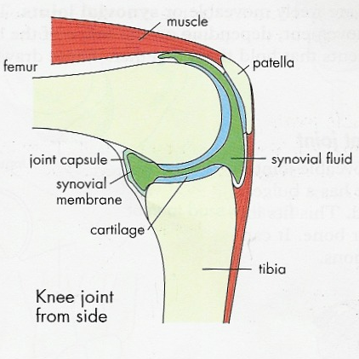
The structure of Synovial Joints
All the moving parts including the bones (femur and tibia) are held together by ligaments which provide stability / prevent unwanted movements
Smooth coverings of cartilage at the ends of the bones stops them rubbing together and provide some shock absorption
For more help, please visit www.exampaperspractice.co.uk
© 2025 Exams Papers Practice. All Rights Reserved

Slide 25
Summary quiz
Name 3 types of joint
Give an example of an immovable (fibrous) joint
Name 2 types of synovial joints
Give 4 examples of synovial joints in the body
List the 5 structures found in synovial joints
What is the role of the synovial membrane?
What is the role of the ligaments?
What is the role of the joint (fibrous) capsule?
What is the role of the cartilage?
For more help, please visit www.exampaperspractice.co.uk
© 2025 Exams Papers Practice. All Rights Reserved

Slide 26
Summary quiz - answers
Immovable, cartilaginous, synovial
Between the flat bones in the cranium
Hinge, ball and socket
E.g. ankle, shoulder, hip, elbow, knee
Membrane, fluid, joint capsule, ligaments, cartilage
To secrete and contain synovial fluid
Hold the joint together/provide joint stability
Protection and helps to hold joint together
Shock absorption/prevent bones rubbing together
For more help, please visit www.exampaperspractice.co.uk
© 2025 Exams Papers Practice. All Rights Reserved

Slide 27
1.3 Movement at joints
Chapter 1
The skeletal and muscular system
Anatomy and Physiology
Learning objectives
1) Know the types of movement possible around a joint
2) Provide sporting examples for each movement type
For more help, please visit www.exampaperspractice.co.uk
© 2025 Exams Papers Practice. All Rights Reserved

Slide 28
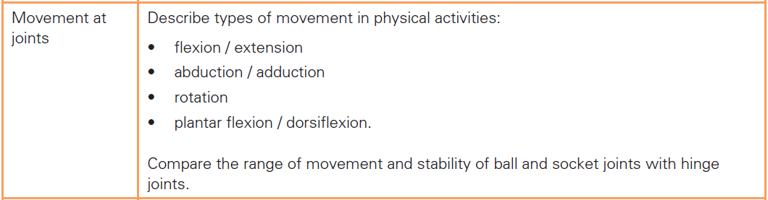
What you need to know
For more help, please visit www.exampaperspractice.co.uk
© 2025 Exams Papers Practice. All Rights Reserved

Slide 29
Types of movement
You need to be able to define and provide sporting examples for the different types of movement possible at synovial joints:
flexion
extension
abduction
adduction
rotation
circumduction
plantar flexion
dorsiflexion
For more help, please visit www.exampaperspractice.co.uk
© 2025 Exams Papers Practice. All Rights Reserved

Slide 30
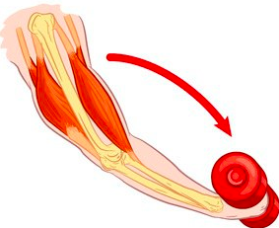
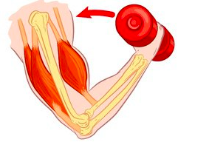
Flexion and Extension
Flexion – Decreasing the angle at a joint (bending a body part)
Extension – Increasing the angle at a joint (straightening a body part)
Question At which joints can flexion and extension occur?
For more help, please visit www.exampaperspractice.co.uk
© 2025 Exams Papers Practice. All Rights Reserved

Slide 31
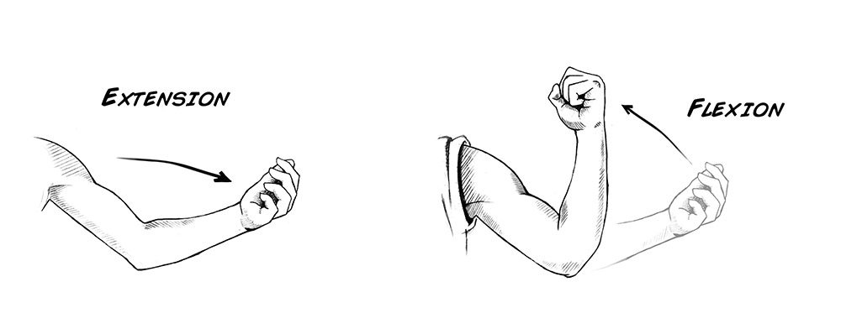
Flexion and Extension
Task – Provide an example from sport for the following movement types:
  Flexion
  Extension
For more help, please visit www.exampaperspractice.co.uk
© 2025 Exams Papers Practice. All Rights Reserved

Slide 32
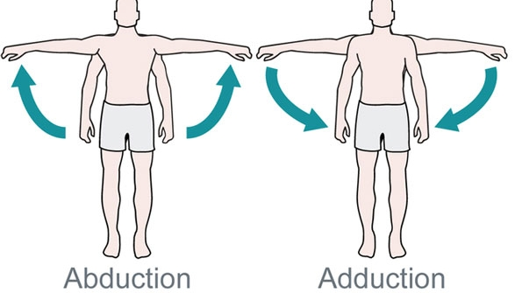
Abduction and Adduction
Abduction – a sideways movement away from the centre of the body
Adduction - a sideways movement towards the centre of the body
ABDUCTED BY ALIENS
ADDED TO THE BODY
Task – Name the joints where abduction and adduction occur and provide 3 sporting examples
For more help, please visit www.exampaperspractice.co.uk
© 2025 Exams Papers Practice. All Rights Reserved

Slide 33
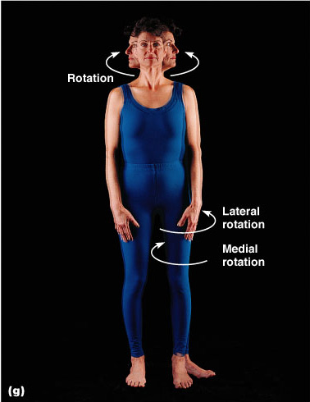
Rotation
Rotation – A turning point around an imaginary line (axis)
E.g. turning your head from left to right, with the axis running vertically through the cranium
Task - Name 2 sporting examples and the joints at which rotation occurs
For more help, please visit www.exampaperspractice.co.uk
© 2025 Exams Papers Practice. All Rights Reserved

Slide 34
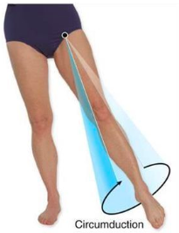
Circumduction
Circumduction – the end of a bone moves in a circle
E.g. circumduction occurs at the shoulder joint when performing the butterfly stroke in swimming
Task - Name 2 other sporting examples and the joints at which rotation occurs
For more help, please visit www.exampaperspractice.co.uk
© 2025 Exams Papers Practice. All Rights Reserved

Slide 35
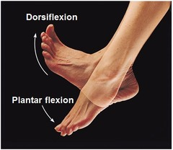
Plantar flexion and Dorsiflexion
Unique to the ankle joint
Dorsiflexion – movement that causes the toes to move upward toward the leg
Plantar flexion – movement that causes the toes to move downward toward the floor
‘PLANT’ your foot
Task Name 2 sporting examples where plantar and dorsiflexion occur
For more help, please visit www.exampaperspractice.co.uk
© 2025 Exams Papers Practice. All Rights Reserved

Slide 36
Movement and joint stability
Different joints are capable of performing different movement types
Task – Name the movements possible at the following joint types:
  Hinge joints (e.g. knee and elbow)
  Ball and socket joints (e.g. hip and shoulder)
“Hinge joints can only perform flexion and extension movements. This means they are far more stable however, providing support for the rest of the body”
“Ball and socket joints are capable of a larger range of movement but are less stable and therefore more prone to injury”
For more help, please visit www.exampaperspractice.co.uk
© 2025 Exams Papers Practice. All Rights Reserved

Slide 37
Summary task
Copy and complete the table:
Movement type | Joint | Sporting example
Flexion
Extension
Adduction
Abduction
Rotation
Circumduction
Dorsiflexion
Plantar flexion
For more help, please visit www.exampaperspractice.co.uk
© 2025 Exams Papers Practice. All Rights Reserved

Slide 38
1.4 Muscles
Chapter 1
The skeletal and muscular system
Anatomy and Physiology
Learning objectives
1) Know the location and role of the major muscles
2) Understand the importance and role of tendons
3) Provide sporting examples for the movements the
muscles create
For more help, please visit www.exampaperspractice.co.uk
© 2025 Exams Papers Practice. All Rights Reserved

Slide 39
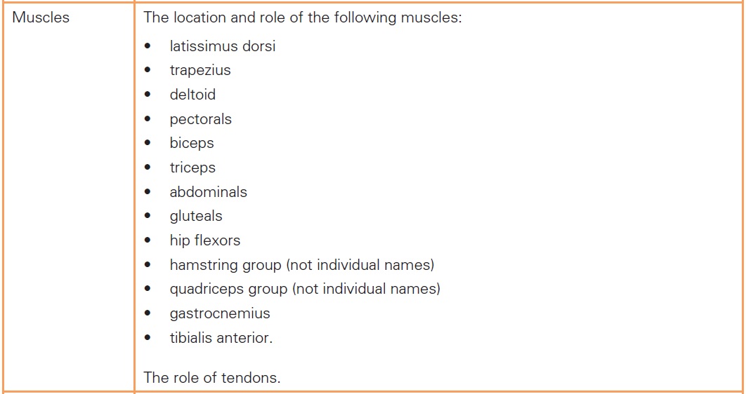
What you need to know
For more help, please visit www.exampaperspractice.co.uk
© 2025 Exams Papers Practice. All Rights Reserved

Slide 40
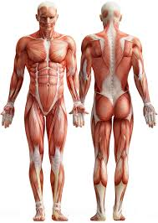
Starter task
Muscle: “A band of tissue that contracts, producing movement in the body by pulling on the bones”
Write down the names of as many muscles as you can
Extension task – can you point out the locations of these muscles?
For more help, please visit www.exampaperspractice.co.uk
© 2025 Exams Papers Practice. All Rights Reserved

Slide 41
The muscles you need to know
• latissimus dorsi
• trapezius
• deltoids
• pectorals
• biceps
• triceps
• abdominals
• gluteals
• hip flexors
• hamstring group
• quadriceps group
• gastrocnemius
• tibialis anterior
Label muscles using the diagram (next slide)
For more help, please visit www.exampaperspractice.co.uk
© 2025 Exams Papers Practice. All Rights Reserved

Slide 42
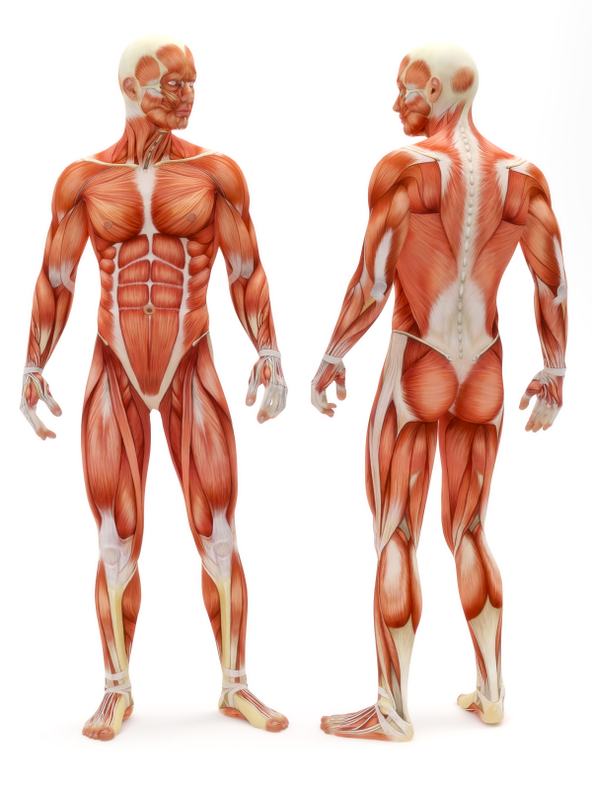
For more help, please visit www.exampaperspractice.co.uk
© 2025 Exams Papers Practice. All Rights Reserved

Slide 43
The function of tendons
Tendons connect muscle to bone
They therefore enable muscles to ‘pull’ on bones,
using them as levers,
and creating movement at the joints
For more help, please visit www.exampaperspractice.co.uk
© 2025 Exams Papers Practice. All Rights Reserved
Notes:
Movement
Muscle, bone

Slide 44
Muscular actions
You need to understand the role of each muscle / the movements they create
Muscle | Main action(s) | Sporting example
Trapezius | -Holds and rotates the shoulders -Moves the head back and sideways | -A swimmer turning their head to breathe
Deltoids | -Raises each arm forwards, backwards and sideways at the shoulder (flexion, extension, abduction) | -Overhead clear in badminton
Pectorals | -Moves the arm in at the shoulder (adduction) | -Forehand drive in tennis
Biceps | -Bends the arm at the elbow (flexion) | -Drawing back a bow in archery
Triceps | - Straightens your arm at the elbow (extension) | - Releasing a javelin or ball when throwing
For more help, please visit www.exampaperspractice.co.uk
© 2025 Exams Papers Practice. All Rights Reserved
Notes:
Movement
Muscle, bone

Slide 45
Muscular actions
You need to understand the role of each muscle / the movements they create
Muscle | Main action(s) | Sporting example
Latissimus dorsi | -Pulls the arm down at the shoulder and draws it behind your back (extension) | -Swimming (front crawl)
Abdominals | -Flexes the spine so that you can bend forwards. | -Rowing (preparation phase)
Hip flexors | -Moving the leg forwards / raising the knee (flexion at the hip joint) | -Knee lift in sprinting - Kicking a football
Gluteals | -Pulls the leg back at the hip (extension) and raises the leg to the side (abduction) | -Long-jump take-off - Raising the trail-leg to the side when hurdling
Quadriceps | - Straightens the leg at the knee (extension) | - To gain elevation in a high-jump
For more help, please visit www.exampaperspractice.co.uk
© 2025 Exams Papers Practice. All Rights Reserved
Notes:
Movement
Muscle, bone

Slide 46
Muscular actions
You need to understand the role of each muscle / the movements they create
Muscle | Main action(s) | Sporting example
Hamstrings | -Bends the leg at the knee (flexion) | -Pulling back the knee before kicking a ball (preparation phase)
Gastroc-nemius | -Straightens the ankle joint (plantarflexion), so that you can stand on your toes | -Take-off for a lay-up in basketball
Tibialis anterior | -Helps with dorsiflexion, the action of pulling the toes toward the shin | -Walking or running
Apply what you’ve learned:
- For each of the muscles stated, provide another sporting example of when that muscle produces movement
For more help, please visit www.exampaperspractice.co.uk
© 2025 Exams Papers Practice. All Rights Reserved
Notes:
Movement
Muscle, bone

Slide 47
1.5 Antagonistic muscle action
Chapter 1
The skeletal and muscular system
Anatomy and Physiology
Learning objectives
1) Understand how muscles work in pairs to create movement
2) Identify the action of an agonist (prime mover) and
antagonist
3) Explain how muscles work using isotonic and isometric
contractions
For more help, please visit www.exampaperspractice.co.uk
© 2025 Exams Papers Practice. All Rights Reserved

Slide 48
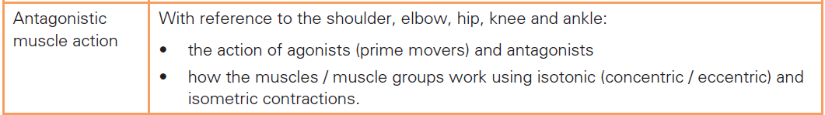
What you need to know
For more help, please visit www.exampaperspractice.co.uk
© 2025 Exams Papers Practice. All Rights Reserved

Slide 49
Antagonistic muscle action
-Since muscles can only pull on bones, they can only
create movement in one direction
-Muscles therefore come in pairs so that movement
in two directions is possible
Task
Which muscles do you think work together?
Identify the ‘partner’, to each of these muscles
Hip flexors
Quadriceps
Triceps
For more help, please visit www.exampaperspractice.co.uk
© 2025 Exams Papers Practice. All Rights Reserved

Slide 50
Antagonistic muscle action
Agonist / prime mover
The muscle that contracts to create movement
Antagonist
The muscle that relaxes during movement
Antagonistic pair
The agonist and the antagonist combined are known as an antagonistic pair (the agonist contracts while the antagonist relaxes)
When muscles work in pairs it is known as an ‘antagonistic muscle action’. As one muscle contracts, the other relaxes to enable movement
For more help, please visit www.exampaperspractice.co.uk
© 2025 Exams Papers Practice. All Rights Reserved

Slide 51
Antagonistic muscle action
Example
During the upward phase of a bicep curl
The bicep (agonist) contracts and shortens, creating flexion at the elbow joint
The tricep (antagonist) relaxes, allowing movement to occur
Task
For each of the following movements, state the agonist and the antagonist
Extension at the knee (kicking a ball in football)
Extension at the hip (pulling the leg back when running)
For more help, please visit www.exampaperspractice.co.uk
© 2025 Exams Papers Practice. All Rights Reserved

Slide 52
The types of muscular contraction
Muscles don’t always get shorter as they contract
There are two ways in which muscles contract, isotonic and isometric contractions
Isotonic contraction - muscles change length as they contract. There are 2 types of isotonic contraction:
  Concentric contraction – The muscle shortens while it contracts (e.g. the hamstring shortens creating flexion at the knee when running)
  Eccentric contraction - The muscle lengthens while it contracts (e.g. the quadriceps lengthen during the downward phase of a squat, allowing the knee to bend with control)
Isometric contraction – The muscle contracts but stays the same length (e.g. the deltoids contract isometrically when holding the bar above the head in an Olympic weight lift)
For more help, please visit www.exampaperspractice.co.uk
© 2025 Exams Papers Practice. All Rights Reserved

Slide 53
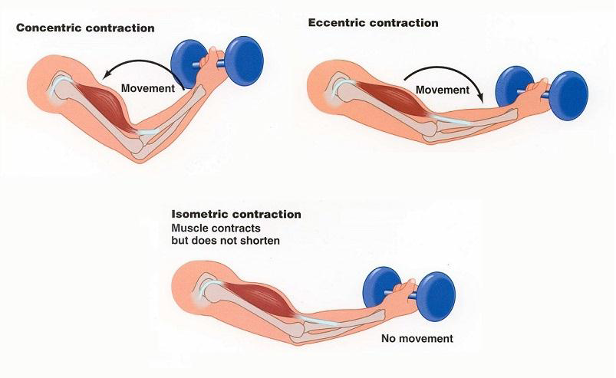
The types of muscular contraction
Isotonic
Isometric
For more help, please visit www.exampaperspractice.co.uk
© 2025 Exams Papers Practice. All Rights Reserved

Slide 54
Task – copy and complete the table
Joint | Action | Agonist | Movement | Antagonist | Movement
Elbow | Flexion | Biceps | Concentric | Triceps | Eccentric
Elbow | Extension | Triceps | Concentric | Biceps | Eccentric
Knee | Extension | Quadriceps
Knee |  | Hamstrings
Ankle | Plantar-flexion |  |  | Tibialis anterior
Ankle |  | Tibialis anterior
For more help, please visit www.exampaperspractice.co.uk
© 2025 Exams Papers Practice. All Rights Reserved

Slide 55
1.6 Muscle fibre types
Chapter 1
The skeletal and muscular system
Anatomy and Physiology
Learning objectives
1) Identify the differences between fast and slow twitch fibres
2) Explain how fast and slow twitch fibres impact on physical
activities
For more help, please visit www.exampaperspractice.co.uk
© 2025 Exams Papers Practice. All Rights Reserved

Slide 56
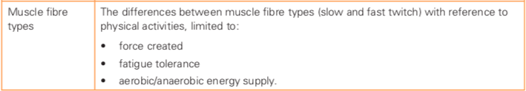
What you need to know
For more help, please visit www.exampaperspractice.co.uk
© 2025 Exams Papers Practice. All Rights Reserved

Slide 57
Muscle fibre types
What are you better at? Sprinting or long-distance running? The answer to this may be found in your muscles!
Everyone has a mixture of different muscle fibre types
  Some are more suited to endurance activities
  While some work best for short, high intensity bursts
Muscle fibres can be classified as fast twitch or slow twitch
Fast twitch | Slow twitch
Thicker fibres Faster to contract Tire more quickly More powerful Lower in endurance | Smaller fibres Slower to contract Can contract for long periods without tiring Suitable for endurance activities

Slide 59
Muscle fibre types
Copy and complete the table
Feature | Fast twitch | Slow twitch
Force produced (high/low)
Fatigue resistance (high/low)
Speed of contraction (faster/slower)
Example of activity
For more help, please visit www.exampaperspractice.co.uk
© 2025 Exams Papers Practice. All Rights Reserved

Slide 60
Muscle fibre types and energy supply
The type of muscle fibre used in a physical activity is also linked to the muscle’s need for energy
Energy is supplied in different ways for different types of exercise
Aerobic exercise | Anaerobic exercise
Moderate intensity activities Over long periods of time Oxygen is used to produce energy E.g. walking, jogging, swimming Associated with slow twitch muscle fibres People with a high proportion of slow twitch muscle fibres are better suited to aerobic activities | High intensity activities Over short periods of time Lactic acid is produced as a bi-product E.g. sprinting, javelin, shot-put Associated with fast twitch muscle fibres People with a high proportion of fast twitch muscle fibres are better suited to anaerobic / power activities
For more help, please visit www.exampaperspractice.co.uk
© 2025 Exams Papers Practice. All Rights Reserved

Slide 61
Summary quiz
The muscle located at the front of the thigh
  Hamstrings
  Gastrocnemius
  Quadriceps
The muscle located at the shoulder
  Latissimus dorsi
  Trapezius
  Deltoids
The muscle located at the chest
  Pectorals
  Gluteals
  Tibialis anterior
For more help, please visit www.exampaperspractice.co.uk
© 2025 Exams Papers Practice. All Rights Reserved

Slide 62
Summary quiz
The agonist during ‘plantar flexion’ at the ankle joint
  Tibialis anterior
  Hamstrings
  Gastrocnemius
The antagonist during flexion at the elbow joint
  Tricep
  Bicep
  Deltoids
The agonist at the knee during a squat
  Hamstrings
  Hip flexors
  Quadriceps
The agonist during extension at the hip
  Hip flexors
  Gluteals
  Quadriceps
For more help, please visit www.exampaperspractice.co.uk
© 2025 Exams Papers Practice. All Rights Reserved

Slide 63
Summary quiz
During the downward phase of a Basketball jump shot
  Isometric contraction of the hamstrings
  Eccentric contraction of the quadriceps
  Concentric contraction of the quadriceps
When kicking a football
  Concentric contraction of the hip flexors
  Concentric contraction of the gluteals
  Isometric contraction of the gluteals
Releasing the ball when bowling (underarm) in rounders
  Concentric contraction of the latissimus dorsi
  Concentric contraction of the deltoids
  Eccentric contraction of the bicep
For more help, please visit www.exampaperspractice.co.uk
© 2025 Exams Papers Practice. All Rights Reserved

Slide 64
Summary quiz
Pushing in a Rugby scrum without moving
  Isometric contraction of the gastrocnemius
  Eccentric contraction of the gastrocnemius
  Concentric contraction of the gastrocnemius
The muscle fibre most suited to a 50m freestyle swimmer
  Slow twitch
  Fast twitch
The muscle fibre most suited to a marathon runner
  Slow twitch
  Fast twitch
For more help, please visit www.exampaperspractice.co.uk
© 2025 Exams Papers Practice. All Rights Reserved

Slide 65
Summary quiz
Which activities are better suited to fast twitch and slow twitch muscle fibres?
A
B
C
D
For more help, please visit www.exampaperspractice.co.uk
© 2025 Exams Papers Practice. All Rights Reserved

Slide 66
Summary quiz - answers
C
C
A
C
B
C
B
B
A
B
A
B
A
A = fast/slow, B = fast, C = fast, D = slow
For more help, please visit www.exampaperspractice.co.uk
© 2025 Exams Papers Practice. All Rights Reserved

