Slide 1
Sketch out what this page looks like in a browser
<!DOCTYPE html>
<html>
<!-- Website about my football team -->
<head>
<title> Super United </title>
</head>
<body>
<h1>Super United</h1>
<p> This is a web page about Super United </p>
<h2>Best players</h2>
<ul>
<li> B. Diver </li>
<li> D. Nutmeg </li>
<li> C. Miss </li>
</ul>
<a href="tickets.html"> Buy tickets </a>
</body>
</html>
Tab:

Slide 2
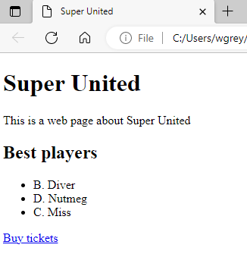
Super United
Super United This is a web page about Super United Best players B. Diver D. Nutmeg C. Miss Buy tickets (this is a link)

Slide 3
Cascading Styles Sheet (CSS)

Slide 4
Learning objectives
Know that CSS controls how website looks
Use CSS to change the style of different elements in our web page

Slide 6
Selector
CSS consists of selectors that style the elements and take the form:
Selector {
property: value;
}
There are 3 types of selectors:
Element selector
Class Selector
ID selector

Slide 7
Element selector examples
p {
color: red;
}
h1,h2 {
text-align: center;
color: green;
}

Slide 8
Internal style sheet
For internal style sheets the CSS code goes in the head and style elements such that:
<head>
<style>
p {
text-align: center;
color: red;
}
h1, h2 {
font-family: "Arial";
text-align: center;
color: green;
}
</style>
</head>

Slide 9
Element selector in HTML
<!DOCTYPE html>
<html>
<head>
<style>
p { font-family: "Arial"; text-align: center; color: red; }
/* Group multiple selectors */
h1, h2 { font-family: "Arial"; text-align: center; color: green; }
</style>
</head>
<body>
<h1>Wales</h1>
<p>Ireland</p>
<h2>Scotland</h2>
</body>
</html>
Predict what this code output
Add this code to a html file and view in a browser. Does it display as you expect?

Slide 10
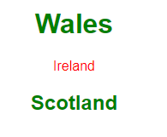
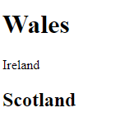
Output
Without CSS With CSS

Slide 11
Output
<head>
<style>
p {
text-align: center;
color: red;
}
h1, h2 {
font-family: "Arial";
text-align: center;
color: green;
}
</style>
</head>

Slide 12
Class selector
You may not way to add the same styling to all elements.
To select which elements you would like to add a specific styling to, you can use a class selector.
/* class selector can be applied to h1 element */
h1.red {
text-align: center;
color: red;
}
h1.green {
text-align: center;
color: green;
}
/* class selector can be applied to any element */
.blue {
text-align: center;
color: blue;
}

Slide 13
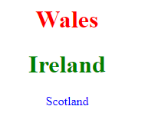
Applying class selector
<!DOCTYPE html>
<html>
<head>
<style>
h1.red { text-align: center; color: red;}
h1.green { text-align: center; color: green;}
.blue { text-align: center; color: blue;}
</style>
</head>
<body>
<h1 class="red">Wales</h1>
<h1 class="green">Ireland</h1>
<p class="blue">Scotland</p>
</body>
</html>
Predict what this code output
Add this code to a html file and view in a browser. Does it display as you expect?

Slide 14
ID selector
The ID selector is applied uniquely to an element.
<!DOCTYPE html>
<html>
<head>
<style>
#red { text-align: center; color: red;}
</style>
</head>
<body>
<h1 id="red">Wales</h1>
</body>
</html>

Slide 16
External style sheet
We can add the CSS code to an external file.
Create a new file called style.css and add the following code
p {
font-family: "Arial";
text-align: center;
color: red;
}
h1, h2 {
font-family: "Arial";
text-align: center;
color: green;
}
Within the html file add the following to the <head> element
<link rel="stylesheet" href="style.css">

Slide 17
Complete code listing
<!DOCTYPE html>
<html>
<head>
<link rel="stylesheet" href=“style.css">
</head>
<body>
<h1>Wales</h1>
<p> Ireland </p>
<h2>Scotland</h2>
</body>
</html>
Modify the code to the following.

Slide 18
Inline style
We can also include inline styles such as:
<h1 style="color:blue">Wales</h1>

Slide 19
CSS Frameworks
Bootstrap and W3.css are frameworks with prewritten CSS code.
This means that you can create professional looking websites without you having to write the CSS code yourself thereby saving you lots of time and effort.
You can use w3.css by adding the following link to your HTML page
<link rel="stylesheet" href="https://www.w3schools.com/w3css/4/w3.css">

Slide 20
Complete code listing
<!DOCTYPE html>
<html>
<head>
<link rel="stylesheet" href="https://www.w3schools.com/w3css/4/w3.css">
</head>
<body>
<h1 class="w3-sans-serif w3-text-teal">Wales</h1>
</body>
</html>

Slide 21
Things to try
Visit https://www.w3schools.com/w3css
Apply a range of CSS formatting to the wales.html web page that you created in the previous lesson

