Slide 1
Cambridge International
A Level Computer Science
(9618) – Revision Notes
File Processing and Exception
Handling
This pack is intended for students to who are taking CIE A Level in Computer Science, either in preparation for their A Level exam, or more likely alongside year 2 of the course to improve fluency, recall and pace on AS & A topics. It could be used as lesson starters, or supplied to students for independent use.

Slide 2




Chapter
29
File processing and exception handling
AS & A Level Computer Science 9618

Slide 3


Chapter
Outline
29.2
29.1
Sequential and Random Access File processing
29.3
Records
Exception Handling

Slide 4

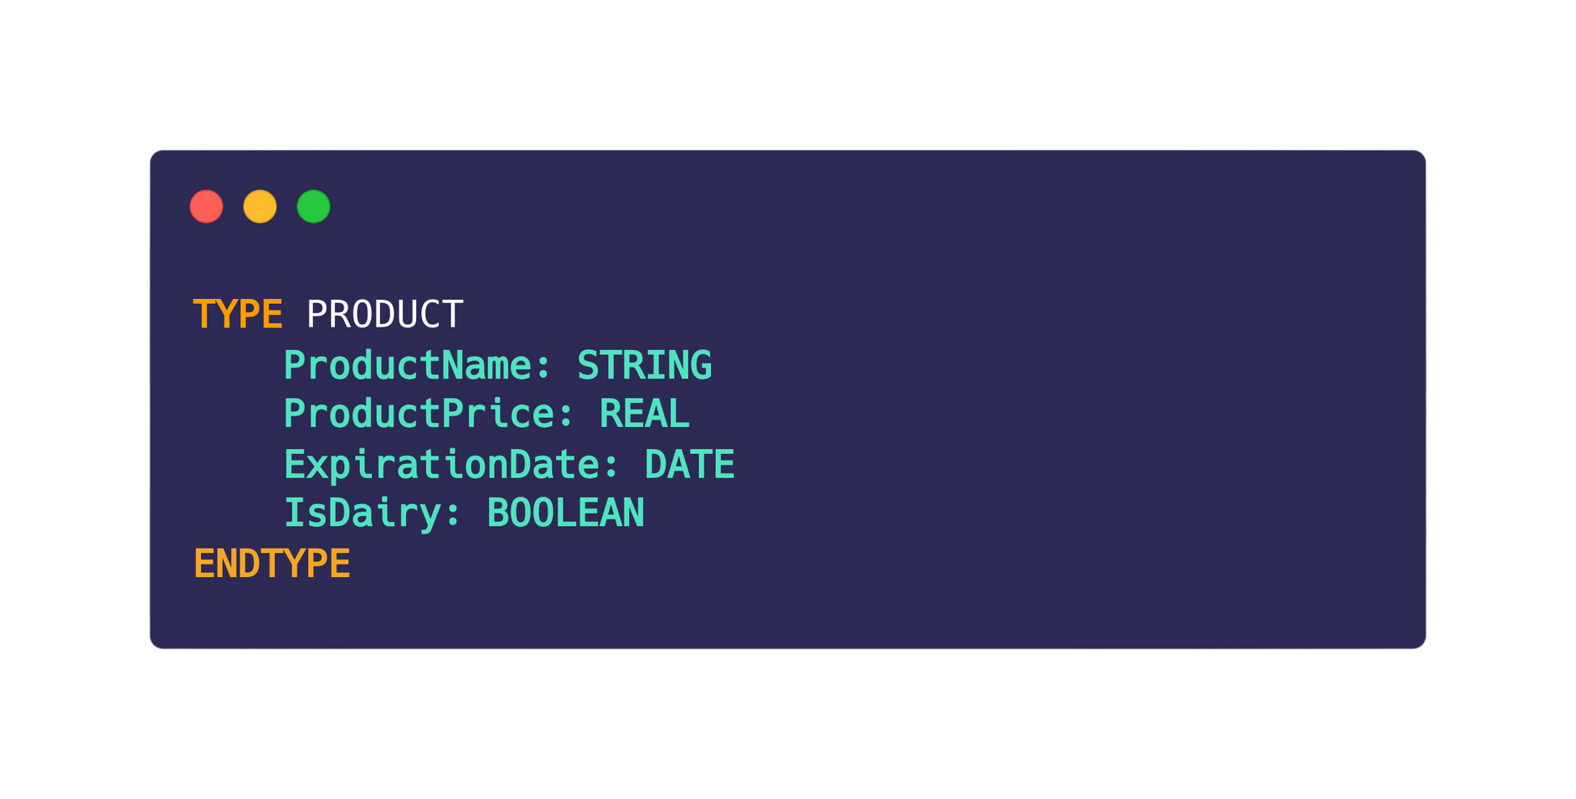
29.1 Records
Definition
A record is a user-defined data type that encapsulates multiple related fields, allowing for the grouping of diverse data under a single name in programming languages.
Eg. A record type for PRODUCT could look like this:

Slide 5
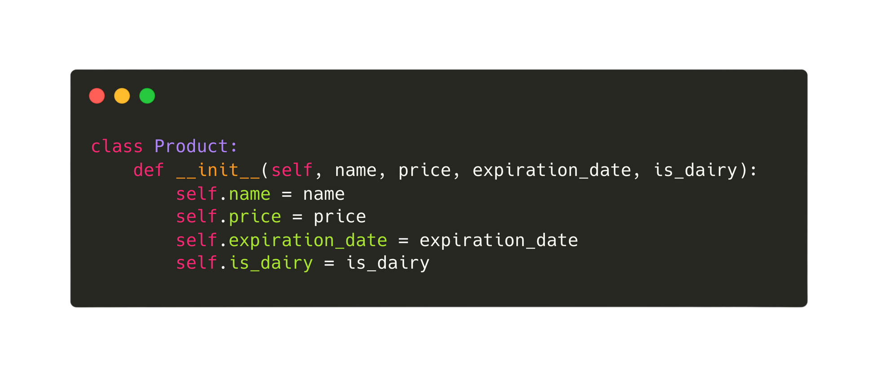
29.1 Records
Declaring a record type in python
In Python, a class with attributes and a constructor can be used to create a record-like structure, encapsulating related data under a single name and allowing the instantiation of instances with specific values for each attribute.

Slide 6
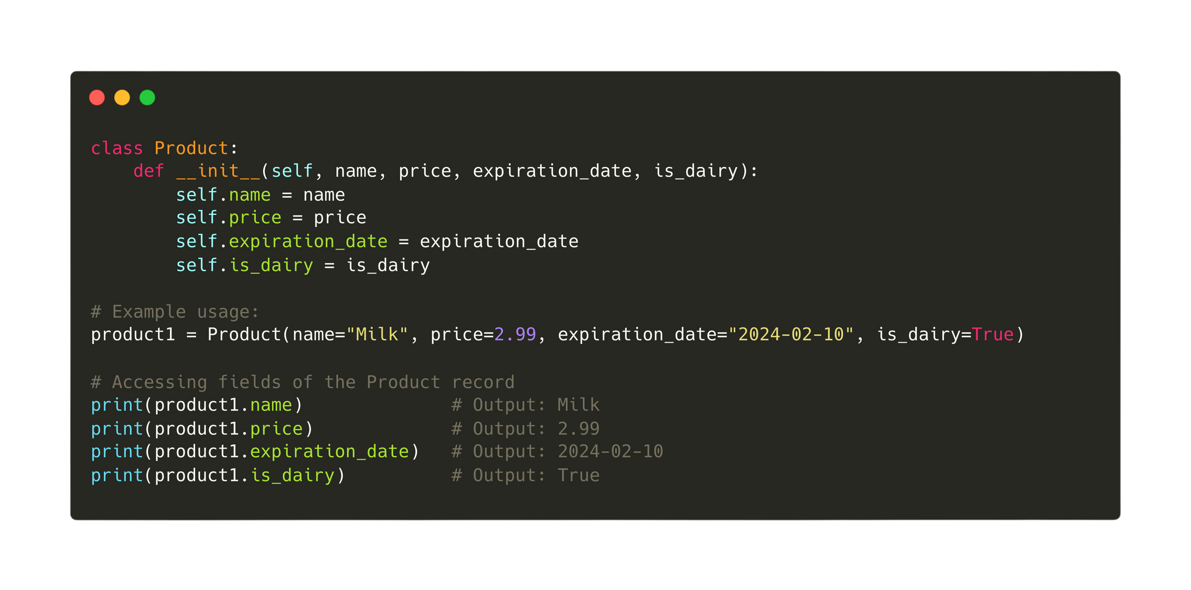
29.1 Records
Instantiating a product record

Slide 7
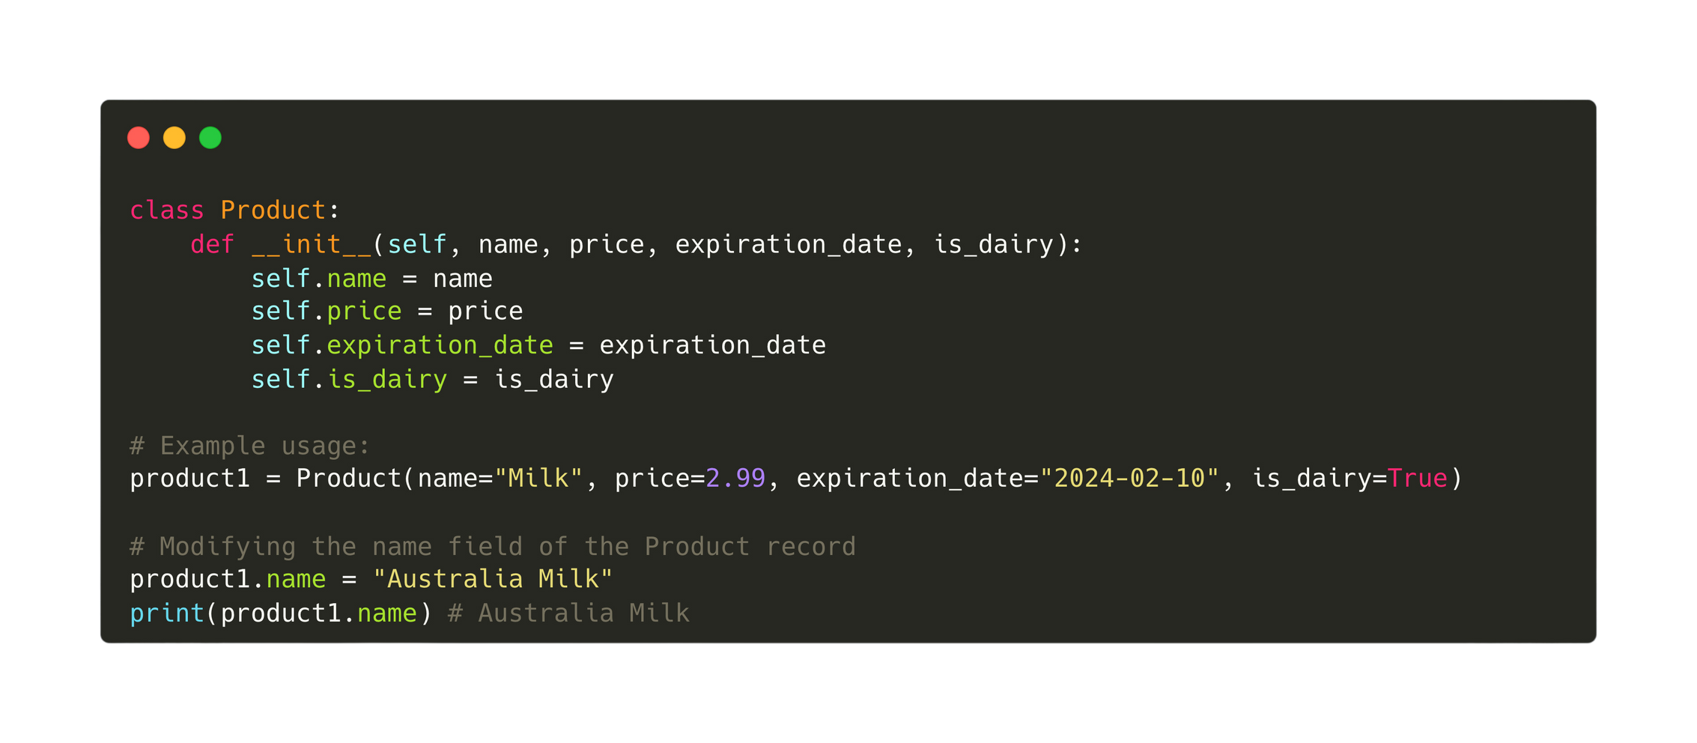
29.1 Records
Modifying a field in the Product record

Slide 8
29.2 Sequential and Random Access File processing
Subtopic 1
Using binary files
Text files restrict us to writing strings in a linear, sequential fashion with the ability to append strings at the file's end, but for storing records, binary files offer the flexibility of sequential or direct access storage.
Sequential file processing
Random
file processing

Slide 9
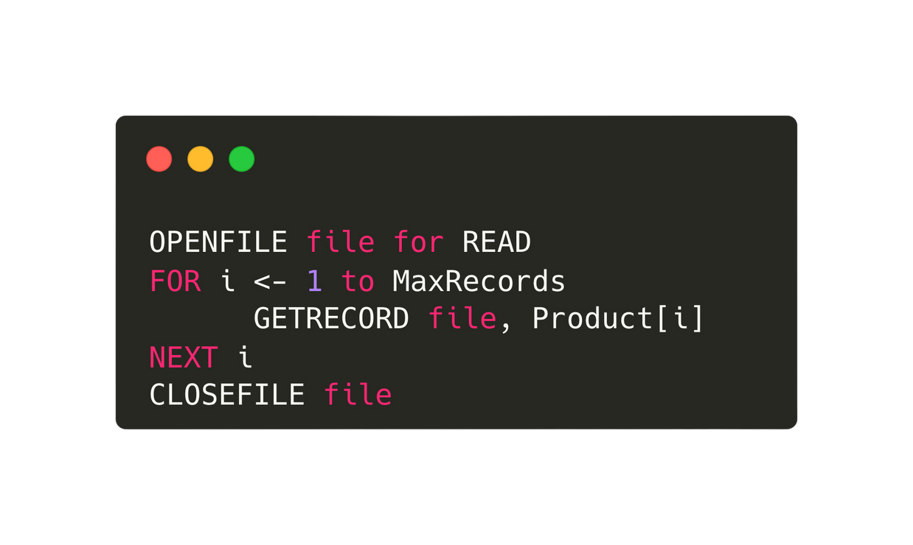
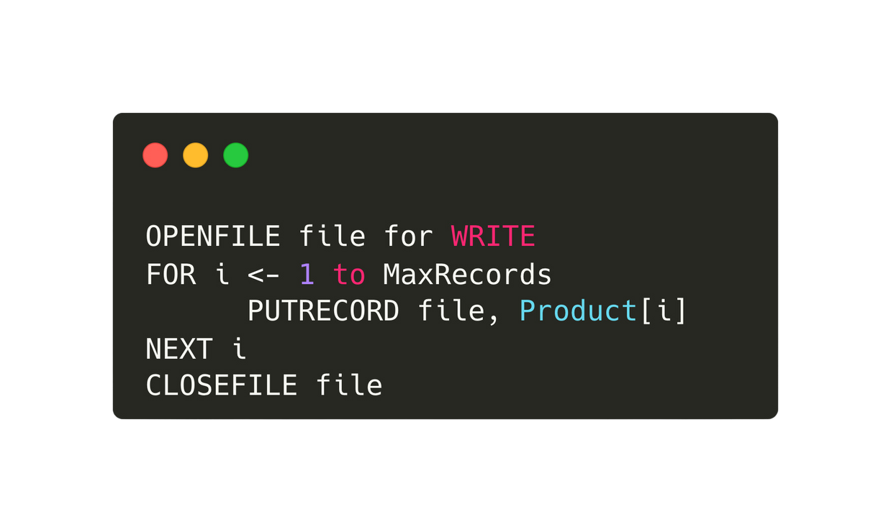
29.2 Sequential and Random Access File processing
Subtopic 1
Sequential file processing
Writing records to a file one record after another.
We can then read the records back into the array when the program is run again.
Pseudocode:

Slide 10
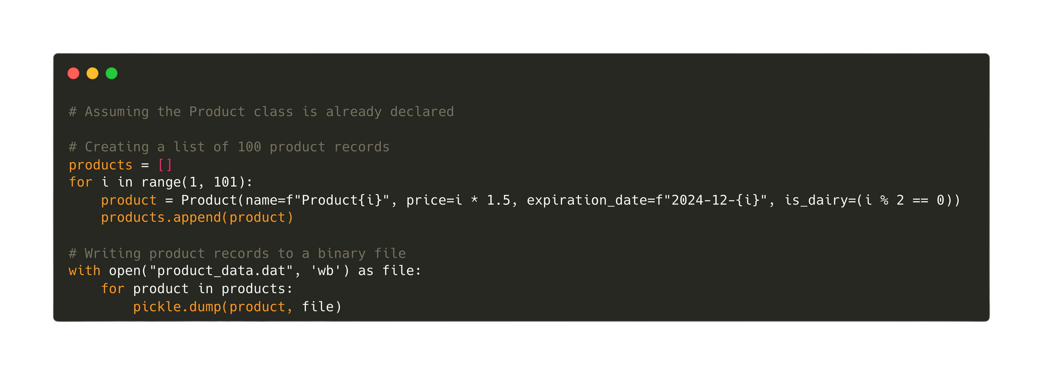
29.2 Sequential and Random Access File processing
Subtopic 1
Sequential file processing
Sample code (Writing records to a .dat file):

Slide 11
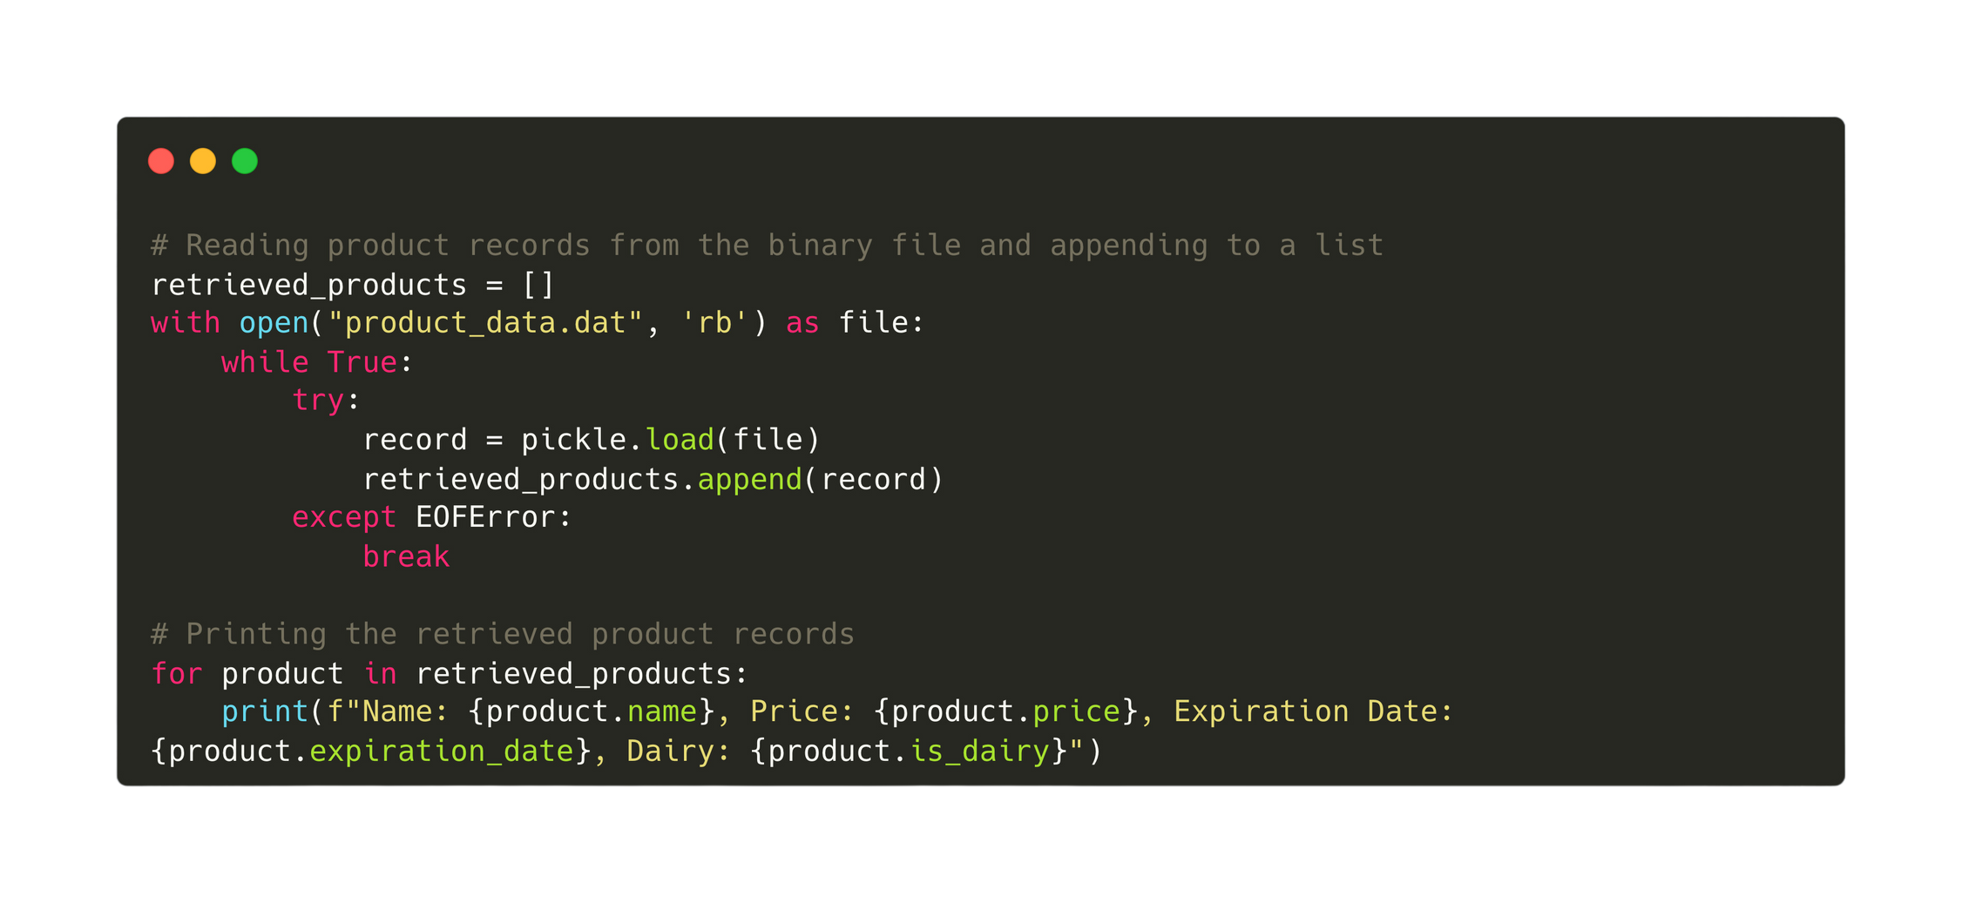
29.2 Sequential and Random Access File processing
Subtopic 1
Sequential file processing
Sample code (Reading records from a .dat file):

Slide 12
29.2 Sequential and Random Access File processing
Subtopic 1
Random-access file processing
Random access file processing allows direct access to specific locations within a file, enabling reading or writing of data at any position without the need to sequentially process the entire file.
Random access file processing is achieved by using hash functions to compute file offsets or positions based on unique identifiers, allowing direct access to specific data locations within the file.

Slide 13
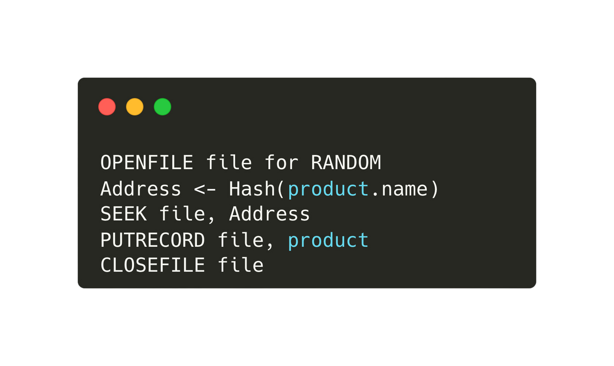

29.2 Sequential and Random Access File processing
Subtopic 1
Random-access file processing

Slide 14
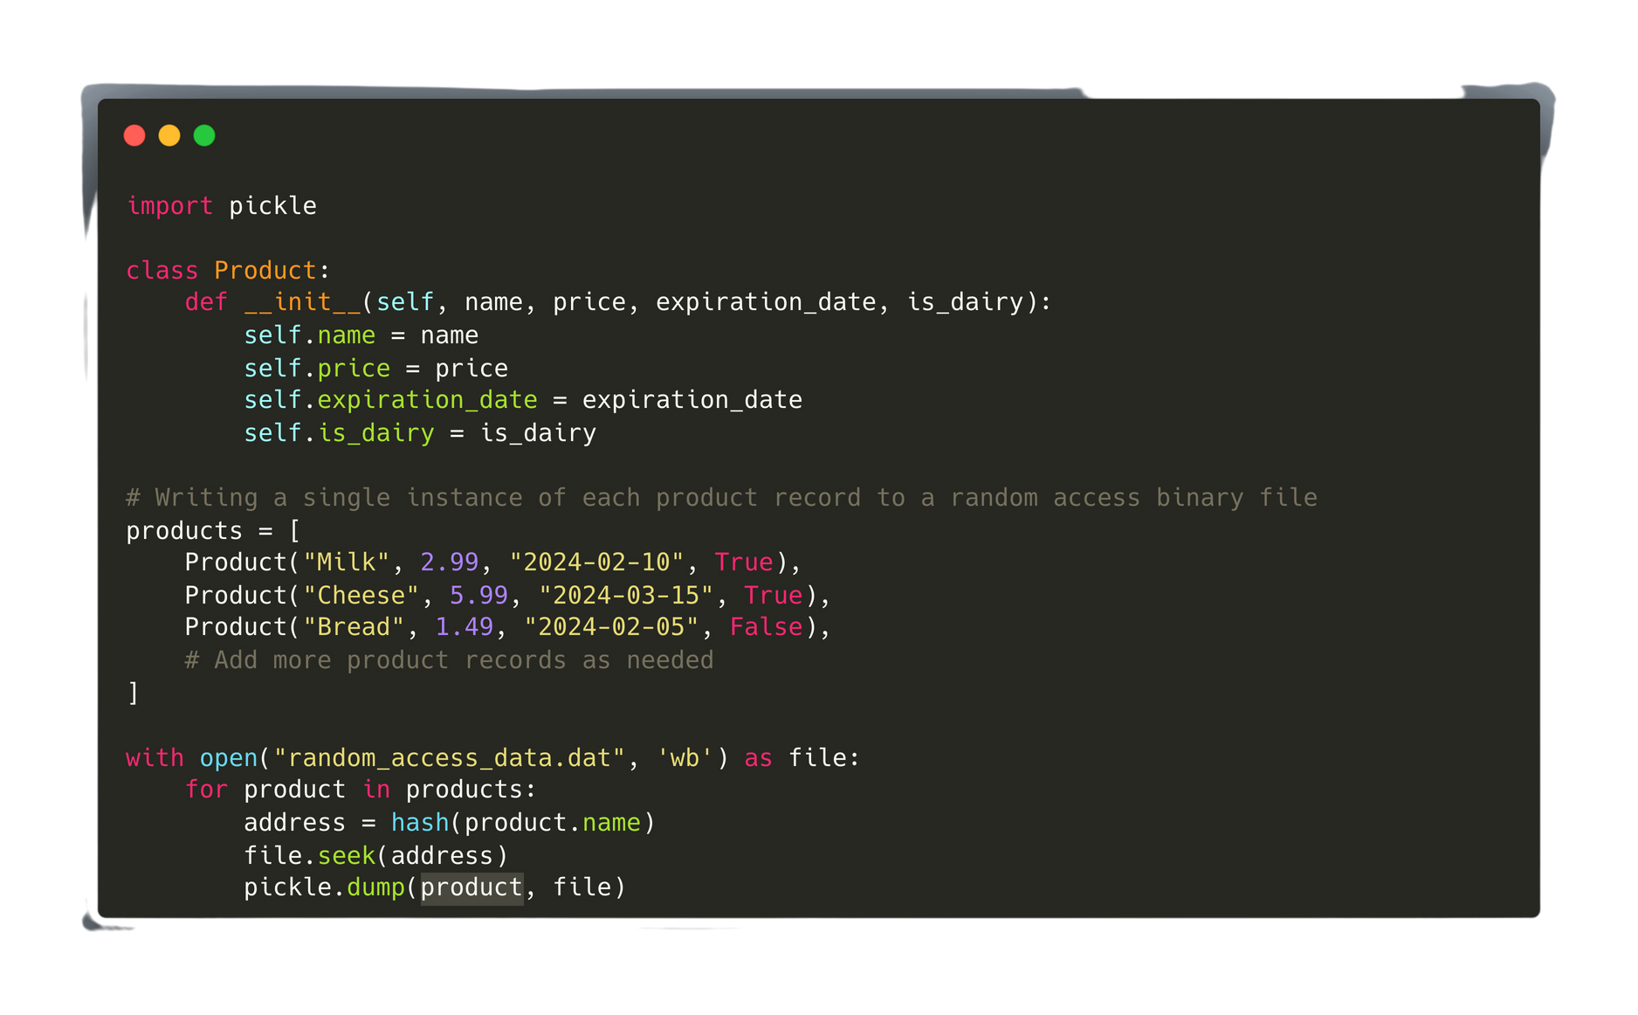
29.2 Sequential and Random Access File processing
Subtopic 1
Random-access file processing - Searching for an address

Slide 15
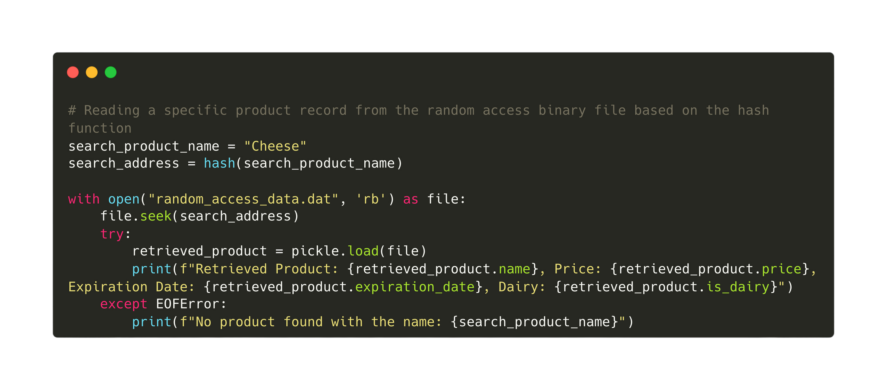
29.2 Sequential and Random Access File processing
Subtopic 1
Random-access file processing - Searching for an address

Slide 16

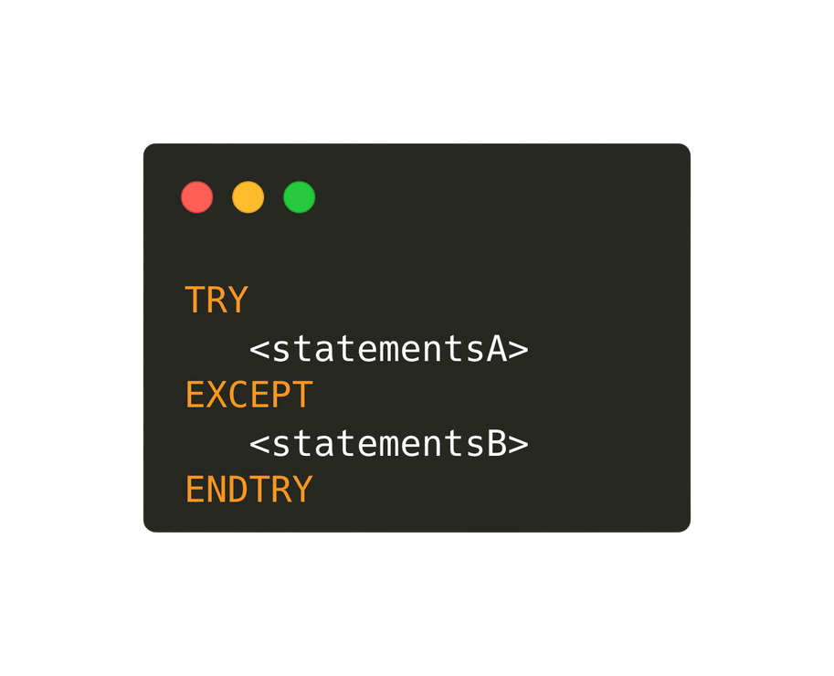
29.3 Exception Handling
Why is exception handling needed?
Exception handling is particularly crucial for addressing runtime errors, as it allows programs to detect and respond to unexpected issues that may occur during execution, preventing the program from crashing and providing mechanisms for error diagnosis and resolution at runtime.
Pseudocode:
Any run-time error that occurs during the execution of <statementA> is caught and handled by executing <statementB>

Slide 17
29.3 Exception Handling
Different types of exception in python:
  IOError is raised when an input/output operation fails due to issues like attempting to open a non-existent file or writing to a read-only file.
  ImportError occurs when the import statement cannot find or load the specified module, indicating a problem with the module's availability or correct installation.
  ValueError is raised when a built-in operation or function receives an argument of the correct type but with an invalid value, indicating an inappropriate input.
  KeyboardInterrupt is triggered when the user interrupts the execution of the program, typically by pressing Ctrl+C in the console, halting the program abruptly.
  EOFError occurs when an input operation, such as reading from a file, reaches the end-of-file unexpectedly, indicating an attempt to read beyond the available data.
  ZeroDivisionError is raised when attempting to divide a number by zero, which is mathematically undefined and results in an error.

Slide 18
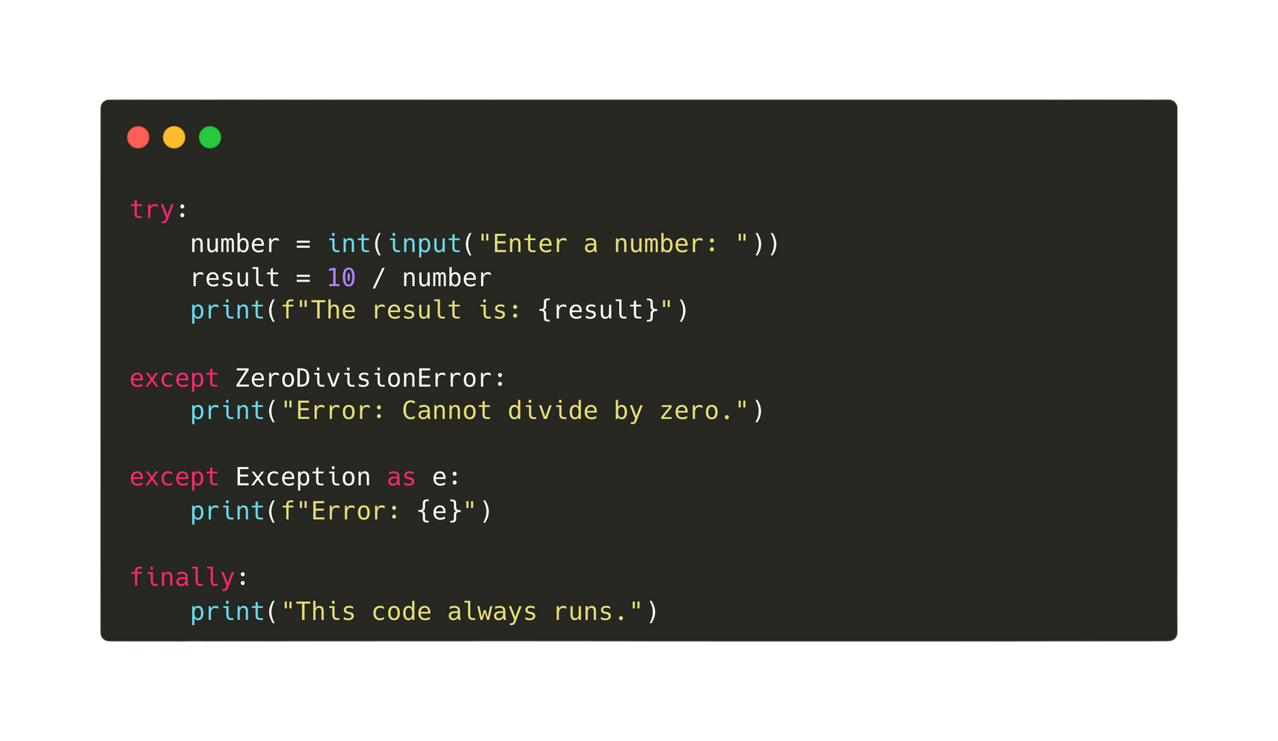
29.3 Exception Handling
Codes:

