Slide 1
Cambridge International
A Level Computer Science
(9618) – Revision Notes
Programming Paradigms
This pack is intended for students to who are taking CIE A Level in Computer Science, either in preparation for their A Level exam, or more likely alongside year 2 of the course to improve fluency, recall and pace on AS & A topics. It could be used as lesson starters, or supplied to students for independent use.

Slide 2



Chapter
25
Programming Paradigms
AS & A Level Computer Science 9618

Slide 3

Programming Paradigms
Definition
A programming paradigm is a set of principles, concepts, and guidelines that dictate the organisation, structure, and execution of computer programs, providing a framework for developers to design and implement software.
Paradigms are supported by programming language features. Some programming language support more than one paradigm.

Slide 4
Programming Paradigms
Object-oriented programming paradigm
Low-level programming paradigm
Imperative programming paradigm
Declarative programming paradigm
C27
C26
C28

Slide 5
Programming Paradigms
Low-level programming paradigm
Low-level programming paradigm involves direct manipulation of hardware and memory resources, emphasising precise control over a computer's architecture through languages like assembly or machine code.
Imperative programming paradigm
Object-oriented programming paradigm
Declarative programming paradigm
Memory
IN
200
SUB #48
201
STO MAX
202
LDM #0
203
STO TOTAL
204
STO COUNT
205
IN
206
SUB #48
207
ADD TOTAL
208
STO TOTAL
209
LDD COUNT
210
INC ACC
211
CMP MAX
212
JPN STRLTP
213
END
214
MAX
215
TOTAL
216
COUNT
217

Slide 6
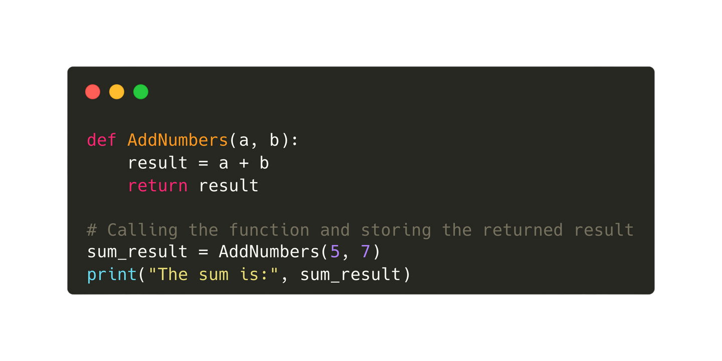
Programming Paradigms
Imperative programming paradigm
Imperative programming paradigm focuses on specifying explicit sequences of statements that update the program's state, emphasising the step-by-step execution of commands to achieve desired outcomes.
Low-level programming paradigm
Object-oriented programming paradigm
Declarative programming paradigm

Slide 7
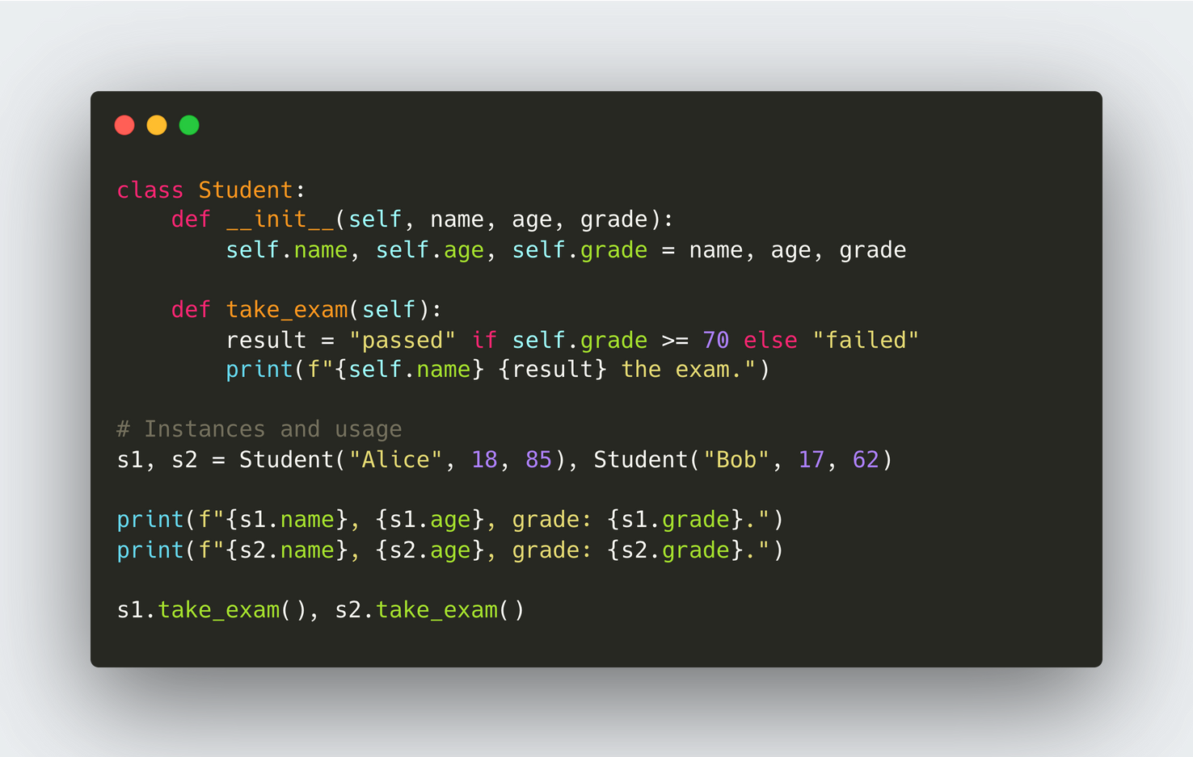
Programming Paradigms
Object-Oriented programming paradigm
Object-oriented programming (OOP) is a programming paradigm that organises code into objects, which encapsulate data and behaviour, fostering modularity and reusability.
Low-level programming paradigm
Imperative programming paradigm
Declarative programming paradigm

Slide 8
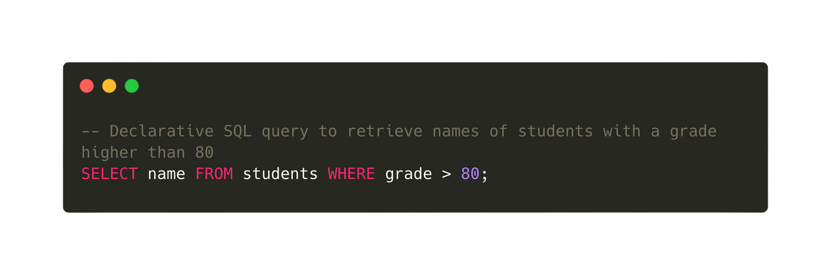
Programming Paradigms
Declarative programming paradigm
Declarative programming is a paradigm where the developer specifies the desired result or goal, leaving the implementation details to the system, in contrast to imperative programming, which focuses on specifying explicit steps for achieving a task.
Low-level programming paradigm
Imperative programming paradigm
Object-Oriented programming paradigm

