Slide 1
Cambridge International
A Level Computer Science
(9618) – Revision Notes
Programming Paradigms
(Declarative Programming)
This pack is intended for students to who are taking CIE A Level in Computer Science, either in preparation for their A Level exam, or more likely alongside year 2 of the course to improve fluency, recall and pace on AS & A topics. It could be used as lesson starters, or supplied to students for independent use.

Slide 2


Chapter
28
Declarative Programming
AS & A Level Computer Science 9618

Slide 3



28.1
28.2
28.3
Introduction to Declarative Programming
Fundamentals of Prolog
Defining Facts in Prolog
28.4
Understanding Variables in Prolog
28.5
Using the Anonymous Variable in Prolog
Chapter
Outline
28.6
Creating and Applying Rules in Prolog
28.7
28.8
28.9
Mechanisms of Instantiation and Backtracking in Prolog
Recursive Techniques in Prolog
Manipulating Lists in Prolog

Slide 4

28.1 Introduction to Declarative Programming
What does the term include?
Declarative programming is a programming paradigm where the desired outcome or result is specified, rather than the steps needed to achieve it.
Database query languages - SQL
Regular expressions
Logic programming
Functional programming

Slide 5
Subtopic 1
28.2 Fundamentals of Prolog
Constructs in Prolog
Facts, rules and queries.
Knowledge base
Clause
Facts and rules
Problems are solved by running a query
Clause
Facts and rules
Clause
Facts and rules
Clause
Facts and rules

Slide 6
Subtopic 1
28.2 Fundamentals of Prolog
Constructs in Prolog
Clause
Facts and rules
Head : - Body .
A full stop is required.

Slide 7
Subtopic 1
28.2 Fundamentals of Prolog
Data type in Prolog
is called a term.
A term can be
an atom. It represents a constant, consisting of a sequence of alphanumeric characters starting with a lowercase letter or enclosed in single quotes
A number, integer or float
A variable, denoted by an identifier that starts with a capital letter or an underscore
A compound term, a predicated, consisting of an atom and a number of arguments in parenthesis

Slide 8

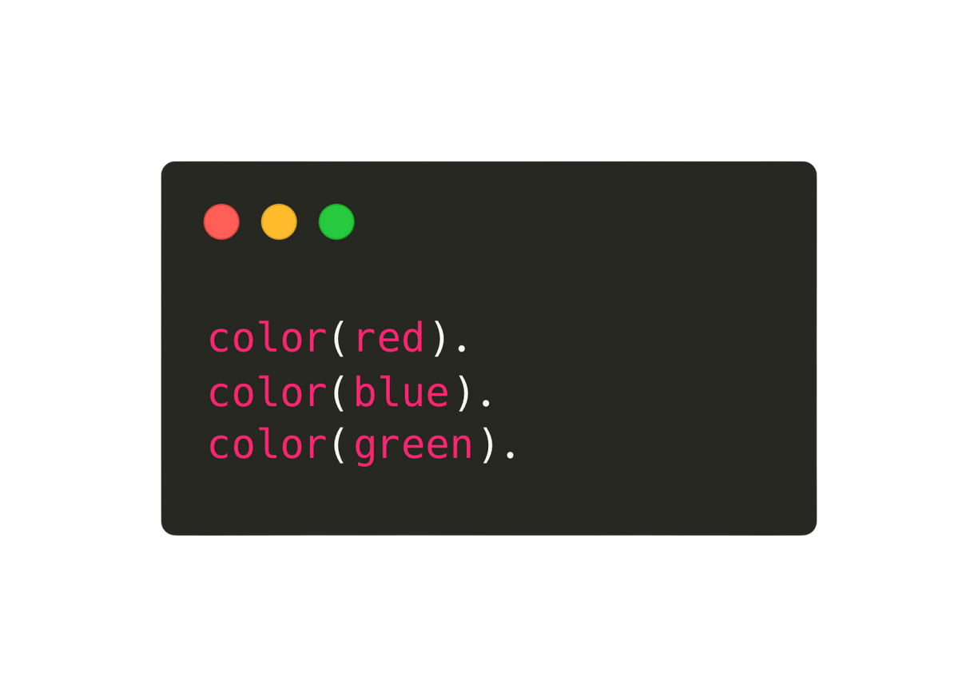

28.3 Defining Facts in Prolog
Clause
Facts and rules
A clause without a body is a fact. Eg.
Atoms
//
Predicate
Atoms
//
Argument
Compound term
Arity = 1
//
1 argument

Slide 9
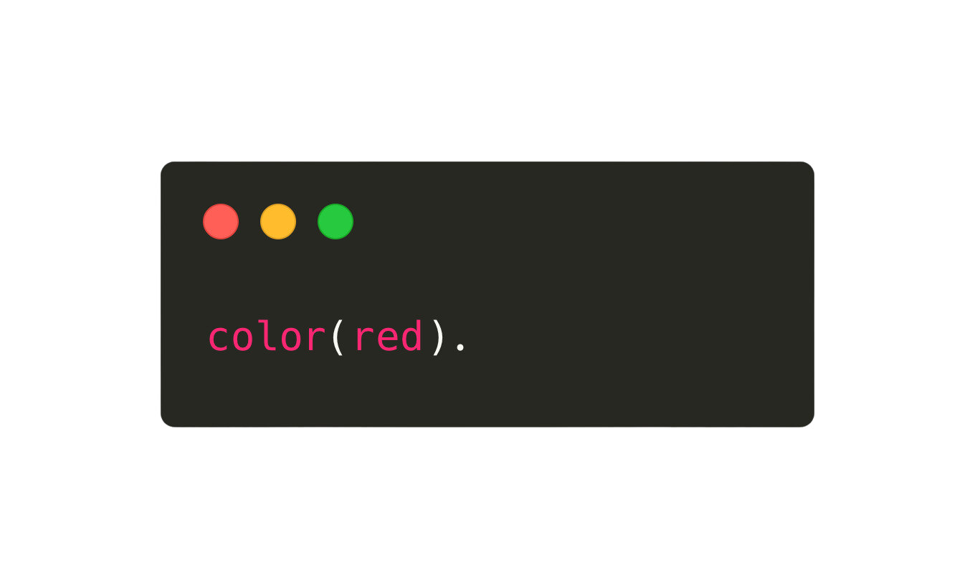
28.3 Defining Facts in Prolog
Clause
Facts and rules
We can run a query to ask if “red” is a colour.
Prolog answers true.

Slide 10
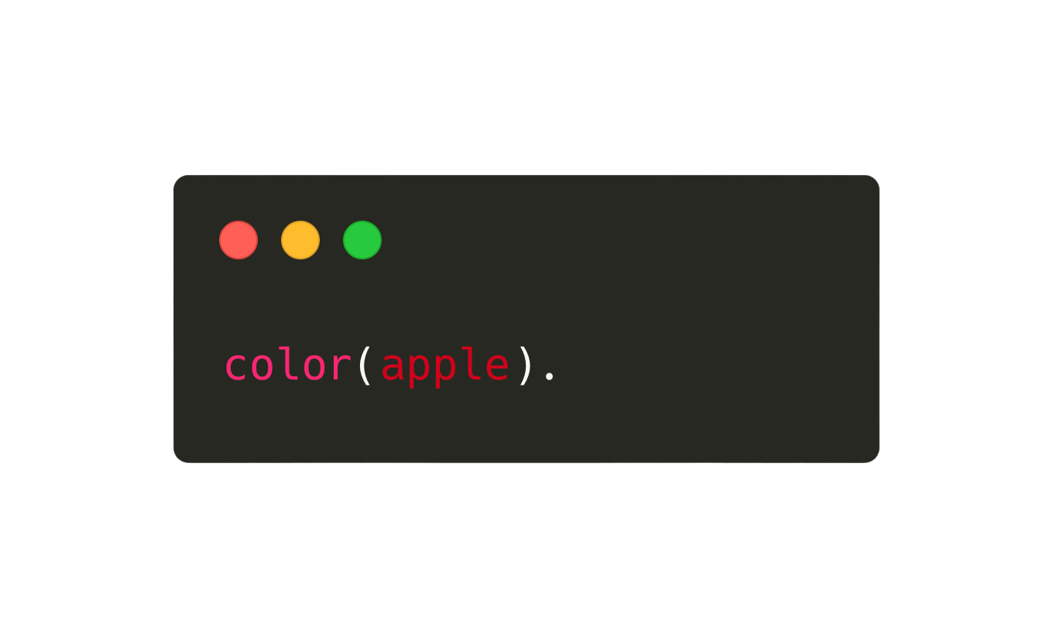
28.3 Defining Facts in Prolog
Clause
Facts and rules
We can run a query to ask if “apple” is a colour.
Prolog answers false. Apple is not a colour in our knowledge base.

Slide 11



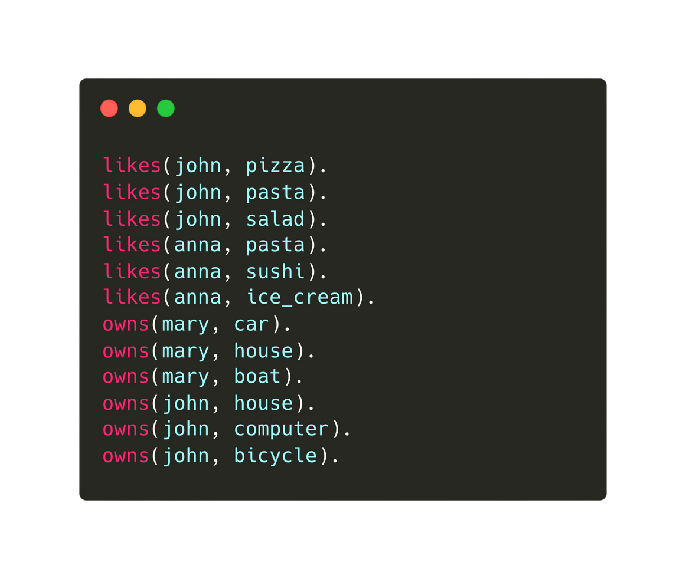
28.4 Understanding Variables in Prolog
Variables
Assume that we have the following knowledge base:

Slide 12
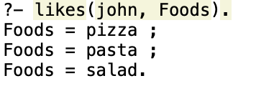
28.4 Understanding Variables in Prolog
Variables
Variable
Knowledge base
We can run the following query to find out what john likes!
if there is more than one option, you need to put a semi colon

Slide 13
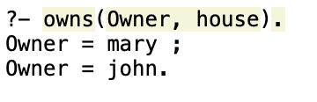
28.4 Understanding Variables in Prolog
Variable
Variables
Knowledge base
We can run the following query to find out who owns a house
if there is more than one option, you need to put a semi colon

Slide 14
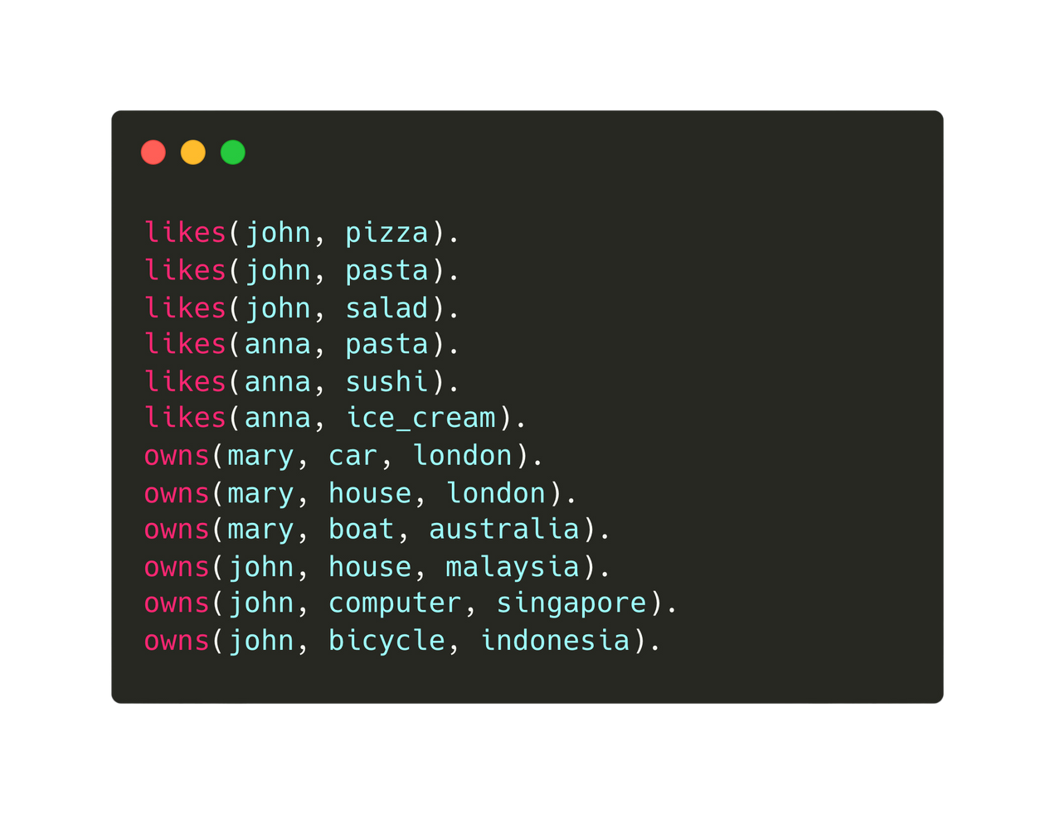
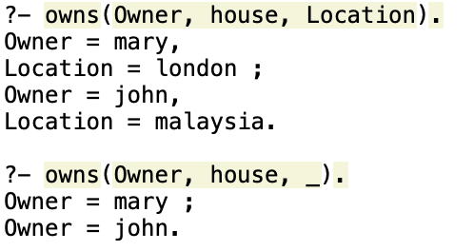
28.5 Using the Anonymous Variable in Prolog
What does the term include?
Knowledge base
With anonymous variables
(use it when we are not interested in the variable)

Slide 15
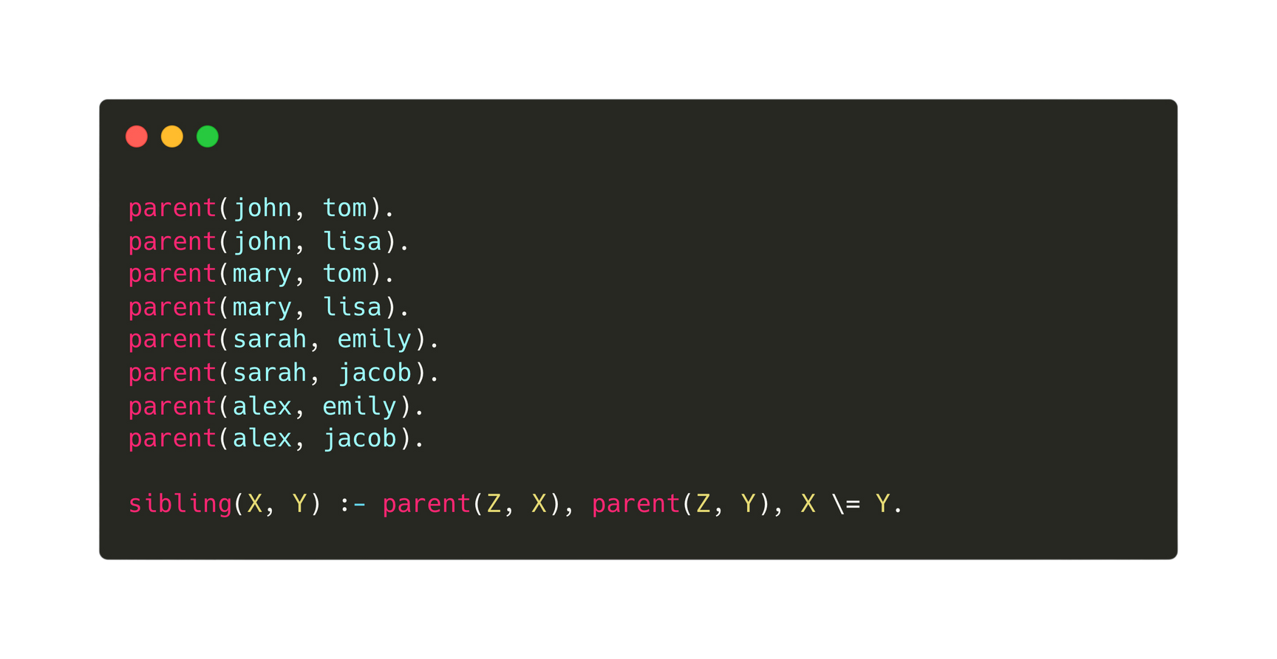

Subtopic 1
28.6 Creating and Applying Rules in Prolog
Rules
In Prolog, rules define logical relationships or conditions based on facts and predicates, typically represented as a head followed by a body, allowing for inference and query-based reasoning.
Knowledge base
Rule
IF
AND

Slide 16
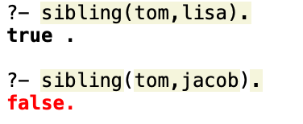
Subtopic 1
28.6 Creating and Applying Rules in Prolog
Rules
Query:

Slide 17
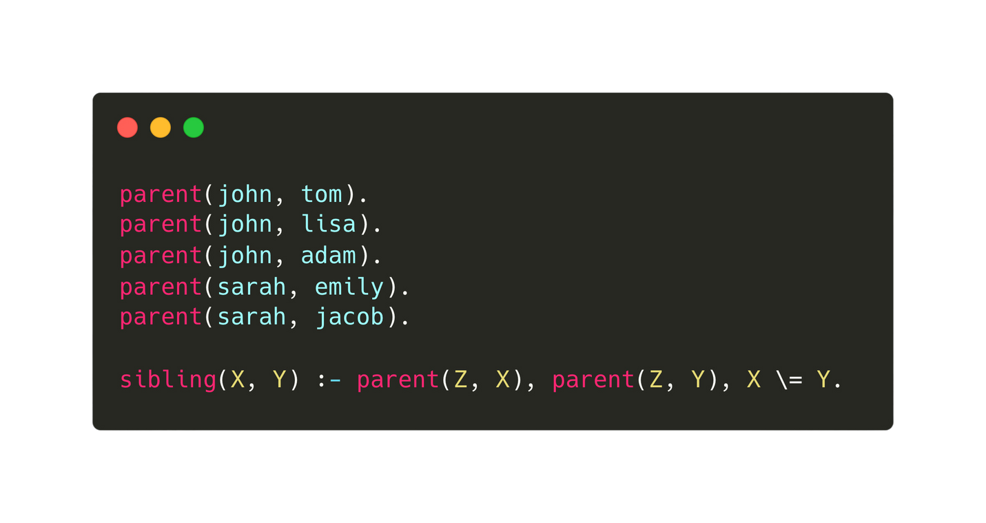

28.7 Mechanisms of Instantiation and Backtracking in Prolog
Definition
In Prolog, instantiation binds variables to values, while backtracking enables the exploration of alternative solutions by undoing previous choices.
Query

Slide 18
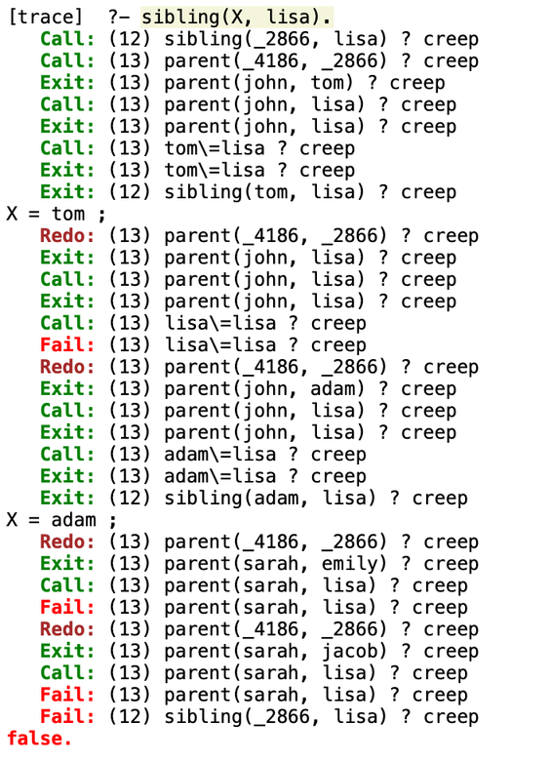
28.7 Mechanisms of Instantiation and Backtracking in Prolog
Definition
By using the trace facility, we can find out how Prolog arrives at the solution.
  "call" indicates the initiation of a predicate
  "creep" shows step-by-step execution
  "exit" marks successful completion
  "redo" re-attempts
  "fail" denotes a predicate failure.
Solution
Trace how the solution is arrived!

Slide 19
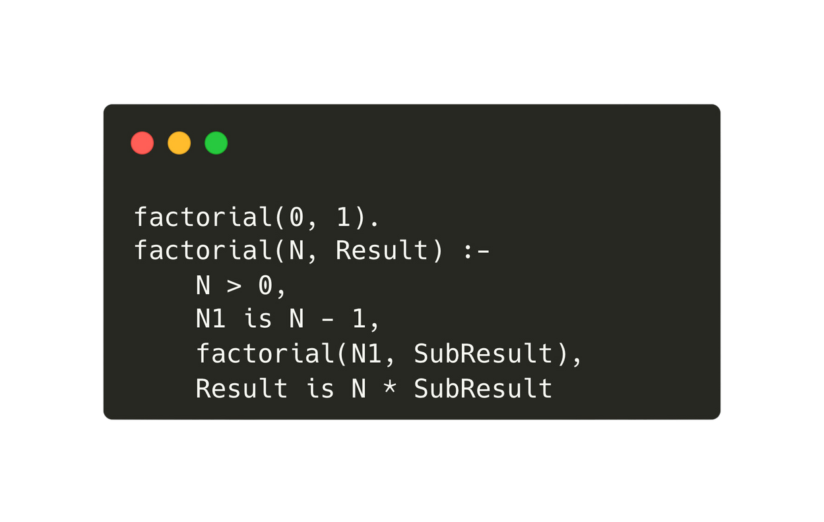
28.8 Recursive Techniques in Prolog
Recursion in Prolog
Recursion in Prolog involves the process of a predicate calling itself to iteratively solve problems by breaking them down into smaller, more manageable subproblems. Eg. factorial functions in Prolog.
base case: 0! = 1
Result = N!
N1 = N - 1
SubResult = (N-1)!
Result = N * (N-1)!

Slide 20
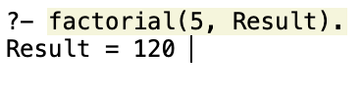
28.8 Recursive Techniques in Prolog
Recursion in Prolog
Recursion in Prolog involves the process of a predicate calling itself to iteratively solve problems by breaking them down into smaller, more manageable subproblems. Eg. factorial functions in Prolog.
Query

Slide 21
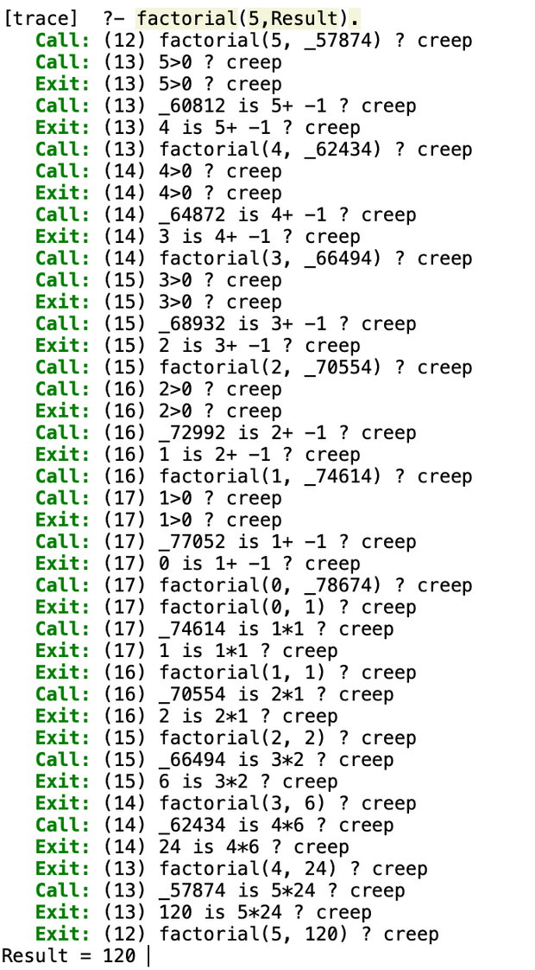
28.8 Recursive Techniques in Prolog
Factorial Tracing

Slide 22

28.9 Manipulating Lists in Prolog
Lists in prolog
In Prolog, a list is an ordered collection of elements enclosed within square brackets ([ ]), capable of storing objects of different types, including atoms, numbers, variables, and even other lists, providing flexibility in representing structured data.
A list is comprised of a head and a tail, where the head represents the first element of the list, and the tail represents the rest of the list.
Head
Head
[1,2,3,4]
[car, ship, taxi]
Tail
Tail

Slide 23
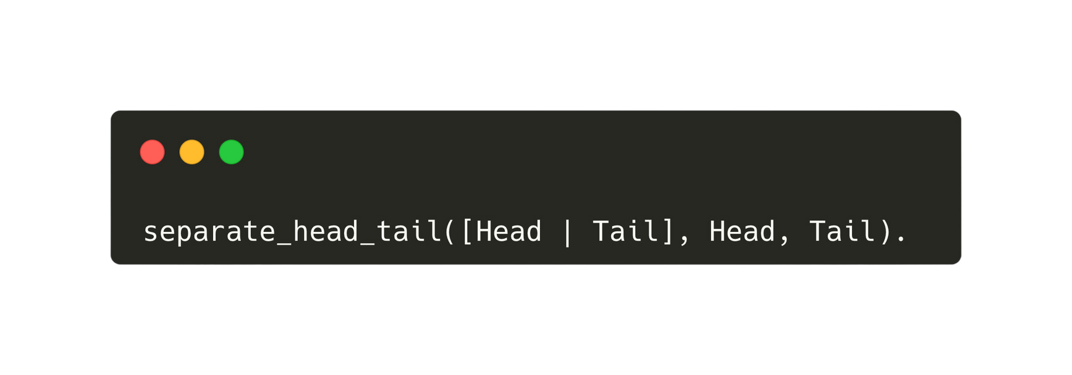
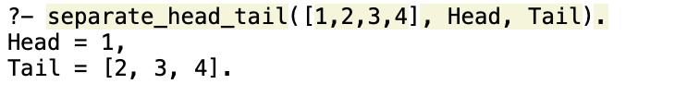
28.9 Manipulating Lists in Prolog
Lists in prolog
In Prolog, list manipulation involves accessing the head (first element) and tail (remaining elements) recursively, allowing for various operations such as appending, splitting, or processing elements efficiently.
clause
query

Slide 24
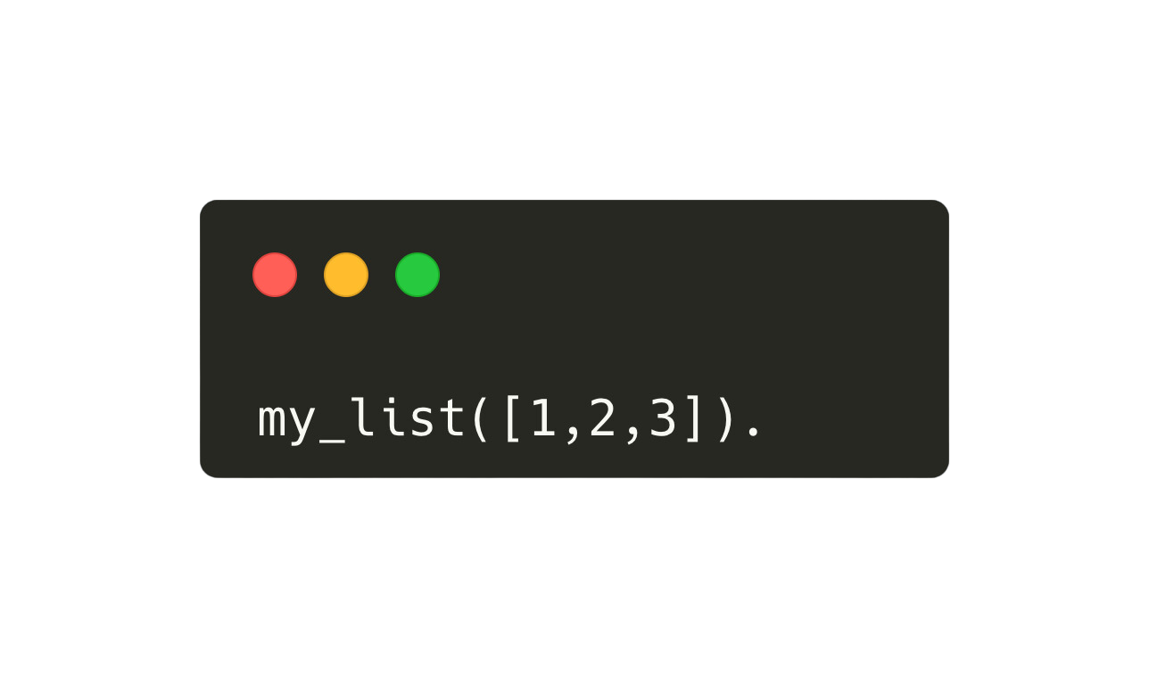

28.9 Manipulating Lists in Prolog
Lists in prolog
clause
query

Slide 25
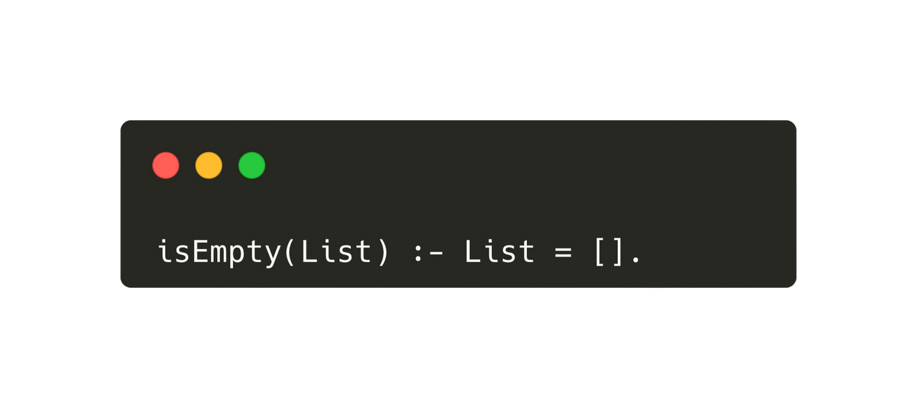
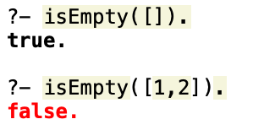
28.9 Manipulating Lists in Prolog
Lists in prolog
clause
query

Slide 26
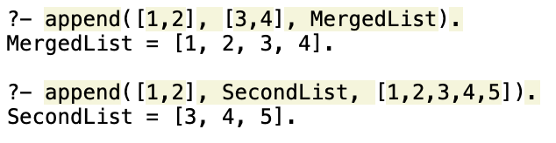
28.9 Manipulating Lists in Prolog
List processing predicate - append
The `append` predicate in Prolog concatenates two lists.

Slide 27
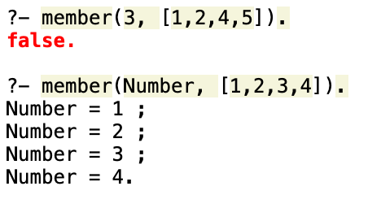
28.9 Manipulating Lists in Prolog
List processing predicate - member
The `member` predicate in Prolog checks if an element is a member of a list.

Slide 28
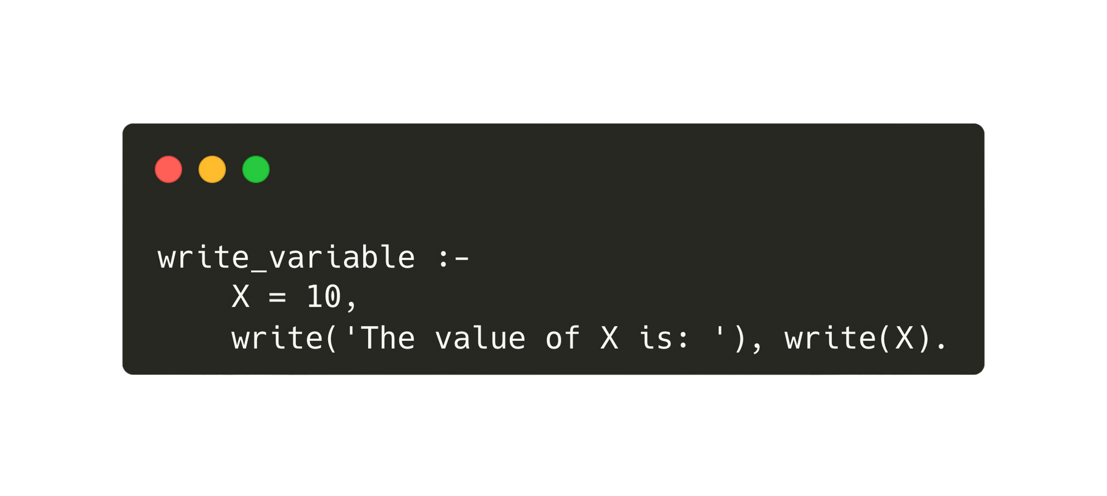
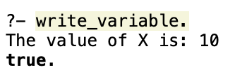
28.9 Manipulating Lists in Prolog
List processing predicate - write
The `write` predicate in Prolog is used to output terms to the standard output stream.
clause
query

Slide 29
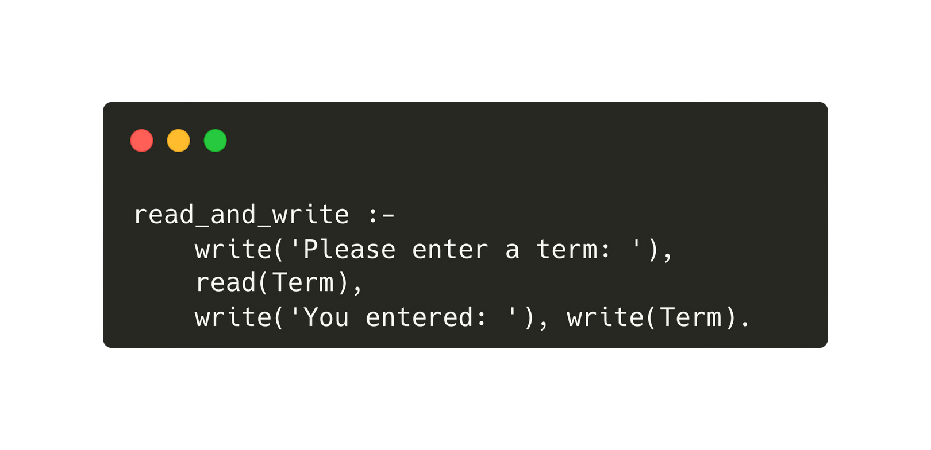
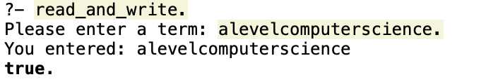
28.9 Manipulating Lists in Prolog
List processing predicate - read
The `read` predicate in Prolog is used to read a term from the standard input stream.
clause
The input must start with a lower case letter and not have spaces or be enclosed in quotes.
query

Slide 30
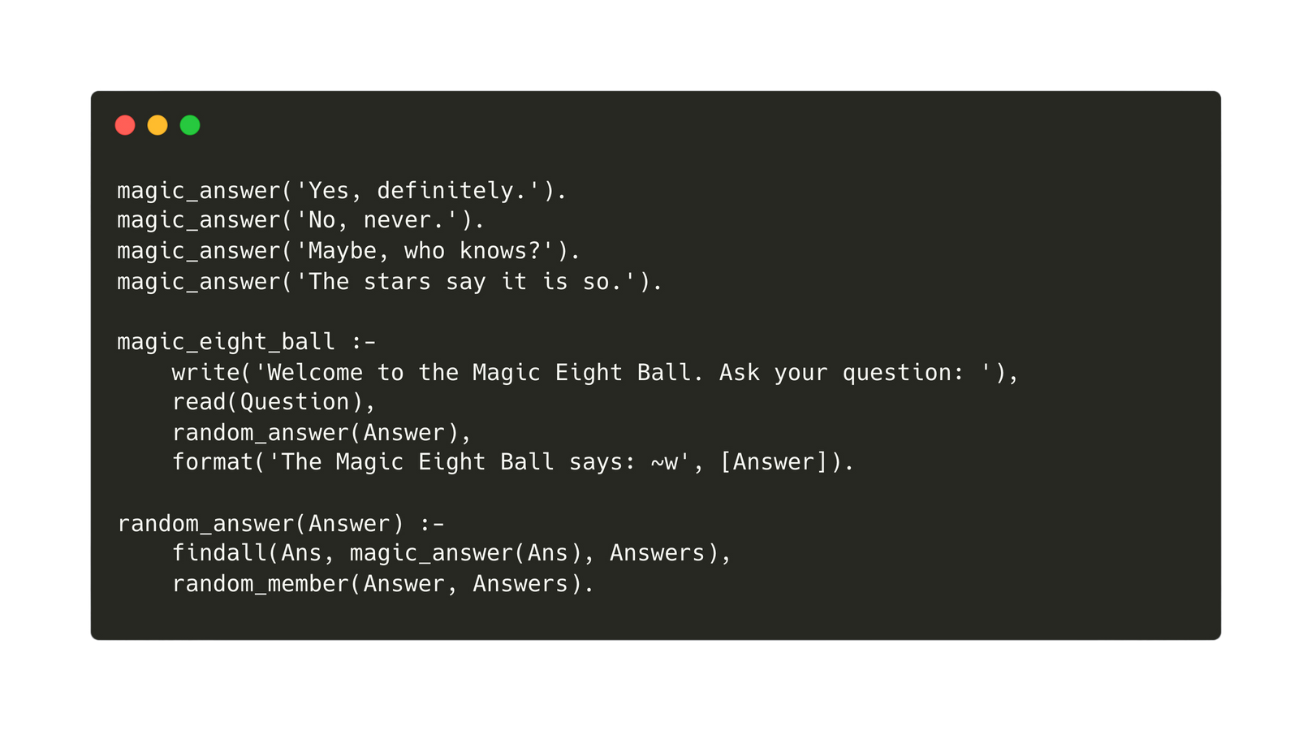
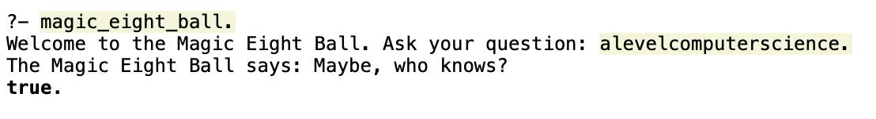
28.9 Manipulating Lists in Prolog
Creating a program in prolog
We can write user-friendly programs using the read and write predicates.
clause
query

