Slide 1
Cambridge International
A Level Computer Science
(9618) – Revision Notes
Programming Paradigms
(Low-Level Programming)
This pack is intended for students to who are taking CIE A Level in Computer Science, either in preparation for their A Level exam, or more likely alongside year 2 of the course to improve fluency, recall and pace on AS & A topics. It could be used as lesson starters, or supplied to students for independent use.

Slide 2



Chapter
27
Low-level programming
AS & A Level Computer Science 9618

Slide 3



Chapter Outline
27.1
27.2
27.3
27.4
Understanding the Processor's Instruction Set
Using Symbolic Addressing in Programming
Solving Problems with Assembly Language
Addressing Modes: Absolute vs. Relative
27.5
Indirect addressing

Slide 4

27.1 Understanding the Processor's Instruction Set
Data Movement
involves loading data into a register / storing data in memory.
Opcode
Operand
Explanation
LDM
#n
Immediate addressing. Load the number n to acc.
LDR
#n
Immediate addressing. Load the number n to IX.
LDD
<Address>
Direct addressing. load the contents at the given address to acc.
LDI
<Address>
indirect addressing. The address to be used is at the given address. load the contents of this second address to acc.
LDX
<Address>
indexed addressing. form the address from <address> + the contents of the index register. Copy the contents of this calculated address to acc.
MOV
<register>
move the contents of the accumulator to the given register.
STO
<Address>
store the contents of acc at the given address.

Slide 5
27.1 Understanding the Processor's Instruction Set
Data Movement
involves loading data into a register / storing data in memory.
Opcode
Operand
Explanation
STX
<address>
indexed addressing. form the address from <address> + the contents of the index register. STORE the contents of ACC TO this calculated address.
STI
<address>
indirect addressing. The address to be used is at the given address. Store the contents of ACC TO this second address.

Slide 6
27.1 Understanding the Processor's Instruction Set
Arithmetic Operations
involves adding and subtracting
Opcode
Operand
Explanation
Add
<Address>
add the contents of the given address to the acc.
Add
#n
add the denary number n to the acc.
Sub
<address>
subtract the contents of the given address from the acc.
Sub
#n
subtract the denary number n from the acc.
INC
<register>
Add 1 to the contents of the register (acc or Ix).
Dec
<register>
subtract 1 from the content of the register (acc or ix).

Slide 7
27.1 Understanding the Processor's Instruction Set
Comparisons and Jumps
involves conditional / unconditional “jump” to a location in the memory address.
Opcode
Operand
Explanation
JMP
<Address>
Jump to the given address.
CMP
<Address>
Compare the contents of acc with the contents of <address>.
CMP
#n
Compare the contents of acc with the number n.
CMI
<Address>
Indirect addressing. the address to be used is at the given address. compare the contents of acc with the contents of this second address.
JPE
<Address>
following a compare instruction, jump to <address> if the compare was true.
JPN
<Address>
following a compare instruction, jump to <address> if the compare was false.
*comparison is restricted to asking if two values are equal.

Slide 8
27.1 Understanding the Processor's Instruction Set
Input and Output
Opcode
Explanation
in
THE ascii value of a character typed at the keyboard will be stored in the acc.
Out
Show on the screen the character corresponding to the ASCII code stored in the accumulator.

Slide 9
27.1 Understanding the Processor's Instruction Set
Shift Operations
involves multiplying and dividing.
Opcode
Operand
Explanation
LSL
#N
the bits in the accumulator is shifted n bit(s) to the left.
LSR
#n
the bits in the accumulator is shifted n bit(s) to the right.

Slide 10
27.1 Understanding the Processor's Instruction Set
Bitwise Logic Operation
Opcode
Operand
Explanation
AND
#Bn
Bitwise and operation of the contents of acc with the binary number n.
AND
<address>
Bitwise and operation of the contents of acc with the contents of <address>
XOR
#Bn
Bitwise XOR operation of the contents of acc with the binary number n
XOR
<address>
Bitwise XOR operation of the contents of acc with the contents of <address>
OR
#Bn
Bitwise OR operation of the contents of acc with the binary number n
Or
<address>
Bitwise OR operation of the contents of acc with the contents of <address>

Slide 11
27.1 Understanding the Processor's Instruction Set
Terms
ACC denotes the Accumulator
IX denotes the Index Register
# denotes immediate addressing
B denotes a binary number
& denotes a hexadecimal number
<address> can be an absolute or a symbolic address

Slide 12
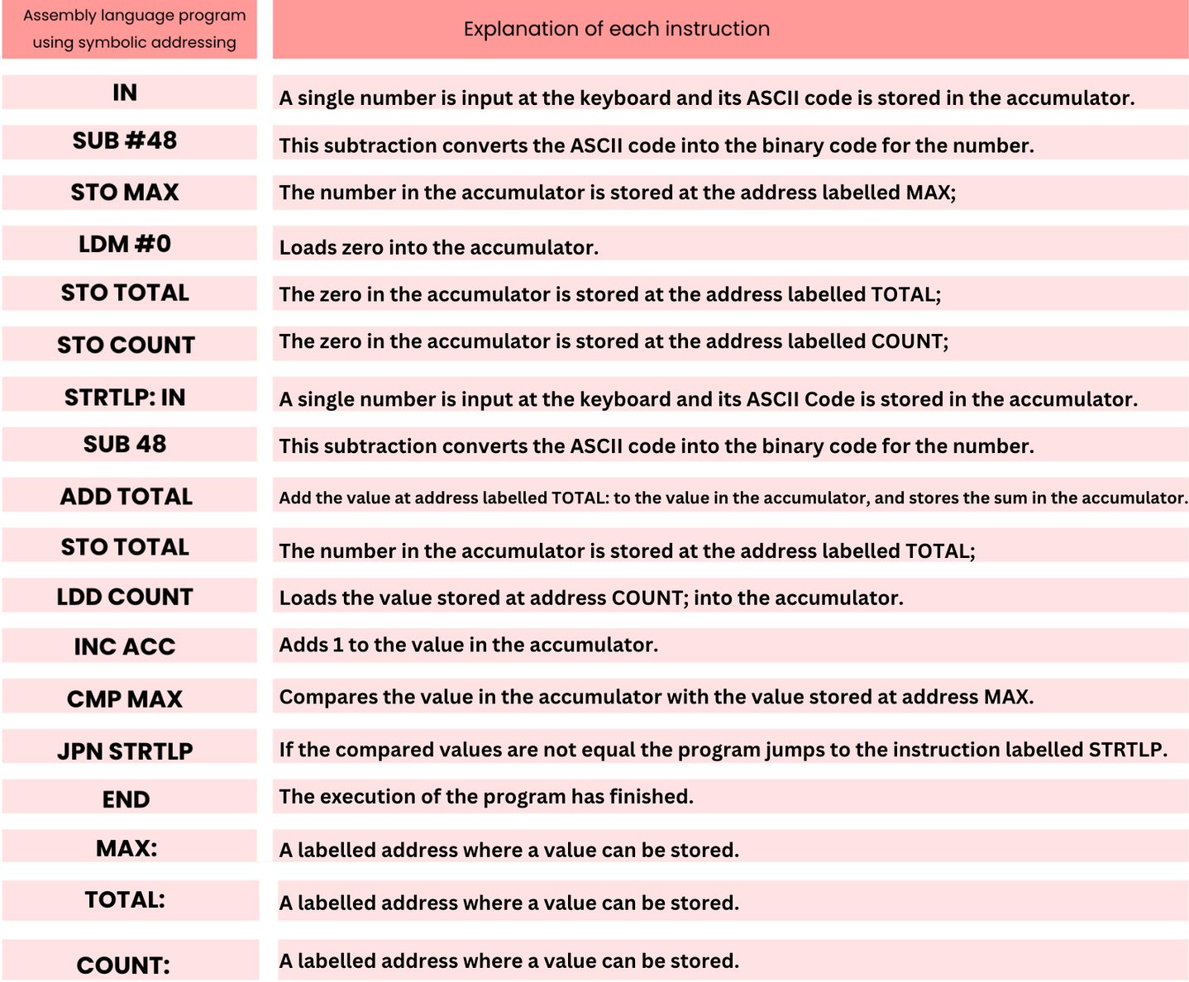
27.2 Using Symbolic Addressing in Programming
Subtopic 1
Definition
Symbolic addressing in computer programming involves using symbolic names or labels to represent memory locations, constants, or instructions instead of explicit numerical addresses.

Slide 13

27.3 Solving Problems with Assembly Language
When tackling a problem with low-level programming, it's essential to decompose the issue into manageable steps that align with the available instruction set for programming. We will look at the following construct.
Input
/ Output
Assignment
Selection
Repetition

Slide 14
27.3 Solving Problems with Assembly Language
Assignment
Pseudocode
Assembly code
LDM #59
STO A
A
59
LDD A
INC ACC
STO A
A
A + 1
LDD B
ADD A
STO B
B
B + A

Slide 15
27.3 Solving Problems with Assembly Language
= 11111111 to produce one’s complement
Assignment
Pseudocode
Assembly code
LDD A
XOR #&FF
INC ACC
STO A
add 1 to product two’s complement
A
- A
Alternative method
LDM #0
SUB A
STO A

Slide 16
27.3 Solving Problems with Assembly Language
Jump if false
Selection
Pseudocode
Assembly code
LDD X
CMP #0
JPN ENDIF
LDD Y
INC ACC
STO Y
....
IF X = 0
THEN
Y Y + 1
ENDIF
THEN:
ENDIF:

Slide 17
27.3 Solving Problems with Assembly Language
ASCII of G
Selection
Pseudocode
Assembly code
LDD X
SUB Y
CMP #0
JPN ELSE
IF X = Y
THEN
OUTPUT “G”
ELSE
OUTPUT “N”
ENDIF
THEN:
LDM #71
OUT
JMP ENDIF
LDM #78
OUT
.....
ELSE:
ENDIF:
ASCII of N

Slide 18
27.3 Solving Problems with Assembly Language
ASCII of H
Repetition
Pseudocode
Assembly code
X 0
REPEAT
OUTPUT “H”
X X + 1
UNTIL X = 3
LDM #0
STO X
LOOP:
LDM #42
OUT
LDD X
INC ACC
STO X
CMP #3
JPN LOOP
Jump if false

Slide 19
27.3 Solving Problems with Assembly Language
Assuming that input is only one character long
Input / Output
Pseudocode
Assembly code
IN
STO X
INPUT X
Move the value -1 to index register, then increment it to make it 0.
LDM #-1
MOV IX
INC IX
LDX Y
OUT
CMP #13
JPN LOOP
LOOP:
OUTPUT Y
Load the contents located at (<address of Y> + IX)
H
I
end of string
Y: 200
201
Ascii for the end of string character
202

Slide 20
27.3 Solving Problems with Assembly Language
Input / Output
Move the value -1 to index register, then increment it to make it 0.
Pseudocode
Assembly code
LDM # -1
MOV IX
INC IX
IN
STX X
CMP #13
JPN LOOP
LOOP:
Store the contents of ACC at (<address of X> + IX)
INPUT X
B
Y
E
end of string
X: 200
201
202
Ascii for the end of string character
The syllabus for 9618 does not include the STX instruction within its specified set of instructions. Consequently, it is not possible to store a string using the 9618 instruction set.
203

Slide 21



27.4 Addressing Modes: Absolute vs. Relative
Definition
Absolute addressing refers to specifying a memory location or operand by its fixed numerical address, while relative addressing involves specifying a location or operand relative to a known reference point or current position in memory or data structure.

Slide 22
27.4 Addressing Modes: Absolute vs. Relative
Comparing symbolic addressing, absolute addressing and relative addressing
Memory
Memory
Memory
IN
200
IN
200
IN
0
SUB #48
201
SUB #48
201
SUB #48
1
STO MAX
202
STO 215
202
STO [BR] +15
2
LDM #0
203
LDM #0
203
LDM #0
3
STO TOTAL
204
STO 216
204
STO [BR] +16
4
STO COUNT
205
STO 217
205
STO [BR] +17
5
IN
206
IN
206
IN
6
SUB #48
207
SUB #48
207
SUB #48
7
ADD TOTAL
208
ADD 216
208
ADD [BR] +16
8
STO TOTAL
209
STO 216
209
STO [BR] +16
9
LDD COUNT
210
LDD 217
210
LDD [BR] +17
10
INC ACC
211
INC ACC
211
INC ACC
11
CMP MAX
212
CMP 215
212
CMP [BR] + 15
12
JPN STRLTP
213
JPN 207
213
JPN [BR] + 7
13
END
214
END
214
END
14
215
Total
215
15
216
Max
216
16
217
Count
217
17

Slide 23
27.5 Indirect addressing
Why “indirect”?
Indirect addressing proves valuable when the memory address required for an instruction may undergo changes throughout the program's execution.

Slide 24
27.5 Indirect addressing
Example: Simple Queue
  Add a character
    Store the data stored in the accumulator into the memory location indicated by the tail pointer.
    Increment the tail pointer
  Remove a character from the queue
    Load contents of the memory location at the head of the queue
    Increment the head pointer
Head pointer
A
B
C
Tail pointer

Slide 25

27.5 Indirect addressing
Example: Simple Queue
JOINQ:
STI TAILPTR
LDD TAILPTR
INC ACC
STO TAILPTR
JMP ENDQ
LDI HEADPTR
OUT
LDD HEADPTR
INC ACC
STO HEADPTR
JMP ENDQ
Adding item to the queue
200
A
B
C
200
202
201
LEAVEQ:
Removing item from the queue
202
203
ENDQ:
Head pointer
HEADPTR:
QSTART
TAILPTR:
Tail pointer
QSTART
“ ”
QSTART:

