Slide 1
Cambridge International
A Level Computer Science
(9618) – Revision Notes
Programming Paradigms
(Object-Oriented Programming)
This pack is intended for students to who are taking CIE A Level in Computer Science, either in preparation for their A Level exam, or more likely alongside year 2 of the course to improve fluency, recall and pace on AS topics. It could be used as lesson starters, or supplied to students for independent use.

Slide 2




Chapter
26
Object-Oriented Programming
AS & A Level Computer Science 9618

Slide 3




Chapter Outline
26.1
26.2
26.3
26.4
26.5
Principles of Object-Oriented Programming
Creating Classes and Objects in OOP
Developing Object-Oriented Software
Code Reusability through Inheritance
Dynamic Behaviour with Polymorphism
26.6
Garbage Collection
26.7
Class Relationships: Aggregation and Containment

Slide 4


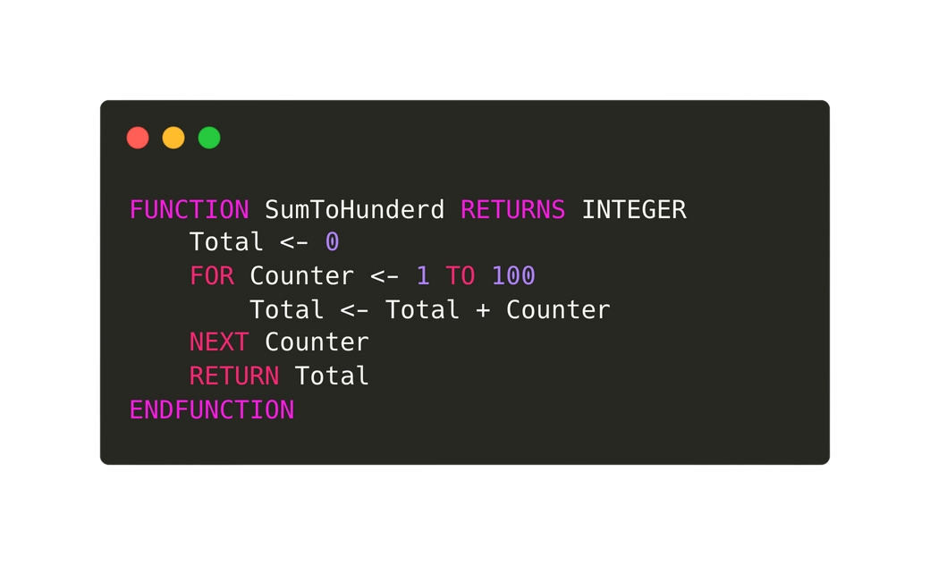
26.1 Principles of Object-Oriented Programming
Object-Oriented Programming
To understand OOP, we need to understand the concept of records and subroutines.
Records
Subroutines
Product Name: STRING
Product Price: REAL
Expiration Date: DATE
A Dairy Product: BOOLEAN
A record type in programming is a data structure that allows the storage of multiple fields or pieces of information under a single name or identifier.
Subroutines contains a group of related programming statements.

Slide 5
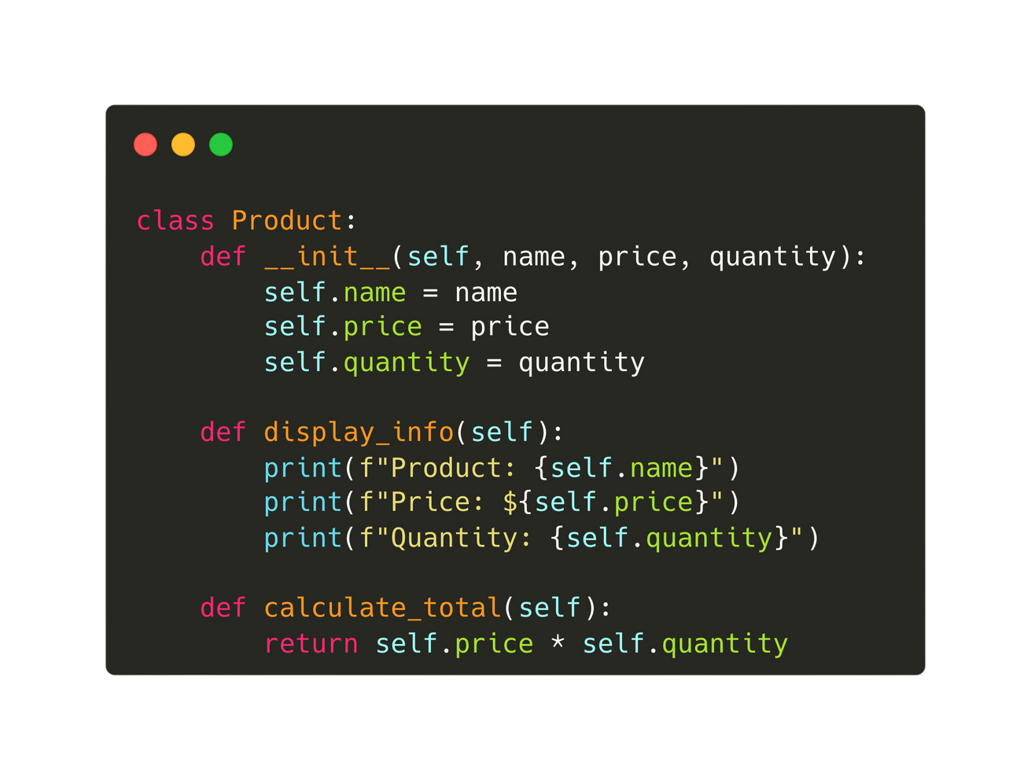

26.1 Principles of Object-Oriented Programming
Classes in OOP
In OOP, a class is a blueprint for objects. It groups together the data structure and the subroutines that operate on the data items in this data structures.
Attributes represent the object's state.
Attributes are referred to as ‘private’.
Methods define its behaviour.
Methods are referred to as ‘public’.
Encapsulation is maintained by accessing attributes only through methods.

Slide 6
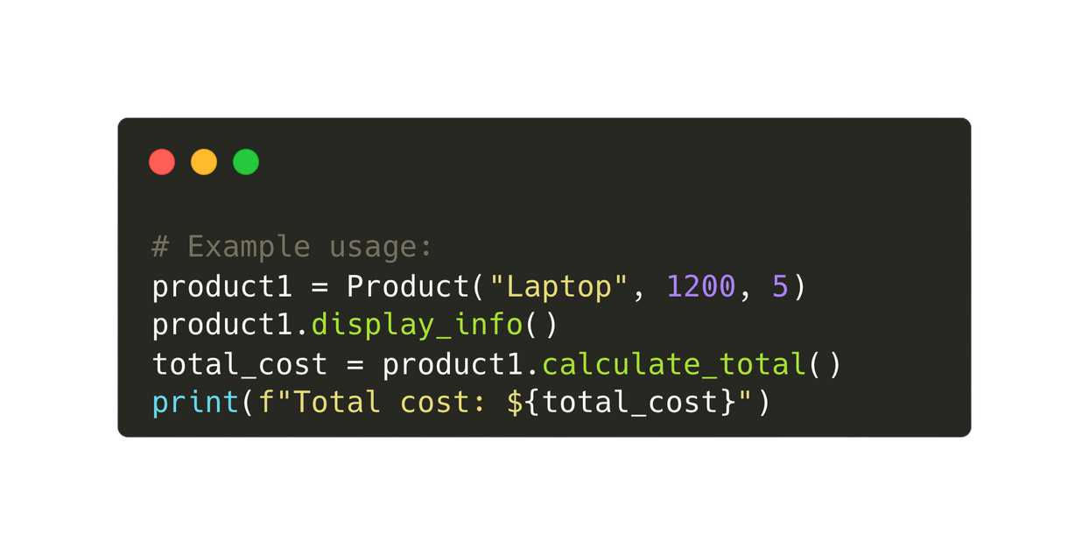
26.1 Principles of Object-Oriented Programming
Classes in OOP
In OOP, a class is a blueprint for objects.
Instantiation: An instance of a class is created by calling the class as if it were a function, initialising it with the desired values for its attributes.

Slide 7
26.1 Principles of Object-Oriented Programming
Benefits of OOP over procedural languages
OOP enhances data protection through encapsulation, restricting direct access to attributes. It promotes modularity, code reusability, and easier maintenance.

Slide 8

26.2 Creating Classes and Objects in OOP
Subtopic 1
Designing a class from scratch
Designing a class involves identifying the essential attributes (data) and methods (functions) that represent the class's characteristics and behaviour. Eg.
Data: ProductID, Name, price, quantity, manufacture date
Functions: setPrice(), getName(), etc
Getters: A method that retrieves the value of an attribute.
Setter: A method that modifies the value of an attribute.
Product
Constructor: A special method used for initializing an object's attributes upon instantiation.

Slide 9
26.2 Creating Classes and Objects in OOP
Subtopic 1
Designing a class from scratch
Designing a class involves identifying the essential attributes (data) and methods (functions) that represent the class's characteristics and behaviour. Eg.
PRODUCT
ProductID: STRING Name: STRING PRICE: REAL QUANTITY: INTEGER MANUFACTURE DATE: DATE
get_product_id() get_name() get_price() get_quantity() get_manufacture_date set_price() set_quantity() display_info()
Product

Slide 10

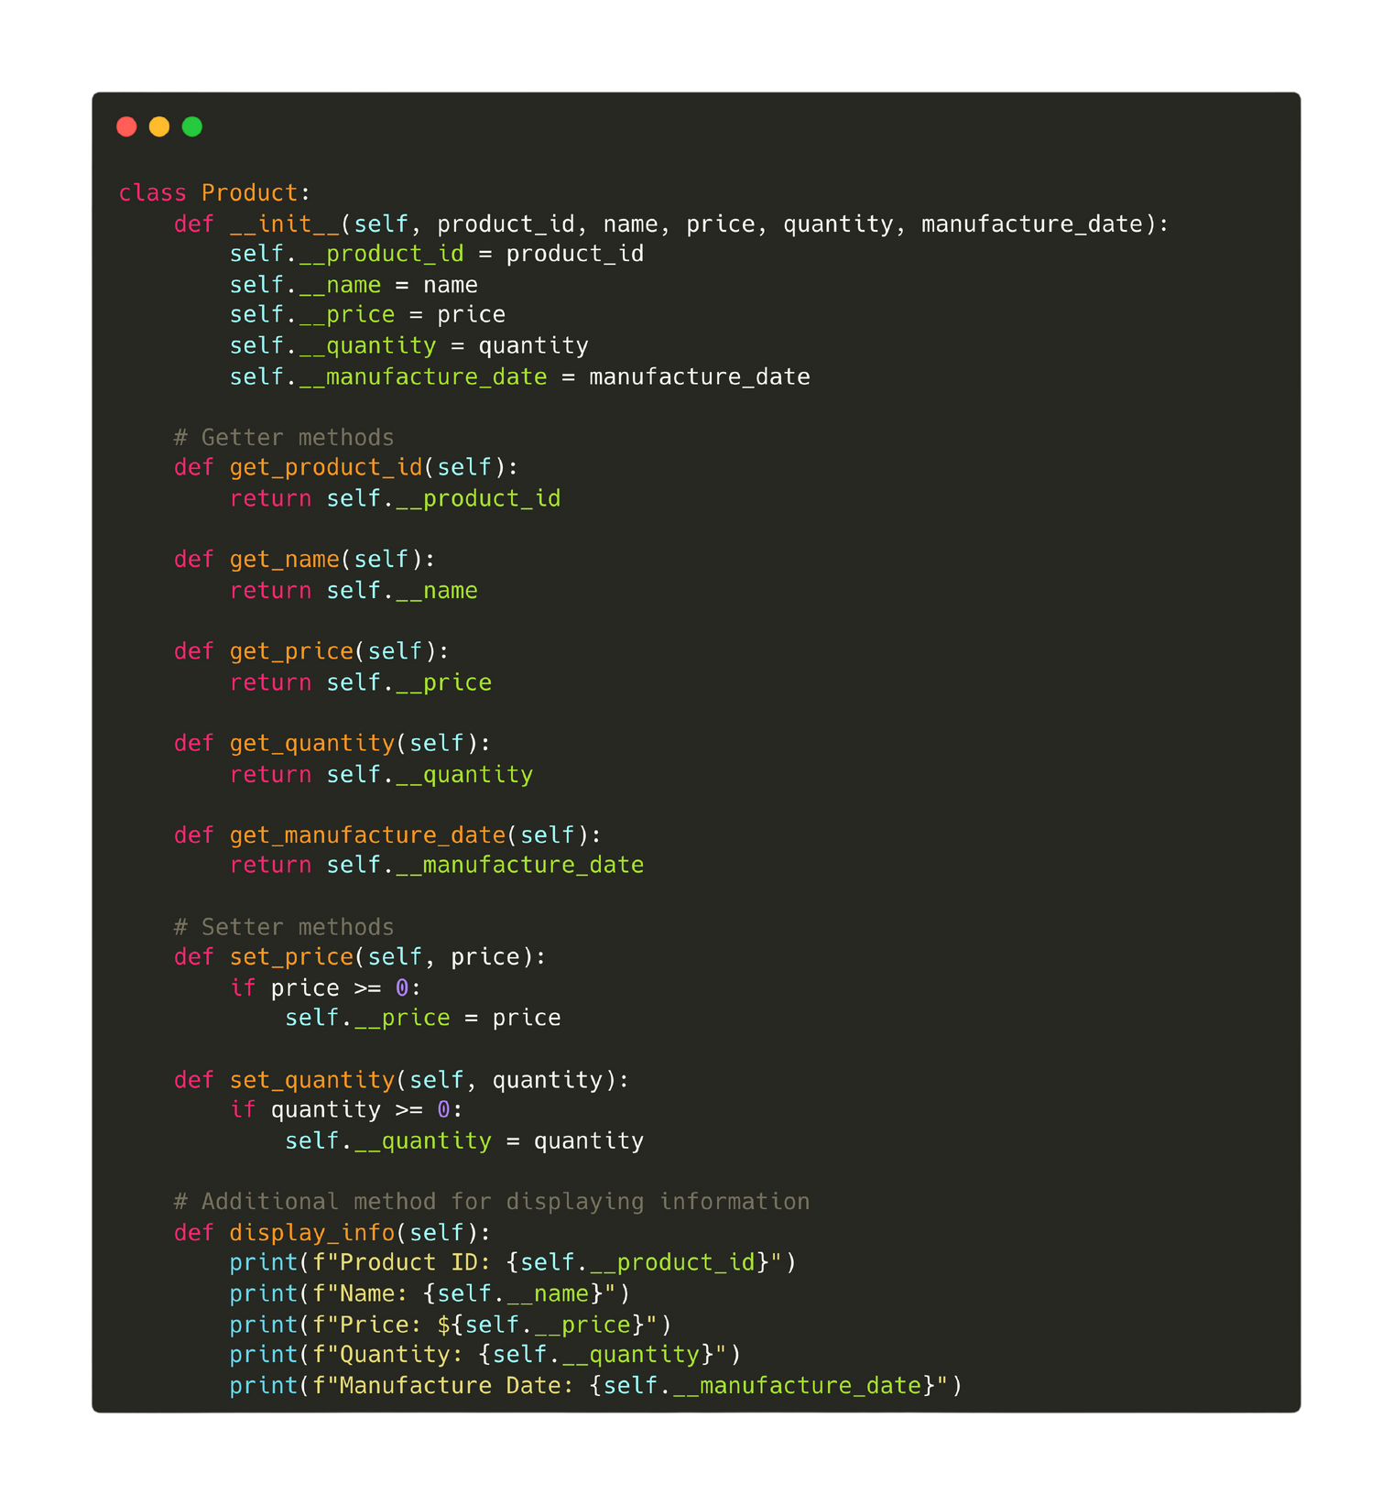
26.3 Developing Object-Oriented Software
Constructor
Attributes
(Private)
2 underscores - signify that it is private
Python codes for declaring the PRODUCT class
Methods
(Public)

Slide 11
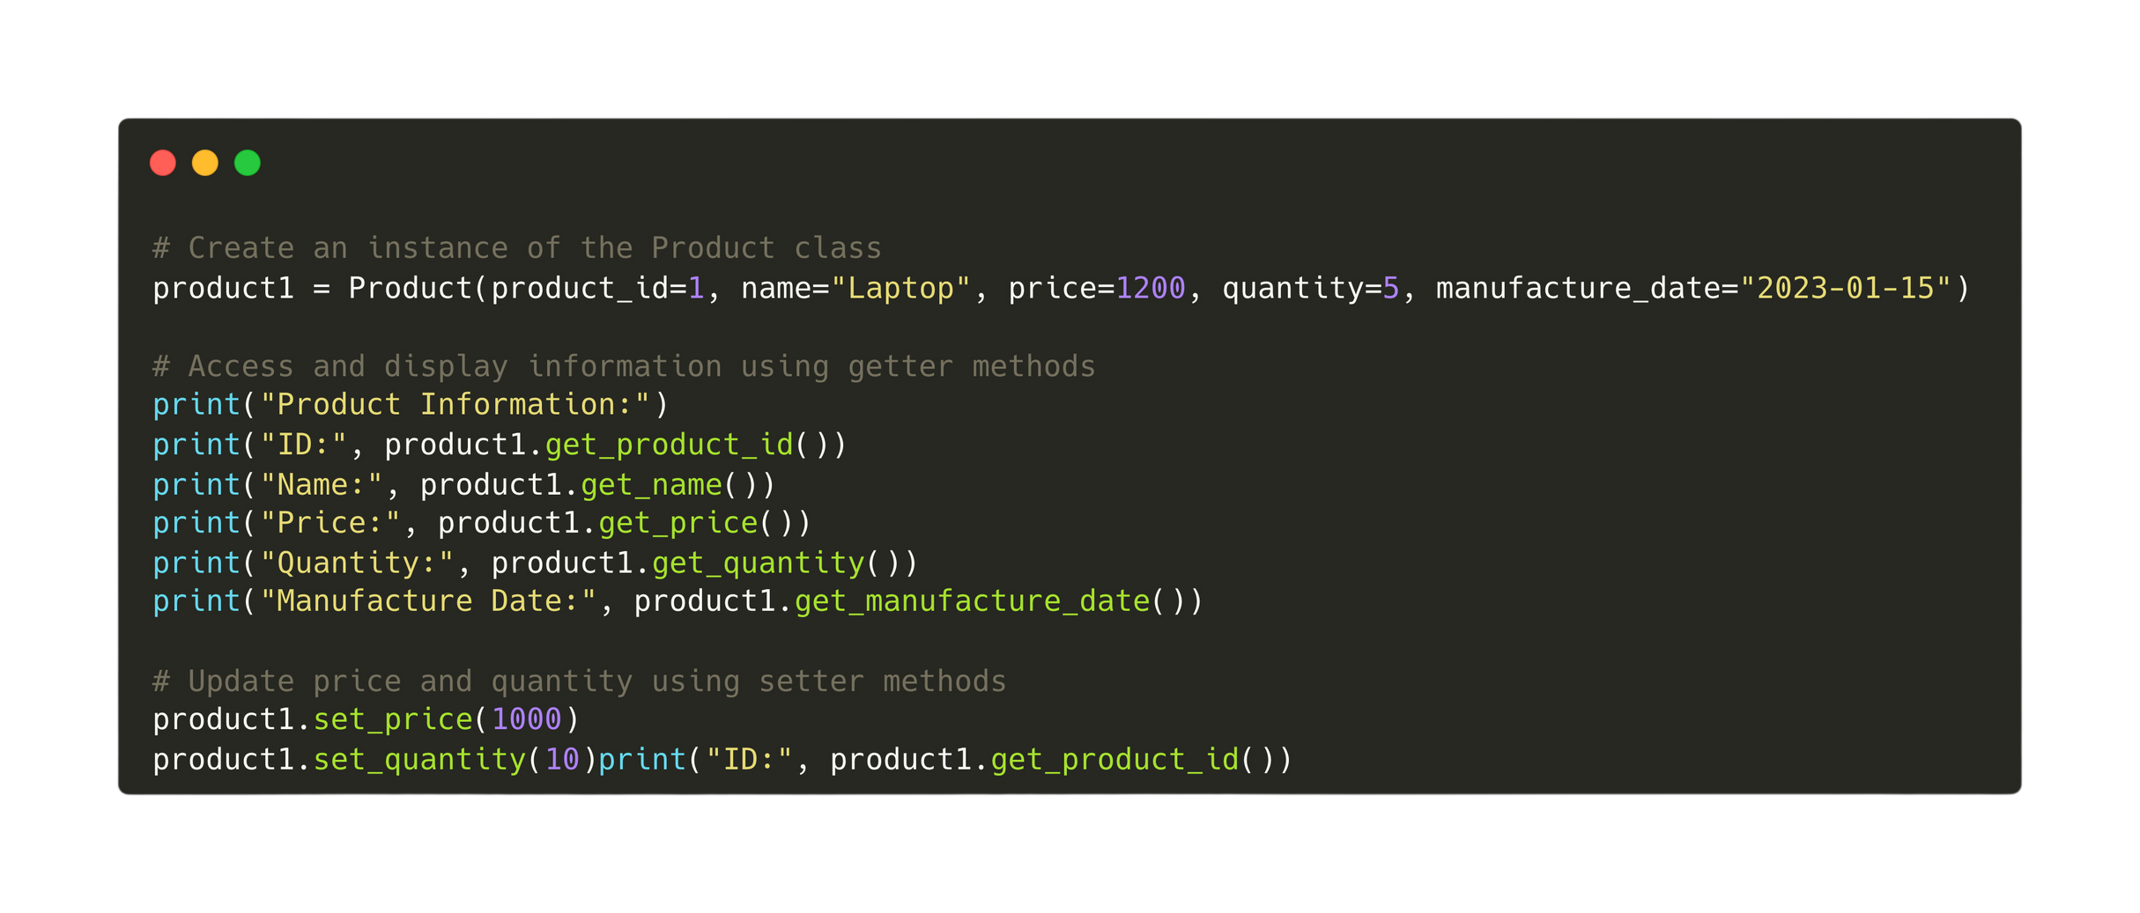
26.3 Developing Object-Oriented Software
Python codes to create an instance of the PRODUCT class

Slide 12
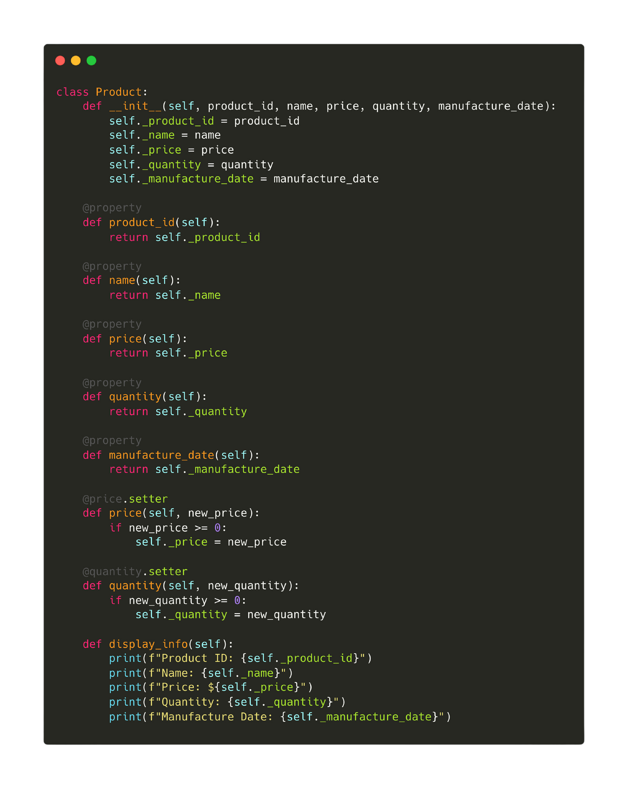
26.3 Developing Object-Oriented Software
Python codes for declaring the PRODUCT class
A property in a Python class allows defining getter, setter, and deleter methods for accessing, modifying, and deleting the value of an attribute, respectively.

Slide 13


26.4 Code Reusability through Inheritance
Inheritance in OOP
Inheritance in OOP allows new classes (child classes) to reuse and extend the functionality of existing classes (parent classes). This simplifies code maintenance, promotes code reuse, and facilitates the creation of hierarchical relationships between classes, making the code more organized and easier to understand.
Base Class
Sub Class
Sub Class

Slide 14
26.4 Code Reusability through Inheritance
Inheritance in OOP
Examples:
Product
Electronic Products
Grocery Products

Slide 15
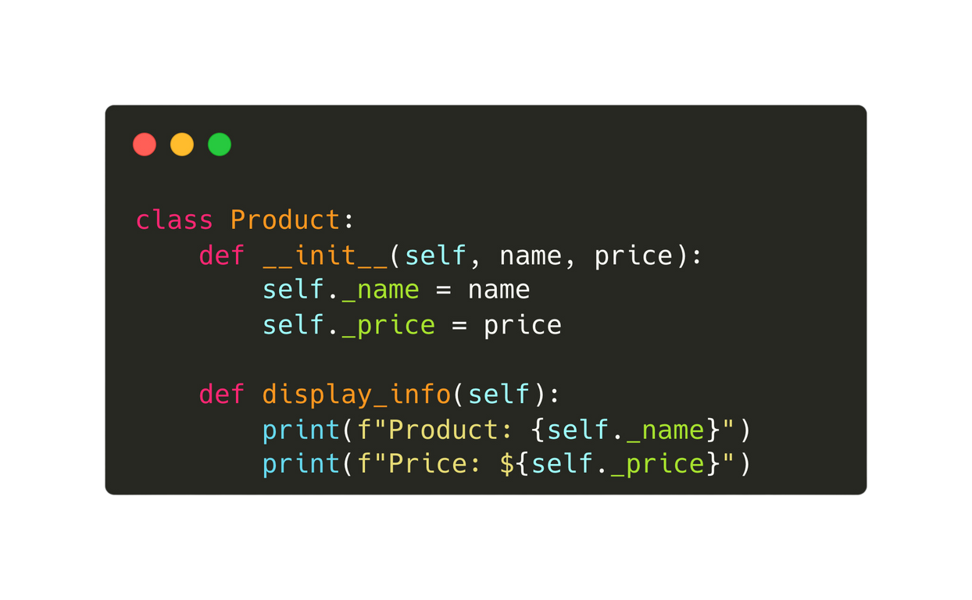
26.4 Code Reusability through Inheritance
Inheritance in OOP
Base Class

Slide 16
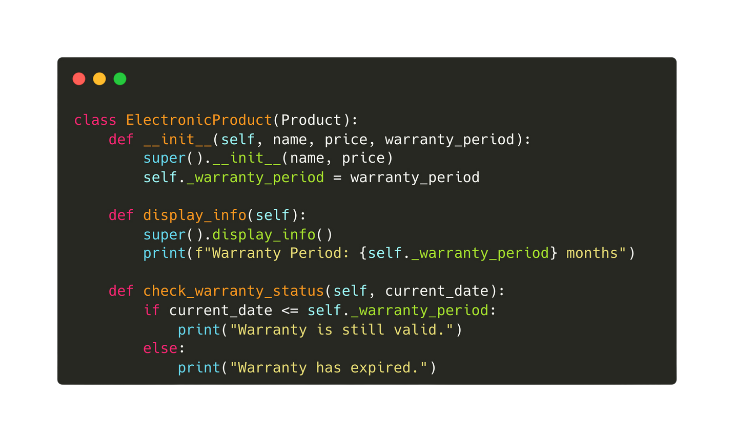
26.4 Code Reusability through Inheritance
A subclass definition
Inheritance in OOP
Calls the constructor & method of the base class
The subclass will “inherit” all the attributes and methods of the base class!
Base Class

Slide 17
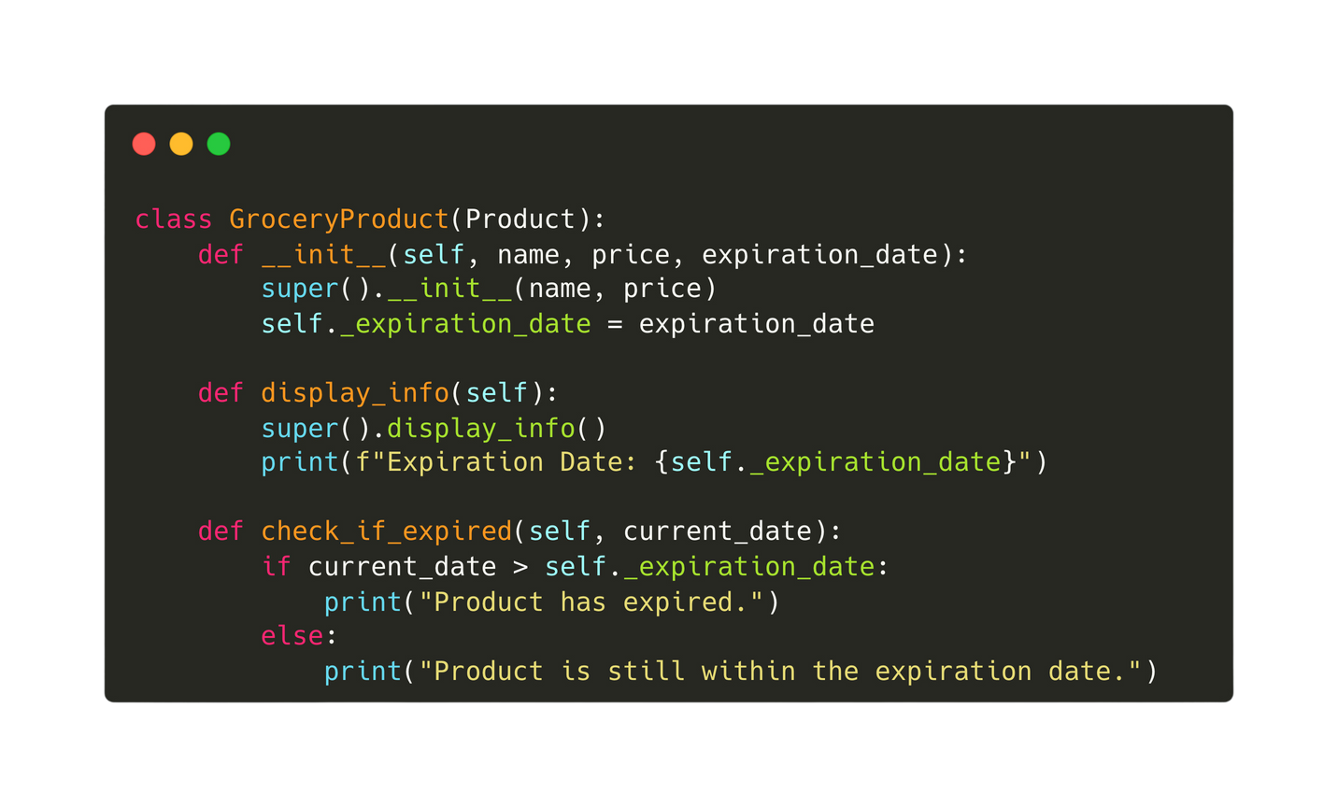
26.4 Code Reusability through Inheritance
Inheritance in OOP
Base Class

Slide 18
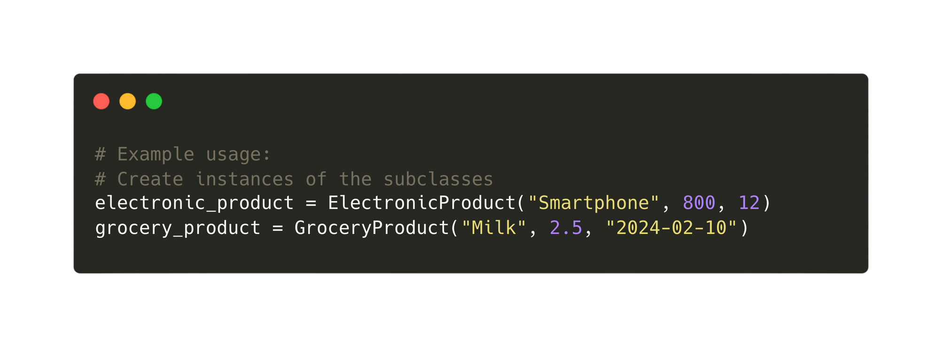
26.4 Code Reusability through Inheritance
Instantiating a sub class

Slide 19
26.5 Dynamic Behaviour with Polymorphism
Polymorphism in OOP
Polymorphism is a core concept in object-oriented programming (OOP) that allows objects of different classes to be treated as objects of a common superclass. It enables methods in a superclass to be implemented in different ways by its subclasses, providing flexibility and enabling code reuse.

Slide 20
26.5 Dynamic Behaviour with Polymorphism
Polymorphism in OOP
Subclasses
Base Class

Slide 21
26.5 Dynamic Behaviour with Polymorphism
Polymorphism in OOP
The base class method will be called first.
The base class method will be called first.
Base Class
Subclasses

Slide 22
26.5 Dynamic Behaviour with Polymorphism
Polymorphism in OOP
Polymorphism is a core concept in object-oriented programming (OOP) that allows objects of different classes to be treated as objects of a common superclass. It enables methods in a superclass to be implemented in different ways by its subclasses, providing flexibility and enabling code reuse.
Base Class
Subclass

Slide 23
Subtopic 1
26.6 Garbage Collection
Memory Leakage
Memory leakage occurs when a program fails to release memory it no longer needs, leading to inefficient memory usage and potentially causing the program to slow down or crash.
Python's memory management, including garbage collection, ensures that memory allocated on the heap for objects is automatically released when those objects are no longer referenced, preventing memory leakage.

Slide 24
26.7 Class Relationships: Aggregation and Containment
Containment
Containment refers to the relationship between two objects where one object (container) holds or includes another object (contained) within its structure.
Eg. Books are part of the library.
Library
Books
1
*

Slide 25
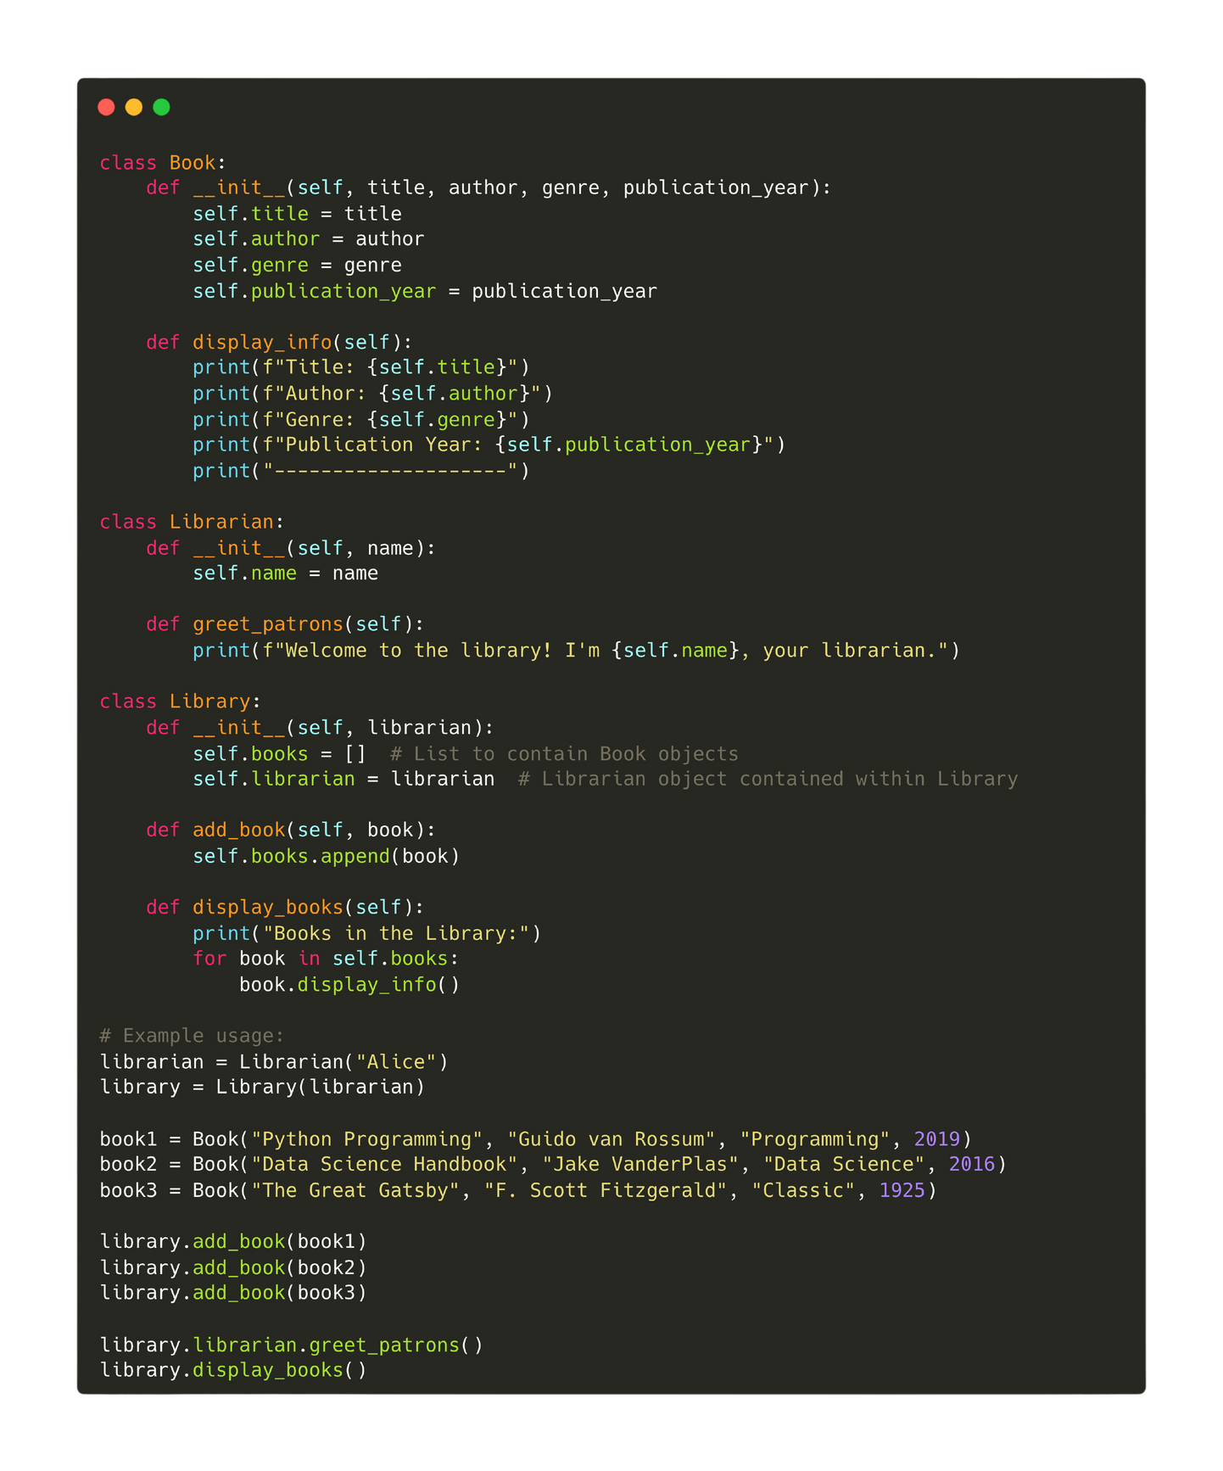
Code to showcase containment

