Slide 1
Cambridge International
A Level Computer Science
(9618) – Revision Notes
Artificial Intelligence (AI)
This pack is intended for students to who are taking CIE A Level in Computer Science, either in preparation for their A Level exam, or more likely alongside year 2 of the course to improve fluency, recall and pace on AS & A topics. It could be used as lesson starters, or supplied to students for independent use.

Slide 2



Chapter
22
Artificial Intelligence
AS & A Level Computer Science 9618

Slide 3



22.2
Chapter
Outline
22.2
22.3
22.1
Dijkstra’s and A* Algorithms
Introduction to Machine Learning
22.4
Overview
Understanding Artificial Neural Networks

Slide 4

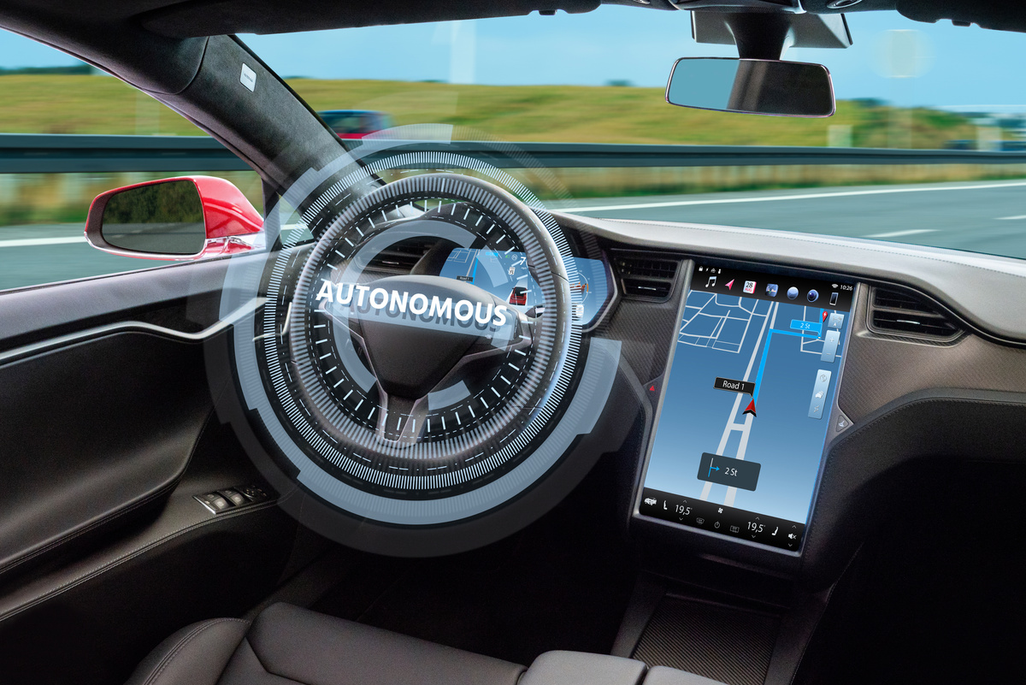


22.1 Overview
What is Artificial Intelligence?
Self driving car
How to make computers do things at which, at the moment, people are better.
Chatbot

Slide 5

Subtopic 1
22.2 Dijkstra’s and A* Algorithms
Node
Graphs
D
50
30
F
40
A
30
C
10
15
B
50
Edge
40
E
Edge Label

Slide 6
Subtopic 1
22.2 Dijkstra’s and A* Algorithms
Shortest path problem
Which path is the shortest path from A to F?
D
50
30
F
40
A
30
C
10
15
B
50
40
E

Slide 7
Subtopic 1
22.2 Dijkstra’s and A* Algorithms
Shortest path problem
D
50
30
A -> D -> F = 80
F
40
A
30
C
10
15
B
50
40
E

Slide 8
Subtopic 1
22.2 Dijkstra’s and A* Algorithms
Shortest path problem
D
50
30
A -> D -> F = 80
F
40
A -> C -> F = 70
A
30
C
10
15
B
50
40
E

Slide 9
Subtopic 1
22.2 Dijkstra’s and A* Algorithms
Shortest path problem
D
50
30
A -> D -> F = 80
F
40
A -> C -> F = 70
A
30
C
A -> B -> C -> F = 65
10
15
B
50
40
E

Slide 10
Subtopic 1
22.2 Dijkstra’s and A* Algorithms
Shortest path problem
D
50
30
A -> D -> F = 80
F
40
A -> C -> F = 70
A
30
C
A -> B -> C -> F = 65
10
15
B
A -> B -> E -> F = 100
50
40
E

Slide 11
Subtopic 1
22.2 Dijkstra’s and A* Algorithms
Dijkstra’s algorithm
Identify the source node
D
50
30
F
40
A
30
C
10
15
B
50
40
E

Slide 12
Subtopic 1
22.2 Dijkstra’s and A* Algorithms
Dijkstra’s algorithm
  Identify the source node (S)
  Create an empty set called ShortestPath set and another one called RemainingNodes set and put all the nodes including S into it.
D
50
30
F
40
A
30
C
ShortestPath set | RemainingNodes set
{} | {A,B,C,D,E,F}
10
15
B
50
40
E

Slide 13

Subtopic 1
22.2 Dijkstra’s and A* Algorithms
D
30
50
F
40
A
30
C
Initialisation
10
15
B
50
40
E
Remaining Set = {B,C,D,E,F}
Content of the ShortestPath set | Label | Content of the record | Content of the record | Content of the record | Content of the record | Content of the record | Content of the record
{} | NodeName | A | B | C | D | E | F
{} | Distance from the node to the source | 0
{} | Sequence of nodes in the route

Slide 14
Subtopic 1
22.2 Dijkstra’s and A* Algorithms
D
50
While ShortestPath set does not contain all the nodes DO
30
F
Pick the node (N) from the remaining nodes set that has the lowest value. Add it into ShortestPath set.
40
A
30
C
For each node in the RemainingNodes set that is adjacent to N
10
15
B
50
a. Calculate a new distance value by adding the value given by the label for the edge connecting the two nodes to the already stored distance for N.
b. If this value is less than the value currently stored replace this stored value by the new one that has been calculated.
c. If a new value has been stored enter the sequence of nodes used to obtain this value.
40
E
Remaining Set = {A,B,C,D,E,F}
Content of the ShortestPath set | Label | Content of the record | Content of the record | Content of the record | Content of the record | Content of the record | Content of the record
{} | NodeName | A | B | C | D | E | F
{} | Distance from the node to the source | 0
{} | Sequence of nodes in the route

Slide 15
Subtopic 1
22.2 Dijkstra’s and A* Algorithms
D
50
While ShortestPath set does not contain all the nodes DO
30
F
Pick the node (N) from the remaining nodes set that has the lowest value. Add it into ShortestPath set.
40
A
30
C
For each node in the RemainingNodes set that is adjacent to N
10
15
B
50
a. Calculate a new distance value by adding the value given by the label for the edge connecting the two nodes to the already stored distance for N.
b. If this value is less than the value currently stored replace this stored value by the new one that has been calculated.
c. If a new value has been stored enter the sequence of nodes used to obtain this value.
40
E
Remaining Set = {B,C,D,E,F}
Content of the ShortestPath set | Label | Content of the record | Content of the record | Content of the record | Content of the record | Content of the record | Content of the record
{A} | NodeName | A | B | C | D | E | F
{A} | Distance from the node to the source | 0
{A} | Sequence of nodes in the route

Slide 16
Subtopic 1
22.2 Dijkstra’s and A* Algorithms
D
50
While ShortestPath set does not contain all the nodes DO
30
F
Pick the node (N) from the remaining nodes set that has the lowest value. Add it into ShortestPath set.
40
A
30
C
For each node in the RemainingNodes set that is adjacent to N
10
15
B
50
a. Calculate a new distance value by adding the value given by the label for the edge connecting the two nodes to the already stored distance for N.
b. If this value is less than the value currently stored replace this stored value by the new one that has been calculated.
c. If a new value has been stored enter the sequence of nodes used to obtain this value.
40
E
Remaining Set = {B,C,D,E,F}
Content of the ShortestPath set | Label | Content of the record | Content of the record | Content of the record | Content of the record | Content of the record | Content of the record
{A} | NodeName | A | B | C | D | E | F
{A} | Distance from the node to the source | 0
{A} | Sequence of nodes in the route

Slide 17
Subtopic 1
22.2 Dijkstra’s and A* Algorithms
D
50
While ShortestPath set does not contain all the nodes DO
30
F
Pick the node (N) from the remaining nodes set that has the lowest value. Add it into ShortestPath set.
40
A
30
C
For each node in the RemainingNodes set that is adjacent to N
10
15
B
50
a. Calculate a new distance value by adding the value given by the label for the edge connecting the two nodes to the already stored distance for N.
b. If this value is less than the value currently stored replace this stored value by the new one that has been calculated.
c. If a new value has been stored enter the sequence of nodes used to obtain this value.
40
E
Remaining Set = {B,C,D,E,F}
Content of the ShortestPath set | Label | Content of the record | Content of the record | Content of the record | Content of the record | Content of the record | Content of the record
{A} | NodeName | A | B | C | D | E | F
{A} | Distance from the node to the source | 0 | 10 | 30 | 30
{A} | Sequence of nodes in the route

Slide 18
Subtopic 1
22.2 Dijkstra’s and A* Algorithms
D
50
While ShortestPath set does not contain all the nodes DO
30
F
Pick the node (N) from the remaining nodes set that has the lowest value. Add it into ShortestPath set.
40
A
30
C
For each node in the RemainingNodes set that is adjacent to N
10
15
B
50
a. Calculate a new distance value by adding the value given by the label for the edge connecting the two nodes to the already stored distance for N.
b. If this value is less than the value currently stored replace this stored value by the new one that has been calculated.
c. If a new value has been stored enter the sequence of nodes used to obtain this value.
40
E
Remaining Set = {B,C,D,E,F}
Content of the ShortestPath set | Label | Content of the record | Content of the record | Content of the record | Content of the record | Content of the record | Content of the record
{A} | NodeName | A | B | C | D | E | F
{A} | Distance from the node to the source | 0 | 10 | 30 | 30
{A} | Sequence of nodes in the route |  | A -> B | A -> C | A -> D

Slide 19
Subtopic 1
22.2 Dijkstra’s and A* Algorithms
D
50
While ShortestPath set does not contain all the nodes DO
30
F
Pick the node (N) from the remaining nodes set that has the lowest value. Add it into ShortestPath set.
40
A
30
C
For each node in the RemainingNodes set that is adjacent to N
10
15
B
50
a. Calculate a new distance value by adding the value given by the label for the edge connecting the two nodes to the already stored distance for N.
b. If this value is less than the value currently stored replace this stored value by the new one that has been calculated.
c. If a new value has been stored enter the sequence of nodes used to obtain this value.
40
E
Remaining Set = {C,D,E,F}
Content of the ShortestPath set | Label | Content of the record | Content of the record | Content of the record | Content of the record | Content of the record | Content of the record
{A,B} | NodeName | A | B | C | D | E | F
{A,B} | Distance from the node to the source | 0 | 10 | 30 | 30
{A,B} | Sequence of nodes in the route |  | A -> B | A -> C | A -> D

Slide 20
Subtopic 1
22.2 Dijkstra’s and A* Algorithms
D
50
While ShortestPath set does not contain all the nodes DO
30
F
Pick the node (N) from the remaining nodes set that has the lowest value. Add it into ShortestPath set.
40
A
30
C
For each node in the RemainingNodes set that is adjacent to N
10
15
B
50
a. Calculate a new distance value by adding the value given by the label for the edge connecting the two nodes to the already stored distance for N.
b. If this value is less than the value currently stored replace this stored value by the new one that has been calculated.
c. If a new value has been stored enter the sequence of nodes used to obtain this value.
40
E
Remaining Set = {C,D,E,F}
Content of the ShortestPath set | Label | Content of the record | Content of the record | Content of the record | Content of the record | Content of the record | Content of the record
{A,B} | NodeName | A | B | C | D | E | F
{A,B} | Distance from the node to the source | 0 | 10 | 30 | 30
{A,B} | Sequence of nodes in the route |  | A -> B | A -> C | A -> D

Slide 21

Subtopic 1
22.2 Dijkstra’s and A* Algorithms
James Gan
D
50
While ShortestPath set does not contain all the nodes DO
30
F
Pick the node (N) from the remaining nodes set that has the lowest value. Add it into ShortestPath set.
40
A
30
C
For each node in the RemainingNodes set that is adjacent to N
10
15
B
50
a. Calculate a new distance value by adding the value given by the label for the edge connecting the two nodes to the already stored distance for N.
b. If this value is less than the value currently stored replace this stored value by the new one that has been calculated.
c. If a new value has been stored enter the sequence of nodes used to obtain this value.
40
E
Remaining Set = {C,D,E,F}
Content of the ShortestPath set | Label | Content of the record | Content of the record | Content of the record | Content of the record | Content of the record | Content of the record
{A,B} | NodeName | A | B | C | D | E | F
{A,B} | Distance from the node to the source | 0 | 10 | 30 | 30
{A,B} | Sequence of nodes in the route |  | A -> B | A -> C | A -> D
15+10 = 25

Slide 22
Subtopic 1
22.2 Dijkstra’s and A* Algorithms
D
50
While ShortestPath set does not contain all the nodes DO
30
F
Pick the node (N) from the remaining nodes set that has the lowest value. Add it into ShortestPath set.
40
A
30
C
For each node in the RemainingNodes set that is adjacent to N
10
15
B
50
a. Calculate a new distance value by adding the value given by the label for the edge connecting the two nodes to the already stored distance for N.
b. If this value is less than the value currently stored replace this stored value by the new one that has been calculated.
c. If a new value has been stored enter the sequence of nodes used to obtain this value.
40
E
Remaining Set = {C,D,E,F}
Content of the ShortestPath set | Label | Content of the record | Content of the record | Content of the record | Content of the record | Content of the record | Content of the record
{A,B} | NodeName | A | B | C | D | E | F
{A,B} | Distance from the node to the source | 0 | 10 | 25 | 30
{A,B} | Sequence of nodes in the route |  | A -> B | A -> B -> C | A -> D

Slide 23
Subtopic 1
22.2 Dijkstra’s and A* Algorithms
D
50
While ShortestPath set does not contain all the nodes DO
30
F
Pick the node (N) from the remaining nodes set that has the lowest value. Add it into ShortestPath set.
40
A
30
C
For each node in the RemainingNodes set that is adjacent to N
10
15
B
50
a. Calculate a new distance value by adding the value given by the label for the edge connecting the two nodes to the already stored distance for N.
b. If this value is less than the value currently stored replace this stored value by the new one that has been calculated.
c. If a new value has been stored enter the sequence of nodes used to obtain this value.
40
E
Remaining Set = {C,D,E,F}
Content of the ShortestPath set | Label | Content of the record | Content of the record | Content of the record | Content of the record | Content of the record | Content of the record
{A,B} | NodeName | A | B | C | D | E | F
{A,B} | Distance from the node to the source | 0 | 10 | 25 | 30 | 50
{A,B} | Sequence of nodes in the route |  | A -> B | A -> B -> C | A -> D | A -> B -> E

Slide 24
Subtopic 1
22.2 Dijkstra’s and A* Algorithms
D
50
While ShortestPath set does not contain all the nodes DO
30
F
Pick the node (N) from the remaining nodes set that has the lowest value. Add it into ShortestPath set.
40
A
30
C
For each node in the RemainingNodes set that is adjacent to N
10
15
B
50
a. Calculate a new distance value by adding the value given by the label for the edge connecting the two nodes to the already stored distance for N.
b. If this value is less than the value currently stored replace this stored value by the new one that has been calculated.
c. If a new value has been stored enter the sequence of nodes used to obtain this value.
40
E
Remaining Set = {D,E,F}
Content of the ShortestPath set | Label | Content of the record | Content of the record | Content of the record | Content of the record | Content of the record | Content of the record
{A,B,C} | NodeName | A | B | C | D | E | F
{A,B,C} | Distance from the node to the source | 0 | 10 | 25 | 30 | 50
{A,B,C} | Sequence of nodes in the route |  | A -> B | A -> B -> C | A -> D | A -> B -> E

Slide 25
Subtopic 1
22.2 Dijkstra’s and A* Algorithms
D
50
While ShortestPath set does not contain all the nodes DO
30
F
Pick the node (N) from the remaining nodes set that has the lowest value. Add it into ShortestPath set.
40
A
30
C
For each node in the RemainingNodes set that is adjacent to N
10
15
B
50
a. Calculate a new distance value by adding the value given by the label for the edge connecting the two nodes to the already stored distance for N.
b. If this value is less than the value currently stored replace this stored value by the new one that has been calculated.
c. If a new value has been stored enter the sequence of nodes used to obtain this value.
40
E
Remaining Set = {D,E,F}
Content of the ShortestPath set | Label | Content of the record | Content of the record | Content of the record | Content of the record | Content of the record | Content of the record
{A,B,C} | NodeName | A | B | C | D | E | F
{A,B,C} | Distance from the node to the source | 0 | 10 | 25 | 30 | 50
{A,B,C} | Sequence of nodes in the route |  | A -> B | A -> B -> C | A -> D | A -> B -> E

Slide 26
Subtopic 1
22.2 Dijkstra’s and A* Algorithms
D
50
While ShortestPath set does not contain all the nodes DO
30
F
Pick the node (N) from the remaining nodes set that has the lowest value. Add it into ShortestPath set.
40
A
30
C
For each node in the RemainingNodes set that is adjacent to N
10
15
B
50
a. Calculate a new distance value by adding the value given by the label for the edge connecting the two nodes to the already stored distance for N.
b. If this value is less than the value currently stored replace this stored value by the new one that has been calculated.
c. If a new value has been stored enter the sequence of nodes used to obtain this value.
40
E
Remaining Set = {D,E,F}
Content of the ShortestPath set | Label | Content of the record | Content of the record | Content of the record | Content of the record | Content of the record | Content of the record
{A,B,C} | NodeName | A | B | C | D | E | F
{A,B,C} | Distance from the node to the source | 0 | 10 | 25 | 30 | 50 | 65
{A,B,C} | Sequence of nodes in the route |  | A -> B | A -> B -> C | A -> D | A -> B -> E | A -> B -> C -> F

Slide 27
Subtopic 1
22.2 Dijkstra’s and A* Algorithms
D
50
While ShortestPath set does not contain all the nodes DO
30
F
Pick the node (N) from the remaining nodes set that has the lowest value. Add it into ShortestPath set.
40
A
30
C
For each node in the RemainingNodes set that is adjacent to N
10
15
B
50
a. Calculate a new distance value by adding the value given by the label for the edge connecting the two nodes to the already stored distance for N.
b. If this value is less than the value currently stored replace this stored value by the new one that has been calculated.
c. If a new value has been stored enter the sequence of nodes used to obtain this value.
40
E
Remaining Set = {E,F}
Content of the ShortestPath set | Label | Content of the record | Content of the record | Content of the record | Content of the record | Content of the record | Content of the record
{A,B,C,D} | NodeName | A | B | C | D | E | F
{A,B,C,D} | Distance from the node to the source | 0 | 10 | 25 | 30 | 50 | 65
{A,B,C,D} | Sequence of nodes in the route |  | A -> B | A -> B -> C | A -> D | A -> B -> E | A -> B -> C -> F

Slide 28
Subtopic 1
22.2 Dijkstra’s and A* Algorithms
D
50
While ShortestPath set does not contain all the nodes DO
30
F
Pick the node (N) from the remaining nodes set that has the lowest value. Add it into ShortestPath set.
40
A
30
C
For each node in the RemainingNodes set that is adjacent to N
10
15
B
50
a. Calculate a new distance value by adding the value given by the label for the edge connecting the two nodes to the already stored distance for N.
b. If this value is less than the value currently stored replace this stored value by the new one that has been calculated.
c. If a new value has been stored enter the sequence of nodes used to obtain this value.
40
E
Remaining Set = {E,F}
Content of the ShortestPath set | Label | Content of the record | Content of the record | Content of the record | Content of the record | Content of the record | Content of the record
{A,B,C,D} | NodeName | A | B | C | D | E | F
{A,B,C,D} | Distance from the node to the source | 0 | 10 | 25 | 30 | 50 | 65
{A,B,C,D} | Sequence of nodes in the route |  | A -> B | A -> B -> C | A -> D | A -> B -> E | A -> B -> C -> F

Slide 29
Subtopic 1
22.2 Dijkstra’s and A* Algorithms
D
50
While ShortestPath set does not contain all the nodes DO
30
F
Pick the node (N) from the remaining nodes set that has the lowest value. Add it into ShortestPath set.
40
A
30
C
For each node in the RemainingNodes set that is adjacent to N
10
15
B
50
a. Calculate a new distance value by adding the value given by the label for the edge connecting the two nodes to the already stored distance for N.
b. If this value is less than the value currently stored replace this stored value by the new one that has been calculated.
c. If a new value has been stored enter the sequence of nodes used to obtain this value.
40
E
Remaining Set = {E,F}
Content of the ShortestPath set | Label | Content of the record | Content of the record | Content of the record | Content of the record | Content of the record | Content of the record
{A,B,C,D} | NodeName | A | B | C | D | E | F
{A,B,C,D} | Distance from the node to the source | 0 | 10 | 25 | 30 | 50 | 65
{A,B,C,D} | Sequence of nodes in the route |  | A -> B | A -> B -> C | A -> D | A -> B -> E | A -> B -> C -> F
30 + 50 = 80
(NOT > 65)

Slide 30
Subtopic 1
22.2 Dijkstra’s and A* Algorithms
D
50
While ShortestPath set does not contain all the nodes DO
30
F
Pick the node (N) from the remaining nodes set that has the lowest value. Add it into ShortestPath set.
40
A
30
C
For each node in the RemainingNodes set that is adjacent to N
10
15
B
50
a. Calculate a new distance value by adding the value given by the label for the edge connecting the two nodes to the already stored distance for N.
b. If this value is less than the value currently stored replace this stored value by the new one that has been calculated.
c. If a new value has been stored enter the sequence of nodes used to obtain this value.
40
E
Remaining Set = {E,F}
Content of the ShortestPath set | Label | Content of the record | Content of the record | Content of the record | Content of the record | Content of the record | Content of the record
{A,B,C,D} | NodeName | A | B | C | D | E | F
{A,B,C,D} | Distance from the node to the source | 0 | 10 | 25 | 30 | 50 | 65
{A,B,C,D} | Sequence of nodes in the route |  | A -> B | A -> B -> C | A -> D | A -> B -> E | A -> B -> C -> F

Slide 31
Subtopic 1
22.2 Dijkstra’s and A* Algorithms
James Gan
D
50
While ShortestPath set does not contain all the nodes DO
30
F
Pick the node (N) from the remaining nodes set that has the lowest value. Add it into ShortestPath set.
40
A
30
C
For each node in the RemainingNodes set that is adjacent to N
10
15
B
50
a. Calculate a new distance value by adding the value given by the label for the edge connecting the two nodes to the already stored distance for N.
b. If this value is less than the value currently stored replace this stored value by the new one that has been calculated.
c. If a new value has been stored enter the sequence of nodes used to obtain this value.
40
E
Remaining Set = {F}
Content of the ShortestPath set | Label | Content of the record | Content of the record | Content of the record | Content of the record | Content of the record | Content of the record
{A,B,C,D,E} | NodeName | A | B | C | D | E | F
{A,B,C,D,E} | Distance from the node to the source | 0 | 10 | 25 | 30 | 50 | 65
{A,B,C,D,E} | Sequence of nodes in the route |  | A -> B | A -> B -> C | A -> D | A -> B -> E | A -> B -> C -> F

Slide 32
Subtopic 1
22.2 Dijkstra’s and A* Algorithms
D
50
While ShortestPath set does not contain all the nodes DO
30
F
Pick the node (N) from the remaining nodes set that has the lowest value. Add it into ShortestPath set.
40
A
30
C
For each node in the RemainingNodes set that is adjacent to N
10
15
B
50
a. Calculate a new distance value by adding the value given by the label for the edge connecting the two nodes to the already stored distance for N.
b. If this value is less than the value currently stored replace this stored value by the new one that has been calculated.
c. If a new value has been stored enter the sequence of nodes used to obtain this value.
40
E
Remaining Set = {F}
Content of the ShortestPath set | Label | Content of the record | Content of the record | Content of the record | Content of the record | Content of the record | Content of the record
{A,B,C,D,E} | NodeName | A | B | C | D | E | F
{A,B,C,D,E} | Distance from the node to the source | 0 | 10 | 25 | 30 | 50 | 65
{A,B,C,D,E} | Sequence of nodes in the route |  | A -> B | A -> B -> C | A -> D | A -> B -> E | A -> B -> C -> F

Slide 33
Subtopic 1
22.2 Dijkstra’s and A* Algorithms
D
50
While ShortestPath set does not contain all the nodes DO
30
F
Pick the node (N) from the remaining nodes set that has the lowest value. Add it into ShortestPath set.
40
A
30
C
For each node in the RemainingNodes set that is adjacent to N
10
15
B
50
a. Calculate a new distance value by adding the value given by the label for the edge connecting the two nodes to the already stored distance for N.
b. If this value is less than the value currently stored replace this stored value by the new one that has been calculated.
c. If a new value has been stored enter the sequence of nodes used to obtain this value.
40
E
Remaining Set = {F}
Content of the ShortestPath set | Label | Content of the record | Content of the record | Content of the record | Content of the record | Content of the record | Content of the record
{A,B,C,D,E} | NodeName | A | B | C | D | E | F
{A,B,C,D,E} | Distance from the node to the source | 0 | 10 | 25 | 30 | 50 | 65
{A,B,C,D,E} | Sequence of nodes in the route |  | A -> B | A -> B -> C | A -> D | A -> B -> E | A -> B -> C -> F
50 + 50 = 100
(NOT > 65)

Slide 34
Subtopic 1
22.2 Dijkstra’s and A* Algorithms
D
50
While ShortestPath set does not contain all the nodes DO
30
F
Pick the node (N) from the remaining nodes set that has the lowest value. Add it into ShortestPath set.
40
A
30
C
For each node in the RemainingNodes set that is adjacent to N
10
15
B
50
a. Calculate a new distance value by adding the value given by the label for the edge connecting the two nodes to the already stored distance for N.
b. If this value is less than the value currently stored replace this stored value by the new one that has been calculated.
c. If a new value has been stored enter the sequence of nodes used to obtain this value.
40
E
Remaining Set = {F}
Content of the ShortestPath set | Label | Content of the record | Content of the record | Content of the record | Content of the record | Content of the record | Content of the record
{A,B,C,D,E} | NodeName | A | B | C | D | E | F
{A,B,C,D,E} | Distance from the node to the source | 0 | 10 | 25 | 30 | 50 | 65
{A,B,C,D,E} | Sequence of nodes in the route |  | A -> B | A -> B -> C | A -> D | A -> B -> E | A -> B -> C -> F

Slide 35
Subtopic 1
22.2 Dijkstra’s and A* Algorithms
D
50
While ShortestPath set does not contain all the nodes DO
30
F
Pick the node (N) from the remaining nodes set that has the lowest value. Add it into ShortestPath set.
40
A
30
C
For each node in the RemainingNodes set that is adjacent to N
10
15
B
50
a. Calculate a new distance value by adding the value given by the label for the edge connecting the two nodes to the already stored distance for N.
b. If this value is less than the value currently stored replace this stored value by the new one that has been calculated.
c. If a new value has been stored enter the sequence of nodes used to obtain this value.
40
E
Remaining Set = {}
Content of the ShortestPath set | Label | Content of the record | Content of the record | Content of the record | Content of the record | Content of the record | Content of the record
{A,B,C,D,E,F} | NodeName | A | B | C | D | E | F
{A,B,C,D,E,F} | Distance from the node to the source | 0 | 10 | 25 | 30 | 50 | 65
{A,B,C,D,E,F} | Sequence of nodes in the route |  | A -> B | A -> B -> C | A -> D | A -> B -> E | A -> B -> C -> F

Slide 36
Subtopic 1
22.2 Dijkstra’s and A* Algorithms
D
50
While ShortestPath set does not contain all the nodes DO
30
F
Pick the node (N) from the remaining nodes set that has the lowest value. Add it into ShortestPath set.
40
A
30
C
For each node in the RemainingNodes set that is adjacent to N
10
15
B
50
a. Calculate a new distance value by adding the value given by the label for the edge connecting the two nodes to the already stored distance for N.
b. If this value is less than the value currently stored replace this stored value by the new one that has been calculated.
c. If a new value has been stored enter the sequence of nodes used to obtain this value.
40
E
Remaining Set = {}
Content of the ShortestPath set | Label | Content of the record | Content of the record | Content of the record | Content of the record | Content of the record | Content of the record
{A,B,C,D,E,F} | NodeName | A | B | C | D | E | F
{A,B,C,D,E,F} | Distance from the node to the source | 0 | 10 | 25 | 30 | 50 | 65
{A,B,C,D,E,F} | Sequence of nodes in the route |  | A -> B | A -> B -> C | A -> D | A -> B -> E | A -> B -> C -> F

Slide 37
Subtopic 1
22.2 Dijkstra’s and A* Algorithms
D
50
While ShortestPath set does not contain all the nodes DO
30
F
Pick the node (N) from the remaining nodes set that has the lowest value. Add it into ShortestPath set.
40
A
30
C
For each node in the RemainingNodes set that is adjacent to N
10
15
B
50
a. Calculate a new distance value by adding the value given by the label for the edge connecting the two nodes to the already stored distance for N.
b. If this value is less than the value currently stored replace this stored value by the new one that has been calculated.
c. If a new value has been stored enter the sequence of nodes used to obtain this value.
40
E
Remaining Set = {}
Content of the ShortestPath set | Label | Content of the record | Content of the record | Content of the record | Content of the record | Content of the record | Content of the record
{A,B,C,D,E,F} | NodeName | A | B | C | D | E | F
{A,B,C,D,E,F} | Distance from the node to the source | 0 | 10 | 25 | 30 | 50 | 65
{A,B,C,D,E,F} | Sequence of nodes in the route |  | A -> B | A -> B -> C | A -> D | A -> B -> E | A -> B -> C -> F

Slide 38
Subtopic 1
22.2 Dijkstra’s and A* Algorithms
A* algorithm
A* (A-star) algorithm is a pathfinding and graph traversal algorithm that efficiently finds the shortest path between two points by combining the benefits of Dijkstra's algorithm with a heuristic to prioritise paths likely to lead to the goal.
A
B
C
G
E
I
H
D
F
J

Slide 39
Subtopic 1
22.2 Dijkstra’s and A* Algorithms
A* algorithm
6
B
A
3
4
G
Problem Statement:
What is the shortest path from A to J?
C
5
8
1
3
2
E
I
H
D
2
5
5
4
3
F
9
J

Slide 40
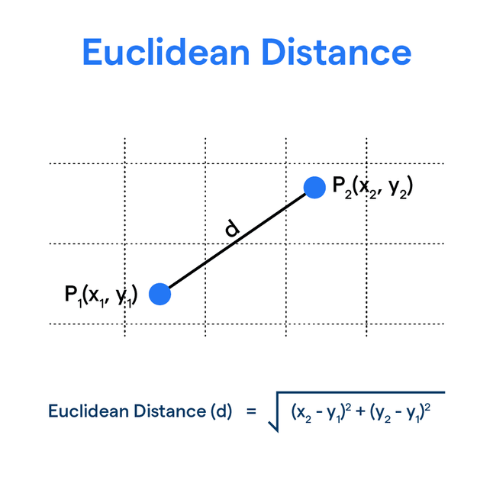
Subtopic 1
22.2 Dijkstra’s and A* Algorithms
Unlike, in Dijkstra, the A* algorithm uses a heuristic value too when determining the shortest path.
The heuristic in A* is typically calculated as the estimated cost from the current node to the goal using a heuristic function, eg. the Euclidean distance.
A* algorithm
10
8
6
B
A
3
4
9
6
G
C
5
8
1
3
2
E
3
2
I
H
5
D
2
4
5
5
4
3
F
3
J
9

Slide 41
Subtopic 1
22.2 Dijkstra’s and A* Algorithms
A* algorithm
10
8
6
B
A
3
4
Starting from A
9
6
G
C
5
8
1
3
2
E
3
2
I
H
5
D
2
4
5
5
4
3
F
3
J
9

Slide 42
Subtopic 1
22.2 Dijkstra’s and A* Algorithms
A* algorithm
10
8
6
B
A
3
4
Starting from A
Go node C = 3 + 6 = 9
Go node B = 6 + 8 = 14
Pick the path that has the lowest value. Therefore, go node C.
9
6
G
C
5
8
1
3
2
E
3
2
I
H
5
D
2
4
5
5
4
3
F
3
J
9

Slide 43
Subtopic 1
22.2 Dijkstra’s and A* Algorithms
A* algorithm
10
8
6
B
A
3
4
Starting from C
9
6
G
C
5
8
1
3
2
E
3
2
I
H
5
D
2
4
5
5
4
3
F
3
J
9

Slide 44
Subtopic 1
22.2 Dijkstra’s and A* Algorithms
A* algorithm
10
8
6
B
A
3
4
Starting from C
Go to D = 2 + 4 = 6
Go to E = 1 + 3 = 4
Pick the path that has the lowest value. Therefore, go node E.
9
6
G
C
5
8
1
3
2
E
3
2
I
H
5
D
2
4
5
5
4
3
F
3
J
9

Slide 45
Subtopic 1
22.2 Dijkstra’s and A* Algorithms
A* algorithm
10
8
6
B
A
3
4
9
Starting from E
6
C
G
5
8
1
3
2
E
3
2
I
H
5
D
2
4
5
5
4
3
F
3
J
9

Slide 46
Subtopic 1
22.2 Dijkstra’s and A* Algorithms
A* algorithm
10
8
6
B
A
3
4
Starting from E
Go to G = 5 + 9 = 14
Go to F = 5 + 3 = 8
Pick the path that has the lowest value. Therefore, go node F.
9
6
C
G
5
8
1
3
2
E
3
2
I
H
5
D
2
4
5
5
4
3
F
3
J
9

Slide 47
Subtopic 1
22.2 Dijkstra’s and A* Algorithms
A* algorithm
10
8
6
B
A
3
4
Starting from F
Only one way to J.
Go to J.
The shortest path has been found.
9
6
C
G
5
8
1
3
2
E
3
2
I
H
5
D
2
4
5
5
4
3
F
3
J
9

Slide 48
Subtopic 1
22.2 Dijkstra’s and A* Algorithms
A* algorithm
10
8
6
B
A
3
4
A* can be superior to Dijkstra's algorithm by incorporating a heuristic that guides the search towards the goal, resulting in a more efficient exploration of paths and often finding the shortest path more quickly.
9
6
C
G
5
8
1
3
2
E
3
2
I
H
5
D
2
4
5
5
4
3
F
3
J
9

Slide 49

22.3 Introduction to Machine Learning
Definition
Machine learning, a subset of artificial intelligence, involves the development of algorithms that enable systems to learn from data, identify patterns, and make predictions or decisions without explicit programming.
Unsupervised Learning
Supervised Learning
Reinforcement Learning

Slide 50
22.3 Introduction to Machine Learning
Unsupervised Learning
Unsupervised learning is a machine learning paradigm where algorithms are trained on unlabelled data to discover patterns, structures, or relationships within the data without explicit guidance or predefined target outputs.
In unsupervised learning, conceptual clusters are utilised to automatically group and organise similar patterns or entities within data, enabling the algorithm to uncover inherent structures and relationships without predefined labels or categories.

Slide 51
22.3 Introduction to Machine Learning
Unsupervised Learning
Unsupervised learning can be employed to categorise news on Google by analysing patterns and similarities within the content, allowing the algorithm to automatically cluster and organise news articles into relevant categories without the need for explicit labelling.

Slide 52

22.3 Introduction to Machine Learning
Unsupervised Learning
Unsupervised learning can be applied to categorise videos on YouTube by analysing patterns and similarities within the video content, enabling the algorithm to automatically group and organise videos into relevant categories without the need for manual labelling.

Slide 53
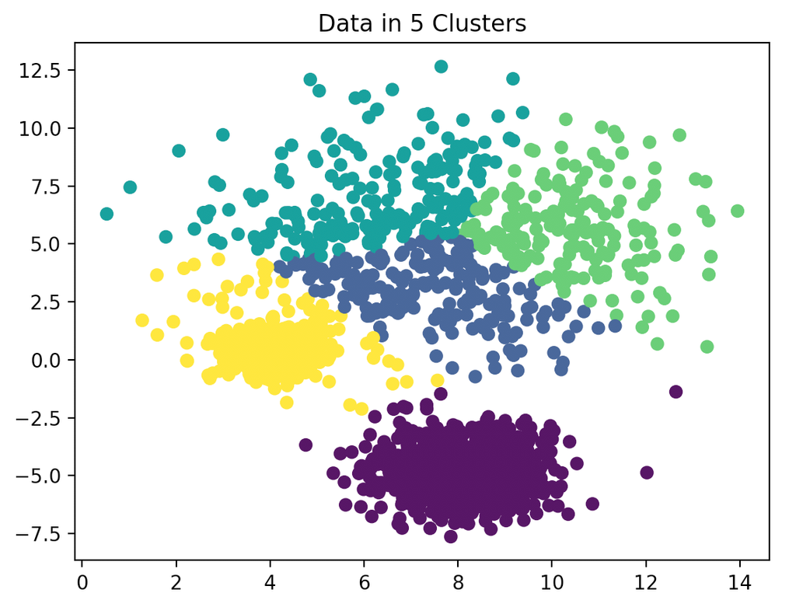
22.3 Introduction to Machine Learning
Unsupervised Learning - K-means clustering

Slide 54
22.3 Introduction to Machine Learning
Supervised learning
Supervised learning is a machine learning paradigm where algorithms are trained on labeled data to predict or classify new instances based on the correlation between input features and known output labels.

Slide 55



22.3 Introduction to Machine Learning
Supervised learning
A classic example of supervised learning is a spam email filter, where the algorithm is trained on a labeled dataset of emails (spam or not spam) to learn patterns and features associated with each category, allowing it to predict and classify new, unseen emails as either spam or non-spam.
x 10000
Algorithm that knows how to classify email into spam and not spam
Algorithm
x 10000

Slide 56
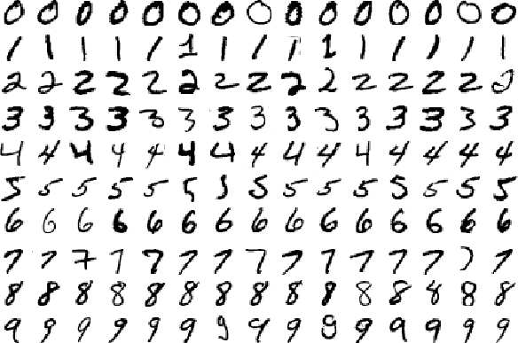
22.3 Introduction to Machine Learning
Supervised learning
Another example of supervised learning is handwriting recognition, where the algorithm is trained on a labeled dataset of handwritten characters to learn the patterns associated with each letter or digit, enabling it to accurately classify and recognise handwritten input in the future.

Slide 57
22.3 Introduction to Machine Learning
Supervised learning - Expert System
An expert system is a computer program that utilizes knowledge and decision rules provided by human experts, akin to supervised learning, where the system is trained on labeled data with explicit guidance to make informed decisions and predictions in a specific domain.
If performance is poor, then further data and conclusions are input to the system.

Slide 58
22.3 Introduction to Machine Learning
Reinforcement Learning
Reinforcement learning is a machine learning paradigm in which an agent learns to make decisions by interacting with an environment, receiving feedback in the form of rewards or punishments, and adjusting its strategy to maximize cumulative reward over time.

Slide 59
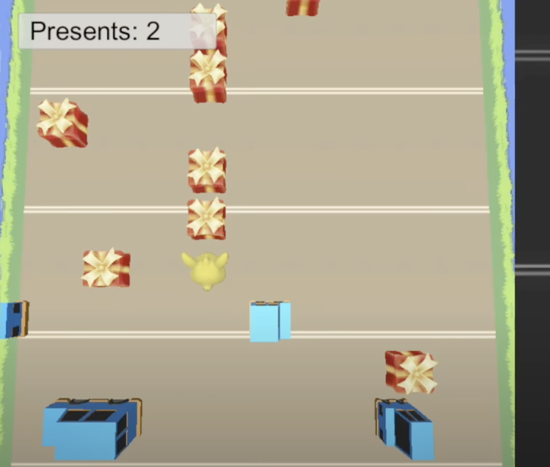
22.3 Introduction to Machine Learning
Reinforcement Learning
An example of reinforcement learning is training a computer program to play a game. The agent (program) interacts with the game environment, takes actions (such as making moves in chess or playing moves in a video game), receives feedback in the form of rewards or penalties based on its performance, and adjusts its strategy over time to optimize its overall score or success in the game.
Unity Machine Learning - Reinforcement Learning
Demo [Search on YouTube]

Slide 60
22.3 Introduction to Machine Learning
Regression Analysis Methods
Regression analysis is a statistical technique that models the relationship between variables using a mathematical function. This function will takes in input and predict what the outputs will be.
Eg. Linear Regression.
Sales (k$)
800
600
400
200
Advertising(K$)
10
20
30
40
50

Slide 61
22.3 Introduction to Machine Learning
Regression Analysis Methods
A line of best fit, characterised by a function can be created based on the input data.
Sales (k$)
800
600
400
200
Advertising(K$)
10
20
30
40
50

Slide 62
22.3 Introduction to Machine Learning
Regression Analysis Methods
The function created can be used to predict the output for unseen/new data. Eg. How much sales will we get if we spend $30k in advertising?
Sales (k$)
800
600
400
200
Advertising(K$)
10
20
30
40
50

Slide 63
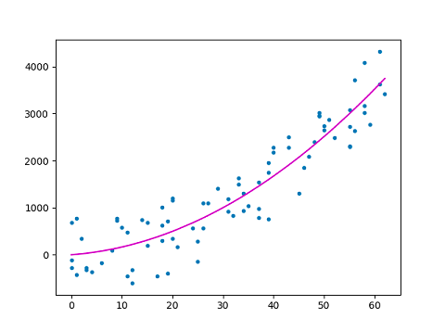
22.3 Introduction to Machine Learning
Regression Analysis Methods
Polynomial regression: A statistical method that extends linear regression by fitting a polynomial function to the relationship between a dependent variable and one or more independent variables.

Slide 64




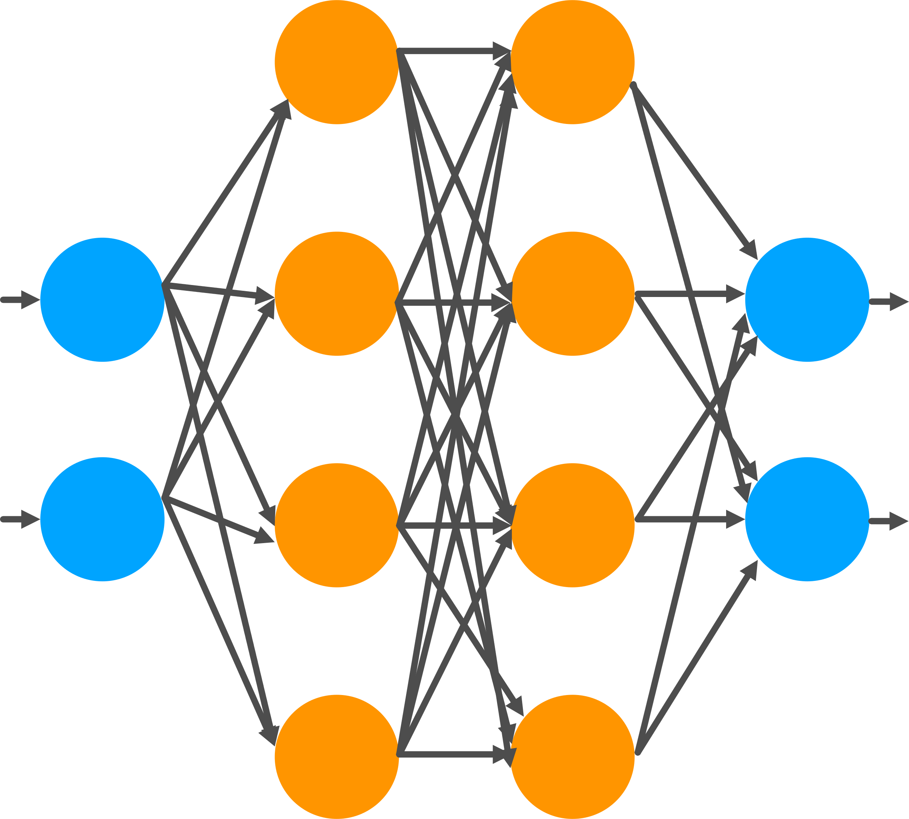
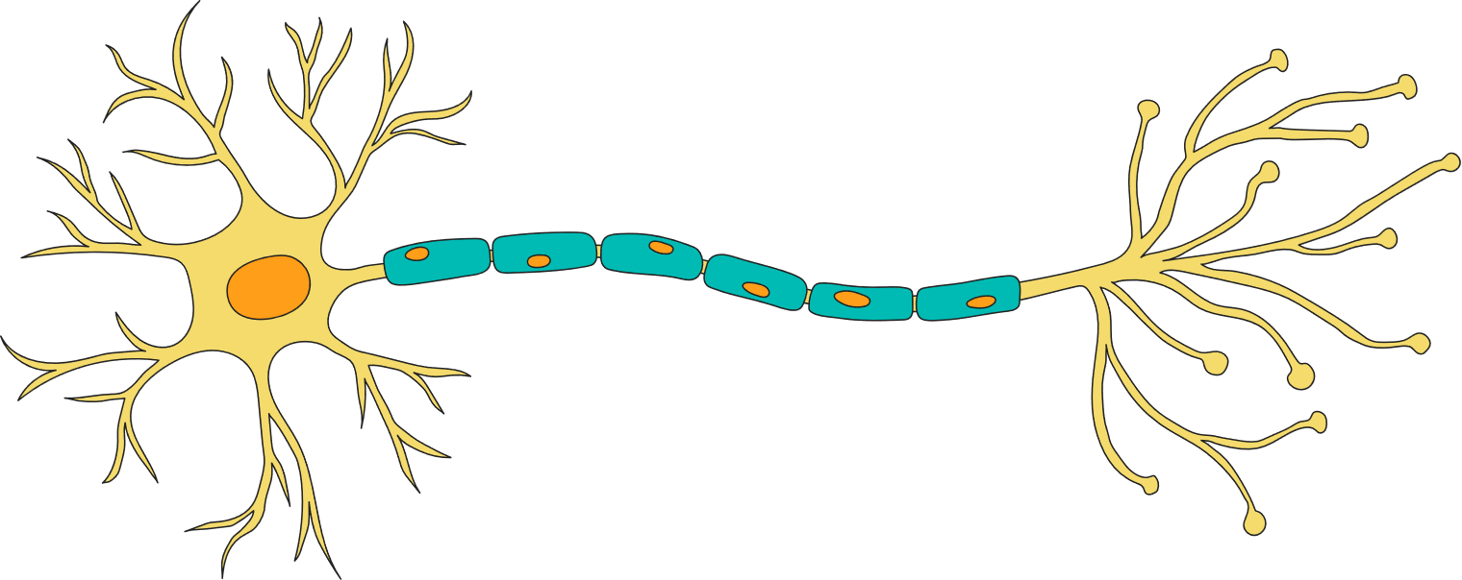
22.4 Understanding Artificial Neural Networks
Each node contains an activation function, which in a is a mathematical operation applied to the weighted sum of input values, introducing non-linearity and determining the output of a node or neuron.
Natural vs Artifical Neural Network
Neural Network in our brains
Artificial Neural Network
Dendrites
Axon
Postsynaptic cell
Cell Body
Synaptic terminals
Nodes =
Represent artificial neurons
A node can receive one or more
weighted inputs and can provide an output to one or more of the other nodes.

Slide 65

22.4 Understanding Artificial Neural Networks
AI System that uses an artificial neural network
An AI system utilising an artificial neural network for sentiment analysis takes text as input and produces an output predicting the sentiment polarity (positive, negative, or neutral) of the given text.
Notes: The text has to be converted into numbers before being fed into the neural network.

Slide 66
22.4 Understanding Artificial Neural Networks
Back Propagation
Back-propagation is a training algorithm for neural networks that adjusts the weights and biases by propagating the error backward from the output layer to the input layer, enabling the network to learn and improve its predictions.

Slide 67
22.4 Understanding Artificial Neural Networks
Back Propagation - Summary (SA example)
Convert each word in the input sentence to a numerical representation (word embedding).
Input Encoding
Neural Network Architecture
Set up a neural network with an input layer, one or more hidden layers, and an output layer.
Pass the numerical input through the neural network to get a predicted sentiment output.
Forward Pass
Compare the predicted sentiment with the actual sentiment label, calculating the error (the difference between predicted and actual).
Error Calculation
Backpropagation and Weight Update
Propagate the error backward through the network, adjusting weights and biases using the back propagation algorithm to minimise the error, and repeat until the model learns to make accurate sentiment predictions.

Slide 68
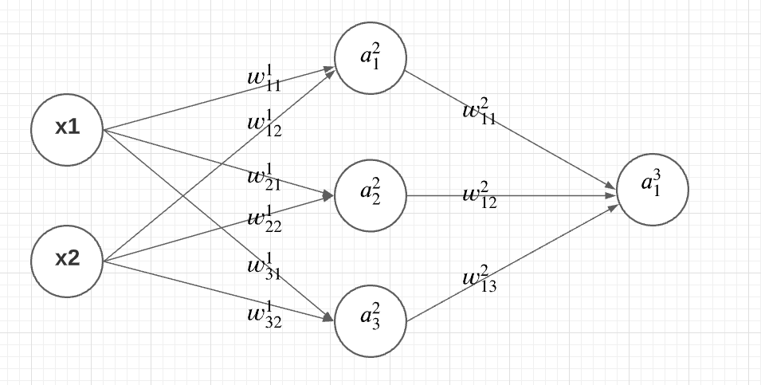
22.4 Understanding Artificial Neural Networks
Back Propagation - Summary (SA example)

Slide 69
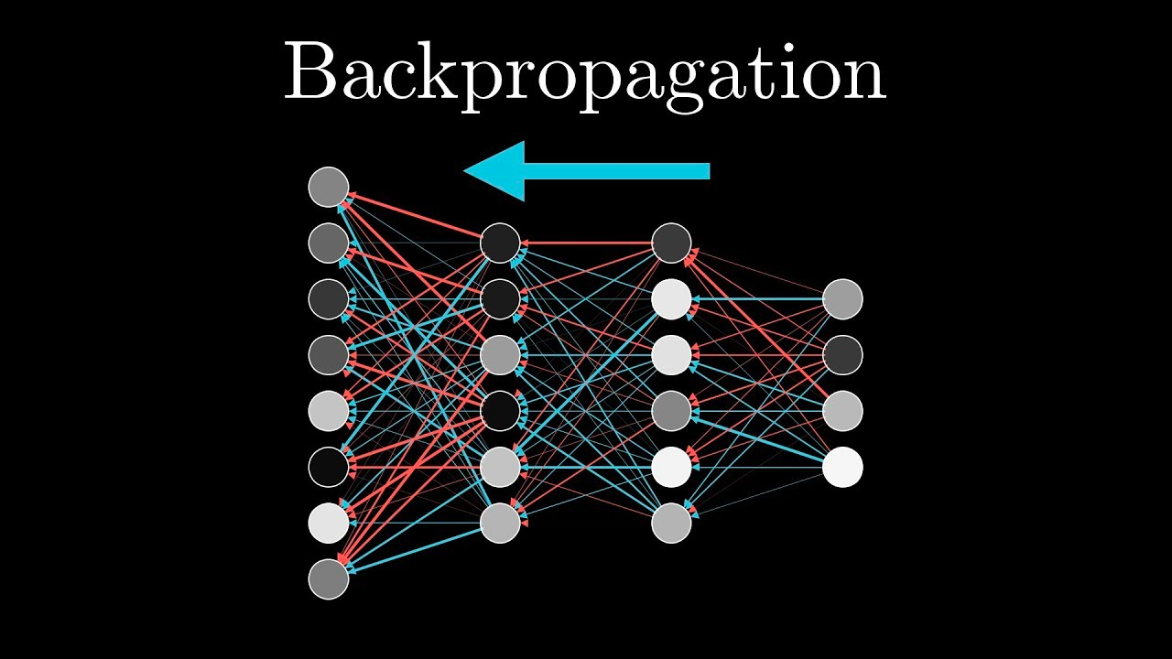
22.4 Understanding Artificial Neural Networks
Back Propagation - Better Explained by

