Slide 1
Cambridge International
A Level Computer Science
(9618) – Revision Notes
Digital Logic and Boolean Algebra
This pack is intended for students to who are taking CIE A Level in Computer Science, either in preparation for their A Level exam, or more likely alongside year 2 of the course to improve fluency, recall and pace on AS & A topics. It could be used as lesson starters, or supplied to students for independent use.

Slide 2



Chapter
19
Digital Logic and Boolean Algebra
AS & A Level Computer Science 9618

Slide 3



Chapter
Outline
19.1
19.2
19.3
Fundamentals of Logic Circuits
Designing Sequential Logic Circuits
Introduction to Boolean Algebra
19.4
Practical Applications of Boolean Algebra
19.5
Karnaugh maps
(K-maps)

Slide 4


19.1 Fundamentals of Logic Circuits
Half adder
A half adder performs the addition of two single binary digits, generating the sum and carry output.
1
1
1
Bit 1
1 bit half adder circuitry
Sum
Carry
+
Bit 2
10

Slide 5
19.1 Fundamentals of Logic Circuits
Half adder
Truth Table for a half adder:
Input | Input | Output | Output
A | B | S | C
0 | 0 | 0 | 0
0 | 1 | 1 | 0
1 | 0 | 1 | 0
1 | 1 | 0 | 1

Slide 6
19.1 Fundamentals of Logic Circuits
Half adder
The S output can be constructed using an XOR gate.
Input | Input | Output | Output
A | B | S | C
0 | 0 | 0 | 0
0 | 1 | 1 | 0
1 | 0 | 1 | 0
1 | 1 | 0 | 1

Slide 7
19.1 Fundamentals of Logic Circuits
Half adder
The C output can be constructed using an AND gate.
Input | Input | Output | Output
A | B | S | C
0 | 0 | 0 | 0
0 | 1 | 1 | 0
1 | 0 | 1 | 0
1 | 1 | 0 | 1

Slide 8




19.1 Fundamentals of Logic Circuits
Universal Gates
The NAND Gates and NOR Gates are universal gates. Any logical circuit can be constructed using these gates.
Circuit manufacturers prefer using universal gates, like NAND or NOR gates, to create adder circuits due to their versatility and the ability to construct all other logic gates, minimizing the number of distinct components needed for various circuit designs.
A
A
X
X
B
B
NOT Gate
NOT Gate
AND Gate
OR Gate

Slide 9
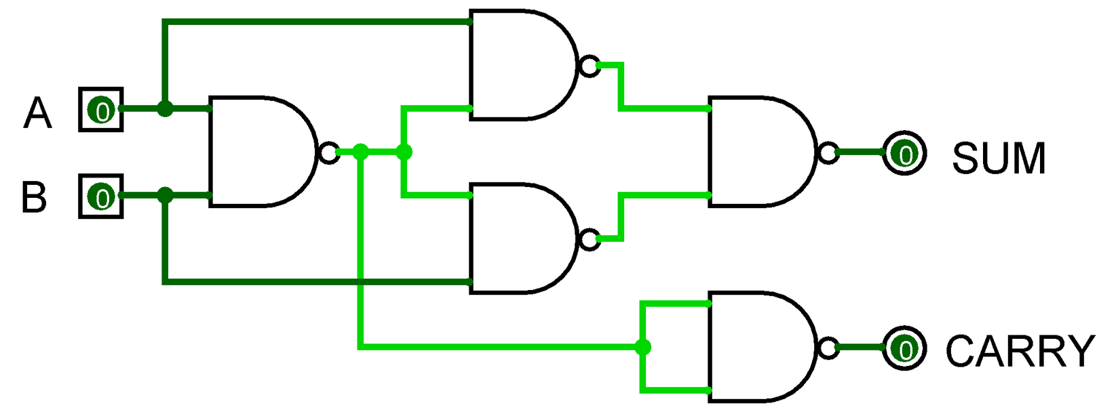
19.1 Fundamentals of Logic Circuits
Half adder (using NAND Gates)

Slide 10
19.1 Fundamentals of Logic Circuits
Full adder
A full adder is necessary because it can handle the addition of three inputs (two bits and a carry) to produce a sum and carry output, allowing for accurate arithmetic calculations in multi-bit operations, which a half adder alone cannot accomplish.
1
1
11
11
+
110

Slide 11
19.1 Fundamentals of Logic Circuits
Full adder
Input | Input | Input | Output | Output
A | B | C in | S | C out
Truth table for a full adder:
0
0
0
0
0
0
0
1
1
0
0
1
0
1
0
0
1
1
0
1
1
0
0
1
0
1
0
1
0
1
1
1
0
0
1
1
1
1
1
1

Slide 12
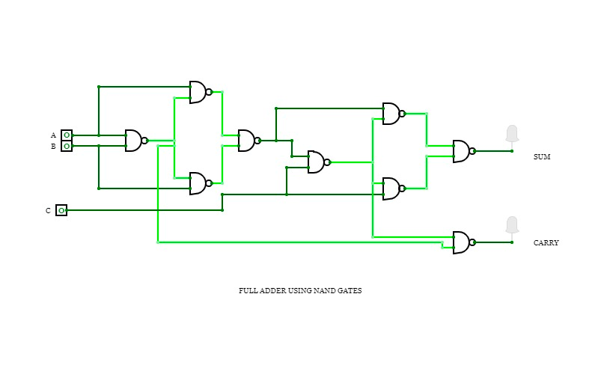
19.1 Fundamentals of Logic Circuits
Full adder
Truth table for a full adder:

Slide 13
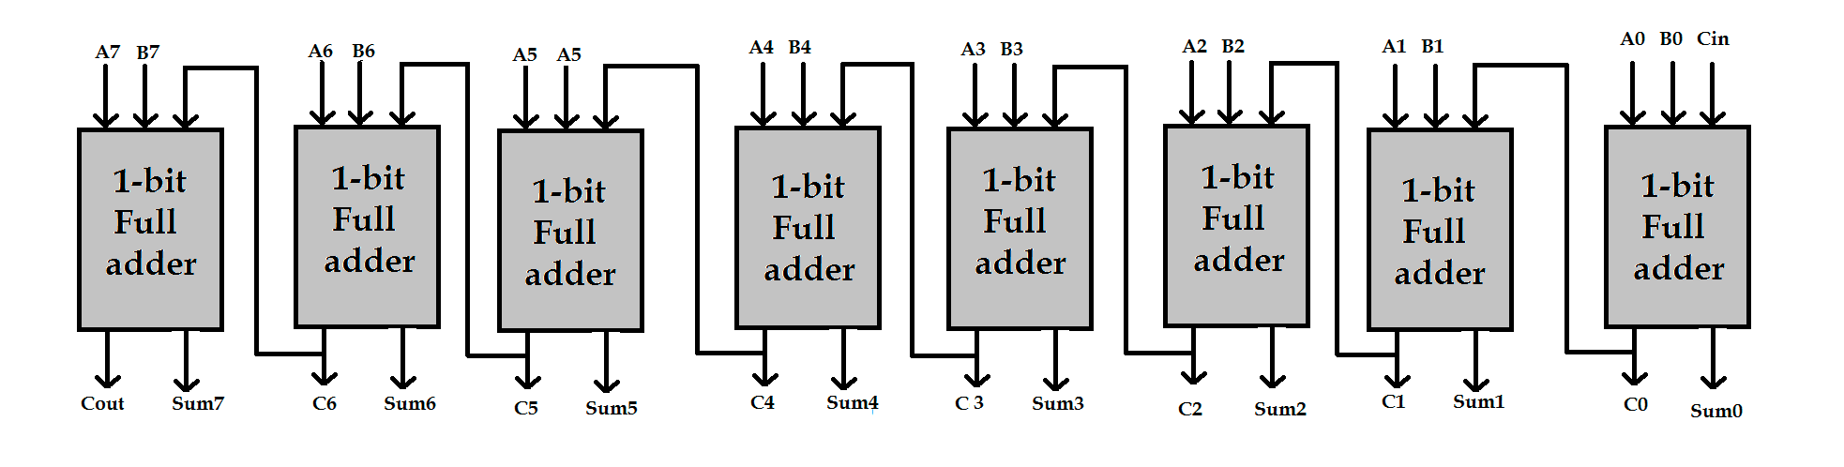
19.1 Fundamentals of Logic Circuits
Full adder
8-bit full adder

Slide 14
Subtopic 1
19.2 Designing Sequential Logic Circuits
Types of logic circuits
Combinational circuit
Sequential circuit
A digital circuit whose output at any given time is solely determined by its current inputs.
A digital circuit where the output is influenced not only by the current inputs but also by the circuit's previous state.

Slide 15
Subtopic 1
19.2 Designing Sequential Logic Circuits
Types of logic circuits
Combinational circuit
A digital circuit whose output at any given time is solely determined by its current inputs.

Slide 16
Subtopic 1
19.2 Designing Sequential Logic Circuits
Sequential circuits
SR flip-flop
JK flip-flop

Slide 17
Subtopic 1
19.2 Designing Sequential Logic Circuits
Sequential circuits
SR flip-flop
JK flip-flop

Slide 18
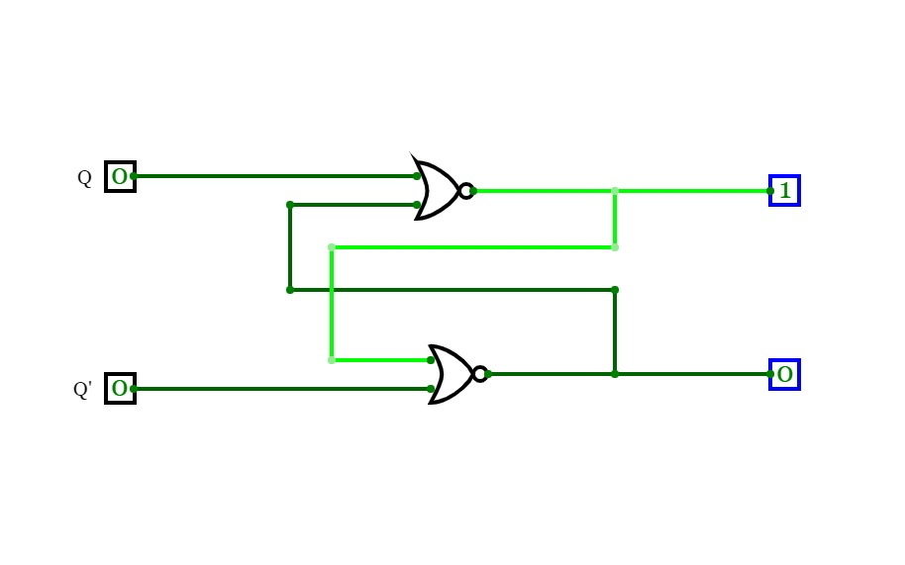

Subtopic 1
19.2 Designing Sequential Logic Circuits
(Set Reset)
SR flip-flop - a two state device
R
Output of one circuit is the input of the other.
Either Q = 1 and Q’ = 0 or reverse
S
If R,S,Q, Q’ all have the value 0, it will be self contradictory.
A state with Q and Q’ both set to 1 is also self contradictory.

Slide 19
Subtopic 1
19.2 Designing Sequential Logic Circuits
SR flip-flop - Truth Table
Input | Input | Initial State | Initial State | Final State | Final State
S | R | Q | Q’ | Q | Q’
0
0
1
0
1
0
1
0
1
0
1
0
0
1
0
0
0
1
0
0
0
1
0
1
1
0
0
1
1
0
0
1
0
1
0
1

Slide 20
Subtopic 1
19.2 Designing Sequential Logic Circuits
SR flip-flop
S = 0 , R = 0.
Self consistency state.
Input | Input | Initial State | Initial State | Final State | Final State
S | R | Q | Q’ | Q | Q’
0
0
1
0
1
0
0
0
0
1
0
1

Slide 21
Subtopic 1
19.2 Designing Sequential Logic Circuits
SR flip-flop
S = 1 , R = 0.
Converts an unset state to a set state (SET).
Input | Input | Initial State | Initial State | Final State | Final State
S | R | Q | Q’ | Q | Q’
1
0
1
0
1
0
1
0
0
1
0
1

Slide 22
Subtopic 1
19.2 Designing Sequential Logic Circuits
SR flip-flop
S = 0 , R = 1.
Converts an set state to a unset state (RESET).
Input | Input | Initial State | Initial State | Final State | Final State
S | R | Q | Q’ | Q | Q’
0
1
1
0
0
1
0
1
0
1
0
1

Slide 23
Subtopic 1
19.2 Designing Sequential Logic Circuits
SR flip-flop
Note that S and R cannot be 1 at the same time. You can’t reset and set at the same time. This would be contradictory.
Input | Input | Initial State | Initial State | Final State | Final State
S | R | Q | Q’ | Q | Q’
0
0
1
0
1
0
1
0
1
0
1
0
0
1
0
0
0
1
0
0
0
1
0
1
1
0
0
1
1
0
0
1
0
1
0
1

Slide 24
Subtopic 1
19.2 Designing Sequential Logic Circuits
SR flip-flop
Q and Q’ cannot have the same state too. SR flip-flop is a two-state device.
Input | Input | Initial State | Initial State | Final State | Final State
S | R | Q | Q’ | Q | Q’
0
0
1
0
1
0
1
0
1
0
1
0
0
1
0
0
0
1
0
0
0
1
0
1
1
0
0
1
1
0
0
1
0
1
0
1

Slide 25
Subtopic 1
19.2 Designing Sequential Logic Circuits
SR flip-flop
SR flip-flops are employed in creating the storage cells within RAM (Random Access Memory) where each flip-flop represents a single memory bit, storing data in the form of binary information (0s and 1s).

Slide 26
Subtopic 1
19.2 Designing Sequential Logic Circuits
Sequential circuits
SR flip-flop
JK flip-flop

Slide 27
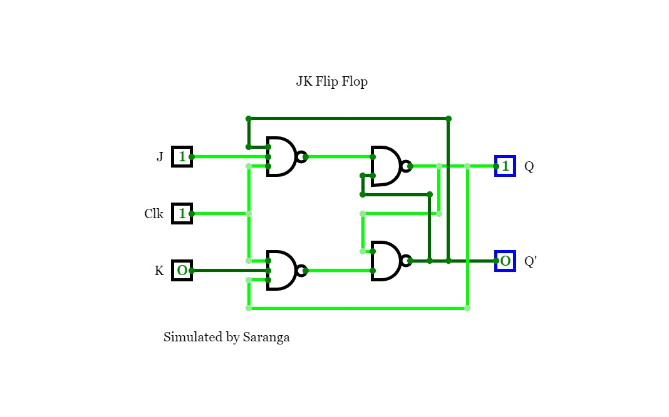
Subtopic 1
19.2 Designing Sequential Logic Circuits
JK flip-flop
It is possible for a circuit to arrive at an uncertain state if inputs do not arrive quite at the same time. JK flip flop include a clock pulse input to give a better chance of synchronising inputs.

Slide 28
Subtopic 1
19.2 Designing Sequential Logic Circuits
JK flip-flop (part of the truth table)
Set Input
Clear Input
J | K | Clock | Q
0 | 0 |  | Q unchanged
1 | 0 |  | 1
0 | 1 |  | 0
1 | 1 |  | Q toggles
When both J and K are 1, Q toggles. This makes JK flip flop a more reliable device because there is no invalid state (Unlike SR).

Slide 29

19.3 Introduction to Boolean Algebra
Notation
We can write A AND B like this:
A.B
We can write A OR B like this:
A+B
We can write NOT A like this:
_
A

Slide 30
19.3 Introduction to Boolean Algebra
Boolean Algebra Laws - Identity
Law
AND form
OR form
Identity
1.A = A
0+A = A
TRUE AND (TRUE) = TRUE
FALSE OR (TRUE) = TRUE
TRUE AND (FALSE) = FALSE
FALSE OR (FALSE) = FALSE

Slide 31
19.3 Introduction to Boolean Algebra
Boolean Algebra Laws - Null
Law
AND form
OR form
Null
0.A = 0
1 + A = 1
FALSE AND (TRUE) = FALSE
TRUE OR (TRUE) = TRUE
FALSE AND (FALSE) = FALSE
TRUE OR (FALSE) = TRUE

Slide 32
19.3 Introduction to Boolean Algebra
Boolean Algebra Laws - Idempotent
Law
AND form
OR form
Idempotent
A.A = A
A + A = A
TRUE AND (TRUE) = TRUE
TRUE OR (TRUE) = TRUE
FALSE AND (FALSE) = FALSE
FALSE OR (FALSE) = FALSE

Slide 33
19.3 Introduction to Boolean Algebra
Boolean Algebra Laws - Inverse
Law
AND form
OR form
_
_
Inverse
A.A = 0
A + A = 1
TRUE AND (NOT TRUE) = FALSE
TRUE OR (NOT TRUE) = TRUE
FALSE AND (NOT FALSE) = FALSE
FALSE OR (NOT FALSE) = FALSE

Slide 34
19.3 Introduction to Boolean Algebra
Boolean Algebra Laws - Commutative
Law
AND form
OR form
Commutative
A.B = B.A
A+B = B+A
TRUE AND FALSE = FALSE AND TRUE
TRUE OR FALSE = FALSE OR TRUE
FALSE AND TRUE = TRUE AND FALSE
FALSE OR TRUE = TRUE OR FALSE

Slide 35
19.3 Introduction to Boolean Algebra
Boolean Algebra Laws - Associative
Law
AND form
OR form
Associative
(A.B).C = A.(B.C)
(A+B)+C = A+(B+C)
(TRUE AND FALSE) AND TRUE =
(TRUE OR FALSE) OR TRUE =
TRUE AND (FALSE AND TRUE)
TRUE OR (FALSE OR TRUE)

Slide 36
19.3 Introduction to Boolean Algebra
Boolean Algebra Laws - Distributive
Law
AND form
OR form
Distributive
A + B.C = (A+B) . (A + C)
A.(B+C) = A.B + A.C
TRUE OR FALSE AND TRUE =
TRUE AND FALSE OR TRUE =
(TRUE OR FALSE) AND (TRUE OR TRUE)
(TRUE AND FALSE) OR (TRUE AND TRUE)

Slide 37
19.3 Introduction to Boolean Algebra
Boolean Algebra Laws - Absorption
Law
AND form
OR form
Absorption
A.(A+B) = A
A + A.B = A
TRUE AND (TRUE OR FALSE) = TRUE
TRUE OR (TRUE AND FALSE) = TRUE

Slide 38
19.3 Introduction to Boolean Algebra
Boolean Algebra Laws - De Morgan’s
Law
AND form
OR form
De Morgan’s
A.B = A + B
A + B = A . B
NOT (TRUE AND FALSE) = NOT TRUE OR NOT FALSE
NOT (TRUE OR FALSE) = NOT TRUE AND NOT FALSE

Slide 39
19.3 Introduction to Boolean Algebra
Boolean Algebra Laws - Double Complement
Law
_
_
Double Complement
A = A
NOT NOT TRUE = TRUE

Slide 40
19.3 Introduction to Boolean Algebra
Using Boolean algebra to simplify an equation
_
Prove ➡️
A + A.B
= A + B

Slide 41
19.3 Introduction to Boolean Algebra
Using Boolean algebra to simplify an equation
_
A + A.B
Absorption
= A + B
A + A.B = A
_
A+(A.B) + A.B

Slide 42
19.3 Introduction to Boolean Algebra
Using Boolean algebra to simplify an equation
_
A + A.B
Absorption
= A + B
A + A.B = A
_
A+(A.B) + A.B
_
Commutative
A+(B.A) + B.A
A.B = B.A

Slide 43
19.3 Introduction to Boolean Algebra
Using Boolean algebra to simplify an equation
_
A + A.B
Absorption
= A + B
A + A.B = A
_
A+(A.B) + A.B
_
Commutative
A+(B.A) + B.A
A.B = B.A
_
Distributive
A+B(A + A)
A + B.C = (A+B) . (A + C)

Slide 44
19.3 Introduction to Boolean Algebra
Using Boolean algebra to simplify an equation
_
A + A.B
Absorption
= A + B
A + A.B = A
_
A+(A.B) + A.B
_
Commutative
A+(B.A) + B.A
A.B = B.A
_
Distributive
A+B(A + A)
A + B.C = (A+B) . (A + C)
Inverse
A+B(1)
_
A + A = 1
A+B

Slide 45



19.4 Practical Applications of Boolean Algebra
Creating a Boolean algebra
We can create a Boolean algebra expression with a truth table by applying the sum of products method. Eg. The Half Adder Truth Table.
Input | Input | Output | Output
A | B | S | C
0 | 0 | 0 | 0
0 | 1 | 1 | 0
1 | 0 | 1 | 0
1 | 1 | 0 | 1
C = A.B
_
_
S = A.B + A.B

Slide 46
19.4 Practical Applications of Boolean Algebra
We will prove that:
_
_
Creating a Boolean algebra (from a circuit)
S = A.B + A.B
Working
Diagram
S = D.E
D
C
E

Slide 47
19.4 Practical Applications of Boolean Algebra
We will prove that:
_
_
Creating a Boolean algebra (from a circuit)
S = A.B + A.B
Working
_
_
_
_
Diagram
C = A.B + A.B + A.B
D
C
Truth Table
INPUT
AND
NAND
E
A
B
X
X
0
0
0
1
0
1
0
1
1
0
0
1
1
1
1
0

Slide 48
19.4 Practical Applications of Boolean Algebra
We will prove that:
_
_
Creating a Boolean algebra (from a circuit)
S = A.B + A.B
_
_
_
_
C = A.B + A.B + A.B
Working
Diagram
D
D = A . C
C
_
_
_
_
E
D = A . (A.B + A.B + A.B)

Slide 49
19.4 Practical Applications of Boolean Algebra
We will prove that:
_
_
Creating a Boolean algebra (from a circuit)
S = A.B + A.B
Working
Diagram
D
D = A . C
C
_
_
_
_
E
D = A . (A.B + A.B + A.B)
_
_
_
_
D = A.A.B + A.A.B + A.A.B
Distributive
Law
A.(B+C) = A.B + A.C

Slide 50
19.4 Practical Applications of Boolean Algebra
We will prove that:
_
_
Creating a Boolean algebra (from a circuit)
S = A.B + A.B
Working
Diagram
D = A . C
_
_
_
_
D
D = A . (A.B + A.B + A.B)
C
_
_
_
_
Distributive
Law
D = A.A.B + A.A.B + A.A.B
E
_
_
Inverse Law
_
D = 0.B + A.A.B + 0.B
A.A = 0

Slide 51
19.4 Practical Applications of Boolean Algebra
We will prove that:
_
_
Creating a Boolean algebra (from a circuit)
S = A.B + A.B
Working
Diagram
D = A . C
_
_
_
_
D
D = A . (A.B + A.B + A.B)
C
_
_
_
_
Distributive
Law
D = A.A.B + A.A.B + A.A.B
E
_
_
D = 0.B + A.A.B + 0.B
Inverse Law
_
D = A.A.B
Null Law
0.A = 0
_
D = A.B
Idempotent
A.A = A

Slide 52
19.4 Practical Applications of Boolean Algebra
We will prove that:
_
_
Creating a Boolean algebra (from a circuit)
S = A.B + A.B
Working
Diagram
_
D = A.B
D
_
De Morgan’s
_
_
C
D = A + B
A.B = A + B
E
_
Double Complement
D = A + B
_
_
A = A

Slide 53
19.4 Practical Applications of Boolean Algebra
We will prove that:
_
_
Creating a Boolean algebra (from a circuit)
S = A.B + A.B
_
_
_
_
C = A.B + A.B + A.B
Working
Diagram
D
E = C . B
C
... after applying the same laws
E
_
E = A + B

Slide 54
19.4 Practical Applications of Boolean Algebra
We will prove that:
_
_
Creating a Boolean algebra (from a circuit)
S = A.B + A.B
Working
Diagram
S = D.E
_
_
D
S = A + B . A + B
C
_
_
_
_
_
_
S = A.B + A.B
E
_
_
S = A.B + A.B

Slide 55
19.5 Karnaugh maps (K-maps)
Previous solution - Sum of Product Method
Truth Table (Or Gate)
INPUT
OUTPUT
_
_
A
B
X
A.B + A.B + A.B
0
0
0
... after applying the same laws
0
1
1
A + B
1
0
1
1
1
1

Slide 56
19.5 Karnaugh maps (K-maps)
What does a K-maps do?
Produce the simplest possible form for the Boolean algebra expression, and the process is much easier than the sum-of-products method.
Truth Table
K Map
INPUT
OUTPUT
_
 | 0 | 1
 | 1 | 1
A
B
X
B
B
0
0
0
_
A
0
1
1
1
0
1
A
1
1
1

Slide 57
19.5 Karnaugh maps (K-maps)
What does a K-maps do?
How to find the expression from a KMAP?
K Map
  Identify groups (row, column, or square) of 1
  Group must contain 2,4, 8, etc cells
  Each group should be as large as possible
  Groups can overlap and all overlapping groups must be used
  If an individual cell cannot be contained in any group it is treated as being a group
_
 | 0 | 1
 | 1 | 1
B
B
_
A
A

Slide 58

19.5 Karnaugh maps (K-maps)
What does a K-maps do?
Deriving the expression from a Kmap
K Map
Expression
_
 | 0 | 1
 | 1 | 1
B
B
_
A
A
A

Slide 59
19.5 Karnaugh maps (K-maps)
What does a K-maps do?
Deriving the expression from a Kmap
K Map
Expression
_
 | 0 | 1
 | 1 | 1
B
B
_
A + B
A
A

Slide 60
19.5 Karnaugh maps (K-maps)
What does a K-maps do?
Deriving the expression from a Kmap (Example 2)
Truth Table
K Map
INPUT
OUTPUT
_
 | 1 | 1
 | 1 | 0
A
B
X
B
B
0
0
1
_
A
0
1
1
1
0
1
A
1
1
0

Slide 61
19.5 Karnaugh maps (K-maps)
What does a K-maps do?
Deriving the expression from a Kmap (Example 2)
K Map
Expression
_
 | 1 | 1
 | 1 | 0
_
B
B
_
A
A
A

Slide 62
19.5 Karnaugh maps (K-maps)
What does a K-maps do?
Deriving the expression from a Kmap (Example 2)
K Map
Expression
_
_
 | 1 | 1
 | 1 | 0
_
B
B
_
A + B
A
A

Slide 63

19.5 Karnaugh maps (K-maps)
What does a K-maps do?
Deriving the expression from a Kmap (Example 3, 3 inputs)
Truth Table
INPUT
K Map
B
C
OUTPUT
A
BC
Gray coding sequence
Only 1 bit different
...
0
0
1
0
0
1
0
A
00
01
11
10
0
1
0
0
1
0
1
1
0
1
0
0
1
0
0
1
1
1
0
1
0
1
1
1
1
1
1

Slide 64
19.5 Karnaugh maps (K-maps)
What does a K-maps do?
Deriving the expression from a Kmap (Example 3, 3 inputs)
Truth Table
INPUT
K Map
B
C
OUTPUT
A
BC
0
0
1
0
0
1
0
A
00
01
11
10
0
1
0
0
1
0
1
0
1
1
1
1
0
1
0
0
1
0
0
1
1
0
0
1
1
1
0
1
0
1
1
1
1
1
1

Slide 65

19.5 Karnaugh maps (K-maps)
What does a K-maps do?
Deriving the expression from a Kmap (Example 3, 3 inputs)
K Map
Expression
BC
A
00
01
11
10
0
1
0
1
1
B +
1
0
0
1
1

Slide 66

19.5 Karnaugh maps (K-maps)
What does a K-maps do?
Deriving the expression from a Kmap (Example 3, 3 inputs)
K Map
Expression
BC
A
00
01
11
10
0
1
0
1
1
B + A.C
1
0
0
1
1

Slide 67
19.5 Karnaugh maps (K-maps)
What does a K-maps do?
Deriving the expression from a Kmap (Example 4, 3 inputs)
Truth Table
INPUT
K Map
B
C
OUTPUT
A
BC
Only 1 bit different
Only 1 bit different
Only 1 bit different
0
0
0
0
0
1
0
A
00
01
11
10
0
1
0
0
1
0
1
1
0
1
0
0
1
1
0
1
1
1
1
1
0
1
1
1
1
1
1

Slide 68
19.5 Karnaugh maps (K-maps)
What does a K-maps do?
Deriving the expression from a Kmap (Example 4, 3 inputs)
Truth Table
INPUT
K Map
B
C
OUTPUT
A
BC
Only 1 bit different
Only 1 bit different
Only 1 bit different
0
0
0
0
0
1
0
A
00
01
11
10
0
1
0
0
1
0
0
1
0
1
1
1
0
1
0
0
1
1
0
1
1
1
1
1
1
1
1
1
0
1
1
1
1
1
1

Slide 69
19.5 Karnaugh maps (K-maps)
What does a K-maps do?
Deriving the expression from a Kmap (Example 4, 3 inputs)
Expression
K Map
BC
A
00
01
11
10
0
0
0
1
1
B
1
1
1
1
1

Slide 70

19.5 Karnaugh maps (K-maps)
What does a K-maps do?
Deriving the expression from a Kmap (Example 4, 3 inputs)
K Map
Expression
BC
A
B + A
00
01
11
10
0
0
0
1
1
1
1
1
1
1

