Slide 1
Cambridge International
A Level Computer Science
(9618) – Revision Notes
Advance Data Representation
This pack is intended for students to who are taking CIE A Level in Computer Science, either in preparation for their A Level exam, or more likely alongside year 2 of the course to improve fluency, recall and pace on AS & A topics. It could be used as lesson starters, or supplied to students for independent use.

Slide 2



Chapter
16
Advanced
Data Representation
AS & A Level Computer Science 9618

Slide 3


Chapter
Outline
16.1
16.2
16.3
Data Types
File Organisation
Real numbers

Slide 4

16.1 Data Types
Data Types
A data type is a classification that determines the type of data a variable can hold, and specifying it is crucial as it defines the range of values and operations applicable to that variable, ensuring accurate storage, manipulation, and interpretation of data within a program.
“a” in ASCII
1100001
97 in denary

Slide 5

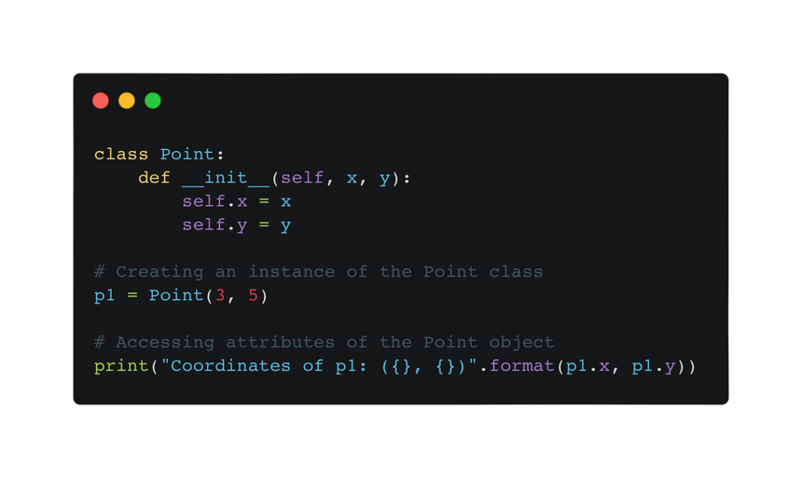

16.1 Data Types
Built-in VS User-defined data types
Built-in data type
User defined data type
Built-in data types are predefined data types provided by a programming language.
User-defined data types are created by programmers to suit specific needs within a program.
The programming language defines:
Eg. In Python, you can create user-defined data types using classes.
The range of possible values that can be assigned to a variable when its type has been chosen. Eg: Java Int Data Type:
-2,147,483,648 to 2,147,483,647
The operations that are available for manipulating values assigned to that variable.
“a” + “b” = “ab”
3 + 5 = 8

Slide 6
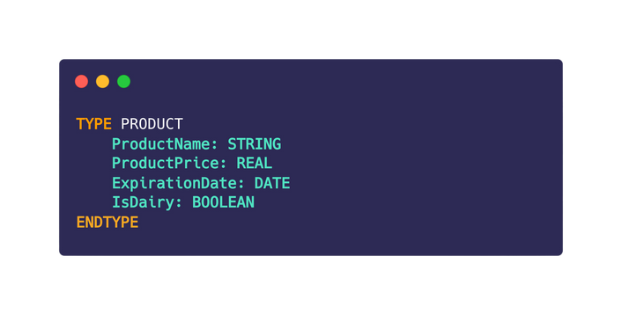

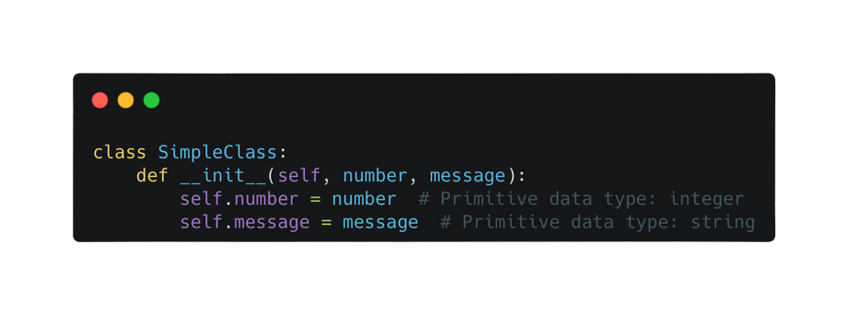
16.1 Data Types
Composite VS Non-composite data types
Composite data type
Non composite data type
A composite data type refers to a data structure that contains multiple components. Examples: Arrays, lists, dictionaries, structs. The following are the composite user-defined data types.
A non-composite data type, also known as a primitive data type, represents a single value and does not have internal subcomponents. Examples: Integers, floating-point numbers, characters, and Boolean values, and enumerated data type.
Record Data Type
Class

Slide 7
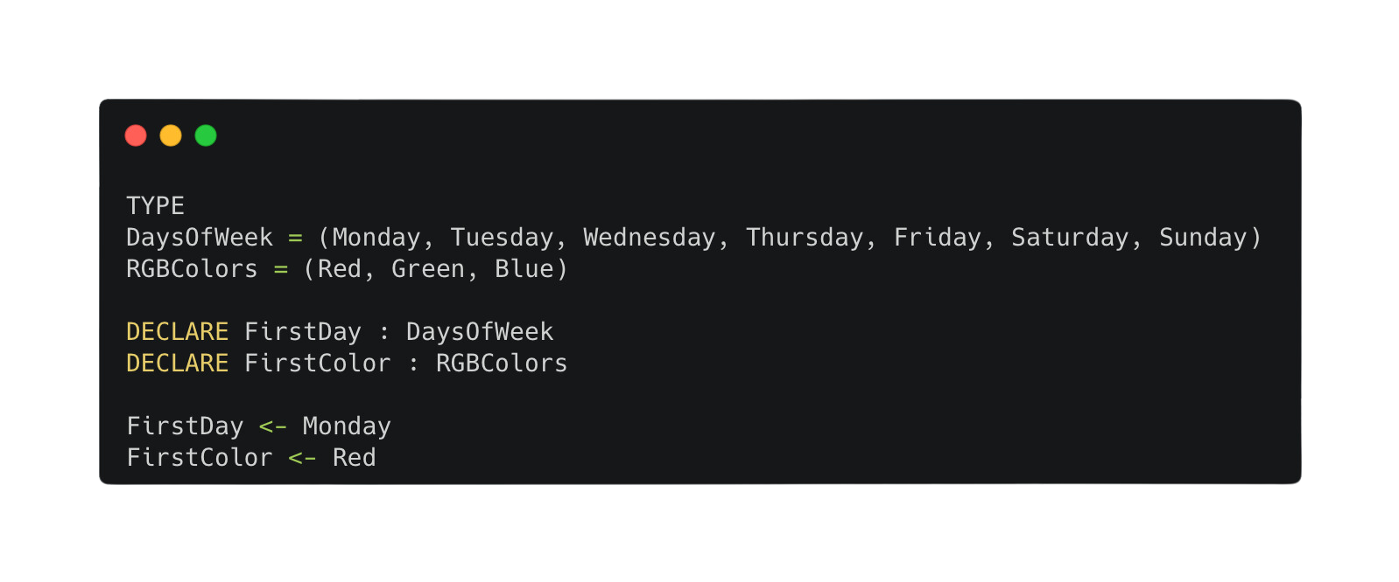

16.1 Data Types
Enumerated Data Type
An enumerated data type in programming is a user-defined collection of named constant values that represent a set of related items or options within a specific domain. For example:
Order matters
Pseudocode
Not a string

Slide 8
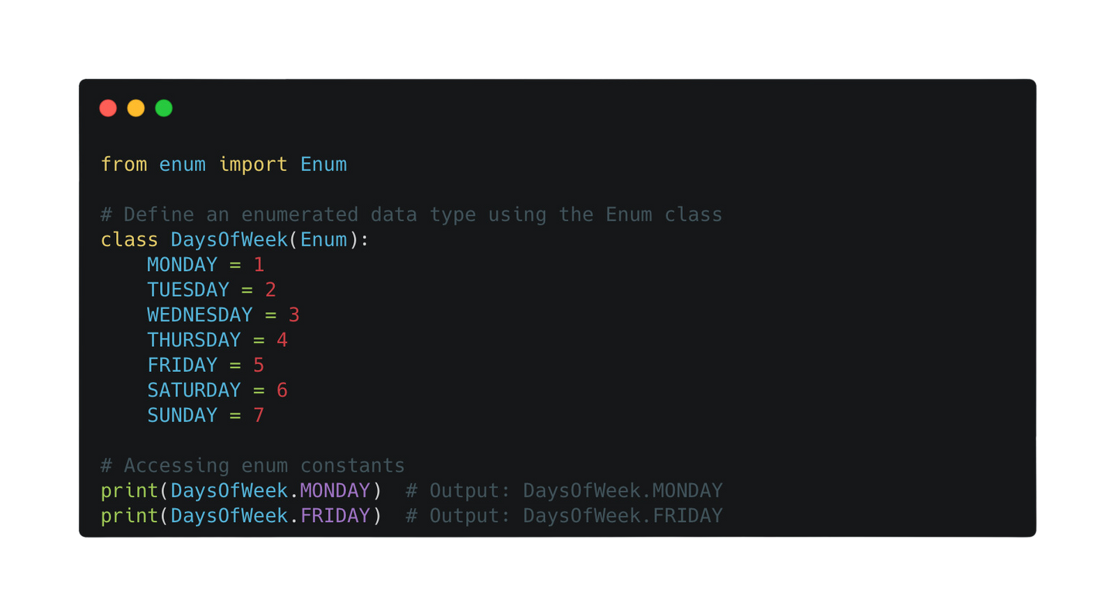
16.1 Data Types
Enumerated Data Type
An enumerated data type in programming is a user-defined collection of named constant values that represent a set of related items or options within a specific domain. For example:
Python

Slide 9
16.1 Data Types
Pointer Data Type
A pointer data type in programming stores the memory address of another variable or data element in the computer's memory.

Slide 10
16.1 Data Types
Set Data Type
A set data type in programming is an unordered collection of unique elements without duplicate values.
Unordered: Sets do not maintain elements in any specific order.
Unique Elements: Sets only contain unique elements; duplicates are automatically removed.
Unstructured: Set has no structure hence no indexing can be associated with the elements in the set.
{4, 3, 5, 1, 2}
{a, z, s, f, c}

Slide 11

16.1 Data Types
Set Data Type Operations
{4, 3, 5, 1, 2}
  Check if a value exists in a set
  Adding a new data value
{a, z, s, f, c}
  Removing an existing data value
  Adding one set to another set
James Gan

Slide 12
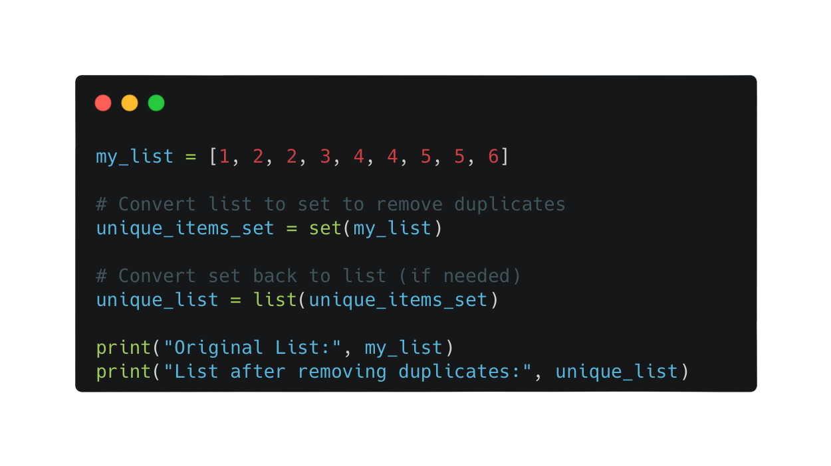
16.1 Data Types
Set Data Type Operatios
Using set in Python to remove duplicated items in the list.

Slide 13
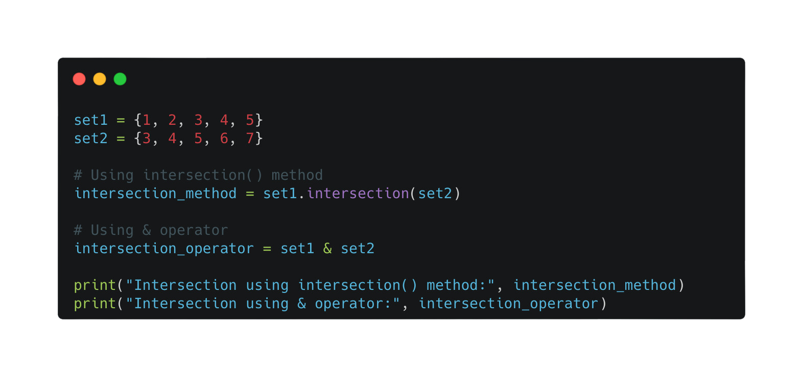
16.1 Data Types
Set Data Type Operatios
Using set in Python to find out the intersection of the two sets.

Slide 14



Subtopic 1
16.2 File organisation
Binary Code
All type of file is stored using a specific binary code that allows the file to be used as intended.

Slide 15
Subtopic 1
16.2 File organisation
Text files and Binary files
Text files
Binary files
A text file stores data in a human-readable format according to a character code (ASCII, Unicode).
A binary file stores data in a format that the computer can interpret directly as sequences of bytes.
The organisation of a binary file is based on the concept of a record.
File
Record
Record
Fields
Value
Fields
Value
Fields
Value
Fields
Value

Slide 16
Subtopic 1
16.2 File organisation
Binary files
  The number of fields per record must be known
  The size of each field (number of bytes) must be known as well
Image file
Audio file
Pixel 1
Pixel 2
1st ms
2nd ms
Red
Value
Red
Value
Left Amplitude
Value
Left Amplitude
Value
Blue
Value
Blue
Value
Right Amplitude
Value
Right Amplitude
Value
Pixel 3
Pixel 4
3rd ms
4th ms
Red
Value
Red
Value
Left Amplitude
Value
Left Amplitude
Value
Blue
Value
Blue
Value
Right Amplitude
Value
Right Amplitude
Value

Slide 17


Subtopic 1
16.2 File organisation
File organisation and access
Serial files
Sequential files
Direct-access files
A file organization method where records are arranged in a linear sequence, accessed sequentially from start to end.
Real-life Scenario: Daily transaction logs in a financial institution. Each day, the institution records transactions sequentially in a log file, appending new transactions at the end.
A file organization method where records are arranged sequentially and accessed in a predefined order, typically from the beginning to the end, and modification often requires re-writing the entire file.
Real-life Scenario: Order processing in an e-commerce platform. Orders placed by customers are stored sequentially in a file, and the system processes them one by one in the order they were received.
A file organization method allowing data retrieval or storage at any location within the file without needing to sequentially traverse the entire file.
Record 1
Record 2
Record 3
Record 4

Slide 18
Subtopic 1
16.2 File organisation
Two ways to achieve direct access
First Way: Use a sequential file with a separate index file.
An index is like a data structure that contains a sorted list of key values and pointers to the actual records in the table.
Team﻿sName | ID | Local
Selangor FC | 44343 | Y
Penang FC | 23455 | N
KL FC | 54545 | Y
ID | Pointer
23455
44343
54545
Scanning through the index table is a lot faster than scanning through the entire table due to the usage of efficient data structure (hash table / B-tree) - We will learn more in chapter 23.

Slide 19
Subtopic 1
16.2 File organisation
Two ways to achieve direct access
Second Way: Use a hashing algorithm.
File
1
Data
2
ID
Name
Age
3
2076
Jack
25
4
1073
Muhammad
24
5
5077
David
29
6
7
8

Slide 20
Subtopic 1
16.2 File organisation
Two ways to achieve direct access
Second Way: Use a hashing algorithm.
Data
File
ID
Name
Age
1
2076
Jack
25
2
1073
Muhammad
24
3
5077
David
29
4
Hashing algorithm (example):
  Divide the ID number by 10.
  Get the Remainder
5
6
7
8

Slide 21
Subtopic 1
16.2 File organisation
Two ways to achieve direct access
Second Way: Use a hashing algorithm.
Data
File
ID
Name
Age
1
2076
Jack
25
2
1073
Muhammad
24
3
1073
Muhammad
24
5077
David
29
4
Hashing algorithm (example):
  Divide the ID number by 10.
  Get the Remainder
5
6
2076
Jack
25
7
5077
David
29
8

Slide 22

Subtopic 1
16.2 File organisation
Two ways to achieve direct access
Second Way: Use a hashing algorithm.
Data
File
ID
Name
Age
1
2076
Jack
25
2
1077
Muhammad
24
3
5077
David
29
A collision can occur in a hashing algorithm when two different inputs produce the same hash value.
4
5
6
2076
Jack
25
1077
Muhammad
24
7
5077
David
29
8

Slide 23
Subtopic 1
16.2 File organisation
Best way to reduce collision
A good hash function exhibits even distribution, minimal collisions, and produces hash values that seem random, without predictable patterns or clustering.
One of the methods is to use a prime numebr of a similar size to the expected size of the file.

Slide 24
Subtopic 1
16.2 File organisation
Dealing with collisions
  Implement a sequential search method to locate an empty address immediately following the calculated position.
  Reserve a set of additional addresses at the end of the file to accommodate overflow data.
  Establish a linked list accessible from each address for efficient data retrieval and management.

Slide 25
Subtopic 1
16.2 File organisation
Two ways to achieve direct access
Second Way: Use a hashing algorithm.
Data
Name
Jack
Muhammad
David
If the record does not have a numeric field, then the ASCII code for alphabetic characters can be used in the calculation.

Slide 26
Subtopic 1
16.2 File organisation
File access
Serial files
Sequential files
Direct-access files
Access occurs sequentially from start to end, with data retrieved or appended in a linear order.
Access also takes place sequentially, but if the key value is known for the record containing the wanted data, the process is faster because only key field values need to be read.
In direct access files using hashing, file access involves directly mapping the hashed key to a specific location in the file where the desired data is stored.
However, in cases of collision where multiple keys hash to the same location, serial searching within that location might be necessary to retrieve the correct data, potentially impacting direct access efficiency.
1
File
2
3
4
5
6
2076
Jack
25
7
5077
David
29
8

Slide 27
Subtopic 1
16.2 File organisation
File deletion
Serial files
Sequential files
Direct-access files
Deleting in a serial file typically involves marking the record as "deleted" without physically removing it to maintain sequential order.
Data is transferred from the old file to a new one until the targeted record for deletion or modification is encountered, after which any changes are made, and the remaining records are then copied to the new file.
Deleting in a direct access file involves marking the specific location as available, allowing it to be reused for new data.

Slide 28
Subtopic 1
16.2 File organisation
Choice of file organisation
  Serial File: Utilise a serial file when data needs to be maintained in chronological order or when continuous appending of data is required.
  Sequential File: Choose a sequential file when the data needs to be processed in a predefined order, allowing efficient sequential reading or writing operations.
  Direct Access File: Opt for a direct access file when quick access to specific data by its location or key is essential, offering faster retrieval and modification capabilities.

Slide 29

16.3 Real Numbers
Representing Real Numbers
1
6.47 x 10
can be written as
=
64.7
2
0.647 x 10
-1
647 x 10

Slide 30

16.3 Real Numbers
Representing Real Numbers
1
6.47 x 10
can be written as
=
64.7
2
0.647 x 10
-1
647 x 10
The only sensible choice

Slide 31

16.3 Real Numbers
Fixed-point representation
Fixed-point representation is a numerical format used in computing where a specific number of bits are allocated for the fractional and integer parts of a fixed-length binary number, enabling representation of fractional values with a fixed precision.
000 = 0.125
001 = 0.25
010 = 0.375
011 = 0.5
100 = 0.625
101 = 0.75
110 = 0.875
111 = 0.000
Eg (8 bits):
sign bit
4 bits for whole numbers
3 bits for fractional part

Slide 32
16.3 Real Numbers
000 = 0.125
001 = 0.25
010 = 0.375
011 = 0.5
100 = 0.625
101 = 0.75
110 = 0.875
111 = 0.000
Fixed-point representation
1
1
0
1
1
1
0
1
sign bit
4 bits for whole numbers
3 bits for fractional part
- 11.75

Slide 33
16.3 Real Numbers
Largest positive value = 15.875
Smallest positive value = 0.125
Largest magnitude negative value = -15.875
Smallest magnitude negative value = -0.125
Fixed-point representation
Eg (8 bits):
sign bit
4 bits for whole numbers
3 bits for fractional part
Description
Binary Code
Denary
Largest positive value
0 1111 111
15.875
Smallest positive value
0 0000 001
0.125
Smallest magnitude negative value
1 0000 001
- 0.125
Largest magnitude negative value
1 1111 111
- 15.875

Slide 34
16.3 Real Numbers
Floating-point representation
A representation of real numbers that stores a value for the mantissa and a value for the exponent.
E
M x R
+
-
Has an implied value of 2

Slide 35
16.3 Real Numbers
Floating-point representation
Assume that we are using 8 bits:
E
M x R
+
4 bits
-
4 bits

Slide 36
16.3 Real Numbers
Floating-point representation
There are multiple ways we can structure the 4 bits to change where is the binary point.
Integer
Point
Fractional
Value
M
011
1
3.5
+
011
0
3.0
-
010
1
2.0
101
0
-3.0
4 bits
100
1
-3.5
100
0
-4.0
3 largest and 3 smallest representations

Slide 37
16.3 Real Numbers
Floating-point representation
There are multiple ways we can structure the 4 bits to change where is the binary point.
Integer
Point
Fractional
Value
M
0
111
0.875
+
0
110
0.75
-
0
101
0.625
1
010
-0.75
4 bits
1
001
-0.875
1
000
-1.0
3 largest and 3 smallest representations

Slide 38
16.3 Real Numbers
Floating-point representation
There are multiple ways we can structure the 4 bits to change where is the binary point.
Integer
Value
0111
7
M
+
0110
6
-
0101
5
1010
-6
4 bits
1001
-7
1000
-8
3 largest and 3 smallest representations

Slide 39
16.3 Real Numbers
Floating-point representation
Eg (8 bits):
sign bit
M
E
+
-
Description
Binary Code
Denary
Largest positive value
0 111 0111
7
0.875 x 2 = 112
0 001 1000
-8
Smallest positive value
0.125 x 2 = 1 / 2048
1 111 1000
-8
Smallest magnitude negative value
-0.125 x 2 = - 1 / 2048
7
Largest magnitude negative value
1 000 0111
-1 x 2 = - 128

Slide 40

16.3 Real Numbers
Comparison
Fixed point representation
Description
Binary Code
Denary
Largest positive value
0 1111 111
15.875
Smallest positive value
0 0000 001
0.125
Smallest magnitude negative value
1 0000 001
- 0.125
Largest magnitude negative value
1 1111 111
- 15.875
Floating point representation
Description
Binary Code
Denary
Largest positive value
0 111 0111
7
0.875 x 2 = 112
Smallest positive value
0 001 1000
-8
0.125 x 2 = 1 / 2048
1 111 1000
-8
Smallest magnitude negative value
-0.125 x 2 = - 1 / 2048
1 000 0111
7
Largest magnitude negative value
-1 x 2 = - 128

Slide 41
16.3 Real Numbers
Precision and normalisation
To achieve maximum precision, we need to normalise a floating-point number.
In practice, using the largest possible magnitude for the value represented by the mantissa would achieve optimum precision.
Denary 2
Denary - 4
Denary Representation
Floating-point binary representation
Denary Representation
Floating-point binary representation
4
0 001 0100
4
1 110 0100
0.125 x 2
-0.25 x 2
3
3
0.25 x 2
0 010 0011
- 0.5 x 2
1 100 0011
2
2
0.5 x 2
0 100 0010
-1.0 x2
1 000 0010

Slide 42
16.3 Real Numbers
Precision and normalisation
When the number is represented with the highest magnitude for the mantissa, the two most significant bits are different.
Denary 2
Denary - 4
Denary Representation
Floating-point binary representation
Denary Representation
Floating-point binary representation
4
0 001 0100
4
1 110 0100
0.125 x 2
-0.25 x 2
3
3
0.25 x 2
0 010 0011
- 0.5 x 2
1 100 0011
2
2
0.5 x 2
0 100 0010
-1.0 x2
1 000 0010

Slide 43

16.3 Real Numbers
Precision and normalisation
For positive numbers, the mantissa's bits are moved to the left until the leading bits become 0 followed by 1, causing a decrease of 1 in the exponent value for each left shift.
Denary 2
Denary Representation
Floating-point binary representation
4
0 001 0100
0.125 x 2
Left shift
3
Exponent decreases
0 010 0011
0.25 x 2
2
0 100 0010
0.5 x 2

Slide 44
16.3 Real Numbers
Precision and normalisation
The same process of shifting is used for a negative number until the most significant bits are 1 followed by 0, causing a decrease of 1 in the exponent value for each left shift.
Denary - 4
Denary Representation
Floating-point binary representation
4
1 110 0100
-0.25 x 2
3
Exponent decreases
Left shift
- 0.5 x 2
1 100 0011
2
-1.0 x2
1 000 0010

Slide 45




16.3 Real Numbers
Conversion of representations
Convert 9.75.
Convert the whole number part. Add a leading 0.
9.75
01001
Convert the fractional part.
Notes:
.00 = 00
.25 = 01
.5 = 10
.75 = 11
9.75
11
Combine the two parts
9.75
01001.11
Shift the binary point until beyond “10” (for positive number) to achieve normalisation
01001.11
0.100111

Slide 46

16.3 Real Numbers
Conversion of representations
Convert 9.75.
This gives an exponent value of 4 (we shift the point 4 times to the left).
Assume that 14 bits are allocated (10 bits for the mantissa and 4 bits for the exponent),
0.100111
0100111000
0100
mantissa
exponent

Slide 47
16.3 Real Numbers
Conversion of representations
Convert 9.73.
Convert the whole number part. Add a leading 0.
9.73
01001
Convert the fractional part.
9.73
0.73 x 2 = 1.46 (keep 1)
.1
Method = Multiply by 2 and record the whole number (4 bits)

Slide 48
16.3 Real Numbers
Conversion of representations
Convert 9.73.
Convert the whole number part. Add a leading 0.
9.73
01001
Convert the fractional part.
9.73
0.73 x 2 = 1.46 (keep 1)
0.46 x 2 = 0.92 (keep 0)
0.92 x 2 = 1.84 (keep 1)
0.84 x 2 = 1.62
.1011
Method = Multiply by 2 and record the whole number (4 bits)

Slide 49
16.3 Real Numbers
Conversion of representations
Convert 9.73.
Convert the whole number part. Add a leading 0.
9.73
01001
Convert the fractional part.
9.73
0.73 x 2 = 1.46 (keep 1)
0.46 x 2 = 0.92 (keep 0)
0.92 x 2 = 1.84 (keep 1)
0.84 x 2 = 1.62
.1011
Method = Multiply by 2 and record the whole number (4 bits)
Combine the two parts
01001.1011

Slide 50
16.3 Real Numbers
Conversion of representations
Convert 9.73.
Shift the binary point until beyond “10” (for positive number) to achieve normalisation
01001.1011
0.10011011
This gives an exponent value of 4 (we shift the point 4 times to the left).
Assume that 14 bits are allocated (10 bits for the mantissa and 4 bits for the exponent),
0.100111
0100﻿110110
0100
mantissa
exponent

Slide 51
16.3 Real Numbers
Conversion of representations
Convert -7.75.
Start by converting 7.75 to binary.
7.75
0111
Convert the fractional part.
Notes:
.00 = 00
.25 = 01
.5 = 10
.75 = 11
7.75
11
Combine the two parts
7.75
0111.11
Convert to two’s complement form.
0111.11
one.c
1000.00
two.c
1000.0﻿1

Slide 52

16.3 Real Numbers
Conversion of representations
Convert -7.75.
Shift the binary point until beyond “10” to achieve normalisation
1000.0﻿1
100001
This gives an exponent value of 4 (we shift the point 4 times to the left).
Assume that 14 bits are allocated (10 bits for the mantissa and 4 bits for the exponent),
10000﻿1
10000﻿10000
0100
mantissa
exponent

Slide 53
16.3 Real Numbers
Problems with using floating-point numbers
Approximation and Rounding Errors: Floating-point numbers involve approximations, and rounding errors can become significant during computations, particularly in repetitive operations. Accumulation of these small errors might lead to inaccuracies in the final result, especially in complex computations or numerical algorithms.
Limited Range of Numbers: Floating-point representation has a finite range to store numbers, resulting in limitations on both the minimum and maximum values that can be accurately represented. This limitation can lead to underflow errors when representing extremely small numbers, causing loss of precision or inaccuracies in calculations involving very small values.

