Slide 1
Cambridge International
AS Level Computer Science
(9618) – Revision Notes
Databases
This pack is intended for students to who are taking CIE AS Level in Computer Science, either in preparation for their AS exam, or more likely alongside year 2 of the course to improve fluency, recall and pace on AS topics. It could be used as lesson starters, or supplied to students for independent use.

Slide 2



11
Chapter
Databases
A LEVEL COMPUTER SCIENCE

Slide 3




11.1
11.2
Drawbacks of File-Based Data Management
Introduction to Relational Databases
11.3
Designing with Entity-Relationship Modelling
Chapter
Outline
11.4
Logical ER Models in Database Design
11.5
11.6
11.7
Database Management Systems (DBMS)
SQL: Structured Query Language
Database Normalisation Techniques

Slide 4

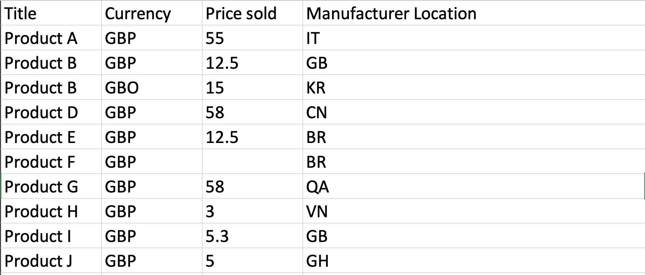
11.1 Drawbacks of File-Based Data Management
Example of a file-based approach
Using google sheet to store product data

Slide 5
11.1 Drawbacks of File-Based Data Management
No validation to detect invalid currency
Data Integrity Issues
No validation to detect the missing price
No validation to detect duplicated products
The lack of in-built control when data is entered causes data integrity issues.

Slide 6
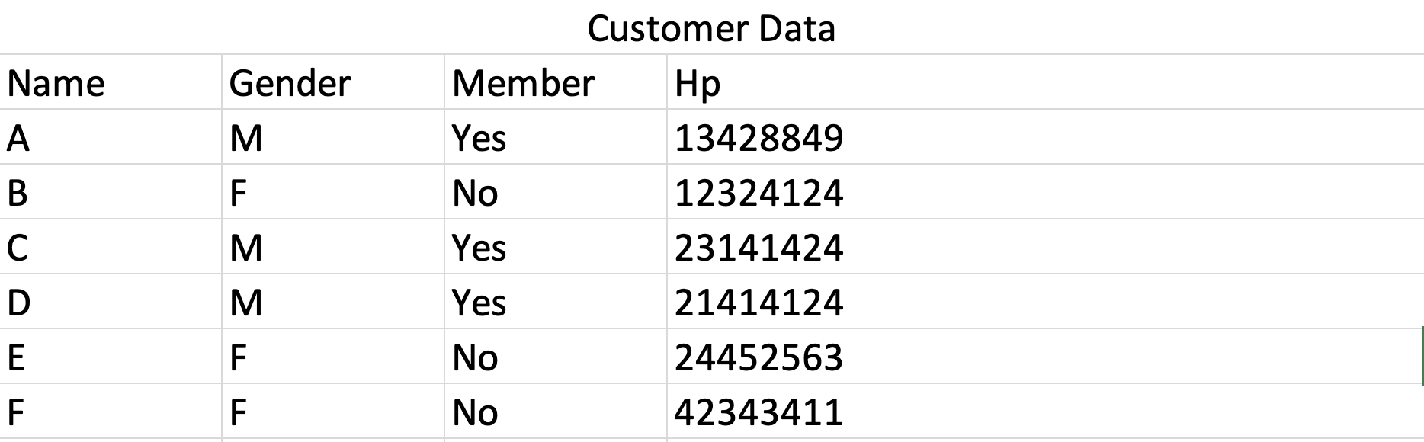
11.1 Drawbacks of File-Based Data Management
Data Privacy
Anyone can view this data; there is no access control.
Customer data

Slide 7
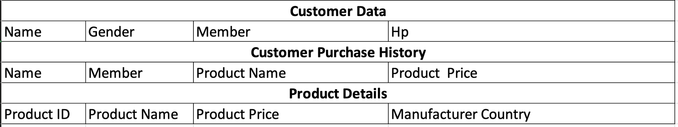




11.1 Drawbacks of File-Based Data Management
Data redundancy
Data redundancy - The same data stored more than once.

Slide 8
11.1 Drawbacks of File-Based Data Management
Data inconsistency
Data redundancy can lead to data inconsistency when the same information is stored in multiple locations and is subsequently updated differently in those locations, resulting in conflicting or contradictory data.

Slide 9

11.1 Drawbacks of File-Based Data Management
Data dependency concerns
In the past, programmers created programs and designated necessary data files, while each department had its own programs accessing specific data files. To ensure program functionality, programmers needed to understand how data was structured in these files.

Slide 10
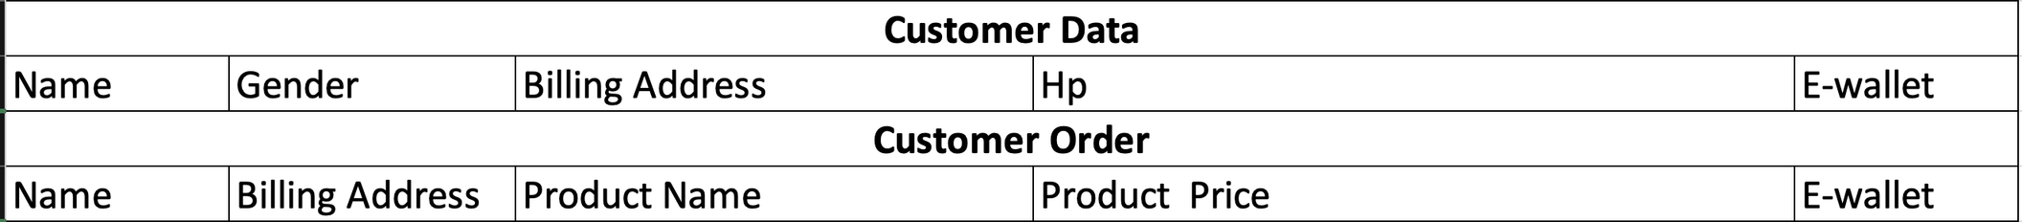
11.1 Drawbacks of File-Based Data Management
Data dependency concerns
The organization might need to modify stored data to reflect changes in the industry, like connecting a new payment method (e-wallet), which would require updating existing files and rewriting associated programs for accurate data handling, though in a database context, new programs might be created to utilize the additional data without affecting the existing ones.

Slide 11
Subtopic 1
11.2 Introduction to Relational Databases
Definition
A relational database is a type of database that organizes data into tables, which can be linked or related based on common attributes, enabling efficient storage, retrieval, and management of structured data.
Students (Student_ID, Name, Age, Grade, CourseID)
Courses (Course_ID, Course_name, Instructor, Department)
Notes:
It is hard to explain what a relational database is in one sentence. Therefore, I will first go through some terminologies of databases, show you some benefits of a relational database in order to show how it ensures data integrity and prevent data dependency and data duplication.

Slide 12
Subtopic 1
11.2 Introduction to Relational Databases
Logical View
A virtual representation of data derived from one or more tables using SQL queries, providing users or applications with a simplified and customized perspective of the database content.
Students
Student_ID
Name
Age
Grade
Course_ID
Courses
Course_ID
Course_name
Instructor
Department

Slide 13
Subtopic 1
11.2 Introduction to Relational Databases
Logical View
Example: Show only students whose name started with a letter ‘A’.
Students
Student_ID
Name
Age
Grade
Course_ID
12345678
Ali
18
A
C2001
22345678
Abel
19
A
C2002
32345678
Adriana
18
A
C2003

Slide 14
Subtopic 1
11.2 Introduction to Relational Databases
Terminology
Attribute
Student_ID
Name
Age
Grade
Course_ID
Record, a.k.a tuple.
12345678
Ali
18
A
C2001
22345678
Abel
19
A
C2002
32345678
Adriana
18
A
C2003
Field

Slide 15
Subtopic 1
11.2 Introduction to Relational Databases
Primary Key
A primary key in a relational database is a unique identifier for each record in a table, ensuring that each row can be uniquely identified and accessed.
Student_ID
Name
Age
Grade
Course_ID
12345678
Ali
18
A
C2001
22345678
Abel
19
A
C2002
32345678
Adriana
18
A
C2003
Students (Student_ID, Name, Age, Grade, CourseID)

Slide 16
Subtopic 1
11.2 Introduction to Relational Databases
Importance of a Primary Key
A primary key is crucial in a database as it ensures data integrity by not allowing an attempt to insert a value for a primary key when that value already exists.
Student_ID
Name
Age
Grade
Course_ID
12345678
Ali
18
A
C2001
22345678
Abel
19
A
C2002
32345678
Adriana
18
A
C2003
Students (Student_ID, Name, Age, Grade, CourseID)

Slide 17
Subtopic 1
11.2 Introduction to Relational Databases
Candidate Key and Secondary Key
A candidate key is a unique identifier, while a secondary key is an alternate identifier that is not the primary key.
Student_ID
Name
Age
Grade
Course_ID
12345678
Ali
18
A
C2001
22345678
Abel
19
A
C2002
32345678
Adriana
18
A
C2003
Students (Student_ID, Name, Age, Grade, CourseID)

Slide 18

Subtopic 1
11.2 Introduction to Relational Databases
Foreign Key
A foreign key in a relational database is a field that establishes a link between two tables, referencing the primary key of another table and enforcing referential integrity.
Student_ID
Name
Age
Grade
Course_ID
12345678
Ali
18
A
C2001
Course_ID
Course_name
Instructor
Department
22345678
Abel
19
A
C2002
C2001
Computer Science
Jessica
IT
32345678
Adriana
18
A
C2003
Students (Student_ID, Name, Age, Grade, CourseID)
C2002
Finance
Jason
Business
C2003
Pharmacy
Rayyan
Medical Science
Courses (Course_ID, Course_name, Instructor, Department)
Notes:
refe

Slide 19
Subtopic 1
11.2 Introduction to Relational Databases
Foreign Key
A foreign key enforces referential integrity by ensuring that values in the referencing column (in the child table) either match values in the referenced column (in the parent table) or are null.
Student_ID
Name
Age
Grade
Course_ID
12345678
Ali
18
A
C2001
Course_ID
Course_name
Instructor
Department
22345678
Abel
19
A
C2002
C2001
Computer Science
Jessica
IT
32345678
Adriana
18
A
C2003
C2002
Finance
Jason
Business
42345678
James
99
F
C2004
Students (Student_ID, Name, Age, Grade, CourseID)
C2003
Pharmacy
Rayyan
Medical Science
Courses (Course_ID, Course_name, Instructor, Department)
The DBMS will not allow this because C2004 is not a valid code in the Courses table.

Slide 20


11.3 Designing with Entity-Relationship Modelling
Entity Relationship Modelling
Entity-relationship modelling is a conceptual data modelling technique used to represent the relationships between various entities in a database system. An entity could represent a person, place, thing, or event about which data can be stored.
Scenario
The football court agency needs a database to handle bookings for a football team. Each team has a number of players. Each booking is for a football field. Each booking might be for one or more teams.

Slide 21
11.3 Designing with Entity-Relationship Modelling
Step 1: Choose the entities
The football court agency needs a database to handle bookings for a football team. Each team has a number of players. Each booking is for a football field. Each booking might be for one or more teams.
  Football team
  Players
  Football field
  Booking

Slide 22
11.3 Designing with Entity-Relationship Modelling
Step 2: Identify the relationship
  A football team with players
  Booking with football field (which field is booked)
  Booking with football team (which team has booked)

Slide 23
11.3 Designing with Entity-Relationship Modelling
Step 3: Draw the preliminary entity-relationship diagram
  A football team with players
  Booking with football field (which field is booked)
  Booking with football team (which team has booked)
Players
Football Team
Booking
Football Field

Slide 24
11.3 Designing with Entity-Relationship Modelling
Step 4: Decide the cardinalities of the relationships
Cardinality refers to the numerical relationship between entities in a database, indicating how many instances of one entity can be associated with instances of another entity.
1-to-1
1-to-M
M-to-1
M-to-M

Slide 25
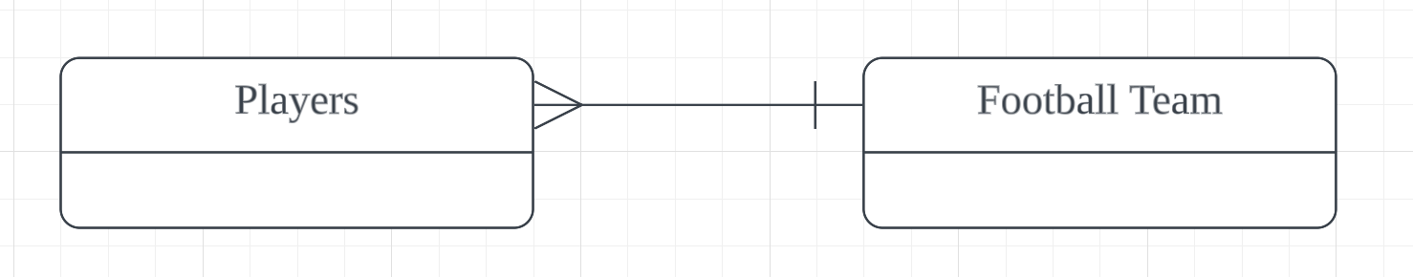
11.3 Designing with Entity-Relationship Modelling
Step 4: Decide the cardinalities of the relationships
  A football team with players
    A football team must have more than 1 player
    A player must belong to one club only
A football team has more than 1 player
A player belongs to one club only

Slide 26
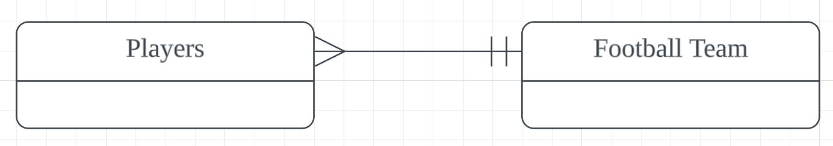
11.3 Designing with Entity-Relationship Modelling
Step 4: Decide the cardinalities of the relationships
  A football team with players
    A football team must have more than 1 player
    A player must belong to one club only
A football team must has more than 1 player
A player must belong to one club only

Slide 27
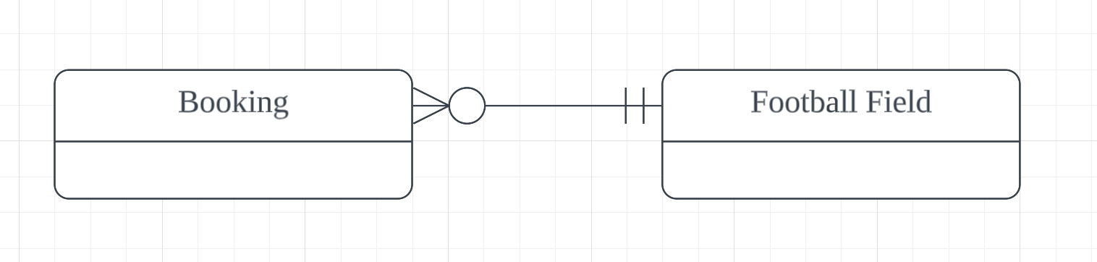
11.3 Designing with Entity-Relationship Modelling
Step 4: Decide the cardinalities of the relationships
  Booking with a fo﻿otball field
    One booking is for one football field (cannot be more than 1).
    One football field can be used for many bookings. Yet, a football field might not have any booking yet.
One football field can be used for many bookings. Yet, a football field might not have any booking yet.
One booking is for one football field (must be 1).

Slide 28
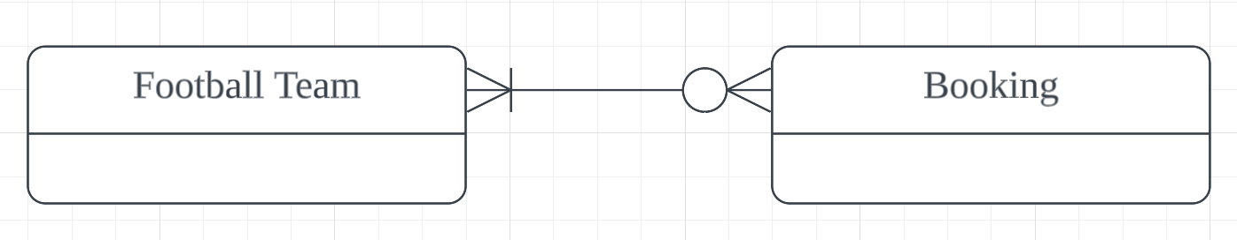
11.3 Designing with Entity-Relationship Modelling
Step 4: Decide the cardinalities of the relationships
  Booking with football team
    One booking might involve many football teams (can also be only one team)
    One football teams might make many bookings (might also be zero booking)
One booking might involve many football teams (can also be only one team)
One football teams might make many bookings
(might also be zero booking)

Slide 29
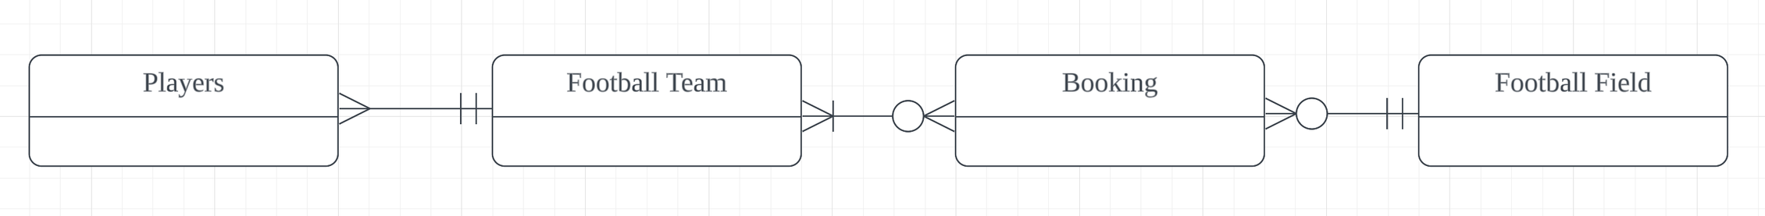
11.3 Designing with Entity-Relationship Modelling
Step 4: Decide the cardinalities of the relationships
  Putting it together.

Slide 30



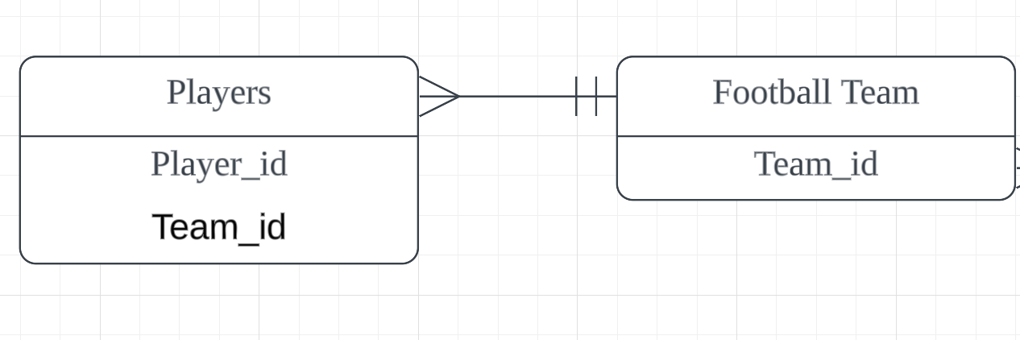

11.4 Logical ER Models in Database Design
Logical Model
The ER diagram that we drew in the previous section needs to be converted to a logical model if the system is to be implemented as a relational database.
For 1:M relationship, no refinement is needed. Same goes to 1-1 relationship.
A foreign key referencing to the primary key of another is needed on the “many” side of the relationship.

Slide 31
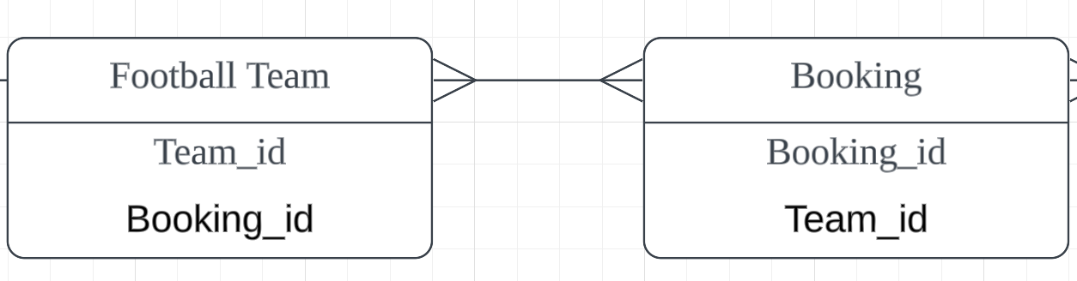
11.4 Logical ER Models in Database Design
Logical Model
The complexity of an M:M relationship arises from the necessity of a foreign key in each entity, making it challenging to create either table first since the presence of the other table is required to define the foreign key.

Slide 32
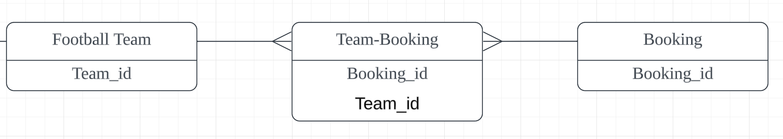
11.4 Logical ER Models in Database Design
Logical Model
Solution: Create a link entity.
A combination of these attributes will make a compound primary key.

Slide 33

11.5 Database Normalisation Techniques
Definition
Normalization in database design is the process of organizing and structuring data to reduce redundancy and dependency, ensuring that data is stored efficiently without unnecessary duplication.
Eg.
Stadium Booking Form
Booking Number: 183901
Court Venue:
  Branch = Cheras
  Branch Address 1 = Jalan Gasing
  Branch Address 2 = Taman Len Sen
How will the design of the database look like?
Booking Date: 11/11/2023
TeamsName:
Selangor FC
Penang FC
KL FC
Number of players
12
11
13
Local
Y
N
Y

Slide 34
11.5 Database Normalisation Techniques
Without Normalisation
Data redundancy would happen if we just put all the data into one table.
Booking Number | Court Branch | Branch Address1 | Branch Address2 | Booking Date | Team﻿s Name | NoOfPlayers | Local
183901 | Cheras | Jalan Gasing | Taman Len Sen | 11/11/23 | Selangor FC | 12 | Y
183901 | Cheras | Jalan Gasing | Taman Len Sen | 11/11/23 | Penang FC | 11 | N
183901 | Cheras | Jalan Gasing | Taman Len Sen | 11/11/23 | KL FC | 13 | Y
Repeating group: A repeating group in the context of database design refers to a set of related data fields that can occur multiple times within a single record, violating the principles of normalization.

Slide 35

11.5 Database Normalisation Techniques
1NF
Split the data into two groups. One table contains the non-repeating group attributes, the other the repeating group attributes.
Booking Number | Court Branch | Branch Address1 | Branch Address2 | Booking Date | Team﻿s Name | NoOfPlayers | Local
Non-repeating group
Booking Number | Court Branch | Branch Address1 | BranchAddress2 | Booking Date
Repeating group
Booking Number | Team﻿sName | NoOfPlayers | Local

Slide 36
11.5 Database Normalisation Techniques
1NF
Split the data into two groups. One table contains the non-repeating group attributes, the other the repeating group attributes.
Booking Number | Court Branch | Branch Address1 | Branch Address2 | Booking Date | Team﻿s Name | Number of players | Local
Non-repeating group
Booking (BookingNumber, CourtBranch, BranchAddress1, BranchAddress2, BookingDate)
Repeating group
Team-Booking (Te﻿am﻿sName, BookingNumber (fk), NoOfPlayers, Local)

Slide 37
11.5 Database Normalisation Techniques
2NF
Evaluate each non-key attribute and determine if it relies on both components of the compound key; any attribute dependent solely on one of the elements in the compound key should be transferred to a separate table.
Team-Booking (Te﻿am﻿sName, BookingNumber (fk), NoOfPlayers, Local)
Team-Booking (BookingNumber (fk), TeamsName(fk))
Teams (TeamsName, NoOfPlayers, Local) )

Slide 38
11.5 Database Normalisation Techniques
2NF
After 2NF:
Booking (BookingNumber, CourtBranch, BranchAddress1, BranchAddress2, BookingDate)
Team-Booking (BookingNumber (fk), Teams(fk))
Teams (TeamsName, NoOfPlayers, Local) )

Slide 39
11.5 Database Normalisation Techniques
3NF
The table has to be examined to see if there are any non-key dependencies. If there is, a new table must be defined.
Non-key dependency
Booking (BookingNumber, CourtBranch, BranchAddress1, BranchAddress2, BookingDate)
Team-Booking (BookingNumber (fk), Teams(fk))
Teams (TeamsName, NoOfPlayers, Local) )

Slide 40
11.5 Database Normalisation Techniques
3NF
The table has to be examined to see if there are any non-key dependencies. If there is, a new table must be defined.
Booking (BookingNumber, CourtBranch (fk), BookingDate)
Team-Booking (BookingNumber (fk), TeamsName (fk))
Teams (TeamsName, NoOfPlayers, Local) )
BranchInfo (CourtBranch, BranchAddress1, BranchAddress2)

Slide 41
11.5 Database Normalisation Techniques
Benefits of normalisation
Normalization in database design enhances data integrity and reduces redundancy by organizing data efficiently.
Booking Number | Court Branch | Booking Date
183901 | Cheras | 11/11/23
Team﻿sName | NoOfPlayers | Local
Selangor FC | 12 | Y
Penang FC | 11 | N
KL FC | 13 | Y
Booking Number | Team﻿s Name
183901 | Selangor FC
183901 | Penang FC
183901 | KL FC
Court Branch | Branch Address1 | Branch Address2
Cheras | Jalan Gasing | Taman Len Sen

Slide 42
Subtopic 1
11.6 Database Management Systems (DBMS)
Definition
A Database Management System (DBMS) is a software application that facilitates the creation, organization, retrieval, and management of data in a structured and efficient manner.
The basic concept of a 3-level database proposed by
ANSI (American National Standards Institute):
External Level
Conceptual Level
Internal Level

Slide 43

Subtopic 1
11.6 Database Management Systems (DBMS)
External Level
Conceptual Level
The DBMS is responsible for managing the physical storage of data, defining data structures, access paths, and handling aspects related to performance and optimization.
Internal Level
Handled by:
Description:
Physical storage of data
This is the lowest level and deals with how the data is physically stored, accessed, and processed at the storage level. It includes details such as data storage structures, access paths, and indexing.

Slide 44

Subtopic 1
11.6 Database Management Systems (DBMS)
External Level
This level represents the community view of the data. It defines the logical structure of the entire database, including relationships, constraints, and integrity rules, without specifying how the data is stored or accessed.
Conceptual Level
Description:
Internal Level
Database Administrator
A professional who oversees the design, implementation, and maintenance of a database management system, ensuring data integrity, security, and optimal performance.

Slide 45

Subtopic 1
11.6 Database Management Systems (DBMS)
This is the highest level and represents how individual users perceive the data. It defines the way each user group sees the data relevant to their tasks, providing a customized view.
External Level
Description:
Conceptual Level
Users
Internal Level
Importance:
A Database Administrator (DBA) uses the feature of a view to enforce security by providing a controlled and restricted access point to the underlying data, allowing them to grant specific permissions to users or applications based on their needs without exposing the entire database structure.

Slide 46



Subtopic 1
11.6 Database Management Systems (DBMS)
Facilities provided by a DMBS
Developer Interface
User Interface
Query Processor
Creating a Report
The DBMS provides tools for developers to interact with and design applications for the database.
The DBMS offers a user interface to interact with the database, allowing users to perform tasks such as data entry, retrieval, and manipulation through a graphical or command-based interface.
The DBMS interprets and executes queries, translating user requests into database actions.
The DBMS supports report creation by facilitating data extraction and formatting through queries and reporting tools.

Slide 47

Subtopic 1
11.6 Database Management Systems (DBMS)
DBMS functions likely to be used by a DBA
Defining access rights
Data dictionary
Backup
DBAs use specific access rights to control and grant permissions, ensuring that users or roles have appropriate levels of access to the database objects.
The DBA utilizes the data dictionary to maintain metadata, providing a centralized repository for information about the database's structure, relationships, and constraints.
The DBA performs the backup function to create and maintain copies of the database, ensuring data preservation and providing a means for recovery in the event of data loss or system failures.

Slide 48

Subtopic 1
11.6 Database Management Systems (DBMS)
DBMS functions likely to be used by a DBA
Creating an index for rapid data retrieval
For example, the DBA wants to find the team that an ID number of 54545.
Without an Index:
  Start at the first row.
  Check if the team has an ID number of 54545. No match.
  Move to the next row.
  Repeat steps 2-3 until a match is found or the end of the table is reached.
Team﻿sName | ID | Local
Selangor FC | 44343 | Y
Penang FC | 23455 | N
KL FC | 54545 | Y
This process becomes inefficient as the table grows in size.

Slide 49
Subtopic 1
11.6 Database Management Systems (DBMS)
DBMS functions likely to be used by a DBA
Creating an index for rapid data retrieval
An index is like a data structure that contains a sorted list of key values and pointers to the actual records in the table.
Team﻿sName | ID | Local
Selangor FC | 44343 | Y
Penang FC | 23455 | N
KL FC | 54545 | Y
ID | Pointer
23455
44343
54545
Scanning through the index table is a lot faster than scanning through the entire table due to the usage of efficient data structure (hash table / B-tree) - We will learn more in chapter 23.

Slide 50

11.7 Structured Query Language
SQL
Data Definition Language
Data Manipulation Language
Example: Managing a database for a school

Slide 51
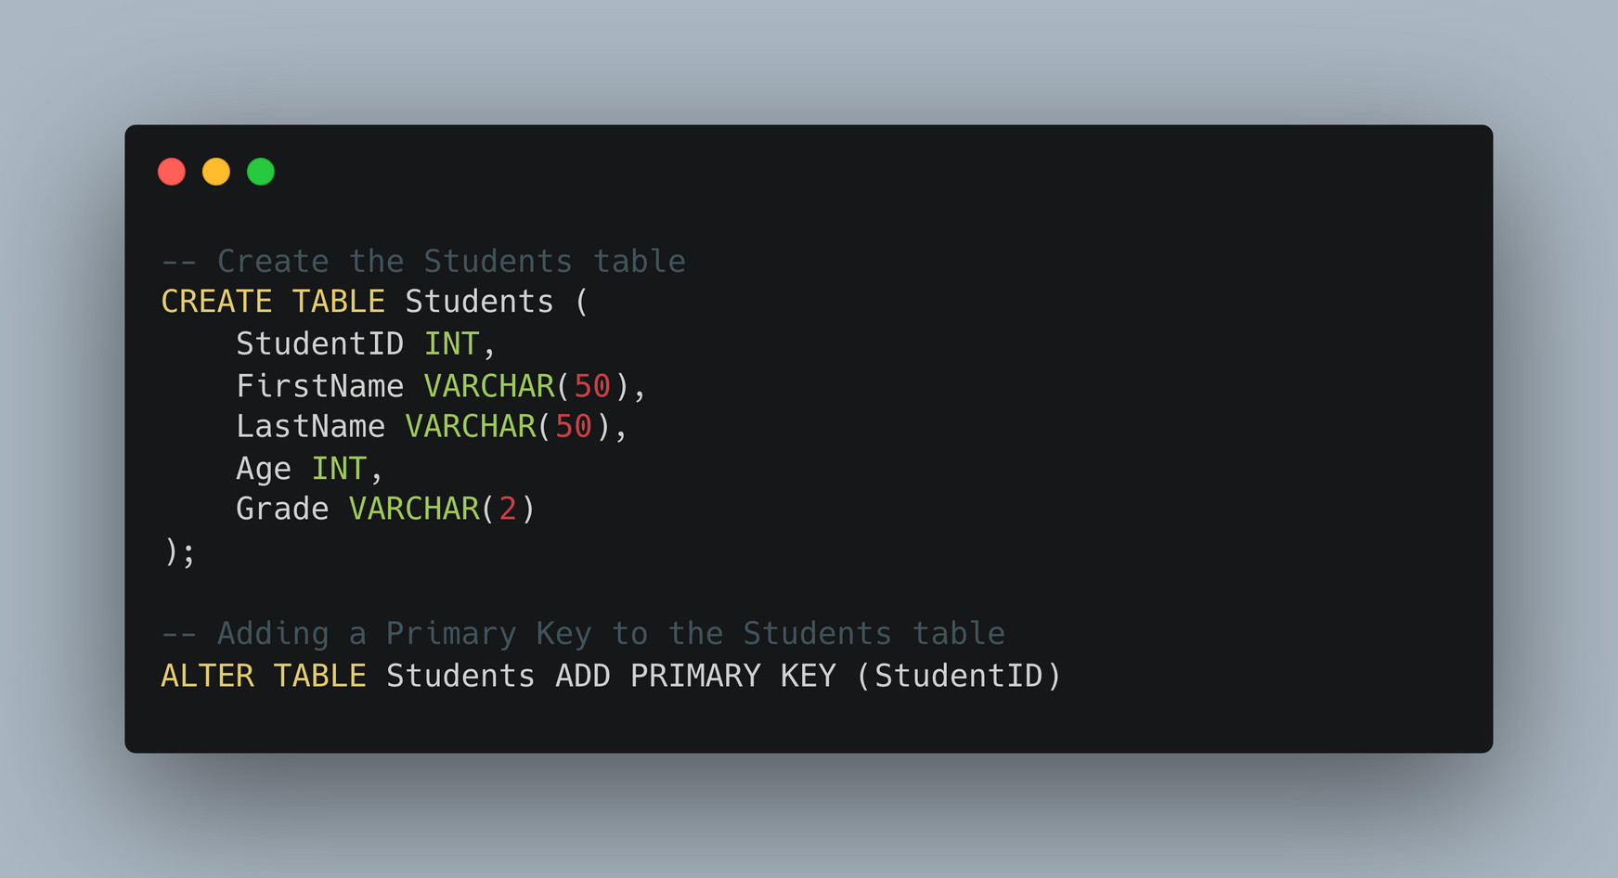
11.7 Structured Query Language
Highlighter
Data Definition Language
CREATE TABLE
Defines a new database table with specified columns and data types.
Define closure using parentheses
Max 50 character
Data types must be declared: Character, varchar, boolean, integer, real, date, time
ALTER TABLE
Modifies an existing table structure, such as adding primary and foreign keys.
Each command is terminated by ;

Slide 52

11.7 Structured Query Language
Highlighter
Data Definition Language
StudentID | FirstName | LastName | Age | Grade

Slide 53
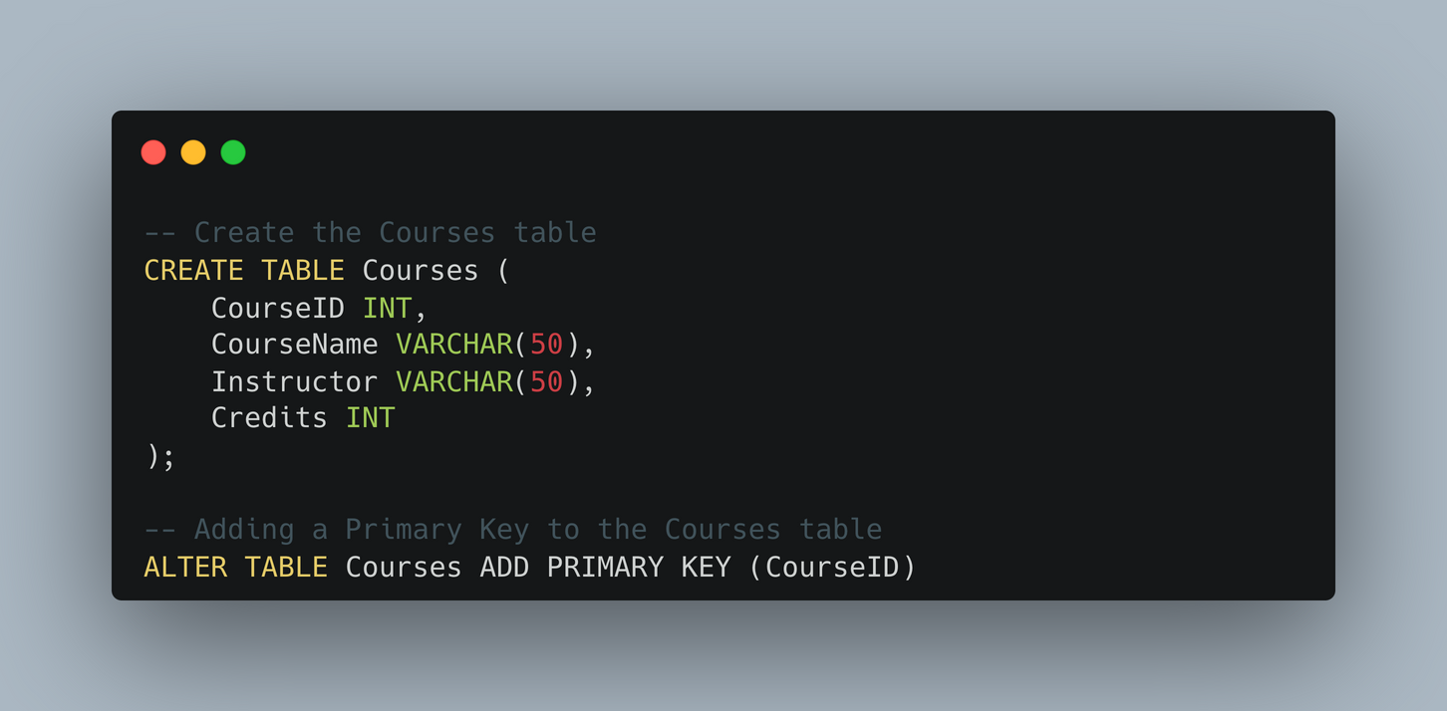
11.7 Structured Query Language
Highlighter
Data Definition Language
CourseID | CourseName | Instructor | Credit

Slide 54
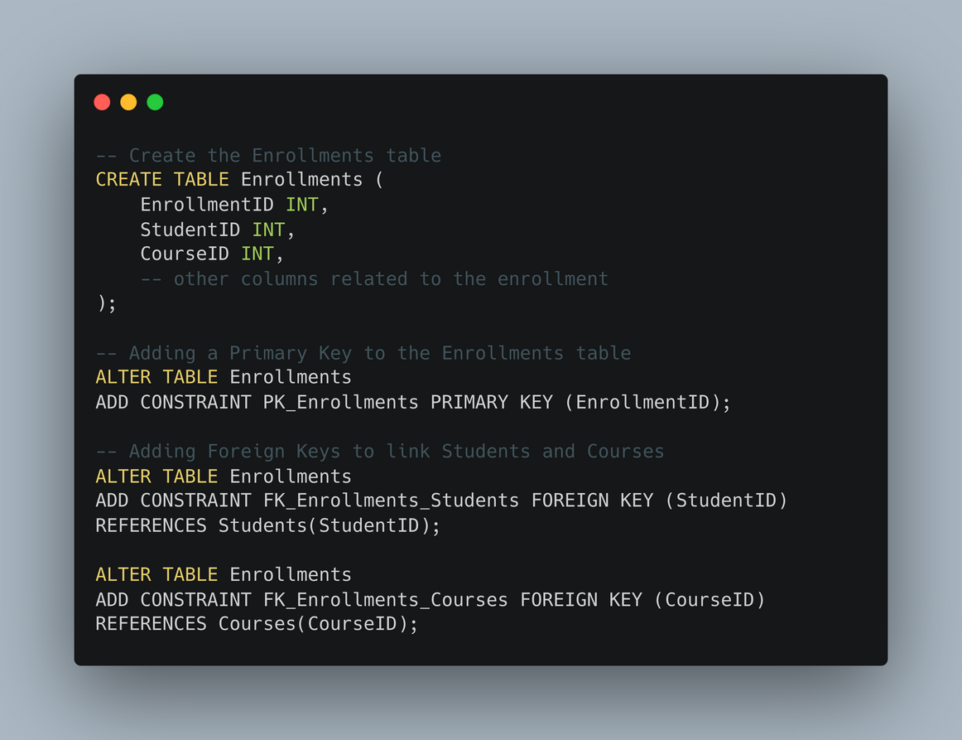
11.7 Structured Query Language
Highlighter
Data Definition Language
EnrollmentID | StudentID (Fk) | CourseID (Fk)
StudentID | FirstName | LastName | Age | Grade
CourseID | CourseName | Instructor | Credit

Slide 55
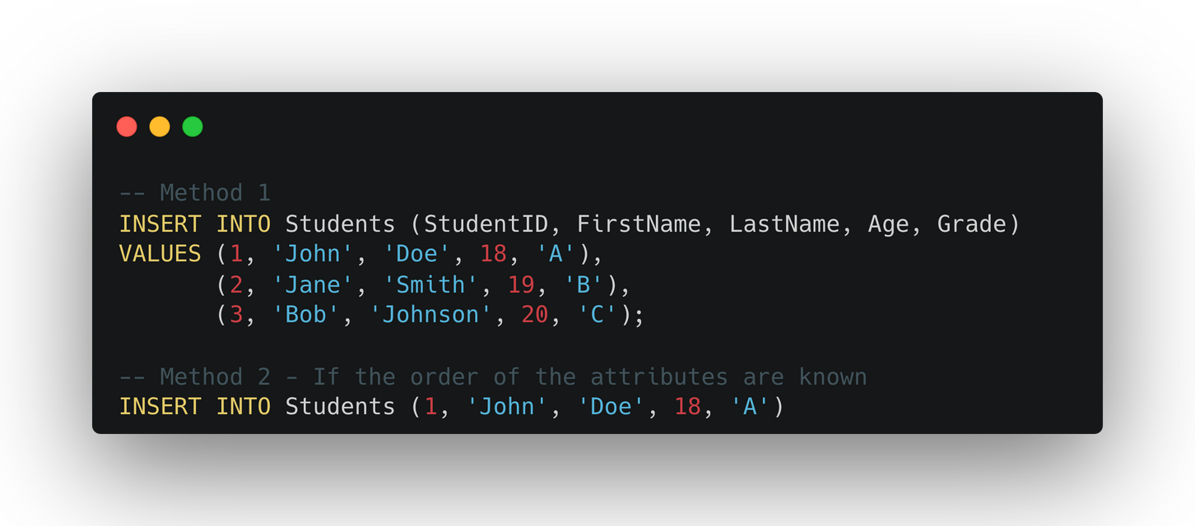
11.7 Structured Query Language
Data Manipulation Language
Insert
StudentID | FirstName | LastName | Age | Grade
1 | John | Doe | 18 | A
2 | Jane | Smith | 19 | B
3 | Bob | Johnson | 20 | C

Slide 56
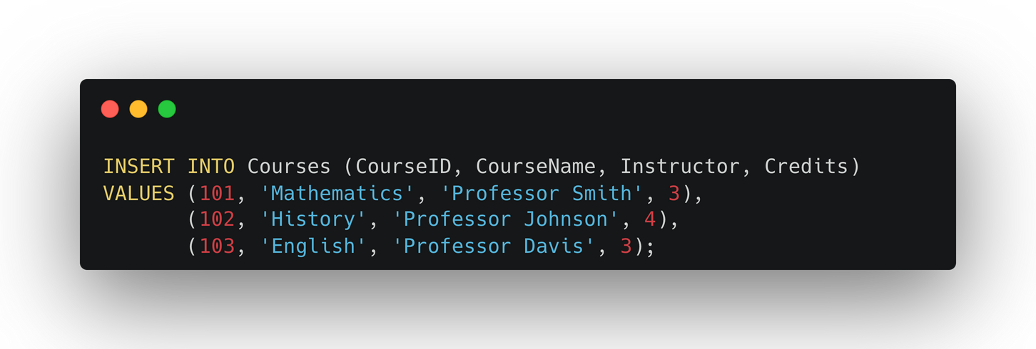
11.7 Structured Query Language
Data Manipulation Language
Insert
CourseID | CourseName | Instructor | Credit
101 | Mathematics | Professor Smith | 3
102 | History | Professor Johnson | 4
103 | English | Professor Davis | 3

Slide 57
11.7 Structured Query Language
Data Manipulation Language
Select - Retrieves data from one or more tables based on specified criteria.
StudentID | FirstName | LastName | Age | Grade
1 | John | Doe | 18 | A
2 | Jane | Smith | 19 | B
3 | Bob | Johnson | 20 | C
Scenario: Get the names of all the students.

Slide 58

11.7 Structured Query Language
Data Manipulation Language
Select - Retrieves data from one or more tables based on specified criteria.
StudentID | FirstName | LastName | Age | Grade
1 | John | Doe | 18 | A
2 | Jane | Smith | 19 | B
3 | Bob | Johnson | 20 | C
FirstName | LastName
John | Doe
Jane | Smith
Bob | Johnson
Fields that are selected

Slide 59

11.7 Structured Query Language
Data Manipulation Language
Select - Retrieves data from one or more tables based on specified criteria.
CourseID | CourseName | Instructor | Credit
101 | Mathematics | Professor Smith | 3
102 | History | Professor Johnson | 4
103 | English | Professor Davis | 3
CourseID | CourseName | Instructor | Credit
101 | Mathematics | Professor Smith | 3
102 | History | Professor Johnson | 4
103 | English | Professor Davis | 3
* = All fields

Slide 60
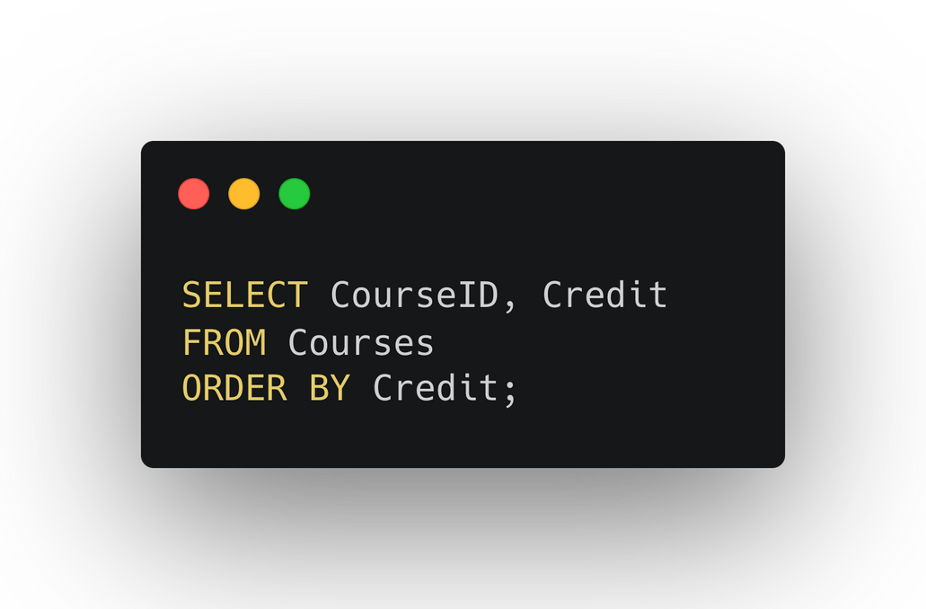
11.7 Structured Query Language
Data Manipulation Language
Order by - Sorts the result set of a query in ascending or descending order based on one or more columns.
CourseID | CourseName | Instructor | Credit
101 | Mathematics | Professor Smith | 3
103 | English | Professor Davis | 3
102 | History | Professor Johnson | 4

Slide 61
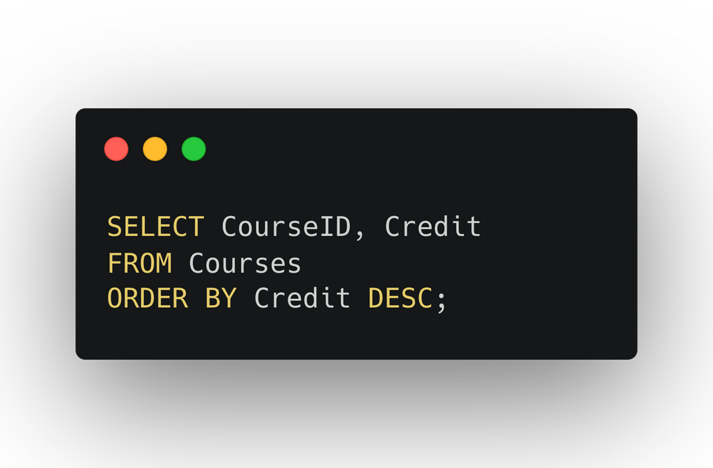
11.7 Structured Query Language
Data Manipulation Language
Order by - Sorts the result set of a query in ascending or descending order based on one or more columns.
CourseID | CourseName | Instructor | Credit
102 | History | Professor Johnson | 4
101 | Mathematics | Professor Smith | 3
103 | English | Professor Davis | 3

Slide 62
11.7 Structured Query Language
Data Manipulation Language
Where - Filters rows based on a specified condition.
StudentID | FirstName | LastName | Age | Grade
1 | John | Doe | 18 | A
2 | Jane | Smith | 19 | B
3 | Bob | Johnson | 20 | C
4 | Lebron | James | 24 | C
5 | Taylor | Swift | 22 | B
6 | Steve | Job | 20 | A
Scenario: Get the data of students who got a ‘B’.

Slide 63
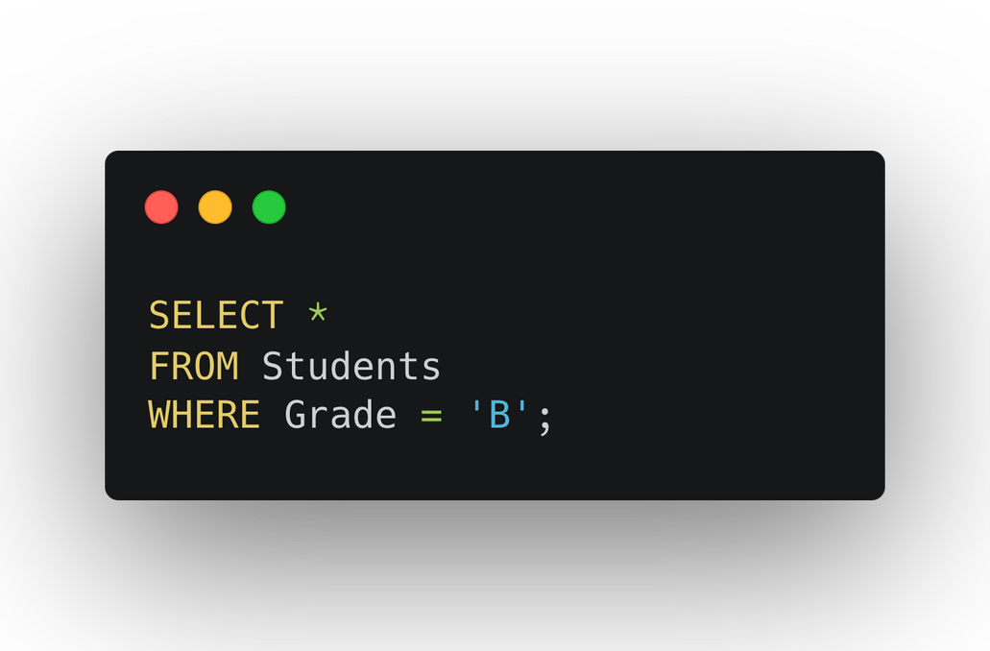
11.7 Structured Query Language
Data Manipulation Language
Where - Filters rows based on a specified condition.
StudentID | FirstName | LastName | Age | Grade
1 | John | Doe | 18 | A
2 | Jane | Smith | 19 | B
3 | Bob | Johnson | 20 | C
4 | Lebron | James | 24 | C
5 | Taylor | Swift | 22 | B
6 | Steve | Job | 20 | A
StudentID | FirstName | LastName | Age | Grade
2 | Jane | Smith | 19 | B
5 | Taylor | Swift | 22 | B

Slide 64
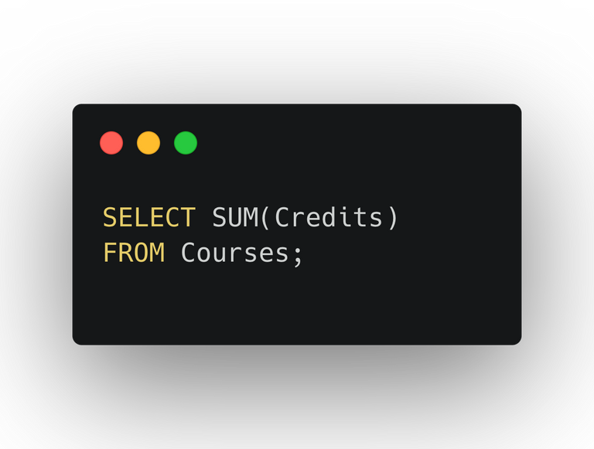
11.7 Structured Query Language
Data Manipulation Language
Find the sum of all the credit using the SUM function.
CourseID | CourseName | Instructor | Credit
101 | Mathematics | Professor Smith | 3
102 | History | Professor Johnson | 4
103 | English | Professor Davis | 3
10

Slide 65
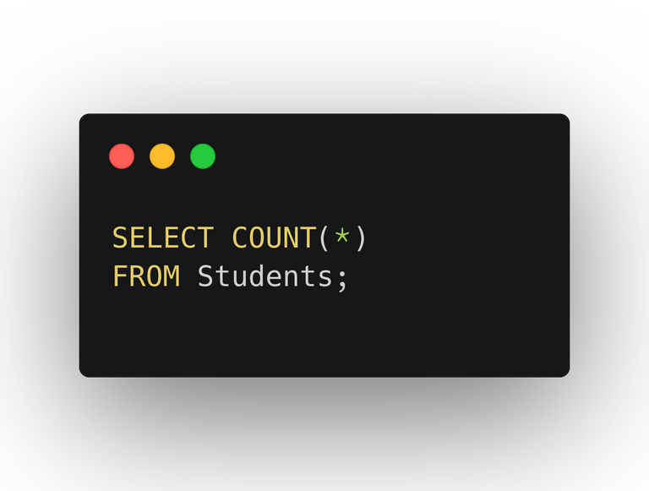
11.7 Structured Query Language
Data Manipulation Language
Count the number of students in the table using the COUNT function.
StudentID | FirstName | LastName | Age | Grade
1 | John | Doe | 18 | A
2 | Jane | Smith | 19 | B
3 | Bob | Johnson | 20 | C
4 | Lebron | James | 24 | C
5 | Taylor | Swift | 22 | B
6 | Steve | Job | 20 | A
6

Slide 66
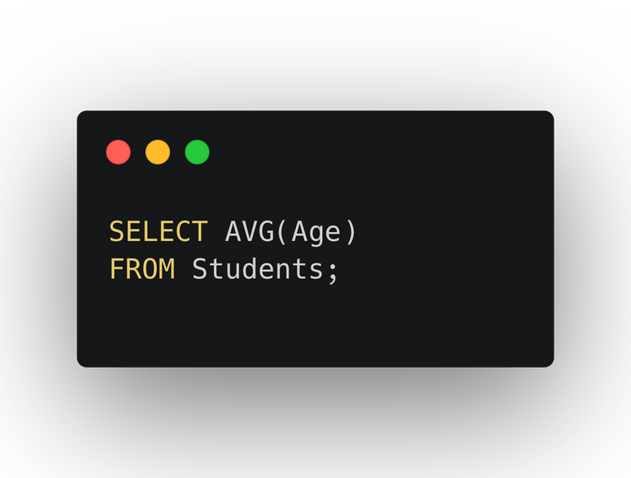
11.7 Structured Query Language
Data Manipulation Language
Count the average age of the students using the AVG function.
StudentID | FirstName | LastName | Age | Grade
1 | John | Doe | 18 | A
2 | Jane | Smith | 19 | B
3 | Bob | Johnson | 20 | C
4 | Lebron | James | 24 | C
5 | Taylor | Swift | 22 | B
6 | Steve | Job | 20 | A
20.5

Slide 67
11.7 Structured Query Language
Data Manipulation Language
Group by
StudentID | FirstName | LastName | Age | Grade
1 | John | Doe | 18 | A
2 | Jane | Smith | 19 | B
3 | Bob | Johnson | 20 | C
4 | Lebron | James | 24 | C
5 | Taylor | Swift | 22 | B
6 | Steve | Job | 20 | A
Scenario: Count the number of students in each grade.

Slide 68
11.7 Structured Query Language
StudentID | FirstName | LastName | Age | Grade
1 | John | Doe | 18 | A
6 | Steve | Job | 20 | A
Data Manipulation Language
Group by ‘Grade’ Visualisation
StudentID | FirstName | LastName | Age | Grade
1 | John | Doe | 18 | A
2 | Jane | Smith | 19 | B
3 | Bob | Johnson | 20 | C
4 | Lebron | James | 24 | C
5 | Taylor | Swift | 22 | B
6 | Steve | Job | 20 | A
StudentID | FirstName | LastName | Age | Grade
2 | Jane | Smith | 19 | B
5 | Taylor | Swift | 22 | B
StudentID | FirstName | LastName | Age | Grade
3 | Bob | Johnson | 20 | C
4 | Lebron | James | 24 | C

Slide 69
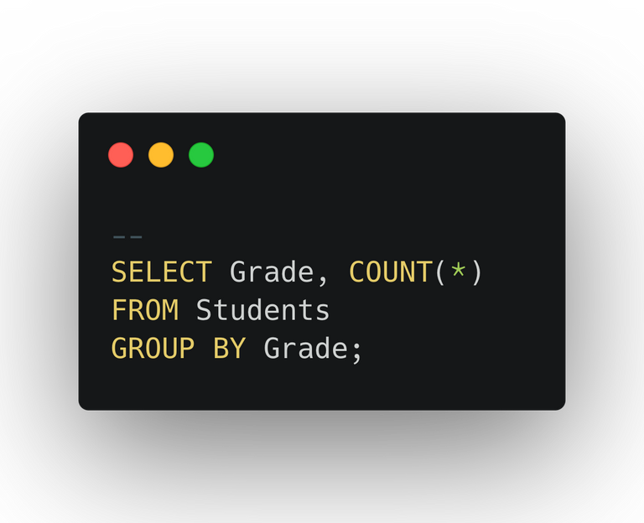
11.7 Structured Query Language
Data Manipulation Language
Group by
Grade | COUNT(*)
A | 2
B | 2
C | 2
StudentID | FirstName | LastName | Age | Grade
1 | John | Doe | 18 | A
2 | Jane | Smith | 19 | B
3 | Bob | Johnson | 20 | C
4 | Lebron | James | 24 | C
5 | Taylor | Swift | 22 | B
6 | Steve | Job | 20 | A

Slide 70
11.7 Structured Query Language
StudentID | FirstName | LastName | Age | Grade
1 | John | Doe | 18 | A
2 | Jane | Smith | 19 | B
3 | Bob | Johnson | 20 | C
4 | Lebron | James | 24 | C
5 | Taylor | Swift | 22 | B
6 | Steve | Job | 20 | A
CourseID | CourseName | Instructor | Credit
101 | Mathematics | Professor Smith | 3
102 | History | Professor Johnson | 4
103 | English | Professor Davis | 3
EnrollmentID | StudentID (Fk) | CourseID (Fk)
A1
1
101
A2
1
102
A3
2
102
Scenario: Get students and their enrolled courses
A4
5
101
A5
5
102

Slide 71
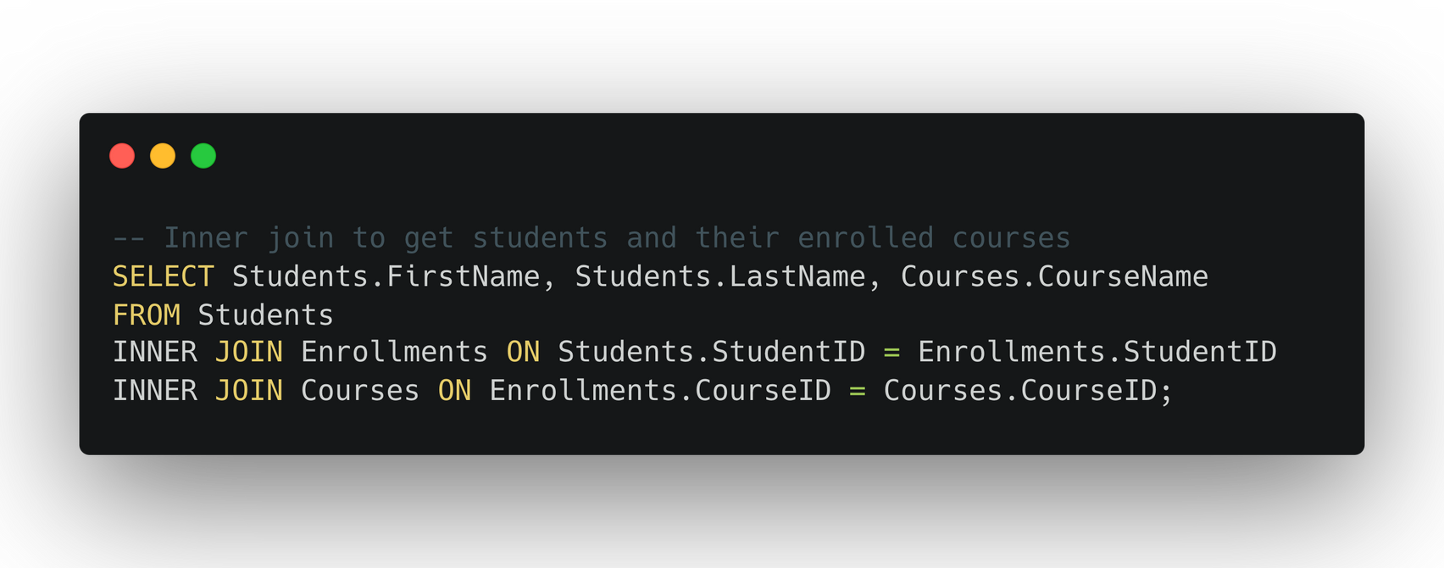
11.7 Structured Query Language
StudentID | FirstName | LastName | Age | Grade
1 | John | Doe | 18 | A
2 | Jane | Smith | 19 | B
3 | Bob | Johnson | 20 | C
4 | Lebron | James | 24 | C
5 | Taylor | Swift | 22 | B
6 | Steve | Job | 20 | A
EnrollmentID | StudentID (Fk) | CourseID (Fk)
A1
1
101
A2
1
102
+
A3
2
102
A4
5
101
A5
5
102

Slide 72
11.7 Structured Query Language
StudentID | FirstName | LastName | Age | Grade
1 | John | Doe | 18 | A
2 | Jane | Smith | 19 | B
3 | Bob | Johnson | 20 | C
4 | Lebron | James | 24 | C
5 | Taylor | Swift | 22 | B
6 | Steve | Job | 20 | A
EnrollmentID | StudentID (Fk) | CourseID (Fk)
A1
1
101
A2
1
102
+
A3
2
102
A4
5
101
A5
5
102

Slide 73
11.7 Structured Query Language
StudentID | First Name | Last Name | Age | Grade | EnrollmentID | Course ID
1 | John | Doe | 18 | A | A1 | 101
1 | John | Doe | 18 | A | A2 | 102
2 | Jane | Smith | 19 | B | A3 | 102
5 | Taylor | Swift | 22 | B | A4 | 101
5 | Taylor | Swift | 22 | B | A5 | 102

Slide 74
11.7 Structured Query Language
Student ID | First Name | Last Name | Age | Grade | EnrollmentID | Course ID
1 | John | Doe | 18 | A | A1 | 101
1 | John | Doe | 18 | A | A2 | 102
2 | Jane | Smith | 19 | B | A3 | 102
5 | Taylor | Swift | 22 | B | A4 | 101
5 | Taylor | Swift | 22 | B | A5 | 102
CourseID | CourseName | Instructor | Credit
101 | Mathematics | Professor Smith | 3
102 | History | Professor Johnson | 4
103 | English | Professor Davis | 3
+

Slide 75
11.7 Structured Query Language
Student ID | First Name | Last Name | Age | Grade | EnrollmentID | Course ID | CourseName | Instructor | Credit
1 | John | Doe | 18 | A | A1 | 101 | Mathematics | Professor Smith | 3
1 | John | Doe | 18 | A | A2 | 102 | History | Professor Johnson | 4
2 | Jane | Smith | 19 | B | A3 | 102 | History | Professor Johnson | 4
5 | Taylor | Swift | 22 | B | A4 | 101 | Mathematics | Professor Smith | 3
5 | Taylor | Swift | 22 | B | A5 | 102 | History | Professor Johnson | 4

Slide 76
11.7 Structured Query Language
First Name | Last Name | CourseName
John | Doe | Mathematics
John | Doe | History
Jane | Smith | History
Taylor | Swift | Mathematics
Taylor | Swift | History

Slide 77

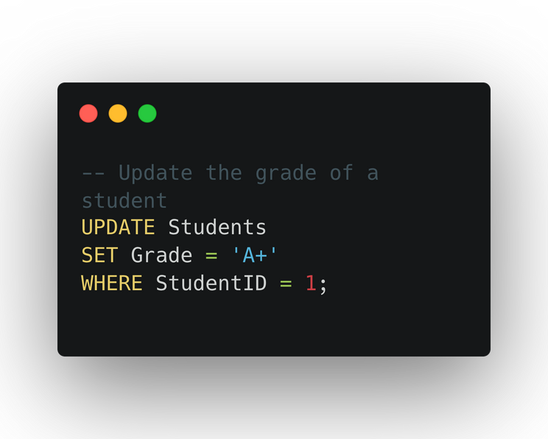
11.7 Structured Query Language
Data Manipulation Language
Update - Modifies existing records in a table based on a specified condition.
StudentID | FirstName | LastName | Age | Grade
1 | John | Doe | 18 | A
2 | Jane | Smith | 19 | B
3 | Bob | Johnson | 20 | C
4 | Lebron | James | 24 | C
5 | Taylor | Swift | 22 | B
6 | Steve | Job | 20 | A
StudentID | FirstName | LastName | Age | Grade
1 | John | Doe | 18 | A+
2 | Jane | Smith | 19 | B
3 | Bob | Johnson | 20 | C
4 | Lebron | James | 24 | C
5 | Taylor | Swift | 22 | B
6 | Steve | Job | 20 | A

Slide 78
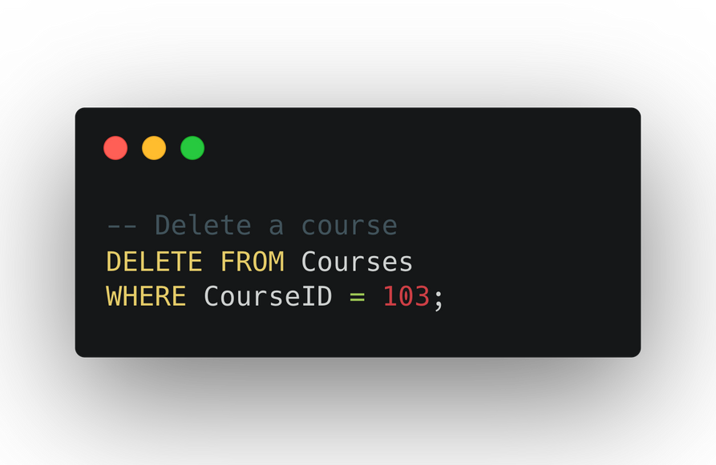
11.7 Structured Query Language
Data Manipulation Language
Delete - Removes one or more records from a table based on a specified condition.
CourseID | CourseName | Instructor | Credit
101 | Mathematics | Professor Smith | 3
102 | History | Professor Johnson | 4
103 | English | Professor Davis | 3
CourseID | CourseName | Instructor | Credit
101 | Mathematics | Professor Smith | 3
102 | History | Professor Johnson | 4

