Slide 1
Cambridge International
AS Level Computer Science
(9618) – Revision Notes
System Software and Operating System
This pack is intended for students to who are taking CIE AS Level in Computer Science, either in preparation for their AS exam, or more likely alongside year 2 of the course to improve fluency, recall and pace on AS topics. It could be used as lesson starters, or supplied to students for independent use.

Slide 2



Chapter
8
System Software and Operating System
A LEVEL COMPUTER SCIENCE

Slide 3



System Software
System software is a type of computer program that provides a platform for running application software and manages computer hardware resources.
8.1
8.2
8.3
Operating system
Utility Software
Program Libraries
8.4
Translators: Compilers and Interpreters
8.5
Integrated Development Environment

Slide 4

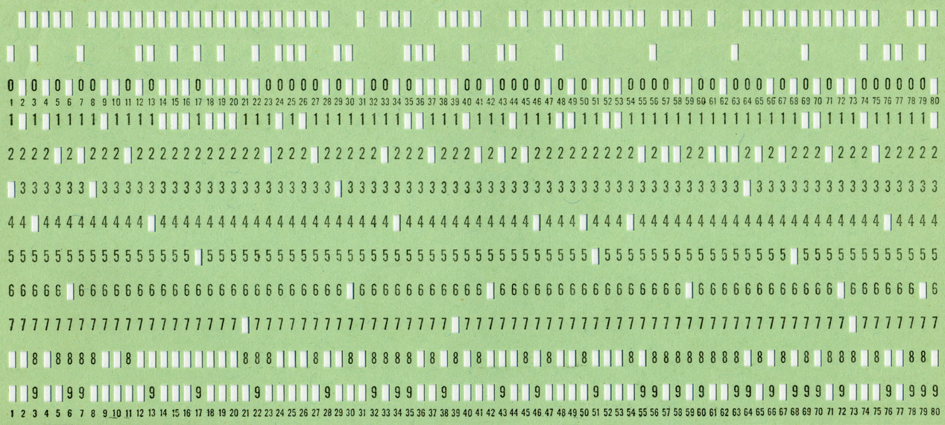

8.1 Operating System
Punched Card and Punched Tapes
Punched card
- contains the program
Punched tapes
- contains the data

Slide 5
8.1 Operating System
Using a computer without an Operating System ..
Inserted by human
Card Reader
Punched card
- contains the program
Get output printed on the line-printer
Press Run
Inserted by human
Tape Reader
Punched tapes
- contains the data

Slide 6



8.1 Operating System
Operating System
A software that controls that hardware and interact with application software.
Operating System
Application Software
Hardware

Slide 7


8.1 Operating System
Tasks carried out by the OS

Slide 8


8.1 Operating System
User-system interface
It enables the user to make the software and hardware perform meaningful tasks. For examples:
Graphical User Interface
Command-line Interface
User-system interface

Slide 9

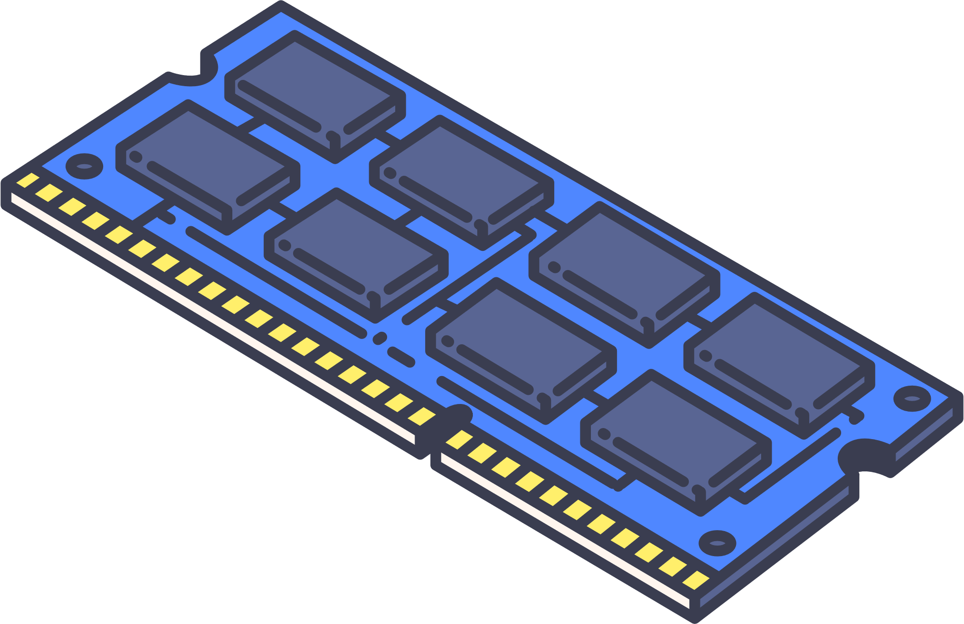
8.1 Operating System
Program-hardware interface
A program-hardware interface facilitates communication between software programs and hardware components.
Software
(eg. Final Cut Pro)
Operating System
Hardware
(RAM, CPU)
It ensures that software can effectively utilise hardware capabilities to perform specific tasks and functions. Programmers that write the software do not need to know the details of how the hardware work.
Program-hardware interface

Slide 10
8.1 Operating System
Resource Management
A process is program that has begun execution. Multiple processes can run simultaneously and each process needs access to the resources provided by the computer system.
Process 1
Process 2
Process 3
Requires RAM and processing power
Resource management

Slide 11
8.1 Operating System
Resource Management
The operating system provides resource management aims to achieve the best possible efficiency in computer system use.
Process 1
Process 1
Process 2
Process 1
Process 2
Process 3
Process 2
Process 1
Process 2
Scheduling of process
Resolution of conflicts when two processes require the same resource
Resource management

Slide 12


8.1 Operating System
Highlighter
Memory Management
There are three important aspects of memory management.
Memory protection guarantees that a single program cannot attempt to access identical memory locations as another program.
The selection of the memory organization scheme aims to optimize the utilization of restricted memory capacity, such as employing virtual memory through paging or segmentation, for instance.
Optimizing memory usage entails making choices regarding which processes should reside in the primary memory at a given moment and their specific storage locations within this memory.
0
99
0
100
0
99
Process 1
101
0
100
Process 2
102
Process 1
101
Process 2
102
Process 3
103
Process 3
103
Memory management

Slide 13



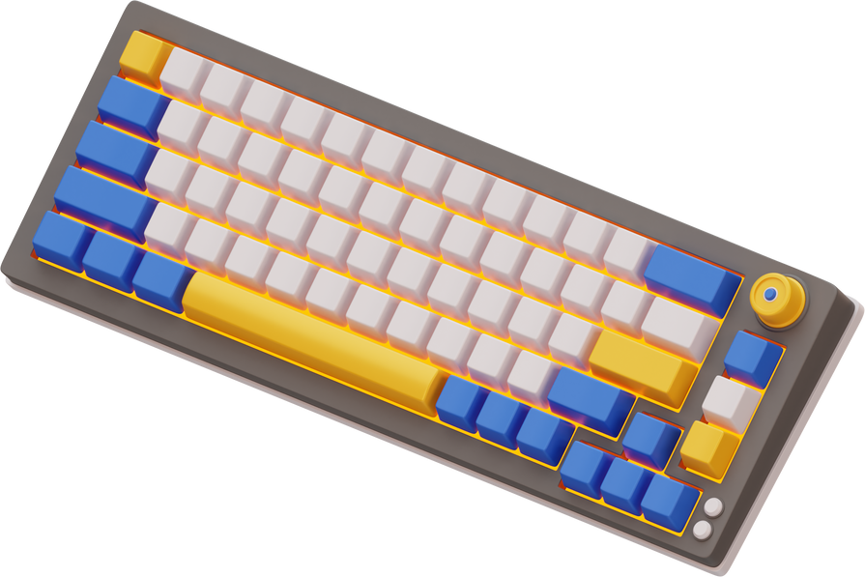
8.1 Operating System
Device Management
The operating system handles the installation of the appropriate device driver.
Device Management

Slide 14

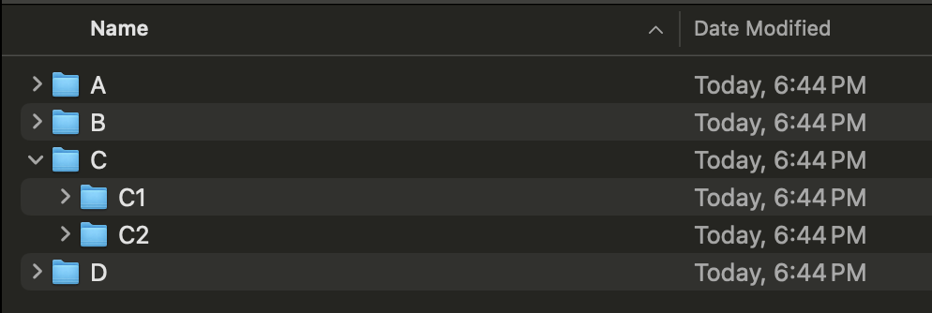


8.1 Operating System
File Management
The three main features here include providing:
File naming convention (rules)
Directory (folder) structure
Access control mechanism
Access control is the process of regulating and restricting access to data or resources, ensuring that only authorized entities can access specific information or perform certain actions.
File Management

Slide 15

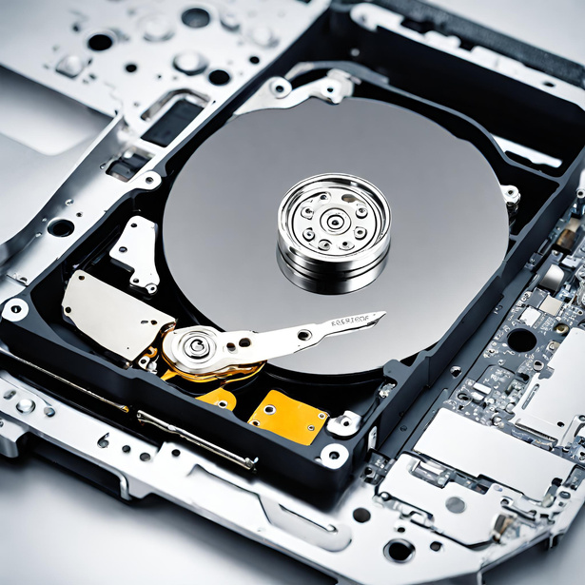

8.1 Operating System
Security Management
The aspects of security management done by OS include:
Data recovery in cases of data loss
Prevention of intrusion
Ensuring data privacy
Security Management

Slide 16
8.1 Operating System
Error Detection and Recovery
The operating system should be capable of pausing an ongoing process and offering error diagnostics when necessary. In critical situations, it must be able to systematically shut down the system without any data loss.
Error Detection and Recovery

Slide 17
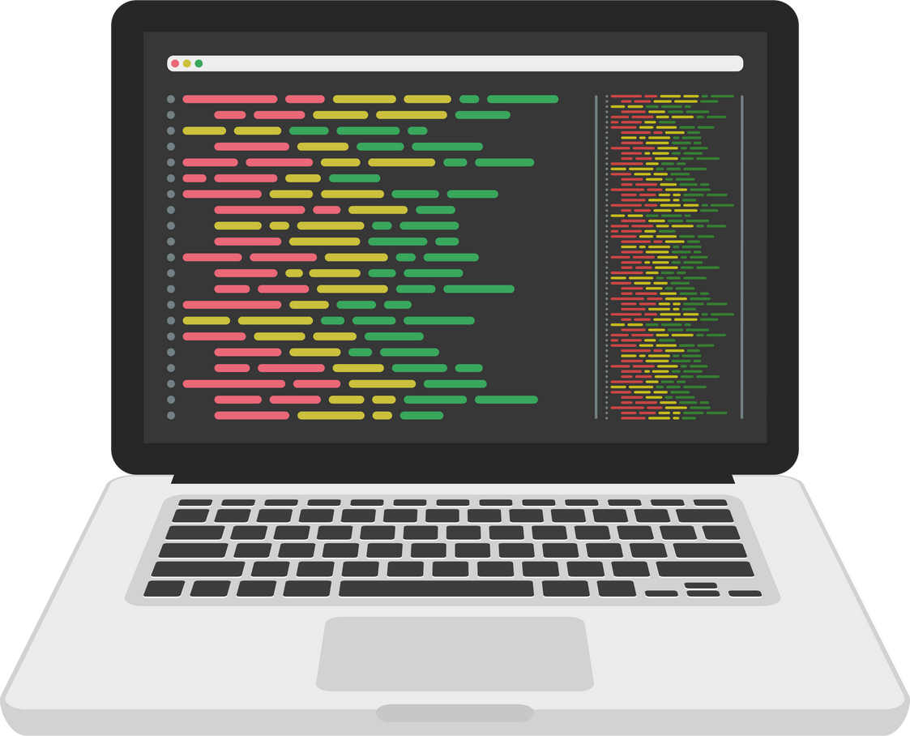

Subtopic 1
8.2 Utility Software
What is it?
Utility software is a type of software designed to perform specific tasks that enhance the overall functionality and maintenance of a computer system, such as disk cleanup, antivirus scanning, or file compression.
It isn't executed during regular operation of the operating system, but is rather a program that can be initiated by the user or the operating system when necessary.

Slide 18
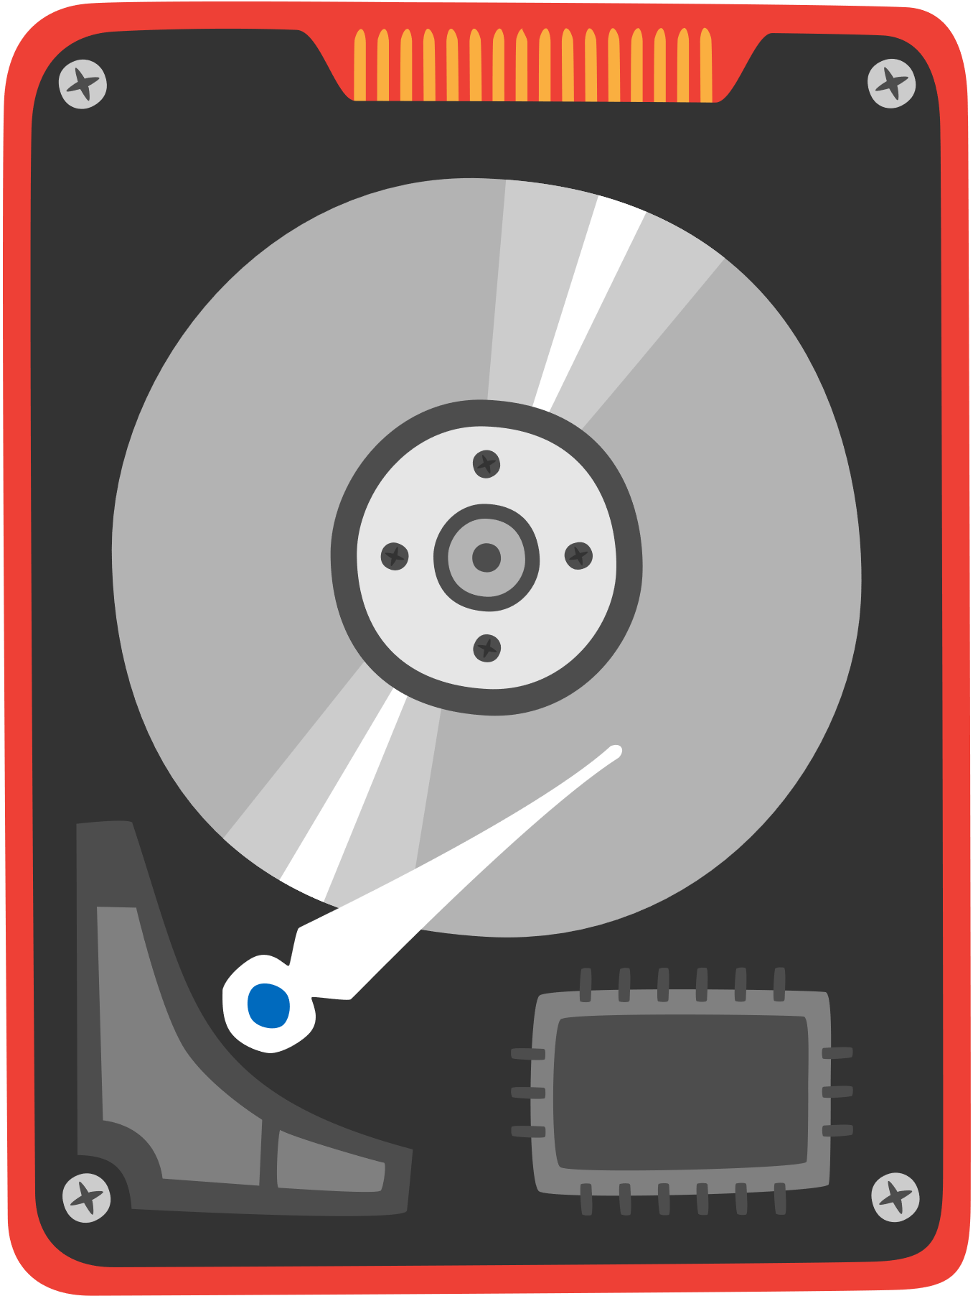
Subtopic 1
8.2 Utility Software
Hard disk formatter and checker
Erasing data from a previously used disk.
Establishing the file system on the disk using a directory that links files recognized by the operating system to specific physical locations on the disk.
Dividing the disk into logical drives if necessary
Hard disk formatter and checker

Slide 19
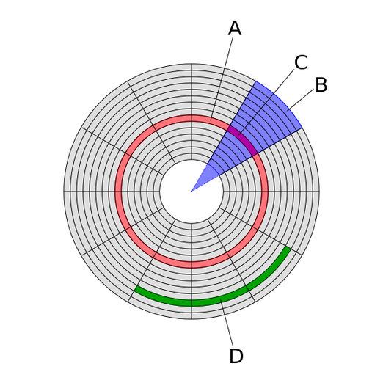
Subtopic 1
8.2 Utility Software
Hard disk formatter and checker
Disk Repair - How it works?
  Disk errors occur due to a physical flaw leading to the emergence of what is known as a 'bad sector’.
  A utility program for disk repair can flag bad sectors and guarantee that the file system avoids utilizing them.
Hard disk formatter and checker

Slide 20
Subtopic 1
8.2 Utility Software
Hard Disk Defragmenter
Sector
Track
An operational disk, when in use, will gradually lose its efficiency due to the continuous creation, modification, and removal of files, which results in fragmentation. A hard disk defragmenter reorganizes the fragmented data on a disk to improve its performance and speed.
011010
011010
011010
011010
011010
011010
011010
011010
011010
011010
011010
011010
011010
011010
011010
Block
Sector
Track
011010
011010
011010
011010
011010
011010
011010
Hard Disk Defragmenter
011010
011010
011010
011010
011010
011010
011010
011010
Block

Slide 21

Subtopic 1
8.2 Utility Software
Backup Software
Backup software creates duplicate copies of files and data from a computer or network, which can be used to restore the original data in case of data loss, corruption, or accidental deletion. They achieve this by:
Set up a timetable for conducting backups
Generate a fresh backup file only when there is a modification.
Backup Software

Slide 22
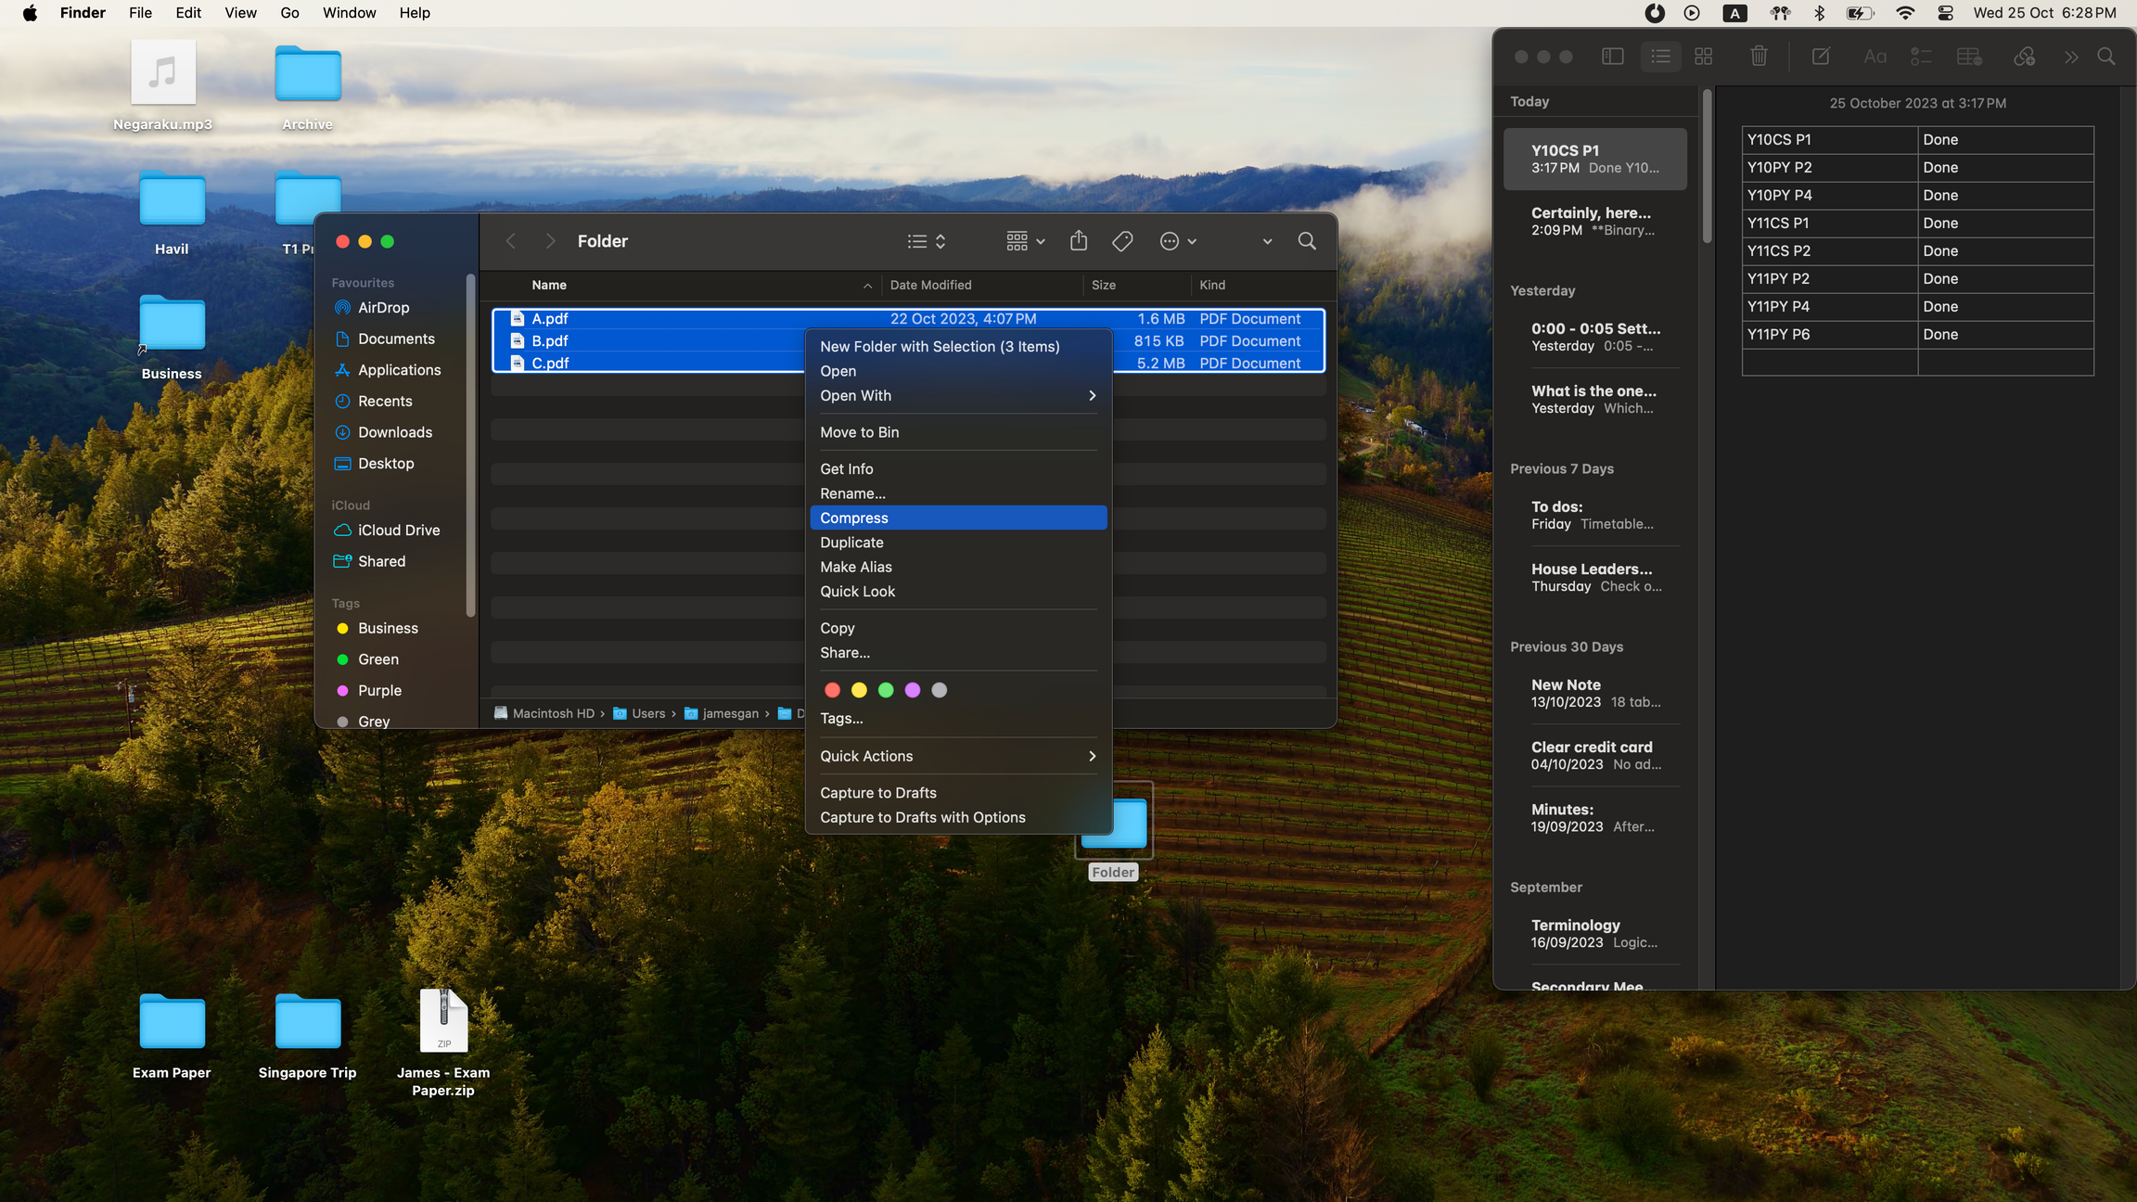
Subtopic 1
8.2 Utility Software
File Compression
A file compression utility program reduces the size of one or more files, making them more manageable for storage or transmission purposes.
Zip File
File Compression

Slide 23

Subtopic 1
8.2 Utility Software
Virus Checker
A virus checker scans and detects malicious software and potentially harmful code within files and programs to ensure the security of a computer system.
Virus checkers need to be regularly updated
Virus Checker

Slide 24



8.3 Program Libraries
Subroutines
  Subroutines are designed for specific operations, which programmers can integrate into their own code, reducing the time and effort needed by using pre-tested code snippets from a subroutine library.
Use the code, don’t have to write them from scratch
Subroutine
Programmers

Slide 25
8.3 Program Libraries
Source Code
Machine Code
10101101001010100101010101101001010100101010010100101000010010101000101001010101001010101010010101010101001010101001101001010010100001001010100010100101010100101010101001010101010100101010100110
Compiler
The executable code cannot run independently and must be linked with any utilized subroutine code. It is feasible to link prior to loading the entire code into memory and executing it.
Disadvantage
  Since every routine has to have its own copy, this increases the storage space requirement for the executable file.
  It also increases memory usage when more than one process uses the routine.

Slide 26
8.3 Program Libraries
Highlighter
Dynamic Linked Library
A dynamic linked library is a collection of executable functions and procedures that can be dynamically loaded and accessed by a program at runtime.
Advantages
Disadvantages
  The executable code only requires a small code inclusion for linking to a separately stored routine in memory during program execution.
  This leads to reduced storage space requirements for all program executable files.
  Minimized memory usage is another benefit of this linking process.
  Whenever a new version of the routine is available, it can be loaded into memory, automatically upgrading any program using it.
  Dependency on external libraries can lead to issues if the required library is not available or is incompatible.
  Performance can be affected due to the need for runtime linking, which can cause delays during program execution.

Slide 27



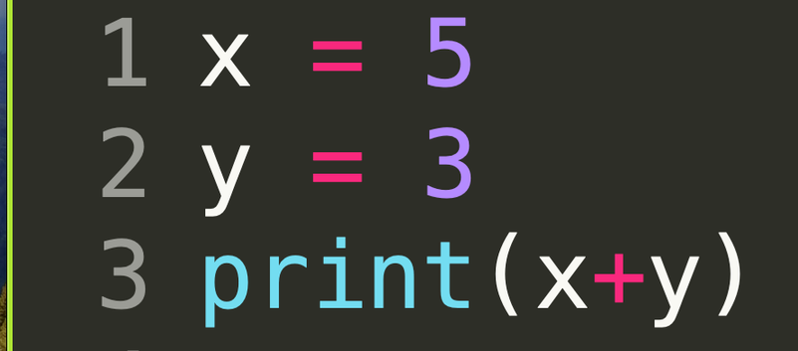
8.4 Translators: Compilers and Interpreters
Purpose of a Translator
The purpose of a translator for high-level programming languages is to convert human-readable code into machine-readable code for execution on a computer.
01001010110001001010010010101001010010101001010110110010010111010011010

Slide 28






8.4 Translators: Compilers and Interpreters
Interpreter
An interpreter translates and executes high-level code line by line during runtime.
How it works?
The first line of the source code is processed.
The line is analysed.
In case an error is detected, it is reported, and the interpreter program stops execution.
If no errors are identified, the source code line is transformed into an intermediate code.
The interpreter program employs this intermediate code to perform the necessary operation.

Slide 29
8.4 Translators: Compilers and Interpreters
Interpreter
An interpreter translates and executes high-level code line by line during runtime.
Repeat these steps for line 2!
The first line of the source code is processed.
The line is analysed.
In case an error is detected, it is reported, and the interpreter program stops execution.
If no errors are identified, the source code line is transformed into an intermediate code.
The interpreter program employs this intermediate code to perform the necessary operation.

Slide 30
8.4 Translators: Compilers and Interpreters
Compiler
A compiler translates the entire high-level code into machine code all at once before execution.
How it works?
The first line of the source code is read.
The line is analysed.
In case an error is detected, this is recorded.
If no errors are identified, the source code line is transformed into an intermediate code.

Slide 31
8.4 Translators: Compilers and Interpreters
Compiler
At the end of the compilation, there are two possible outcomes:
When no errors are found in the entire source code, the entirety of the intermediate code is translated into object code.
If any errors are identified, a list of these errors is generated as output, and no object code is produced.
Unlike interpreter, execution of the program can only begin when the compilation has shown no errors.

Slide 32
8.4 Translators: Compilers and Interpreters
Interpreter vs Compiler
Advantages and Disadvantages for the programmer
 | Interpreter | Compiler
Advantages
Disadvantages
  Identifiable errors can be recognized in real time and promptly rectified.
  In a specific program execution, sections of the code with syntax errors might remain inaccessible, resulting in any lingering errors being detected only at a later stage.
  Source code has to be distributed to the user.

Slide 33
8.4 Translators: Compilers and Interpreters
Interpreter vs Compiler
Advantages and Disadvantages for the programmer
 | Interpreter | Compiler
Advantages
Disadvantages
  An executable file can be distributed to users without them having access to the source code.
  It typically requires more time for the initial development and debugging process.

Slide 34
8.4 Translators: Compilers and Interpreters
Interpreter vs Compiler
Advantages and Disadvantages for the user
 | Interpreter | Compiler
Advantages
Disadvantages
  The execution speed achievable with compiled object code exceeds what can be attained by an interpreted program.
  For the compiled program, only the object code has to be available each time an error-free program is run.
  Every time an error-free program is executed, both the interpreter and the source code need to be accessible.
  It is less secure because it could contain a virus.

Slide 35
8.4 Translators: Compilers and Interpreters
Interpreter and Compiler
Irrespective of whether an interpreter or a compiler is employed, a program can only be executed on a specific computer with a specific processor if the interpreter or compiler program has been tailored for that particular processor.

Slide 36
8.4 Translators: Compilers and Interpreters
Interpreter and Compiler
If the option exists, the preference for an interpreter during program development is warranted due to the following reasons:
  A single error in the code can trigger the occurrence of multiple additional errors.
  An interpreter can identify and rectify an initial error, thereby restricting subsequent ones.
  The debugging tools integrated with the interpreter expedite this process.

Slide 37
8.4 Translators: Compilers and Interpreters
Interpreter and Compiler
If the option exists, the preference for an interpreter during program development is warranted due to the following reasons:
  A single error in the code can trigger the occurrence of multiple additional errors.
  An interpreter can identify and rectify an initial error, thereby restricting subsequent ones.
  The debugging tools integrated with the interpreter expedite this process.
Opting for a compiler is justified when the programmer is assured of minimal errors in the program:
  A compiler allows for the creation of an executable file that can be distributed for general use, resulting in faster execution compared to an interpreter.

Slide 38
8.4 Translators: Compilers and Interpreters
Java
When Java was developed, it introduced a distinct approach to its utilization, requiring a Java Virtual Machine specific to each type of computer. Upon writing a Java program, it is initially compiled into Java Byte Code, which is then interpreted by the Java Virtual Machine during runtime. The portability of Java Byte Code enables its transfer to any computer equipped with a Java Virtual Machine.

Slide 39



8.5 Integrated Development Environment
What is an IDE?
IDE is a software application that provides comprehensive tools and features for software development, including code editing, debugging, and building capabilities, all within a single interface. Eg.
PyCharm

Slide 40
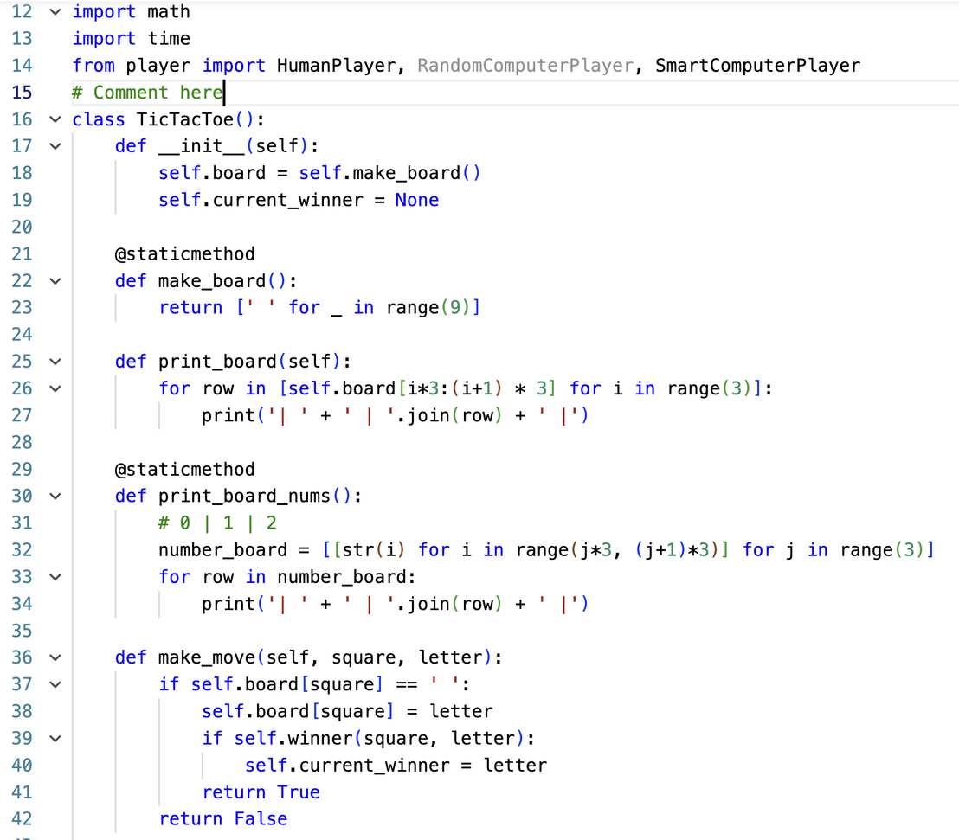
8.5 Integrated Development Environment
Pretty Printing
Colour coded keywords
Colour coded data type
Automatic Indentation
Pretty printing

Slide 41
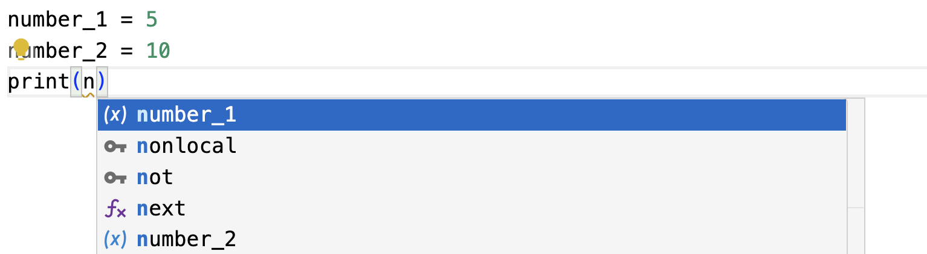
8.5 Integrated Development Environment
Context-Sensitive Prompt
This function shows suggestions and accessible labels that could be suitable at the current position where the program code is being entered.
Context-Sensitive Prompt

Slide 42
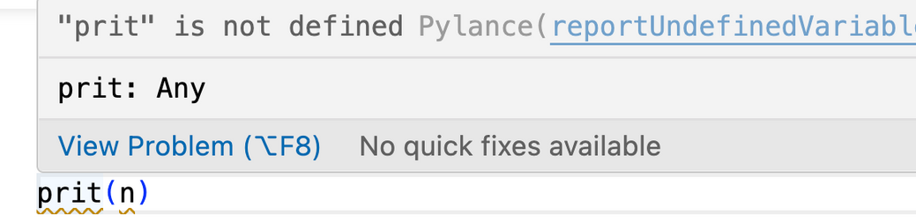
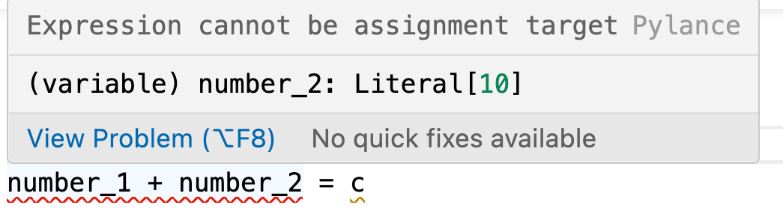
8.5 Integrated Development Environment
Dynamic Syntax Checks
This function will alert the programmer when there is a syntax error.
Dynamic Syntax Checks

Slide 43
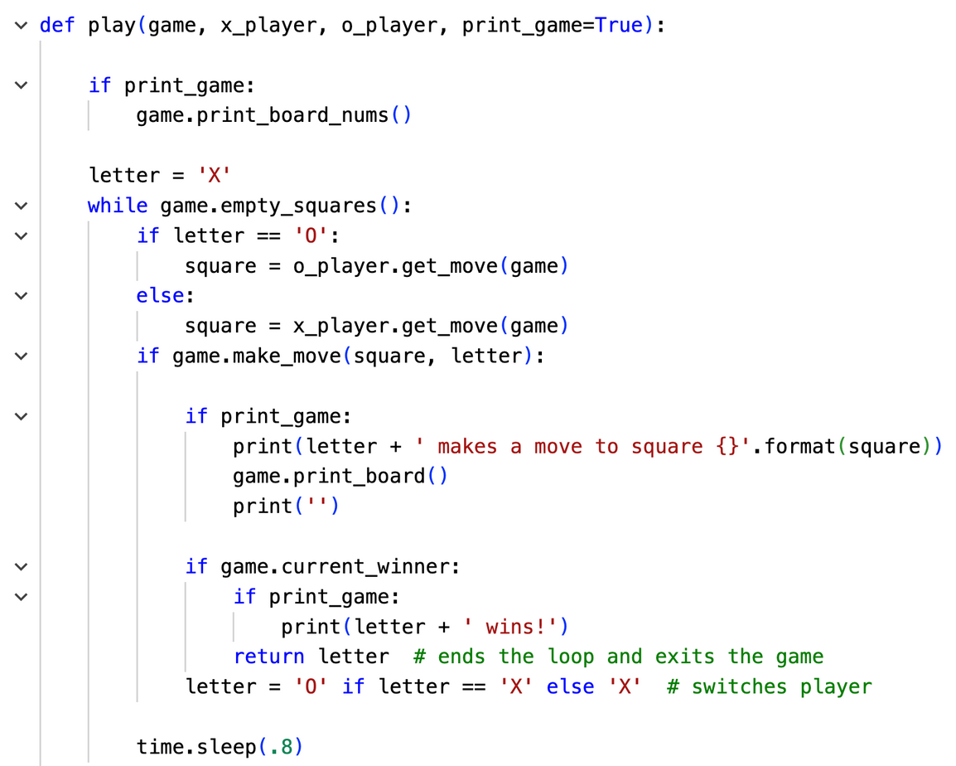

8.5 Integrated Development Environment
Expanding and collapsing code blocks
This function allows programmer to collapse blocks of statements.
Expanding and collapsing code blocks

Slide 44
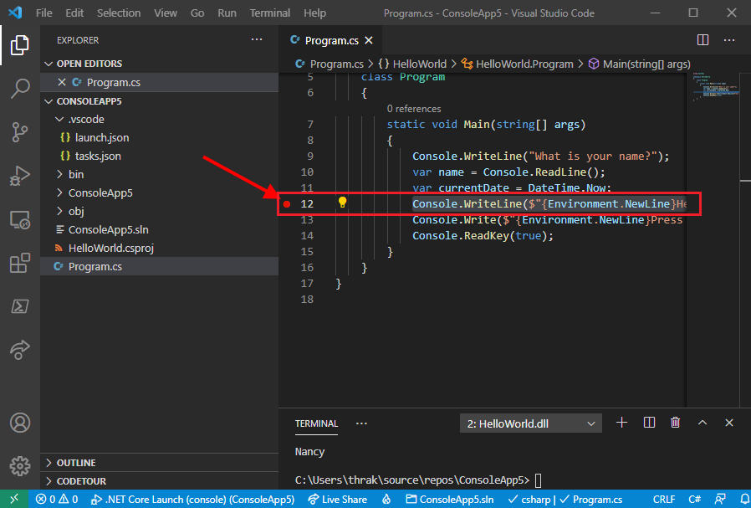
8.5 Integrated Development Environment
Debugging
A debugger in an IDE can help identify and rectify errors or bugs in the code by allowing developers to track the execution of a program step by step and inspect variables and expressions at different points.
Debugging

