Slide 1







Chapter
4
Logic Gates and Logic Circuits
A LEVEL COMPUTER SCIENCE

Slide 2
Cambridge International
AS Level Computer Science
(9618) – Revision Notes
Logic Gates and Logic Circuits
This pack is intended for students to who are taking CIE AS Level in Computer Science, either in preparation for their AS exam, or more likely alongside year 2 of the course to improve fluency, recall and pace on AS topics. It could be used as lesson starters, or supplied to students for independent use.

Slide 3

Chapter
4
Logic Gates
Purpose: They perform logical functions, which help in the processing and manipulation of binary data in digital circuits and computer systems.
A LEVEL COMPUTER SCIENCE

Slide 4





Boolean Operators
4.1
Terminology
4.2
  Logic Propositions
  Problem Statement
  Logic Expression
4.3
Truth Table
and
Logic Gates
Chapter
Outline
Logic Circuit
Construct a logic expression from a problem statement
4.4
Constructing a logic circuit from a problem statement or logic expression
Worked Example
Construct a truth table from a logic circuit
Construct a logic circuit based on a truth table

Slide 5



4.1 Terminology
Logic Proposition
Eg. The Sun rises in the east.
A logic proposition is a statement that can be evaluated as either true or false, but not both, based on factual or theoretical conditions.

Slide 6


4.1 Terminology
Problem Statement
An outcome that relies on either a single logic proposition or a combination of two or more logic propositions.
When the traffic light isn't green and the pedestrian signal is on, Stop your vehicle and yield to pedestrians.
Highlighter

Slide 7

4.1 Terminology
Problem Statement
Logic Proposition 1
Logic Proposition 2
An outcome that relies on either a single logic proposition or a combination of two or more logic propositions.
When the traffic light isn't green and the pedestrian signal is on,
Stop your vehicle and yield to pedestrians.
Highlighter
Outcome

Slide 8
Subtopic 1
4.2 Boolean Operators
Introduction
Boolean Operator
When the traffic light isn't green AND the pedestrian signal is on,
Stop your vehicle and yield to pedestrians.

Slide 9
Subtopic 1
4.2 Boolean Operators
Introduction
A boolean operator is a logical operator that performs operations on boolean values (true or false) to produce a boolean result.
The three boolean operators are:
AND
OR
NOT
Statement
A
B
A
B
A
= True
=
= True
= True
=
= False
=
= FALSE
TRUE
TRUE
TRUE

Slide 10

Subtopic 1
4.2 Boolean Operators
Logic Expression
When the traffic light isn't green and the pedestrian signal is on,
Stop your vehicle and yield to pedestrians.
A logic expression is a combination of logical operators and statements that evaluates to a boolean value (either true or false) based on the given conditions or rules.

Slide 11
Subtopic 1
4.2 Boolean Operators
Logic Expression
When the traffic light isn't green and the pedestrian signal is on,
Stop your vehicle and yield to pedestrians.
A logic expression is a combination of logical operators and statements that evaluates to a boolean value (either true or false) based on the given conditions or rules.
Can be rewritten to
STOP_VEHICLE =
NOT (traffic light is green = TRUE)
AND (pedestrian signal on = TRUE)

Slide 12
Subtopic 1
4.2 Boolean Operators
Other boolean operators
The following operators are also commonly used:
NOT + AND
NOT + OR
EITHER OR
NAND
NOR
XOR
A
B
A
B
A
B
= False
=
= False
= False
=
= False
= True
=
= False
= True
= False
TRUE
TRUE
TRUE

Slide 13



4.3 Truth Tables and Logic Gates
Introduction
Truth Table
Logic Gate
INPUT
OUTPUT
A
B
X
0
0
0
1
1
0
1
1
A truth table is a table that displays
all possible input combinations
and their corresponding output values
in logic or Boolean expressions.
An element within a logic circuit that performs functions consistent with those of a Boolean Operator.

Slide 14

4.3 Truth Tables and Logic Gates
AND Operator
Truth Table
AND gate
INPUT
OUTPUT
A
X
A
B
X
0
0
0
B
0
1
0
The AND date takes the inputs A and B and produces the output, X.
If both inputs are 1, then the output will be 1, but otherwise the output will be 0.
1
0
0
1
1
1

Slide 15
4.3 Truth Tables and Logic Gates
OR Operator
Truth Table
OR gate
INPUT
OUTPUT
A
A
B
X
X
0
0
0
B
0
1
1
The OR gate takes two inputs, A and B, and produces output X. If either or both inputs is 1, the output will be 1.
1
0
1
1
1
1

Slide 16
4.3 Truth Tables and Logic Gates
NOT Operator
NOT gate
Truth Table
INPUT
OUTPUT
A
X
A
X
0
1
1
0
The NOT gate takes a single input and produces the opposite of that input in a single output

Slide 17


4.3 Truth Tables and Logic Gates
NAND Operator
Truth Table
NAND gate
Negation of
AND
INPUT
AND
NAND
A
X
A
B
X
X
B
NOT Gate
0
0
0
1
0
1
0
1
AND Gate
1
0
0
1
NAND (NOT + AND). It will only give an output of 0 if both inputs are 1.
1
1
1
0

Slide 18
4.3 Truth Tables and Logic Gates
NOR Operator
Truth Table
Negation of
OR
NOR gate
INPUT
OR
NOR
A
X
A
B
X
X
B
0
0
0
1
NOT Gate
0
1
1
0
OR Gate
1
0
1
0
NOR (NOT + OR). Produces an output if both inputs A and B are 0.
1
1
1
0

Slide 19
4.3 Truth Tables and Logic Gates
XOR Operator
Truth Table
XOR gate
INPUT
OUTPUT
A
A
B
X
X
B
0
0
0
0
1
1
XOR (Exclusive OR). The output X is 1 when either (but not both) of the A or B inputs is 1.
1
0
1
1
1
0

Slide 20




4.4 Worked Example
Worked Example 1: Construct a logic expression from a problem statement
You are designing a computer game character selection system. Players can choose their characters based on the following criteria:
Firstly, they should have achieved a high score of at least 100 points. Secondly, they must have successfully completed a minimum of three game levels. Thirdly, they need to have unlocked a special in-game achievement. However, there's an exception for premium members; if a player is a premium member, they can access exclusive characters even if they have not unlocked the special in-game achievement.
These four conditions collectively determine a player's eligibility to access and play as the exclusive characters in the game.

Slide 21
4.4 Worked Example
Worked Example 1: Construct a logic expression from a problem statement
Identify the conditions in a statement that can have true or false values
Firstly, they should have achieved a high score of at least 100 points.
Secondly, they must have successfully completed a minimum of three game levels.
Thirdly, they need to have unlocked a special in-game achievement. However, there's an exception for premium members; if a player is a premium member, they can access exclusive characters even if they have not unlocked the special in-game achievement.

Slide 22
4.4 Worked Example
Worked Example 1: Construct a logic expression from a problem statement
Change each condition into symbols
A - achieved a high score of at least 100 points.
B - completed a minimum of three game levels.
C - unlocked a special in-game achievement.
D - premium member

Slide 23
4.4 Worked Example
Worked Example 1: Construct a logic expression from a problem statement
Construct the logical expression
A AND B AND (C OR D)

Slide 24

4.4 Worked Example
Worked Example 2: Constructing a logic circuit from a problem statement or logic expression
A university will only admit a student in if the student fulfils the following criteria:
  The student has achieved at least 3A* in the A-level exam
  Two of the following conditions must also apply
    The student has demonstrated extensive leadership experience
    The student has gotten 2 recommendation letters from field experts
    The student has a portfolio of projects deemed impressive

Slide 25
4.4 Worked Example
Worked Example 2: Constructing a logic circuit from a problem statement or logic expression
A - The student has achieved at least 3A* in the A-level exam
Two of the following conditions must also apply
B - The student has extensive leadership experience
C - The student has gotten 2 recommendation letters from field experts
D - The student has a portfolio deemed impressive

Slide 26
4.4 Worked Example
Worked Example 2: Constructing a logic circuit from a problem statement or logic expression
A - The student has achieved at least 3A* in the A-level exam
Two of the following conditions must also apply
B - The student has extensive leadership experience
C - The student has gotten 2 recommendation letters from field experts
D - The student has a portfolio deemed impressive
A AND

Slide 27
4.4 Worked Example
Worked Example 2: Constructing a logic circuit from a problem statement or logic expression
A - The student has achieved at least 3A* in the A-level exam
Two of the following conditions must also apply
B - The student has extensive leadership experience
C - The student has gotten 2 recommendation letters from field experts
D - The student has a portfolio deemed impressive
A AND
(( ) OR
( ) OR
( ))

Slide 28
4.4 Worked Example
Worked Example 2: Constructing a logic circuit from a problem statement or logic expression
A - The student has achieved at least 3A* in the A-level exam
Two of the following conditions must also apply
B - The student has extensive leadership experience
C - The student has gotten 2 recommendation letters from field experts
D - The student has a portfolio deemed impressive
A AND
((B AND C) OR
(B AND D) OR
(C AND D))

Slide 29

4.4 Worked Example
Worked Example 2: Constructing a logic circuit from a problem statement or logic expression
A AND ((B AND C) OR (B AND D) OR (C AND D))
Based on a logic expression, create a circuit.

Slide 30

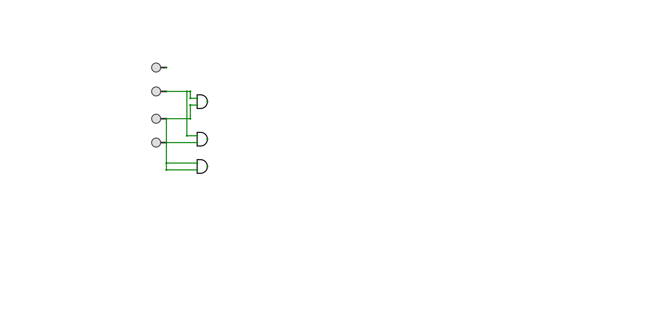
4.4 Worked Example
Worked Example 2: Constructing a logic circuit from a problem statement or logic expression
A AND ((B AND C) OR (B AND D) OR (C AND D))
A
B
C
D

Slide 31
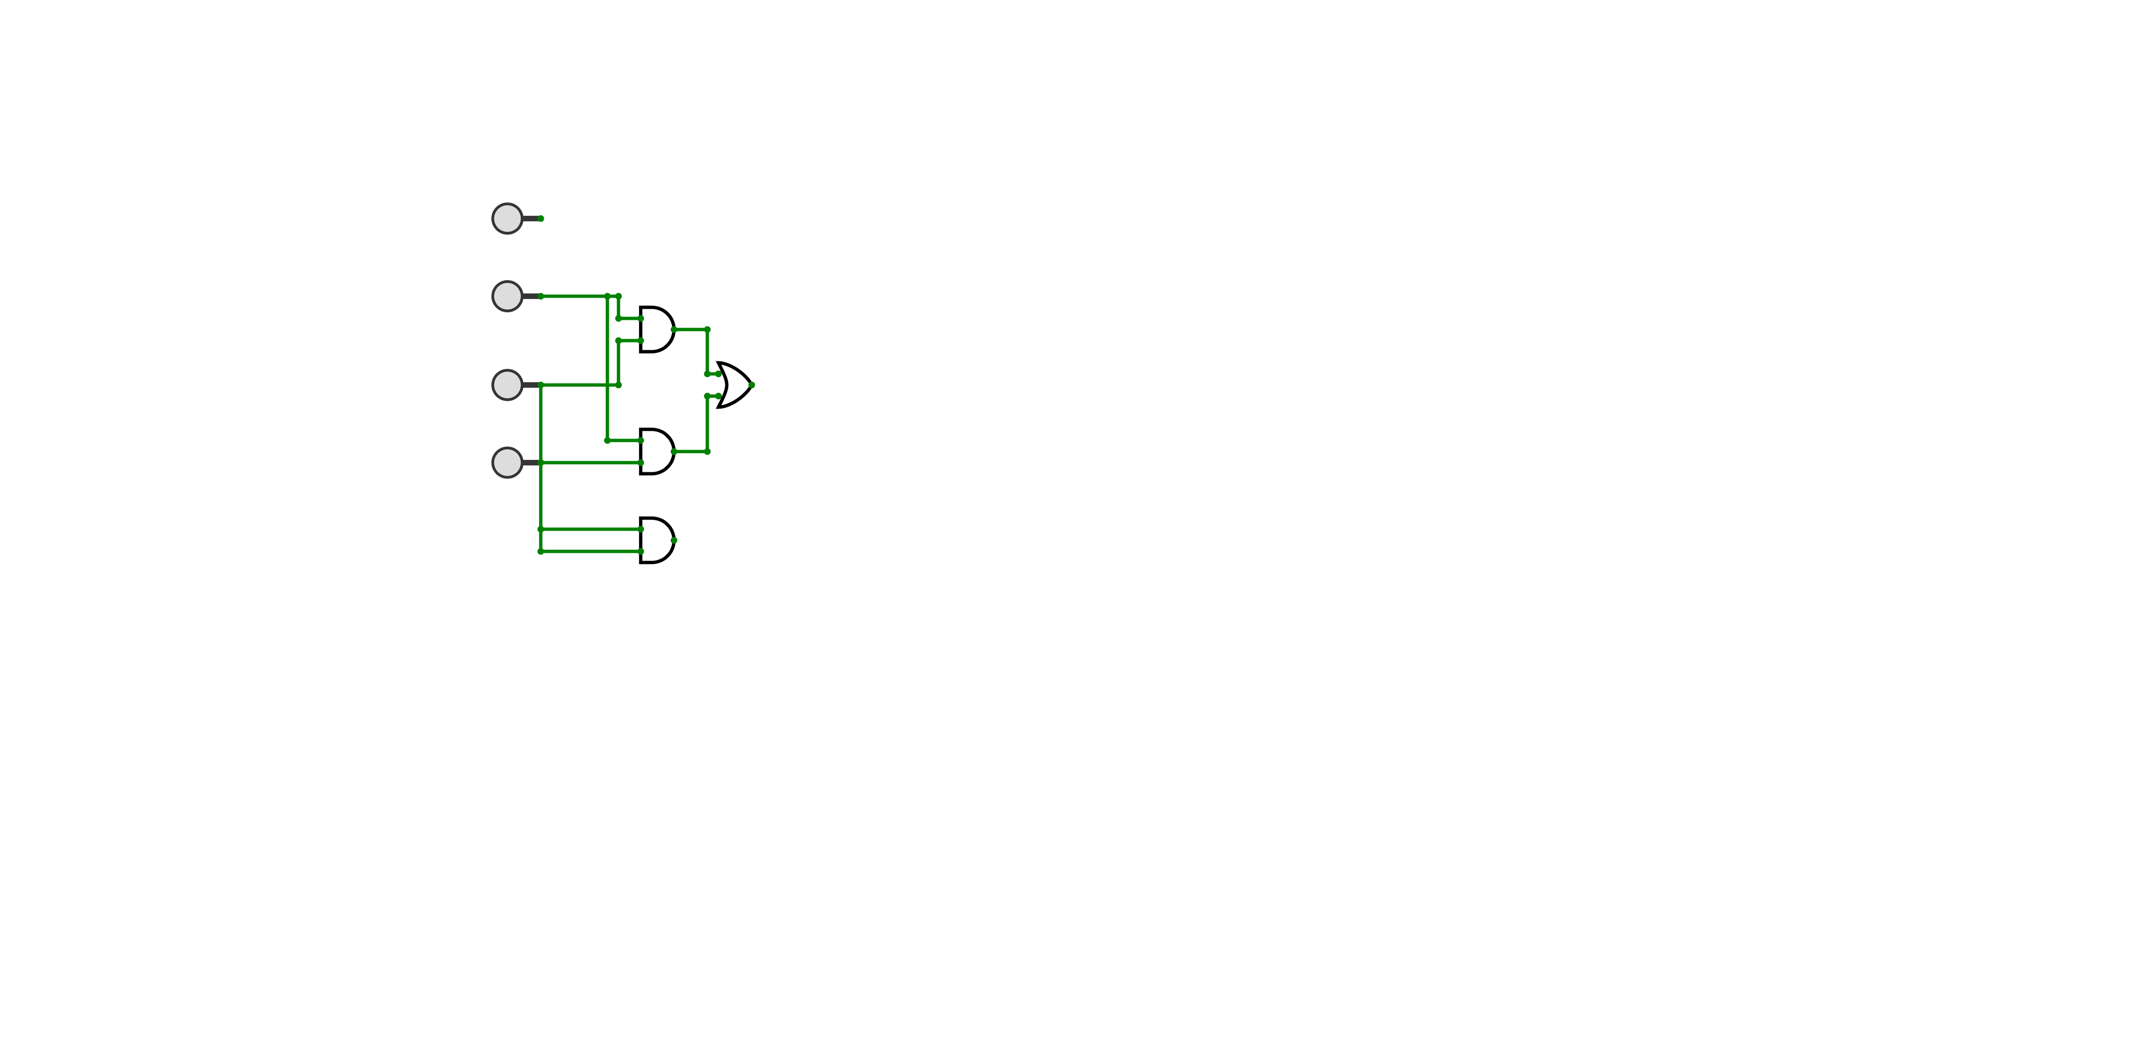
4.4 Worked Example
Worked Example 2: Constructing a logic circuit from a problem statement or logic expression
A AND ((B AND C) OR (B AND D) OR (C AND D))
A
B
C
D

Slide 32
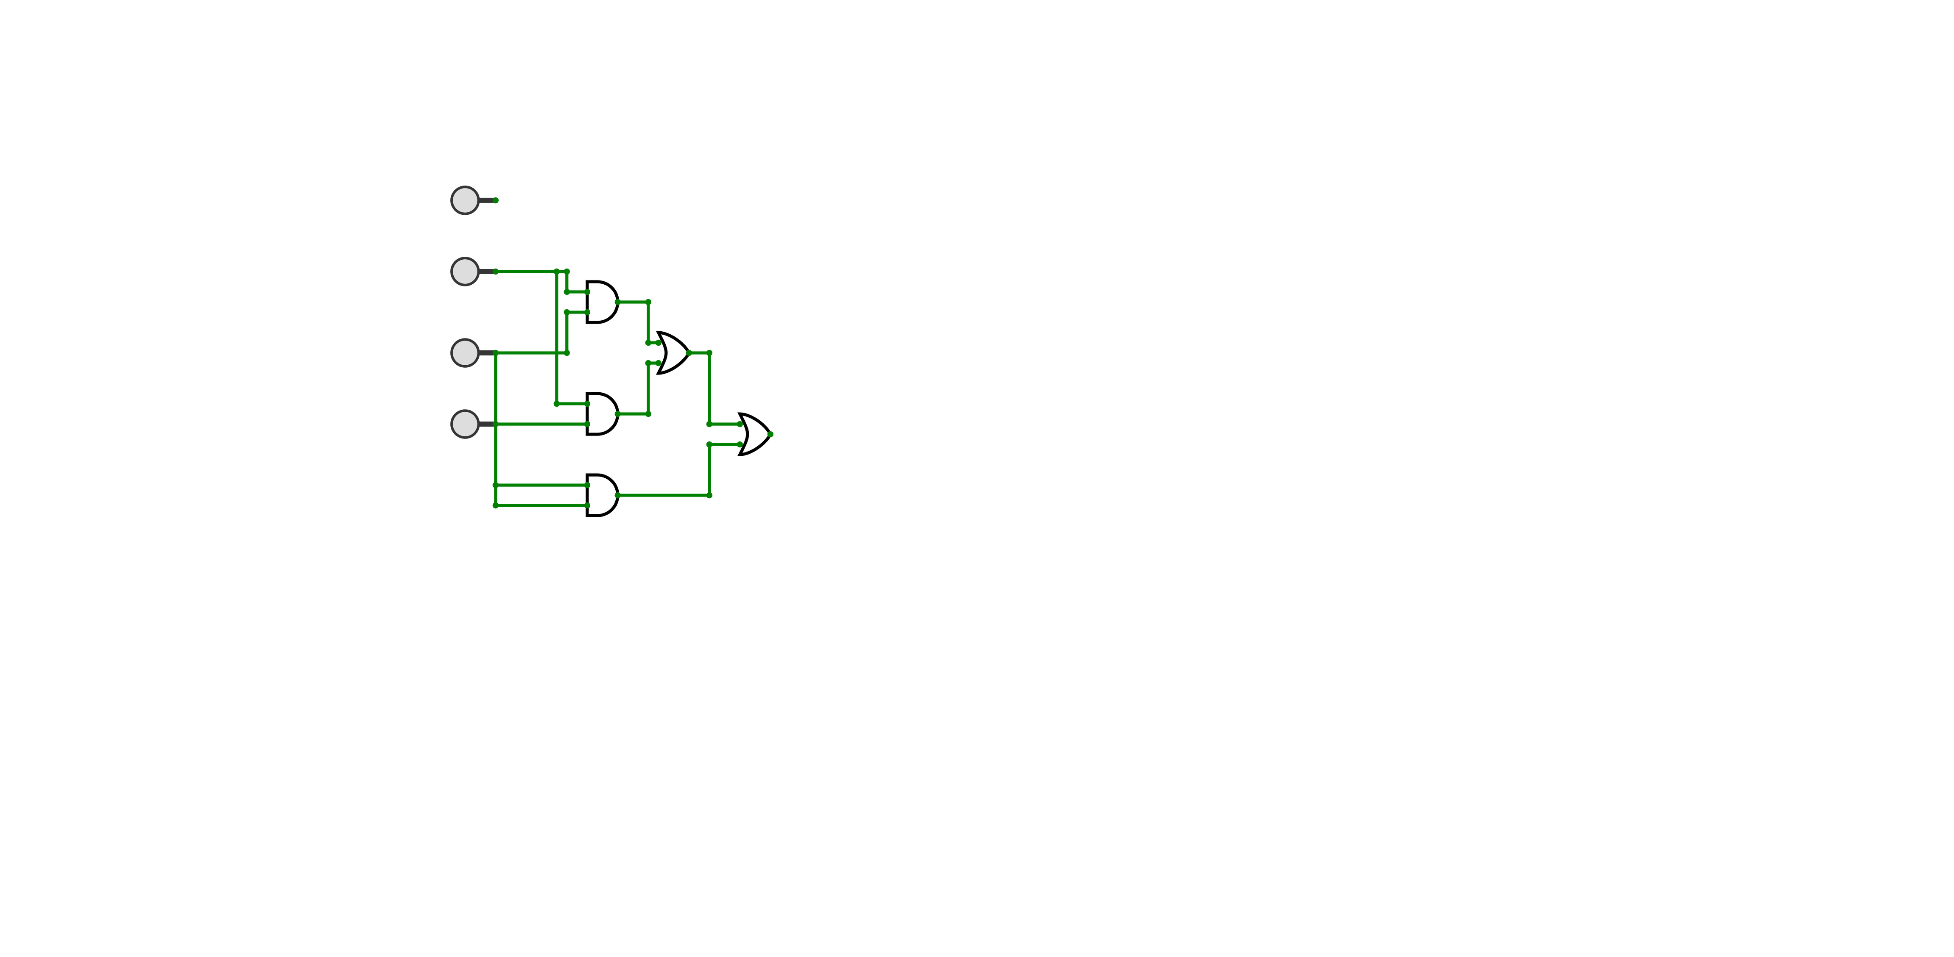
4.4 Worked Example
Worked Example 2: Constructing a logic circuit from a problem statement or logic expression
A AND ((B AND C) OR (B AND D) OR (C AND D))
A
B
C
D

Slide 33
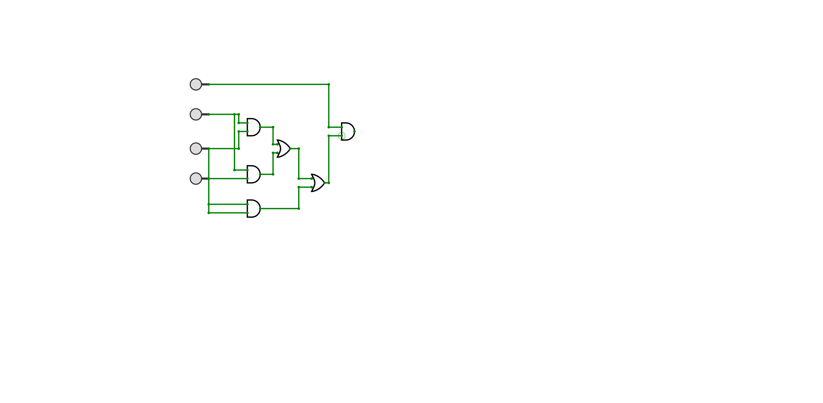
4.4 Worked Example
Worked Example 2: Constructing a logic circuit from a problem statement or logic expression
A AND ((B AND C) OR (B AND D) OR (C AND D))
A
B
C
D

Slide 34
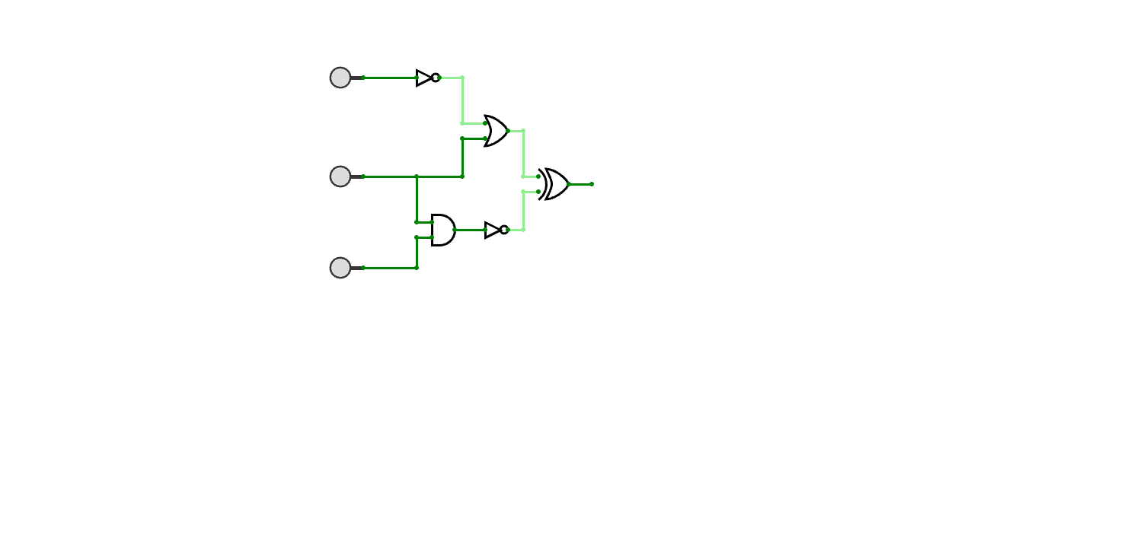

4.4 Worked Example
Worked Example 3: Construct a truth table from a logic circuit
A
INPUT
Intermediate Output
OUTPUT
B
C
A
0
0
0
0
1
0
1
0
B
0
1
1
0
0
0
1
0
1
1
1
0
C
1
1
1
1

Slide 35
4.4 Worked Example
Worked Example 3: Construct a truth table from a logic circuit
P
A
R
Step 1: Identify all the intermediate outputs
B
Q
S
C

Slide 36
4.4 Worked Example
Worked Example 3: Construct a truth table from a logic circuit
Step 2: Identify the result of each intermediate output
P
A
INPUT
Intermediate Output
OUTPUT
B
P
A
C
R
0
0
0
0
1
0
1
0
0
B
1
1
0
0
0
Q
1
S
0
1
1
1
0
1
C
1
1
1

Slide 37
4.4 Worked Example
Worked Example 3: Construct a truth table from a logic circuit
Step 2: Identify the result of each intermediate output
P
A
INPUT
Intermediate Output
OUTPUT
B
P
A
C
R
0
0
1
0
0
1
1
0
1
0
1
0
B
1
1
1
0
0
0
Q
1
0
S
0
0
1
1
1
0
1
0
C
1
0
1
1

Slide 38
4.4 Worked Example
Worked Example 3: Construct a truth table from a logic circuit
Step 2: Identify the result of each intermediate output
P
A
INPUT
Intermediate Output
OUTPUT
B
C
P
Q
A
R
0
0
1
0
0
1
1
0
1
0
1
0
B
1
1
1
0
0
0
0
Q
1
S
0
1
0
1
1
0
0
1
C
1
1
0
1

Slide 39
4.4 Worked Example
Worked Example 3: Construct a truth table from a logic circuit
Step 2: Identify the result of each intermediate output
P
A
INPUT
Intermediate Output
OUTPUT
B
C
P
Q
A
R
0
0
1
0
0
0
1
1
0
0
1
0
1
0
0
B
1
1
1
1
0
0
0
0
0
Q
1
S
0
1
0
0
1
1
0
0
0
1
C
1
1
0
1
1

Slide 40
4.4 Worked Example
Worked Example 3: Construct a truth table from a logic circuit
Step 2: Identify the result of each intermediate output
P
A
INPUT
Intermediate Output
OUTPUT
C
Q
R
A
B
P
R
0
0
0
1
0
0
0
1
1
0
0
1
0
1
0
B
1
0
1
1
1
Q
1
0
0
0
0
S
1
0
1
0
0
1
1
0
0
0
C
1
1
1
0
1

Slide 41
4.4 Worked Example
Worked Example 3: Construct a truth table from a logic circuit
Step 2: Identify the result of each intermediate output
P
A
INPUT
Intermediate Output
OUTPUT
C
Q
R
A
B
P
R
0
0
0
1
0
1
0
0
1
1
0
1
0
1
0
1
0
1
B
1
1
0
1
1
1
Q
1
0
0
0
0
0
S
1
0
1
0
0
0
1
1
0
0
0
1
C
1
1
1
0
1
1

Slide 42
4.4 Worked Example
Worked Example 3: Construct a truth table from a logic circuit
Step 2: Identify the result of each intermediate output
P
A
INPUT
Intermediate Output
OUTPUT
C
Q
R
S
A
P
B
R
0
0
1
0
1
0
0
1
1
0
1
0
0
0
1
0
1
1
B
1
0
1
1
1
1
1
0
0
0
0
Q
0
S
1
1
0
0
0
0
1
0
0
0
1
1
C
1
1
0
1
1
1

Slide 43
4.4 Worked Example
Worked Example 3: Construct a truth table from a logic circuit
Step 2: Identify the result of each intermediate output
P
A
INPUT
Intermediate Output
OUTPUT
C
Q
R
S
A
P
B
R
0
0
1
0
1
1
0
0
1
1
0
1
1
0
0
0
1
0
1
1
1
B
1
0
0
1
1
1
1
1
0
0
0
0
1
Q
0
S
1
1
0
0
0
1
0
1
0
0
0
1
1
1
C
1
1
0
1
1
0
1

Slide 44
4.4 Worked Example
Worked Example 3: Construct a truth table from a logic circuit
Step 3: Find out the final output.
P
A
INPUT
Intermediate Output
OUTPUT
C
Q
X
A
P
R
S
B
R
0
0
1
0
1
1
0
0
1
1
0
1
1
0
0
0
1
0
1
1
1
B
0
1
1
1
1
0
1
1
0
0
0
1
Q
0
0
S
1
1
0
0
0
1
0
1
0
0
0
1
1
1
C
1
1
0
1
1
0
1

Slide 45
4.4 Worked Example
Worked Example 3: Construct a truth table from a logic circuit
Step 3: Find out the final output.
P
A
INPUT
Intermediate Output
OUTPUT
C
Q
X
A
P
R
S
B
R
0
0
1
0
1
1
0
0
0
1
1
0
1
1
0
0
0
0
1
0
1
1
0
1
B
1
0
1
1
1
1
0
1
1
0
0
0
1
1
Q
0
0
S
1
1
0
0
0
1
1
0
1
0
0
0
1
1
0
1
C
1
1
0
1
1
0
1
1

Slide 46
4.4 Worked Example
Worked Example 4: Construct a logic circuit based on a truth table
INPUT
OUTPUT
A
B
C
X
0
0
0
1
Step 1: Identify rows in which the output is 1
Step 2: Form a logical expression from each of these rows using an OR statement
Step3: Combine all the logical expressions created using an AND statement
0
0
1
0
0
1
0
0
0
1
1
0
1
0
0
0
1
0
1
1
1
1
0
1
1
1
1
0

Slide 47
4.4 Worked Example
Worked Example 4: Construct a logic circuit based on a truth table
INPUT
OUTPUT
A
B
C
X
Step 1: Identify rows in which the output is 1
Step 2: Form a logical expression from each of these rows using an OR statement
Step3: Combine all the logical expressions created using an AND statement
0
0
0
1
0
0
1
0
0
1
0
0
0
1
1
0
1
0
0
0
1
0
1
1
1
1
0
1
1
1
1
0

Slide 48



4.4 Worked Example
Worked Example 4: Construct a logic circuit based on a truth table
INPUT
OUTPUT
Step 1: Identify rows in which the output is 1
Step 2: Form a logical expression from each of these rows using an AND statement
*if the input value is a 0, we add a NOT gate (eg. NOT A)
Step3: Combine all the logical expressions created using an OR statement
A
B
C
X
0
0
0
1
0
0
1
0
1
0
0
NOT A AND NOT B AND NOT C
0
0
1
1
0
A AND NOT B AND C
1
0
0
0
A AND B AND NOT C
1
0
1
1
1
1
0
1
1
1
1
0

Slide 49
4.4 Worked Example
Worked Example 4: Construct a logic circuit based on a truth table
INPUT
OUTPUT
Step 1: Identify rows in which the output is 1
Step 2: Form a logical expression from each of these rows using an AND statement
*if the input value is a 0, we add a NOT gate (eg. NOT A)
Step3: Combine all the logical expressions created using an OR statement
A
B
C
X
0
0
0
1
0
0
1
0
1
0
0
NOT A AND NOT B AND NOT C
0
0
1
1
0
A AND NOT B AND C
1
0
0
0
A AND B AND NOT C
1
0
1
1
1
1
0
1
1
1
1
0

Slide 50
4.4 Worked Example
Worked Example 4: Construct a logic circuit based on a truth table
INPUT
OUTPUT
Step 1: Identify rows in which the output is 1
Step 2: Form a logical expression from each of these rows using an AND statement
*if the input value is a 0, we add a NOT gate (eg. NOT A)
Step3: Combine all the logical expressions created using an OR statement
A
B
C
X
0
0
0
1
0
0
1
0
0
1
0
0
0
1
1
0
(NOT A AND NOT B AND NOT C)
1
0
0
0
OR
(A AND NOT B AND C)
1
0
1
1
OR
1
1
0
1
(A AND B AND NOT C)
1
1
1
0

Slide 51
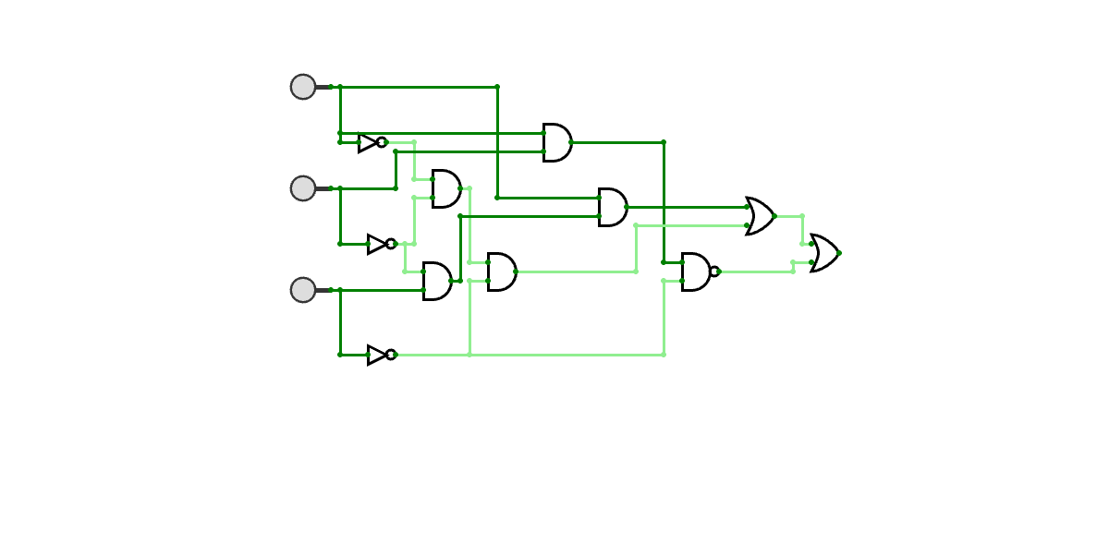
4.4 Worked Example
Worked Example 4: Construct a logic circuit based on a truth table
(NOT A AND NOT B AND NOT C)
OR
(A AND NOT B AND C)
OR
(A AND B AND NOT C)

