Slide 1
Cambridge International
AS Level Computer Science
(9618) – Revision Notes
Hardware
This pack is intended for students to who are taking CIE AS Level in Computer Science, either in preparation for their AS exam, or more likely alongside year 2 of the course to improve fluency, recall and pace on AS topics. It could be used as lesson starters, or supplied to students for independent use.

Slide 2
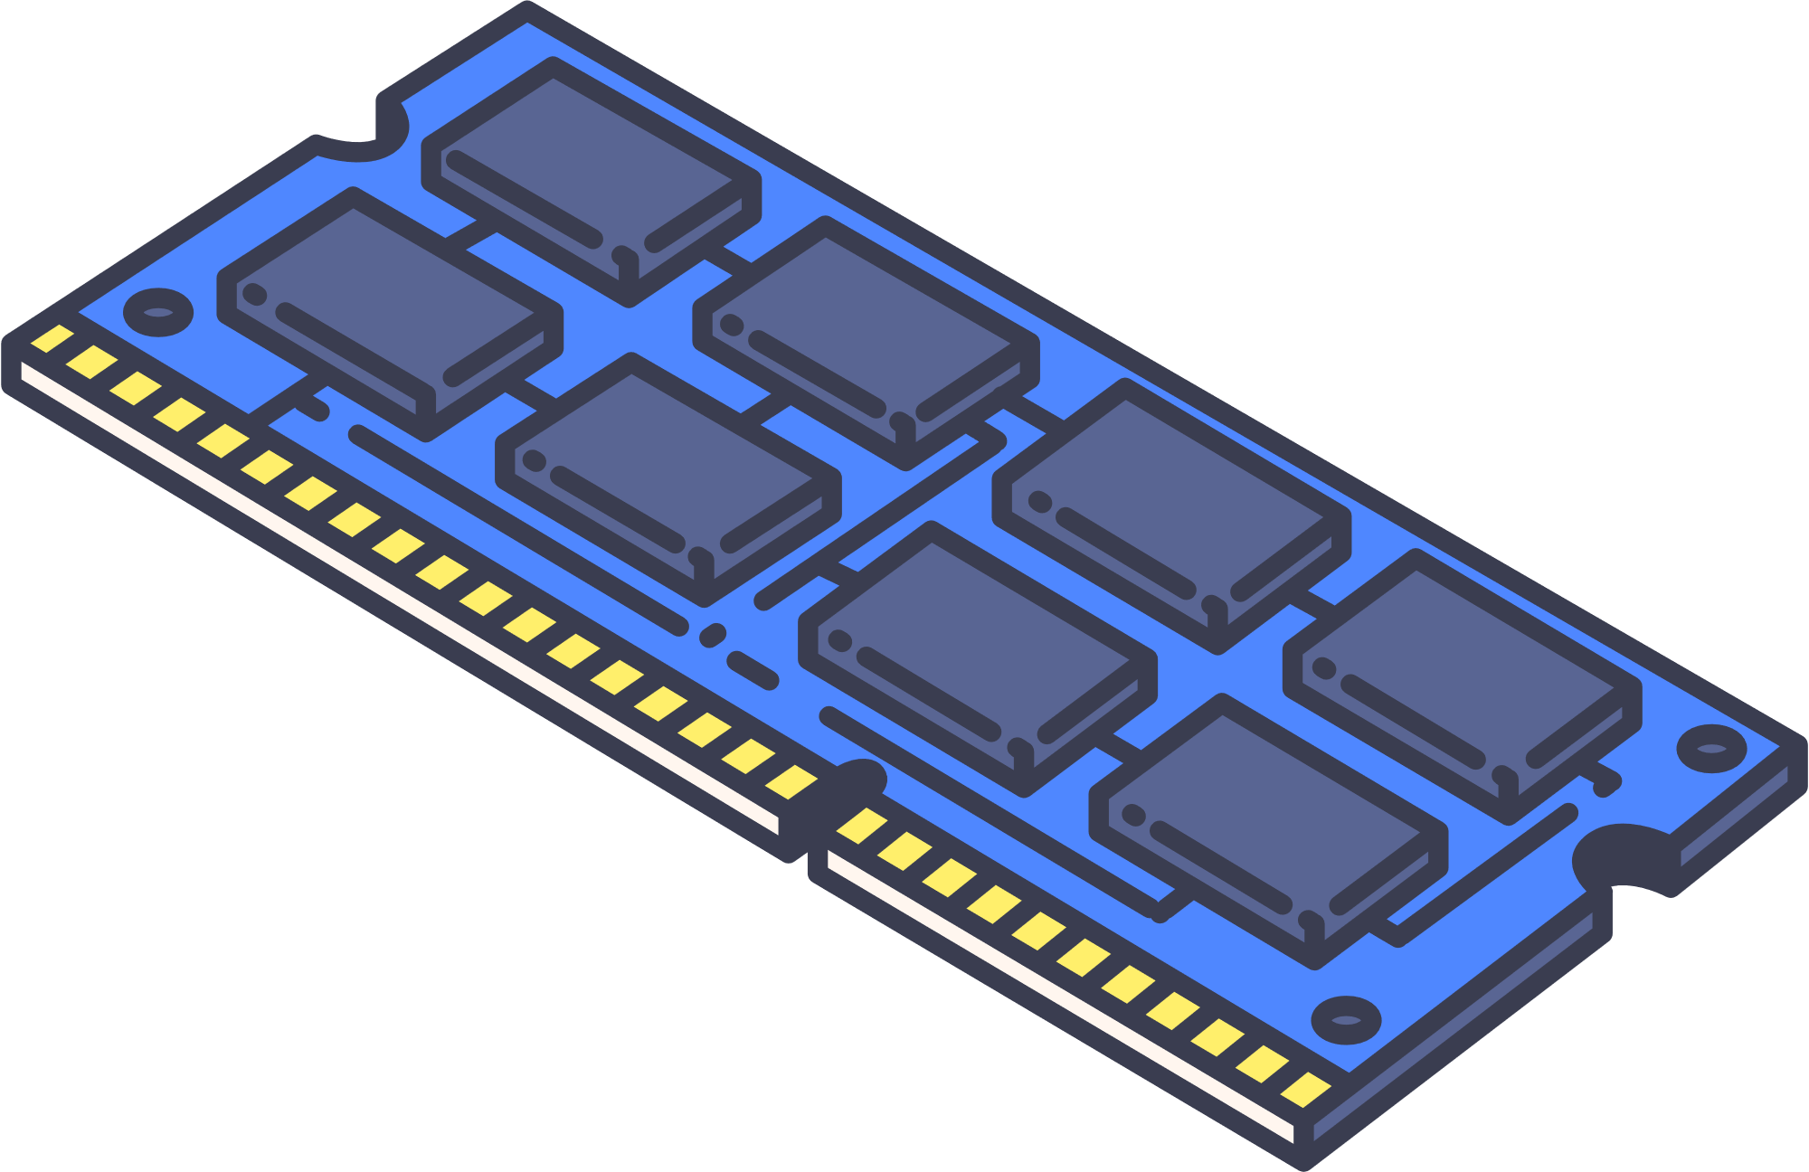


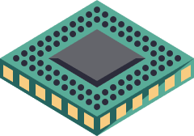

Chapter
3
Hardware
A LEVEL COMPUTER SCIENCE

Slide 3



3.1
3.2
Fundamentals of Computer Hardware Operations
Embedded Systems and Applications
3.3
Primary Memory:
RAM and ROM
3.4
Secondary storage devices
Chapter
Outline
3.5
Input Devices: Data Entry and Control
3.6
3.7
Output Devices: Data Display and Communication
Sound Input and Output Systems

Slide 4

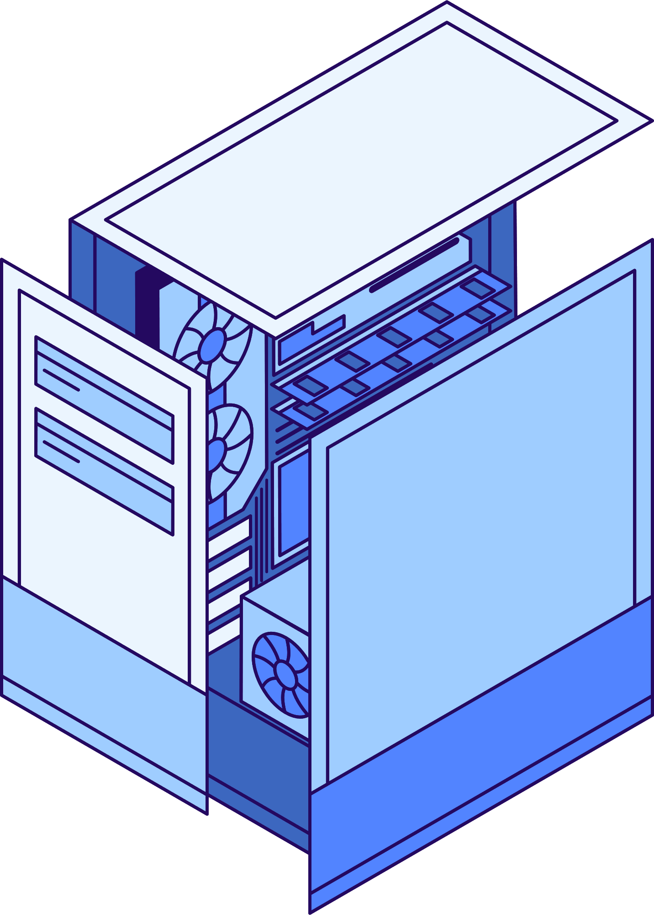






3.1 Fundamentals of Computer Hardware Operations
Computer System
A computer system has to support the following operational capability:
Processing of data
Input of data
Output of data
Storage
of data

Slide 5


3.1 Fundamentals of Computer Hardware Operations
von Neumann architecture
The von Neumann architecture is a computer design that incorporates a single memory to store both data and instructions, with a central processing unit (CPU) that can sequentially fetch, decode, and execute these instructions.
CONTROL BUS
Central Processing Unit (CPU)
DATA BUS
CU
MAR
ADDRESS BUS
PC
MDR
CIR
ALU
ACC
CACHE
Input
Memory Unit (RAM)
Output
Load executable code when needed
Secondary Storage
(HDD, SSD, Removable Disk, CD)

Slide 6

3.1 Fundamentals of Computer Hardware Operations
Storage of Data
The following are the components for storage of data.
CONTROL BUS
Central Processing Unit (CPU)
DATA BUS
MAR
ADDRESS BUS
CU
PC
Registers
MDR
CIR
ALU
ACC
CACHE
Input
Output
Memory Unit (RAM)
Load executable code when needed
Secondary Storage
(HDD, SSD, Removable Disk, CD)

Slide 7
3.1 Fundamentals of Computer Hardware Operations
Storage of Data
The memory hierarchy serves as a valuable concept when deciding on the elements to employ in a computer system for storing data.
Central Processing Unit (CPU)
CU
MAR
PC
Registers
MDR
CIR
ALU
ACC
CACHE
Processor component
Registers
Input
Memory Unit (RAM)
Output
Primary Storage
Cache Memory
Main Memory
Load executable code when needed
Secondary Storage
Hard Disk
Auxiliary
Storage
Secondary Storage
(HDD, SSD, Removable Disk, CD)

Slide 8
3.1 Fundamentals of Computer Hardware Operations
Storage of Data
Access time
Capacity
Size
Cost
MAR
PC
Registers
MDR
CIR
ACC
Cache
Memory Unit (RAM)
Secondary Storage
(HDD, SSD, Removable Disk, CD)
Auxiliary Storage

Slide 9
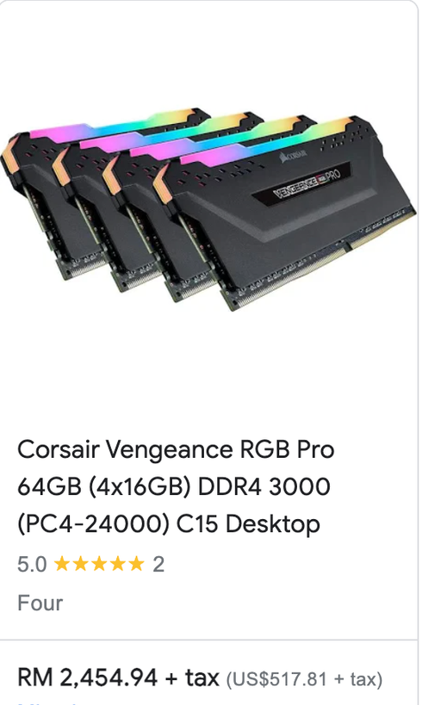
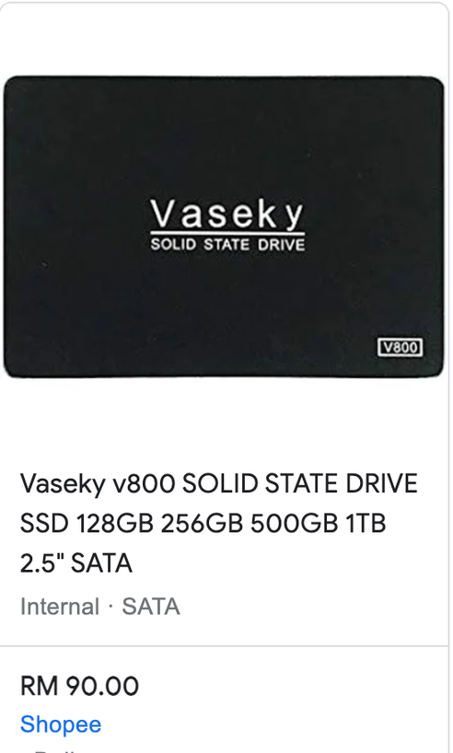
3.1 Fundamentals of Computer Hardware Operations
Storage of Data

Slide 10
3.1 Fundamentals of Computer Hardware Operations
Storage of Data
Function vs Hardware
A storage device that is an integral part of the system
Hard Disk or Solid State Drive
An individual storage object that can be placed into a computer system's drive
Floppy disk, optical disc, magnetic tape cartridge
Peripheral device that can be connected to the system when needed
Hard drive, memory stick/card
Portable memory device that can be carried around
Flash memory stick, floppy disk, optical disc
Remote from the system, accessible via a network connection
Cloud storage, magnetic tape

Slide 11




3.1 Fundamentals of Computer Hardware Operations
Output device
When it comes to data output from a computer system, you have the following choices:
Screen
Speaker
Writing to data storage device
Virtual Headset Display
etc.
Printer

Slide 12
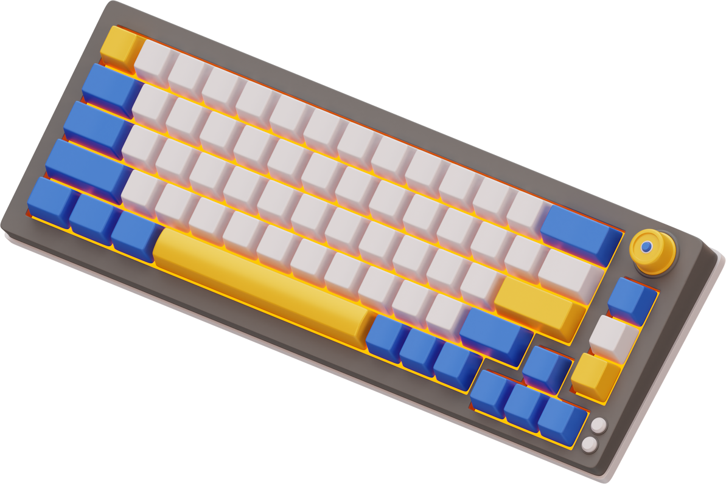
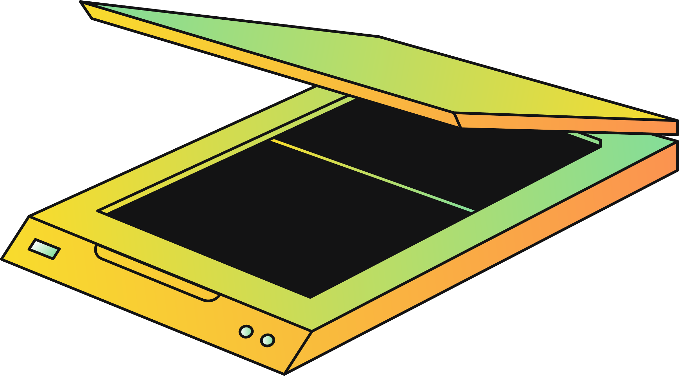



3.1 Fundamentals of Computer Hardware Operations
Input device
When it comes inputting data into a computer system, you have the following choices:
Keyboard
Scanner
Reading from data storage devices
Touch Screen
Microphone
etc.

Slide 13
Subtopic 1
3.2 Embedded Systems and Applications
Definition
An embedded system is a specialised computer system designed to perform dedicated functions within a larger electronic or mechanical system. Their characteristics:
Structure: It must contain a processor, memory and an I/O capability.
Purpose: They are special-purpose, possibly performing only a single function.
Input
Processor
Output
Memory
*If these systems are built on a single integrated circuit, they are referred to as microprocessors.

Slide 14

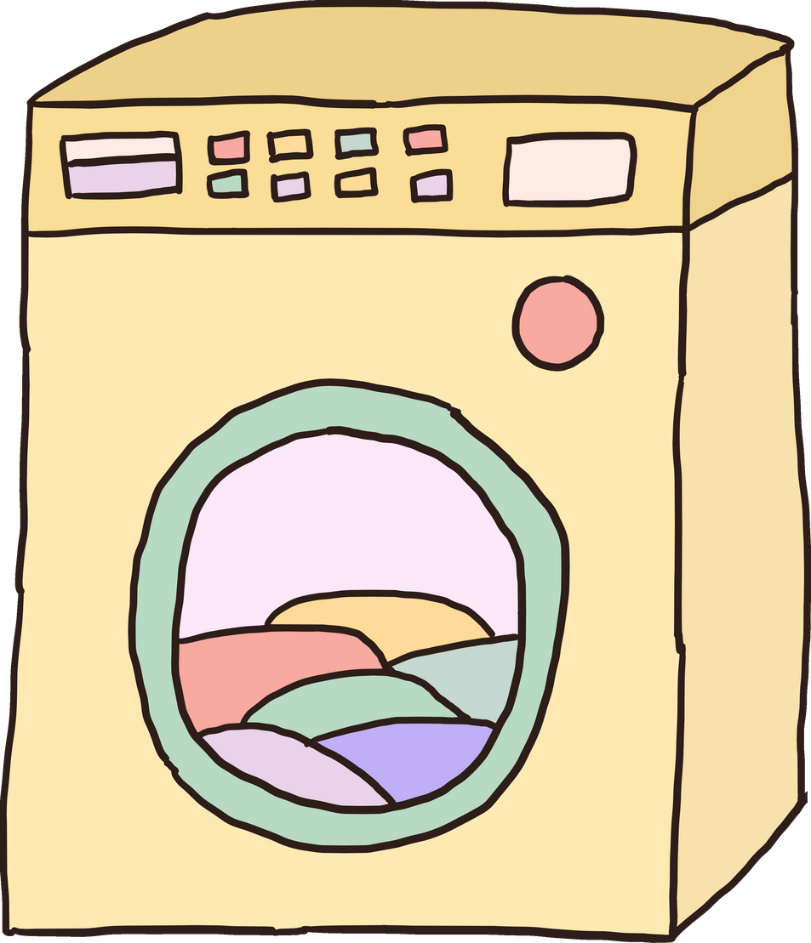
Subtopic 1
3.2 Embedded Systems and Applications
Examples of Embedded Systems
Input
Output
Input
Memory
Processor
Memory
Processor
Output
Vending Machine
Washing Machine

Slide 15
Subtopic 1
3.2 Embedded Systems and Applications
Advantages
These systems are typically designed for a specific purpose and may specialize in executing just one function.
Due to economies of scale, these chips can be relatively cheap.
Disadvantages
Past
Now
Embedded systems are integral components of the Internet of Things (IoT), and as more of these embedded systems become connected to networks, their security measures may be less robust, making them susceptible to unauthorized actions.
Program has to be short as the memory space available is limited.

Slide 16

3.3 Primary Memory: RAM and ROM
Big Picture
CONTROL BUS
Central Processing Unit (CPU)
DATA BUS
MAR
ADDRESS BUS
CU
PC
Registers
MDR
CIR
ALU
ACC
CACHE
Input
Output
Memory Unit (RAM)
Load executable code when needed
Secondary Storage
(HDD, Optical Media,SSD)

Slide 17

3.3 Primary Memory: RAM and ROM
Random Access Memory (RAM)
Central Processing Unit (CPU)
RAM (Random Access Memory) is a type of computer memory that provides high-speed data access to temporarily store and retrieve data that the CPU (Central Processing Unit) can quickly work with during computer operations.
CU
MAR
PC
MDR
ALU
CIR
ACC
CACHE
Memory
0
8
Also known as direct-access memory
0
9
2
10
3
11
It loses its stored data when the computer's power is turned off or interrupted.
0
12
...
0
13
0
99
0
100
Load 10
101
Add 11
102
Store 12
103

Slide 18

3.3 Primary Memory: RAM and ROM
Types of RAM
DRAM (Dynamic RAM)
SRAM (Static RAM)
is a type of volatile computer memory that stores data in capacitors within cells and requires periodic refreshing to maintain data integrity,
is a type of volatile computer memory that stores data using flip-flops, allowing for faster access and lower power consumption compared to DRAM
+
Cheaper
+
Shorter access time
+
Requires fewer electronic components per bit stored

Slide 19

3.3 Primary Memory: RAM and ROM
Types of RAM
CONTROL BUS
Central Processing Unit (CPU)
DATA BUS
MAR
ADDRESS BUS
CU
PC
Registers
MDR
CIR
ALU
ACC
CACHE
SRAM
*Embedded system that only requires a small amount of RAM also uses SRAM.
Input
Output
Memory Unit (RAM)
DRAM
Load executable code when needed
Secondary Storage
(HDD, SSD, Removable Disk, CD)

Slide 20

3.3 Primary Memory: RAM and ROM
Read Only Memory (ROM)
Shares the random-access or direct access properties of RAM.
Cannot be written to when in use within the computer system.
Used to store bootstrap program (startup file). The program run immediately when a system is switched on.
So, while ROM is an important component of a computer system, it is not part of the core von Neumann architecture.
Highlighter

Slide 21

3.3 Primary Memory: RAM and ROM
Types of ROM
Simple ROM
Installed as part of the manufacturing process.
Chips need to be replaced if different contents are needed.

Slide 22

3.3 Primary Memory: RAM and ROM
Types of ROM
Programmable ROM (PROM)
Simple ROM
Installed as part of the manufacturing process.
Allow program to be written to by a system builder once.
Chips need to be replaced if different contents are needed.
After installation, data becomes permanent and cannot be changed or erased

Slide 23
3.3 Primary Memory: RAM and ROM
Types of ROM
Programmable ROM (PROM)
Simple ROM
Installed as part of the manufacturing process.
Allow program to be written to by a system builder once.
Chips need to be replaced if different contents are needed.
After installation, data becomes permanent and cannot be changed or erased
Erasable
PROM
Data/program in place can be deleted using ultraviolet light.
A new program can be loaded, but the chip must be taken out of the circuit.

Slide 24
3.3 Primary Memory: RAM and ROM
Types of ROM
Programmable ROM (PROM)
Simple ROM
Installed as part of the manufacturing process.
Allow program to be written to by a system builder once.
Chips need to be replaced if different contents are needed.
After installation, data becomes permanent and cannot be changed or erased
Erasable
PROM
Electrically EPROM
Data/program in place can be deleted using ultraviolet light.
Electricity is used to remove existing data.
A new program can be loaded, but the chip must be taken out of the circuit.
The chip can stay in the circuit as its contents are modified.
Highlighter

Slide 25


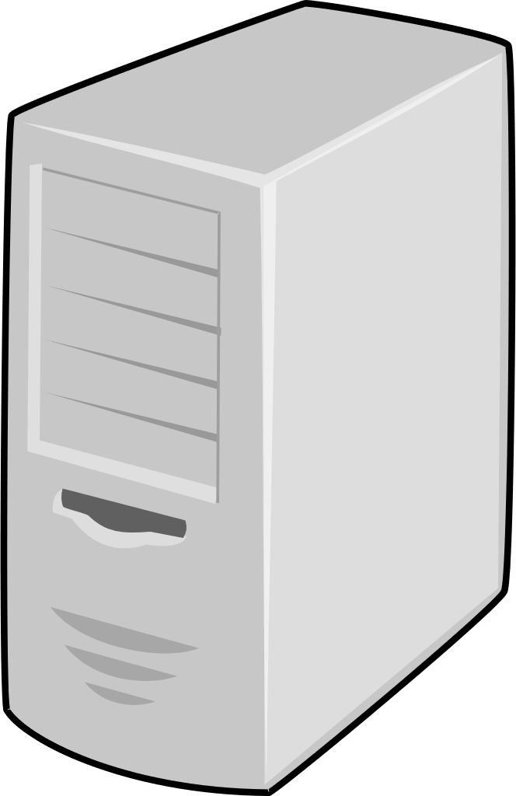


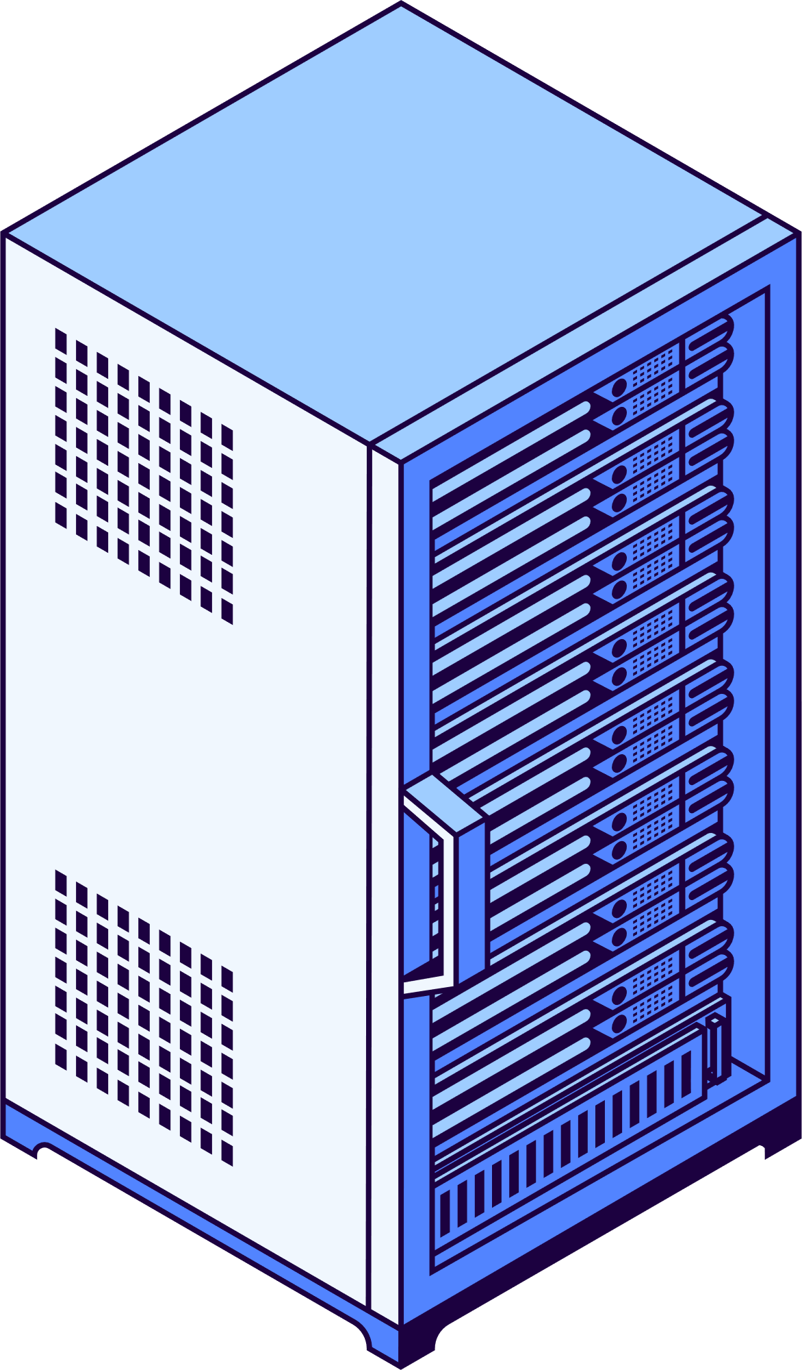


3.3 Primary Memory: RAM and ROM
Buffer
When data is sent from one computer to another, problem arises if data is sent more quickly than it can be received.
The solution is to use a buffer. A buffer acts as a temporary storage and operates as a queue for data moving between system components.
Typically, buffer is created in the computer memory.
010101010
010010111
High-water mark
Low-water mark

Slide 26



3.4 Secondary storage device
Big Picture
CONTROL BUS
Central Processing Unit (CPU)
DATA BUS
MAR
ADDRESS BUS
CU
PC
Registers
MDR
CIR
ALU
ACC
CACHE
Input
Output
Memory Unit (RAM)
Load executable code when needed
Secondary Storage
(HDD, Optical Media,SSD)

Slide 27
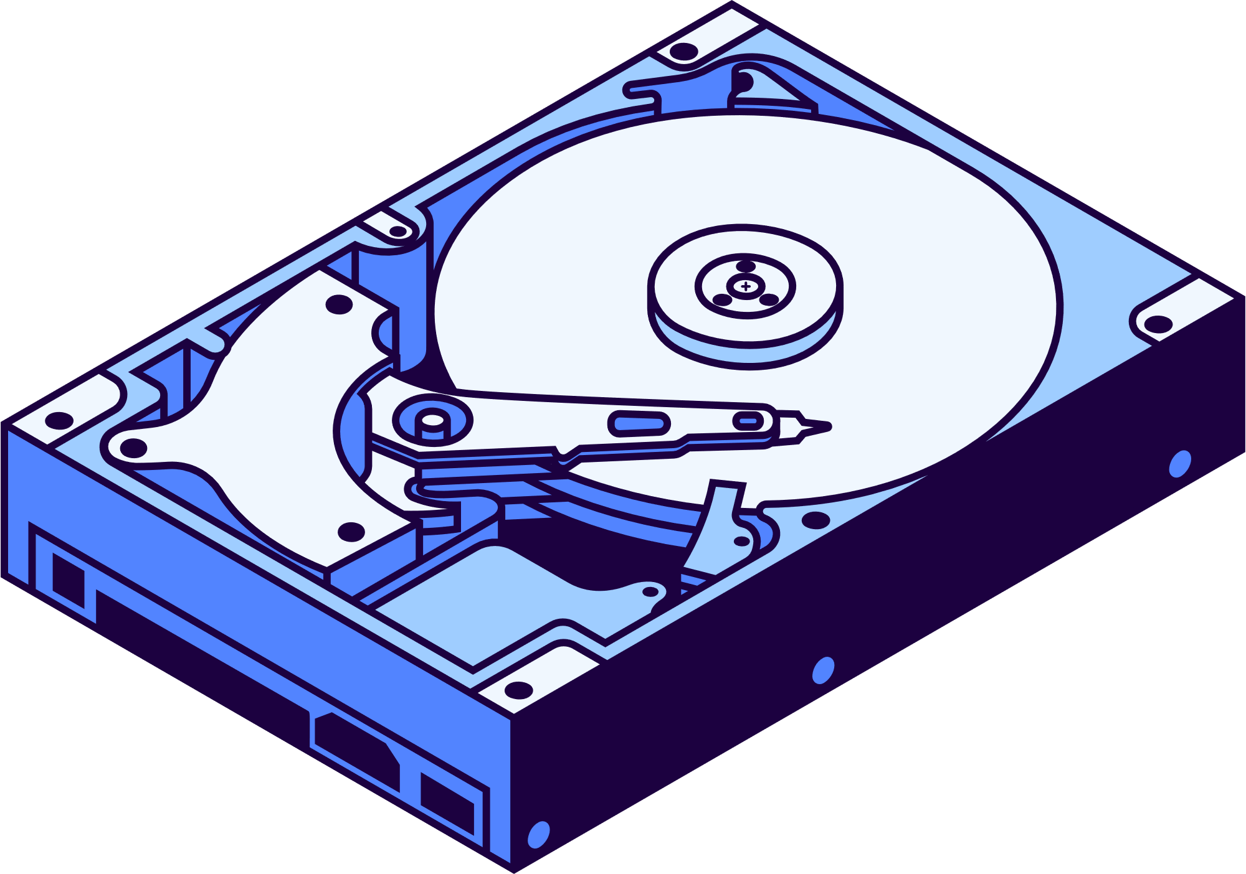
3.4 Secondary storage device
Magnetic Media
Magnetic media refers to storage devices that use magnetic patterns to encode and store digital data, such as hard disk drives and magnetic tapes.

Slide 28
3.4 Secondary storage device
Magnetic Media
How?
Read-Write head
Read head
Write head
The read head is a component in magnetic media storage that senses and interprets the magnetic orientation (North / South) on the storage medium to retrieve stored data.
The write head is a component in magnetic media storage that generates magnetic patterns on the storage medium, encoding digital data onto it during the writing or recording process.

Slide 29
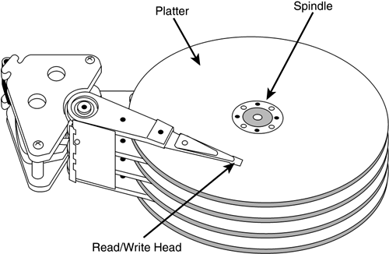

3.4 Secondary storage device
All the platters rotate at a synchronized speed.
The movement of each read-write head is coordinated or synchronized with the motion of the other heads.
The actuator arms are responsible for attaching the read-write heads and enabling them to traverse the platter surfaces.
0101011
There is more than 1 platter
There is a read-write head on each side of every platter.

Slide 30
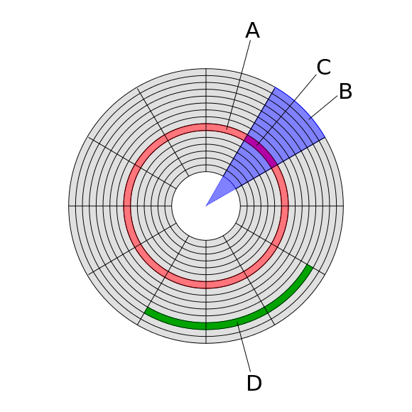
3.4 Secondary storage device
Track
Single Disk
Circular paths on the HDD's surface used to organise data.
Sector
Small storage units within tracks, typically 512 bytes.
Due to the synchronized motion of the heads, it's possible for related data to be stored on the same tracks across different disks.
Block
Groups of consecutive sectors used for file storage and management.

Slide 31
3.4 Secondary storage device
Defragmentation
Track
When storing a file, you need to allocate a necessary number of sectors, but they may not necessarily be contiguous (next to each other).
011010
Sector
011010
011010
011010
011010
011010
011010
011010
011010
Block

Slide 32
3.4 Secondary storage device
Defragmentation
Track
When storing a file, you need to allocate a necessary number of sectors, but they may not necessarily be contiguous (next to each other).
011010
Sector
011010
011010
011010
011010
011010
011010
011010
011010
011010
011010
011010
Block

Slide 33
3.4 Secondary storage device
Defragmentation
Sector
As files are created, deleted, or edited, the utilisation of sectors becomes more fragmented over time, leading to a degradation in disk performance.
Track
011010
011010
011010
011010
011010
011010
011010
011010
011010
011010
011010
011010
011010
011010
011010
Block

Slide 34
3.4 Secondary storage device
Defragmentation
Track
A defragmentation program can rearrange how sectors are allocated to files, restoring disk performance.
Sector
011010
011010
011010
011010
011010
011010
011010
011010
011010
011010
011010
011010
011010
011010
011010
Block

Slide 35
3.4 Secondary storage device
Hard Disk
Track
A hard disk is classified as a direct-access read-write device since any sector can be selected for reading or writing. However, it's important to note that the data within a sector must be read sequentially.
Sector
011010
011010
011010
011010
011010
011010
011010
011010
011010
011010
011010
011010
011010
011010
011010
Block

Slide 36






3.4 Secondary storage device
Optical Media
Optical media is a storage medium that uses laser technology to read and write data on discs, including formats like CDs, DVDs, and Blu-ray discs.
Evolution
CD - Read only
(Compact Disc)
CD - Read and Write
(Compact Disc)
DVD
(Digital Versatile Disc)
BD
Blu-ray Disc

Slide 37



3.4 Secondary storage device
How it works
The optical disc features a single continuous spiral pathway that extends from the innermost part of the surface to the outer periphery.
*Simplified version

Slide 38


3.4 Secondary storage device
How it works
The optical disc features a single continuous spiral pathway that extends from the innermost part of the surface to the outer periphery.
During operation, the disc spins. Simultaneously the laser moves across ensuring that it is continuously focused on the spiral track.
*Simplified version

Slide 39

3.4 Secondary storage device
How it works
The laser beam bounces off the disc's surface through reflection. Pits are interpreted as binary 0, while lands (flat areas) are interpreted as binary 1 in the digital encoding of data on optical discs like CDs.
The surface of the disc contains features known as pits and lands within the track.
land = 1
pit = 0
*Simplified version
reflected

Slide 40
3.4 Secondary storage device
CD-RW, DVD-RW
CD-RW and DVD-RW use a unique alloy material as their reflective surface.
During the writing process (burning), laser heat turns the material into a liquid state.
The intensity of the laser determines whether the material becomes crystalline or amorphous when it cools.
During reading, laser light reflects from crystalline solids but not amorphous ones, enabling the encoding of 1s and 0s.

Slide 41
3.4 Secondary storage device
Property
The disc, despite having a single track, functions as a direct-access device.
This is possible because the laser can move both forward and backward along the track.
Data on the disc is organized into sectors, similar to how data is formatted on a magnetic hard disk.

Slide 42
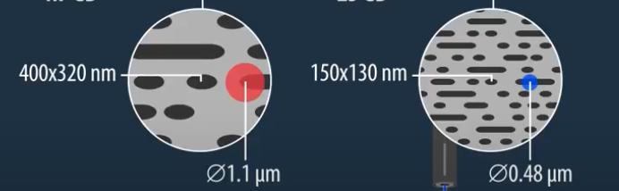
3.4 Secondary storage device
Changing Storage Capacity
Two ways
Speed of rotation
Wavelength of the light; Blue ray has shorter wavelength, allow more pits and lands to be gathered per unit area. Hence allowing more storage capacity.

Slide 43

3.4 Secondary storage device
Solid State Media
It is a semiconductor technology that has no moving parts.
The circuits comprise arrays of transistors functioning as memory cells.
000
000
001
001
010
010
NAND is the most commonly utilized technology due to its basic circuitry's similarity to that of a NAND logic gate.
011
Electrons
011
100
Electrons
100
Electrons
101
Electrons
101
Electrons
110
Electrons
110
Electrons
111
Electrons
111

Slide 44
3.4 Secondary storage device
Terms
x More
x More
x More
x More
x More
000
000
000
000
000
001
001
001
001
001
010
010
010
010
010
011
011
011
011
011
100
100
100
Electrons
100
Electrons
100
Electrons
101
Electrons
101
Electrons
101
Electrons
101
Electrons
101
Electrons
110
Electrons
110
Electrons
110
Electrons
110
Electrons
110
Electrons
111
Electrons
111
Electrons
111
111
111
000
000
000
000
000
001
001
001
001
001
010
010
010
010
010
011
011
011
011
011
100
100
100
Electrons
100
Electrons
100
x more
Electrons
101
Electrons
101
Electrons
101
Electrons
101
Electrons
101
000
Electrons
110
Electrons
110
Electrons
110
Electrons
110
Electrons
110
Electrons
111
Electrons
111
Electrons
111
111
111
001
000
000
000
000
000
001
001
001
001
001
010
010
010
010
010
010
011
011
011
011
011
100
100
100
Electrons
100
Electrons
100
011
Electrons
101
Electrons
101
Electrons
101
Electrons
101
Electrons
101
Electrons
110
Electrons
110
Electrons
110
Electrons
110
Electrons
110
100
Electrons
111
Electrons
111
Electrons
111
111
111
000
000
000
000
000
Electrons
101
001
001
001
001
001
010
010
010
010
010
Electrons
110
011
011
011
011
011
100
100
100
Electrons
100
Electrons
100
Electrons
101
Electrons
101
Electrons
101
Electrons
101
Electrons
101
Electrons
111
Electrons
110
Electrons
110
Electrons
110
Electrons
110
Electrons
110
Electrons
111
Electrons
111
Electrons
111
111
111
Memory cell
String
Page

Slide 45
3.4 Secondary storage device
Terms
x More
x More
x More
x More
x More
x More
x More
x More
x More
x More
x More
x More
x More
x More
x More
x More
000
000
000
000
000
000
000
000
000
000
000
000
000
000
000
000
001
001
001
001
001
001
001
001
001
001
001
001
001
001
001
001
010
010
010
010
010
010
010
010
010
010
010
010
010
010
010
010
011
011
011
011
011
011
011
011
011
011
011
011
011
011
011
011
100
100
100
100
100
100
100
100
100
100
100
100
100
100
Electrons
100
Electrons
100
Electrons
101
Electrons
101
Electrons
101
Electrons
101
Electrons
101
Electrons
101
Electrons
101
Electrons
101
Electrons
101
Electrons
101
Electrons
101
Electrons
101
Electrons
101
Electrons
101
Electrons
101
Electrons
101
Electrons
110
Electrons
110
Electrons
110
Electrons
110
Electrons
110
Electrons
110
Electrons
110
Electrons
110
Electrons
110
Electrons
110
Electrons
110
Electrons
110
Electrons
110
Electrons
110
Electrons
110
Electrons
110
Electrons
111
Electrons
111
Electrons
111
Electrons
111
Electrons
111
Electrons
111
Electrons
111
Electrons
111
Electrons
111
Electrons
111
Electrons
111
Electrons
111
Electrons
111
Electrons
111
111
111
000
000
000
000
000
000
000
000
000
000
000
000
000
000
000
000
001
001
001
001
001
001
001
001
001
001
001
001
001
001
001
001
010
010
010
010
010
010
010
010
010
010
010
010
010
010
010
010
011
011
011
011
011
011
011
011
011
011
011
011
011
011
011
011
100
100
100
100
100
100
100
100
100
100
100
100
x more
100
100
Electrons
100
Electrons
100
x more
Electrons
101
Electrons
101
Electrons
101
Electrons
101
x more
Electrons
101
Electrons
101
Electrons
101
Electrons
101
x more
Electrons
101
Electrons
101
Electrons
101
Electrons
101
Electrons
101
Electrons
101
Electrons
101
Electrons
101
Electrons
110
Electrons
110
Electrons
110
Electrons
110
Electrons
110
Electrons
110
Electrons
110
Electrons
110
Electrons
110
Electrons
110
Electrons
110
Electrons
110
Electrons
110
Electrons
110
Electrons
110
Electrons
110
Electrons
111
Electrons
111
Electrons
111
Electrons
111
Electrons
111
Electrons
111
Electrons
111
Electrons
111
Electrons
111
Electrons
111
Electrons
111
Electrons
111
Electrons
111
Electrons
111
111
111
000
000
000
000
000
000
000
000
000
000
000
000
000
000
000
000
001
001
001
001
001
001
001
001
001
001
001
001
001
001
001
001
010
010
010
010
010
010
010
010
010
010
010
010
010
010
010
010
011
011
011
011
011
011
011
011
011
011
011
011
011
011
011
011
100
100
100
100
100
100
100
100
100
100
100
100
100
100
Electrons
100
Electrons
100
Electrons
101
Electrons
101
Electrons
101
Electrons
101
Electrons
101
Electrons
101
Electrons
101
Electrons
101
Electrons
101
Electrons
101
Electrons
101
Electrons
101
Electrons
101
Electrons
101
Electrons
101
Electrons
101
Electrons
110
Electrons
110
Electrons
110
Electrons
110
Electrons
110
Electrons
110
Electrons
110
Electrons
110
Electrons
110
Electrons
110
Electrons
110
Electrons
110
Electrons
110
Electrons
110
Electrons
110
Electrons
110
Electrons
111
Electrons
111
Electrons
111
Electrons
111
Electrons
111
Electrons
111
Electrons
111
Electrons
111
Electrons
111
Electrons
111
Electrons
111
Electrons
111
Electrons
111
Electrons
111
111
111
000
000
000
000
000
000
000
000
000
000
000
000
000
000
000
000
001
001
001
001
001
001
001
001
001
001
001
001
001
001
001
001
010
010
010
010
010
010
010
010
010
010
010
010
010
010
010
010
011
011
011
011
011
011
011
011
011
011
011
011
011
011
011
011
100
100
100
100
100
100
100
100
100
100
100
100
100
100
Electrons
100
Electrons
100
Electrons
101
Electrons
101
Electrons
101
Electrons
101
Electrons
101
Electrons
101
Electrons
101
Electrons
101
Electrons
101
Electrons
101
Electrons
101
Electrons
101
Electrons
101
Electrons
101
Electrons
101
Electrons
101
Electrons
110
Electrons
110
Electrons
110
Electrons
110
Electrons
110
Electrons
110
Electrons
110
Electrons
110
Electrons
110
Electrons
110
Electrons
110
Electrons
110
Electrons
110
Electrons
110
Electrons
110
Electrons
110
Electrons
111
Electrons
111
Electrons
111
Electrons
111
Electrons
111
Electrons
111
Electrons
111
Electrons
111
Electrons
111
Electrons
111
Electrons
111
Electrons
111
Electrons
111
Electrons
111
111
111
x More
x More
000
000
001
001
010
010
011
011
Electrons
100
Electrons
100
Electrons
101
Electrons
101
Electrons
110
Electrons
110
111
111
000
000
000
001
001
001
010
010
010
011
011
011
100
Electrons
100
Electrons
100
Electrons
101
Electrons
101
Electrons
101
Electrons
110
Electrons
110
Electrons
110
Electrons
111
111
111
000
000
000
001
001
001
010
010
010
011
011
011
100
Electrons
100
Electrons
100
Electrons
101
Electrons
101
Electrons
101
Electrons
110
Electrons
110
Electrons
110
Electrons
111
111
111
000
000
000
001
001
001
010
010
010
011
011
011
100
Electrons
100
Electrons
100
Electrons
101
Electrons
101
Electrons
101
Electrons
110
Electrons
110
Electrons
110
Electrons
111
111
111
Block

Slide 46

3.4 Secondary storage device
Solid State Media
Before writing data to a memory block, the block's existing data must be erased. This unique capability allows for the erasure of an entire block of memory cells in an instant.
000
000
001
001
010
010
011
011
100
100
Electrons
101
101
Electrons
110
110
Electrons
111
111

Slide 47

3.4 Secondary storage device
Solid State Media
When data is read, a single page of data can be read in one operation.
x More
x More
x More
x More
000
000
000
000
001
001
001
001
010
010
010
010
011
011
011
011
100
100
Electrons
100
Electrons
100
Electrons
101
Electrons
101
Electrons
101
Electrons
101
Electrons
110
Electrons
110
Electrons
110
Electrons
110
Electrons
111
Electrons
111
111
111
000
000
000
000
001
001
001
001
010
010
010
010
011
011
011
011
100
100
Electrons
100
Electrons
100
x more
Electrons
101
Electrons
101
Electrons
101
Electrons
101
Electrons
110
Electrons
110
Electrons
110
Electrons
110
Electrons
111
Electrons
111
111
111
000
000
000
000
001
001
001
001
010
010
010
010
011
011
011
011
100
100
Electrons
100
Electrons
100
Electrons
101
Electrons
101
Electrons
101
Electrons
101
Electrons
110
Electrons
110
Electrons
110
Electrons
110
Electrons
111
Electrons
111
111
111
000
000
000
000
001
001
001
001
010
010
010
010
011
011
011
011
100
100
Electrons
100
Electrons
100
Electrons
101
Electrons
101
Electrons
101
Electrons
101
Electrons
110
Electrons
110
Electrons
110
Electrons
110
Electrons
111
Electrons
111
111
111
James Gan

Slide 48
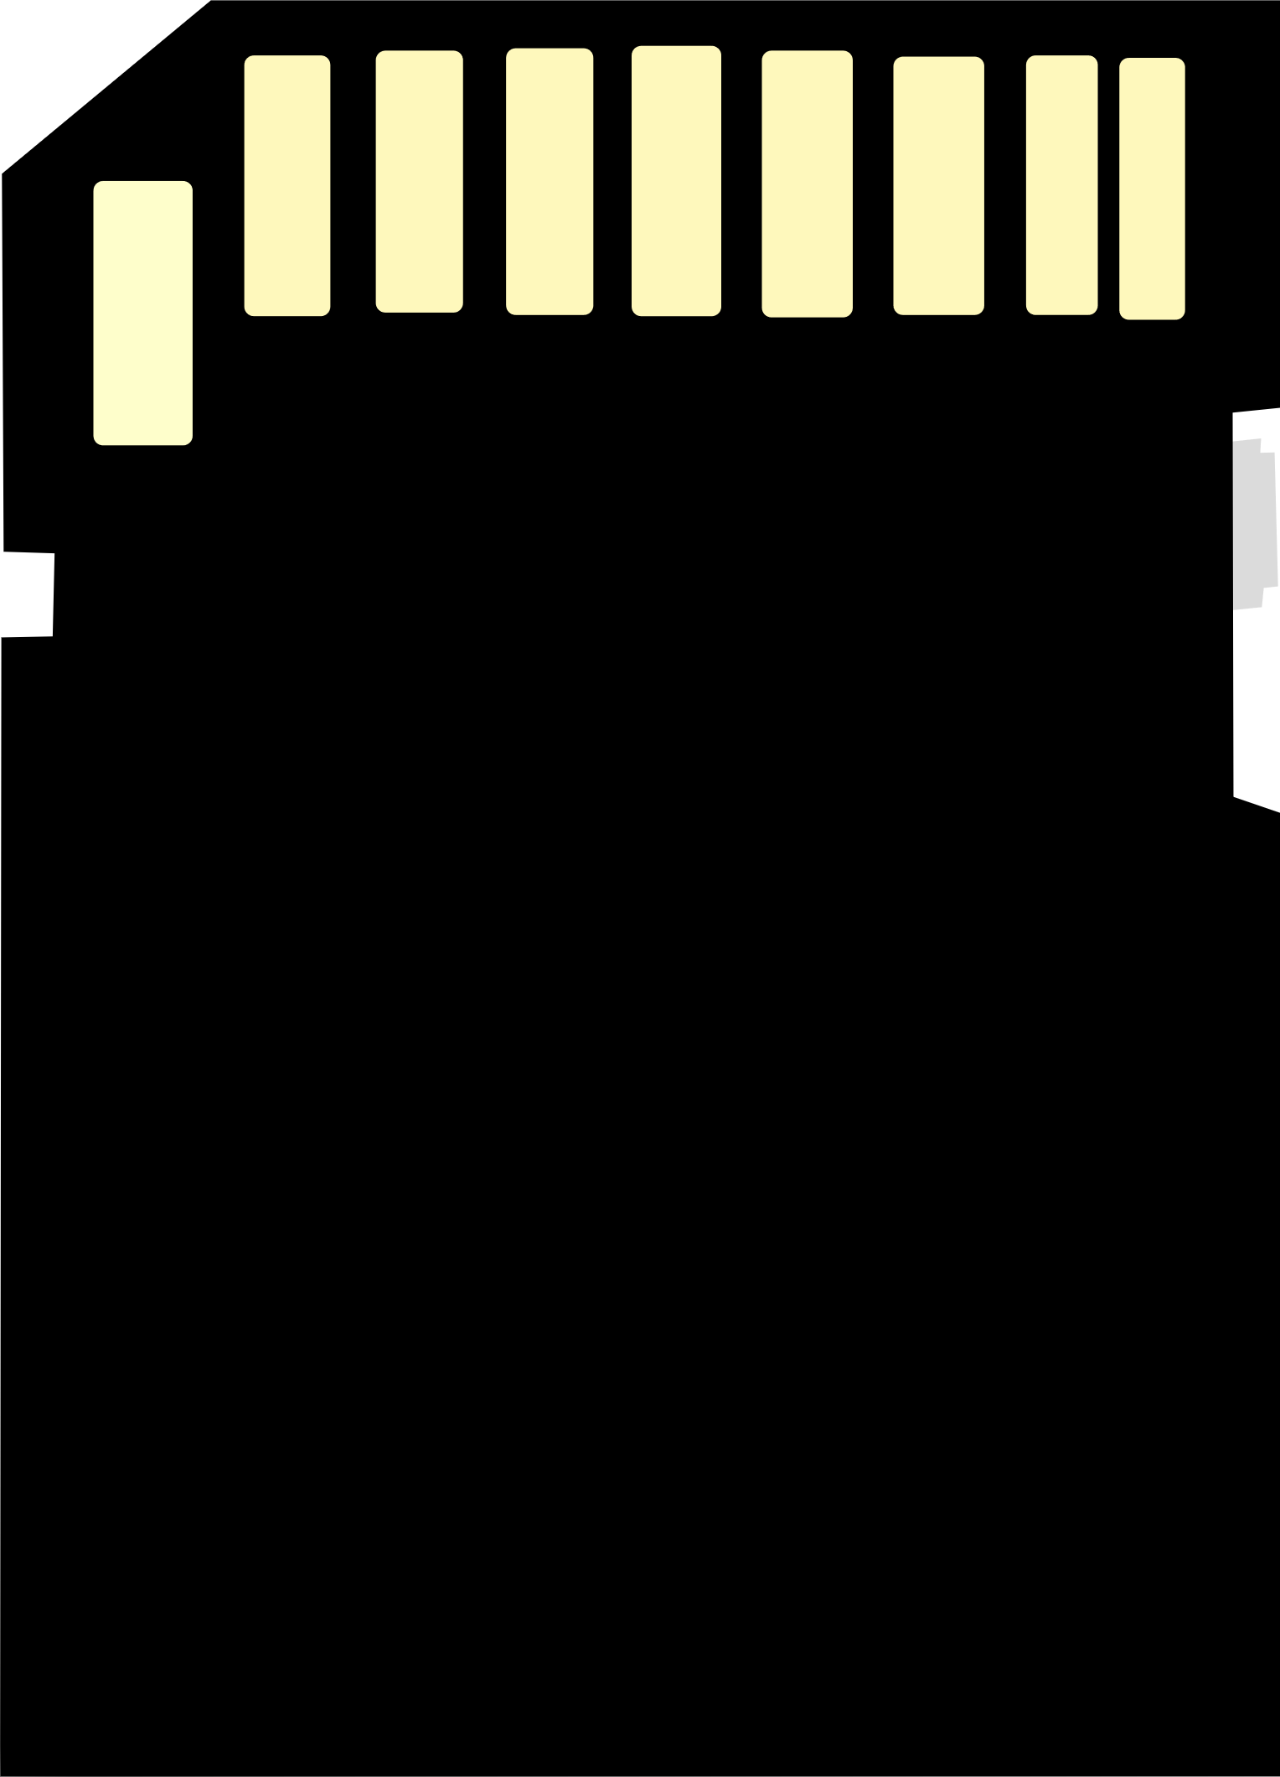

3.4 Secondary storage device
Use cases
The most common use for solid-state media is either in a memory card or a USB flash drive.
Flash memory is integrated into a device with the memory chip connected to a standard USB connector.

Slide 49

3.4 Secondary storage device
Solid State Drive
A solid-state drive (SSD) is a storage device that uses NAND-based flash memory to store data, offering faster performance and durability compared to traditional hard disk drives (HDDs).
While degradation is possible, it will occur gradually and can be identified and mitigated through corrective measures.

Slide 50
3.4 Secondary storage device
Solid State Drive
SSD is
Lighter
More Reliable
Thinner
Faster in data access
Cooler

Slide 51
Subtopic 1
3.5 Input Devices: Data Entry and Control
CONTROL BUS
Central Processing Unit (CPU)
DATA BUS
MAR
ADDRESS BUS
CU
PC
MDR
CIR
ALU
ACC
CACHE
Input
Output
Memory Unit (RAM)
Load executable code when needed
Secondary Storage
(HDD, SSD, Removable Disk, CD)

Slide 52
Subtopic 1
3.5 Input Devices: Data Entry and Control
Keyboard
Functionality
  The keyboard allows users to input text data, creating an illusion of immediate character transfer to the computer screen when a key is pressed.
  In reality, key presses are converted into character codes, which are then transmitted to the processor.
  The operating system, under its control, ensures that the text character appears on the screen.
  The same process occurs when using keyboard shortcuts to initiate actions, with the processor responding by executing the requested action.

Slide 53
Subtopic 1
3.5 Input Devices: Data Entry and Control
Keyboard
Keyboard Components
  The keyboard incorporates electrical circuitry, along with its own microprocessor and a ROM (Read-Only Memory) chip.

Slide 54
Subtopic 1
3.5 Input Devices: Data Entry and Control
Keyboard
Key Recognition Process
  The keys are positioned above a key matrix, consisting of rows and columns of wires.
  Pressing a key establishes contact at the intersection where wires cross.
  A continuous test is conducted by the microprocessor to identify closed electrical circuits between row and column wires.
  When a closed circuit is detected, the microprocessor identifies the specific intersection responsible.
  Data stored in the ROM is then used to determine the character code associated with the pressed key.
  This character code is subsequently sent to the screen for display.

Slide 55


Subtopic 1
3.5 Input Devices: Data Entry and Control
Screen
Graphical User Interface (GUI)
  GUI allows the user to control data input by providing different types of screen icon.
  Pointing device (eg. A mouse) is required.

Slide 56

Subtopic 1
3.5 Input Devices: Data Entry and Control
Touch Screens
Resistive Touch Screens
Resistive touch screen consists of two flexible layers separated by a thin space.
When pressure is applied, the top layer moves to make contact with the lower layer, creating voltage dividers in both horizontal and vertical directions.

Slide 57

Subtopic 1
3.5 Input Devices: Data Entry and Control
Touch Screens
Capacitive Touch Screens
Capacitive touch screens operate by detecting capacitance changes caused by finger touches on a glass screen.
Projective capacitive touch (PCT) technology uses mutual capacitance and features a circuit with an array of capacitors under the screen, enabling multitouch detection and versatile applications.

Slide 58


Subtopic 1
3.5 Input Devices: Data Entry and Control
Input of a graphic
A webcam serves as a tool for transmitting video footage to a computer system, while a digital camera can be linked to a computer to transfer and save photos or videos within the computer's storage.

Slide 59
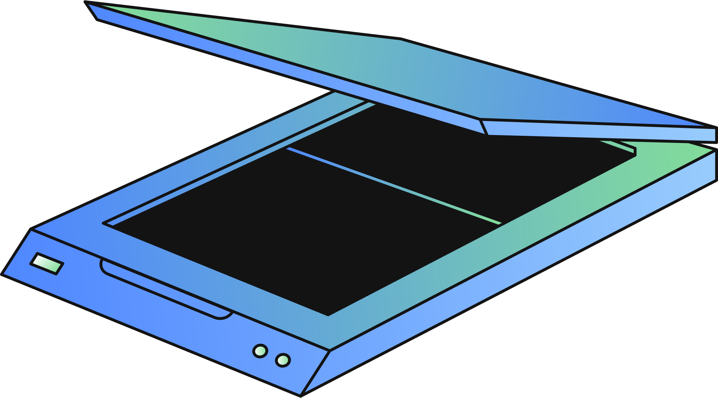
Subtopic 1
3.5 Input Devices: Data Entry and Control
Input of a graphic
A scanner operates in contrast to the printing process by converting an image into a digital form. To do this, it keeps a sheet of paper with the image stationary while a light source moves across its width, spanning from one edge to the other. The reflected light is then guided by a system comprised of mirrors and lenses onto a charge-coupled device (CCD).
CHARACTERISTICS OF A CCD
A CCD comprises a grid of light-sensitive cells.
Each cell within a CCD generates an electrical signal that corresponds to the intensity of light it receives.
To facilitate communication with a computer, a CCD requires an analog-to-digital converter to transform its analog signals into digital values.

Slide 60
3.6 Output Devices: Data Display and Communication
CONTROL BUS
Central Processing Unit (CPU)
DATA BUS
MAR
ADDRESS BUS
CU
PC
MDR
CIR
ALU
ACC
CACHE
Input
Output
Memory Unit (RAM)
Load executable code when needed
Secondary Storage
(HDD, SSD, Removable Disk, CD)

Slide 61


3.6 Output Devices: Data Display and Communication
Screen Display
Pixel
11011010
10110111
01101111
A screen pixel comprises three sub-pixels, typically representing red, green, and blue colours. Adjusting the brightness of these individual sub-pixels enables the display of a wide spectrum of colors.
An image can be stored as a bitmap created from individual pixels.

Slide 62
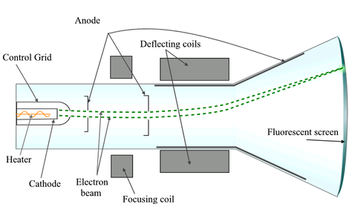
3.6 Output Devices: Data Display and Communication
Evolution
Cathode Ray Tube (CRT)
  A cathode ray tube (CRT) uses an electron gun to emit a stream of electrons.
  These electrons are directed and controlled by electromagnets to strike a phosphorescent screen, producing light and creating the images you see on the screen.

Slide 63
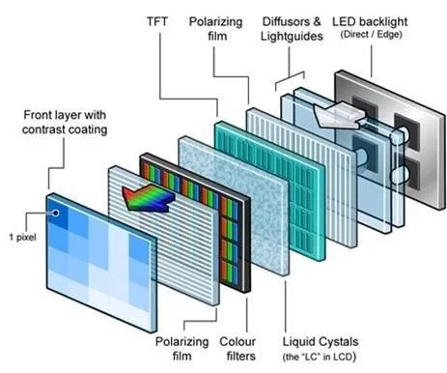

3.6 Output Devices: Data Display and Communication
Evolution
Cathode Ray Tube (CRT)
Liquid Crystal Display (LCD)
  Each pixel contains a liquid crystal cell.
  LED backlighting is used to illuminate the pixel matrix.
  Polarized light is directed at the pixel matrix.
  A polarizer is placed between the pixel matrix and the screen.
  When voltage is applied to a pixel cell, it changes the liquid crystal molecule alignment.
  This change in alignment alters the light's polarization and the displayed screen content.
  A cathode ray tube (CRT) uses an electron gun to emit a stream of electrons.
  These electrons are directed and controlled by electromagnets to strike a phosphorescent screen, producing light and creating the images you see on the screen.

Slide 64
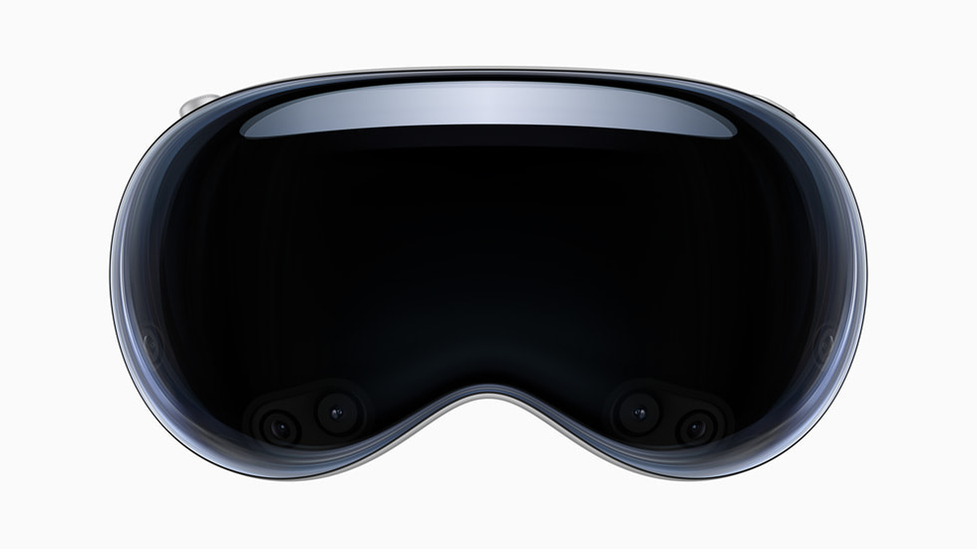
3.6 Output Devices: Data Display and Communication
Virtual Reality Headset
  A virtual reality headset is a wearable device that immerses the user in a computer-generated, three-dimensional environment, often incorporating head and body tracking for an interactive and immersive experience.

Slide 65

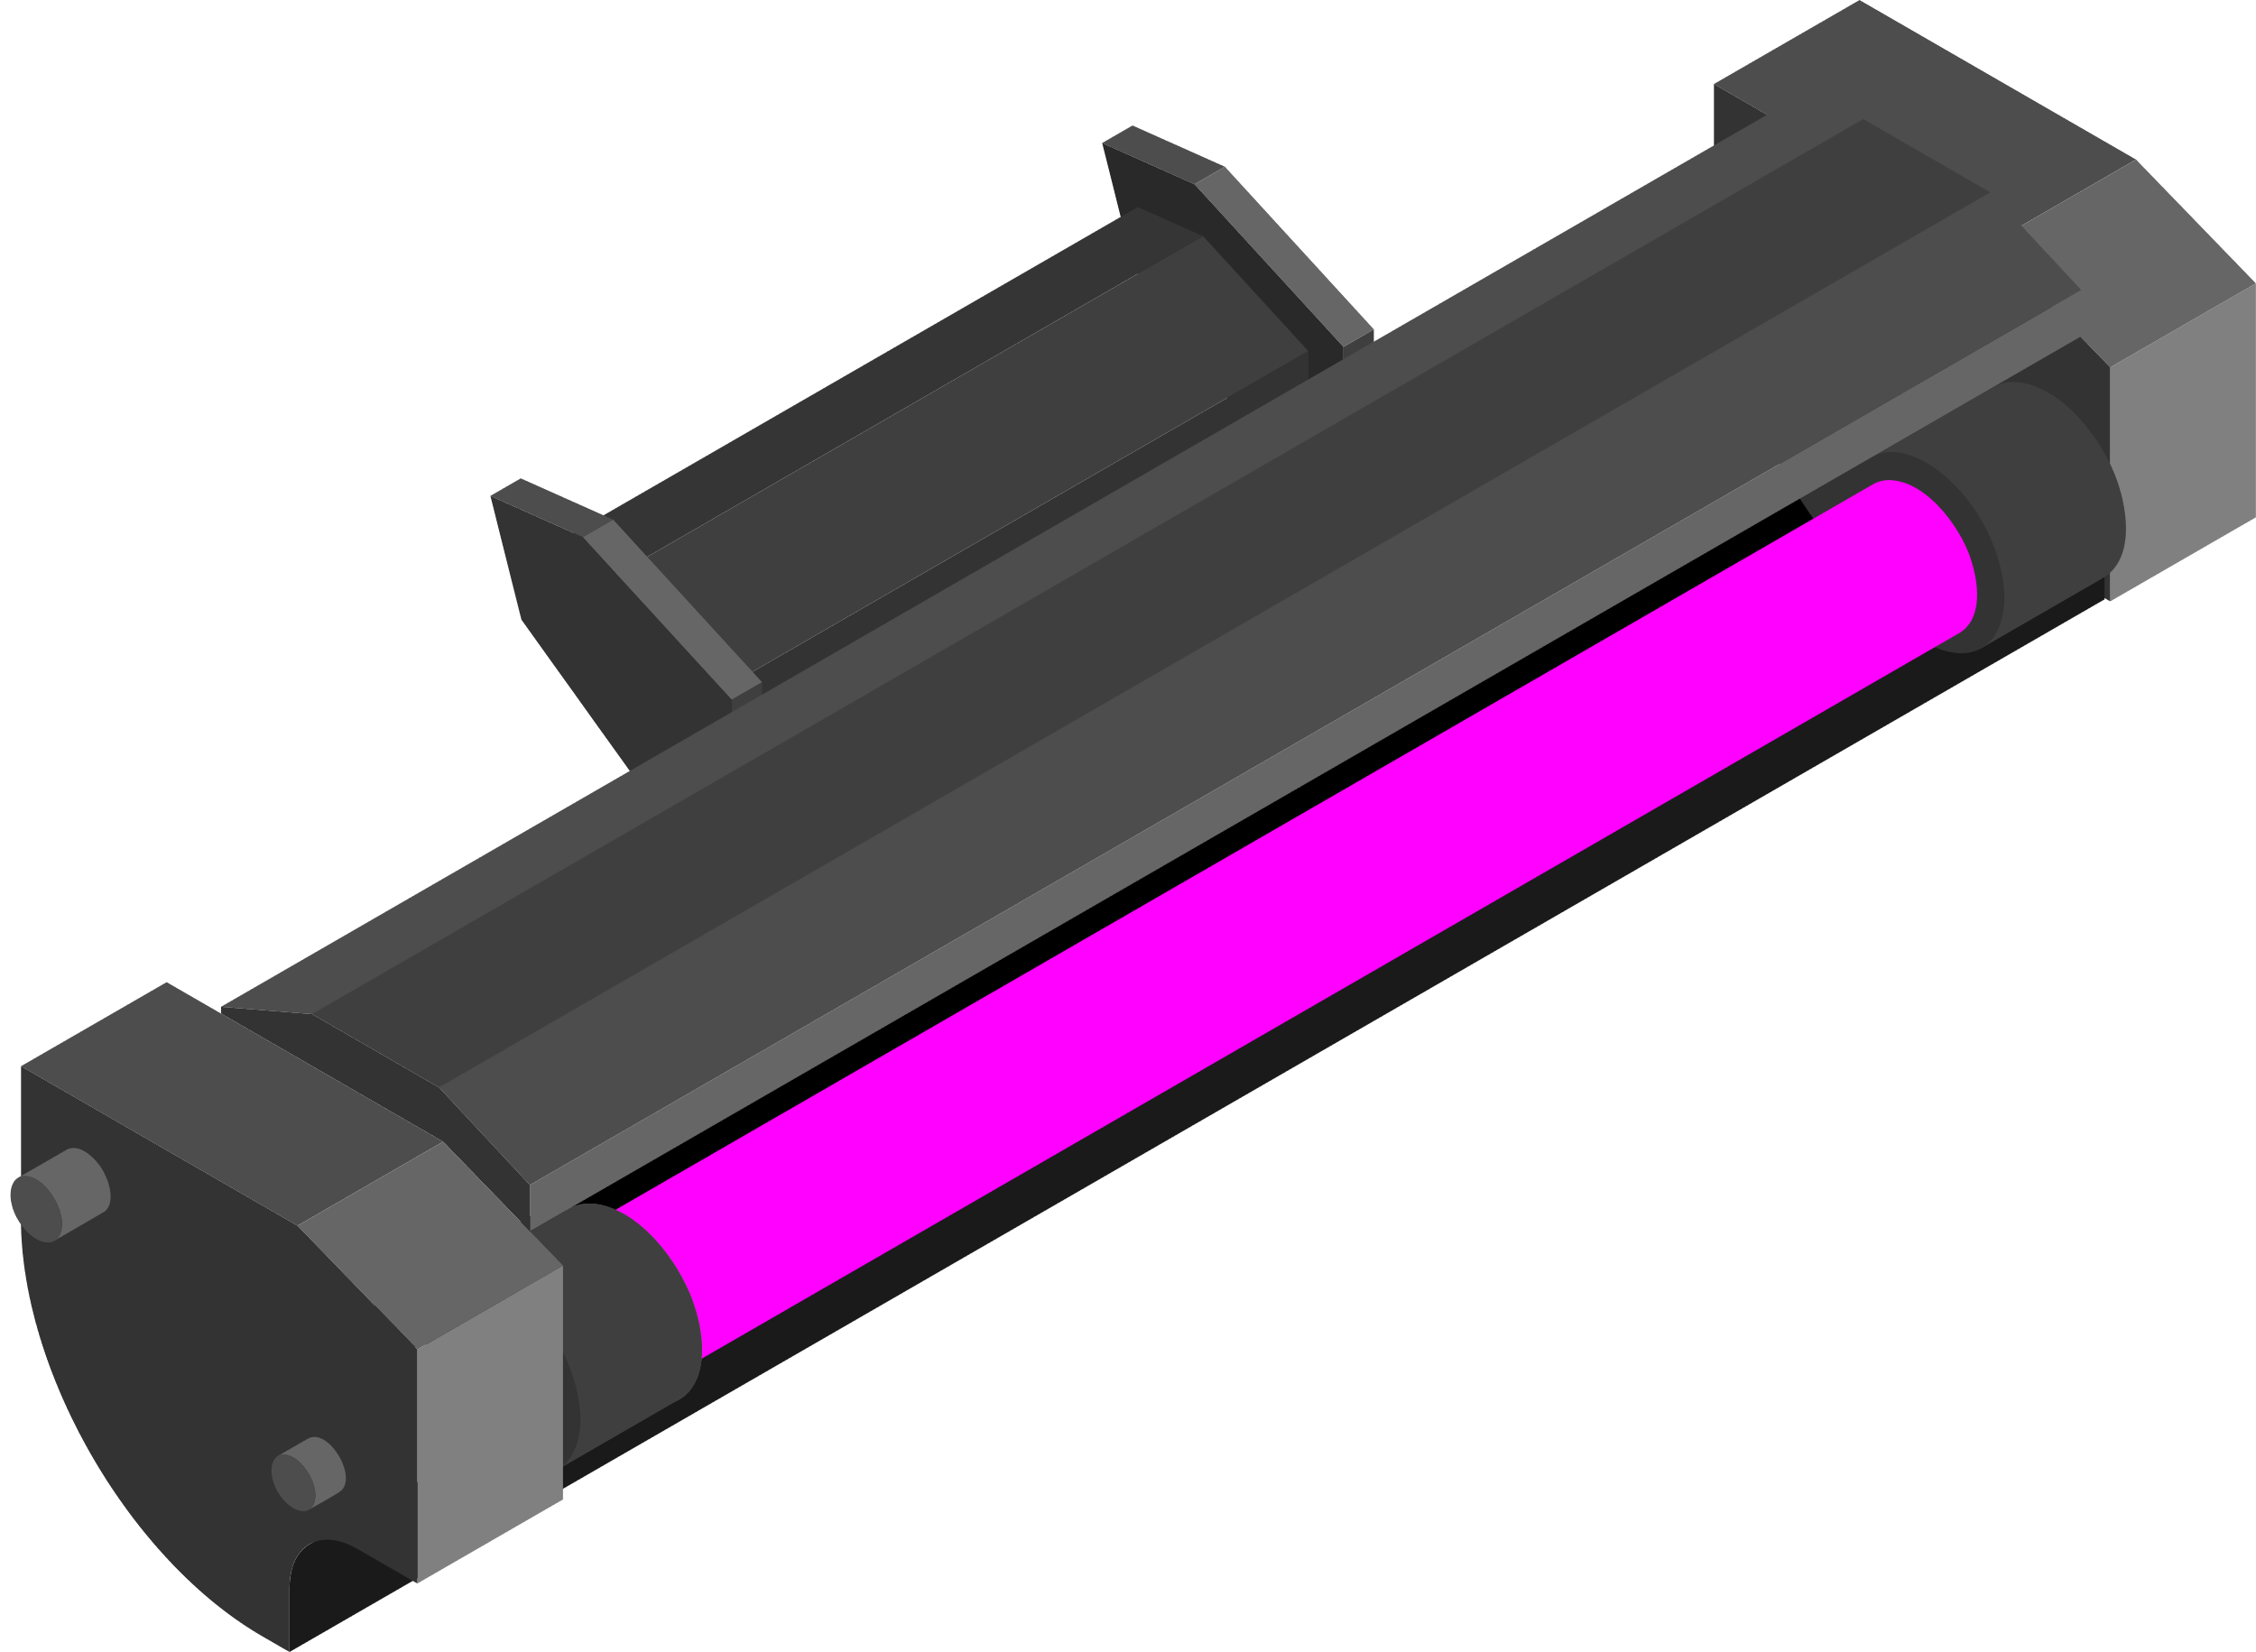
3.6 Output Devices: Data Display and Communication
Hard-copy output of text
Inkjet Printer
Laser Printer
A type of printer that uses a laser beam to create an electrostatic image on a photosensitive drum, which is then transferred and fused onto paper to produce text and images.
A type of printer that sprays tiny droplets of ink onto paper to create text and images.

Slide 66


3.6 Output Devices: Data Display and Communication
How it works
Inkjet Printer
A sheet of paper is inserted, and subsequently, the printhead traverses across the sheet, applying ink onto the paper.
The paper is advanced slightly, and the printhead repeats its movement across the paper, with this process continuing until the entire sheet has been completely printed.
The printhead is composed of nozzles that eject droplets onto the paper, and ink is provided to the printhead from one or multiple ink cartridges.

Slide 67
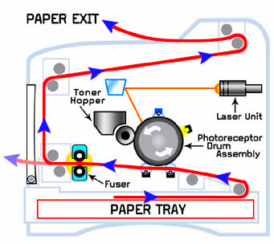

3.6 Output Devices: Data Display and Communication
How it works
Laser Printer
The drum is electrically charged. The revolving drum is exposed to a laser beam guided by mirrors and lenses, selectively discharging its surface at various positions.
The toner is transferred to a charged sheet of paper, fused using heated rollers, and the drum is discharged before repeating the process for the next page.
This repetition creates a full-page electrostatic image. Charged toner adheres only to the discharged areas on the drum's surface.

Slide 68
3.6 Output Devices: Data Display and Communication
How it works
Laser Printer
Color printing necessitates separate toners for cyan, magenta, yellow, and black, with each color processed individually.
The technology generates dots, and image quality is influenced by the dots per inch, which can be controlled by software to adjust the number of dots per pixel.

Slide 69

3.6 Output Devices: Data Display and Communication
Hard-copy graphic output
Graphic Plotter
Graphic Plotter: A graphic plotter is a specialized device for drawing precise, detailed illustrations and designs on paper.
Pen-based Drawing: It works by using pens or drawing tools to move across the paper, creating lines and shapes according to digital instructions.
Vector Graphics: Graphic plotters excel at producing vector graphics with consistent line quality, making them valuable in engineering and design application.

Slide 70
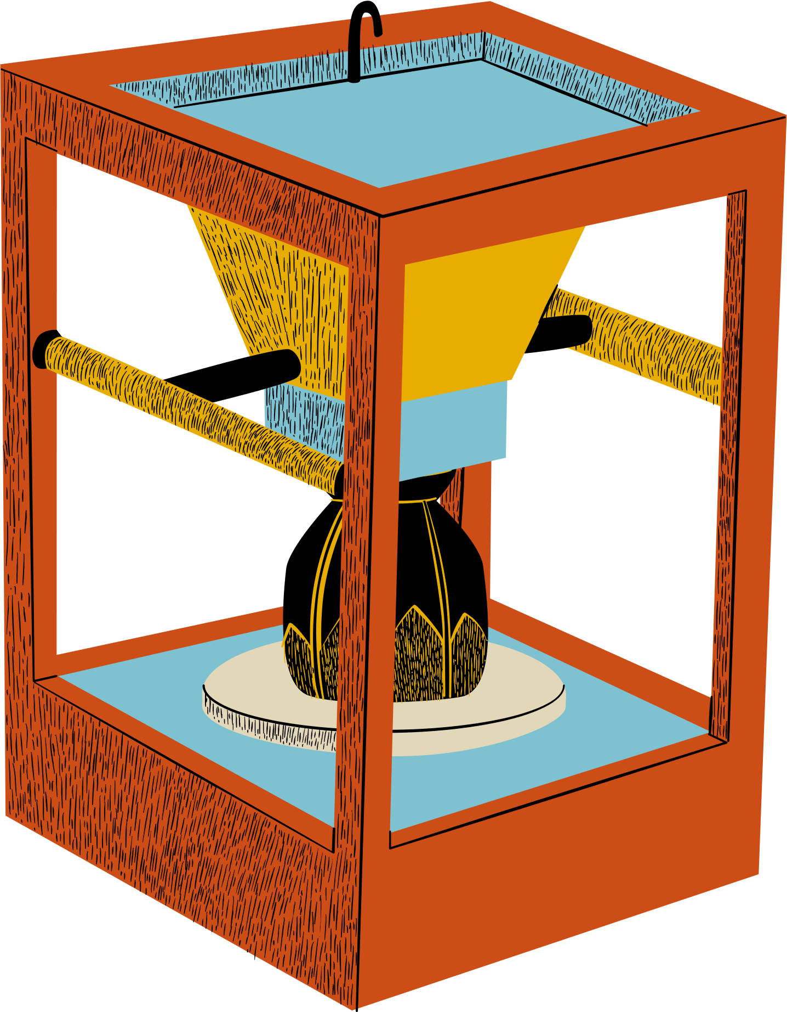
3.6 Output Devices: Data Display and Communication
Hard-copy graphic output
3D Printer
3D Printer: A 3D printer is a machine that creates physical objects layer by layer from digital 3D models.
Mechanism: The design is split into layers. Each layer is sent to the printer. The 3D printer uses a nozzle to squirt material on to the printer bed to create a physical layer. This is repeated for many layers. The object will then be cured to ensure all layers stuck together.
Diverse Applications: 3D printers are used in various fields, from prototyping and product design to healthcare and aerospace for creating custom parts and prototypes.

Slide 71





3.7 Sound Input and Output Systems
There are many applications that require both voice input and voice output:
Video conferencing, IP telephony, and voice assistant (Siri).
Input
Output
A microphone requires a diaphragm that vibrates when it captures sound, producing an electrical signal.
For output, a speaker reverses the process. Digital computer data is converted to an analog signal via a DAC.
Condenser microphones use capacitance changes or piezoelectric crystals for this process.
This analog signal drives a coil in a magnetic field created by a permanent magnet within the speaker. The changing current makes the coil move, which controls a diaphragm to produce sound.
An analog-to-digital converter (ADC) is used to transform the analog electrical signal into a digital format for computer processing.

