Slide 1
Cambridge International
AS Level Computer Science
(9618) – Revision Notes
Networking and Communication Systems
This pack is intended for students to who are taking CIE AS Level in Computer Science, either in preparation for their AS exam, or more likely alongside year 2 of the course to improve fluency, recall and pace on AS topics. It could be used as lesson starters, or supplied to students for independent use.

Slide 2



Chapter
2
Networking and Communication Systems
A LEVEL COMPUTER SCIENCE

Slide 3



2.1
2.2
History and Advantages of Networking
Designs and Structures of Network Topologies
2.3
Network Transmission Media
2.4
LAN
Hardware
components
Chapter
Outline
2.5
Ethernet Technology and Standards
2.6
2.7
2.8
2.9
Architecture of the Internet
Internet-Based Applications
Domain Naming Systems (DNS)
IP Addressing and Network Identification

Slide 4


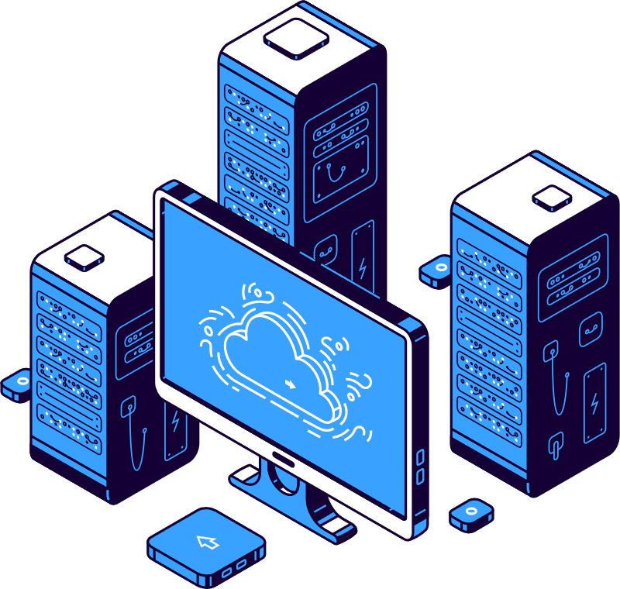
2.1 History and Advantages of Networking
Wide Area Network
In the past, this is how a computer can be accessed by multiple users.
Mainframe Computer
Terminal

Slide 5
2.1 History and Advantages of Networking
Wide Area Network
WAN is developed to allow computers in different organisations to be networked.
Mainframe Computer
In a WAN, computers can be thousands of kilometers apart.
Terminal
Mainframe Computer
Mainframe Computer
Terminal
Terminal
Mainframe Computer
Terminal
Mainframe Computer
Terminal

Slide 6

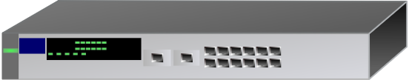
2.1 History and Advantages of Networking
Wide Area Network
WAN is developed to allow computers in different organisations to be networked.
Local Area Network (LAN)
Local Area Network (LAN)
Local Area Network (LAN)

Slide 7
2.1 History and Advantages of Networking
Benefits of a WAN
Local Area Network (LAN)
Local Area Network (LAN)
  A task could be executed on a distant computer equipped with the necessary software.
  An archived dataset located on a remote computer could be retrieved.
  Information could be electronically sent to a user on a computer situated remotely.
Local Area Network (LAN)

Slide 8




2.1 History and Advantages of Networking
Characteristics of a WAN
Local Area Network (LAN)
Local Area Network (LAN)
Local Area Network (LAN)
Ownership won't be with the organization; instead, leasing from a public switched telephone network company (PSTN) will occur. PSTN will offer an exclusive communication link.
Fibre-optic cable will serve as the transmission medium.
Communication inside the WAN will happen between switches.
No end system is connected directly to the WAN.

Slide 9


2.1 History and Advantages of Networking
Local Area Network
WAN
Local Area Network (LAN)
Local Area Network (LAN)
Local Area Network (LAN)
  The 1980s saw the advent of personal computers, altering computing dynamics.
  Users in organisations could have personal computers on their desks.
  Computers could operate standalone or be networked in a local area network.

Slide 10
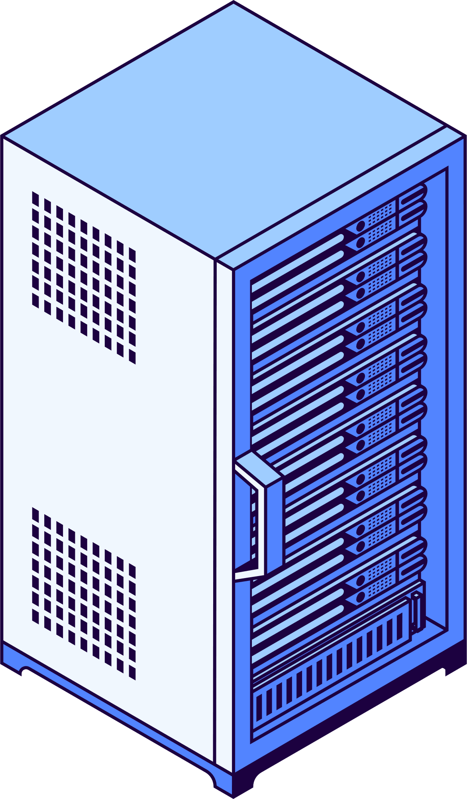
2.1 History and Advantages of Networking
Benefits of a LAN
By installing application software on an application server linked to the LAN, the cost of installing it on every individual PC can be minimized.
Application server
File server

Slide 11
2.1 History and Advantages of Networking
Benefits of a LAN
By installing application software on an application server linked to the LAN, the cost of installing it on every individual PC can be minimized.
Application server
Connecting a file server to the LAN enables users to store larger files and facilitates file sharing among users.
File server

Slide 12
2.1 The evolution of the purpose and benefits of networking
2.1 History and Advantages of Networking
Benefits of a LAN
By installing application software on an application server linked to the LAN, the cost of installing it on every individual PC can be minimized.
Organisational managers could utilize electronic mail for communication with staff, replacing the traditional practice of distributing paper memos.
Application server
Connecting a file server to the LAN enables users to store larger files and facilitates file sharing among users.
File server

Slide 13
2.1 History and Advantages of Networking
Characteristics of a LAN
  Used by an organization or company at a specific site or branch.
  Ownership rests with the organization or company.
  Utilises twisted-pair cables or Wi-Fi as the transmission medium.
  Each LAN will have a device to link to other networks.
  Features end-systems, comprising user systems or servers, linked to the LAN.
Application server
File server

Slide 14
2.1 History and Advantages of Networking
Differences between LAN and WAN
Local Area Network (LAN) | Wide Area Network (WAN)
Ownership rests with the organization or company. | Ownership won't be with the organization; instead, leasing from a public switched telephone network company (PSTN) will occur. PSTN will offer an exclusive communication link.
Utilises twisted-pa﻿ir cables or Wi-Fi as the transmission medium. | Fibre-optic cable will serve as the transmission medium.
Features end-systems, comprising user systems or servers, linked to the LAN. | No end system is connected directly to the WAN.
Application server
Local Area Network (LAN)
Local Area Network (LAN)
File server
Local Area Network (LAN)

Slide 15


2.1 History and Advantages of Networking
Internet (Interconnected Networks)
The fundamental purpose and advantages of networking remain consistent, but their extent and range have expanded significantly. Notably, individuals now enjoy complete network access through their personal devices.
Wide Area Network (WAN)
Local Area Network (LAN)
Local Area Network (LAN)
Wide Area Network (WAN)
Local Area Network (LAN)
Local Area Network (LAN)
Local Area Network (LAN)
Local Area Network (LAN)
Wide Area Network (WAN)
Local Area Network (LAN)
Local Area Network (LAN)
Local Area Network (LAN)

Slide 16


2.1 History and Advantages of Networking
The client-server model
obtain
a service
serve
Definition: An architecture where a client runs an application provided by a server on a network.
Application server
Nowadays, the client constitutes a web browser linked to the internet, while the server embodies a web server hosted on the internet.
File server
james gan

Slide 17


2.1 History and Advantages of Networking
The client-server model
Type 1: Thin-client
Step 1: Choose an application to run on the server.
Step 2: Sends input data to the server when requested by the application.
Step 3: Receives output from the application.

Slide 18


2.1 History and Advantages of Networking
The client-server model
Type 2: Thick-client
Perform certain processing tasks before sending the request to the server and can also handle additional processing after receiving the output from the application.
Step 1: Choose an application to run on the server.
The client might also downloads the application from the server and then runs the application locally on its own device.

Slide 19

2.1 History and Advantages of Networking
Example: Thick Client Preprocessing
Submitting an online form to calculate the total cost of items you want to purchase.
Data sent to server
As you fill in the quantities and prices of items, your web browser (the client) performs calculations to calculate the subtotals for each item based on the quantity and price you entered.

Slide 20
2.1 History and Advantages of Networking
Example: Thick Client Preprocessing
Submitting an online form to calculate the total cost of items you want to purchase.
Data sent to server
As you fill in the quantities and prices of items, your web browser (the client) performs calculations to calculate the subtotals for each item based on the quantity and price you entered.
The server then generates the final output, which includes the total cost and any other relevant information.

Slide 21


2.1 History and Advantages of Networking
Example: Thick Client Preprocessing
Submitting an online form to calculate the total cost of items you want to purchase.
17.99
Data sent to server
Raw data sent back
As you fill in the quantities and prices of items, your web browser (the client) performs calculations to calculate the subtotals for each item based on the quantity and price you entered.
The server then generates the final output, which includes the total cost and any other relevant information.
Once your browser receives the server's response, it may perform additional client-side processing to display the server's output in a user-friendly way.

Slide 22
2.1 History and Advantages of Networking
The client-server model is the choice for the following circumstance:
The server holds a database that the client system can access.
The server hosts a web application that enables the client system to search for or occasionally provide information.
The server hosts a web application that enables the client system to conduct e-commerce or financial transactions.

Slide 23
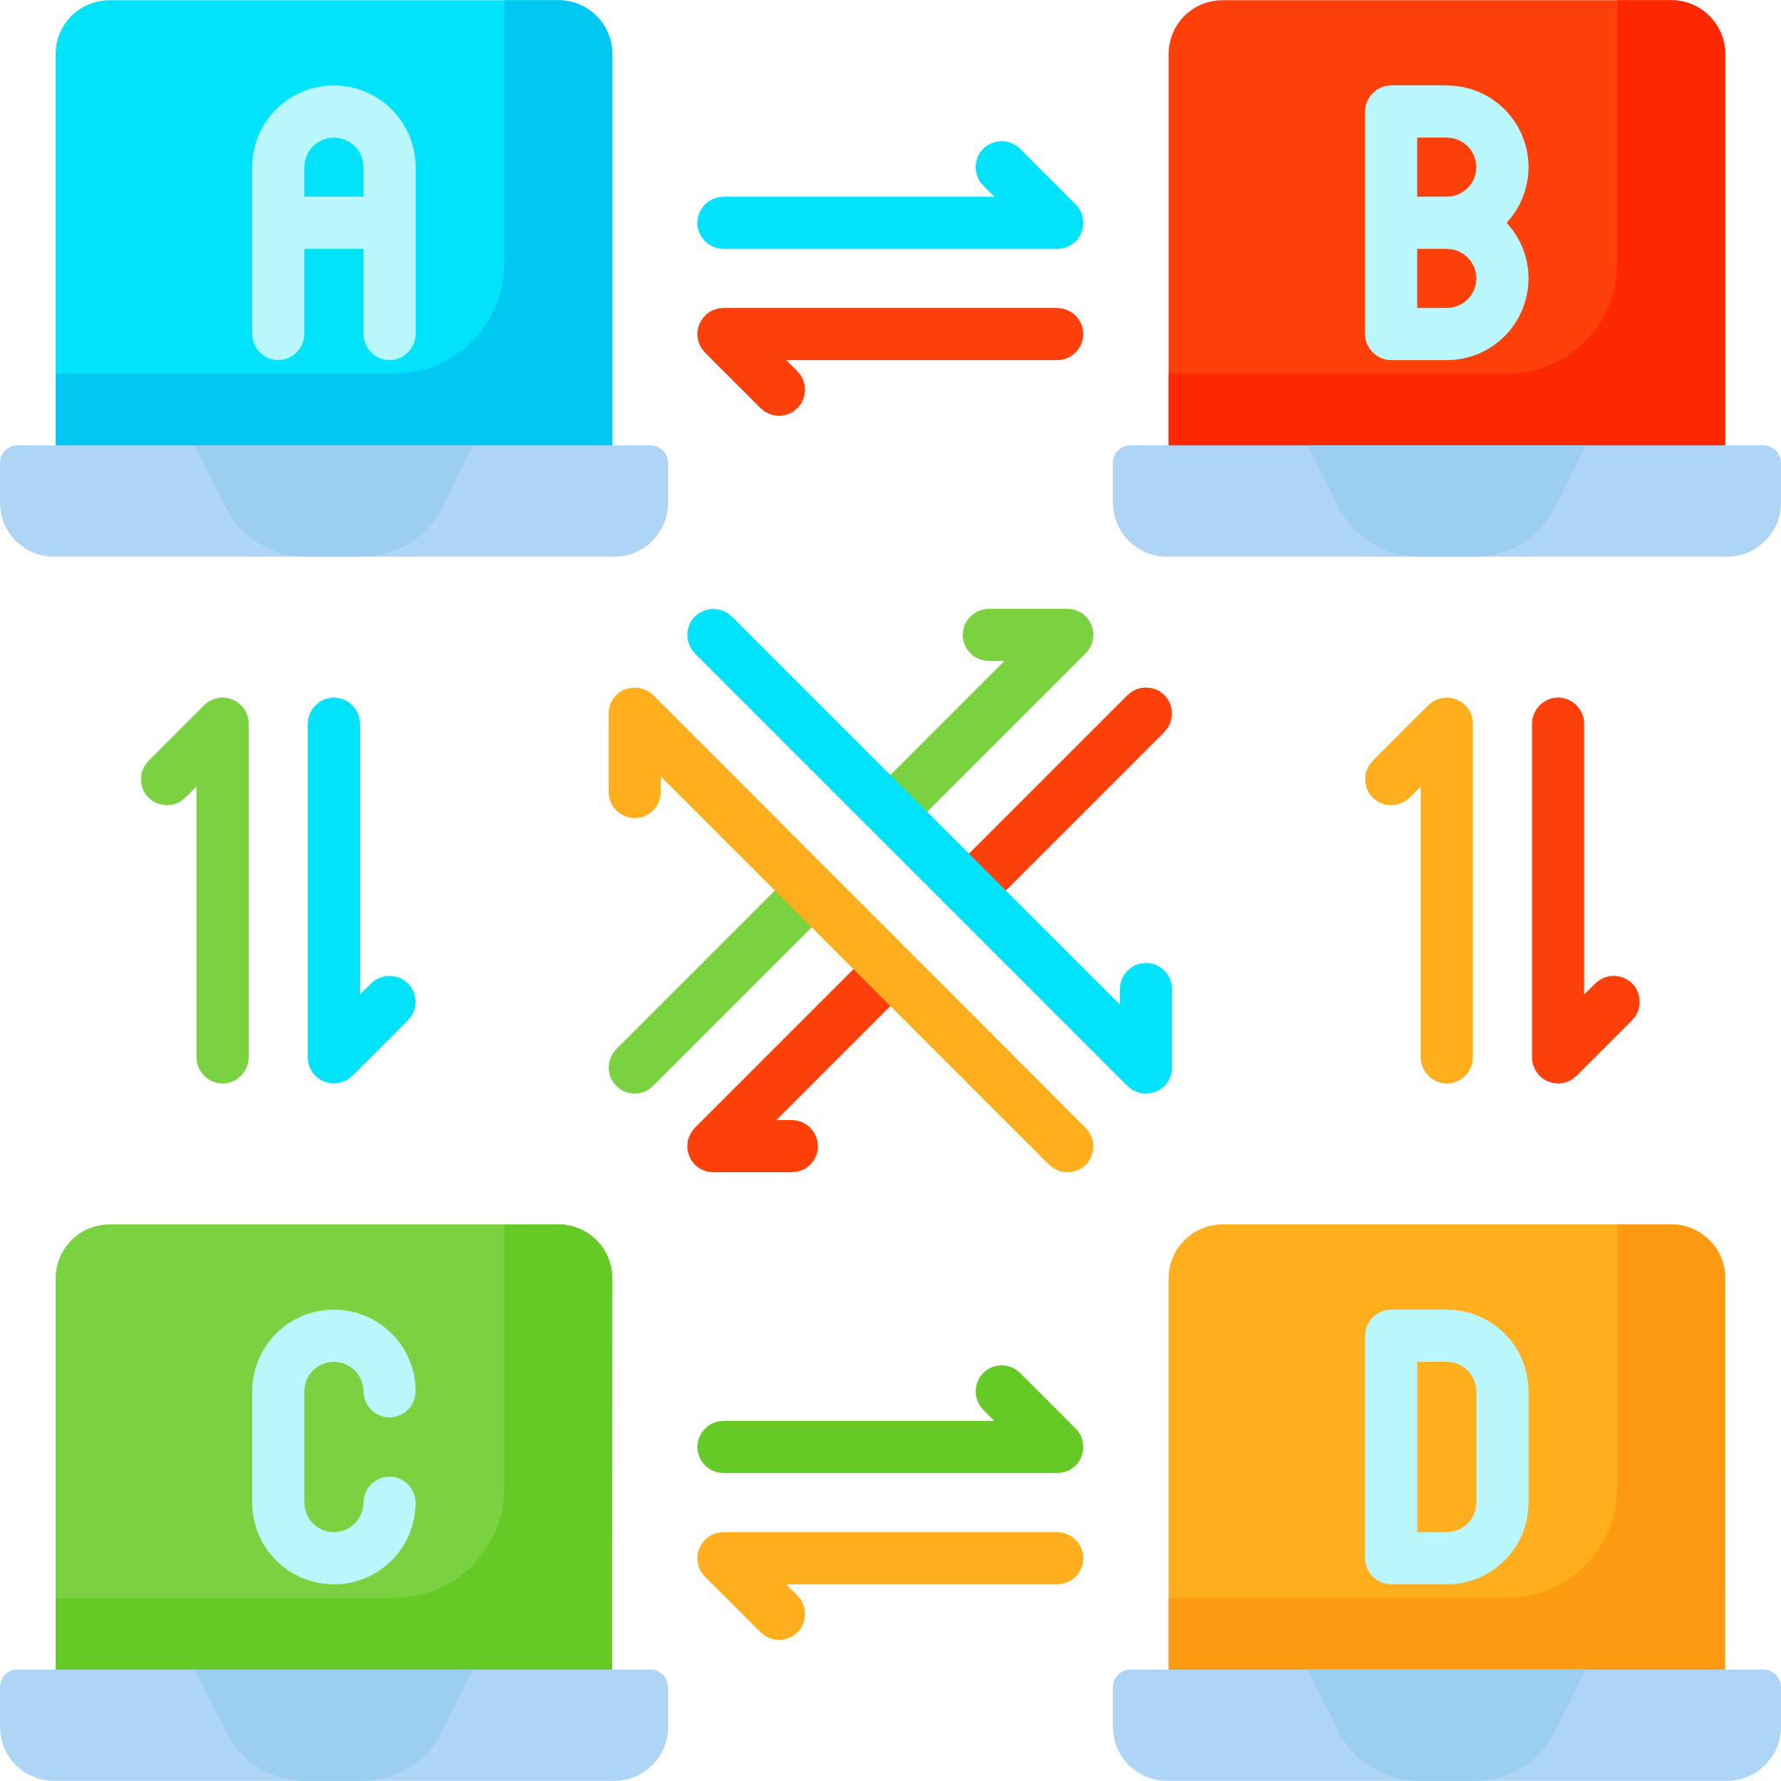
2.1 History and Advantages of Networking
Peer-to-peer model
Rather than relying on a single server that multiple clients access, a peer-to-peer network functions by having each peer store some files.
This setup allows every peer to act both as a client , requesting files from other peers, and as a server, providing requested files for download to other peers.

Slide 24
2.1 History and Advantages of Networking
Comparing the advantages
Client-Server Model | Peer-To-Peer Model
It enables an organization to manage and regulate the downloading and utilization of files. | It prevents network congestion when multiple clients are trying to download files simultaneously.
Files can be safeguarded against malware attacks more effectively as they are stored on a single server that undergoes regular scanning using suitable anti-virus software. | Segments of a file can be downloaded individually.
 | The file segments are accessible from multiple hosts.
Application server
File server

Slide 25

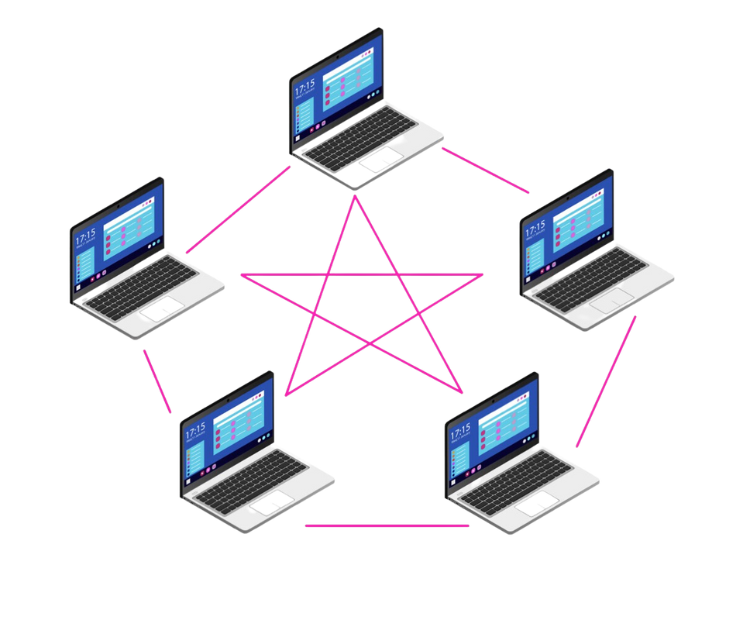
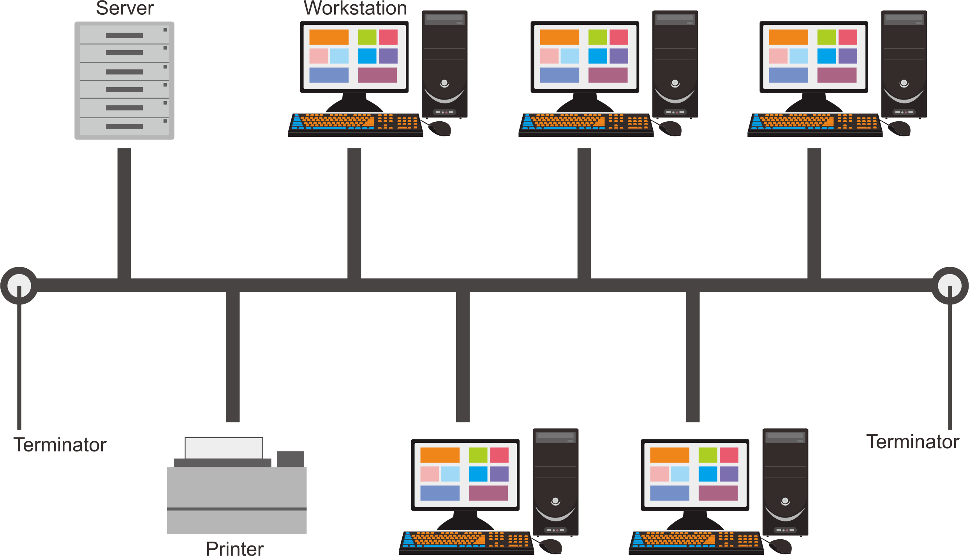
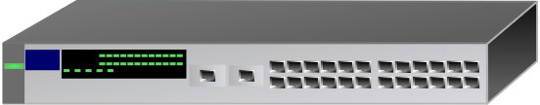

2.2 Designs and Structures of Network Topologies
Subtopic 1
Definition
Network topology refers to the physical or logical layout of devices and their connections within a network. It defines how data flows and devices communicate.
Overview
Point-to-point
Bus
Mesh
Star
James Gan

Slide 26



2.2 Designs and Structures of Network Topologies
Subtopic 1
Topology
Before learning about topologies, we need to know what are the data transmission modes and methods.
Data Transmission Modes
Simplex
Half Duplex
Full Duplex
Data flow is one-way only.
Data flow in two ways but not at the same time.
Data flow in two way but at the same time.

Slide 27
2.2 Designs and Structures of Network Topologies
Subtopic 1
Topology
Before learning about topologies, we need to know what are the data transmission modes and methods.
Data Transmission Methods
Broadcast
Multicast
Unicast
Data
Data
Data
Data
Data
Data
Data
One-to-all communication
One to many communication
One-to-one communication

Slide 28
2.2 Designs and Structures of Network Topologies
Subtopic 1
Point-to-Point Topology
Point-to-point topology is a network configuration where two devices are directly connected to each other, forming a dedicated communication link between them.
Modes
Simplex or Duplex
Methods
Unicast

Slide 29
2.2 Designs and Structures of Network Topologies
Subtopic 1
Bus Topology
Bus topology is a network configuration where all devices are connected to a single main communication cable, often referred to as the "bus" or backbone.
Methods
Broadcast, as there is no direct connection between any pair of end-system.
The network's robustness is evident as a malfunction in an individual end-system or its connecting link doesn't impact the network's usability for other end-systems.
Benefits

Slide 30
2.2 Designs and Structures of Network Topologies
Subtopic 1
Mesh Topology
Mesh topology is a network arrangement where devices are interconnected with every other device for redundancy and robustness.
Modes
Duplex
Methods
Unicast, Multicast, and Broadcast
Usage
Useful to connect individual LAN/Routers in the network.

Slide 31
2.2 Designs and Structures of Network Topologies
Subtopic 1
Star Topology
Star topology is a network configuration where devices are connected to a central hub or switch for communication.
Modes
Duplex
Methods
Unicast, Multicast, and Broadcast
point-to-point connection
Benefits
The malfunction of one end system or its connection doesn't impact the other end systems. However, the central device must not fail.
point-to-point connection
Central Device
A specialised device (eg. Switch) with the purpose of connecting other devices in the network. Currently, the star topology is the usual way to configure a network.

Slide 32

2.2 Designs and Structures of Network Topologies
Subtopic 1
Hybrid network
A hybrid network is a combination of different network topologies, technologies, or architectures, aimed at achieving specific performance, scalability, or redundancy goals.
Advantages: Establish a new LAN with a different topology when using the current topology for the new LAN isn't practical within existing LANs.

Slide 33


2.3 Network Transmission Media
Overview
Cable
Wireless
Twisted pair
Radio
Coaxial
Microwave
Fibre-optic
Infrared

Slide 34





2.3 Network Transmission Media
Cable
A transmission using copper wire or fibre-optic.
Twisted pair
Fibre-optic
Coaxial
Factors that need to be considered when selecting cable.
Cost
Bandwidth or data rate
Attenuation at high frequency
Interference
Need for repeaters

Slide 35
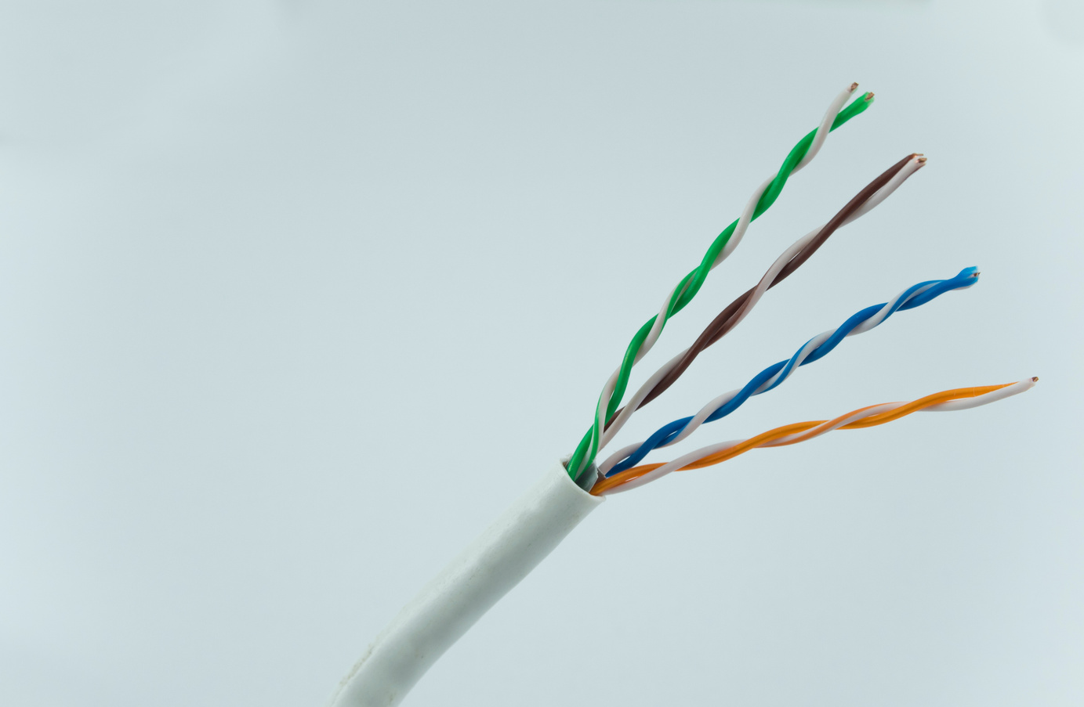


2.3 Network Transmission Media
Cable
 | Twisted Pair | Coaxial | Fibre-optic
Diagram
Central Core
Metallic Shield
Dielectric Insulator
Plastic Jacket
Typically employed to link telephone handsets with telephone lines. Also used in high speed LAN.
Used extensively by cable television companies and in metropolitan network.
The technology of choice for long-distance cabling.

Slide 36
2.3 Network Transmission Media
Cable
 | Twisted Pair | Coaxial | Fibre-optic
Cost | Lowest | Higher | Highest
Bandwidth or data rate | Lowest | Higher | Much higher
Attenuation at high frequency | Affected | Most Affected | Least Affected
Interference | Worst Affected | Less Affected | Least Affected
Need for repeaters | More Often | More Often | Less Often

Slide 37
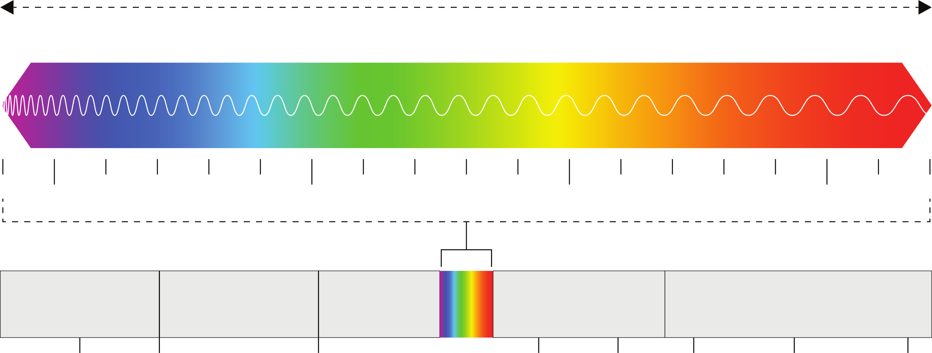

2.3 Network Transmission Media
Wireless
The three choices available are radio, microwave, and infrared, all of which serve as instances of electromagnetic radiation.
Increasing frequency
Increasing wavelength
Gamma rays
X rays
Ultraviolet
Infrared
Microwaves
Radiowaves
Visible
Light

Slide 38
2.3 Network Transmission Media
When considering which wireless option to use, you need to consider all of the same factors that were discussed when comparing different kinds of cable.
Wireless
Radio
Cost
Bandwidth or data rate
Attenuation at high frequency
Microwave
Infrared
Interference
Need for repeaters

Slide 39
2.3 Network Transmission Media
 | Radio | Microwave | Infrared
Frequency | 3kHz - 3GHz | 3 - 300 GHz | 300 GHz- 400 THz
Bandwidth or data rate | 3rd | 2nd | 1st
Attenuation due to rain | 3rd | 2nd | 1st
Need for repeaters | 3rd | 2nd | 1st
Directional focusing capability | 3rd | 2nd | 1st
Penetration through a wall | 1st | 2nd | 3rd
only suitable for indoor applications
good for long distance communication

Slide 40
2.3 Network Transmission Media
Comparing cable and wireless transmission
 | Cable | Wireless
Permission | Placing cables on the ground necessitates obtaining approval from landholders. | Government agencies control the utilization of specific wireless frequencies through regulations.
Global Communications | Transmission through fibre-optic cables laid underground or seabed | Satellite transmission.
Level of Interference | Lower | Higher
Usage of Repeaters | More Often | Seldom
Mobile Phone Prevalence | Not possible | The only way for phones to access the internet

Slide 41



2.3 Network Transmission Media
  Circling above the equator, these orbits serve the purpose of offering extended telephone and computer network communication.
  They revolve at the Earth's rotational velocity.
  Merely three GEO satellites are essential for complete worldwide coverage."
Satellites
Geostationary Earth Orbit
  They are the components of modern communication systems.
  A satellite has the capability to function as a constituent within a network, establishing direct connections with components situated on the ground.
  Provide the Global Positioning System (GPS).
  Ten MEO are needed for global coverage.
Medium Earth Orbit
Low Earth Orbit
  Functioning in constellations to complement mobile phone networks.
  Complete worldwide coverage necessitates fifty Low Earth Orbit (LEO) satellites.

Slide 42




2.4 LAN Hardware components
Wired LAN
Eg. Bus Topology
Highlighter
  Ensure data continuity by preventing signals from reflecting back down the bus.

Slide 43

2.4 LAN Hardware components
A repeater accepts an input signal and generates a new signal at full strength.
Wired LAN
Eg. Bus Topology
Highlighter
Repeater
A device that links two cables while delivering a signal at maximum strength to the second cable.

Slide 44
2.4 LAN Hardware components
Wired LAN

Slide 45

2.4 LAN Hardware components
Wired LAN
Bridge
Segment 1
Segment 2

Slide 46
2.4 LAN Hardware components
Wired LAN
Bridge
An device that links two segments of a Local Area Network (LAN).
Segment 1 | Segment 2
00:1A:2B:3C:4D:5E | 2A:B7:EF:53:19:C8
08:00:27:3D:8A:BF | 40:72:A9:ED:6F:51
12:34:56:78:90:AB | 5E:F8:C3:0A:97:BB
1C:6F:22:9D:F0:E5
Segment 1
Segment 2

Slide 47

2.4 LAN Hardware components
Wired LAN
Network Interface Card
A Network Interface Card (NIC) is a hardware component that enables devices to connect and communicate within a network.
It has a unique address that is used to identify the end-system which it has been installed.

Slide 48
2.4 LAN Hardware components
Wired LAN
Eg. Star Topology
The central device might be a hub, switch or a router.

Slide 49
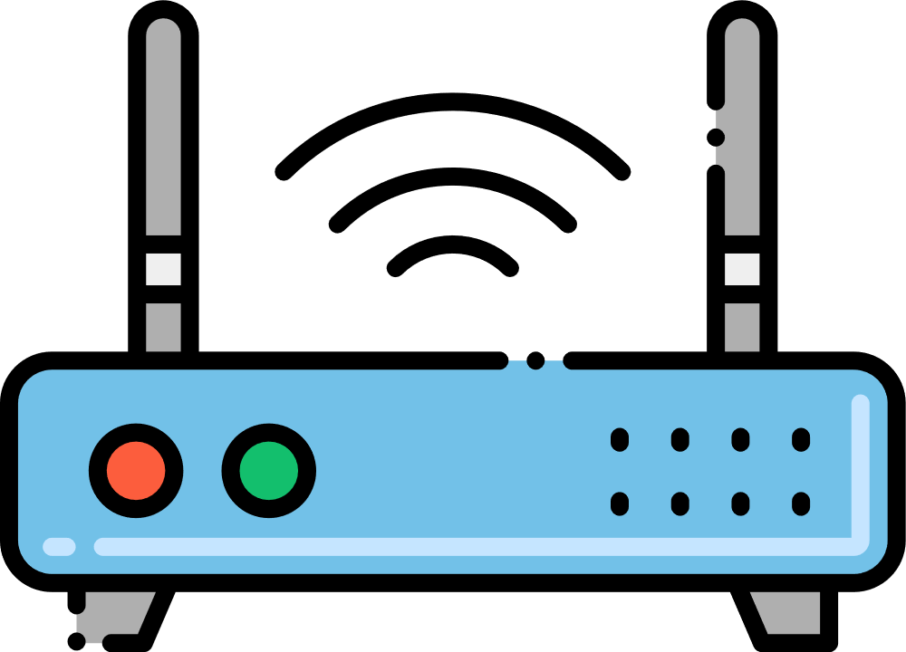
2.4 LAN Hardware components
Wireless LAN
  Also known as WLAN, WiFi
  Formal Description IEEE 802.11, wireless LAN standard that uses radio frequency transmission.
  Central Device: Wireless Access Point (WAP)
  The Wireless Access Point (WAP) is capable of establishing communication with an end-system, given that the end-system is equipped with a Wireless Network Interface Card.

Slide 50
2.5 Ethernet Technology and Standards
Definition
Ethernet is a networking technology encompassing protocols, ports, cables, and computer chips essential for connecting desktops or laptops to local area networks (LANs). This enables high-speed data transmission using coaxial or fiber optic cables.
Alternative name:
IEEE 802.3
Data Speed Capability
100 gigabit
Institute of Electrical and Electronics Engineers (IEEE)

Slide 51
2.5 Ethernet Technology and Standards
Ethernet
Ethernet was deployed in a local area network (LAN) that could be structured as a bus or a star, with a hub acting as the central device. In both arrangements, data transmission utilized a broadcast approach.
Bus Topology
Star Topology

Slide 52
2.5 Ethernet Technology and Standards
Collision
Employing a shared medium for transmitting messages introduces the possibility of message corruption during the transmission process. If two end-systems attempt to transmit messages simultaneously, a situation known as a 'collision' occurs.
Send!
Send!
Bus Topology

Slide 53

2.5 Ethernet Technology and Standards
Collision
Employing a shared medium for transmitting messages introduces the possibility of message corruption during the transmission process. If two end-systems attempt to transmit messages simultaneously, a situation known as a 'collision' occurs.
Send!
message
message
Send!
Bus Topology

Slide 54
2.5 Ethernet Technology and Standards
(Carrier sense multiple access with collision detection)
Transmitter checks the voltage on the transmission medium.
Solution - CSMA/CD
When a message was in transit, a detectable voltage level was present on the Ethernet cable, and this could be sensed by an end-system.
Send!
Voltage!
Send!
Bus Topology

Slide 55
2.5 Ethernet Technology and Standards
(Carrier sense multiple access with collision detection)
Transmitter checks the voltage on the transmission medium.
Solution - CSMA/CD
When a message was in transit, a detectable voltage level was present on the Ethernet cable, and this could be sensed by an end-system.
If this indicates activity, wait a random time before checking again.
Send!
Voltage!
Send!
Bus Topology

Slide 56


2.5 Ethernet Technology and Standards
(Carrier sense multiple access with collision detection)
Transmitter checks the voltage on the transmission medium.
Solution - CSMA/CD
When a message was in transit, a detectable voltage level was present on the Ethernet cable, and this could be sensed by an end-system.
If no activity is detected, start transmission.
Send!
Voltage!
Continuously check for a collision. If no collision is detected, continue transmission.
Send!
Bus Topology

Slide 57
2.5 Ethernet Technology and Standards
(Carrier sense multiple access with collision detection)
Transmitter checks the voltage on the transmission medium.
Solution - CSMA/CD
When a message was in transit, a detectable voltage level was present on the Ethernet cable, and this could be sensed by an end-system.
If no activity is detected, start transmission.
Send!
Voltage!
If collision is detected, stop transmission of the message and transmit a jamming signal to warn all end-stations; after a random time, try again.
Send!
Bus Topology

Slide 58
2.5 Ethernet Technology and Standards
Ethernet - Star Topology
No collision is possible in this case.
Due to the possibility of significant activity, the switch must have the capability to store an incoming message in a buffer until the cable becomes available for transmission to occur.
Switch
Star Topology

Slide 59

Subtopic 1
2.6 Architecture of the Internet
=Internetwork
The Internet
Local Area Network (LAN)

Slide 60
Subtopic 1
2.6 Architecture of the Internet
=Internetwork
The Internet
Local Area Network (LAN)
Local Area Network (LAN)
Local Area Network (LAN)

Slide 61

Subtopic 1
2.6 Architecture of the Internet
=Internetwork
The Internet
Every single network on Earth.
but .. what infrastructure needs to be in place?

Slide 62

Subtopic 1
2.6 Architecture of the Internet
Internet Service Provider (ISP)
An Internet Service Provider (ISP) is an entity that offers individuals and organizations access to the internet, providing services like connectivity and web-related features. ISPs enable users to connect to and utilize the global network of interconnected computers and resources.
Access ISP
Give internet access to an individual or company.

Slide 63

Subtopic 1
2.6 Architecture of the Internet
Internet Service Provider (ISP)
Region ISP = Connect states / regions
Regional ISP
Access ISP
Access ISP
Access ISP

Slide 64
Subtopic 1
2.6 Architecture of the Internet
Internet Service Provider (ISP)
Backbone ISP = Connect countries
Backbone ISP
Regional ISP
Regional ISP
Access ISP
Access ISP
Access ISP
Access ISP
Access ISP
Access ISP
Regional ISP
Regional ISP
Access ISP
Access ISP
Access ISP
Access ISP
Access ISP
Access ISP

Slide 65

Subtopic 1
2.6 Architecture of the Internet
Internet Service Provider (ISP)
Backbone ISP = Connect countries
Regional ISP
Regional ISP
Backbone ISP
Access ISP
Access ISP
Access ISP
Access ISP
Access ISP
Access ISP
Access ISP
Access ISP
Regional ISP
Regional ISP
Access ISP
Access ISP
Regional ISP
Regional ISP
Backbone ISP
Regional ISP
Regional ISP
Backbone ISP
Access ISP
Access ISP
Access ISP
Access ISP
Access ISP
Access ISP
Access ISP
Access ISP
Access ISP
Access ISP
Access ISP
Access ISP
Access ISP
Access ISP
Access ISP
Access ISP
Regional ISP
Regional ISP
Access ISP
Access ISP
Access ISP
Access ISP
Regional ISP
Regional ISP
Access ISP
Access ISP
Access ISP
Access ISP
Regional ISP
Regional ISP
Backbone ISP
Access ISP
Access ISP
Regional ISP
Regional ISP
Backbone ISP
Access ISP
Access ISP
Access ISP
Access ISP
Access ISP
Access ISP
Access ISP
Access ISP
Access ISP
Access ISP
Access ISP
Regional ISP
Regional ISP
Access ISP
Regional ISP
Regional ISP
Backbone ISP
Access ISP
Access ISP
Regional ISP
Regional ISP
Access ISP
Access ISP
Access ISP
Access ISP
Access ISP
Access ISP
Access ISP
Access ISP
Access ISP
Access ISP
Access ISP
Access ISP
Access ISP
Access ISP
Access ISP
Access ISP
Regional ISP
Regional ISP
Backbone ISP
Access ISP
Access ISP
Regional ISP
Regional ISP
Access ISP
Access ISP
Access ISP
Access ISP
Access ISP
Access ISP
Access ISP
Access ISP
Access ISP
Access ISP
Access ISP
Regional ISP
Regional ISP
Access ISP
Access ISP
Access ISP
Access ISP
Access ISP
Regional ISP
Regional ISP
Backbone ISP
Access ISP
Access ISP
Access ISP
Access ISP
Access ISP
Access ISP
Access ISP
Access ISP
Regional ISP
Regional ISP
Access ISP
Access ISP
Access ISP
Access ISP
Regional ISP
Regional ISP
Backbone ISP
Access ISP
Access ISP
Access ISP
Access ISP
Access ISP
Access ISP
Access ISP
Access ISP
Regional ISP
Regional ISP
Access ISP
Access ISP
Regional ISP
Regional ISP
Backbone ISP
Access ISP
Access ISP
Access ISP
Access ISP
Access ISP
Access ISP
Access ISP
Access ISP
Regional ISP
Regional ISP
Backbone ISP
Access ISP
Access ISP
Regional ISP
Regional ISP
Access ISP
Access ISP
Access ISP
Access ISP
Access ISP
Access ISP
Access ISP
Access ISP
Access ISP
Access ISP
Access ISP
Access ISP
Regional ISP
Regional ISP
Access ISP
Access ISP
Access ISP
Access ISP

Slide 66

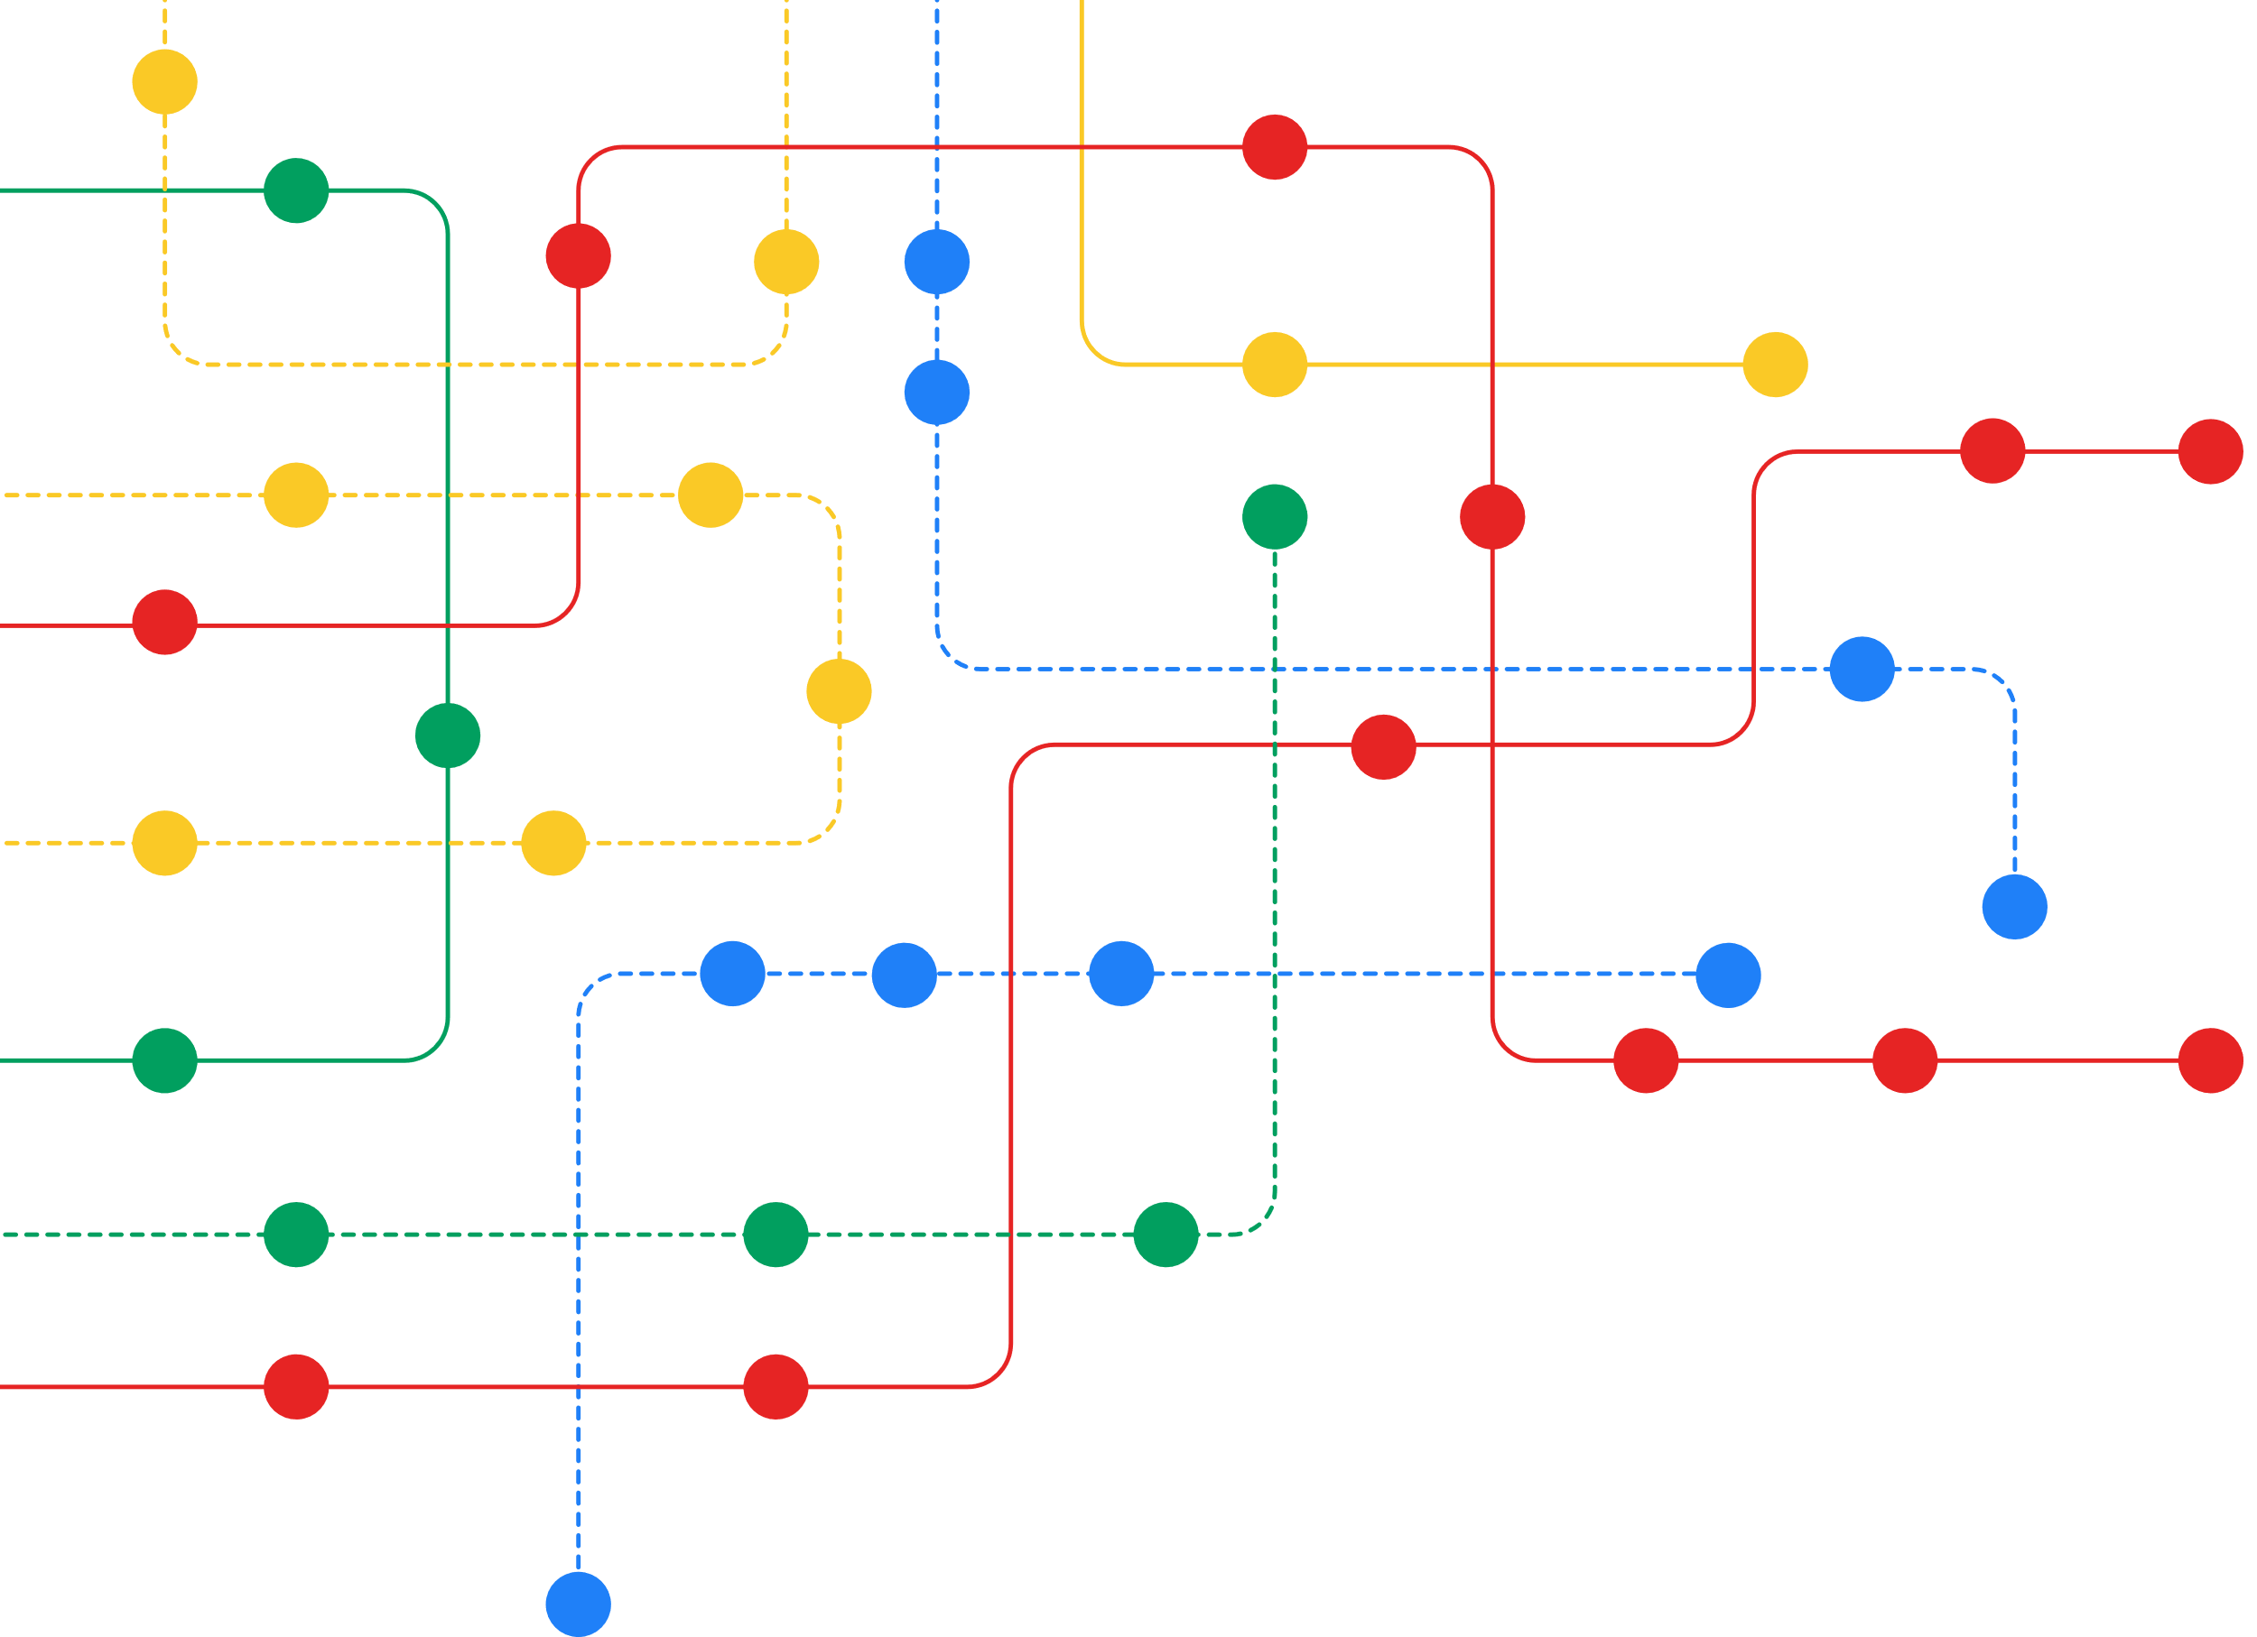
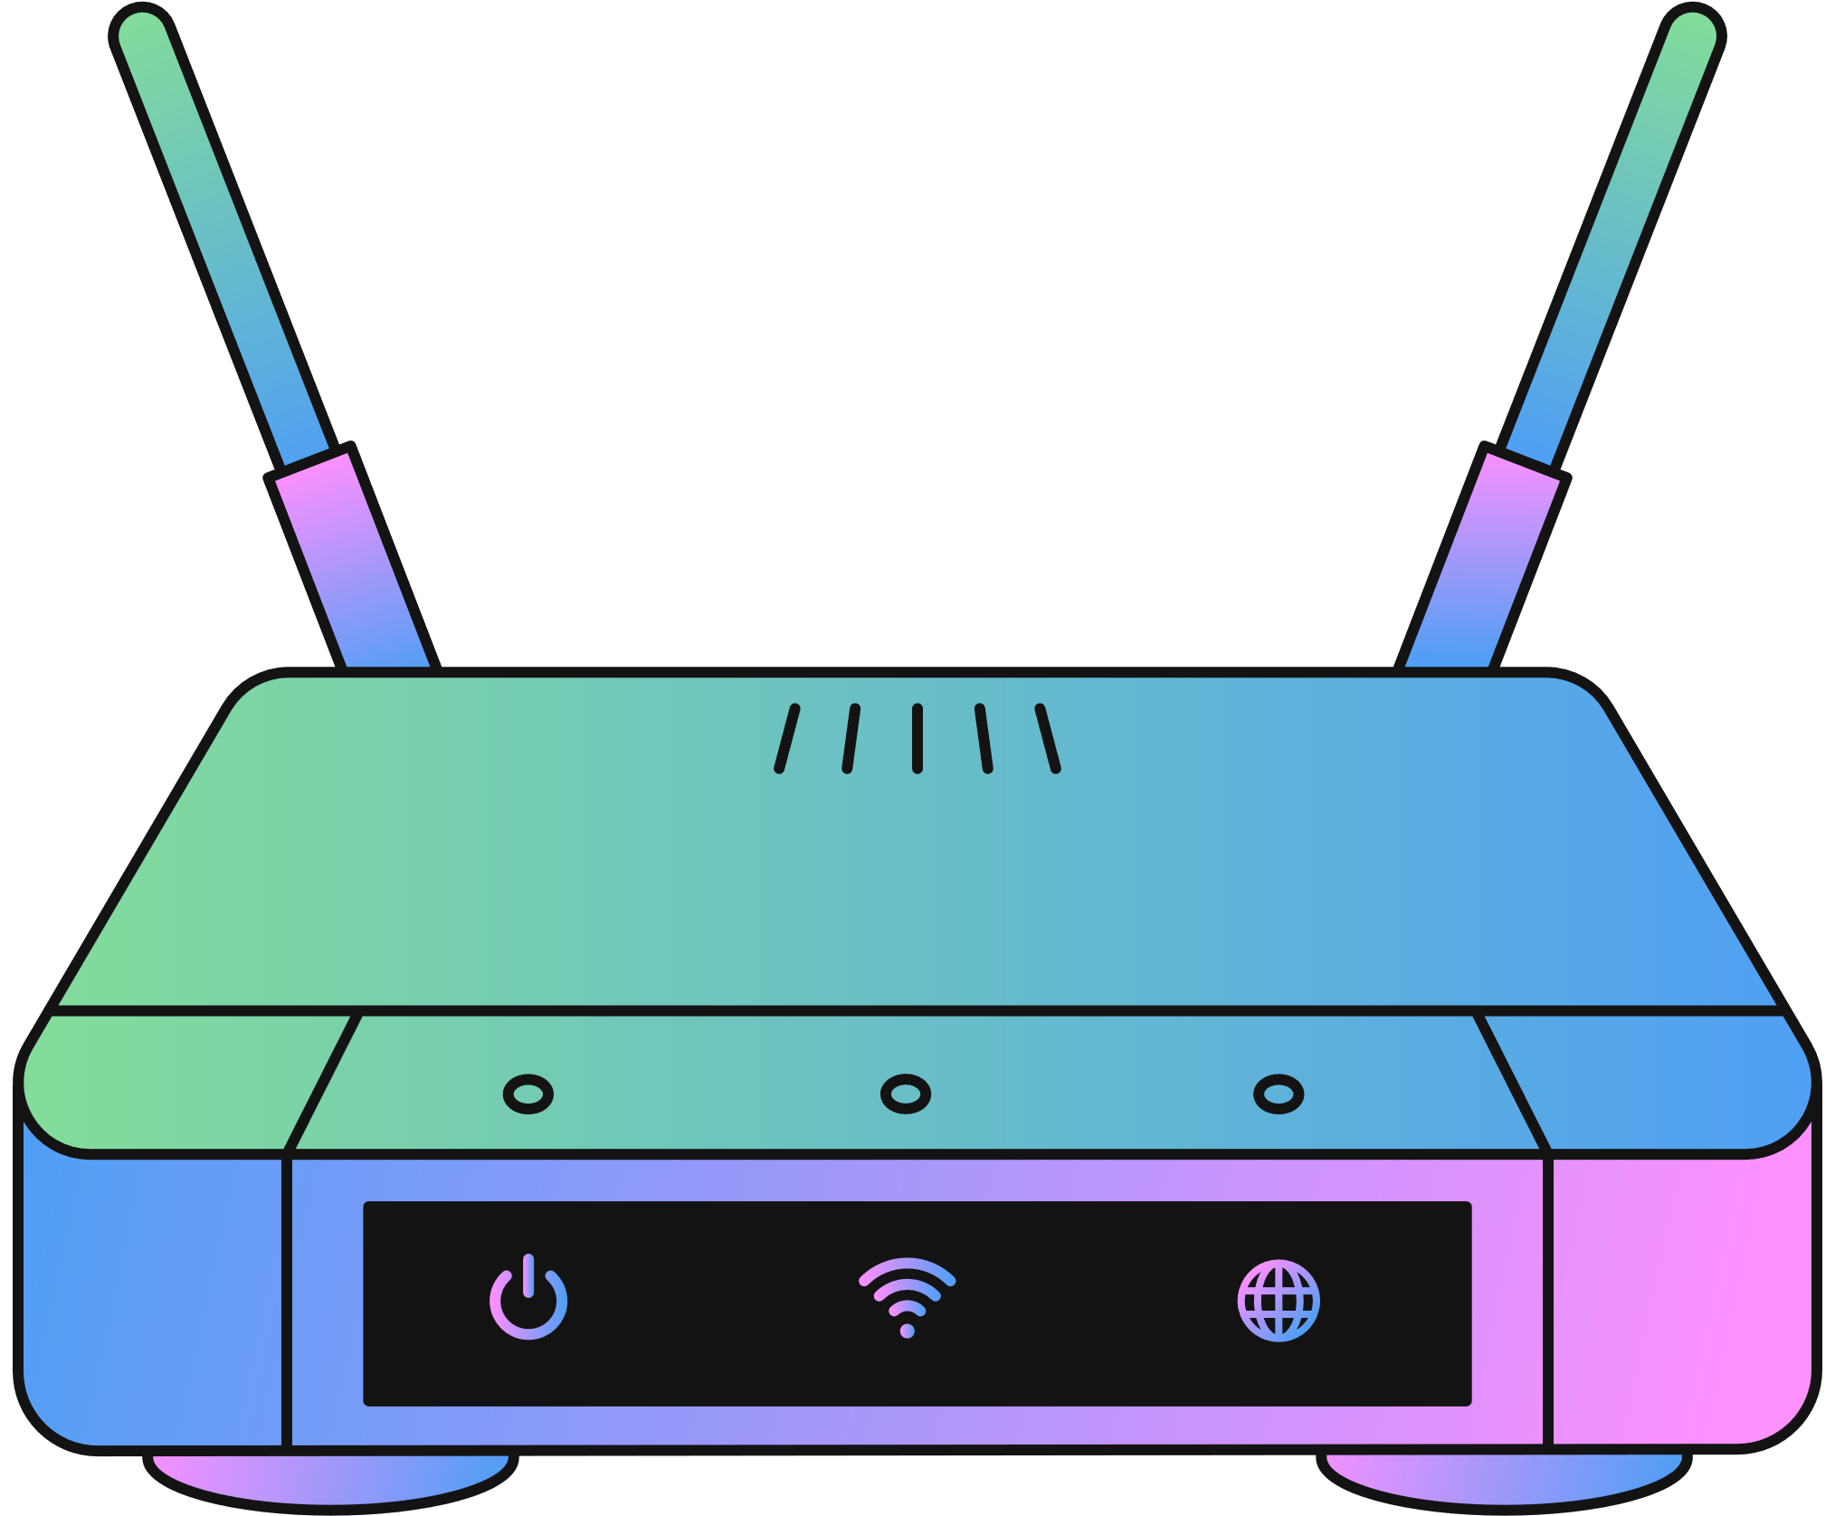
Subtopic 1
2.6 Architecture of the Internet
Router
Mesh Configuration: The cable mesh consists of numerous connection points known as nodes, featuring routers at each node.
fibre-optic cable seabed
Router Function: Routers are present not just in the broader internet mesh but also within ISP networks.
Interconnectivity: Each router links with multiple other routers, responsible for determining the optimal transmission path.
fibre-optic cable
underground
Route Selection: Routers decide the most suitable route for data transmission, aiding efficient network communication.

Slide 67

Subtopic 1
2.6 Architecture of the Internet
Public switched telephone network (PSTN)
The Public Switched Telephone Network (PSTN) was primarily designed to provide infrastructure support for voice communication over traditional landline telephones. However, its underlying infrastructure has played a role in supporting early stages of internet connectivity in the past, particularly during the dial-up era.

Slide 68
Subtopic 1
2.6 Architecture of the Internet
Public switched telephone network (PSTN)
Dial-Up Internet Access: Before broadband technologies became widespread, dial-up internet access was a common method for connecting to the internet. In a dial-up connection, a computer uses a modem to establish a connection over a standard telephone line through the PSTN. The modem translates digital data from the computer into analog signals that can be transmitted over the analog PSTN infrastructure. This connection allowed users to access the internet, albeit at slower speeds compared to modern broadband connections.

Slide 69


Subtopic 1
2.6 Architecture of the Internet
Evolution of PSTN
In more recent times, PSTNs have enhanced their primary communication pathways using fiber-optic cables and digital technology. This upgrade has enabled them to enhance leased line offerings to ISPs and has also opened the door for them to provide their own ISP services.
They offer two services:
Broadband network connection
Wifi Hotspot Technology

Slide 70


Subtopic 1
2.6 Architecture of the Internet
Cell Phone Network
Users of mobile-capable devices have an alternative method to access the internet through mobile companies that function as ISPs. Using suitable software, the mobile phone communicates with a regular cell tower, allowing access to the wireless phone network, subsequently establishing a connection to the internet.

Slide 71

2.7 Internet-Based Applications
1 - The World Wide Web
The World Wide Web is not the internet.
The World Wide Web (WWW) is an application accessible over the internet.

Slide 72
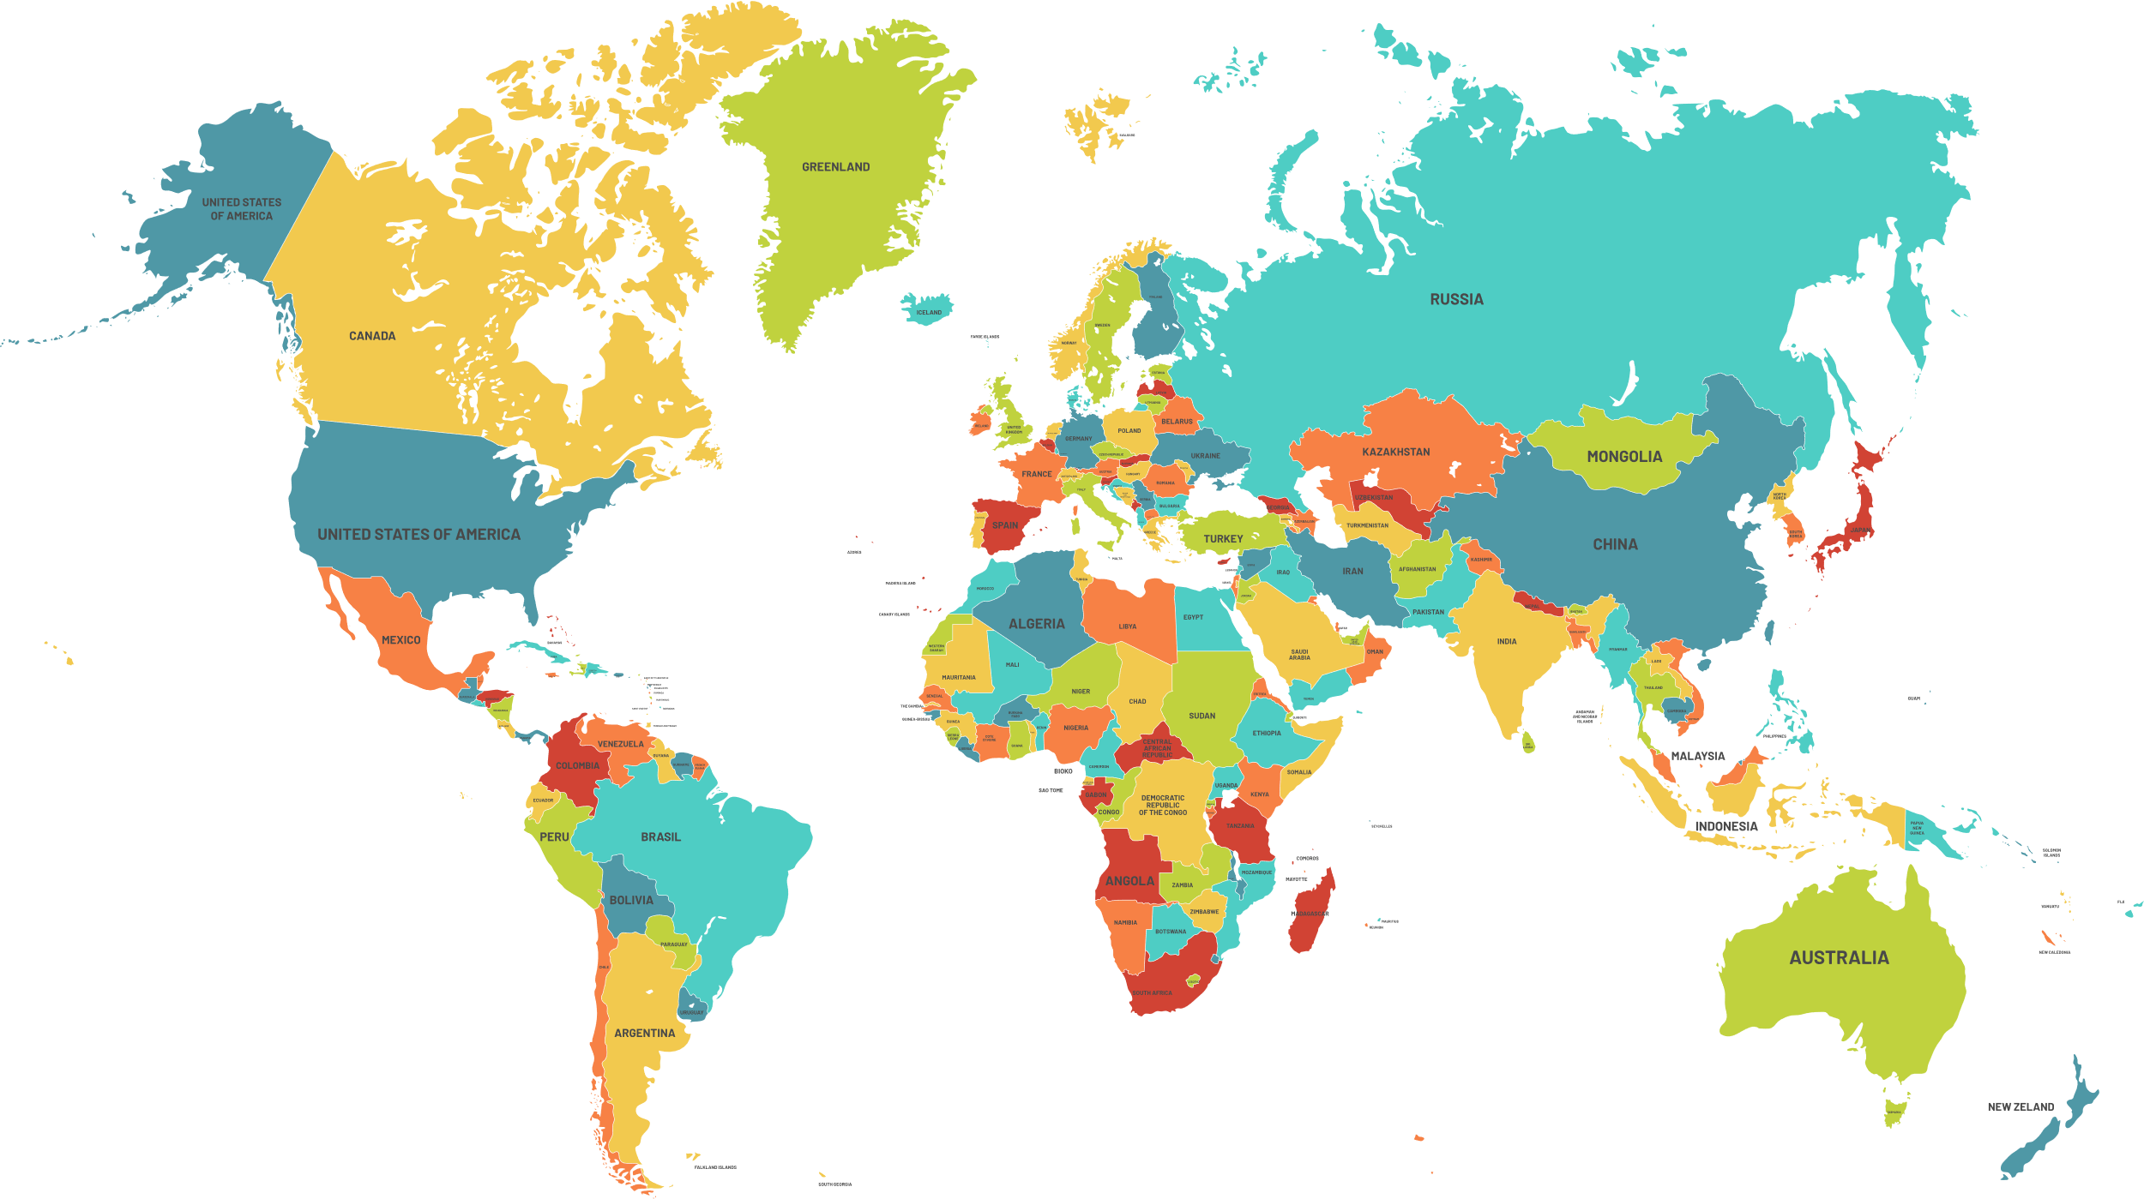



2.7 Internet-Based Applications
2 - Cloud Computing
Cloud computing is a technology model that provides on-demand access to a shared pool of computing resources, such as servers, storage, applications, and services, over the internet.

Slide 73
2.7 Internet-Based Applications
2 - Cloud Computing
Cloud computing is a technology model that provides on-demand access to a shared pool of computing resources, such as servers, storage, applications, and services, over the internet.
Private Cloud
Public Cloud

Slide 74
2.7 Internet-Based Applications
2 - Cloud Computing
A private cloud is a dedicated and isolated cloud computing environment that serves a single organization and is not shared with other users. There are three possible approaches:
Private Cloud
The organization assumes complete accountability for establishing and overseeing the on-premises cloud infrastructure linked to an exclusive network.
The organization delegates the task of setting up and administering an
on-premises installation connected to a private network to a third-party provider.
The organisation outsources the creation and management of an Internet accessible system by a third-party.
Public Cloud

Slide 75
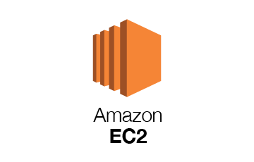

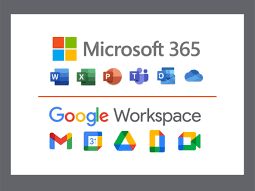
2.7 Internet-Based Applications
2 - Cloud Computing
A public cloud is a shared computing environment provided by a third-party vendor, accessible over the internet to multiple users and organizations.
Public Cloud
Enabled by:
Using large mainframe computers or server farms.
Infrastructure provision
Amazon EC2
Service provided:
Platform provision
Azure App Services
Software provision
Private Cloud

Slide 76
2.7 Internet-Based Applications
Public Cloud
Infrastructure provision
Improved software performance and expanded storage capacity.
Platform provision
Advantages
Provide resources and environments for the purpose of software development and testing.
Software provision
The cloud will be able to run applications that require high performance systems. Save money as company does not have Toby a software package. Users do not need technical expertise.
Data Privacy
Disadvantage
The cloud service provider maintains full access to all data stored in the cloud, leading to uncertainty for the cloud user about the possibility of their data being shared with third parties.

Slide 77

2.7 Internet-Based Applications
3 - Bit Streaming
A bitstream is a sequential series of binary digits (bits) that represents digital data, including video, and is used for transmission, storage, and processing.
0101011001001

Slide 78



2.7 Internet-Based Applications
Media Streaming

Slide 79

2.7 Internet-Based Applications
Media Streaming
Download
On Demand
Real-time
James Gan

Slide 80
2.7 Internet-Based Applications
Media Streaming
Download
User will download content from the server then listen to it / watch it at some future convenient time.
On Demand
Real-time

Slide 81

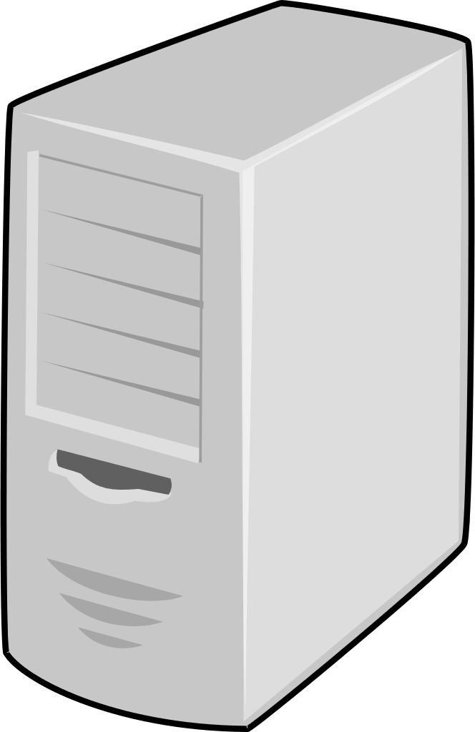

2.7 Internet-Based Applications
Media Streaming
Download
On Demand
When the user selects a specific moment for transmitting the content of the bitstream.
010101010
010010111
Buffer
Real-time

Slide 82


2.7 Internet-Based Applications
Media Streaming
Download
On Demand
Real-time
As the bitstream content is generated, it is simultaneously transmitted.
Because many users might be watching the content at the same time, the media is first sent to lots of content provider servers, and then these servers send it to individual users.
james gan

Slide 83

2.7 Internet-Based Applications
Term- Bit Rate
The number of bits transmitted per second.
1Mb / s
Bit rate has to be > 1 Mb /s for a good viewing experience

Slide 84
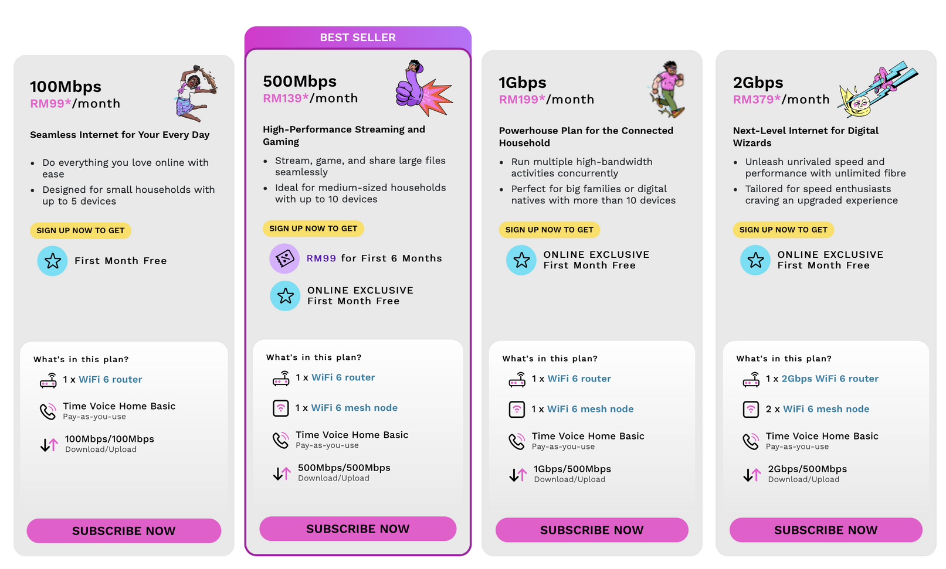
2.7 Internet-Based Applications
Term- Bit Rate
The bit rate is limited by the bandwidth of the network connection.

Slide 85


2.7 Internet-Based Applications
Term- Buffer
The stored media file that has not been played.
It is essential to have a buffer size that is sufficiently large for it to never get filled.
010101010
010010111
High-water mark
Low-water mark
Indicate the maximum amount of data the buffer can hold before it triggers a pause or data removal process.
Indicates the minimum amount of data in the buffer before it triggers a data addition process.

Slide 86

2.7 Internet-Based Applications
Term- Buffer
The stored media file that has not been played.
High-water mark
Low-water mark
Indicate the maximum amount of data the buffer can hold before it triggers a pause or data removal process.
Indicates the minimum amount of data in the buffer before it triggers a data addition process.

Slide 87
2.7 Internet-Based Applications
Term- Buffer
The media player continuously monitors how full the buffer is and controls the bit rate in relation to the defined high-and low-water marks.
High-water mark
Low-water mark
Indicate the maximum amount of data the buffer can hold before it triggers a pause or data removal process.
Indicates the minimum amount of data in the buffer before it triggers a data addition process.

Slide 88


2.8 IP Addressing and Network Identification
IPv4 addressing
Used to define from where and to where data is being transmitted.
192.168.1.1
Send to:
192.168.1.1
192.168.1.2

Slide 89
2.8 IP Addressing and Network Identification
Format
  32 bits / 4 bytes
  Allows for 2 addresses
32
Binary
.
.
.
11000000
10101000
00000001
00001010
Denary
.
.
.
192
168
1
10

Slide 90
2.8 IP Addressing and Network Identification
Highlighter
Original Scheme
The initial addressing system was created using a hierarchical structure where
  A set of bits determined a network (netID)
  A set of bits determined a host within that network (hostID)
  A set of bits determined a class
.
Identifier
netID
hostID
Class A
.
.
0
7 bits
24 bits
Class B
.
.
10
14 bits
16 bits
Class C
.
.
110
21 bits
8 bits

Slide 91
2.8 IP Addressing and Network Identification
Highlighter
Original Scheme
The initial addressing system was created using a hierarchical structure where
  A set of bits determined a network (netID)
  A set of bits determined a host within that network (hostID)
  A set of bits determined a class
.
Identifier
netID
hostID
Class A
.
.
0
0001010
000000000000000000000001
Class B
.
.
10
10110000010000
0000000000000001
Class C
.
.
110
000001010100000000000
00000001

Slide 92
2.8 IP Addressing and Network Identification
Highlighter
Original Scheme
Identifier
netID
hostID
Class A
.
.
0
0001010
000000000000000000000001
Allows initial transmission to be routed.
Will only need to be examined on arrival at the identified network.

Slide 93

2.8 IP Addressing and Network Identification
Problems with the original scheme
The issue emerged as local area networks (LANs) became widespread. There was a shortage of available Class B network IDs, and if organizations were assigned to Class C, the available number of host IDs became inadequate.
Class B
.
.
10
14 bits
16 bits
14
2 = 16384
Class C
.
.
110
21 bits
8 bits
8
2 = 256

Slide 94

2.8 IP Addressing and Network Identification
Classless inter-domain routing
Identifier
netID
hostID
Class A
0
.
7 bits
.
24 bits
Class B
10
.
14 bits
.
16 bits
Class C
110
.
21 bits
.
8 bits

Slide 95
2.8 IP Addressing and Network Identification
Highlighter
Classless inter-domain routing
How? Add an 8-bit suffix to the address that specifies the number of bits for the netID.
For example, let’s say we want our netID to have a length of 18 (hence our hostID will have a length of 14).
00001010.00000000.01000000.00000000
Dotted decimal notation:
10
0
64
0
/ 18

Slide 96
2.8 IP Addressing and Network Identification
Highlighter
Classless inter-domain routing
How? Add an 8-bit suffix to the address that specifies the number of bits for the netID.
For example, let’s say we want our netID to have a length of 18 (hence our hostID will have a length of 14).
first 18 bits:
netID
last 14 bits:
hostID
00001010.00000000.01000000.00000000
Dotted decimal notation:
10
0
64
0
/ 18

Slide 97
2.8 IP Addressing and Network Identification
Benefits of CIDR
CIDR allows us to use variable-length subnet masks, which means we can allocate IP addresses in a more flexible and efficient manner. This is super important in today's internet where we're running out of IPv4 addresses. With CIDR, we can allocate just the right amount of addresses to different networks, preventing address wastage and improving overall IP address utilization.

Slide 98


2.8 IP Addressing and Network Identification
Highlighter
Sub-netting
Subnetting is the process of dividing a larger network into smaller, more manageable sub-networks to improve efficiency and organization in IP address allocation and routing.
Sub-networks
Network
Network

Slide 99



2.8 IP Addressing and Network Identification
Sub-netting
D1
Example:
D2
for each department
Highlighter
D3
The school will need eight individual Class C netIDs; one for each LAN.
24 bits
.
8 bits
D4
first 24 bits:
netID
last 8 bits:
hostID
D5
= 256 workspaces for each department
D6
A school that wants to accommodate 200 workspaces, and they have 8 departments
D7
D8

Slide 100
2.8 IP Addressing and Network Identification
Sub-netting
D1
8 departments x 256 addresses
= 2048 addresses
Example:
D2
D3
Wasted Addresses
D4
2048 - 200
= 1848 addresses
D5
D6
A school that wants to accommodate 250 workspaces, and they have 8 departments
D7
We need to solve this
D8

Slide 101

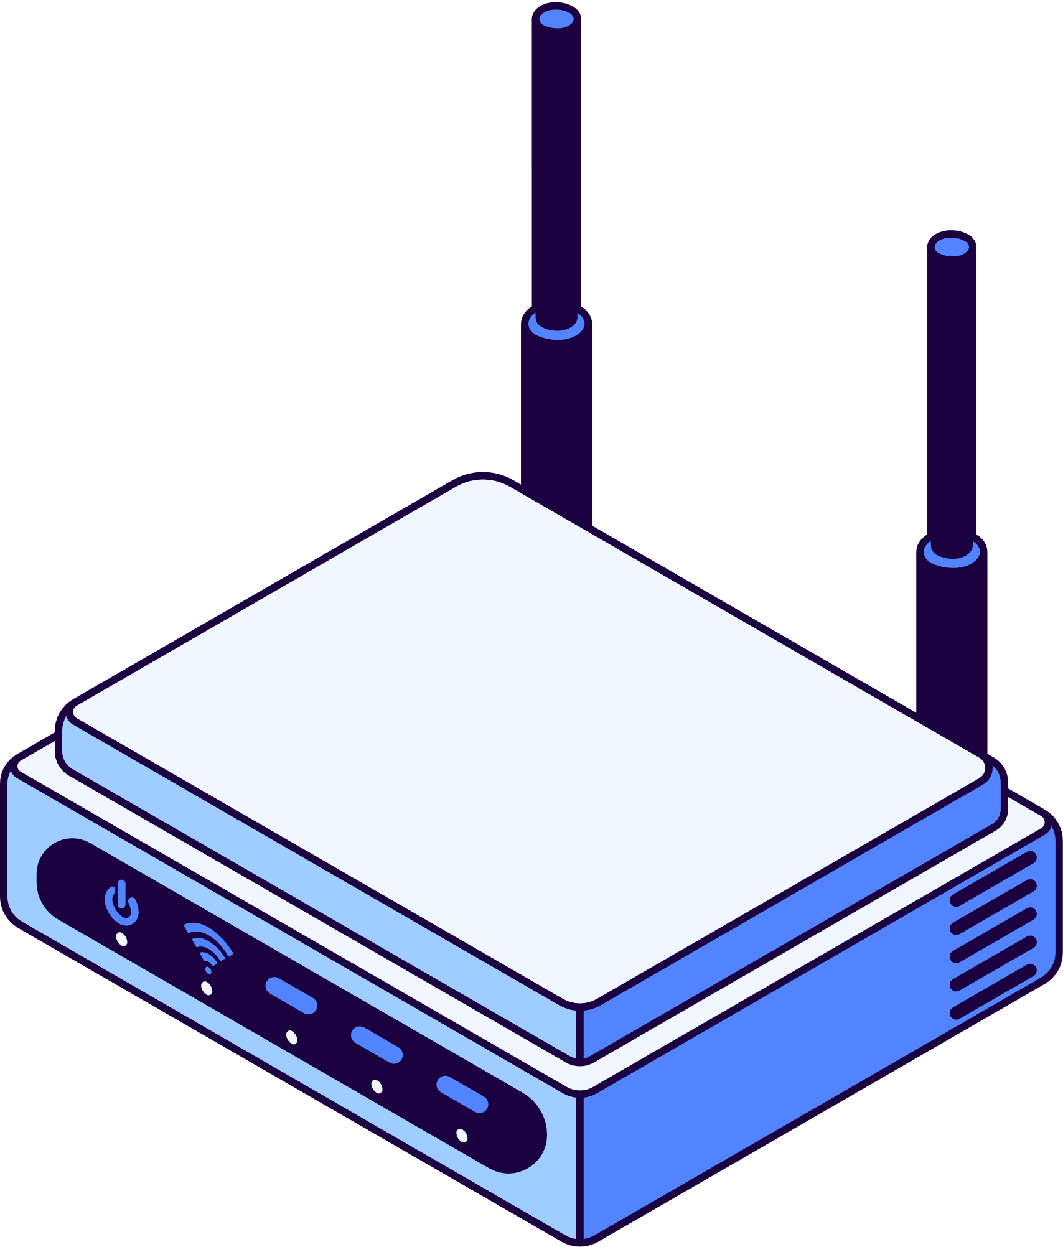
2.8 IP Addressing and Network Identification
last 8 bits:
hostID
Sub-netting
Solution: Let all the departments share one netID.
8 bits
24 bits
3 bits
5 bits
D1
000
00000 - 11111
first 24 bits:
netID
D2
001
00000 - 11111
D3
010
00000 - 11111
D4
011
00000 - 11111
= 32 addresses x 8
= 256 addresses
D5
100
00000 - 11111
101
00000 - 11111
D6
D7
110
00000 - 11111
D8
111
00000 - 11111

Slide 102
2.8 IP Addressing and Network Identification
Sub-netting
No subnetting
Subnetting
last 8 bits:
hostID
D1
24 bits
.
8 bits
8 bits
D2
24 bits
.
8 bits
24 bits
3 bits
5 bits
.
first 24 bits:
netID
D1
000
00000 - 11111
D3
24 bits
8 bits
001
D2
00000 - 11111
D4
24 bits
.
8 bits
D3
010
00000 - 11111
D5
24 bits
.
8 bits
D4
011
00000 - 11111
= 32 addresses x 8
= 256 addresses
D5
100
00000 - 11111
D6
24 bits
.
8 bits
D6
101
00000 - 11111
D7
24 bits
.
8 bits
D7
110
00000 - 11111
D8
111
00000 - 11111
D8
24 bits
.
8 bits
Wasted Addresses
Wasted Addresses
2048 - 200
= 1848 addresses
256 - 200
= 56 addresses

Slide 103

2.8 IP Addressing and Network Identification
Highlighter
Network Address Translation (NAT)
NAT allows multiple devices in a private network to access the internet using a single public IP address.
NAT 1
203.0.113.45
NAT 2
151.101.65.121
NAT 3
8.8.8.8

Slide 104
2.8 IP Addressing and Network Identification
Network Address Translation (NAT)
NAT allows multiple devices in a private network to access the internet using a single public IP address.
NAT 1
203.0.113.45
NAT 2
151.101.65.121
NAT 3
8.8.8.8
Internet Router

Slide 105
2.8 IP Addressing and Network Identification
Network Address Translation (NAT)
192.168.1.10
NAT 1
10.0.2.25
203.0.113.45
172.16.0.100
192.168.1.10
NAT 2
They can be the same! Does not have to be unique.
151.101.65.121
10.0.2.25
172.16.0.100
192.168.1.10
NAT 3
8.8.8.8
10.0.2.25
172.16.0.100
Internet Router
Private IP Address

Slide 106
2.8 IP Addressing and Network Identification
Private Address Range
10.0.0.0
Range
10.255.255.255
172.16.0.0
Range
172.31.255.255
192.168.0.0
Range
192.168.255.255

Slide 107
2.8 IP Addressing and Network Identification
Network Address Translation (NAT)
  The NAT box's interface is equipped with software that analyzes every inbound and outbound communication.
NAT 1
203.0.113.45
  A security assessment can occur prior to routing an incoming transmission to the appropriate internal address.

Slide 108
2.8 IP Addressing and Network Identification
Static and Dynamic Address
When a user desires to access the internet, the responsibility of managing the connection falls on an Internet Service Provider.
There are instances where the ISP might be accommodating more users than the total count of available addresses. This is when a dynamic address is needed.
Dynamic Address
Static Address
An automatically assigned network identifier that changes periodically as devices connect and disconnect
A fixed, unchanging network identifier assigned to a device, often used for consistent hosting or management purposes.

Slide 109
2.8 IP Addressing and Network Identification
IPv6 Addressing
IPv4's limited pool of available addresses is insufficient to accommodate the growing number of devices and users on the internet in this decade, necessitating the adoption of IPv6 with its vastly expanded address space.
IPv6 Address Format
128 bits
Eg:
3ffe : 1900 : 4545 : 3a7b: 200a : f8ff : fe21 : 67cf
Written in colon hexadecimal notation

Slide 110



2.9 Domain Name System
Domain Name System
DNS (Domain Name System) is a decentralized naming system that translates human-readable domain names into IP addresses, facilitating internet communication.
www.abc.com
151.101.65.121

Slide 111

2.9 Domain Name System
Domain Name System
The DNS (Domain Name System) is structured hierarchically, resembling an upside-down tree.
Root servers
Top of hierarchy, starting point for DNS queries.
Top Level Domains
.com, .org, .net, and country-code TLDs like .us, .uk, etc.
Second-Level Domains
Beneath the TLDs are the second-level domains, which are the actual domains that people typically register, like google.com or example.org
more levels ...

Slide 112




2.9 Domain Name System
Name Resolution
Process to look up a domain name to find an IP address. There are 3 outcomes.
If the server receiving the query has control over the domain, it provides an accurate and authoritative IP address in response.
For remote domains in a query, it's sent to a root server that gives the top-level domain's name server address, leading to the next lower domain's name server, and so on, until an authoritative IP address is obtained.
Root servers
Even if the server doesn't control the domain, it can provide an IP address from its cache of recent requests, which might be outdated.
Top Level Domains
Second-Level Domains
more levels ...
james gan

