Slide 1
Cambridge International
AS Level Computer Science
(9618) – Revision Notes
Data Representation, Multimedia – Graphics,
Sound, Compression
This pack is intended for students to who are taking CIE AS Level in Computer Science, either in preparation for their AS exam, or more likely alongside year 2 of the course to improve fluency, recall and pace on AS topics. It could be used as lesson starters, or supplied to students for independent use.

Slide 2



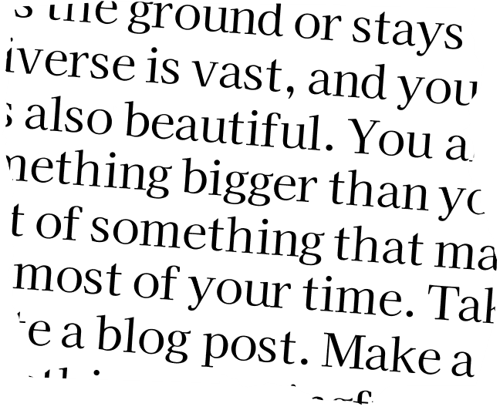



Chapter
1
UnderstandingData Representation
10110101010011
...
A LEVEL COMPUTER SCIENCE

Slide 3



1.1
1.2
1.3
1.4
Number System
Quantitative Data Representation
Numerical Encoding
Text Encoding
1.5
Digital Sound Representation
Chapter
Outline
1.6
Digital Image Representation
1.7
Data Compression Methods

Slide 4

1.1 Number System
DENARY NUMBERS
  Base-10 number system
  10 unique symbols (0,1,2,3,4,5,6,7,8,9)
  The value that a digit represents is defined by the place values of the digits in the number
100
10
1
3
6
5
Highlighter

Slide 5
1.1 Number System
DENARY NUMBERS
  Base-10 number system
  10 unique symbols (0,1,2,3,4,5,6,7,8,9)
  The value that a digit represents is defined by the place values of the digits in the number
10
2
10
1
10
0
3
6
5
Highlighter

Slide 6

1.1 Number System
BINARY NUMBERS
  Base-2 number system
  2 unique symbols (0,1)
  Why Binary? Electronic components can only reliably represent two states: on/off or high/low voltage.
On =1
Off = 0

Slide 7
1.1 Number System
BINARY NUMBERS
128
64
32
16
8
4
2
1
1
0
1
1
0
1
0
1
Like in Denary, the value that a digit represents is defined by the
place values of the digits in the number.

Slide 8
1.1 Number System
1.1 Number System
BINARY NUMBERS
2
7
2
6
2
5
2
4
2
3
2
2
2
1
2
0
1
0
1
1
0
1
0
1
Like in Denary, the value that a digit represents is defined by the
place values of the digits in the number.

Slide 9

1.1 Number System
BINARY NUMBERS
128
64
32
16
8
4
2
1
1
0
1
1
0
1
0
1
8 bits = 1 byte

Slide 10
1.1 Number System
BINARY NUMBERS
128
64
32
16
8
4
2
1
1
0
1
1
0
1
0
1
4 bits = 1 nibble
4 bits = 1 nibble

Slide 11
1.1 Number System
1.1 Number System
Hexadecimal
  Base 16 number system
  16 unique symbols (0,1,2,3,4,5,6,7,8,9,A,B,C,D,E,F)
  The value that a digit represents is defined by the place values of the digits in the number
256
16
1
F
3
A

Slide 12
1.1 Number System
Hexadecimal
  Base 16 number system
  16 unique symbols (0,1,2,3,4,5,6,7,8,9,A,B,C,D,E,F)
  The value that a digit represents is defined by the place values of the digits in the number
16
2
16
1
16
0
F
3
A

Slide 13
1.1 Number System
Why Hexadecimal
  Hexadecimal simplifies binary representation, aiding memory addressing and byte visualization.
  One nibble can be written by one hexadecimal digit.
Binary
Hexadecimal
0
0
0
1
1

Slide 14

1.1 Number System
Binary
Hexadecimal
Binary
Hexadecimal
0
0
0
0
0
1
0
0
0
8
0
0
0
1
1
1
0
0
1
9
0
0
1
0
2
1
0
1
0
A
0
0
1
1
3
1
0
1
1
B
0
1
0
0
4
1
1
0
0
C
0
1
0
1
5
1
1
0
1
D
0
1
1
0
6
1
1
1
0
E
0
1
1
1
7
1
1
1
1
F
james gan

Slide 15
1.1 Number System
0
1
1
1
1
1
1
0
0
1
0
1
1
0
1
0
7
E
5
A
7
E
5
A

Slide 16
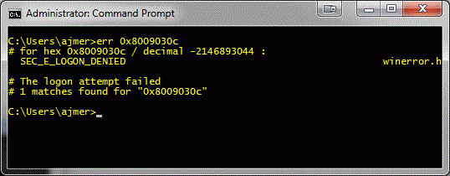
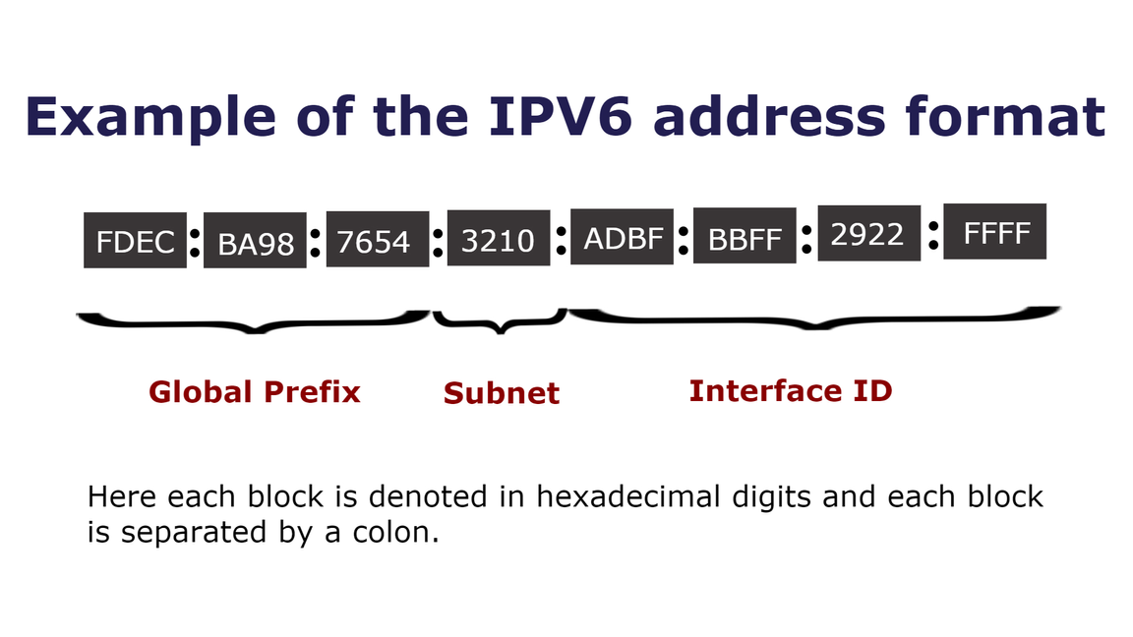
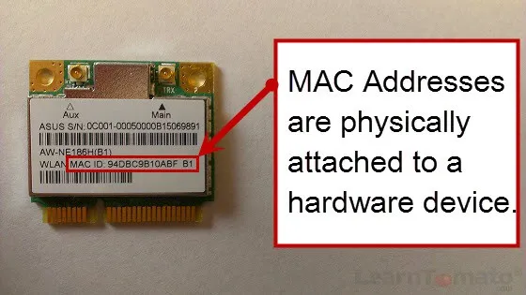
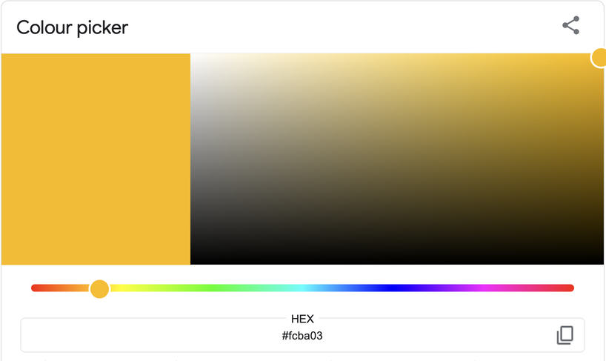
1.1 Number System
Usages of Hexadecimal
Error Codes |  | IP Address
MAC Address |  | HTML Colour Codes

Slide 17
1.1 Number System
Converting from binary to denary
Multiply the digit value by the place value.
16
8
4
2
1
1
0
1
0
1

Slide 18
1.1 Number System
Converting from binary to denary
Multiply the digit value by the place value.
16
8
4
2
1
1
0
1
0
1
(1x1) + (0x2) + (1x4) + (0x8) + (1x16)
= 21

Slide 19
1.1 Number System
Converting from binary to denary
Multiply the digit value by the place value.
64
32
16
8
4
2
1
1
1
0
1
0
1
1

Slide 20
1.1 Number System
Converting from binary to denary
Multiply the digit value by the place value.
64
32
16
8
4
2
1
1
1
0
1
0
1
1
1 + 2 + 8 + 32 + 64
= 107

Slide 21
1.1 Number System
Converting from denary to binary
Keep dividing the denary number by 2. Obtain the remainder. Construct the answer.
Denary = 5
5
2
2
1
remainder
Read the remainder
from bottom to top
remainder
remainder
Binary = 101

Slide 22
1.1 Number System
Converting from denary to binary
Keep dividing the denary number by 2. Obtain the remainder. Construct the answer.
Denary = 5
5
2
2
1
remainder
Read the remainder
from bottom to top
2
1
0
remainder
remainder
Binary = 101

Slide 23
1.1 Number System
Converting from denary to binary
Keep dividing the denary number by 2. Obtain the remainder. Construct the answer.
Denary = 5
5
2
2
1
remainder
Read the remainder
from bottom to top
2
1
0
remainder
2
0
1
remainder
Binary = 101

Slide 24
1.1 Number System
Converting from denary to binary
Keep dividing the denary number by 2. Obtain the remainder. Construct the answer.
Denary =39
39
2
19
1
remainder
remainder
remainder
Read the remainder
from bottom to top
remainder
remainder
remainder

Slide 25
1.1 Number System
Converting from denary to binary
Keep dividing the denary number by 2. Obtain the remainder. Construct the answer.
Denary =39
39
2
19
1
remainder
2
9
1
remainder
2
4
1
Read the remainder
from bottom to top
remainder
2
2
0
remainder
2
1
0
remainder
2
0
1
remainder
Binary = 100111

Slide 26
1.1 Number System
Converting from binary to hexadecimal
Look up / Create a binary to hexadecimal table
Binary
Hexadecimal
0
0
0
0
0
0
0
0
1
1
Binary
0
0
1
0
2
0
0
1
1
3
0
1
1
1
1
1
1
0
0
1
0
0
4
0
1
0
1
5
0
1
1
0
6
0
1
1
1
7
1
0
0
0
8
1
0
0
1
9
1
0
1
0
A
1
0
1
1
B
1
1
0
0
C
1
1
0
1
D
1
1
1
0
E
1
1
1
1
F

Slide 27
1.1 Number System
Converting from binary to hexadecimal
Look up / Create a binary to hexadecimal table
Binary
Hexadecimal
0
0
0
0
0
0
0
0
1
1
Binary
0
0
1
0
2
0
0
1
1
3
0
1
1
1
1
1
1
0
0
1
0
0
4
0
1
0
1
5
0
1
1
0
6
0
1
1
1
7
1
0
0
0
8
Hexadecimal
1
0
0
1
9
1
0
1
0
A
1
0
1
1
B
1
1
0
0
C
7
E
1
1
0
1
D
1
1
1
0
E
1
1
1
1
F

Slide 28
1.1 Number System
Converting from binary to hexadecimal
Look up / Create a binary to hexadecimal table
Binary
Hexadecimal
0
0
0
0
0
0
0
0
1
1
Binary
0
0
1
0
2
0
0
1
1
3
1
1
0
1
1
1
1
1
1
0
0
1
0
0
4
0
1
0
1
5
0
1
1
0
6
0
1
1
1
7
1
0
0
0
8
Hexadecimal
1
0
0
1
9
1
0
1
0
A
1
0
1
1
B
?
7
E
1
1
0
0
C
1
1
0
1
D
1
1
1
0
E
1
1
1
1
F

Slide 29
1.1 Number System
Converting from binary to hexadecimal
Look up / Create a binary to hexadecimal table
Binary
Hexadecimal
0
0
0
0
0
0
0
0
1
1
Binary
0
0
1
0
2
0
0
1
1
3
0
0
1
1
0
1
1
1
1
1
1
0
0
1
0
0
4
0
1
0
1
5
0
1
1
0
6
0
1
1
1
7
1
0
0
0
8
Hexadecimal
1
0
0
1
9
1
0
1
0
A
1
0
1
1
B
3
7
E
1
1
0
0
C
1
1
0
1
D
1
1
1
0
E
1
1
1
1
F

Slide 30
1.1 Number System
Converting from hexadecimal to binary
Look up / Create a binary to hexadecimal table
Binary
Hexadecimal
0
0
0
0
0
Hexadecimal
0
0
0
1
1
0
0
1
0
2
0
0
1
1
3
C
3
0
1
0
0
4
0
1
0
1
5
0
1
1
0
6
0
1
1
1
7
1
0
0
0
8
Binary
1
0
0
1
9
1
0
1
0
A
?
?
?
?
?
?
?
?
1
0
1
1
B
1
1
0
0
C
1
1
0
1
D
1
1
1
0
E
1
1
1
1
F

Slide 31
1.1 Number System
Converting from hexadecimal to binary
Look up / Create a binary to hexadecimal table
Binary
Hexadecimal
0
0
0
0
0
Hexadecimal
0
0
0
1
1
0
0
1
0
2
0
0
1
1
3
C
3
0
1
0
0
4
0
1
0
1
5
0
1
1
0
6
0
1
1
1
7
1
0
0
0
8
Binary
1
0
0
1
9
1
0
1
0
A
1
1
0
0
0
0
1
1
1
0
1
1
B
1
1
0
0
C
1
1
0
1
D
1
1
1
0
E
1
1
1
1
F

Slide 32
1.1 Number System
Converting from hexadecimal to denary
Multiply the digit value by the place value.
4096
256
16
1
1
2
A
E
= 10
= 15

Slide 33
1.1 Number System
Converting from hexadecimal to denary
Multiply the digit value by the place value.
4096
256
16
1
1
2
A
E
= 10
= 15
(15x1) + (10x16) + (2x256) + (1x4096)
=4783

Slide 34
1.1 Number System
Converting from denary to hexadecimal
Keep dividing the denary number by 16. Obtain the remainder. Construct the answer.
Denary =3179
3179
16
198
11
= B
remainder
Read the remainder
from bottom to top
remainder
remainder

Slide 35
1.1 Number System
Converting from denary to hexadecimal
Keep dividing the denary number by 16. Obtain the remainder. Construct the answer.
Denary =3179
3179
16
198
11
= B
remainder
Read the remainder
from bottom to top
16
12
6
remainder
remainder

Slide 36
1.1 Number System
Converting from denary to hexadecimal
Keep dividing the denary number by 16. Obtain the remainder. Construct the answer.
Denary =3179
3179
16
198
11
= B
remainder
Read the remainder
from bottom to top
16
12
6
remainder
16
0
12
= C
remainder
Hexadecimal = C6B

Slide 37
Subtopic 1
1.2 Quantitative Data Representation
In mathematics, here are a few ways that we can use to represent large numbers ...
  689000 grams
  6.89 x 10 grams
  689 kilograms
5

Slide 38
Subtopic 1
1.2 Quantitative Data Representation
Decimal Prefix table
Decimal Prefix Name | Symbol used | Factor applied to the value
kilo | k | 10
mega | M | 10
giga | G | 10
tera | T | 10
3
6
9
12

Slide 39
Subtopic 1
1.2 Quantitative Data Representation
binary prefix
  Why binary prefix? Computer works only with binary.
  When a new digit is added to the binary, the value is multiplied by 2. Eg
    1 (binary) = 1
    10 (binary) = 2
    100 (binary) = 4
    10000000000 (binary) = 1024 = kibi
Binary Prefix Name | Symbol used | Factor applied to the value
Kibi | Ki | 2
Mebi | Mi | 2
Gibi | Gi | 2
Tebi | Ti | 2
10
20
30
40

Slide 40

Subtopic 1
1.2 Quantitative Data Representation
Storage Terminology Overview
1
0
1
1
1
0
1
1
0
1
0
1
1
0
1
1
0
1
0
1
1 kibi
bytes
1024 x
8 bits = 1 byte
4 bits = 1 nibble
8 bits = 1 byte
1 mebi
bytes
...
1 kibi
bytes
1
0
1
1
0
1
0
1
1024 x
1024 x
8 bits = 1 byte

Slide 41



Subtopic 1
1.2 Quantitative Data Representation
Storage Conversion Cheatsheet
Bit
x8
8
Byte
x1024
1024
Kibibytes (KiB)
x1024
1024
Mebibytes (MiB)
x1024
1024
Gibibytes (GiB)
x1024
1024
Tebibytes (TiB)

Slide 42
Subtopic 1
1.2 Quantitative Data Representation
Bit
x8
8
Exercise
Byte
x1024
1024
Convert 8756000 bytes to Mebibytes.
Kibibytes (KiB)
x1024
1024
Mebibytes (MiB)
x1024
1024
8756000 / 1024 = 8550 kibibytes
Gibibytes (GiB)
x1024
1024
Tebibytes (TiB)

Slide 43
Subtopic 1
1.2 Quantitative Data Representation
Bit
x8
8
Exercise
Byte
x1024
1024
Convert 8756000 bytes to Mebibytes.
Kibibytes (KiB)
x1024
1024
Mebibytes (MiB)
x1024
1024
8756000 / 1024 = 8550 kibibytes
8550/ 1024 = 8.34 Mebibytes
Gibibytes (GiB)
x1024
1024
Tebibytes (TiB)

Slide 44
Subtopic 1
Bit
1.2 Quantitative Data Representation
x8
8
Byte
Exercise
x1024
1024
Kibibytes (KiB)
Convert 1.34 Gibibytes to Kibibytes.
x1024
1024
Mebibytes (MiB)
x1024
1024
Gibibytes (GiB)
1.34 x 1024 = 1372 Mebibytes
x1024
1024
Tebibytes (TiB)

Slide 45
Subtopic 1
Bit
1.2 Quantitative Data Representation
x8
8
Byte
Exercise
x1024
1024
Kibibytes (KiB)
Convert 1.34 Gibibytes to Kibibytes.
x1024
1024
Mebibytes (MiB)
x1024
1024
Gibibytes (GiB)
1.34 x 1024 = 1372 Mebibytes
1372 x 1024 = 140, 4928 Kibibytes
x1024
1024
Tebibytes (TiB)

Slide 46

1.3 Numerical Encoding
Positive Integer
Eg. 107
64
32
16
8
4
2
1
1
1
0
1
0
1
1
1 + 2 + 8 + 32 + 64
= 107
Positive Integer
Negative Integer
Binary Arithmetic
Binary Coded Decimal (BCD)

Slide 47
1.3 Numerical Encoding
Negative Integer
-32 ?
64
32
16
8
4
2
1
?
?
?
?
?
?
?
Positive Integer
Negative Integer
Binary Arithmetic
Binary Coded Decimal (BCD)

Slide 48

1.3 Numerical Encoding
Negative Integer
-32 ?
Solution:
Make the leftmost
bit the signed bit
-64
32
16
8
4
2
1
?
?
?
?
?
?
?
0 = Positive
1 = Negative
Positive Integer
Negative Integer
Binary Arithmetic
Binary Coded Decimal (BCD)

Slide 49
1.3 Numerical Encoding
Negative Integer
-32 ?
-64
32
16
8
4
2
1
1
1
0
0
0
0
0
Positive Integer
Negative Integer
Binary Arithmetic
Binary Coded Decimal (BCD)

Slide 50
1.3 Numerical Encoding
Negative Integer
-7 ?
-8
4
2
1
?
?
?
?
Positive Integer
Negative Integer
Binary Arithmetic
Binary Coded Decimal (BCD)

Slide 51
1.3 Numerical Encoding
Negative Integer
-7 ?
-8
4
2
1
1
0
0
1
Positive Integer
Negative Integer
Binary Arithmetic
Binary Coded Decimal (BCD)

Slide 52
1.3 Numerical Encoding
Negative Integer
Convert the two's complement 1110011 into denary.
-64
32
16
8
4
2
1
1
1
1
0
0
1
1
Positive Integer
Negative Integer
Binary Arithmetic
Binary Coded Decimal (BCD)

Slide 53
1.3 Numerical Encoding
Negative Integer
Convert the two's complement 1110011 into denary.
-64
32
16
8
4
2
1
1
1
1
0
0
1
1
-64 + 32 + 16 + 2 + 1
= -13
Positive Integer
Negative Integer
Binary Arithmetic
Binary Coded Decimal (BCD)

Slide 54
1.3 Numerical Encoding
Negative Integer
Give the smallest and largest two’s complement binary number that can be represented using 8 bits.
-128
64
32
16
8
4
2
1
?
?
?
?
?
?
?
?
Positive Integer
Negative Integer
Binary Arithmetic
Binary Coded Decimal (BCD)

Slide 55
1.3 Numerical Encoding
Negative Integer
Give the smallest and largest two’s complement binary number that can be represented using 8 bits.
Smallest:
-128
64
32
16
8
4
2
1
1
0
0
0
0
0
0
0
Positive Integer
Negative Integer
Binary Arithmetic
Binary Coded Decimal (BCD)

Slide 56
1.3 Numerical Encoding
Negative Integer
Give the smallest and largest two’s complement binary number that can be represented using 8 bits.
Largest:
-128
64
32
16
8
4
2
1
0
1
1
1
1
1
1
1
Positive Integer
Negative Integer
Binary Arithmetic
Binary Coded Decimal (BCD)
james gan

Slide 57
1.3 Numerical Encoding
Negative Integer
Facts: You can get the same denary value even if you have two different two's complement value. Eg.
1100
11100
-8
4
2
1
-16
8
4
2
1
1
1
0
0
1
1
1
0
0
-8 + 4
= -4
-16 + 8 + 4
= -4
Positive Integer
Negative Integer
Binary Arithmetic
Binary Coded Decimal (BCD)

Slide 58
1.3 Numerical Encoding
Binary Arithmetic - Adding
Before considering how to add 2 binary numbers, let's revise how we add 2 denary numbers ...
Carry
1
1
1
593
All the possible digits in denary:
0,1,2,3,4,5,6,7,8,9
+
729
1322
Positive Integer
Negative Integer
Binary Arithmetic
Binary Coded Decimal (BCD)

Slide 59
1.3 Numerical Encoding
Notes:
Binary Arithmetic - Adding
0+0 = 0
0+1 = 1
1+0 = 0
1+1 = 10
1+1+1 = 11
Carry
1
111
All the possible digits in binary:
0,1
+
101
0
Positive Integer
Negative Integer
Binary Arithmetic
Binary Coded Decimal (BCD)

Slide 60
1.3 Numerical Encoding
Notes:
Binary Arithmetic - Adding
0+0 = 0
0+1 = 1
1+0 = 0
1+1 = 10
1+1+1 = 11
Carry
1
1
111
All the possible digits in binary:
0,1
+
101
00
Positive Integer
Negative Integer
Binary Arithmetic
Binary Coded Decimal (BCD)

Slide 61
1.3 Numerical Encoding
Notes:
Binary Arithmetic - Adding
0+0 = 0
0+1 = 1
1+0 = 0
1+1 = 10
1+1+1 = 11
Carry
1
1
1
111
All the possible digits in binary:
0,1
+
101
1100
Positive Integer
Negative Integer
Binary Arithmetic
Binary Coded Decimal (BCD)

Slide 62
1.3 Numerical Encoding
Binary Arithmetic - Subtracting
Before considering how to subtract binary numbers, let's revise how carry out subtraction for denary numbers
Borrow
1
1
1593
All the possible digits in denary:
0,1,2,3,4,5,6,7,8,9
-
729
864
Positive Integer
Negative Integer
Binary Arithmetic
Binary Coded Decimal (BCD)

Slide 63
1.3 Numerical Encoding
Notes:
Binary Arithmetic - Subtracting
0-0 = 0
0-1 = 1 (after borrow)
1-0 =1
1-1 =0
Borrow
1
1
110
All the possible digits in binary:
0,1
-
011
11
Positive Integer
Negative Integer
Binary Arithmetic
Binary Coded Decimal (BCD)

Slide 64
1.3 Numerical Encoding
Overflow problem in binary addition
An occurrence where the outcome of a computation exceeds bit-defined storage.
Carry
1
1
1
1
1
1
11110011
+
10111011
110101110
Positive Integer
Negative Integer
Binary Arithmetic
Binary Coded Decimal (BCD)

Slide 65
1.3 Numerical Encoding
Overflow problem in binary addition
An occurrence where the outcome of a computation exceeds bit-defined storage.
CPU View
Carry
Register
1
1
1
1
1
1
11110011
1
1
1
1
0
0
1
1
Register
+
10111011
1
0
1
1
1
0
1
1
Register
110101110
1
1
0
1
0
1
1
1
0
Lost bit
Positive Integer
Negative Integer
Binary Arithmetic
Binary Coded Decimal (BCD)

Slide 66

1.3 Numerical Encoding
Overflow problem in binary addition
Overflow problem can result in problems when 2 two's complement are added.
This is why we need processor to detect overflow and output an error message (to be discussed in C6).
1
1
1
1
1
01110011
= 115
+
00111011
= 115
10101110
= - 82
Positive Integer
Negative Integer
Binary Arithmetic
Binary Coded Decimal (BCD)

Slide 67
1.3 Numerical Encoding
Denary
Binary
0
0
0
0
0
Binary Coded Decimal (BCD)
1
0
0
0
1
Binary Coded Decimal (BCD) is a coding scheme representing each decimal digit with its binary equivalent (4 bits) to enable accurate arithmetic operations.
2
0
0
1
0
3
0
0
1
1
4
0
1
0
0
5
0
1
0
1
6
0
1
1
0
7
0
1
1
1
8
1
0
0
0
9
1
0
0
1
Positive Integer
Negative Integer
Binary Arithmetic
Binary Coded Decimal (BCD)

Slide 68
1.3 Numerical Encoding
Binary Coded Decimal (BCD)
3
8
9
8
4
2
1
8
4
2
1
8
4
2
1
0
0
1
1
1
0
0
0
1
0
0
1
Positive Integer
Negative Integer
Binary Arithmetic
Binary Coded Decimal (BCD)

Slide 69
1.3 Numerical Encoding
Types of BCD - One BCD Per Byte
3
5
7
3
0
0
0
0
0
0
1
1
0
0
0
0
0
1
0
1
0
0
0
0
0
1
1
1
0
0
0
0
0
0
1
1
Positive Integer
Negative Integer
Binary Arithmetic
Binary Coded Decimal (BCD)
james gan

Slide 70
1.3 Numerical Encoding
Types of BCD - Packed BCD / Two BCD Per Byte
3
5
7
3
0
0
1
1
0
1
0
1
0
1
1
1
0
0
1
1
Positive Integer
Negative Integer
Binary Arithmetic
Binary Coded Decimal (BCD)

Slide 71
1.3 Numerical Encoding
Types of BCD - One BCD Per Byte
3
5
7
3
0
0
0
0
0
0
1
1
0
0
0
0
0
1
0
1
0
0
0
0
0
1
1
1
0
0
0
0
0
0
1
1
Packed BCD / Two BCD Per Byte
3
5
7
3
0
0
1
1
0
1
0
1
0
1
1
1
0
0
1
1
Positive Integer
Negative Integer
Binary Arithmetic
Binary Coded Decimal (BCD)

Slide 72
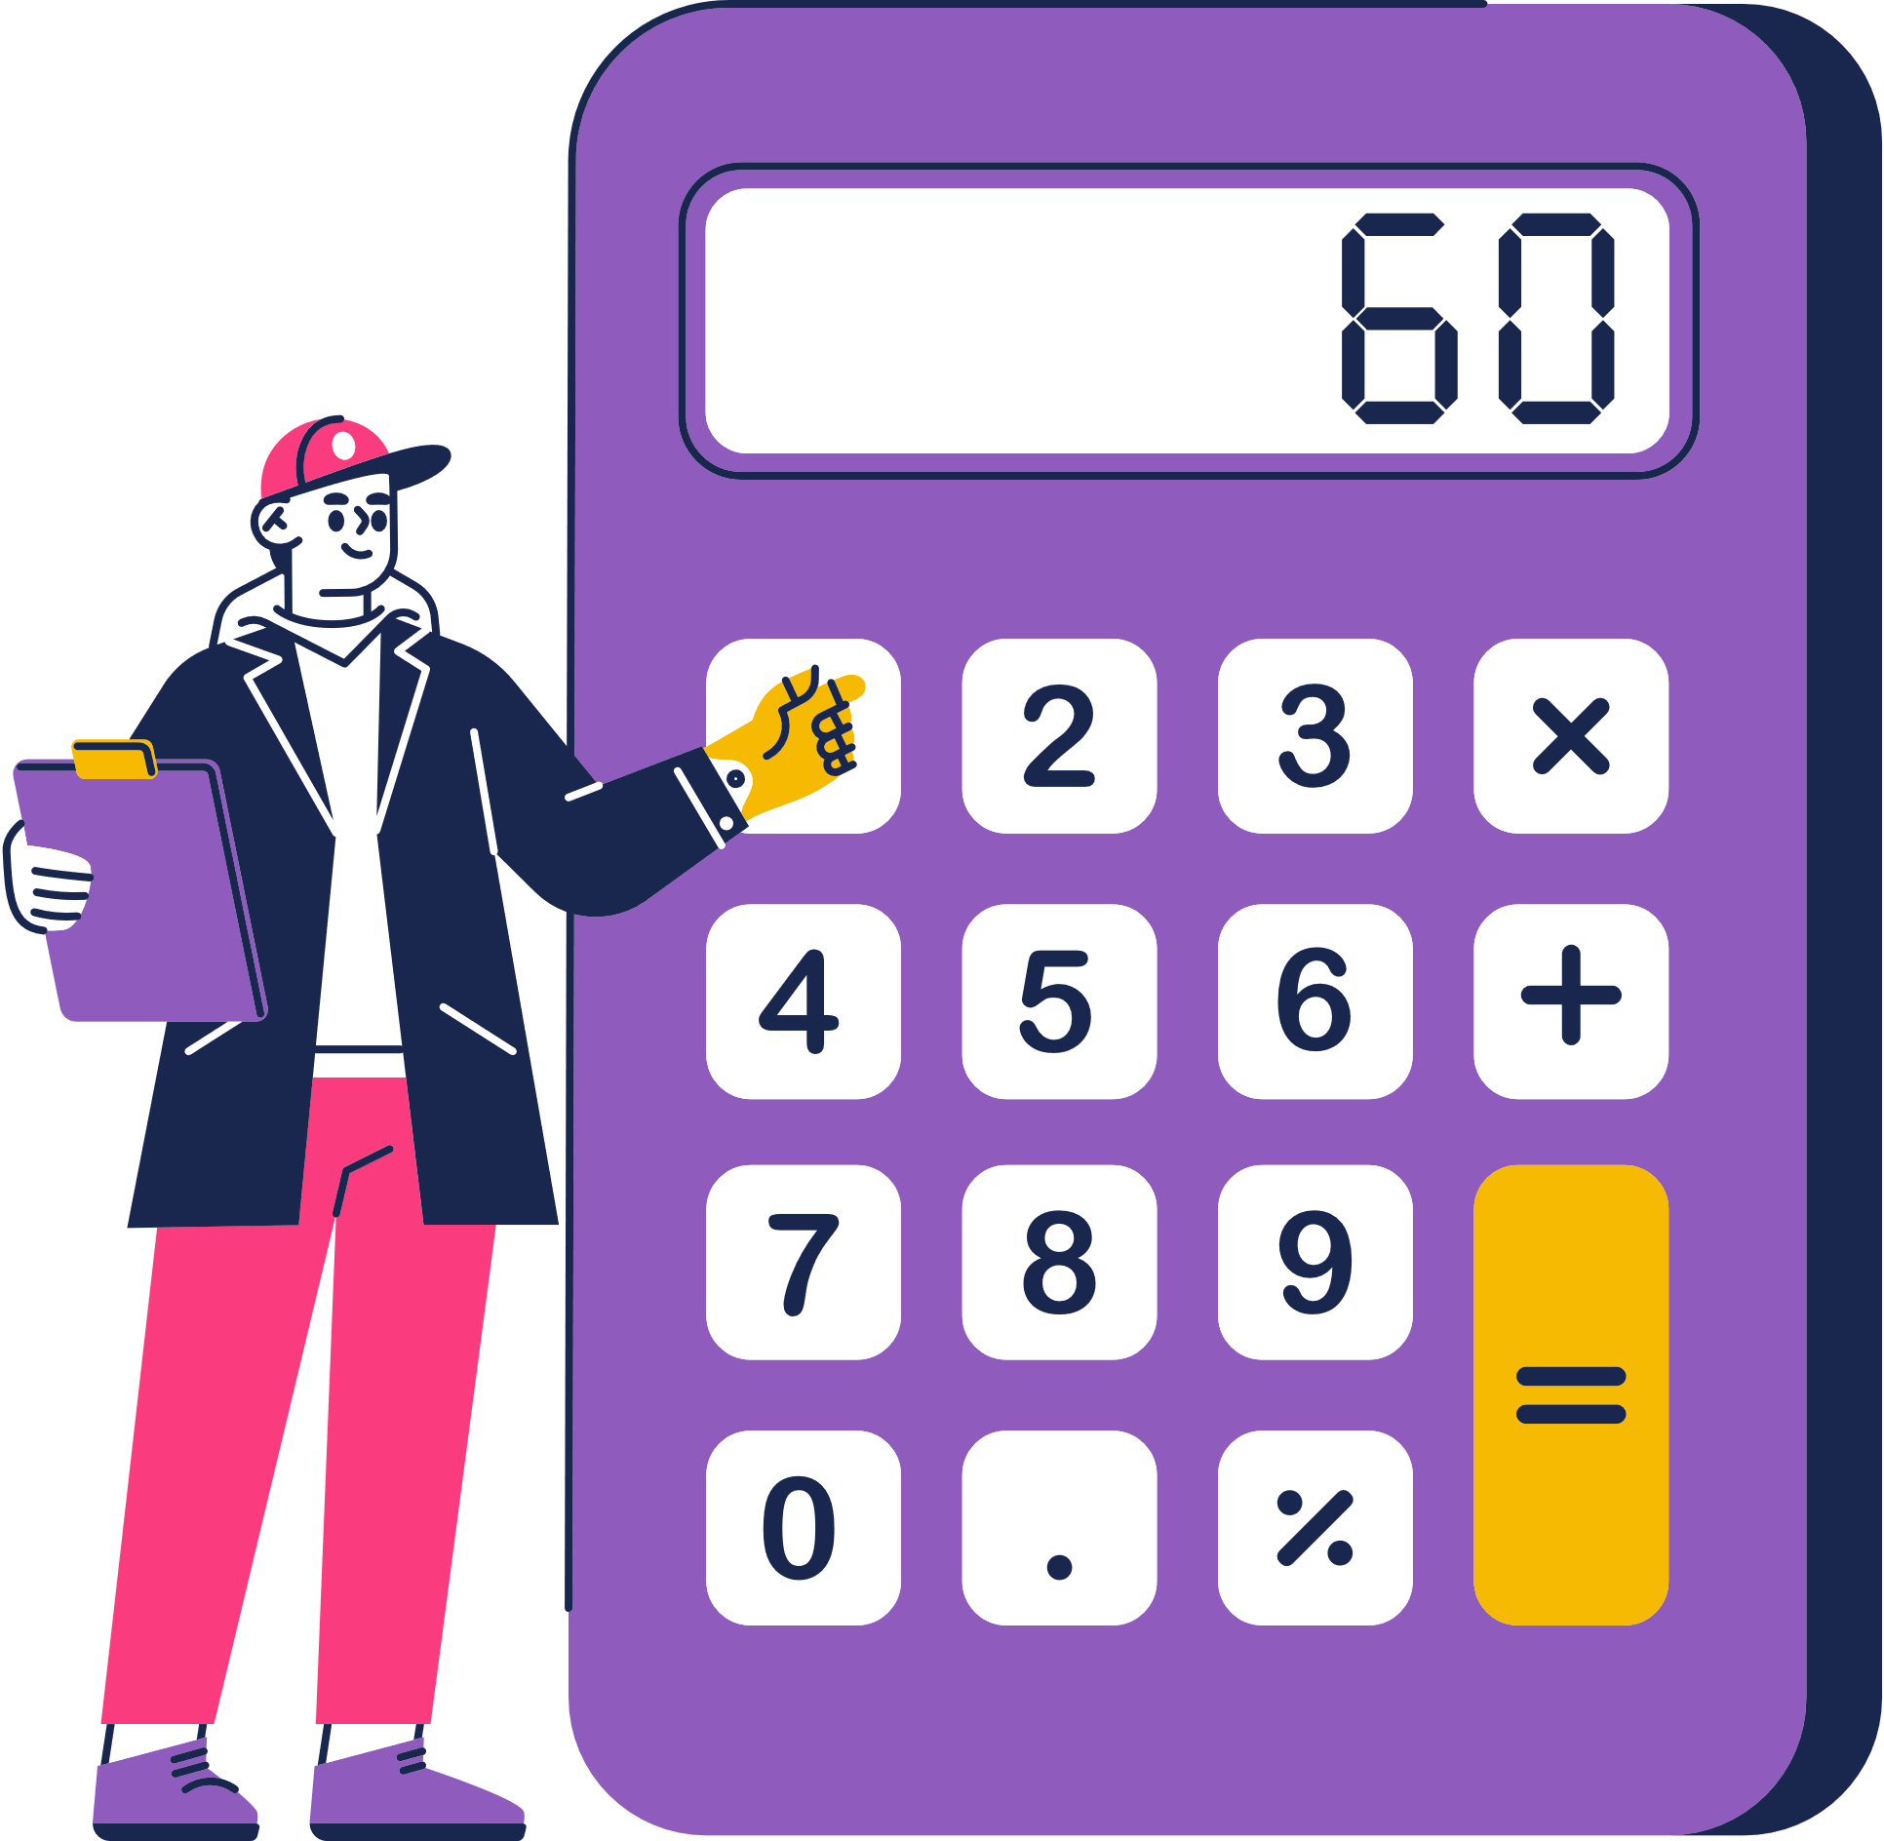
1.3 Numerical Encoding
Binary Coded Decimal
Application examples: Calculator, where denary digits are to be displayed. Also include floating point numbers (More detail in chapter 16).
Positive Integer
Negative Integer
Binary Arithmetic
Binary Coded Decimal (BCD)

Slide 73

1.3 Numerical Encoding
BCD Addition
Say we want to add up the following numbers (assume that 2-bytes packed BCD is used):
0.87
0
0
0
0
0
0
0
0
1
0
0
0
0
1
1
1
+
0.28
0
0
0
0
0
0
0
0
0
0
1
0
1
0
0
0
0
0
0
0
0
0
0
0
1
0
1
0
1
1
1
1
Invalid
Invalid
Positive Integer
Negative Integer
Binary Arithmetic
Binary Coded Decimal (BCD)

Slide 74
1.3 Numerical Encoding
0.87
0
0
0
0
0
0
0
0
1
0
0
0
0
1
1
1
+
0.28
0
0
0
0
0
0
0
0
0
0
1
0
1
0
0
0
0
0
0
0
0
0
0
0
1
0
1
0
1
1
1
1
+
0
1
1
0
Step 1: Add "0110" to the least significant nibble
1
0
1
0
1
Positive Integer
Negative Integer
Binary Arithmetic
Binary Coded Decimal (BCD)

Slide 75
1.3 Numerical Encoding
0.87
0
0
0
0
0
0
0
0
1
0
0
0
0
1
1
1
+
0.28
0
0
0
0
0
0
0
0
0
0
1
0
1
0
0
0
0
0
0
0
0
0
0
0
1
0
1
0
1
1
1
1
+
0
1
1
0
Step 2: Add correction plus carry to the next nibble.
1
1
0
0
0
1
0
1
0
1
Positive Integer
Negative Integer
Binary Arithmetic
Binary Coded Decimal (BCD)

Slide 76
1.3 Numerical Encoding
0.87
0
0
0
0
0
0
0
0
1
0
0
0
0
1
1
1
+
0.28
0
0
0
0
0
0
0
0
0
0
1
0
1
0
0
0
0
0
0
0
0
0
0
0
1
0
1
0
1
1
1
1
+
1
Step 3: Add carry to the next nibble.
0
0
0
1
0
0
0
1
0
1
0
1
Positive Integer
Negative Integer
Binary Arithmetic
Binary Coded Decimal (BCD)

Slide 77
1.3 Numerical Encoding
0.87
0
0
0
0
0
0
0
0
1
0
0
0
0
1
1
1
+
0.28
0
0
0
0
0
0
0
0
0
0
1
0
1
0
0
0
0
0
0
0
0
0
0
0
1
0
1
0
1
1
1
1
0
0
0
0
0
0
0
1
0
0
0
1
0
1
0
1
Correct Answer: 1 . 1 5
Positive Integer
Negative Integer
Binary Arithmetic
Binary Coded Decimal (BCD)

Slide 78



1.4 Text Encoding
Storing text
Highlighter
For computer storage of text, a coding system is required, assigning distinct binary codes to individual text components.
ASCII
Unicode

Slide 79
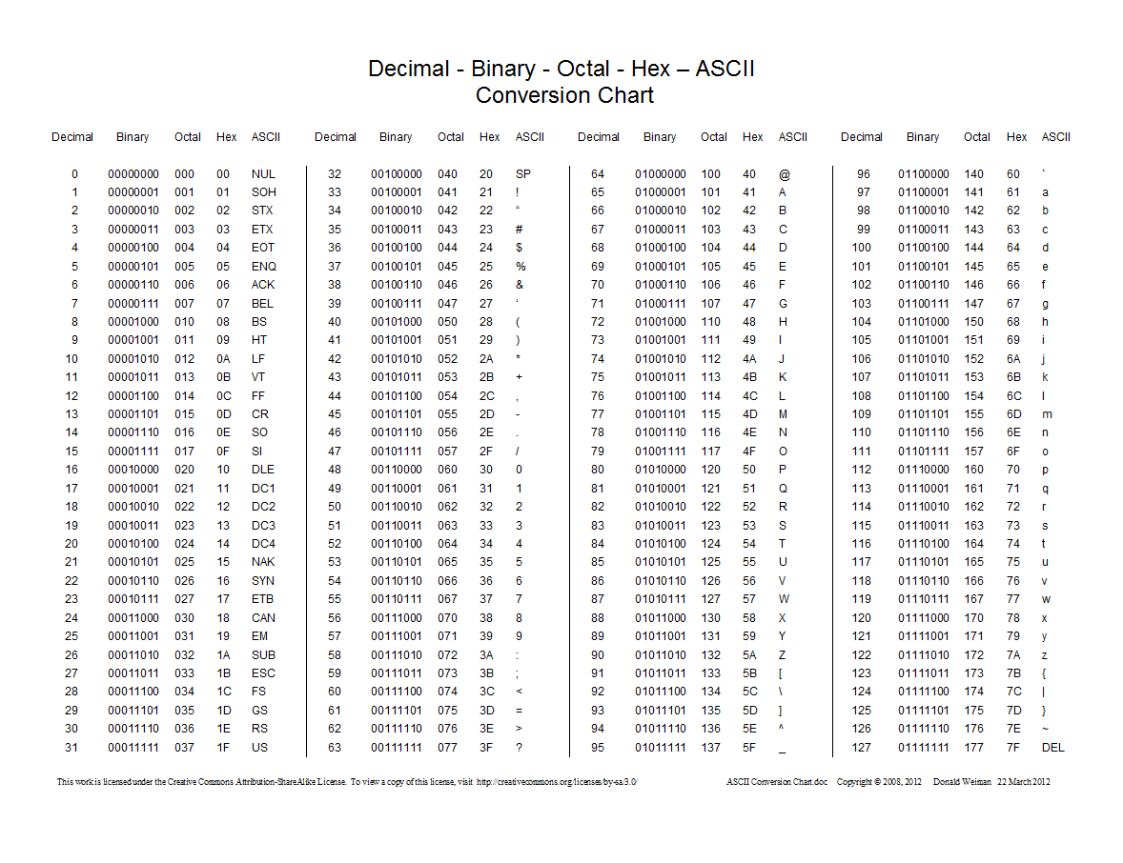
1.4 Text Encoding
ASCII (American Standard Code for Information Interchange)
Highlighter
Bag

Slide 80
1.4 Text Encoding
ASCII (American Standard Code for Information Interchange)
Highlighter
Bag
B
g
0
1
0
0
0
0
0
1
0
1
1
0
0
1
1
1
a
0
1
1
0
0
0
0
1

Slide 81
1.4 Text Encoding
Facts on ASCII
Highlighter
  Limited number of the codes represent non-printing or control characters
  The majority of codes represent English text elements like uppercase and lowercase letters, punctuation, digits, and arithmetic symbols.

Slide 82
1.4 Text Encoding
Facts on ASCII
Highlighter
  Limited number of the codes represent non-printing or control characters
  The majority of codes represent English text elements like uppercase and lowercase letters, punctuation, digits, and arithmetic symbols.
  Codes for numbers and letters follow a sequential pattern.
  Uppercase and lowercase letter codes only vary in the value of bit 6.
  Extended ASCII uses all eight bits in a byte, allowing new characters to be added to the list.

Slide 83
1.4 Text Encoding
Unicode
  Unicode aims to represent any possible text in code form. Eg. UTF-8.
    The inclusion of 8 in the name indicates that this version of the standard includes codes defined by one byte in addition to codes using two, three, and four bytes.
  Each character code in Unicode is referred to as a code point. (Eg. U+0000).
  Structures of Unicode:
    1 byte code
    2 byte code
    3 byte code
    4 byte code

Slide 84
Unicode Structure
1.4 Text Encoding
1 byte code
  The number of codes available is determined by the number of bits that are not pre-defined by the format.
0???????
7 x (?)
7
= 2 combinations
2 byte code
110?????
10??????
11 x (?)
11
= 2 combinations
3 byte code
1110????
10??????
10??????
14 x (?)
14
= 2 combinations
4 byte code
11110???
10??????
10??????
10??????
21 x (?)
21
= 2 combinations

Slide 85
Unicode Structure
1.4 Text Encoding
  An example to show why this is a clever structure!
Assume that this is the binary code for a series of text:
1110 0101 10 010101 10 111001 110 01000 10 110101
We got a problem.
How does the computer know which unicode structure is this?
How does the computer decode the binary codes?

Slide 86
Unicode Structure
1.4 Text Encoding
  An example to show why this is a clever structure!
Assume that this is the binary code for a series of text:
1110 0101 10 010101 10 111001 110 01000 10 110101
Answer, it reads the first few bits to identify whether it is a 1/2/3/4 byte unicode.

Slide 87
Unicode Structure
1.4 Text Encoding
  An example to show why this is a clever structure!
Assume that this is the binary code for a series of text:
1110 0101 10 010101 10 111001 110 01000 10 110101
Answer, it reads the first few bits to identify whether it is a 1/2/3/4 byte unicode.
First, it reads the first 4 bits (1110) and identify that this is the starting bits of a 3-byte unicode. It now knows that the following 3 bytes are in continuation and find the corresponding character.
1)

Slide 88
Unicode Structure
1.4 Text Encoding
  An example to show why this is a clever structure!
Assume that this is the binary code for a series of text:
1110 0101 10 010101 10 111001 110 01000 10 110101
Answer, it reads the first few bits to identify whether it is a 1/2/3/4 byte unicode.
First, it reads the first 4 bits (1110) and identify that this is the starting bits of a 3-byte unicode. It now knows that the following 3 bytes are in continuation and find the corresponding character.
1)
Upon finished decoding the 3-byte unicode. It detects that the following binary bits (110) are the starting code for a 2 byte unicode. It then knows that the following 2 bytes are in continuation.
2)

Slide 89
Unicode Structure
1.4 Text Encoding
1 byte code
0???????
  The initial bits in the byte sequence for a UTF-8 encoded character serve as markers that indicate how many bytes are used to represent that character. These initial bits help the computer distinguish between characters encoded with 1, 2, 3, or 4 bytes.
2 byte code
110?????
10??????
3 byte code
1110????
10??????
10??????
4 byte code
11110???
10??????
10??????
10??????

Slide 90



Subtopic 1
1.5 Digital Sound Representation
Recording sound
For storage or electronic transmission of sound, the initial analog sound signal must undergo conversion into binary code.
Band-limiting filter
ADC Converter
  Eliminate inaudible high-frequency elements to avoid coding issues they might pose.
  Converts analogue data to digital data
Sound
Encoder

Slide 91

Subtopic 1
1.5 Digital Sound Representation
Sampling operation of the ADC
8
7
sampling time
6
approximated amplitude
amplitude
5
4
3
2
1
1
2
3
4
5
6
7
8
9
10
time

Slide 92
Subtopic 1
1.5 Digital Sound Representation
Properties of digital sound
Sampling Resolution: The number of bits used to store each sample
Sampling resolution = 4
Sampling resolution = 3
16
8
15
14
7
13
12
6
11
10
amplitude
5
amplitude
9
4
8
7
3
6
5
2
4
3
1
2
1
10
1
2
3
4
5
6
7
8
9
10
1
2
3
4
5
6
7
8
9
time
time
In practical terms, 16 bits offer sufficient accuracy for digitized sound.

Slide 93
Subtopic 1
1.5 Digital Sound Representation
Properties of digital sound
Sampling Rate = Number of samples taken per second.
8
7
6
amplitude
5
4
3
2
1
1
2
3
4
5
6
7
8
9
10
time
Both higher sampling rates and resolutions lead to larger file sizes.

Slide 94
Subtopic 1
1.5 Digital Sound Representation
Calculating the size of sound file
Formula: Sampling Rate x Sampling Resolution x Time (s)
(Optional)
X2 for stereo sound
The following information refers to a music track being recorded:
  Sampling Rate: 44100 times per second
  Sampling Resolution:8 bits
  Length: 1 minute
  Type: Stereo
Calculate its file size in MiB.

Slide 95
Subtopic 1
1.5 Digital Sound Representation
Calculating the size of sound file
Formula: Sampling Rate x Sampling Resolution x Time (s)
(Optional)
X2 for stereo sound
The following information refers to a music track being recorded:
  Sampling Rate: 44100 times per second
  Sampling Resolution:8 bits
  Length: 1 minute
  Type: Stereo
Calculate its file size in MiB.
44100 x 8 x 60 x 2
= 42336000 bits / 8
= 5292000 bytes / 1024
= 5167 KiB /1024
= 5.04 MiB

Slide 96

1.6 Digital Image Representation
Vector Graphics
Vector graphics are images defined by mathematical equations, allowing for scalability without loss of quality.
The list contains contains a command for each object in the image.
Vector graphics contains a drawing list

Slide 97
1.6 Digital Image Representation
Vector Graphics
Vector graphics are images defined by mathematical equations, allowing for scalability without loss of quality.
The list contains contains a command for each object in the image.
Vector graphics contains a drawing list
Circle(30,80,10, purple, filled)
=
Draw Circle from (30,80), radius 10 filled in purple
Each command has a list of attributes, with each attribute defines the property of the object.
Eg. Basic geometric data, colours, thickness, etc

Slide 98

1.6 Digital Image Representation
Vector Graphics
In vector graphics, the significant characteristic is that object dimensions aren't directly specified; instead, they're relative to an imaginary drawing surface. This means that the quality of the file will not be affected is it scales.
Normal Image
Vector Graphic

Slide 99
1.6 Digital Image Representation
Bitmaps
Since many images lack defined shapes, using vector graphics is unsuitable. Typically, images are stored as bitmaps.
Binary Code | Binary Code | Binary Code | Binary Code | Binary Code | Binary Code | Binary Code | Binary Code | Binary Code | Binary Code
Binary Code | Binary Code | Binary Code | Binary Code | Binary Code | Binary Code | Binary Code | Binary Code | Binary Code | Binary Code
Binary Code | Binary Code | Binary Code | Binary Code | Binary Code | Binary Code | Binary Code | Binary Code | Binary Code | Binary Code
Binary Code | Binary Code | Binary Code | Binary Code | Binary Code | Binary Code | Binary Code | Binary Code | Binary Code | Binary Code
Binary Code | Binary Code | Binary Code | Binary Code | Binary Code | Binary Code | Binary Code | Binary Code | Binary Code | Binary Code

Slide 100
1.6 Digital Image Representation
Bitmaps
Since many images lack defined shapes, using vector graphics is unsuitable. Typically, images are stored as bitmaps.
Binary Code | Binary Code | Binary Code | Binary Code | Binary Code | Binary Code | Binary Code | Binary Code | Binary Code | Binary Code
Binary Code | Binary Code | Binary Code | Binary Code | Binary Code | Binary Code | Binary Code | Binary Code | Binary Code | Binary Code
Binary Code | Binary Code | Binary Code | Binary Code | Binary Code | Binary Code | Binary Code | Binary Code | Binary Code | Binary Code
Binary Code | Binary Code | Binary Code | Binary Code | Binary Code | Binary Code | Binary Code | Binary Code | Binary Code | Binary Code
Binary Code | Binary Code | Binary Code | Binary Code | Binary Code | Binary Code | Binary Code | Binary Code | Binary Code | Binary Code
Each binary code represent a colour
Pixel
The smallest identifiable component of a bitmap image

Slide 101
1.6 Digital Image Representation
Bitmaps
Since many images lack defined shapes, using vector graphics is unsuitable. Typically, images are stored as bitmaps.

Slide 102
1.6 Digital Image Representation
Colours in a bitmap
Colour depth: The number of bits used to represent one pixel. The greater the colour depth, the greater the number of colours that can be represented.
Colour depth: 1
Possible value:
0,1
0: Black
1: White

Slide 103
1.6 Digital Image Representation
Colours in a bitmap
Colour depth: The number of bits used to represent one pixel. The greater the colour depth, the greater the number of colours that can be represented.
Colour depth: 1
Colour depth:2
Possible value:
0,1
Possible value:
00 , 01, 10, 11
0: Black
1: White
00: Blue, 01: Green
10: Yellow, 11: Red

Slide 104
1.6 Digital Image Representation
Colours in a bitmap
Colour depth: The number of bits used to represent one pixel. The greater the colour depth, the greater the number of colours that can be represented.
Colour depth: 1
Colour depth:2
Colour depth:3
Possible value:
0,1
Possible value:
00 , 01, 10, 11
Possible value:
000 , 001, 010, 011, 100, 101, 110, 111
0: Black
1: White
00: Blue, 01: Green
10: Yellow, 11: Red

Slide 105
1.6 Digital Image Representation
Colours in a bitmap
Bit depth, an alternate term for color depth, refers to the count of bits employed for storing red, green, and blue primary colors in the RGB color model.
The standard is to used 8 bits per primary colour, leading to 256 x 256 x 256 possible number of colours per pixel.
10011001(R), 11010100(G), 10111001(B)

Slide 106
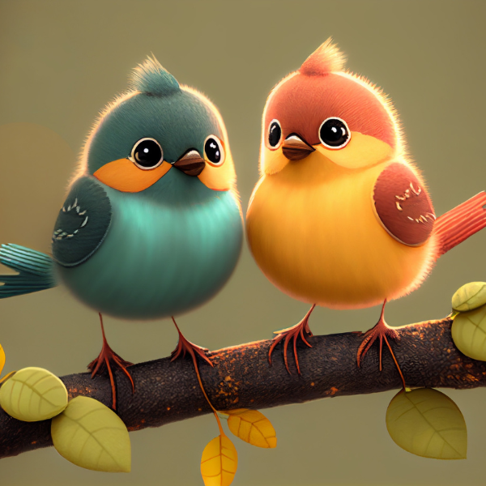
1.6 Digital Image Representation
Resolution in bitmap
Image resolution: The number of pixels in the bitmap file defined as the product of the width and the height values. The higher the image resolution, the better the quality.
100x100
600x600
3px
3px

Slide 107
1.6 Digital Image Representation
Properties of images
  Image Resolution
  Colour depth
  Bit depth (RGB)

Slide 108
1.6 Digital Image Representation
Calculate image size
10101101 | 10111101 | 10111101
10111101 | 00101101 | 11101101
10101100 | 00101101 | 11111101
The image on the right has a colour depth of 8. What is its size in bytes?
Formula: Image Resolution x Colour Depth

Slide 109
1.6 Digital Image Representation
Calculate image size
10101101 | 10111101 | 10111101
10111101 | 00101101 | 11101101
10101100 | 00101101 | 11111101
The image on the right has a colour depth of 8. What is its size in bytes?
Formula: Image Resolution x Colour Depth
3 x 3 x 8 = 72 bits / 8
= 9 bytes

Slide 110
1.6 Digital Image Representation
Calculate image size
The image on the right has an image resolution of 600x600 and a bit depth of 8 (8 bits for each red, green, and blue. What is its size in MiB?
Formula: Image Resolution x Colour Depth
600 x 600 x 8 x 3
= 8640000 bits

Slide 111
1.6 Digital Image Representation
Calculate image size
The image on the right has an image resolution of 600x600 and a bit depth of 8 (8 bits for each red, green, and blue. What is its size in MiB?
Formula: Image Resolution x Colour Depth
600 x 600 x 8 x 3
= 8640000 bits / 8
= 1080000 bytes
= 1054 KiB
= 1.03 MiB

Slide 112
1.6 Digital Image Representation
Bitmap
  A bitmap file includes pixel data and a header describing its construction, causing the file size to exceed the graphic size.

Slide 113
1.6 Digital Image Representation
Vector graphic or bitmap
  Opt for vector graphics in architectural, engineering, or manufacturing design diagrams.
  Convert vector graphics to bitmaps before printing via laser or inkjet.
  Digital cameras generate bitmaps by default.
  Choose bitmap files for embedding images in documents, publications, or web pages.

Slide 114
1.7 Data Compression Methods
Why is compression needed?
Bigger files demand greater storage and significantly slower transmission or download rates.
Lossless compression
Lossy compression
  File size shrinks without losing data
  The process is reversible to restore the original file.
  File size decreases with partial information loss
  Complete restoration of the original file isn't possible.

Slide 115
1.7 Data Compression Methods
Lossless Compression
An effective compression tool identifies compressible patterns in files and is often tailored for specific file types. We will learn two compression methods here.
Run-length encoding
Huffman Encoding

Slide 116
1.7 Data Compression Methods
Run-length encoding
A compression method that encodes repeated byte values by specifying their count and value. Eg. It works well with a bitmap file.
Huffman Encoding
Before RLE
10101101 10101101 10101101 10101101
10111101 10111101 10111101 10111101
10101101 | 10101101 | 10101101 | 10101101
10111101 | 10111101 | 10111101 | 10111101
10101100 | 10101100 | 10101100 | 10101100
10101100 10101100 10101100 10101100

Slide 117
1.7 Data Compression Methods
Run-length encoding
A compression method that encodes repeated byte values by specifying their count and value. Eg. It works well with a bitmap file.
Huffman Encoding
Before RLE
10101101 10101101 10101101 10101101
10111101 10111101 10111101 10111101
10101101 | 10101101 | 10101101 | 10101101
10111101 | 10111101 | 10111101 | 10111101
10101100 | 10101100 | 10101100 | 10101100
10101100 10101100 10101100 10101100
After RLE
10101101 00000100 (4)
10111101 00000100 (4)
10101100 00000100 (4)

Slide 118

1.7 Data Compression Methods
Run-length encoding
It also works well with repeated text
Huffman Encoding
aaaa bbbb
Before RLE (ASCII)
01100001 01100001 01100001 01100001
01100010 01100010 01100010 01100010

Slide 119
1.7 Data Compression Methods
Run-length encoding
It also works well with repeated text
Huffman Encoding
aaaa bbbb
Before RLE (ASCII)
After RLE
01100001 01100001 01100001 01100001
01100010 01100010 01100010 01100010
01100001 00000100 (4)
01100010 00000100 (4)

Slide 120
1.7 Data Compression Methods
Huffman Encoding
Principle: Analyzing text to identify common characters, which are assigned shorter codes than one-byte coding. Eg.
Run-length encoding
abracadabra
Step 1
Count the frequency of each character in the text:
  'a': 5 times
  'b': 2 times
  'r': 2 times
  'c': 1 time
  'd': 1 time

Slide 121
1.7 Data Compression Methods
Huffman Encoding
Principle: Analyzing text to identify common characters, which are assigned shorter codes than one-byte coding. Eg.
Run-length encoding
abracadabra
Step 1
Step 2
Count the frequency of each character in the text:
  'a': 5 times
  'b': 2 times
  'r': 2 times
  'c': 1 time
  'd': 1 time
Create Huffman coding
a | 0
b | 10
r | 110
c | 1110
d | 1111

Slide 122
1.7 Data Compression Methods
Huffman Encoding
Principle: Analyzing text to identify common characters, which are assigned shorter codes than one-byte coding. Eg.
Run-length encoding
abracadabra
Step 1
Step 2
Step 3
Count the frequency of each character in the text:
  'a': 5 times
  'b': 2 times
  'r': 2 times
  'c': 1 time
  'd': 1 time
Create Huffman coding
a | 0
b | 10
r | 110
c | 1110
d | 1111
Replace each character with its assigned code to get the compressed text:
01001101010011010101001001001000

Slide 123
1.7 Data Compression Methods
Lossy Compression
Lossy compression is applicable when less crucial sound or image details can be altered without significant human perception.
8
Sound
7
  Technique 1: Capitalise on the infrequent change of successive sampled values.
  Technique 2: Convert individual sample amplitudes to amplitude difference. Compression is achieved by using a lower sample resolution to store the differences.
6
5
amplitude
4
3
2
1
1
2
3
4
5
6
7
8
9
10
time

Slide 124
1.7 Data Compression Methods
Lossy Compression
Lossy compression is applicable when less crucial sound or image details can be altered without significant human perception.
After compression (Extreme)
Before compression
Image
  Establish a coding scheme with reduced colour depth.

