Slide 1
Cambridge International
AS Level Computer Science
(9618) – Revision Notes
Introduction to Software Development
This pack is intended for students to who are taking CIE AS Level in Computer Science, either in preparation for their AS exam, or more likely alongside year 2 of the course to improve fluency, recall and pace on AS topics. It could be used as lesson starters, or supplied to students for independent use.

Slide 2



Chapter
15
Introduction to Software Development
AS & A LEVEL COMPUTER SCIENCE 9618

Slide 3



15.1
15.3
15.2
Program Development Life Cycle
State Transition Diagrams
15.4
Structure Chart
Types of error
15.5
Software Testing Techniques
Chapter
Outline
15.6
Test Strategy, test plans and test data
15.7
15.8
15.9
Corrective maintenance
Adaptive maintenance
Perfective maintenance

Slide 4

15.1 Stages in the program development life cycle
Program Development Life Cycle
Analysis
Requirements specification - Outlines the functional, technical, and operational criteria that the software must meet, serving as a blueprint to guide the development process.
Plan a solution. Decide whether to use
  A bottom up approach - Building from individual components to create a whole system.
  A top down approach - Breaking down a system by starting with its overview.

Slide 5

15.1 Stages in the program development life cycle
Program Development Life Cycle
Analysis
Design
Requirements specification - Outlines the functional, technical, and operational criteria that the software must meet, serving as a blueprint to guide the development process.
Plan a solution. Decide whether to use
  A bottom up approach - Building from individual components to create a whole system.
  A top down approach - Breaking down a system by starting with its overview.
Plan the algorithm - Decide on what identifiers are needed, what data structure needs to be used.
Plan the algorithm using a flowchart or pseudocode.

Slide 6
15.1 Stages in the program development life cycle
Program Development Life Cycle
Analysis
Design
Coding
Requirements specification - Outlines the functional, technical, and operational criteria that the software must meet, serving as a blueprint to guide the development process.
Plan a solution. Decide whether to use
  A bottom up approach - Building from individual components to create a whole system.
  A top down approach - Breaking down a system by starting with its overview.
Plan the algorithm - Decide on what identifiers are needed, what data structure needs to be used.
Plan the algorithm using a flowchart or pseudocode.
Choose a programming language - Pick one that is the most suitable for the solution you propose.
Might encounter bugs, that is when debugging comes in.
Check at the end whether the code does what it intends to do.

Slide 7
15.1 Stages in the program development life cycle
Program Development Life Cycle
Analysis
Design
Coding
Testing
Requirements specification - Outlines the functional, technical, and operational criteria that the software must meet, serving as a blueprint to guide the development process.
Plan a solution. Decide whether to use
  A bottom up approach - Building from individual components to create a whole system.
  A top down approach - Breaking down a system by starting with its overview.
Plan the algorithm - Decide on what identifiers are needed, what data structure needs to be used.
Plan the algorithm using a flowchart or pseudocode.
Choose a programming language - Pick one that is the most suitable for the solution you propose.
Might encounter bugs, that is when debugging comes in.
Check at the end whether the code does what it intends to do.
Testing - systematic process of evaluating software to ensure it meets specified requirements and functions correctly.

Slide 8

15.1 Stages in the program development life cycle
Program Development Life Cycle
Analysis
Maintenance
Design
Testing
Coding

Slide 9
15.1 Stages in the program development life cycle
Software Development Models
Rapid Application Development
Waterfall model
Iterative Model

Slide 10



15.1 Stages in the program development life cycle
Waterfall model
The waterfall model is a linear and sequential software development approach where progress flows downwards through distinct phases, each dependent on the completion of the previous phase.
Analysis
Design
Arrow down: The result from one stage are input into the next stage.
Arrow up: More work is required at an earlier stage to complete the current stage.
Coding
Testing
Maintenance
James Gan

Slide 11
15.1 Stages in the program development life cycle
Analysis
Design
Waterfall model
Coding
Testing
Maintenance
Advantages | Disadvantages
No working software is produced until late during the life cycle.
Stages are processed and completed one at a time.
Works well for smaller projects where requirements are well understood.
Poor model for long and ongoing projects.
Simple to understand as the stages are clearly defined.
Cannot accomodate changing requirement.
Not a good model for complex and object-oritented projects.

Slide 12


15.1 Stages in the program development life cycle
Iterative model
The iterative model is a software development approach that cycles through repeated phases, allowing for flexible adjustments and improvements throughout the development process.
Analysis
Design
Starts with the implementation of a small subset of the program requirements.
Find out the requirements through the process
Testing
Coding

Slide 13
15.1 Stages in the program development life cycle
Iterative model
Analysis
Design
Testing
Coding
Advantages | Advantages
At an initial phase of development, a functional system prototype exists, enabling easier detection of functional or design flaws, leading to swift corrective actions due to early issue identification.
Early in the life cycle, certain functional aspects can be rapidly developed and made operational.
Cost-effectiveness in altering scope/requirements.
Simpler testing and debugging of smaller program subsets.
Continuous delivery of operational products with each increment.
Leveraging lessons from each increment for subsequent ones.
Facilitating customer evaluation and feedback by producing software early in the life cycle.
Identifying and resolving risks iteratively.

Slide 14
15.1 Stages in the program development life cycle
Iterative model
Analysis
Design
Testing
Coding
Disadvantages
Hard to be used in developing small software systems due to difficulty in breaking them into manageable modules.
Potential need for increased resources.
Design challenges stemming from incomplete initial requirement gathering.
Difficulty in defining increments, possibly requiring a full system definition.

Slide 15

15.1 Stages in the program development life cycle
Rapid Application Development model
The Rapid Application Development (RAD) model is an iterative software development approach emphasizing quick prototyping and iteration cycles for rapid system development.

Slide 16
15.1 Stages in the program development life cycle
Rapid Application Development model
Advantages | Advantages
Enhanced productivity within a concise timeframe with reduced personnel.
Assessable progress.
Diminished development duration and amplified component reusability.
Prompt initial assessments.
Stimulates customer input.
Early integration resolves integration complexities.

Slide 17
15.1 Stages in the program development life cycle
Rapid Application Development model
Disadvantages | Disadvantages
Only systems that can be modularised can be built using RAD.
Requires highly skilled developers / designers.
Applicability to component-based and scalable systems.
User involvement is required.
Suitable for projects requiring shorter development times.

Slide 18
Subtopic 1
15.2 Structure chart
Definition
A structure chart is a visual representation outlining the hierarchical structure and relationships between modules or components in a software system.
Eg: A program that calculates the sum of two numbers input by the user.
Sum
n2
sum
n1
n1
sum
INPUT numbers
n2
OUTPUT Sum
Calculate Sum

Slide 19

Subtopic 1
15.2 Structure chart
Terminology
Eg: A program that calculates the sum of two numbers input by the user.
Sum
Parameter
n2
sum
n1
n1
Interface
sum
Module
INPUT numbers
n2
OUTPUT Sum
Calculate Sum

Slide 20

Subtopic 1
15.2 Structure chart
Example - Conditionals
Eg: A program that checks whether a customer is eligible for discount
Discount Determiner
UserPurchaseAmount
MinAmountForDiscount
MinAmountForDiscount
UserPurchaseAmount
Initialise MinAmountForDiscount
OUTPUT message
Input UserPurchaseAmount
UserPurchaseAmount > MinAmountForDiscount
OUTPUT You got a discount
OUTPUT No discount sorry

Slide 21

Subtopic 1
15.2 Structure chart
Example - Iterations
Eg: A program that generates numbers from 1 square to N square.
N Square Generator
UNTIL Count > N
Count
N
N
2
Initialise values
Count
Count
OUTPUT N
2
Count
2
N
INPUT N
Square it
Increment Count
value is updated within the module
value transferred is a flag

Slide 22

15.3 State-transition diagrams
Finite State Machine (FSM)
A finite state machine in a computer system is a computational model characterised by a set of states, transitions between these states based on input, and defined outputs associated with each state transition.
State Transition Table
State Transition Diagram

Slide 23


15.3 State-transition diagrams
Finite State Machine (FSM)
State Transition Table
State Transition Diagram
Current State
a
S1
S2
start
S1
a
S1
Input
b

Slide 24

15.3 State-transition diagrams
Finite State Machine (FSM)
State Transition Table
State Transition Diagram
Current State
a
b
S1
S2
start
S1
S2
a
S1
Input
b
S2

Slide 25
15.3 State-transition diagrams
Finite State Machine (FSM)
State Transition Table
State Transition Diagram
Current State
a
b
b
S1
S2
start
S1
S2
a
S1
Input
b
S2
S2

Slide 26
15.3 State-transition diagrams
Finite State Machine (FSM)
State Transition Table
State Transition Diagram
Current State
a
b
b
S1
S2
start
S1
S2
a
S1
S1
Input
b
S2
S2
a

Slide 27

15.3 State-transition diagrams
Finite State Machine (FSM)
State Transition Table
State Transition Diagram
Current State
a
b
b
S1
S2
start
S2
S1
a
S1
S1
Input
b
S2
S2
a
Notes: If the FSM has a final state (halting state), this is shown by a double-circle state.

Slide 28
15.3 State-transition diagrams
Finite State Machine (FSM)
State Transition Table
State Transition Diagram
Current State
a | w
b | x
b | y
S1
S2
start
S2
S1
a
S1
S1
Input
b
S2
S2
a | z
Notes: If an input causes an output this is shown by a vertical bar.
A Finate State machine with outputs is also known as a Mealy Machine.

Slide 29
15.3 State-transition diagrams
Worked Example
Design a state-transition diagram for a simplified elevator control system in a building. The elevator operates in four distinct states: Idle on Ground Floor, Moving Up, Moving Down, and Stopped at a Floor.
State transitions occur based on specific criteria: from "Idle on Ground Floor" to "Moving Up" or "Moving Down" upon receiving corresponding directional commands; from "Moving Up" or "Moving Down" to "Stopped at a Floor" when reaching a floor; from "Stopped at a Floor" to either "Moving Up," "Moving Down," or "Idle on Ground Floor" based on received directional commands or absence of pending commands for two minutes respectively. Illustrate these states and transitions in a labeled state-transition diagram.

Slide 30
15.3 State-transition diagrams
Worked Example
Design a state-transition diagram for a simplified elevator control system in a building. The elevator operates in four distinct states: Idle on Ground Floor, Moving Up, Moving Down, and Stopped at a Floor.
State
Idle on Ground Floor
Moving Up
Moving Down
Stopped at a Floor

Slide 31
15.3 State-transition diagrams
Worked Example
State Transition Table
State transitions occur based on specific criteria:
  from "Idle on Ground Floor" to "Moving Up" or "Moving Down" upon receiving corresponding directional commands;
  from "Moving Up" or "Moving Down" to "Stopped at a Floor" when reaching a floor;
  from "Stopped at a Floor" to either "Moving Up," "Moving Down," or "Idle on Ground Floor" based on received directional commands or absence of pending commands for two minutes respectively.
State | Event | Next State

Slide 32
15.3 State-transition diagrams
Worked Example
State Transition Table
State transitions occur based on specific criteria:
  from "Idle on Ground Floor" to "Moving Up" or "Moving Down" upon receiving corresponding directional commands;
  from "Moving Up" or "Moving Down" to "Stopped at a Floor" when reaching a floor;
  from "Stopped at a Floor" to either "Moving Up," "Moving Down," or "Idle on Ground Floor" based on received directional commands or absence of pending commands for two minutes respectively.
State | Event | Next State
Idle on Ground Floor | Up Button Press | Moving Up
Idle on Ground Floor | Down Button Press | Moving Down

Slide 33
15.3 State-transition diagrams
Worked Example
State Transition Table
State transitions occur based on specific criteria:
  from "Idle on Ground Floor" to "Moving Up" or "Moving Down" upon receiving corresponding directional commands;
  from "Moving Up" or "Moving Down" to "Stopped at a Floor" when reaching a floor;
  from "Stopped at a Floor" to either "Moving Up," "Moving Down," or "Idle on Ground Floor" based on received directional commands or absence of pending commands for two minutes respectively.
State | Event | Next State
Idle on Ground Floor | Up Button Press | Moving Up
Idle on Ground Floor | Down Button Press | Moving Down
Moving Up | Reach a floor | Stopped at a Floor
Moving Down | Reach a floor | Stopped at a Floor
Stopped at a Floor | Up Button Press | Moving Up
Stopped at a Floor | Down Button Press | Moving Down
Stopped at a Floor | Idle for two minutes | Idle on Ground Floor

Slide 34

15.3 State-transition diagrams
Worked Example
Up button press
start
Idle on Ground Floor
State Transition Table
Moving Up
State | Event | Next State
Idle on Ground Floor | Up Button Press | Moving Up
Idle on Ground Floor | Down Button Press | Moving Down
Moving Up | Reach a floor | Stopped at a Floor
Moving Down | Reach a floor | Stopped at a Floor
Stopped at a Floor | Up Button Press | Moving Up
Stopped at a Floor | Down Button Press | Moving Down
Stopped at a Floor | Idle for two minutes | Idle on Ground Floor
Idle for two minutes
Up Button Press
Reach a floor
Down button press
Down Button Press
Moving Down
Stopped at a Floor
Reach a floor

Slide 35
15.3 State-transition diagrams
Worked Example
Design a state-transition diagram for a two’s complement FSM.
A finite state machine has been designed that will take as input a positive binary integer, one bit at a time, starting with the least significant bit. The FSM converts the binary integer into the two's complement negative equivalent.
The method to be used is as follows.
  Output the bits input up to and including the first 1.
  Output the other bits following this scheme:
    For each 1, output a 0.
    For each 0, output a 1.

Slide 36

15.3 State-transition diagrams
What does it mean?
A finite state machine has been designed that will take as input a positive binary integer, one bit at a time, starting with the least significant bit. The FSM converts the binary integer into the two's complement negative equivalent.
5 (binary equivalence) -5 (two’s complement)

Slide 37
15.3 State-transition diagrams
What does it mean?
The method to be used is as follows.
  Output the bits input up to and including the first 1.
  Output the other bits following this scheme:
    For each 1, output a 0.
    For each 0, output a 1.
Eg. Input = 010100 (20 in denary)
Input:
Output:

Slide 38
15.3 State-transition diagrams
What does it mean?
The method to be used is as follows.
  Output the bits input up to and including the first 1.
  Output the other bits following this scheme:
    For each 1, output a 0.
    For each 0, output a 1.
Eg. Input = 010100 (20 in denary)
Input:
Output:
 |  |  |  |  | 0
 |  |  |  |  | 0

Slide 39
15.3 State-transition diagrams
What does it mean?
The method to be used is as follows.
  Output the bits input up to and including the first 1.
  Output the other bits following this scheme:
    For each 1, output a 0.
    For each 0, output a 1.
Eg. Input = 010100 (20 in denary)
Input:
Output:
 |  |  |  | 0 | 0
 |  |  |  | 0 | 0

Slide 40
15.3 State-transition diagrams
What does it mean?
The method to be used is as follows.
  Output the bits input up to and including the first 1.
  Output the other bits following this scheme:
    For each 1, output a 0.
    For each 0, output a 1.
Eg. Input = 010100 (20 in denary)
Input:
Output:
 |  |  | 1 | 0 | 0
 |  |  | 1 | 0 | 0

Slide 41
15.3 State-transition diagrams
What does it mean?
The method to be used is as follows.
  Output the bits input up to and including the first 1.
  Output the other bits following this scheme:
    For each 1, output a 0.
    For each 0, output a 1.
Eg. Input = 010100 (20 in denary)
Input:
Output:
 |  | 0 | 1 | 0 | 0
 |  | 1 | 1 | 0 | 0

Slide 42
15.3 State-transition diagrams
What does it mean?
The method to be used is as follows.
  Output the bits input up to and including the first 1.
  Output the other bits following this scheme:
    For each 1, output a 0.
    For each 0, output a 1.
Eg. Input = 010100 (20 in denary)
Input:
Output:
 | 1 | 0 | 1 | 0 | 0
 | 0 | 1 | 1 | 0 | 0

Slide 43
15.3 State-transition diagrams
What does it mean?
The method to be used is as follows.
  Output the bits input up to and including the first 1.
  Output the other bits following this scheme:
    For each 1, output a 0.
    For each 0, output a 1.
Eg. Input = 010100 (20 in denary)
Input:
Output:
0 | 1 | 0 | 1 | 0 | 0
1 | 0 | 1 | 1 | 0 | 0

Slide 44
15.3 State-transition diagrams
What does it mean?
The method to be used is as follows.
  Output the bits input up to and including the first 1.
  Output the other bits following this scheme:
    For each 1, output a 0.
    For each 0, output a 1.
Eg. Input = 010100 (20 in denary)
Input:
Output:
-32
16
8
4
2
1
0 | 1 | 0 | 1 | 0 | 0
1 | 0 | 1 | 1 | 0 | 0
20
-20 in two’s complement

Slide 45
15.3 State-transition diagrams
State Transition Table
Current State | S1 | S1 | S2 | S2
Input Bit | 0 | 1 | 0 | 1
Next State | S1 | S2 | S2 | S2
Output Bit | 0 | 1 | 1 | 0

Slide 46
15.3 State-transition diagrams
State Transition Diagram
0 | 0
1 | 1
1 | 0
start
S1
S2
0 | 1

Slide 47



15.4 Types of Error
Why errors occur?
  Improper syntax or logic in the code leads to unexpected behaviour or crashes.
  Implementing features that do not align with the actual needs of users or stakeholders causes functionality issues.
  Flaws in the architecture or logic of the software lead to bugs or unexpected outcomes.
  Confusing or unintuitive interfaces cause user frustration and errors in operation.
  Malfunctioning hardware components, such as memory issues or disk failures, disrupt software execution and may lead to crashes or data corruption.

Slide 48

15.4 Types of Error
Testing - Find an error
The purpose of testing is to ensure software functions correctly, meeting requirements, identifying defects, and assuring its quality before deployment.

Slide 49
15.4 Types of Error
Syntax Error
A syntax error occurs in programming when the code violates the language's rules or grammar, preventing proper interpretation or execution by the compiler or interpreter.
Compiler
Interpreter
If a program compiles without errors, it indicates the absence of syntax errors in the code.
Syntax checking occurs only on statements scheduled for execution; hence, an insufficiently tested program might still contain undetected syntax errors.

Slide 50
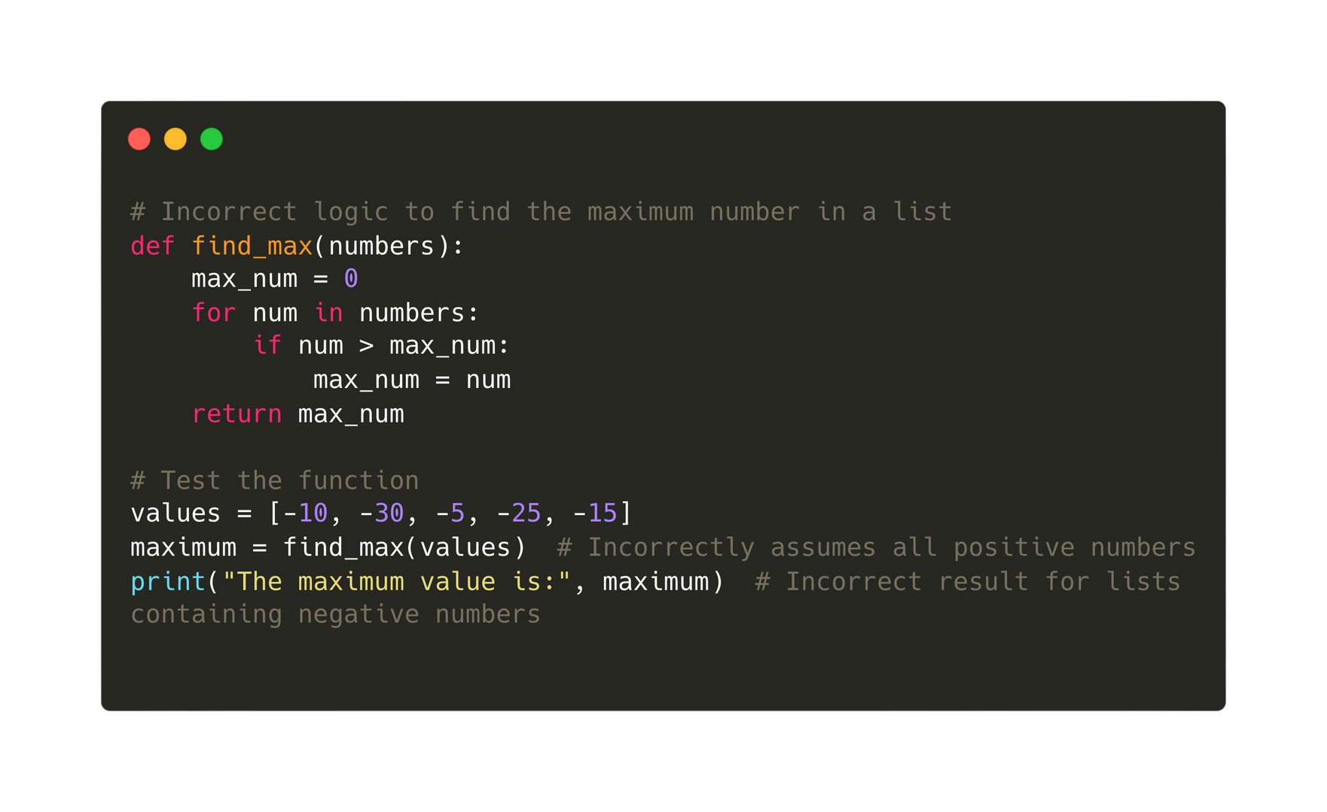
15.4 Types of Error
Logic Error
A logic error in programming refers to a flaw in the code's algorithm or logic, causing unexpected or incorrect outputs. Eg.

Slide 51
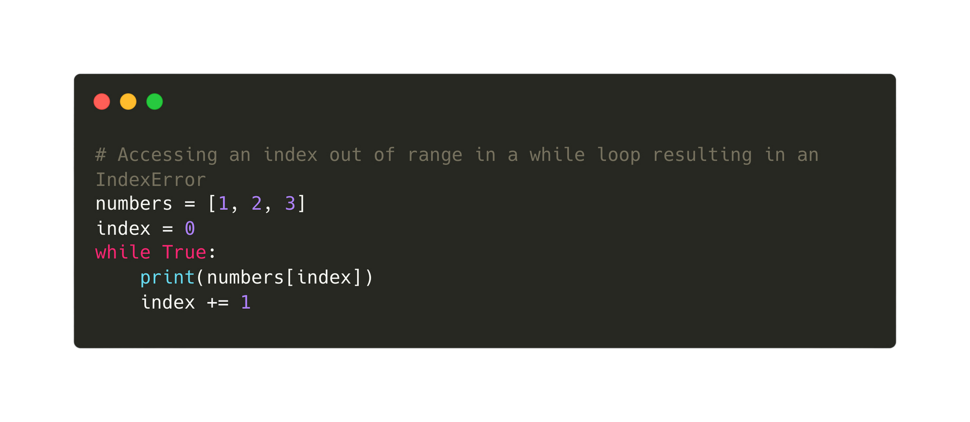
15.4 Types of Error
Run-time Error
A run-time error occurs during program execution due to unforeseen conditions, causing the program to terminate abnormally.

Slide 52
15.5 Software Testing Methods
Stub Testing
Black
Box
Testing
White
Box
Testing
Dry running an algorithm
Integration Testing
Alpha Testing
Beta Testing
Acceptance Testing

Slide 53
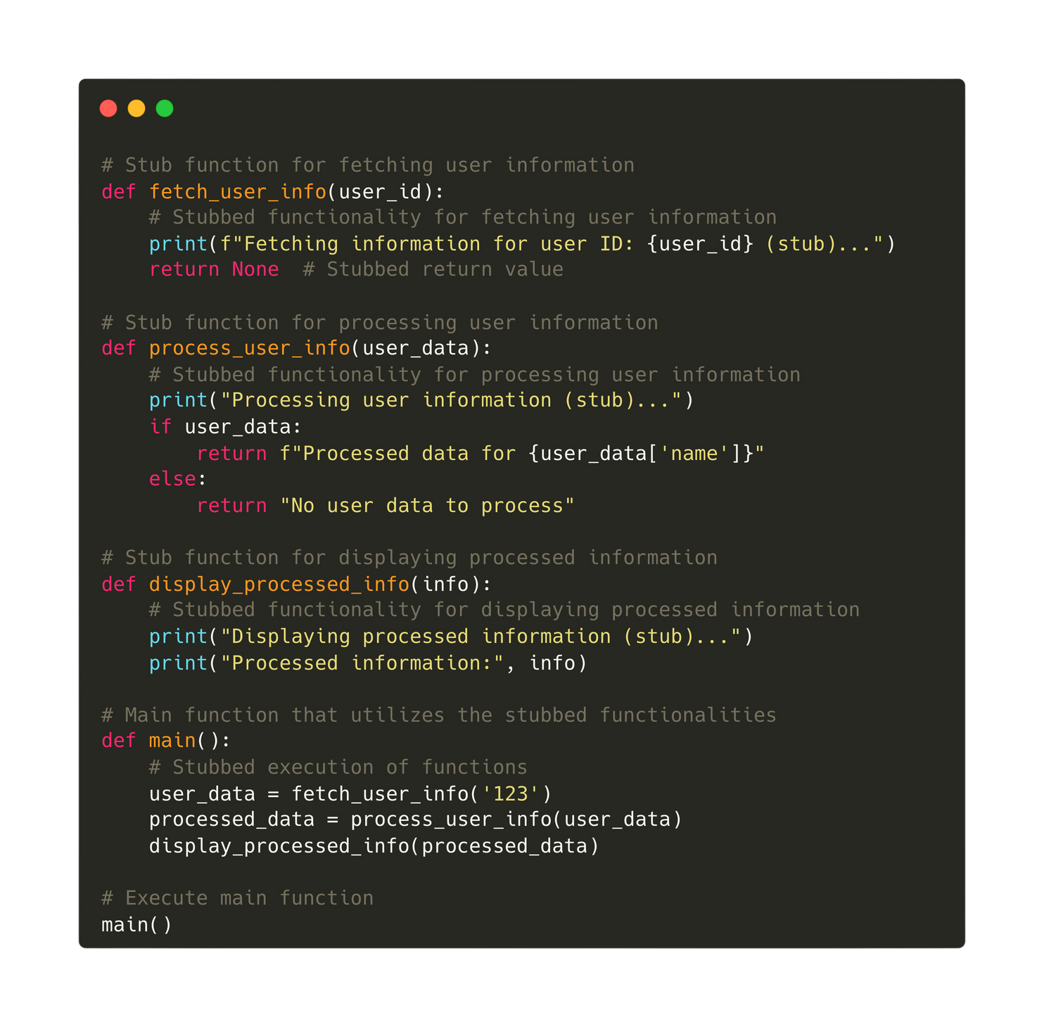
15.5 Software Testing Methods
Stub Testing
Stub testing involves creating minimal code pieces (stubs) that mimic functionalities of larger modules or components to enable initial testing or simulation of interactions within a system.

Slide 54
15.5 Software Testing Methods
Stub Testing
Black
Box
Testing
White
Box
Testing
Dry running an algorithm
Integration Testing
Alpha Testing
Beta Testing
Acceptance Testing

Slide 55

15.5 Software Testing Methods
Black Box Testing
Black box testing is a software testing method where the internal workings or structure of the system under test are not known to the tester, focusing solely on the system's inputs, outputs, and functionality to evaluate its behaviour against specifications or requirements.

Slide 56

15.5 Software Testing Methods
Black Box Testing
During black-box testing, the program tester evaluates the software's functionality by providing test data based on the program specification without having access to the internal code, examining outputs against expected results.

Slide 57

15.5 Software Testing Methods
Black Box Testing
Type of data: Testers employ normal data to validate standard functioning, extreme and boundary data to assess system behaviour at limits, and erroneous data to evaluate how the system handles incorrect or unexpected inputs during black-box testing.

Slide 58
15.5 Software Testing Methods
Stub Testing
Black
Box
Testing
White
Box
Testing
Dry running an algorithm
Integration Testing
Alpha Testing
Beta Testing
Acceptance Testing

Slide 59
15.5 Software Testing Methods
White Box Testing
White box testing is a software testing technique where the internal structure, design, and implementation details of the system under test are known to the tester, allowing for the examination and validation of internal code paths and logic.

Slide 60
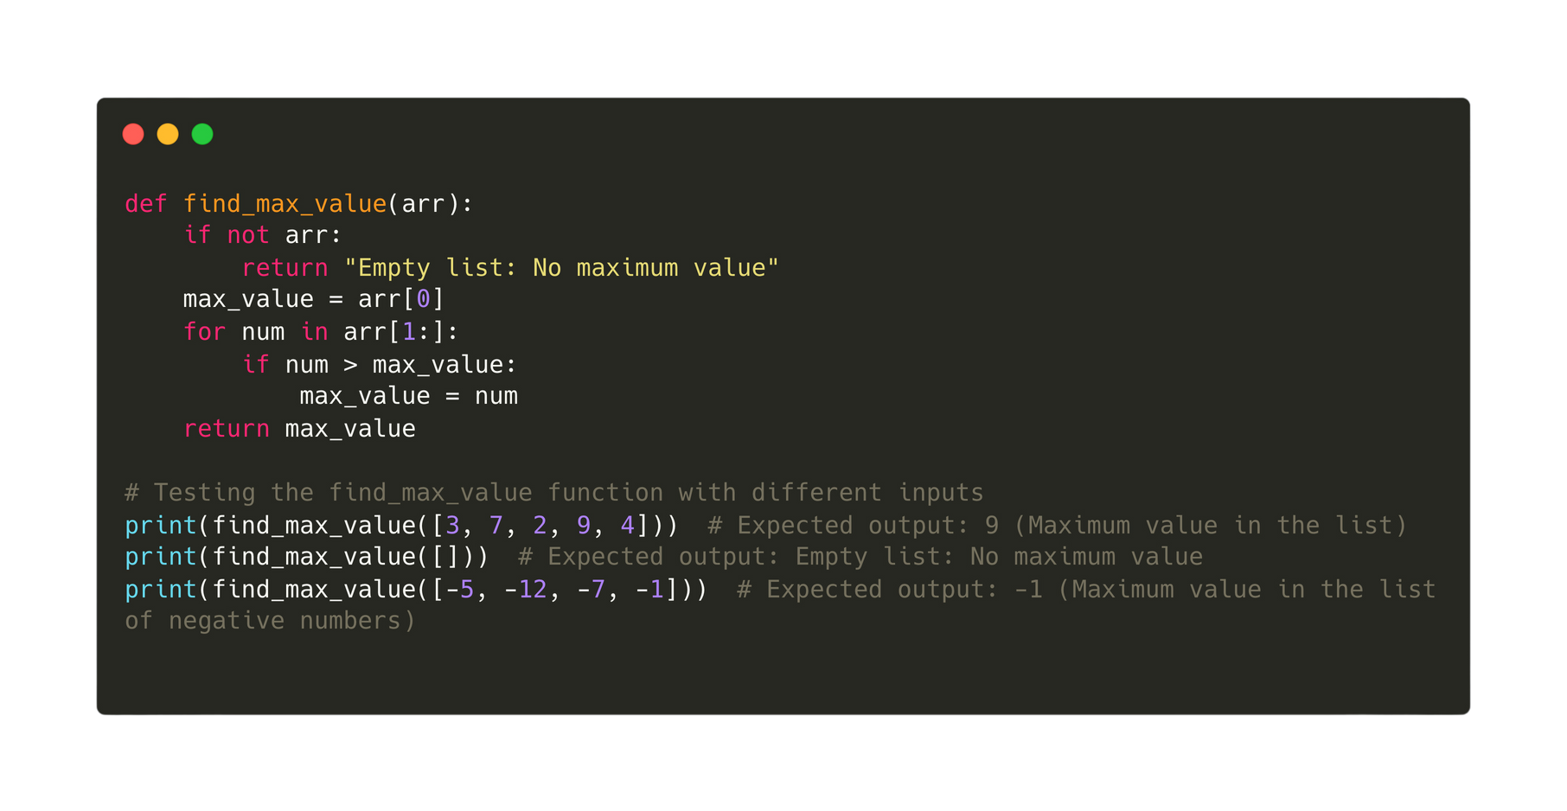
15.5 Software Testing Methods
White Box Testing
For example, the following function will find the maximum number in a list. To make sure that it does its job correctly, we need to test the program using different sets of input.

Slide 61
15.5 Software Testing Methods
Stub Testing
Black
Box
Testing
White
Box
Testing
Dry running an algorithm
Integration Testing
Alpha Testing
Beta Testing
Acceptance Testing

Slide 62

15.5 Software Testing Methods
Dry-running an algorithm
Dry running an algorithm involves manually executing the algorithm step-by-step using a trace table with varying test data to simulate its behaviour and understand how it processes inputs, executes instructions, and produces outputs without actually running the code on a computer.
Trace Table

Slide 63
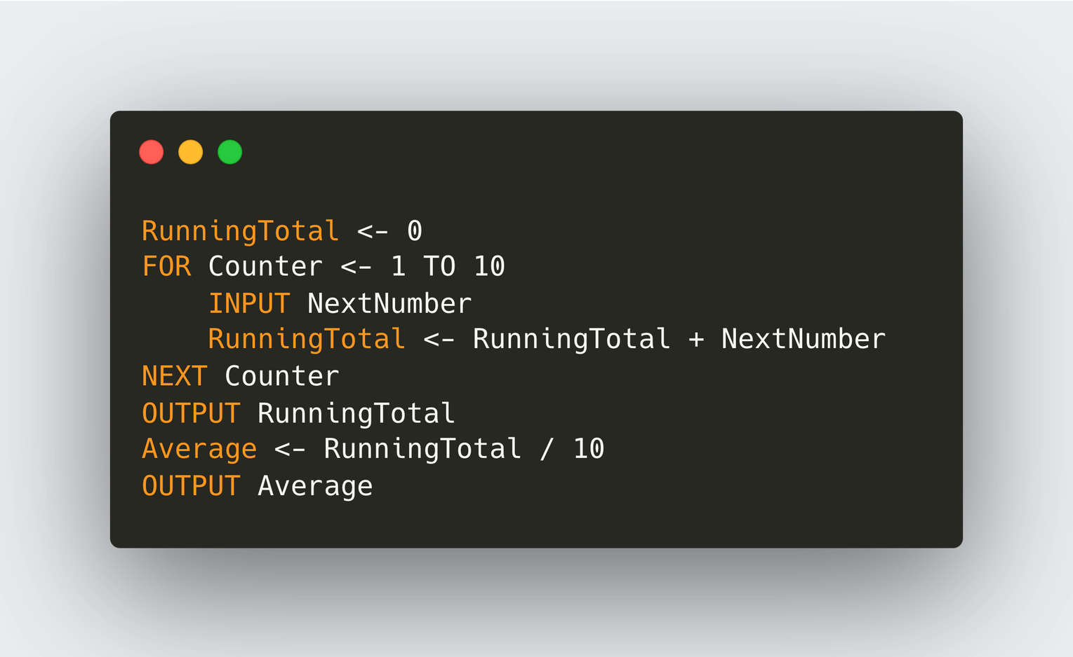

15.5 Software Testing Methods
Trace Table
(Initialisation)
RunningTotal | Counter | NextNumber | Average | Output
0
Pseudocode
Inputs: 4,5,1,3,100

Slide 64
15.5 Software Testing Methods
Trace Table
(Iteration 1)
RunningTotal | Counter | NextNumber | Average | Output
0
 | 1 | 4
Pseudocode
Inputs: 4,5,1,3,100

Slide 65
15.5 Software Testing Methods
Trace Table
(Iteration 1)
RunningTotal | Counter | NextNumber | Average | Output
0
4 | 1 | 4
Pseudocode
Inputs: 4,5,1,3,100

Slide 66
15.5 Software Testing Methods
Trace Table
(Iteration 2)
RunningTotal | Counter | NextNumber | Average | Output
0
4 | 1 | 4
 | 2 | 5
Pseudocode
Inputs: 4,5,1,3,100

Slide 67
15.5 Software Testing Methods
Trace Table
(Iteration 2)
RunningTotal | Counter | NextNumber | Average | Output
0
4 | 1 | 4
9 | 2 | 5
Pseudocode
Inputs: 4,5,1,3,100

Slide 68
15.5 Software Testing Methods
Trace Table
(Iteration 3)
RunningTotal | Counter | NextNumber | Average | Output
0
4 | 1 | 4
9 | 2 | 5
 | 3 | 1
Pseudocode
Inputs: 4,5,1,3,100

Slide 69
15.5 Software Testing Methods
Trace Table
(Iteration 3)
RunningTotal | Counter | NextNumber | Average | Output
0
4 | 1 | 4
9 | 2 | 5
10 | 3 | 1
Pseudocode
Inputs: 4,5,1,3,100

Slide 70
15.5 Software Testing Methods
Trace Table
(Iteration 4)
RunningTotal | Counter | NextNumber | Average | Output
0
4 | 1 | 4
9 | 2 | 5
10 | 3 | 1
 | 4 | 3
Pseudocode
Inputs: 4,5,1,3,100

Slide 71
15.5 Software Testing Methods
Trace Table
(Iteration 4)
RunningTotal | Counter | NextNumber | Average | Output
0
4 | 1 | 4
9 | 2 | 5
10 | 3 | 1
13 | 4 | 3
Pseudocode
Inputs: 4,5,1,3,100

Slide 72
15.5 Software Testing Methods
Trace Table
(Iteration 5)
RunningTotal | Counter | NextNumber | Average | Output
0
4 | 1 | 4
9 | 2 | 5
10 | 3 | 1
13 | 4 | 3
 | 5 | 100
Pseudocode
Inputs: 4,5,1,3,100

Slide 73
15.5 Software Testing Methods
Trace Table
(Iteration 5)
RunningTotal | Counter | NextNumber | Average | Output
0
4 | 1 | 4
9 | 2 | 5
10 | 3 | 1
13 | 4 | 3
113 | 5 | 100
Pseudocode
Inputs: 4,5,1,3,100

Slide 74
15.5 Software Testing Methods
Trace Table
RunningTotal | Counter | NextNumber | Average | Output
0
4 | 1 | 4
9 | 2 | 5
10 | 3 | 1
13 | 4 | 3
113 | 5 | 100
 |  |  | 22.6 | 113
 |  |  |  | 22.6
Pseudocode
Inputs: 4,5,1,3,100

Slide 75
15.5 Software Testing Methods
Stub Testing
Black
Box
Testing
White
Box
Testing
Dry running an algorithm
Integration Testing
Alpha Testing
Beta Testing
Acceptance Testing

Slide 76

15.5 Software Testing Methods
Integration Testing
Integration testing is the process of testing combined modules or components to ensure they work together as expected within the entire software system.
Incremental integration testing involves gradually integrating and testing new modules with existing components, ensuring seamless functionality as they're added to the system.

Slide 77
15.5 Software Testing Methods
Stub Testing
Black
Box
Testing
White
Box
Testing
Dry running an algorithm
Integration Testing
Alpha Testing
Beta Testing
Acceptance Testing

Slide 78

15.5 Software Testing Methods
Alpha Testing
Alpha testing is the initial testing phase conducted by internal teams or users within the developing organization to assess a software product's functionality, usability, and performance before wider release.

Slide 79
15.5 Software Testing Methods
Stub Testing
Black
Box
Testing
White
Box
Testing
Dry running an algorithm
Integration Testing
Alpha Testing
Beta Testing
Acceptance Testing

Slide 80

15.5 Software Testing Methods
Beta Testing
Beta testing is a software testing phase conducted by a select group of external users who assess the software's performance, usability, and functionality in a real-world environment before its official release to the public.
Beta testing gathers user feedback pre-release, aiding in issue identification and improvement, with users providing feedback via established communication channels.

Slide 81
15.5 Software Testing Methods
Stub Testing
Black
Box
Testing
White
Box
Testing
Dry running an algorithm
Integration Testing
Alpha Testing
Beta Testing
Acceptance Testing

Slide 82

15.5 Software Testing Methods
Acceptance Testing
Acceptance testing involves customers or end-users verifying if the software meets their specified requirements and is ready for use or deployment.

Slide 83

Subtopic 1
15.6 Test Strategy, test plans and test data
Importance of a test strategy
A test strategy and test plan provide a structured roadmap, outlining the goals, scope, methods, and resources for testing software, ensuring systematic and efficient quality assurance, defect detection, and software reliability before release.

Slide 84
Subtopic 1
15.6 Test Strategy, test plans and test data
How does a plan look like?
  Ensures the expected sequence of operations within the software.
  Verifies that provided data meets specified criteria.
  Validates accuracy of loop iterations and decision-making processes.
  Ensures data is accurately stored in the intended locations.
  Validates the accuracy of the system's output or outcomes.

Slide 85
Subtopic 1
15.6 Test Strategy, test plans and test data
Ways to carry out these tests - Data
Test data is chosen with a view of testing different possibilities. The followings are the types of data:
Boundary (extreme) Data
Normal Data
Abnormal Data
Represents typical or expected input values within the standard operational range for a system.
Consists of input values that fall outside the usual operational parameters or deviate from expected patterns.
Involves input values at the edges or extremes of valid ranges, aiming to test system behavior at the limits of its functionality.

Slide 86
Subtopic 1
15.6 Test Strategy, test plans and test data
Examples
A program has been written to obtain a number input from the users. The input must be from 1 to 100, and it must be an integer.
Boundary (extreme) Data
Normal Data
Abnormal Data
25
39
99
1
-5
120
3.5
1 (✅) | 0 (❌)
100 (✅) | 101(❌)

Slide 87
Subtopic 1
15.6 Test Strategy, test plans and test data
Ways to prevent errors
  Understanding the requirement better helps prevent software errors by ensuring accurate alignment with user needs.
  Employing tried and tested design techniques like structured programming and object-oriented design reduces errors and enhances software reliability.
  Utilising conventions such as identifier tables, data structures, and standard algorithms promotes consistency and minimises errors in software development.
  Integrating tried and tested modules or objects from program libraries enhances reliability and diminishes errors through validated and established components.

Slide 88

15.7 Corrective Maintenance
Definition
Corrective maintenance involves addressing and fixing software faults or defects identified after deployment to restore the system's intended functionality.
Program errors may remain undetected for an extended period as they might occur infrequently, leading to unexpected outcomes or program crashes only under rare conditions.

Slide 89


15.8 Adaptive Maintenance
Definition
Adaptive maintenance adjusts program functionality in response to specification changes or evolving requirements.
Example: How the Instagram/Facebook evolves to have similar functions like snapchat.

Slide 90

15.9 Perfective Maintenance
Definition
Enhances and improves software by implementing additional features or optimising existing functionalities to meet evolving user needs and expectations.
Example: YouTube introduces a feature that allows users to create and watch short-form vertical videos, typically up to 60 seconds in length, making the app similar to platforms like TikTok and Instagram Reels.

