Slide 1
Cambridge International
AS Level Computer Science
(9618) – Revision Notes
Programming Language
This pack is intended for students to who are taking CIE AS Level in Computer Science, either in preparation for their AS exam, or more likely alongside year 2 of the course to improve fluency, recall and pace on AS topics. It could be used as lesson starters, or supplied to students for independent use.

Slide 2
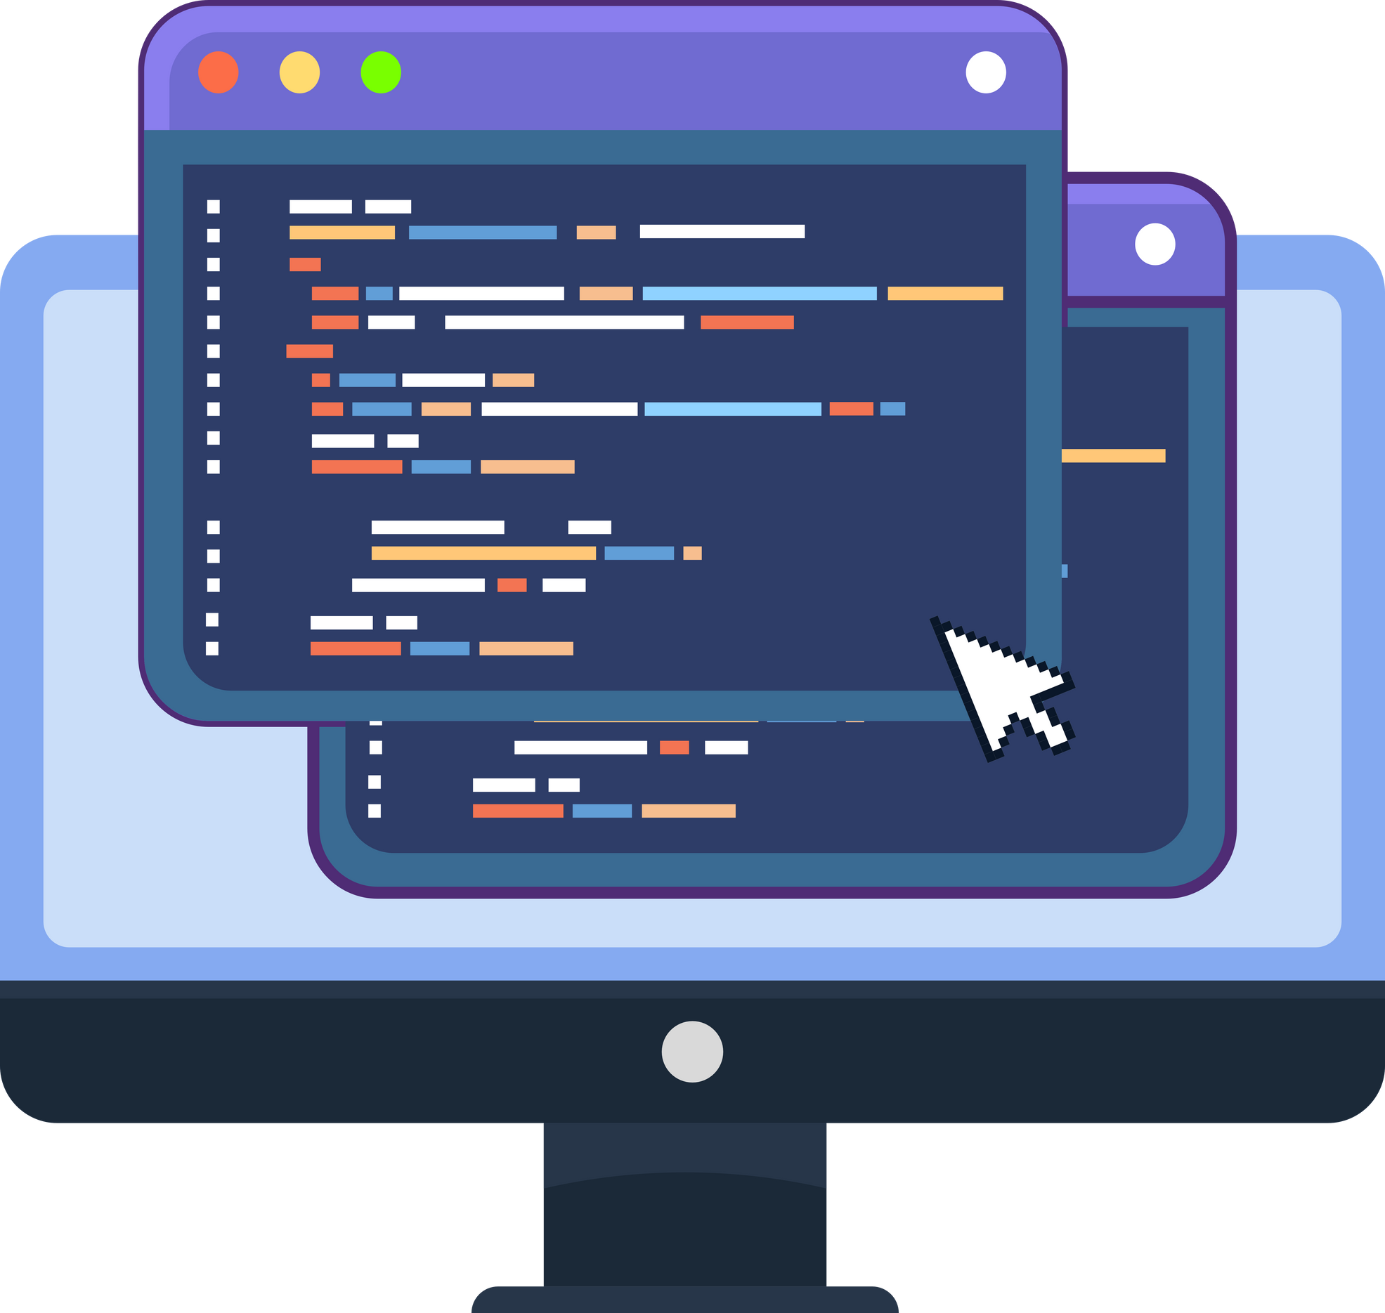



Chapter
14
Programming Language
AS & A LEVEL COMPUTER SCIENCE 9618

Slide 3



14.2
14.3
14.1
Essential Data Types in Programming
14.4
Introducing Python
Fundamentals of Programming
Boolean Expressions
14.5
Conditional Statements
14.12
Text files
Chapter
Outline
14.6
Loops and Repetition Structures
14.11
Arrays
14.10
14.7
14.8
14.9
Passing parameters to subroutines, functions, and procedures
Predefined Functions
Procedures
Functions

Slide 4


14.1 Introducing Python
Why are programming languages needed?
Programming languages are necessary as they enable the translation of abstract algorithmic concepts represented by pseudocode and flowcharts into executable instructions that a computer can understand and execute.

Slide 5
14.1 Introducing Python
Recap on construct
When writing an algorithm, we use four basic types of construct:
Iteration
Assignment
Sequence
Selection
Iterating or looping through a set of instructions multiple times until a certain condition is met (e.g., for loops, while loops).
Assigning a value to a variable in a programming language.
Execution of instructions in a predetermined order, one after another.
Making decisions in a program based on conditions (e.g., if-else statements).
Data is involved in almost every problem we are trying to solve, hence we also need the input and output statements.
Input
Output

Slide 6

14.1 Introducing Python
Python
Python is a multi-paradigm programming language that supports procedural (this chapter), object-oriented (c27), and functional (c29) programming approaches, allowing diverse coding styles within a single language.

Slide 7
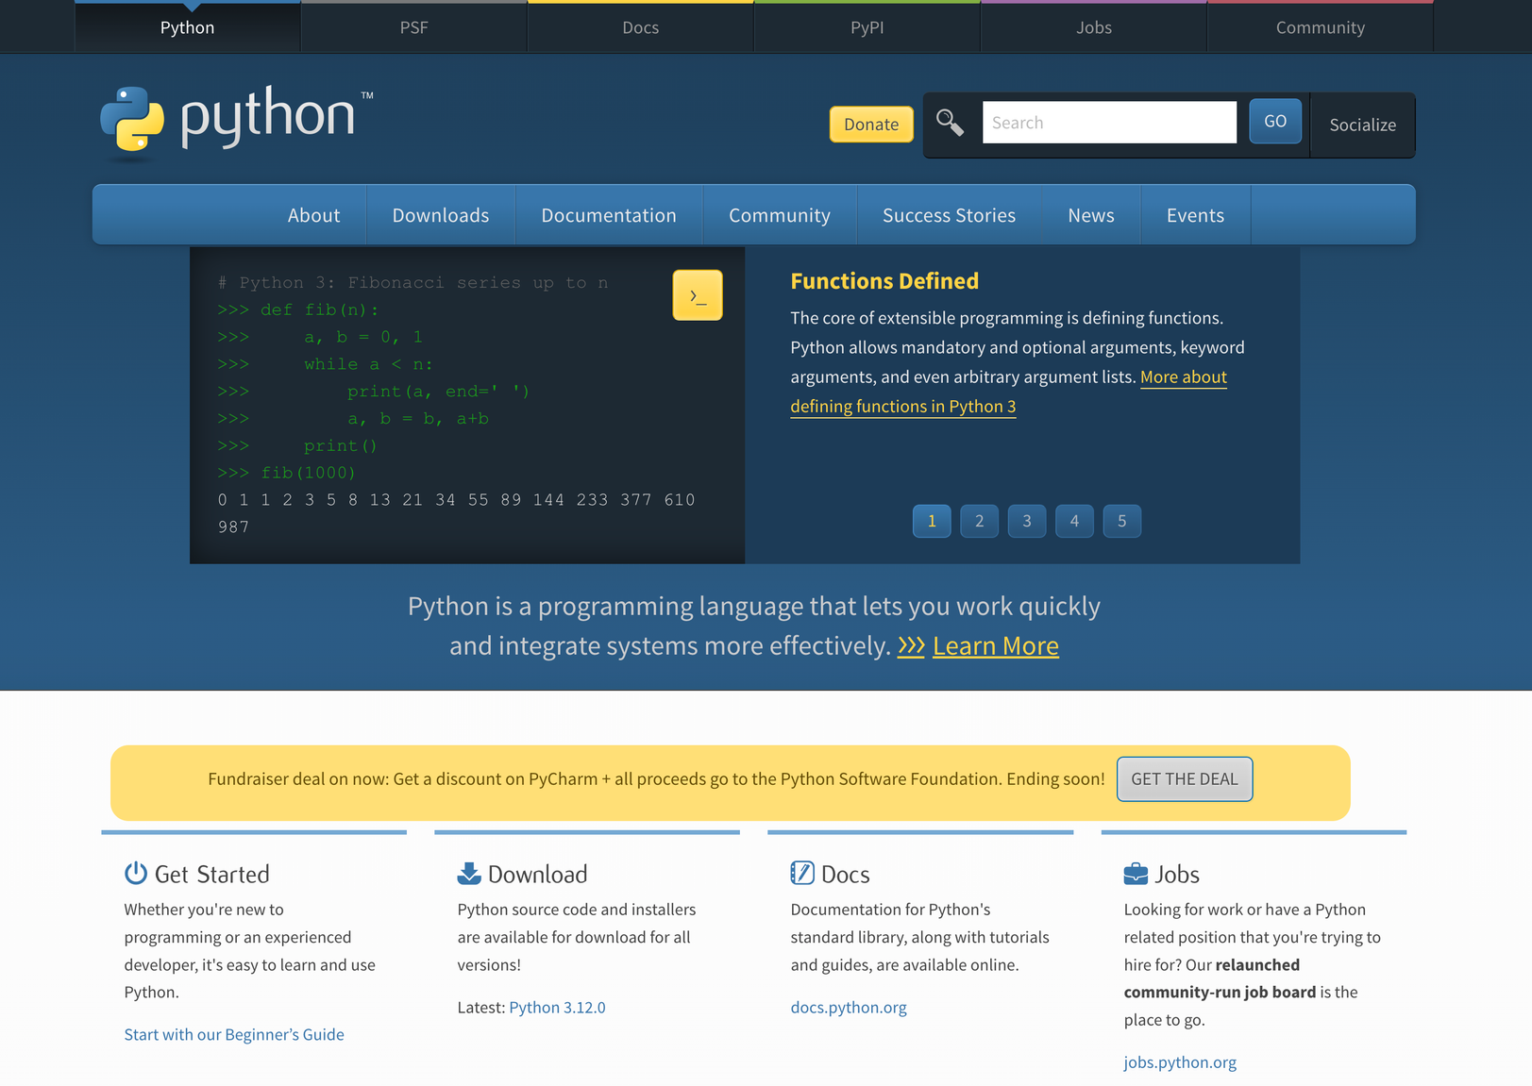
14.1 Introducing Python
Download python here!

Slide 8
14.1 Introducing Python
Key characteristics of Python:
  Case Sensitive: Python is case-sensitive, meaning it distinguishes between uppercase and lowercase letters in variable names and identifiers.
  Mandatory indentation: Python uses indentation to define code blocks, making it mandatory for maintaining readability and determining the structure of the code.
  Keywords in Lower Case: Python's keywords (e.g., if, else, while) are written in lowercase and form the fundamental syntax elements of the language.
  Slicing: Python supports slicing, a technique to extract specific elements from sequences like lists, strings, or tuples using a concise syntax (e.g., list[start:stop:step]).
  Interpreted Language: Python is an interpreted language, executing instructions directly without a separate compilation step, allowing for easier debugging and rapid development.

Slide 9
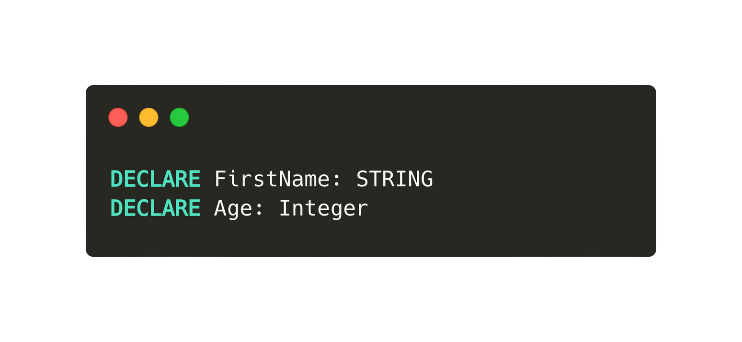
Subtopic 1
14.2 Fundamentals of Programming
Declaration of variable
The majority of programming languages necessitate specifying the data type for variables to enable the compiler to reserve the appropriate memory space.
This is how we declare a variable in pseudocode:
Declaration of variables
Assignment of constants and variables
Arithmetic Operators
Output
Input

Slide 10
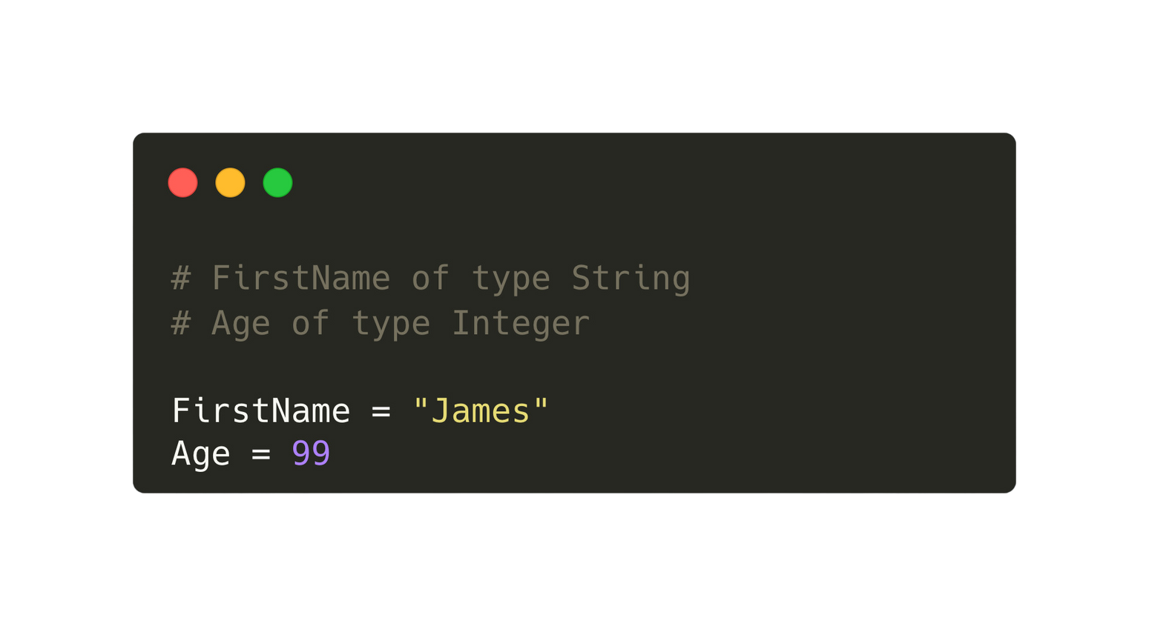
Subtopic 1
14.2 Fundamentals of Programming
Python
Python utilises dynamic typing, allowing variables to be created without explicit declaration of their data type, as it infers types dynamically at runtime.
Declaration of variables
Assignment of constants and variables
Arithmetic Operators
Output
Input

Slide 11
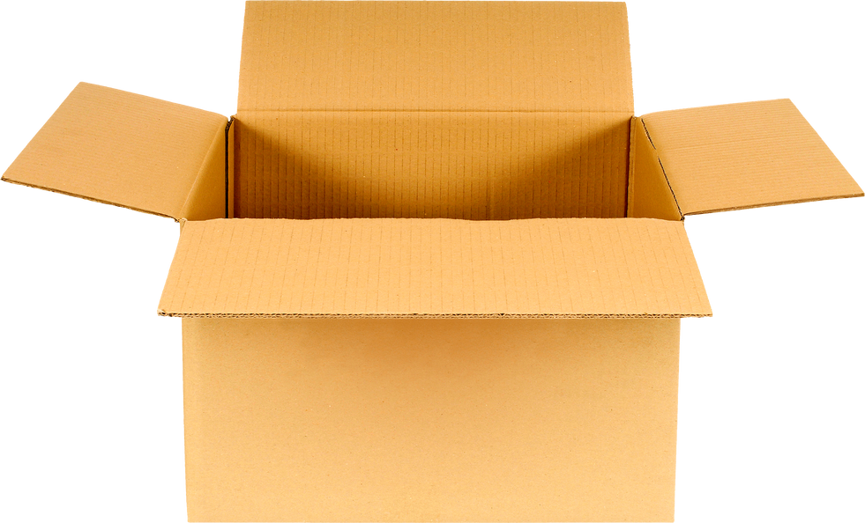

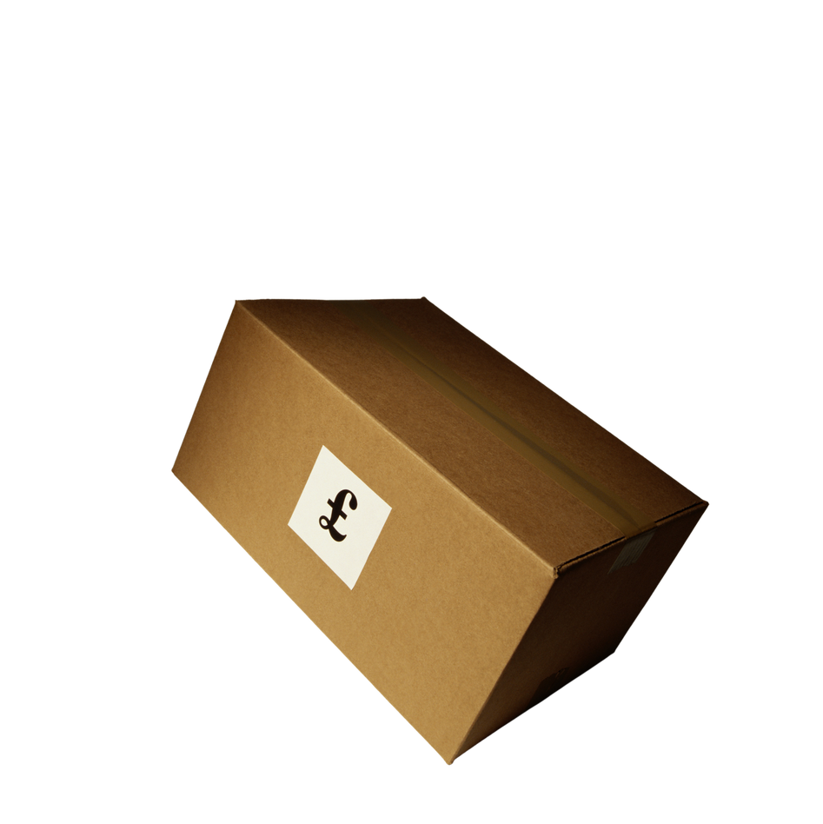
Subtopic 1
14.2 Fundamentals of Programming
Constants and variables
A named data store that contains a value that MAY CHANGE (vary) during the execution of a program.
Eg. High score of a game
Variables
A named data store than contains a value that DOES NOT CHANGE during the execution of a program.
Constant
Eg. Number of days in a week
Declaration of variables
Assignment of constants and variables
Arithmetic Operators
Output
Input

Slide 12
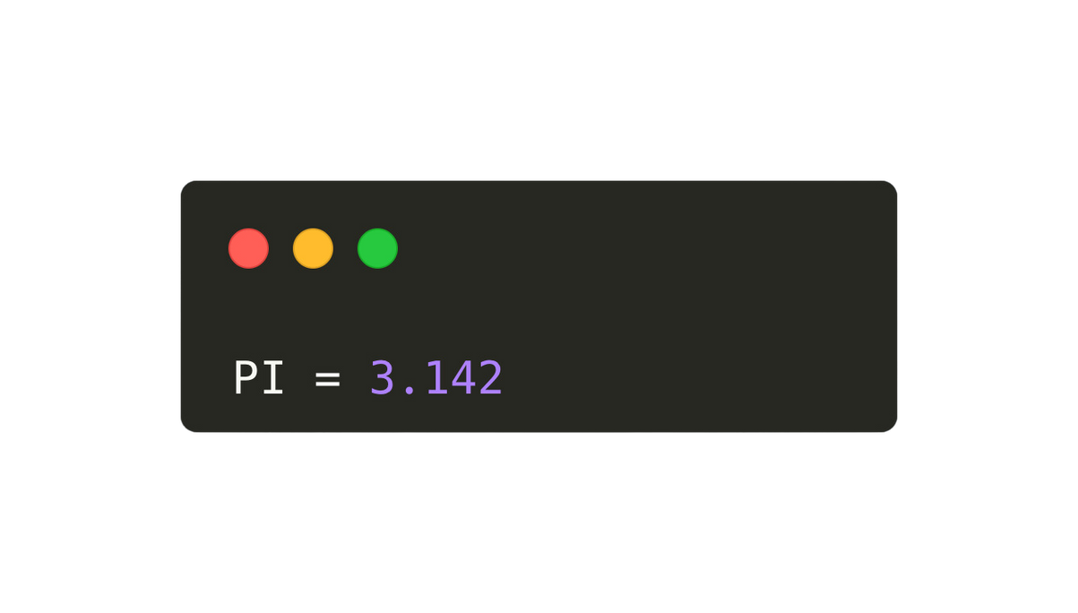
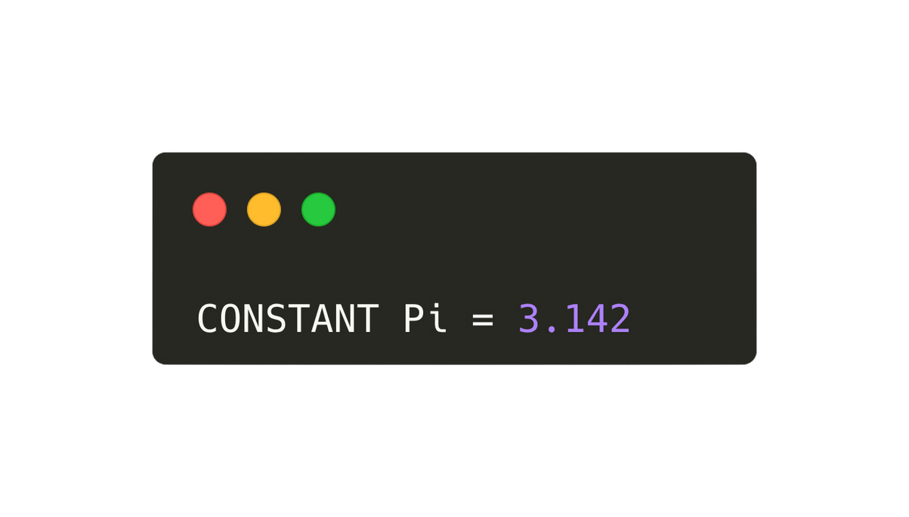
Subtopic 1
14.2 Fundamentals of Programming
Assignment of constants
The customary practice in Python is to employ UPPERCASE letters exclusively for constant identifiers. Although the values can be altered, it's recommended to regard constants as unchangeable.
Pseudocode
Python
Declaration of variables
Assignment of constants and variables
Arithmetic Operators
Output
Input

Slide 13
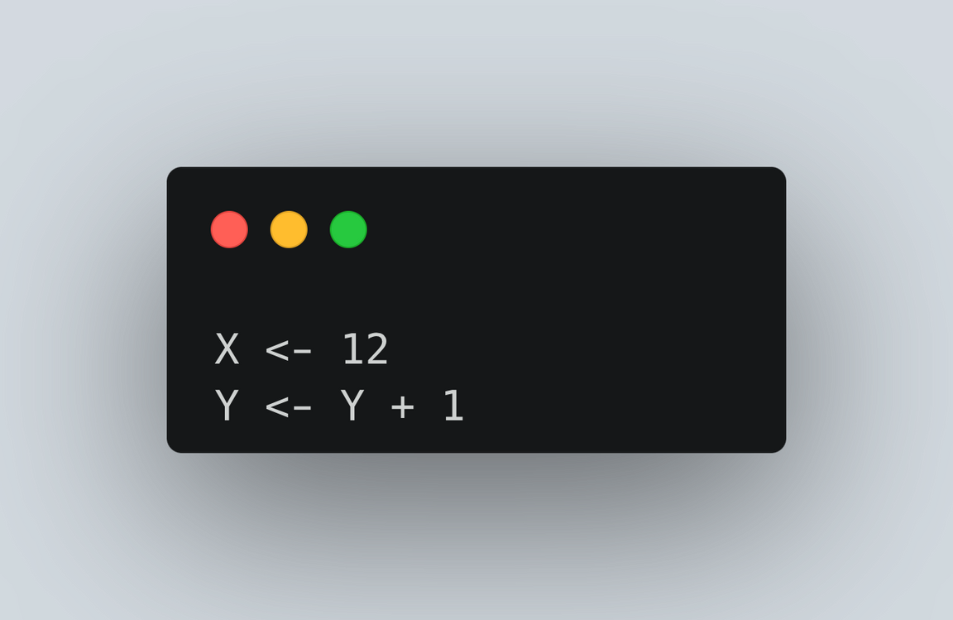
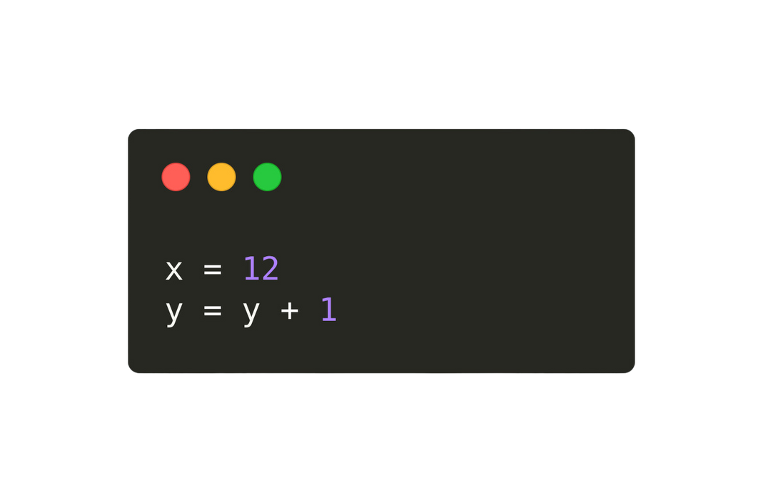
Subtopic 1
14.2 Fundamentals of Programming
Assignments of variables
The customary practice in Python is to employ uppercase letters exclusively for constant identifiers. Although the values can be altered, it's recommended to regard constants as unchangeable.
Pseudocode
Python
Declaration of variables
Assignment of constants and variables
Arithmetic Operators
Output
Input

Slide 14
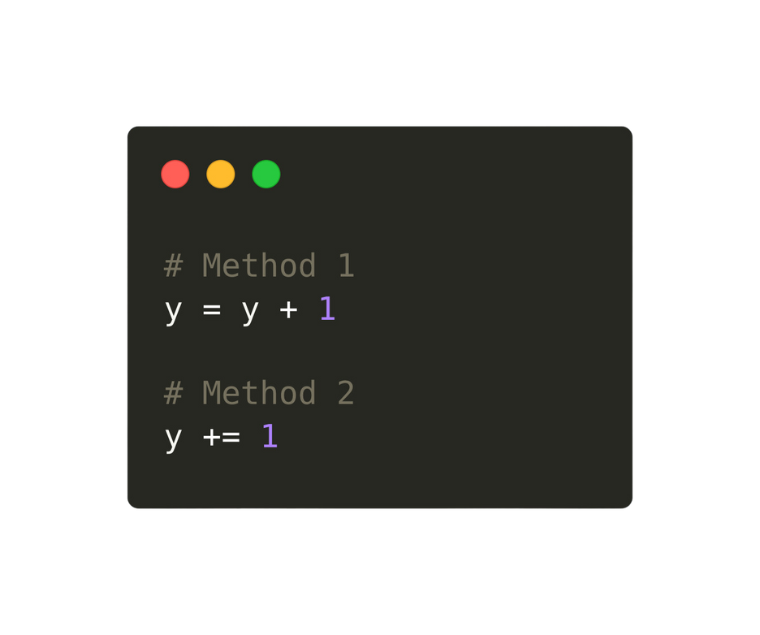

Subtopic 1
14.2 Fundamentals of Programming
Assignments of variables
Python allows you to increment a variable in the following ways:
Python
Declaration of variables
Assignment of constants and variables
Arithmetic Operators
Output
Input

Slide 15
Subtopic 1
14.2 Fundamentals of Programming
Action
Pseudocode
Python
Add
+
+
Arithmetic operators
Subtract
-
-
Arithmetic operators in Python are necessary for performing mathematical computations and manipulating numerical values within the code.
Multiply
*
*
Divide
/
/
Raise to the power of
^
**
Remainder division
MOD
%
Integer
division
DIV
//
Declaration of variables
Assignment of constants and variables
Arithmetic Operators
Output
Input

Slide 16
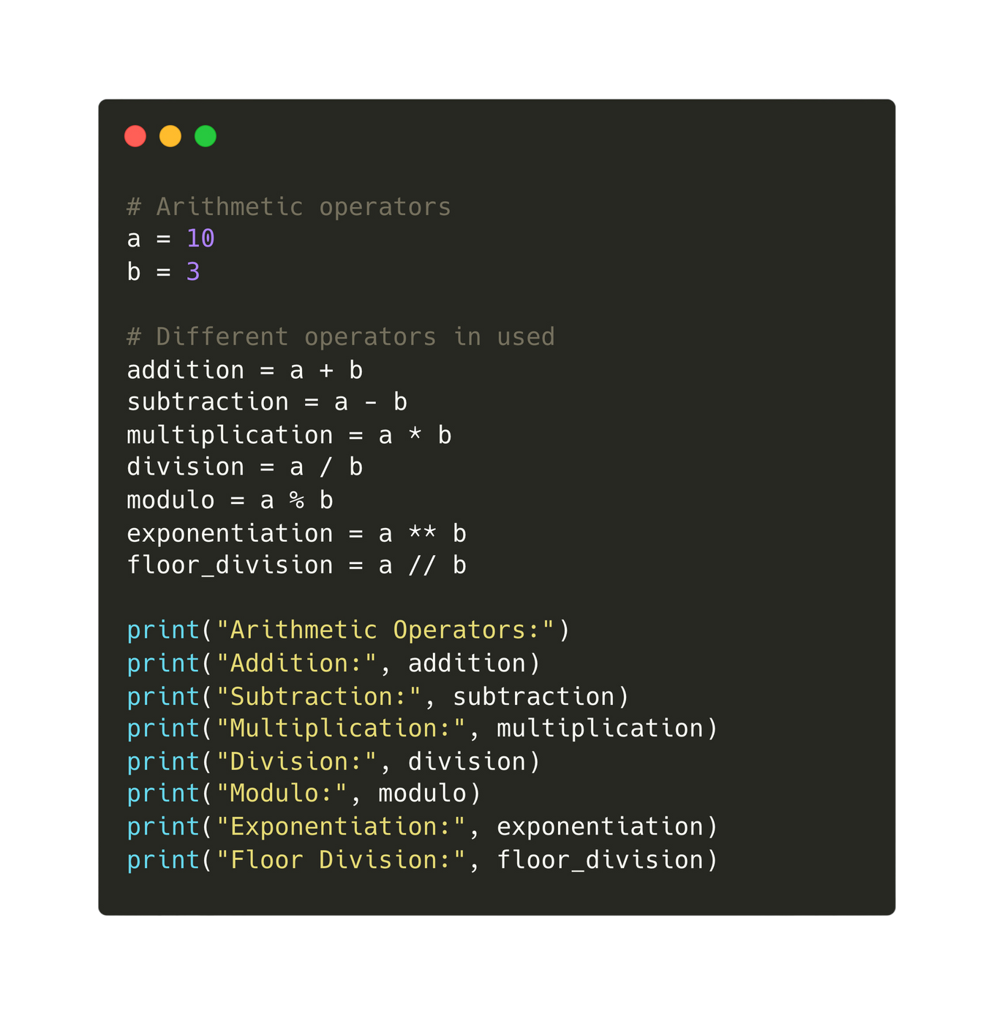
Subtopic 1
14.2 Fundamentals of Programming
Declaration of variables
Assignment of constants and variables
Arithmetic Operators
Output
Input

Slide 17
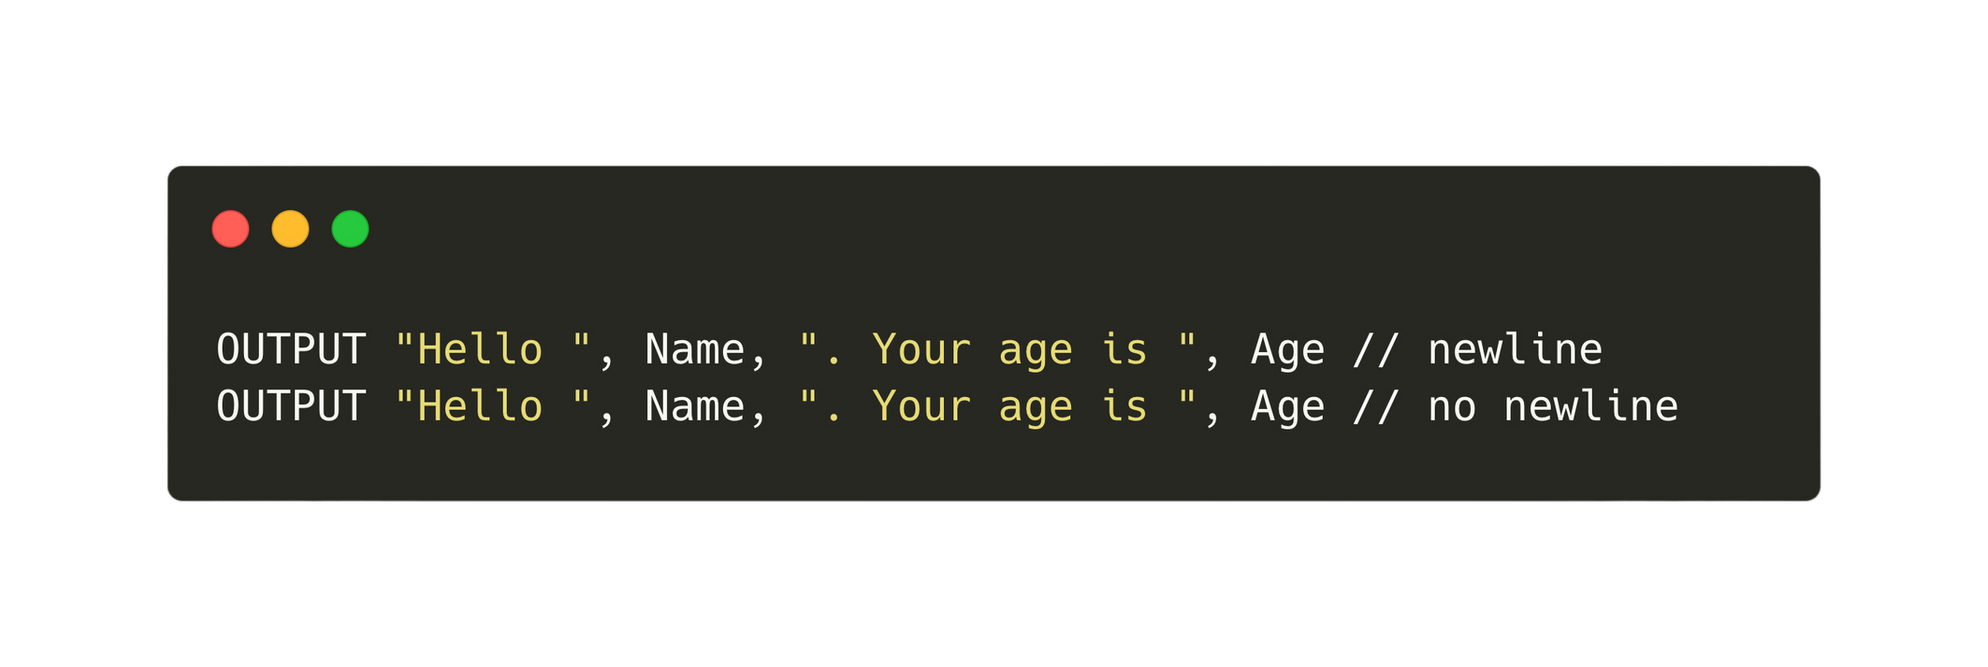
Subtopic 1
14.2 Fundamentals of Programming
Output
Data can also be output to the console screen. Data can be a mixture of output strings and variable values.
Pseudocode
Declaration of variables
Assignment of constants and variables
Arithmetic Operators
Output
Input

Slide 18
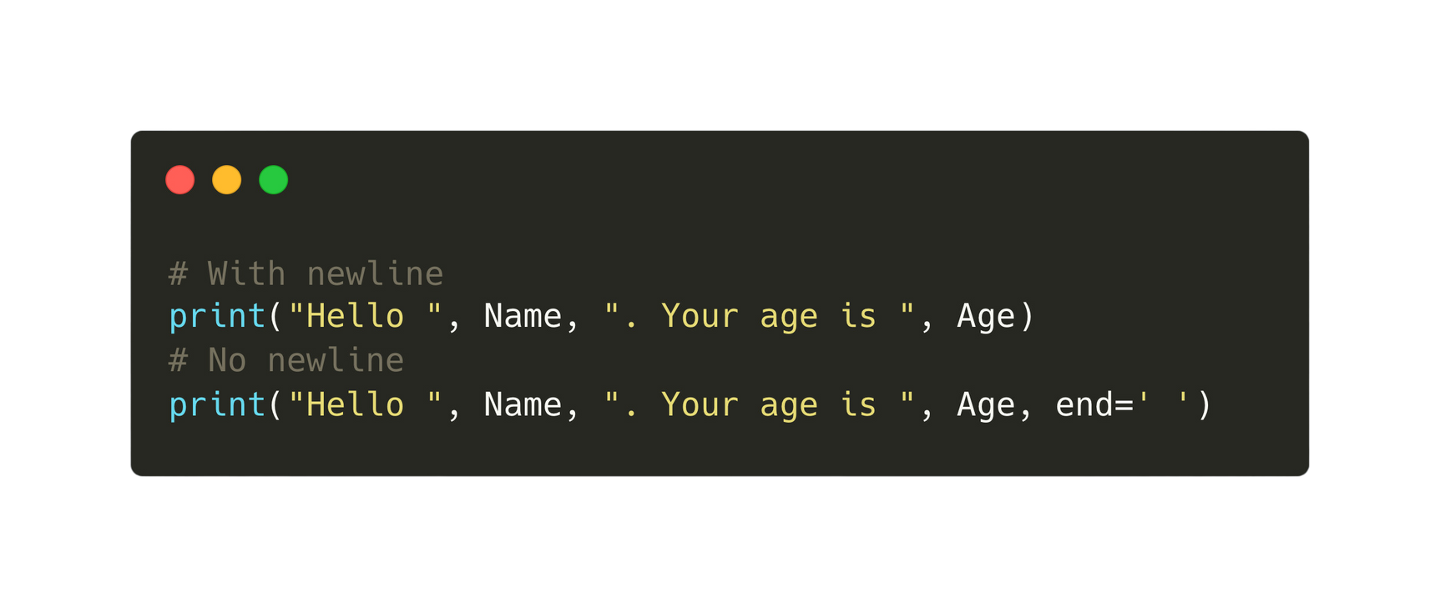
Subtopic 1
14.2 Fundamentals of Programming
Output
Data can also be output to the console screen. Data can be a mixture of output strings and variable values.
Python
Declaration of variables
Assignment of constants and variables
Arithmetic Operators
Output
Input

Slide 19
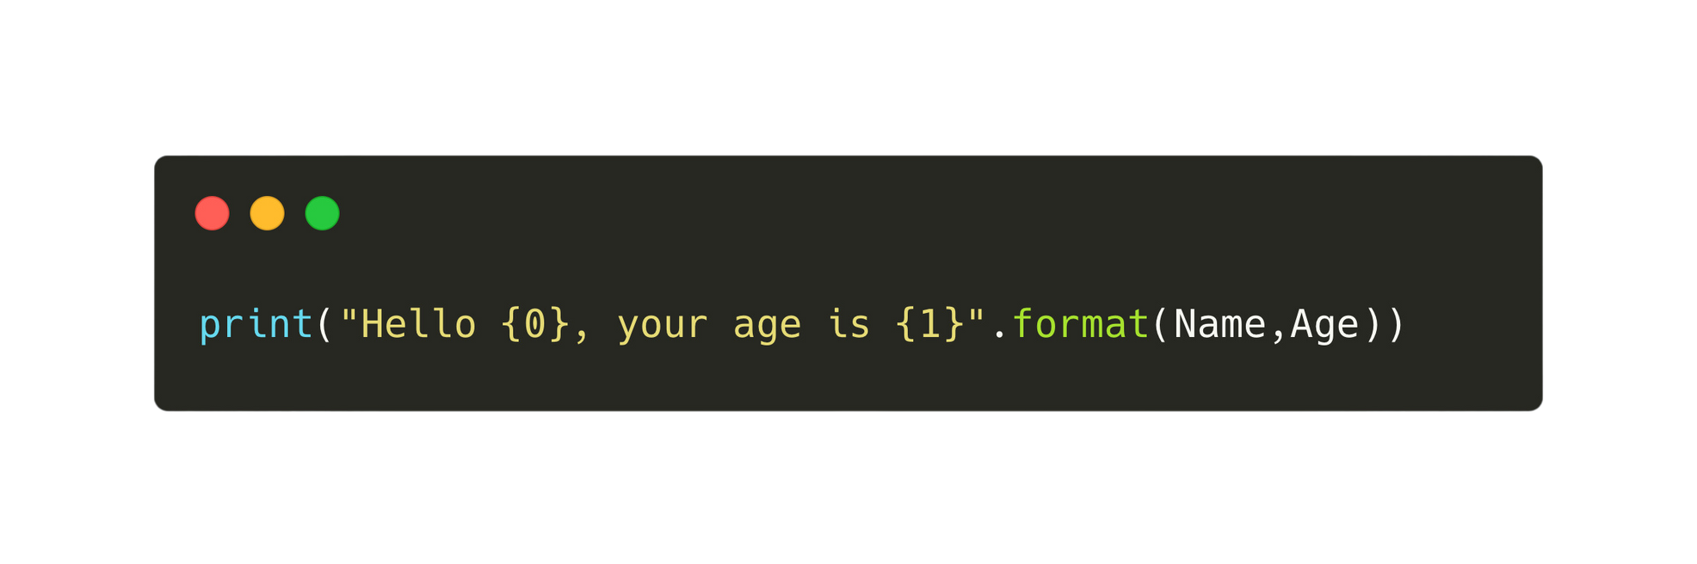
Subtopic 1
14.2 Fundamentals of Programming
Output
Placeholder method for output:
Python
Declaration of variables
Assignment of constants and variables
Arithmetic Operators
Output
Input

Slide 20
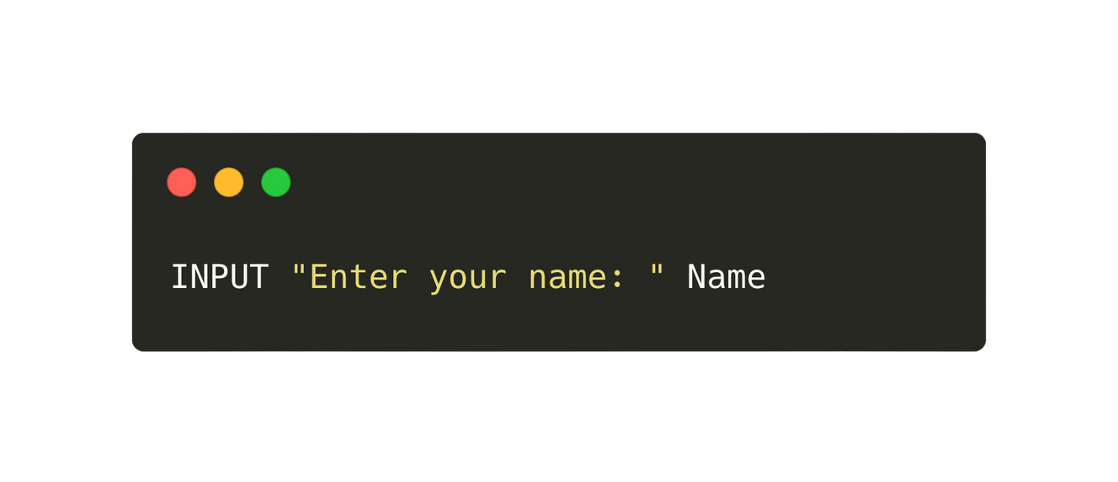
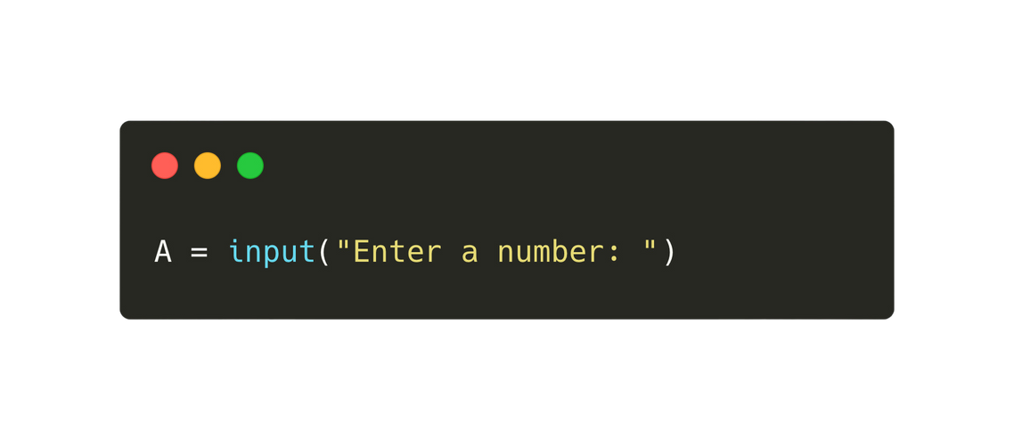
Subtopic 1
14.2 Fundamentals of Programming
Input
Input statements in programming are necessary to enable interaction with users by receiving external data or information during the execution of a program.
Pseudocode
Python
Declaration of variables
Assignment of constants and variables
Arithmetic Operators
Output
Input

Slide 21
Subtopic 1
14.2 Fundamentals of Programming
Comments
Adding comments is a good practice in programming as it enhances code readability and comprehension for both oneself and others who might review or work with the code.
Declaration of variables
Assignment of constants and variables
Arithmetic Operators
Output
Input

Slide 22

14.3 Essential Data Types in Programming
Integer
Real/Float
Char
String
Boolean
A positive or negative whole number that can be used with
mathematical operators
A positive or negative number with a fractional part. Real numbers can
be used with mathematical operators
A variable or constant that is a single character
A variable or constant that is several characters in length. Strings
vary in length and may even have no characters (known as an empty string)
A variable or constant that can have only two values TRUE or FALSE.

Slide 23
14.3 Essential Data Types in Programming
Integer
Real/Float
Char
String
Boolean
"ccc"
TRUE
FALSE
25
25.0
'c'
""

Slide 24



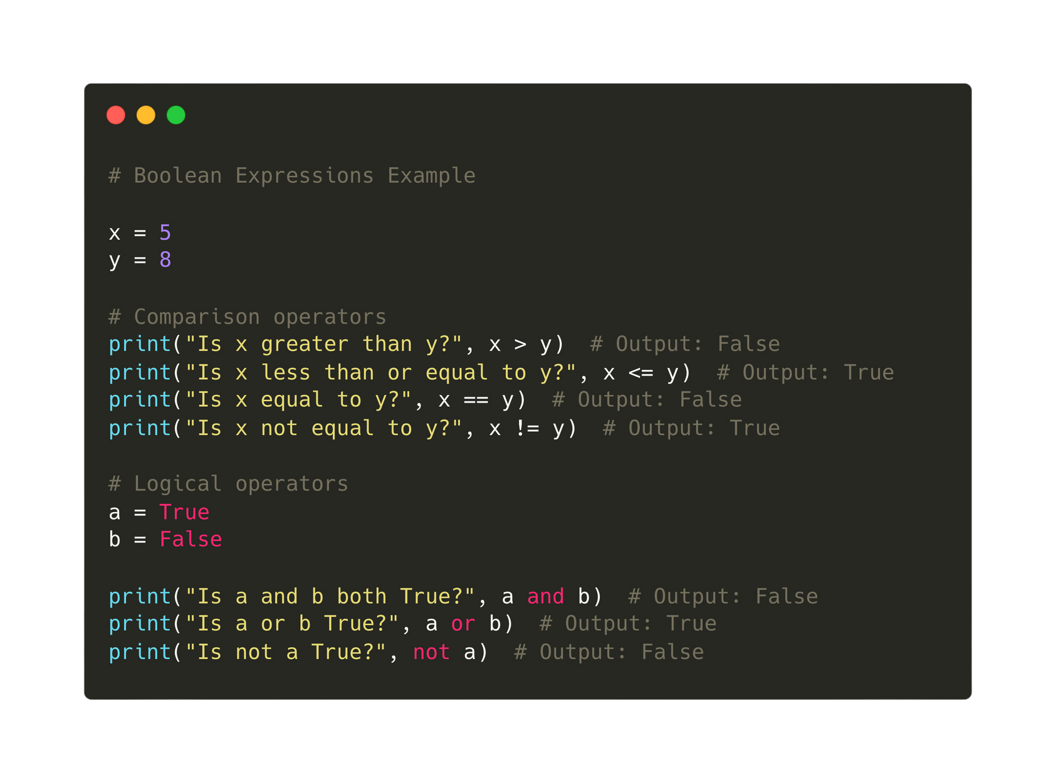
14.4 Boolean expressions
Definition
A boolean expression is a logical statement that evaluates to either true or false, typically involving logical operators or conditions, used for decision-making in programming. True and False are known as boolean values.

Slide 25
14.4 Boolean expressions
Comparison Operator
Operator
Pseudocode
Python
More than
>
>
Less than
<
<
Equal
=
==
Greater than or equal to
>=
>=
Less than or equal to
<=
<=
Not Equal
<>
!=

Slide 26
14.4 Boolean expressions
Boolean Operator
Operator
Description
Pseudocode
Python
AND
Both True
AND
and
OR
Either True
OR
or
NOT
Not True
NOT
not

Slide 27

14.5 Conditional Statements
Selection
Selection in programming is necessary to enable decision-making based on specific conditions, directing the flow of execution to different code paths.
Code Path 1
Code Path 2
condition

Slide 28
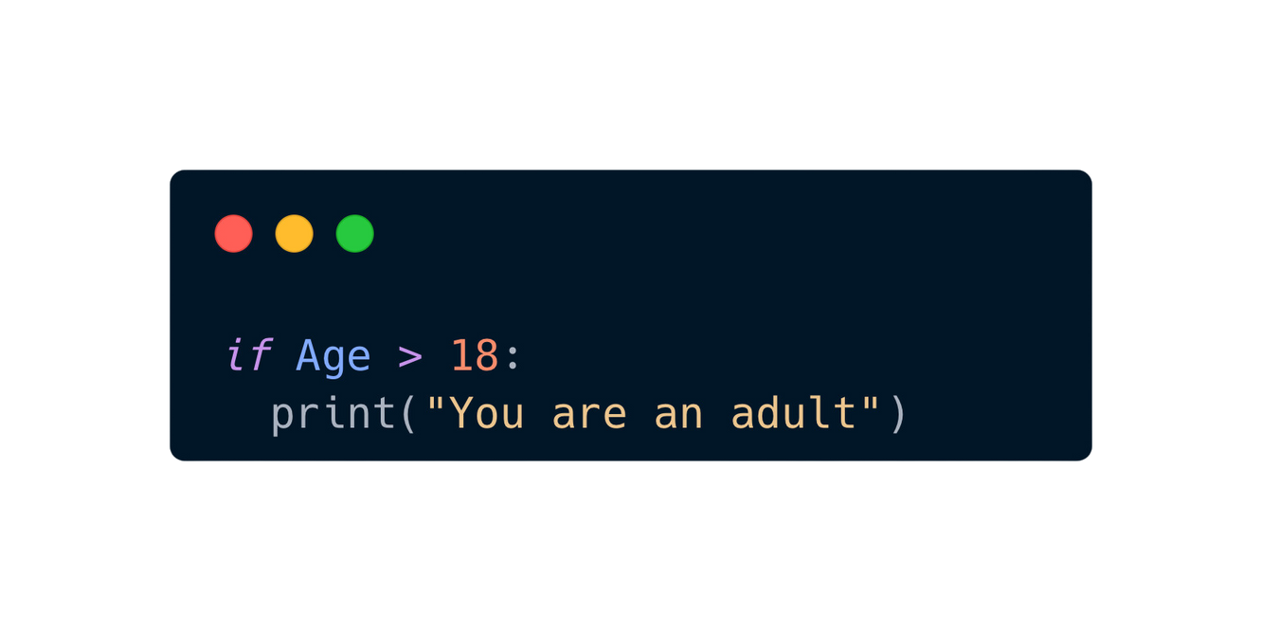
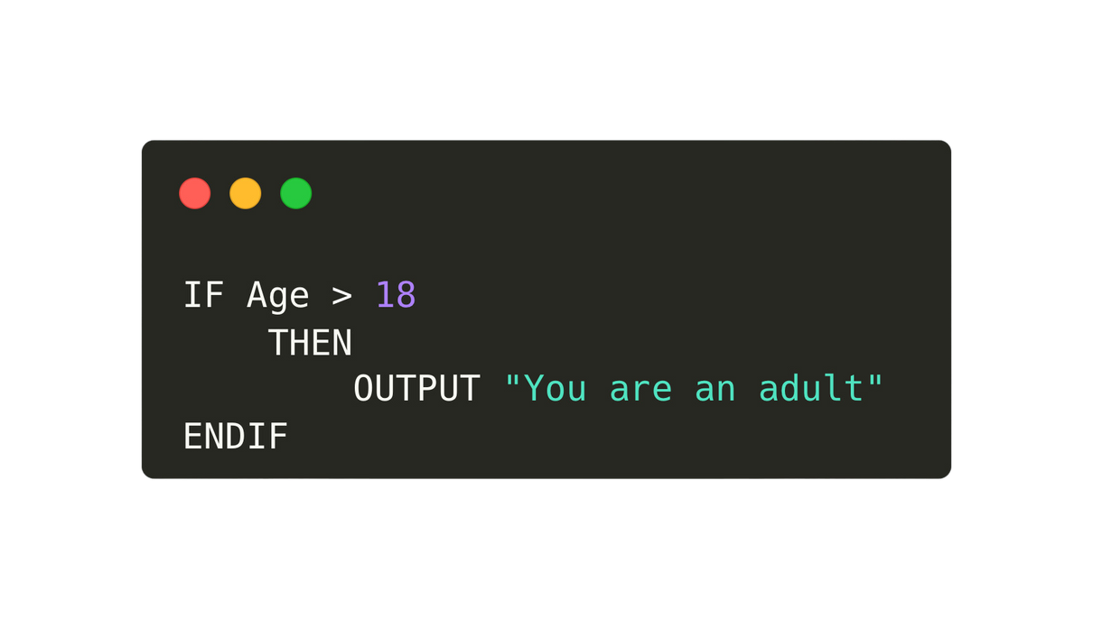
14.5 Conditional Statements
If ... THEN statement
Pseudocode
Python

Slide 29
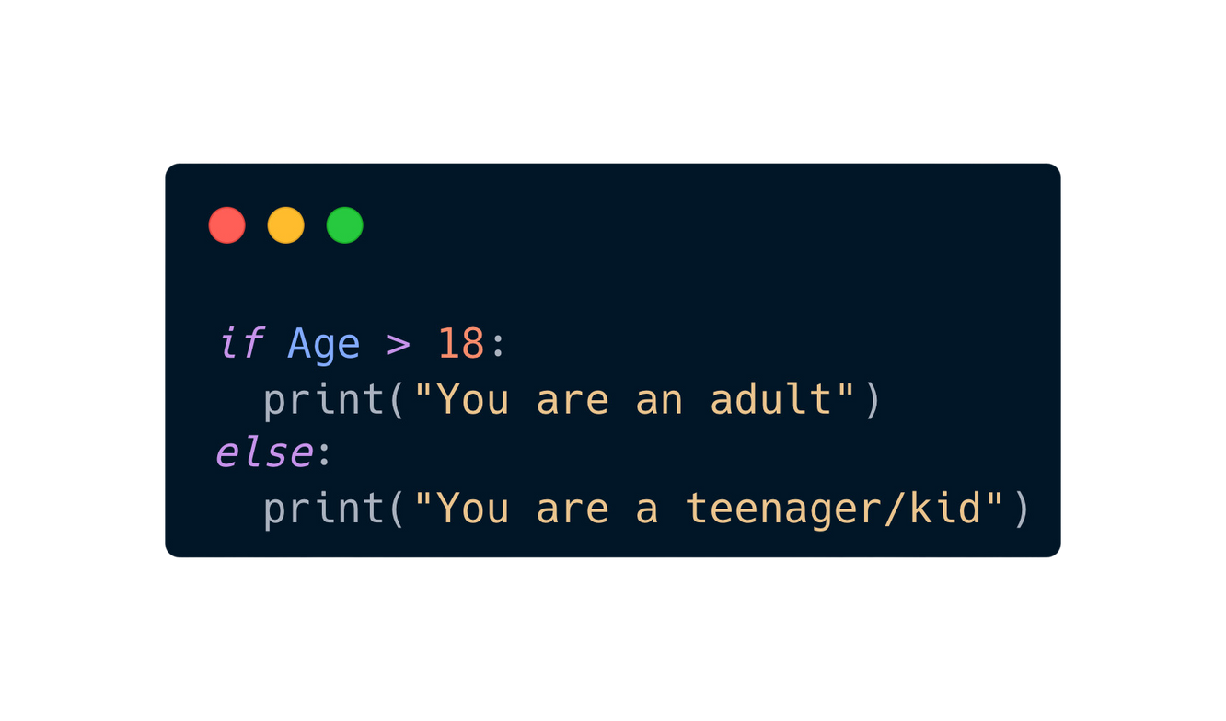
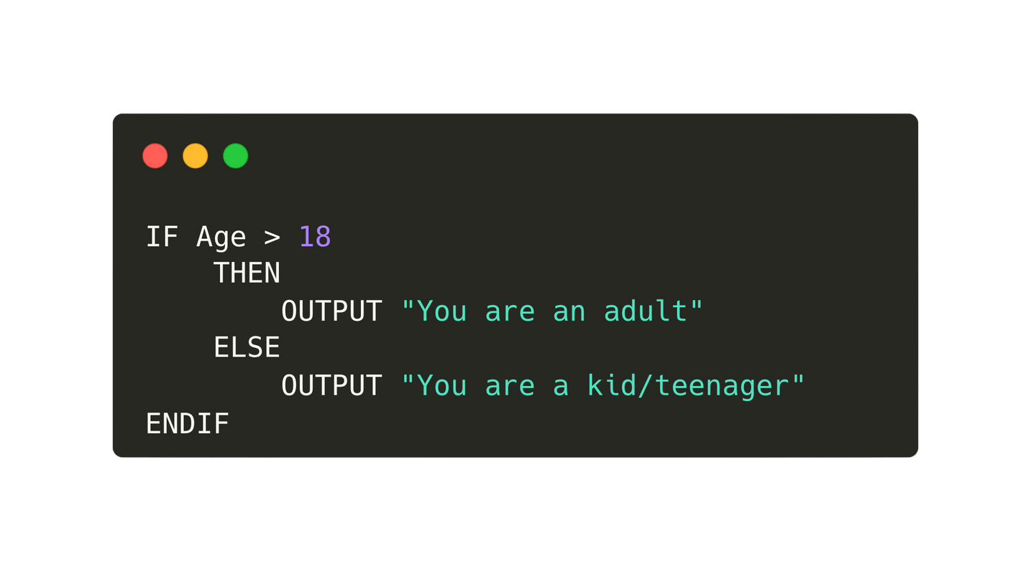
14.5 Conditional Statements
IF ... THEN ... ELSE statements
Pseudocode
Python

Slide 30
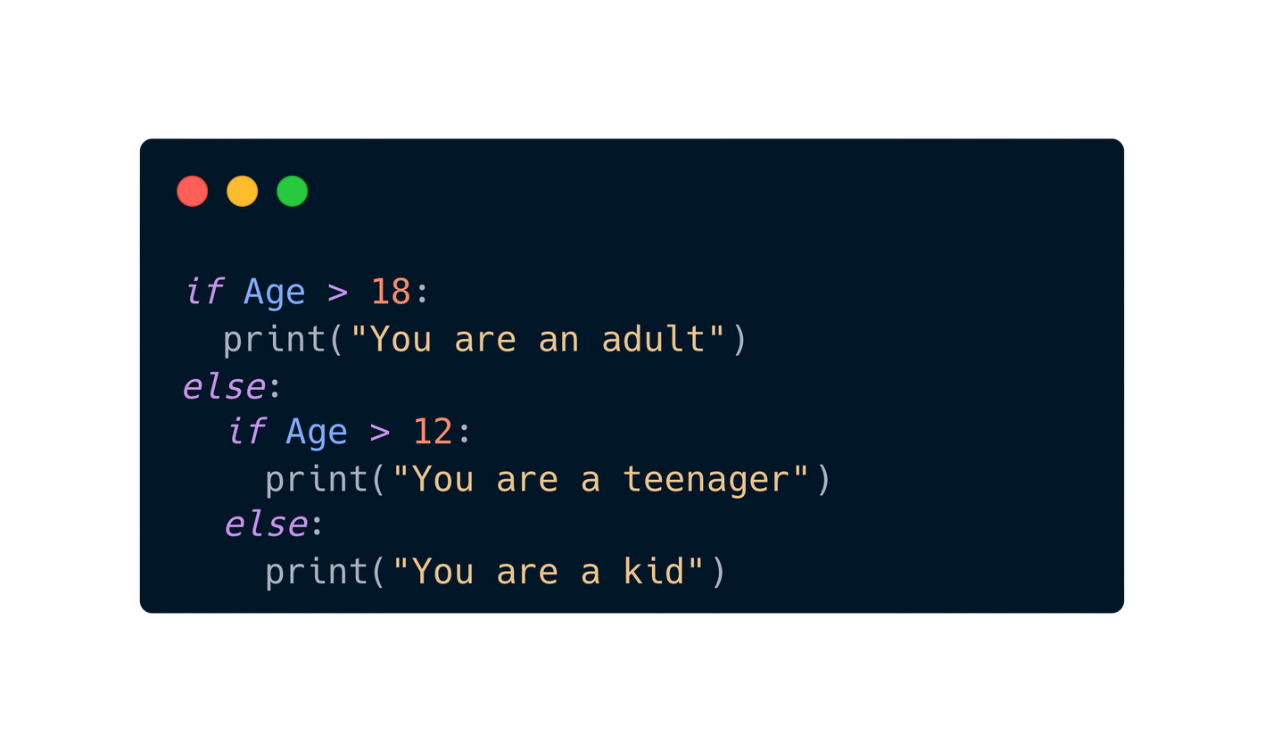
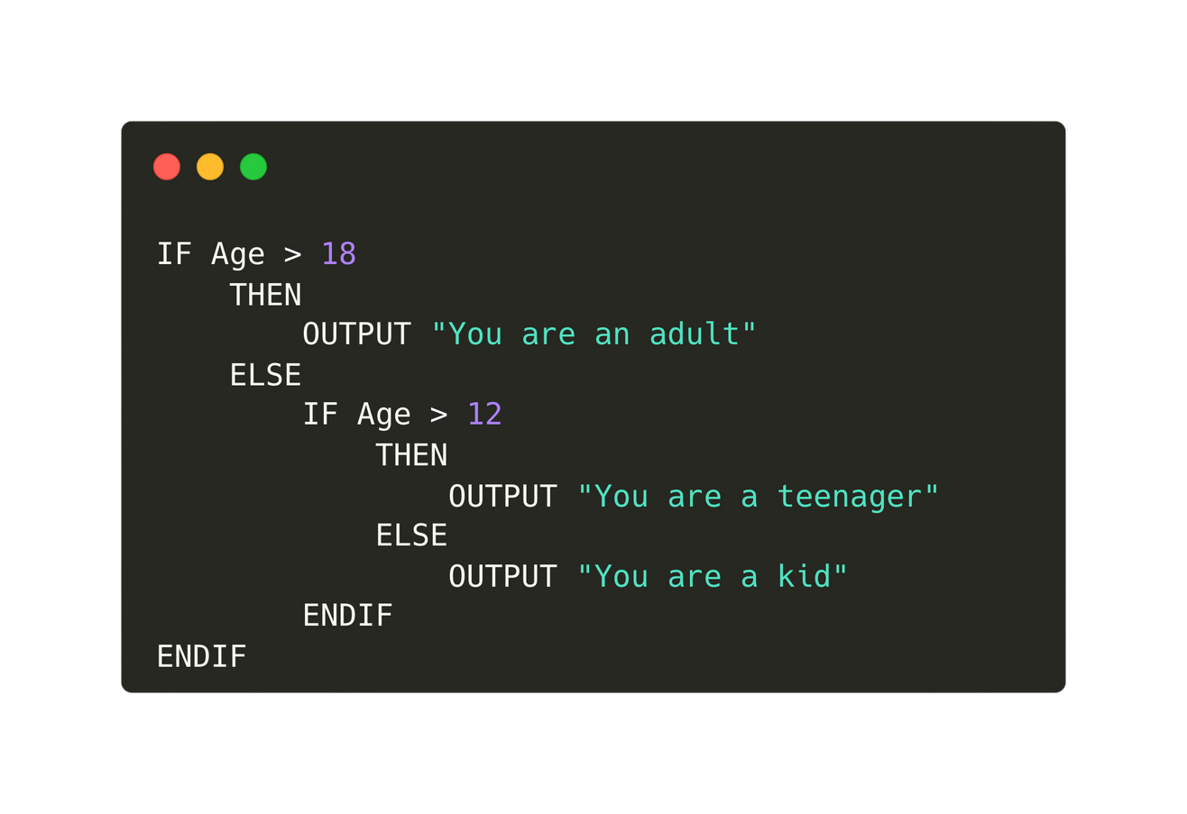
14.5 Conditional Statements
Nested IF statements
Pseudocode
Python

Slide 31
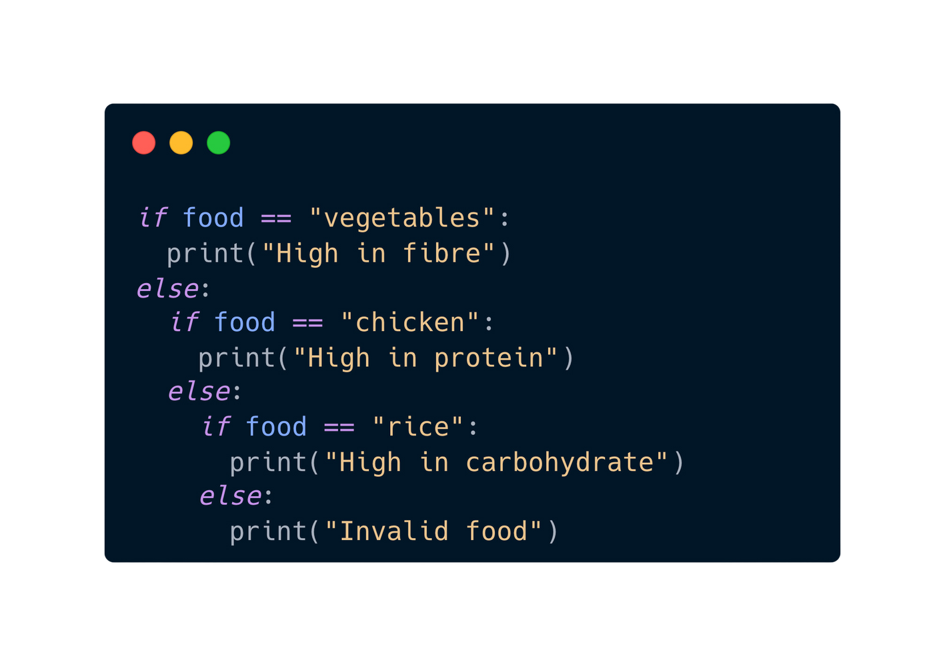
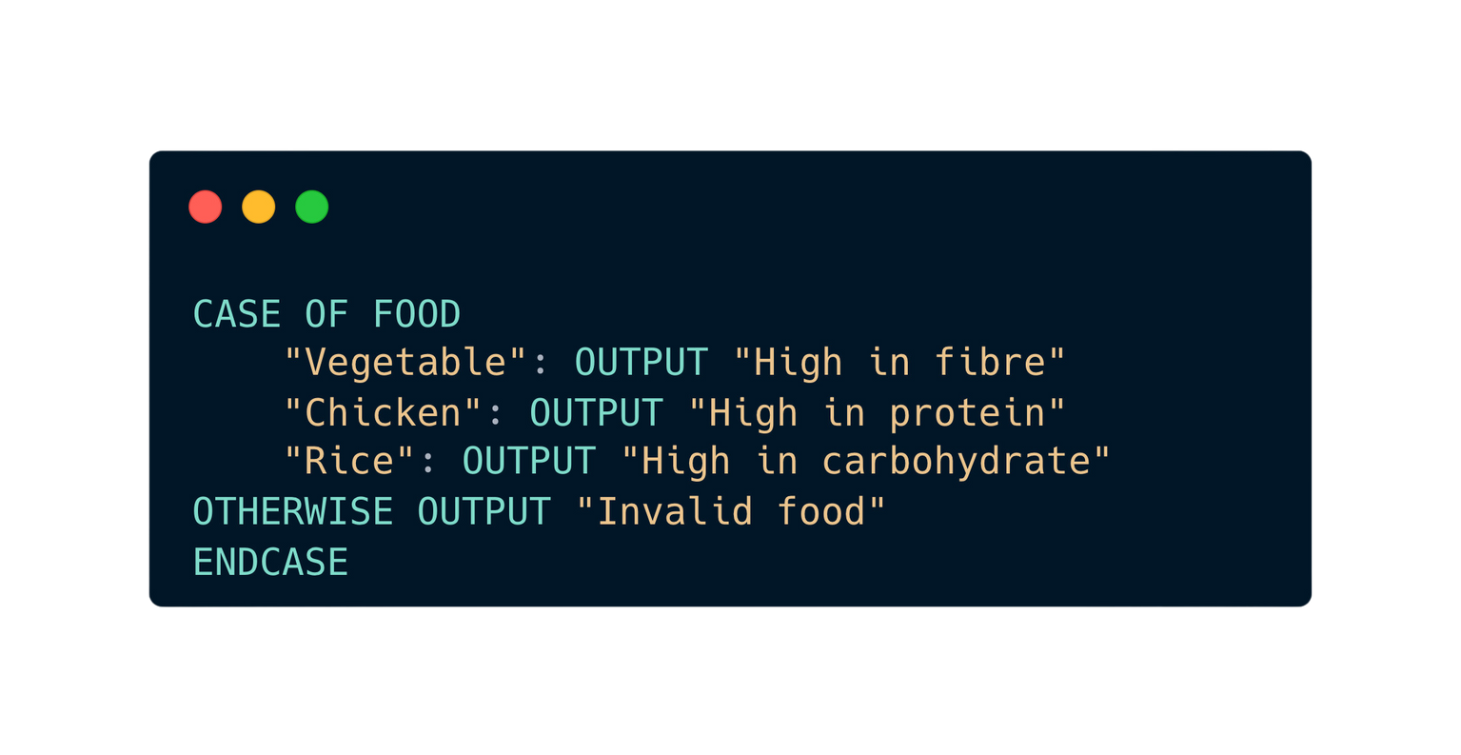
14.5 Conditional Statements
CASE statement
Python
Pseudocode

Slide 32
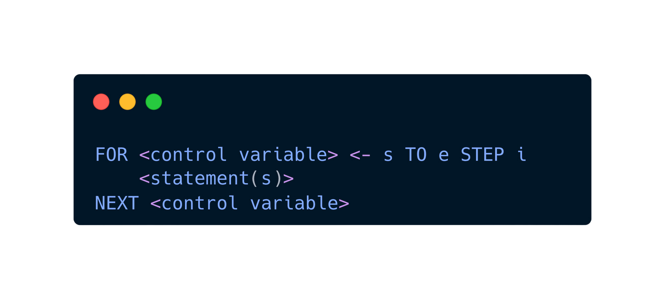
Subtopic 1
14.6 Loops and Repetition Structures
Count-controlled loop
Syntax

Slide 33
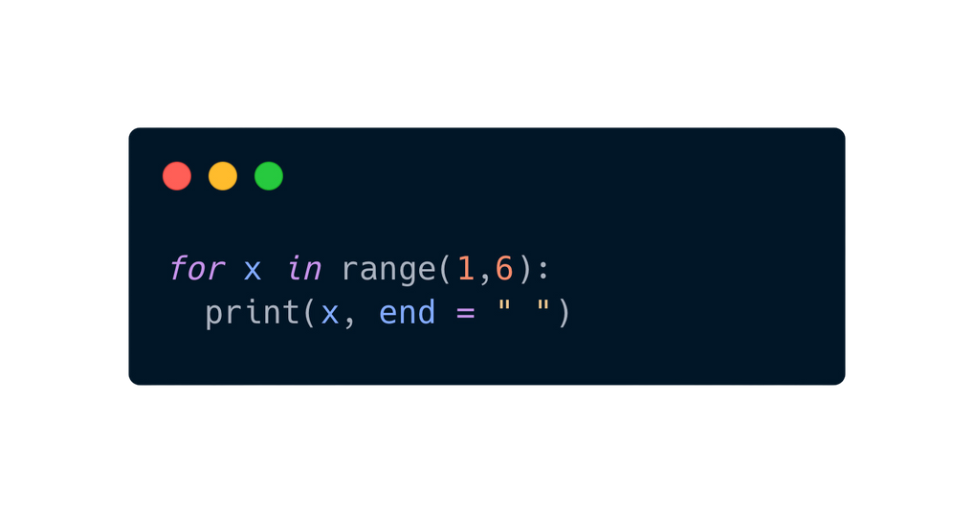
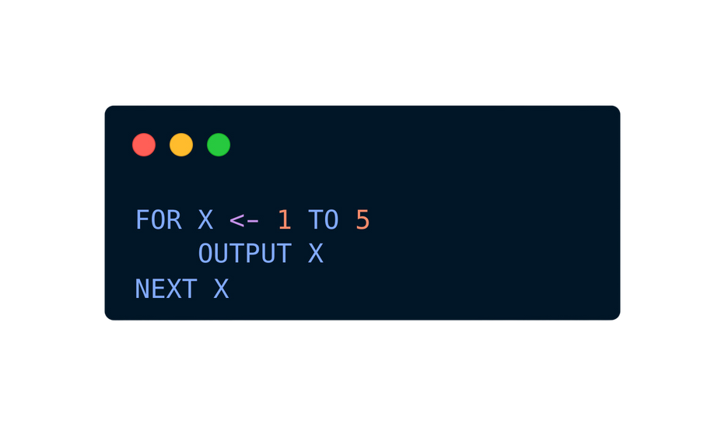
Subtopic 1
14.6 Loops and Repetition Structures
Pseudocode
Python
Output
1 2 3 4 5

Slide 34
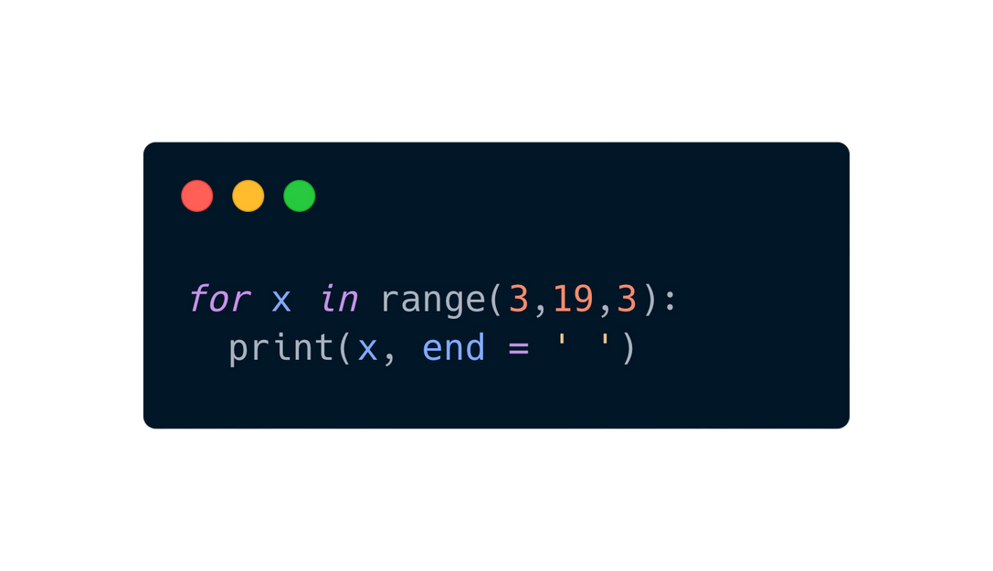
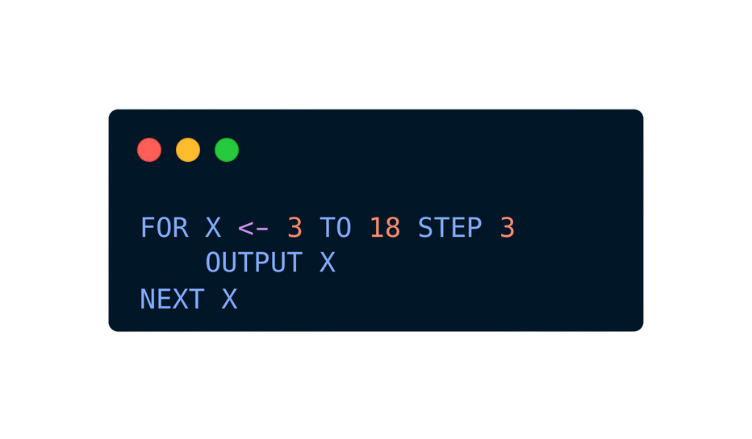
Subtopic 1
14.6 Loops and Repetition Structures
Pseudocode
Python
Output
1 2 3 4 5
3 6 9 12 15 18

Slide 35
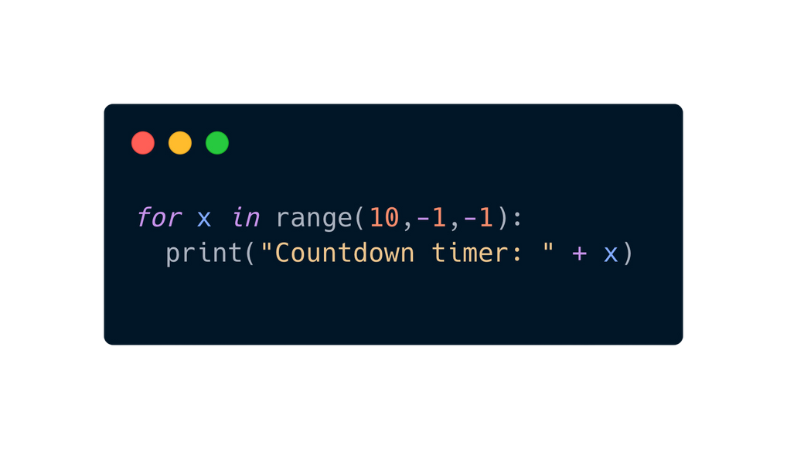
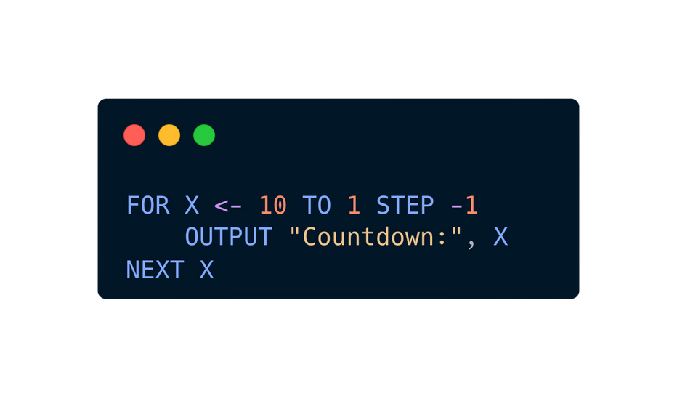
Subtopic 1
14.6 Loops and Repetition Structures
Pseudocode
Python
Output
1 2 3 4 5
3 6 9 12 15 18
Countdown timer: 10
Countdown timer: 9
Countdown timer: 8
Countdown timer: 7
Countdown timer: 6
Countdown timer: 5
Countdown timer: 4
Countdown timer: 3
Countdown timer: 2
Countdown timer: 1
Countdown timer: 0

Slide 36
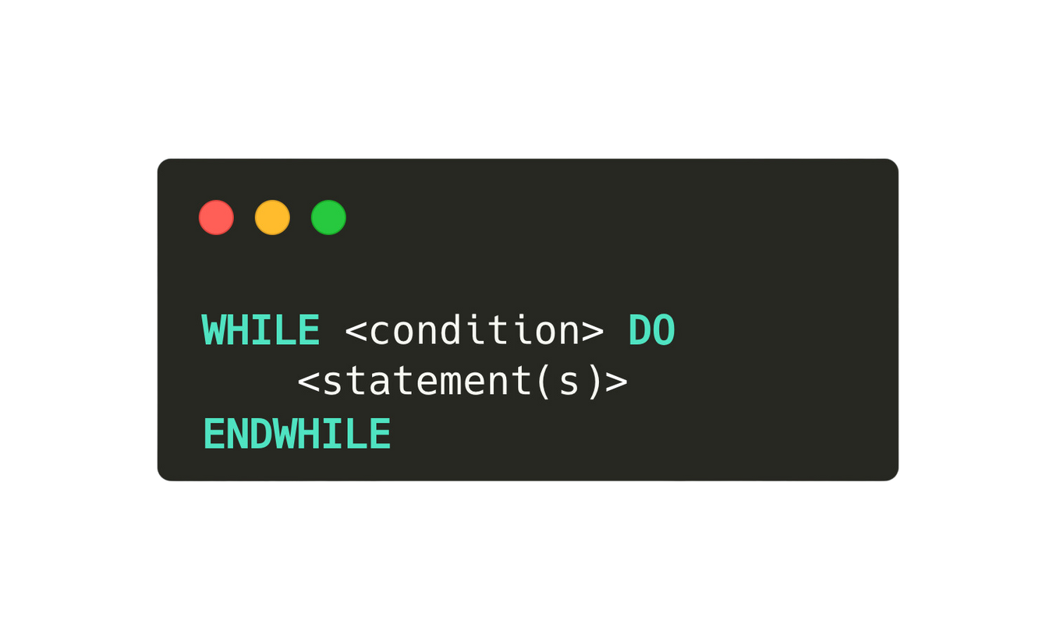
Subtopic 1
14.6 Loops and Repetition Structures
Pre-condition loop
A pre-condition loop is a control flow structure where the condition is checked before entering the loop's body, allowing the body to execute only if the condition is initially satisfied.

Slide 37
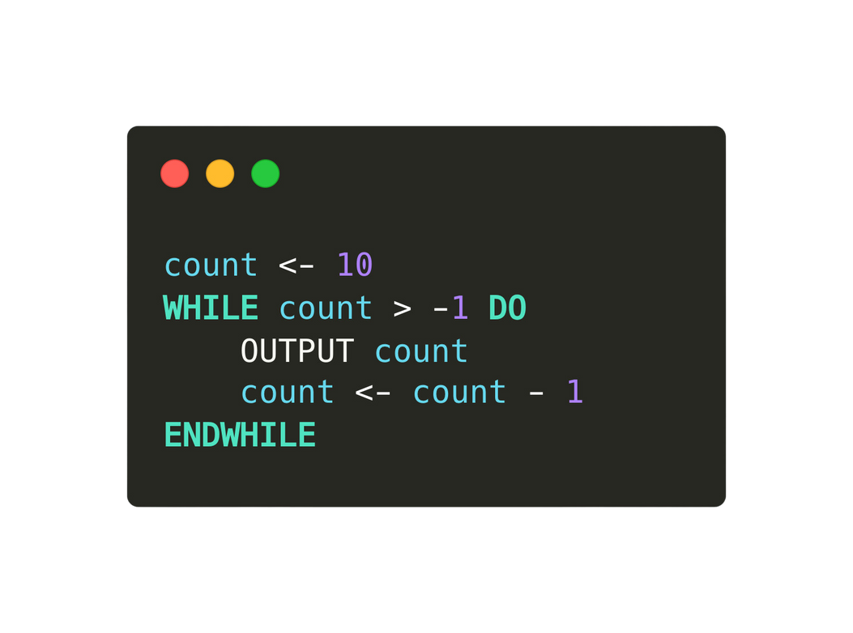
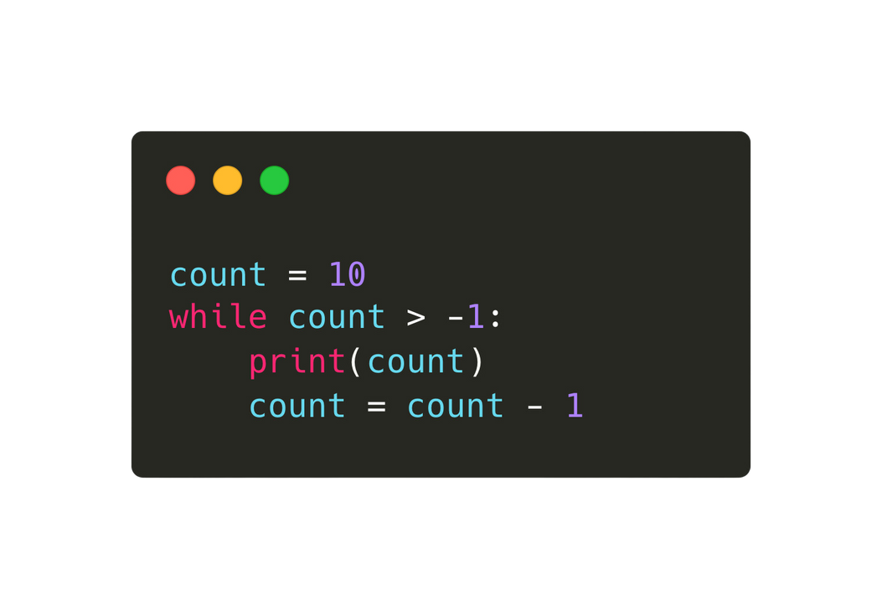
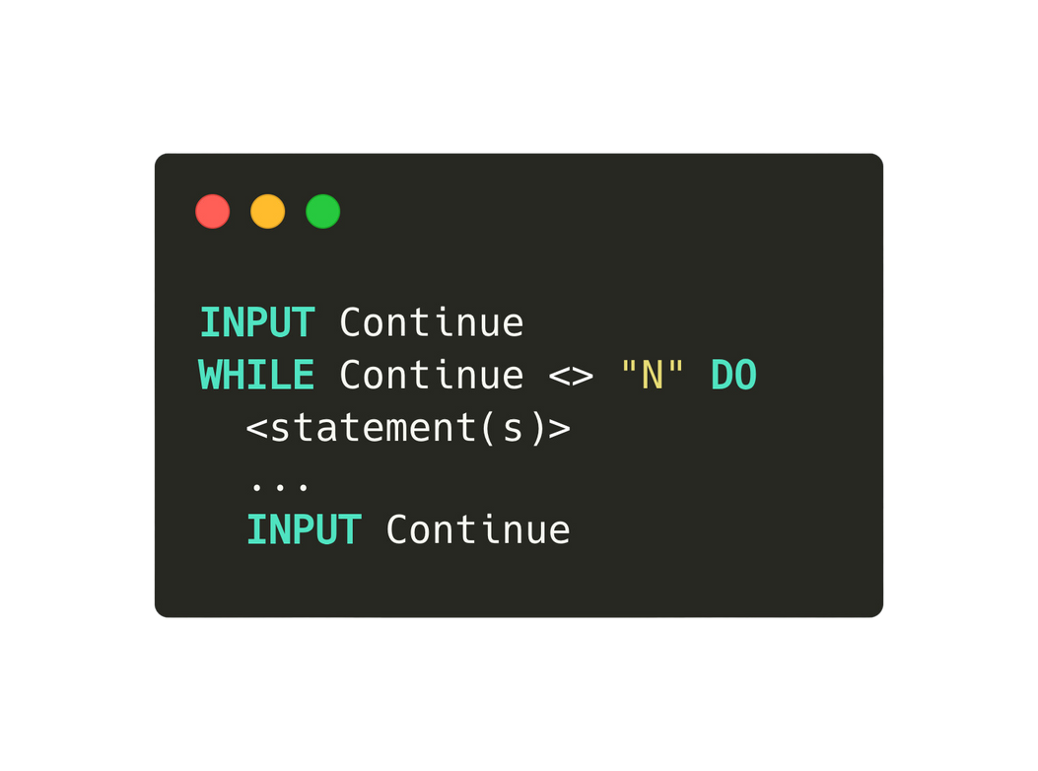
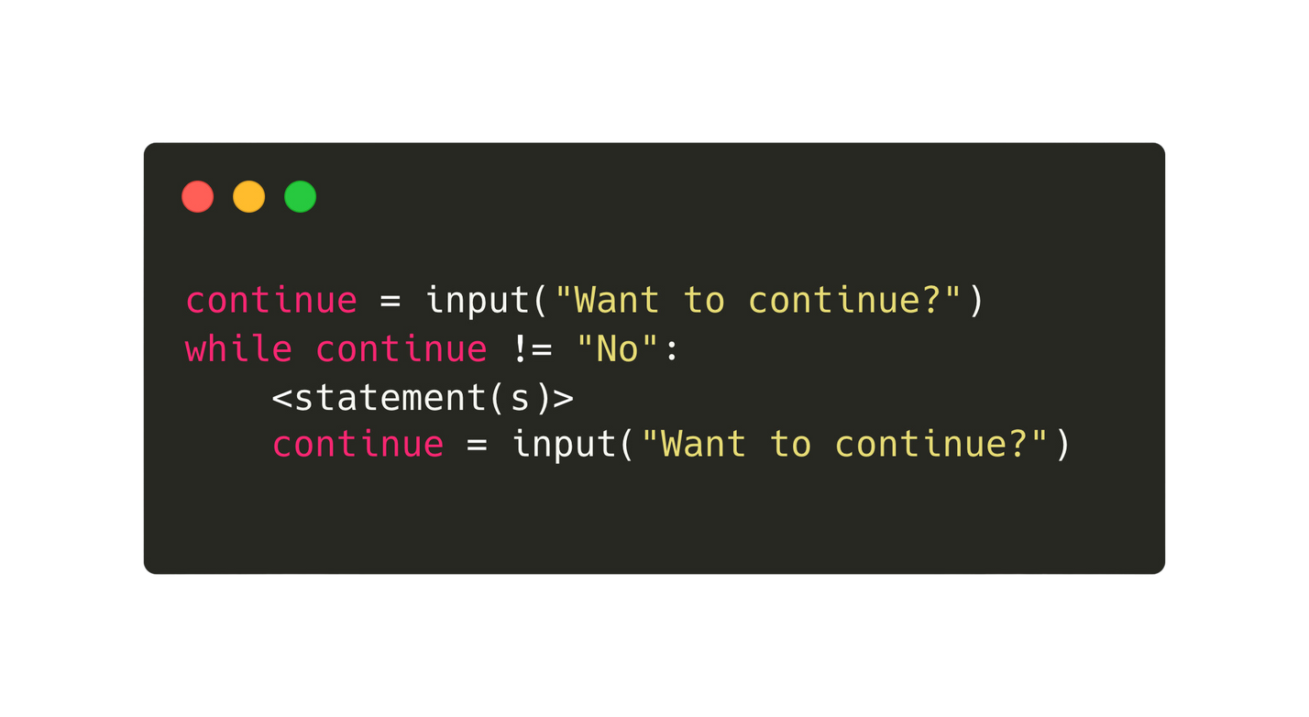
Subtopic 1
14.6 Loops and Repetition Structures
Pseudocode
Python

Slide 38
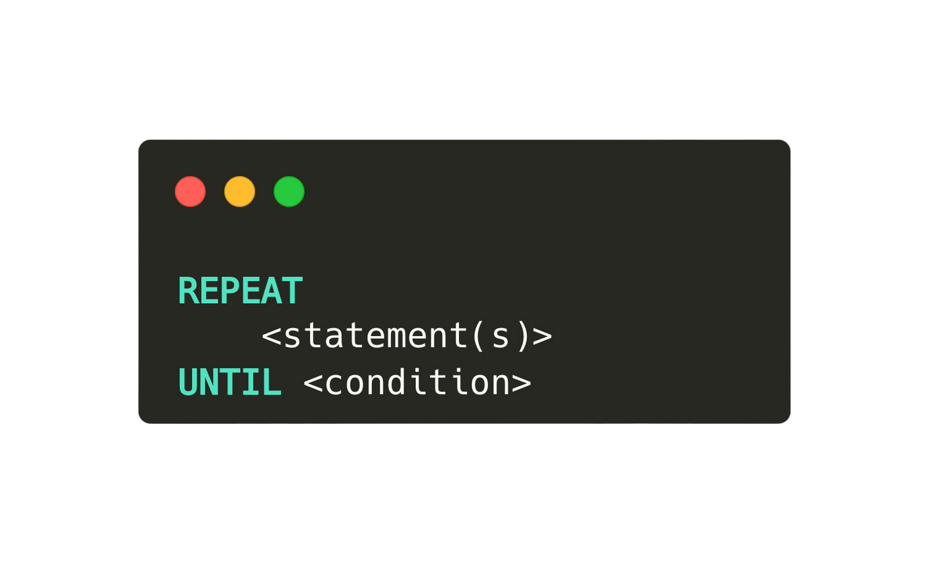
Subtopic 1
14.6 Loops and Repetition Structures
Post-condition loop
A post-condition loop is a control flow structure where the condition is checked after executing the loop's body, ensuring the body is executed at least once.
Not available in Python.

Slide 39
Subtopic 1
14.6 Loops and Repetition Structures
Which loop to use?
Use a count-controlled loop when the number of iterations is known beforehand, a post-condition loop when the loop must execute at least once with condition evaluation afterward, and a pre-condition loop when the condition needs to be checked before entering the loop body.

Slide 40

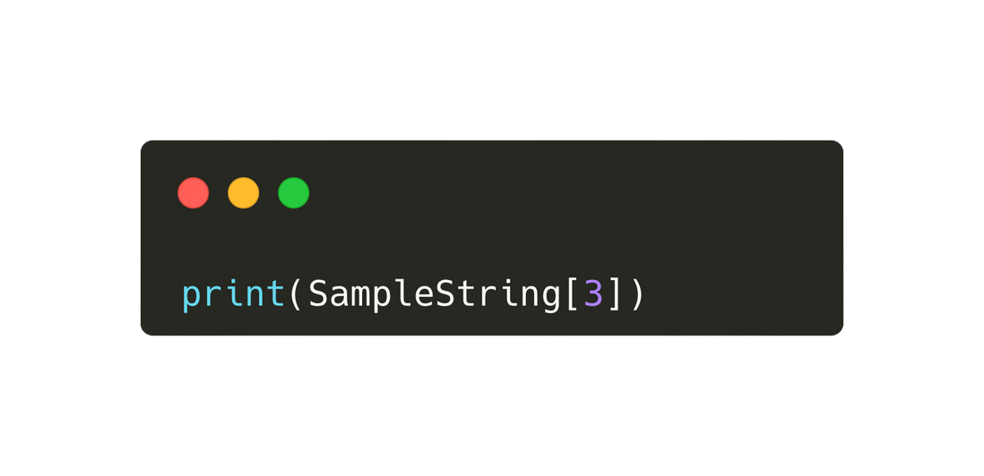
14.7 Predefined Functions in Programming
String manipulation functions
0
1
2
3
4
5
6
7
Sample String:
A
L
E
V
E
L
C
S
Access a single character using its position 3 in a string
Output:
V

Slide 41
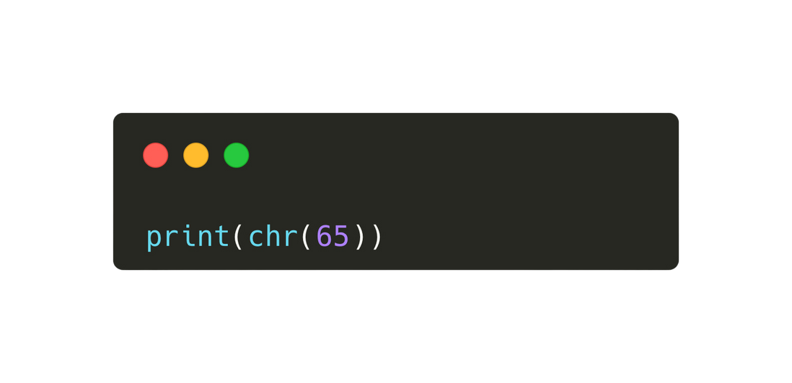
14.7 Predefined Functions in Programming
String manipulation functions - chr( )
Return the character whose ascii value is i
Output:
“a”

Slide 42
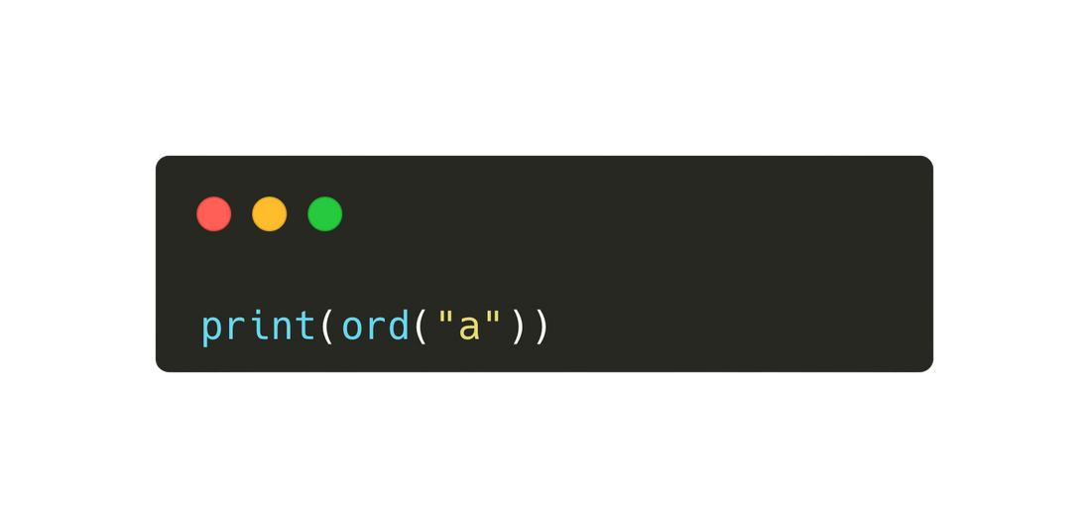
14.7 Predefined Functions in Programming
String manipulation functions -ord ( )
Return the ASCII Value of the character
Output:
65

Slide 43
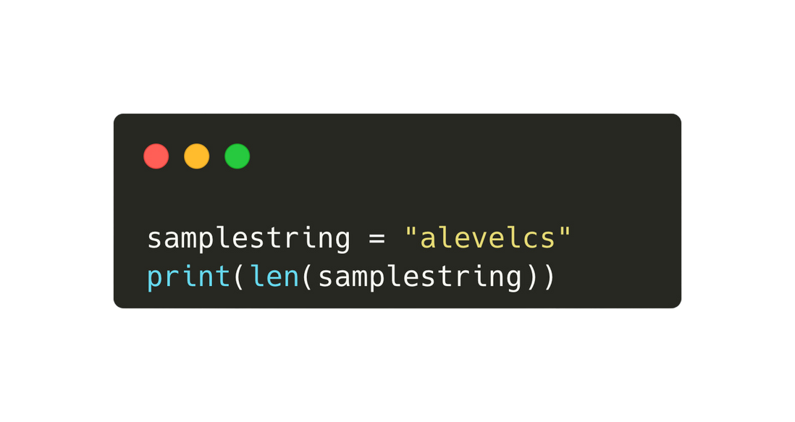
14.7 Predefined Functions in Programming
String manipulation functions -len ( )
0
1
2
3
4
5
6
7
Sample String:
A
L
E
V
E
L
C
S
Returns the integer value representing the length of string S.
Output:
8

Slide 44
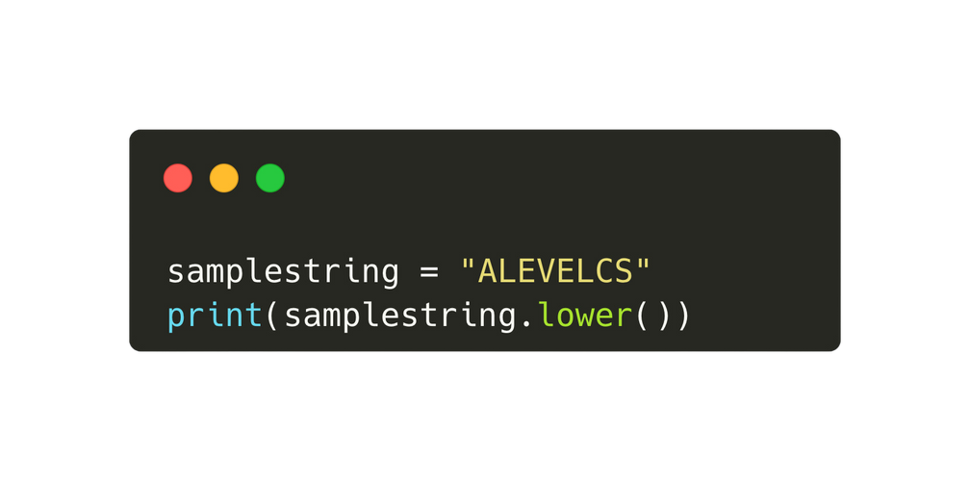
14.7 Predefined Functions in Programming
String manipulation functions -lower( )
0
1
2
3
4
5
6
7
Sample String:
A
L
E
V
E
L
C
S
Output: “alevelcs”

Slide 45
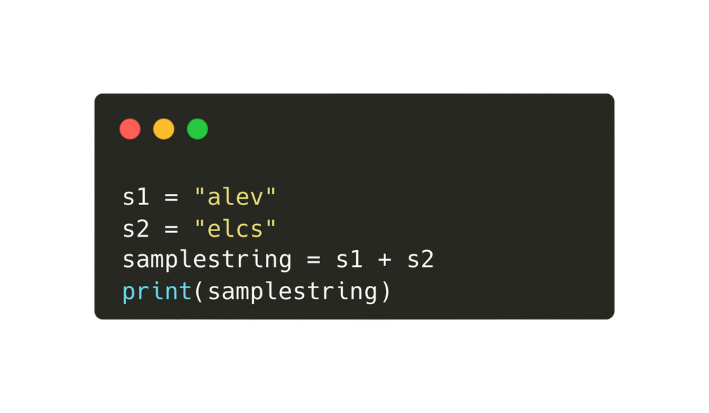
14.7 Predefined Functions in Programming
String manipulation functions -concatenation
Sample String:
a
l
e
v
+
e
l
c
s
Output: “ALEVELCS”

Slide 46
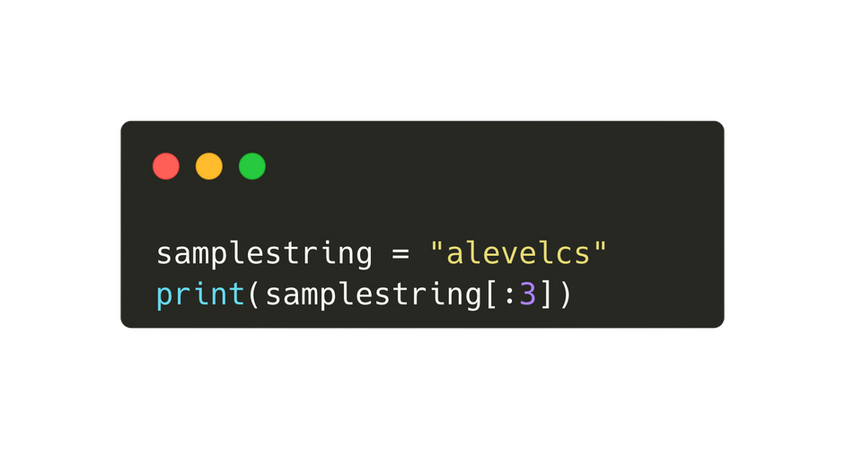
14.7 Predefined Functions in Programming
String manipulation functions -leftmost L characters
0
1
2
3
4
5
6
7
Sample String:
A
L
E
V
E
L
C
S
Returns the leftmost 3 characters.
0
1
2
3
4
5
6
7
A
L
E
V
E
L
C
S
Output: “ALE”

Slide 47
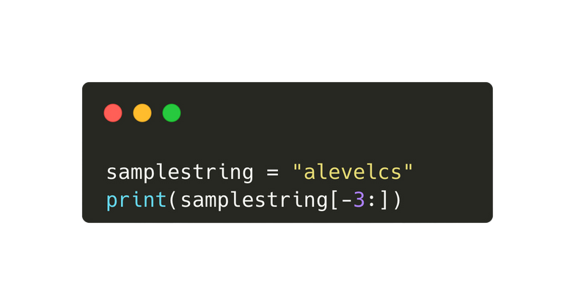
14.7 Predefined Functions in Programming
String manipulation functions -rightmost L characters
-8
-7
-6
-5
-4
-3
-2
-1
0
1
2
3
4
5
6
7
Sample String:
A
L
E
V
E
L
C
S
Returns the rightmost 3 characters.
0
1
2
3
4
5
6
7
A
L
E
V
E
L
C
S
Output: “LCS”

Slide 48
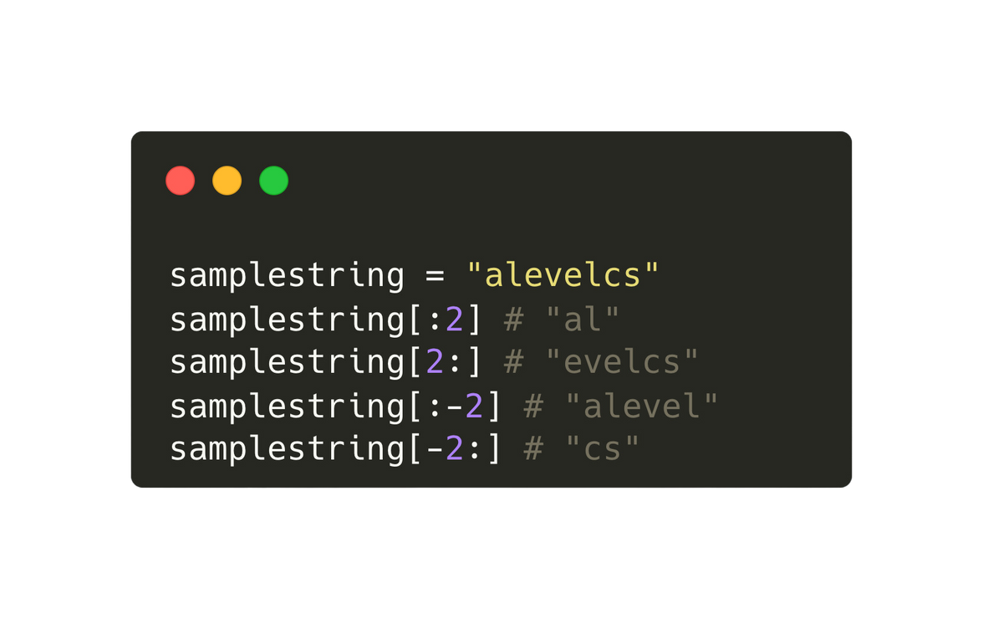
14.7 Predefined Functions in Programming
Slicing in Python
A subsequence of any sequence type (list / string) can be created using slicing.
-8
-7
-6
-5
-4
-3
-2
-1
0
1
2
3
4
5
6
7
Sample String:
A
L
E
V
E
L
C
S

Slide 49
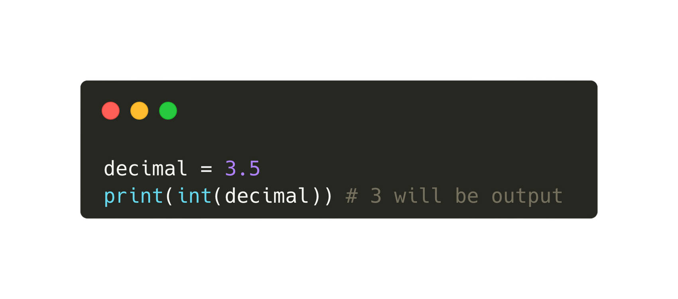
14.7 Predefined Functions in Programming
Truncating numbers
In Python, truncating an integer refers to the process of removing the decimal part (if any) and retaining only the integer portion of a floating-point number.

Slide 50
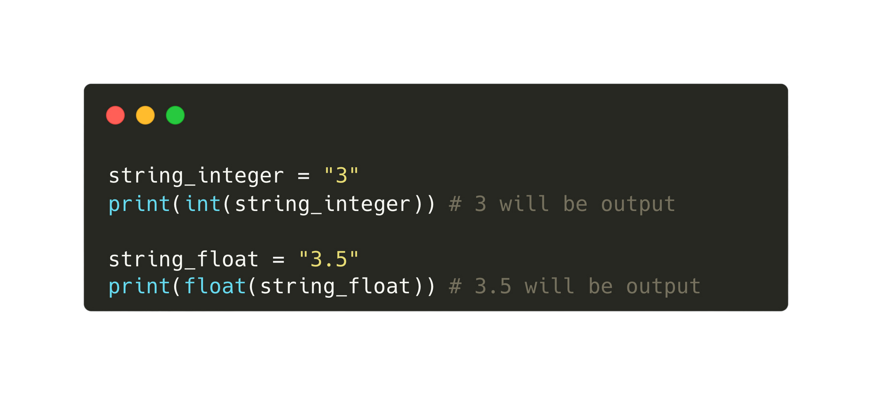
14.7 Predefined Functions in Programming
Converting a string to a number

Slide 51

14.7 Predefined Functions in Programming
Random number generator
The random function in Python is useful for generating pseudo-random numbers, enabling various applications such as simulations, games, statistical sampling, and cryptographic operations.

Slide 52


14.8 Procedures
Pseudocode vs Python
Pseudocode
Python

Slide 53


14.8 Procedures
Pseudocode vs Python
Pseudocode
Python

Slide 54


14.9 Functions
Pseudocode vs Python
Recap: Functions and procedures are quite similar, except that function will return a value.
Pseudocode
Python

Slide 55


14.9 Functions
Pseudocode vs Python
Recap: Functions and procedures are quite similar, except that function will return a value.
Pseudocode
Python

Slide 56
14.10 Passing parameters to subroutines, functions, and procedures
Subtopic 1
Why are parameters needed and how to pass them?
Parameters are needed in procedures and functions to provide input data or information necessary for the execution of the code block.
Arguments are passed to a function or procedure in programming by specifying them within parentheses after the function or procedure name during its invocation or call.

Slide 57


14.10 Passing parameters to subroutines, functions, and procedures
Subtopic 1
Pseudocode
Python

Slide 58
14.10 Passing parameters to subroutines, functions, and procedures
Subtopic 1
Two ways to pass parameters
Passing parameters by value involves creating a copy of the actual value, while passing parameters by reference involves passing a reference (memory address) to the original value, allowing modifications to affect the original data.
Value | Reference
The value of the variable will not be affected by what happens in the subroutine. | Any changes that are applied to the variable’s contents will be effective outside the procedure in the calling program / module.

Slide 59


14.10 Passing parameters to subroutines, functions, and procedures
Subtopic 1
Passing parameters by value
Python
Pseudocode

Slide 60


14.10 Passing parameters to subroutines, functions, and procedures
Subtopic 1
Passing parameters by reference
Python does not have a facility to pass parameters by reference. Instead the subroutines behave like a function and returns multiple values. Eg:
Python
Pseudocode

Slide 61

14.11 Arrays (List in Python)
Pseudocode to declare an array

Slide 62

14.11 Arrays (List in Python)
Python code to create a list, appending to a list
A dynamic list in Python refers to a mutable data structure that can grow or shrink dynamically in size during program execution to accommodate varying numbers of elements.
 |  | ...
Python code
Ali |  | ...
Ali | Bush | ...
Ali | Bush | Catherine

Slide 63

14.11 Arrays (List in Python)
Accessing an item in the list
0
1
2
Ali | Bush | Catherine
Python code

Slide 64


14.11 Arrays (List in Python)
Pseudocode to declare a 2D array
Number of rows
Number of columns

Slide 65

14.11 Arrays (List in Python)
Pseudocode to declare a 2D array
Visualisation
Codes
[0]
[1]
[2]
[3]
[0]
1
1
2
3
4
[1]
5
6
7
8
[2]
9
10
11
12

Slide 66

14.11 Arrays (List in Python)
Pseudocode to declare a 2D array
Codes
Visualisation
[0]
[1]
[2]
[3]
[0]
1
1
2
3
4
[1]
5
6
7
8
[2]
9
10
11
12

Slide 67


Subtopic 1
14.12 Text files
Writing to a text file
Python
Pseudocode

Slide 68


Subtopic 1
14.12 Text files
Reading from a text file
Python
Pseudocode

Slide 69


Subtopic 1
14.12 Text files
Appending to a text file
Python
Pseudocode

Slide 70


Subtopic 1
14.12 Text files
Appending to a text file
Pseudocode
Python

