Slide 1
Cambridge International
AS Level Computer Science
(9618) – Revision Notes
Data Types and Structures
This pack is intended for students to who are taking CIE AS Level in Computer Science, either in preparation for their AS exam, or more likely alongside year 2 of the course to improve fluency, recall and pace on AS topics. It could be used as lesson starters, or supplied to students for independent use.

Slide 2
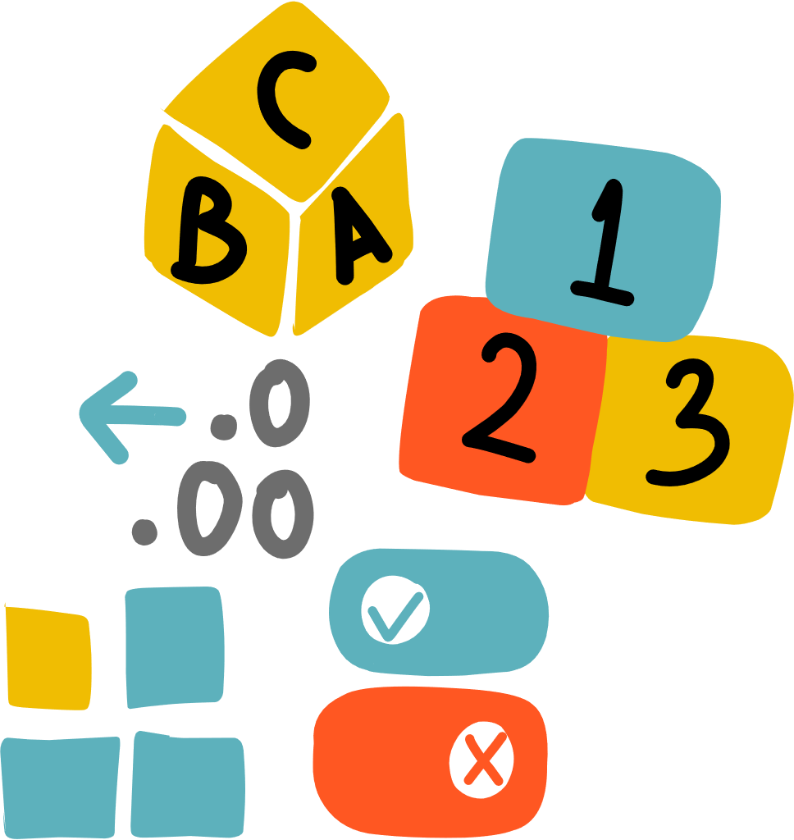



Chapter
13
Data types and structures
AS & A LEVEL COMPUTER SCIENCE 9618

Slide 3



13.1
13.2
Data Types
13.3
Record Type
13.4
Arrays
1D array
13.5
2D array
Chapter
Outline
13.6
Text files Handling
13.7
Stacks
Abstract Data Type
Queues
Linked List

Slide 4

13.1 Data Types
Definition
A data type in programming defines the type or nature of data that can be stored, manipulated, or processed within a programming language, specifying the kind of values a variable can hold.
Primitive data types
Further data types

Slide 5
13.1 Data Types
Primitive data types
A primitive data type is a basic data type provided by a programming language that is directly supported by the underlying hardware, such as:
Data Types | What it represents
INTEGER | Whole Number
REAL | Number with a decimal point
BOOLEAN | Conditions that are either TRUE or FALSE
CHAR | Single Character
Primitive data types
Further data types

Slide 6
13.1 Data Types
Further data types
Further data types, often called composite or derived data types, are built upon primitive types or are custom-defined to create complex structures or collections of data, including:
Data Types | What it represents
STRING | A sequence of characters
DATE | A date consisting of day, month and year, sometimes including a time in hours, minutes and seconds.
Primitive data types
Further data types

Slide 7

Subtopic 1
13.2 Record Type
Definition
A record type in programming is a data structure that allows the storage of multiple fields or pieces of information under a single name or identifier. For example: data about a product could contain the following fields:
Product Name: STRING
Product Price: REAL
Expiration Date: DATE
A Dairy Product: BOOLEAN

Slide 8
Subtopic 1
13.2 Record Type
Definition
The record type is known as a user-defined type, because the programmer can decide which variables to include as a record.
Product Name: STRING
Product Price: REAL
Expiration Date: DATE
A Dairy Product: BOOLEAN

Slide 9
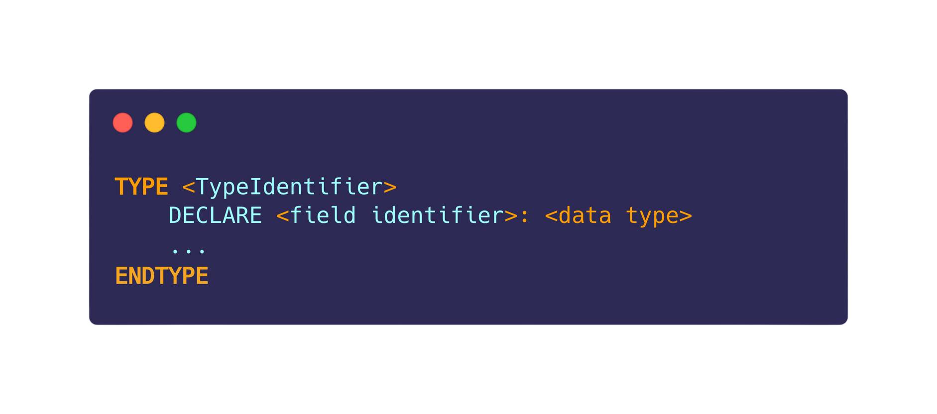
Subtopic 1
13.2 Record Type
Pseudocode
In pseudocode a record type is declared as:

Slide 10
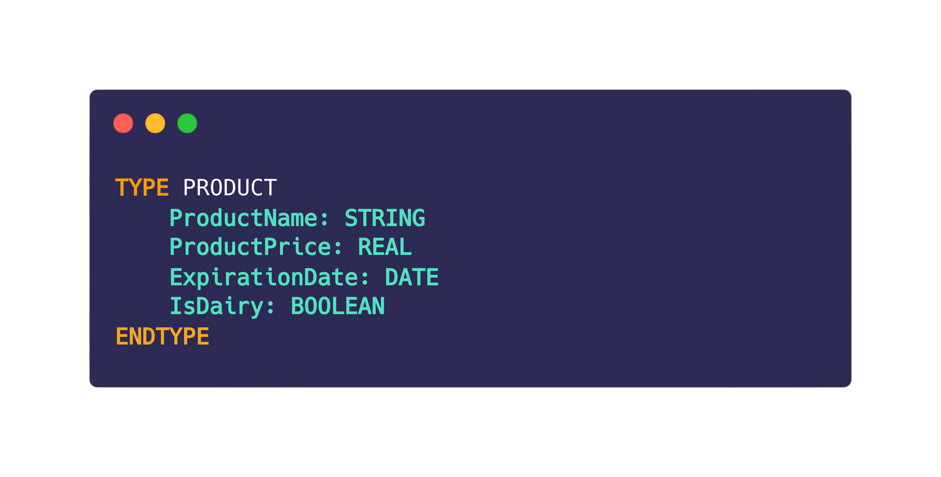
Subtopic 1
13.2 Record Type
Pseudocode
A record type for PRODUCT could look like this:

Slide 11
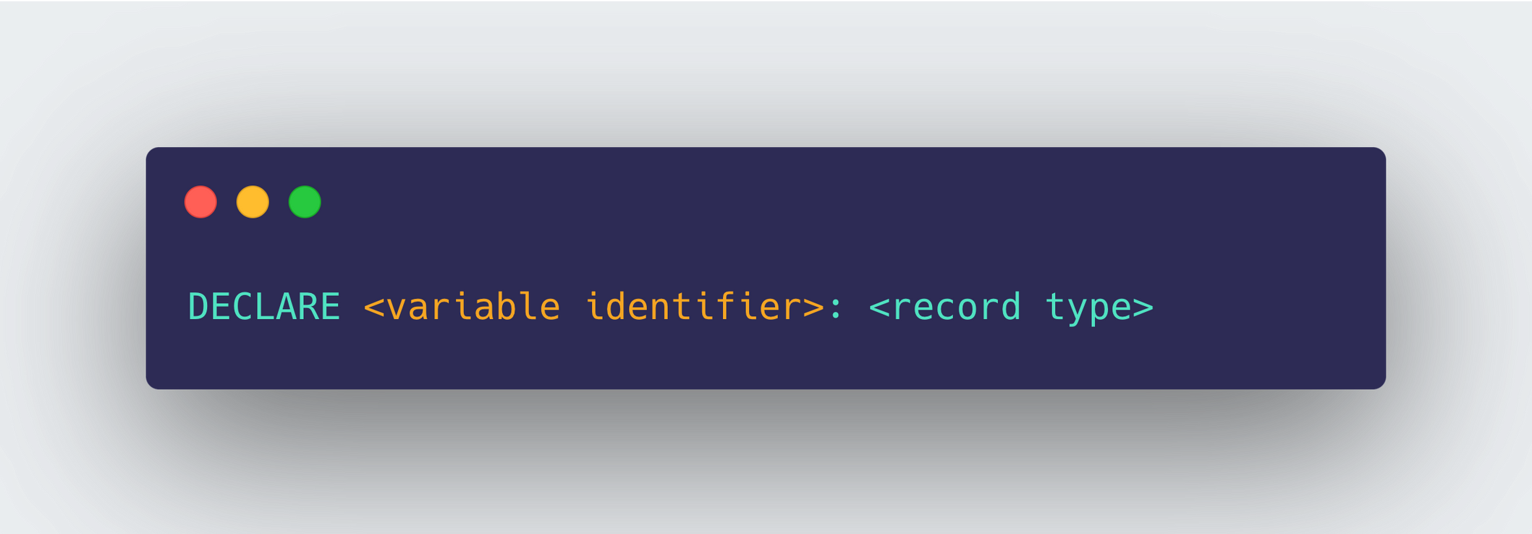
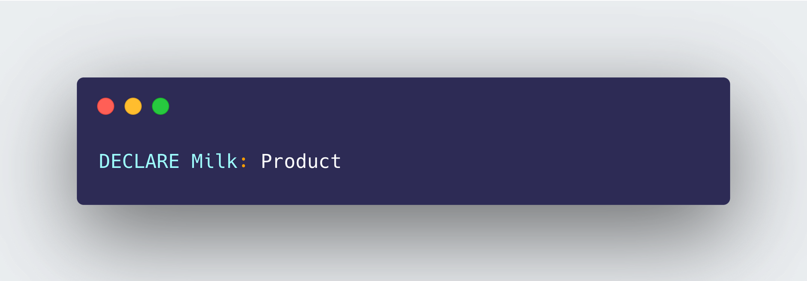
Subtopic 1
13.2 Record Type
Pseudocode
How to declare a variable of this record type:
Declaring a new product - Milk

Slide 12
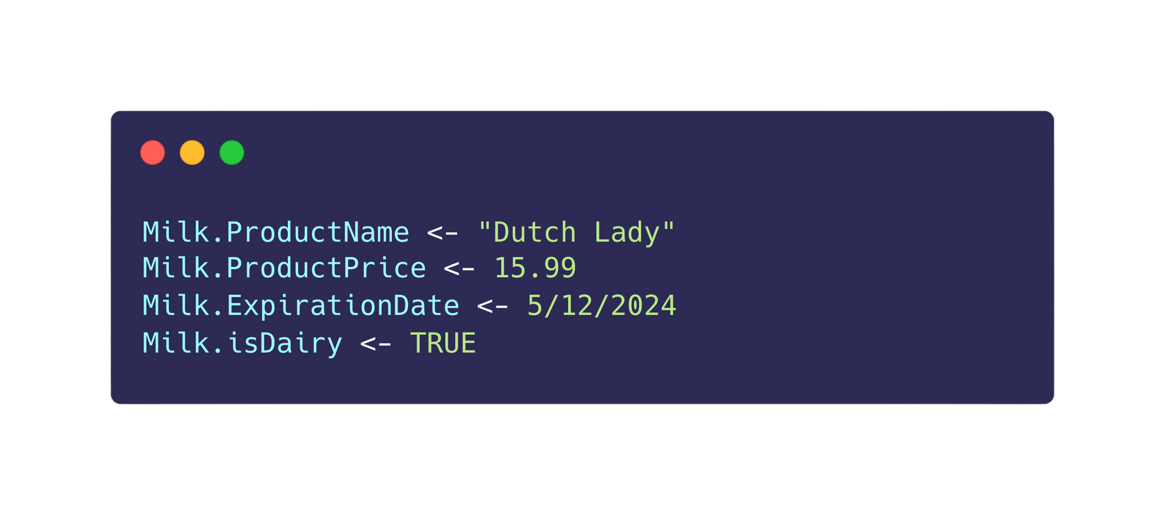
Subtopic 1
13.2 Record Type
Pseudocode
We can assign value to a field of this Product record:

Slide 13


13.3 Arrays
Definition
An array is an ordered set of data items, usually of the same type, grouped together using a single identifier. For example, creating a StudentList variable that stores a list of students’ name (string) in the class.
Jeniffer
Taylor
Andrew
Fernando
Muhammad

Slide 14
13.3 Arrays
Declaring an array
The following needs to be decided when declaring an array:
Identifier
Eg.StudentList
LowerBound
[0]
Jeniffer
Taylor
Andrew
Fernando
Muhammad
Eg.0
[1]
Data Type
Eg.String
[2]
[3]
[4]
UpperBound
Eg.4
Index

Slide 15



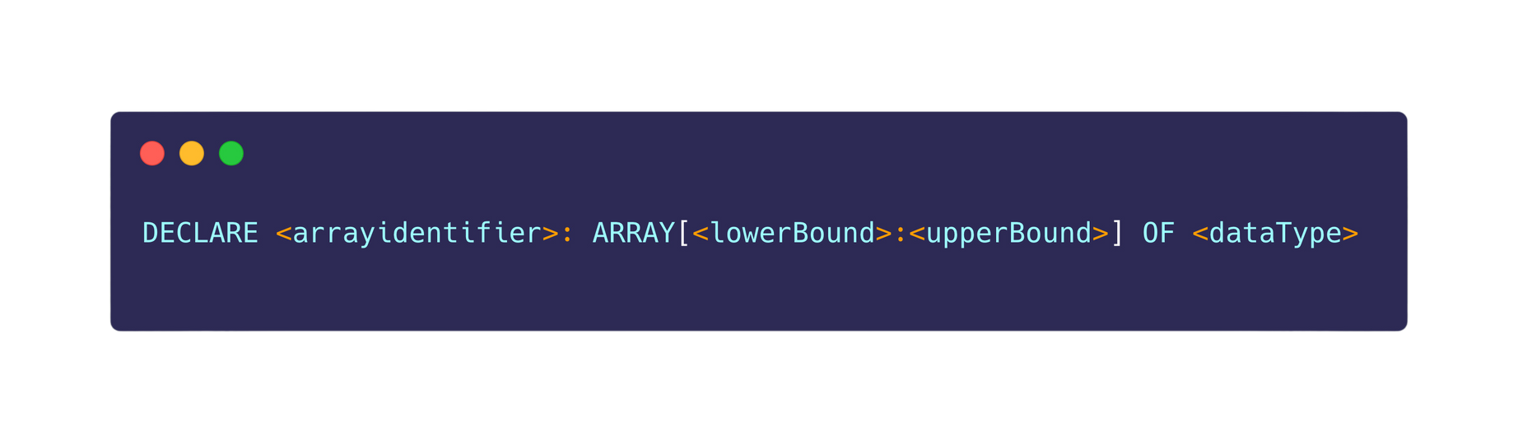
13.4 One-dimensional array
Pseudocode
Declaring a 1D array:
Declaring an array
Populating an array
Linear Search
Bubble Sort

Slide 16

13.4 One-dimensional array
Pseudocode
Eg:
StudentMark
[0]
[1]
StudentList
[2]
[0]
[3]
[1]
[4]
[5]
[2]
[6]
[3]
[7]
[8]
[4]
[9]
Declaring an array
Populating an array
Linear Search
Bubble Sort

Slide 17
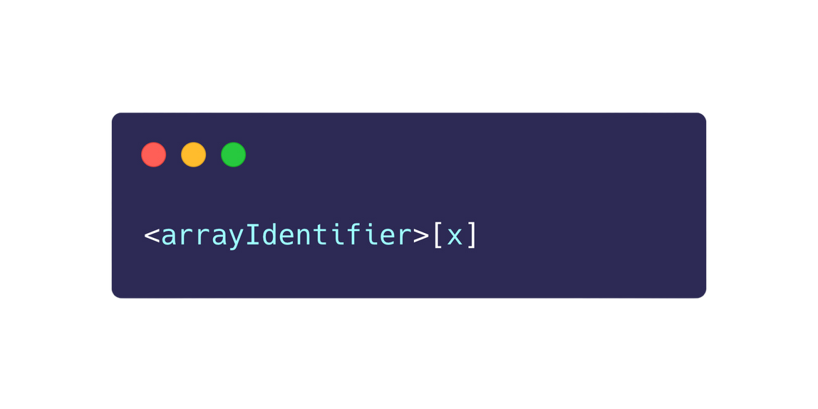
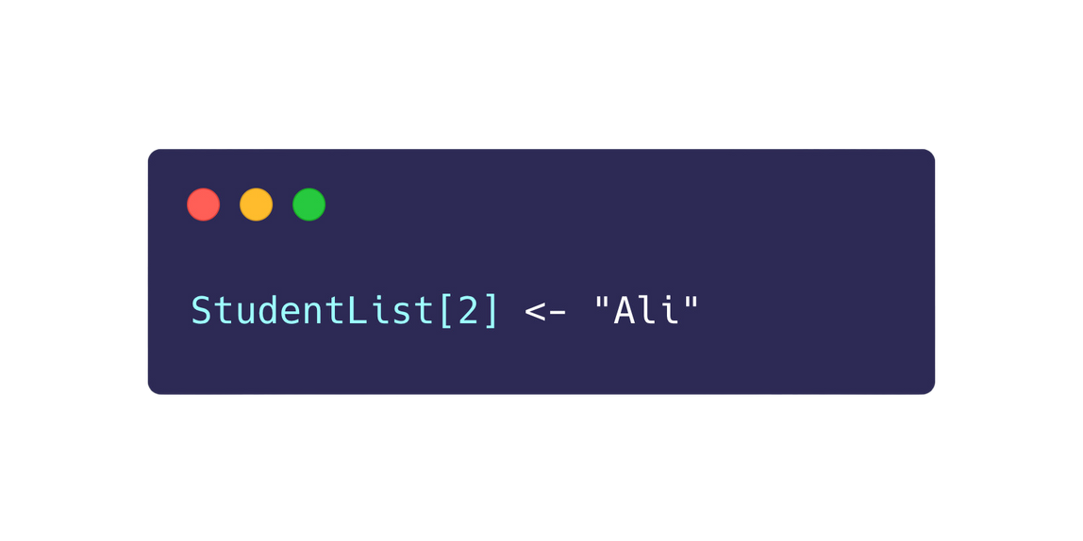
13.4 One-dimensional array
Pseudocode
Accessing an element in the array using an index value:
StudentList
[0]
ALI
Eg:
[1]
[2]
[3]
[4]
Index
Declaring an array
Populating an array
Linear Search
Bubble Sort

Slide 18
13.4 One-dimensional array
Pseudocode
Declare an array called MultiplesOfTens that has 10 values. Then, populate the array with the first 10 multiples of 10.
Declaring an array
Populating an array
Linear Search
Bubble Sort

Slide 19
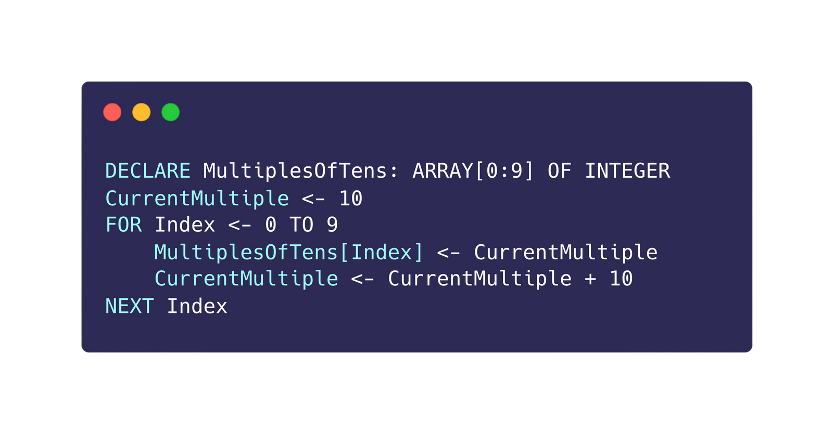
13.4 One-dimensional array
Pseudocode
Declare an array called MultiplesOfTens that has 10 values. Then, populate the array with the first 10 multiples of 10.
StudentMark
[0]
10
[1]
20
[2]
30
[3]
40
[4]
50
[5]
60
[6]
70
[7]
80
[8]
90
[9]
100
Declaring an array
Populating an array
Linear Search
Bubble Sort

Slide 20

13.4 One-dimensional array
Linear Search
Problem: Find whether a given value is stored in the array. Eg. Finding a student in the StudentList array.
Eg.StudentList
[0]
Jeniffer
Taylor
Andrew
Fernando
Muhammad
NameGiven
[1]
???
[2]
[3]
[4]
Declaring an array
Populating an array
Linear Search
Bubble Sort

Slide 21
13.4 One-dimensional array
Linear Search
Linear search is a simple searching algorithm that iterates through each element in a list or array, sequentially checking for a specific value until it finds a match or reaches the end of the list.
Eg.StudentList
[0]
Jeniffer
Taylor
Andrew
Fernando
Muhammad
[1]
[2]
[3]
[4]
Declaring an array
Populating an array
Linear Search
Bubble Sort

Slide 22
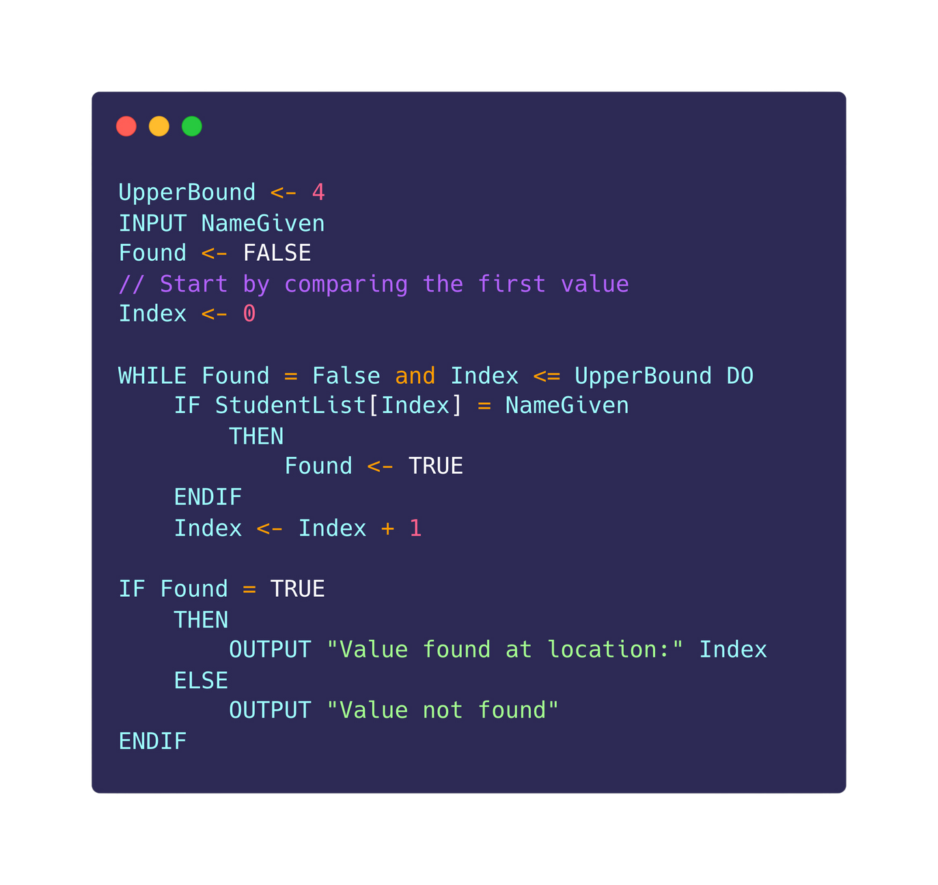
13.4 One-dimensional array
Linear Search
Declaring an array
Populating an array
Linear Search
Bubble Sort

Slide 23
13.4 One-dimensional array
Bubble Sort - Definition
Bubble sort is a basic sorting algorithm that repeatedly steps through the list, compares adjacent elements, and swaps them if they are in the wrong order, continuing until the entire list is sorted.
45
32
78
12
99
0
0
12
32
45
78
99
After bubble sort
Declaring an array
Populating an array
Linear Search
Bubble Sort

Slide 24
13.4 One-dimensional array
Bubble Sort - Intuition
Compare adjacent elements, swap values if needed, eg:
45
32
78
12
99
0
32
45
78
12
99
0
32
45
78
12
99
0
32
45
12
78
99
0
32
45
12
78
99
0
32
45
12
78
0
99
45 > 32,
Swap
45 < 78,
No Swap
78 > 12,
Swap
78 < 99,
No Swap
78 < 99,
No Swap
Declaring an array
Populating an array
Linear Search
Bubble Sort

Slide 25
13.4 One-dimensional array
Bubble Sort - Intuition
After one iteration, the biggest value is in the correct position at the end of the array.
45
32
78
12
99
0
32
45
78
12
99
0
32
45
78
12
99
0
32
45
12
78
99
0
32
45
12
78
99
0
32
45
12
78
0
99
45 > 32,
Swap
45 < 78,
No Swap
78 > 12,
Swap
78 < 99,
No Swap
78 < 99,
No Swap
Declaring an array
Populating an array
Linear Search
Bubble Sort

Slide 26
13.4 One-dimensional array
Bubble Sort - Intuition
Second iteration
Third iteration
Fourth iteration
Fifth iteration
32
12
45
0
78
99
12
35
0
45
78
99
12
0
35
45
78
99
0
12
35
45
78
99
Declaring an array
Populating an array
Linear Search
Bubble Sort

Slide 27
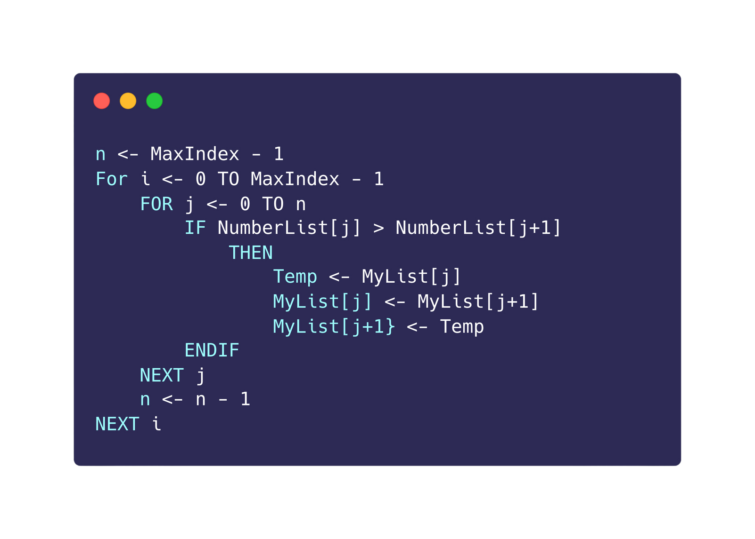
13.4 One-dimensional array
Bubble Sort - Pseudocodes
45
32
78
12
99
0
32
45
78
12
99
0
32
45
78
12
99
0
32
45
12
78
99
0
32
45
12
78
99
0
32
45
12
78
0
99
45 > 32,
Swap
45 < 78,
No Swap
78 > 12,
Swap
78 < 99,
No Swap
78 < 99,
No Swap
Declaring an array
Populating an array
Linear Search
Bubble Sort

Slide 28
13.4 One-dimensional array
Bubble Sort - Pseudocodes
Second iteration
Third iteration
Fourth iteration
Fifth iteration
32
12
45
0
78
99
12
35
0
45
78
99
12
0
35
45
78
99
0
12
35
45
78
99
Declaring an array
Populating an array
Linear Search
Bubble Sort

Slide 29
13.4 One-dimensional array
Bubble Sort - Intuition
1st iteration
2nd iteration
3rd iteration
4th iteration
5th iteration
32
12
45
0
99
78
12
32
0
45
78
99
12
0
32
45
78
99
0
12
32
45
78
99
0
12
35
45
78
99
0
12
35
45
78
99
Declaring an array
Populating an array
Linear Search
Bubble Sort

Slide 30
13.4 One-dimensional array
Already sorted
Not required
Bubble Sort - When it could end earlier?
1st iteration
2nd iteration
3rd iteration
4th iteration
5th iteration
32
12
45
0
99
78
12
32
0
45
78
99
12
0
32
45
78
99
0
12
32
45
78
99
0
12
35
45
78
99
0
12
35
45
78
99
Declaring an array
Populating an array
Linear Search
Bubble Sort

Slide 31
13.4 One-dimensional array
If we have gone through the whole of the inner loop wihtout swapping any values, we know that the array elements must be in the correct order. Therefore, we can stop the loop earlier!
Bubble Sort - Making it faster
1st iteration
2nd iteration
3rd iteration
4th iteration
5th iteration
32
12
45
0
99
78
12
32
0
45
78
99
12
0
32
45
78
99
0
12
32
45
78
99
0
12
35
45
78
99
0
12
35
45
78
99
Declaring an array
Populating an array
Linear Search
Bubble Sort

Slide 32
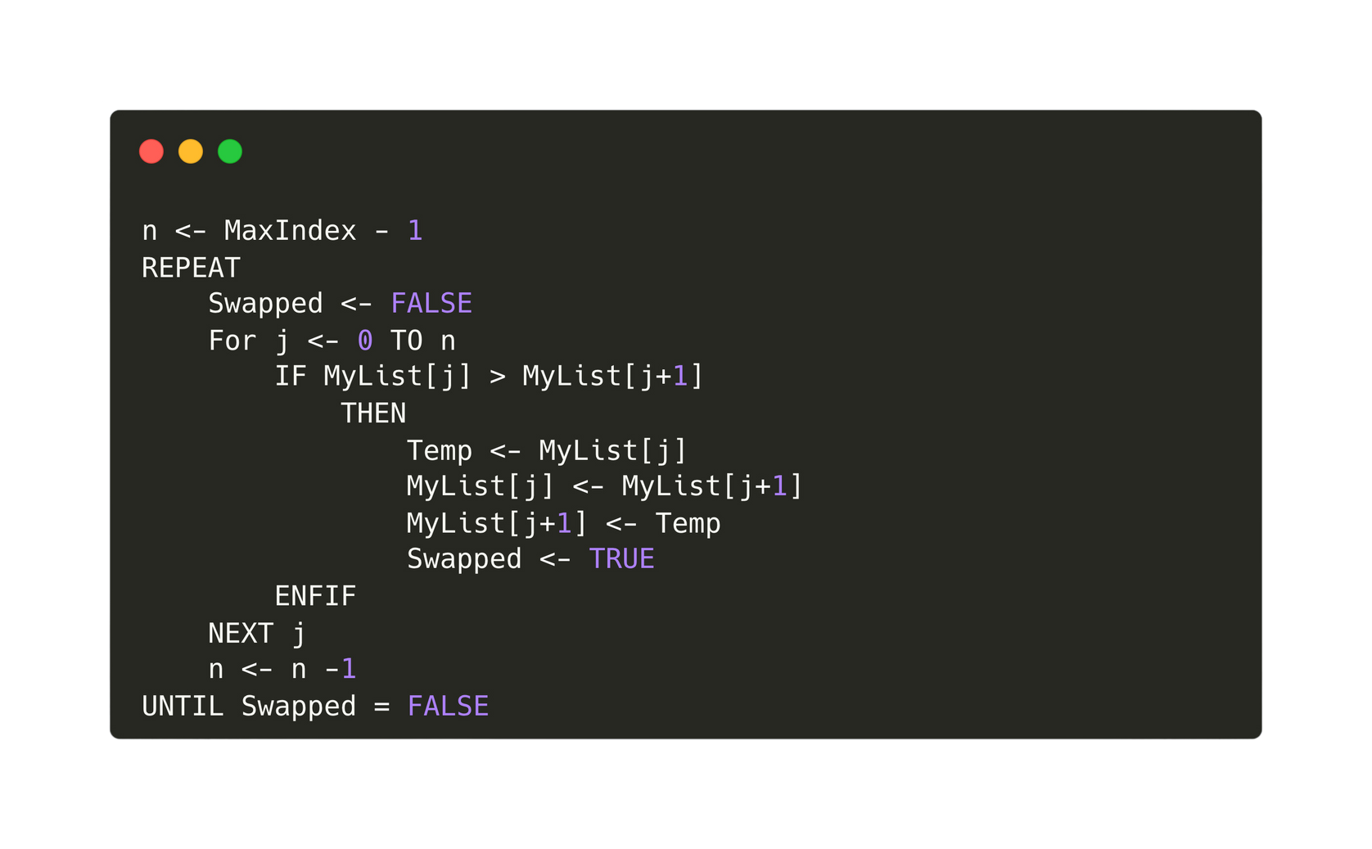
13.4 One-dimensional array
Bubble Sort - Making it faster
Declaring an array
Populating an array
Linear Search
Bubble Sort

Slide 33
13.5 Two-dimensional array
Outline
  Declaring a 2D array
  Accessing a 2D array
  Populating a 2D array with a nested loop
  Creating the connect 4 game

Slide 34

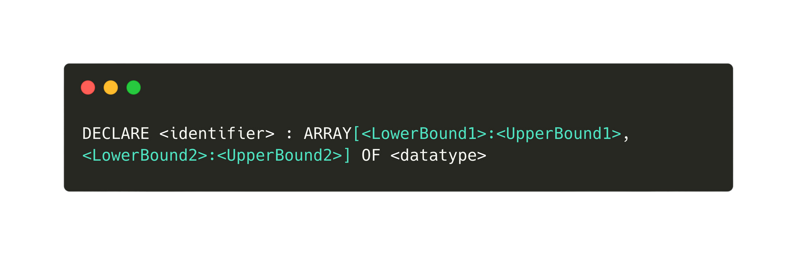
13.5 Two-dimensional array
Declaring a 2D array
Number of rows
Number of columns

Slide 35
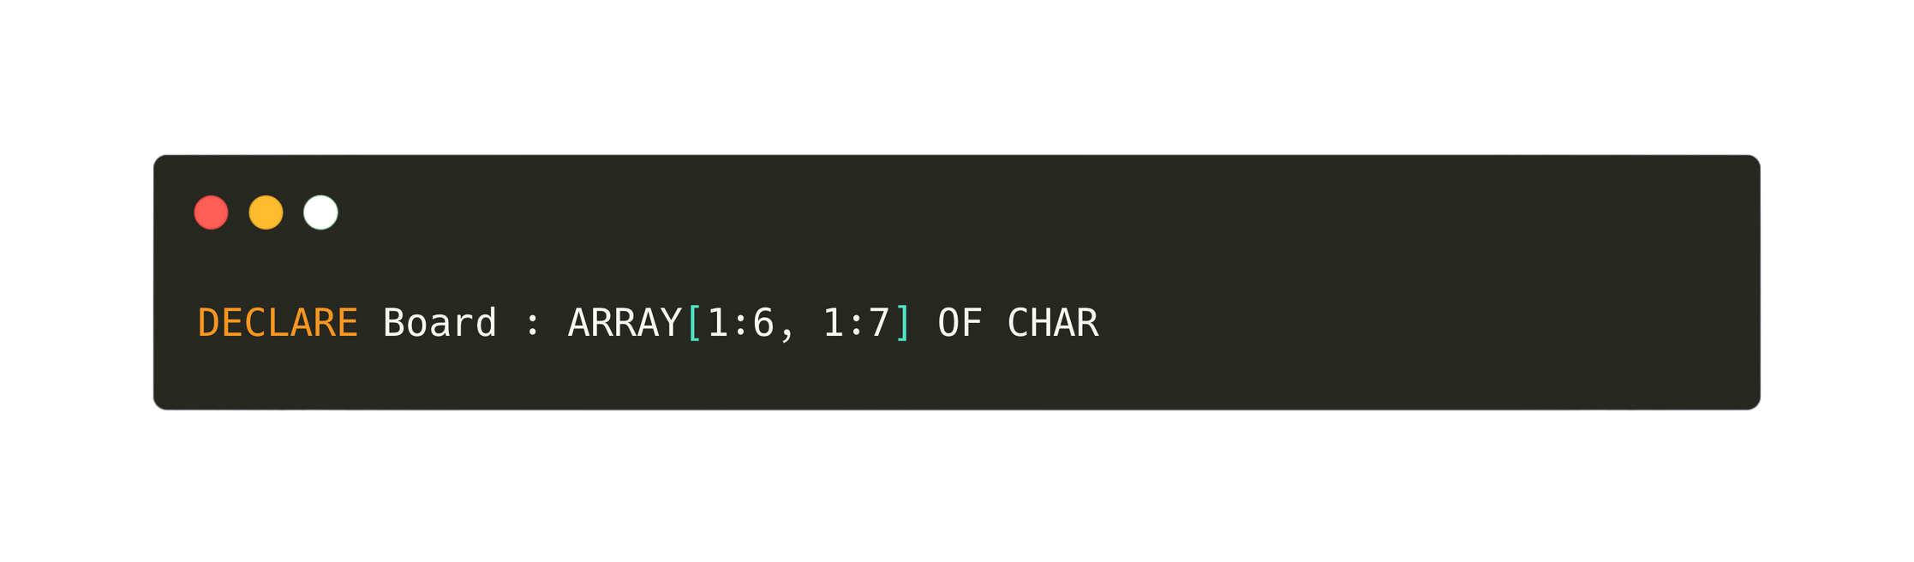
13.5 Two-dimensional array
Declaring a 2D array
[1]
[2]
[3]
[4]
[5]
[6]
[7]
[1]
[2]
[3]
[4]
[5]
[6]

Slide 36
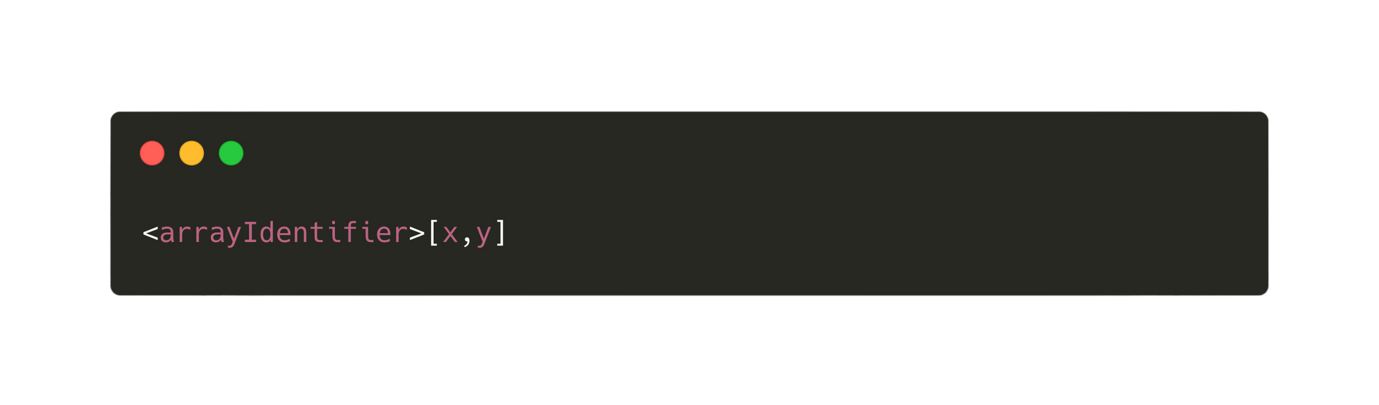
13.5 Two-dimensional array
Accessing a 2D array
Row number
Column number
[1]
[2]
[3]
[4]
[5]
[6]
[7]
[1]
[2]
[3]
[4]
[5]
[6]

Slide 37
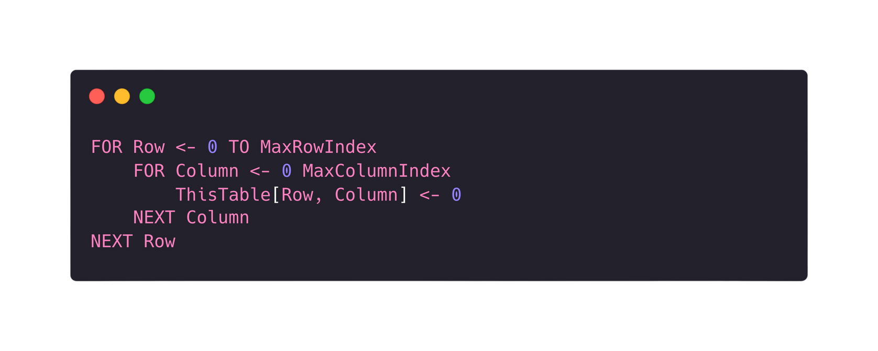

13.5 Two-dimensional array
Populating a 2D array with 0
[1]
[2]
[3]
[4]
[5]
[6]
[7]
[1]
0
0
0
0
0
0
0
[2]
0
0
0
0
0
0
0
[3]
0
0
0
0
0
0
0
[4]
0
0
0
0
0
0
0
[5]
0
0
0
0
0
0
0
[6]
0
0
0
0
0
0
0

Slide 38
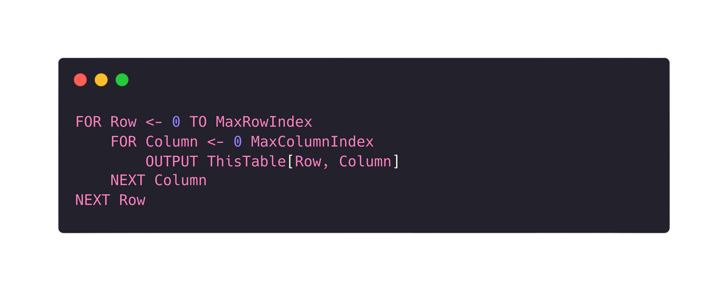
13.5 Two-dimensional array
Outputting the values of a 2D array with 0

Slide 39
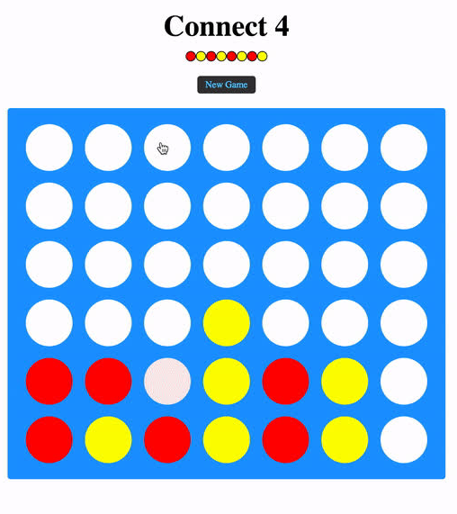
13.5 Two-dimensional array
Creating a connect 4 game
[1]
[2]
[3]
[4]
[5]
[6]
[7]
[1]
[2]
[3]
[4]
[5]
[6]

Slide 40
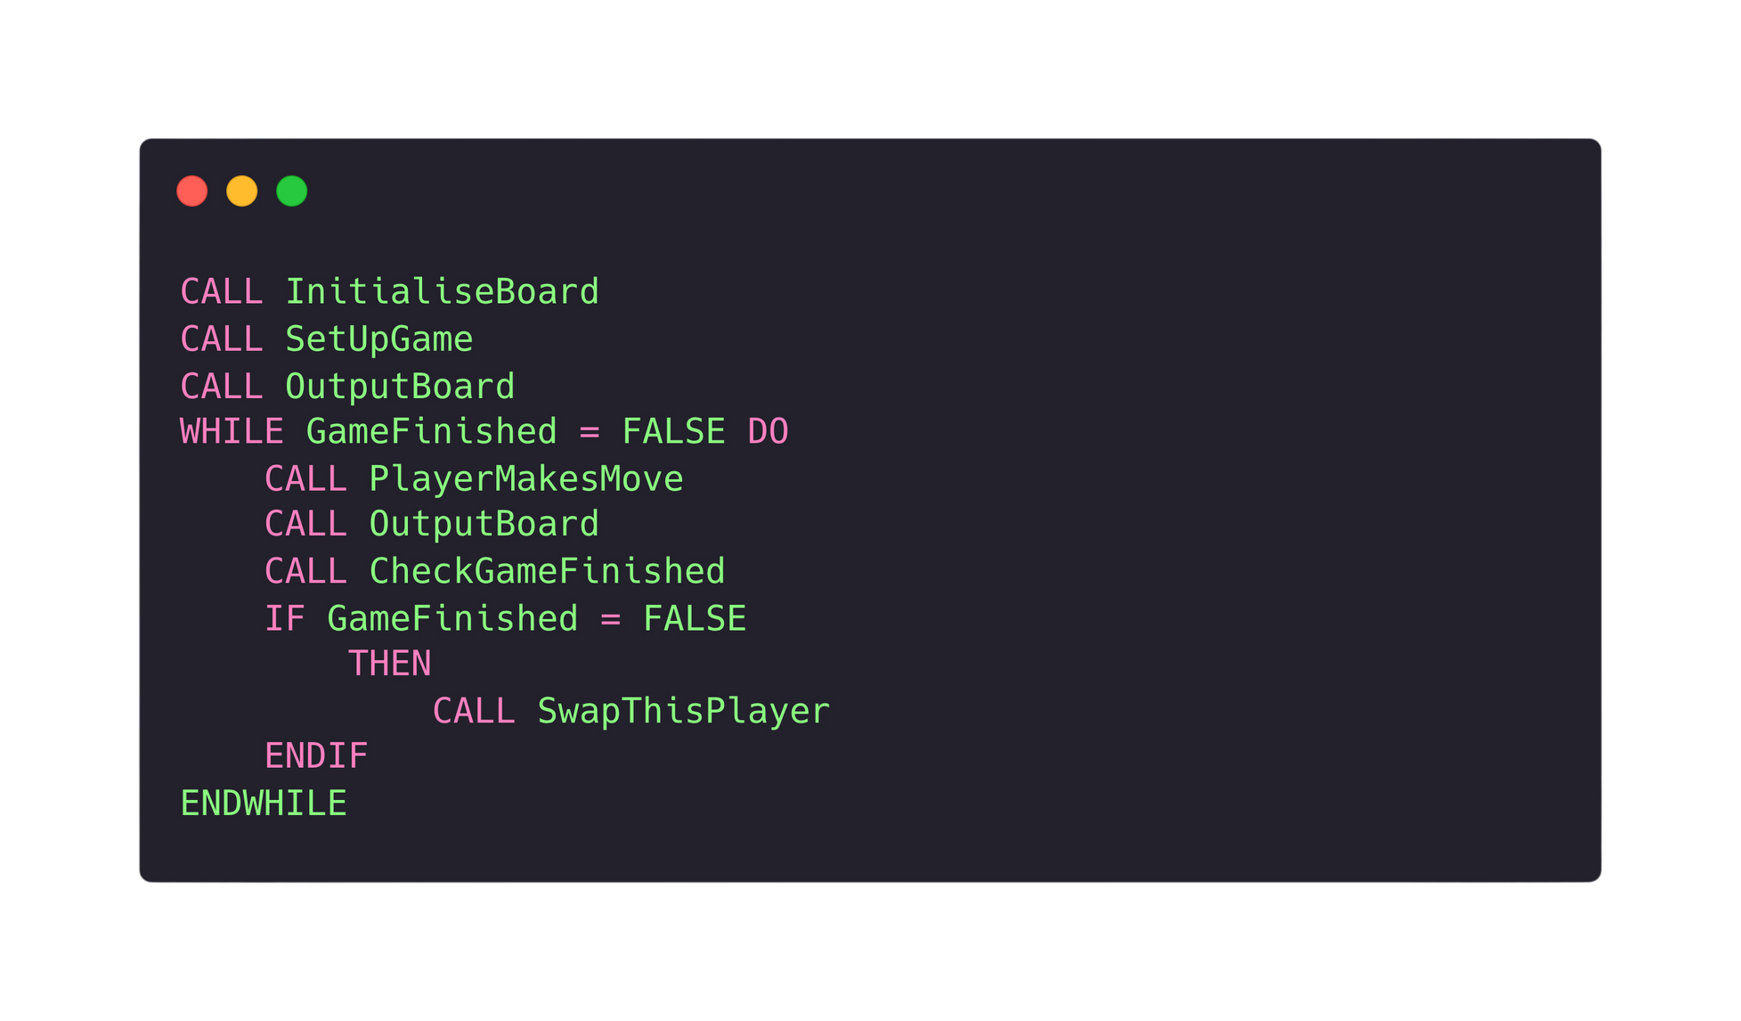
13.5 Two-dimensional array
Creating a connect 4 game
Pseudocode Overview

Slide 41
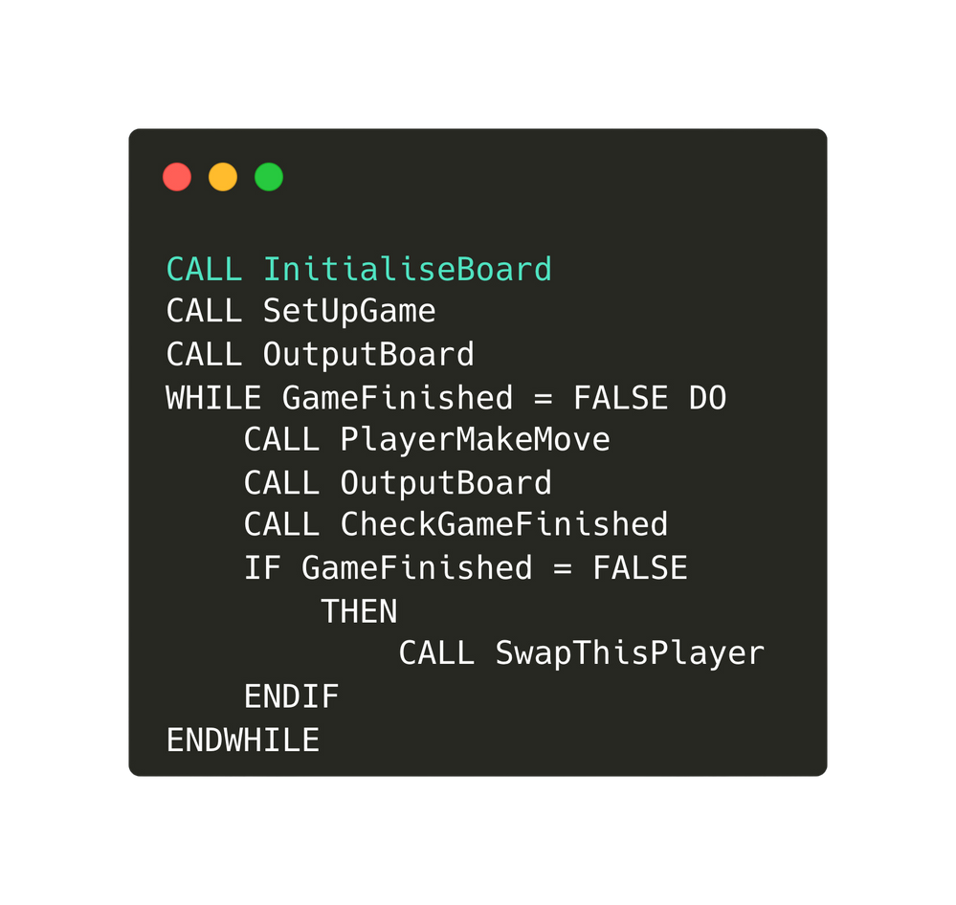
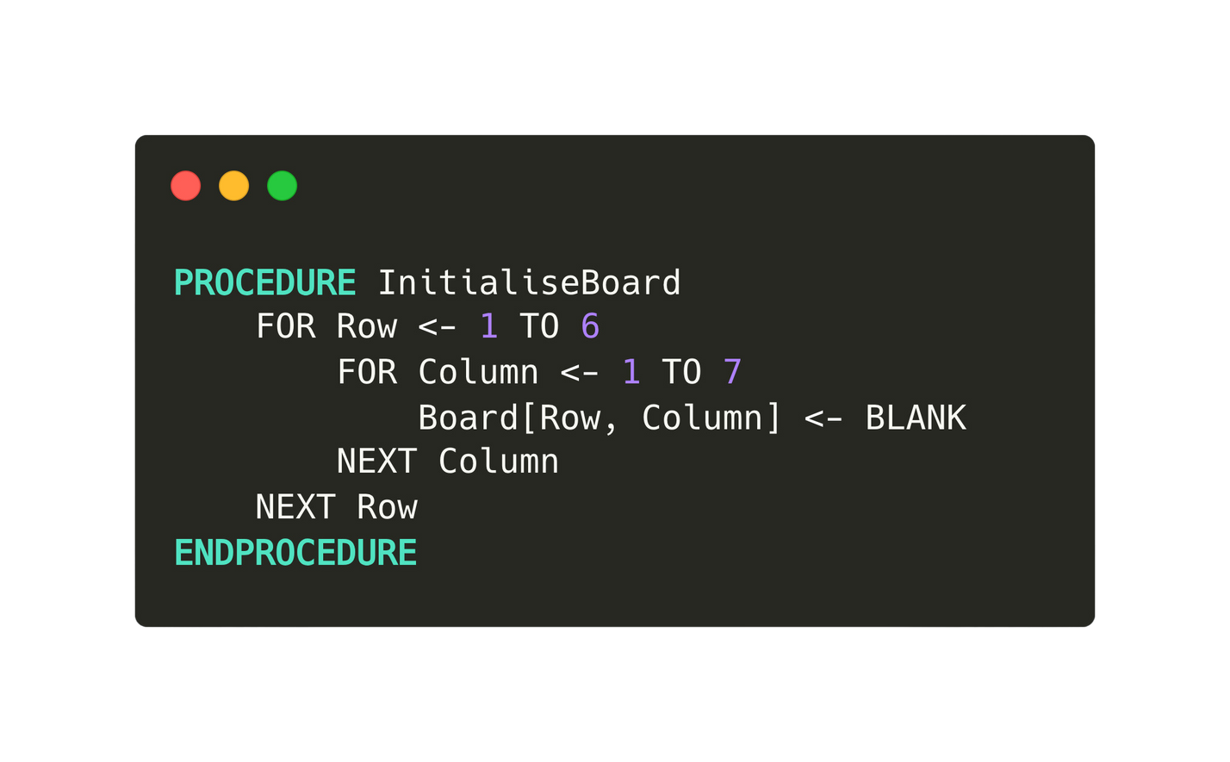

13.5 Two-dimensional array
Working through each procedure
InitialiseBoard

Slide 42
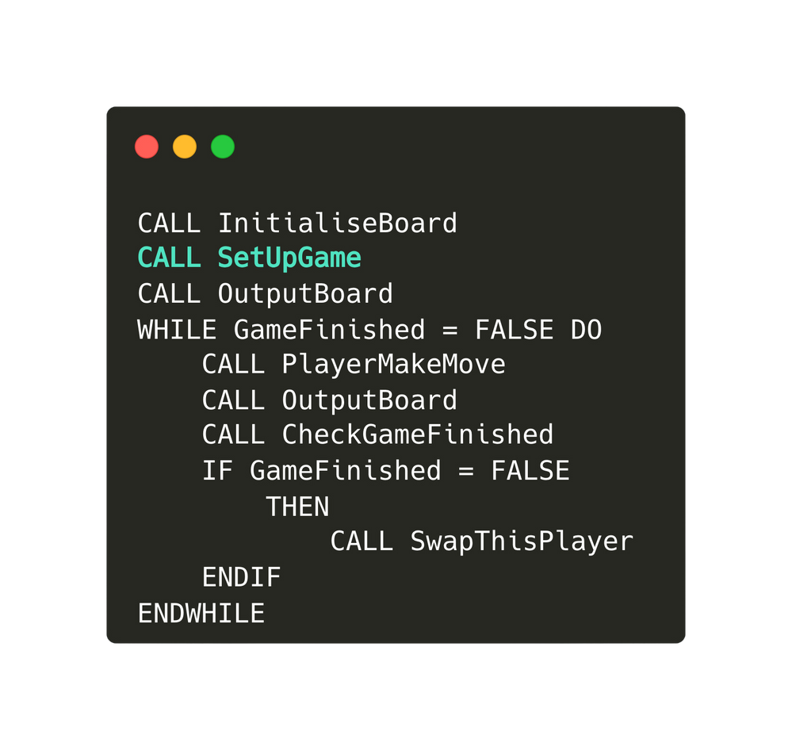
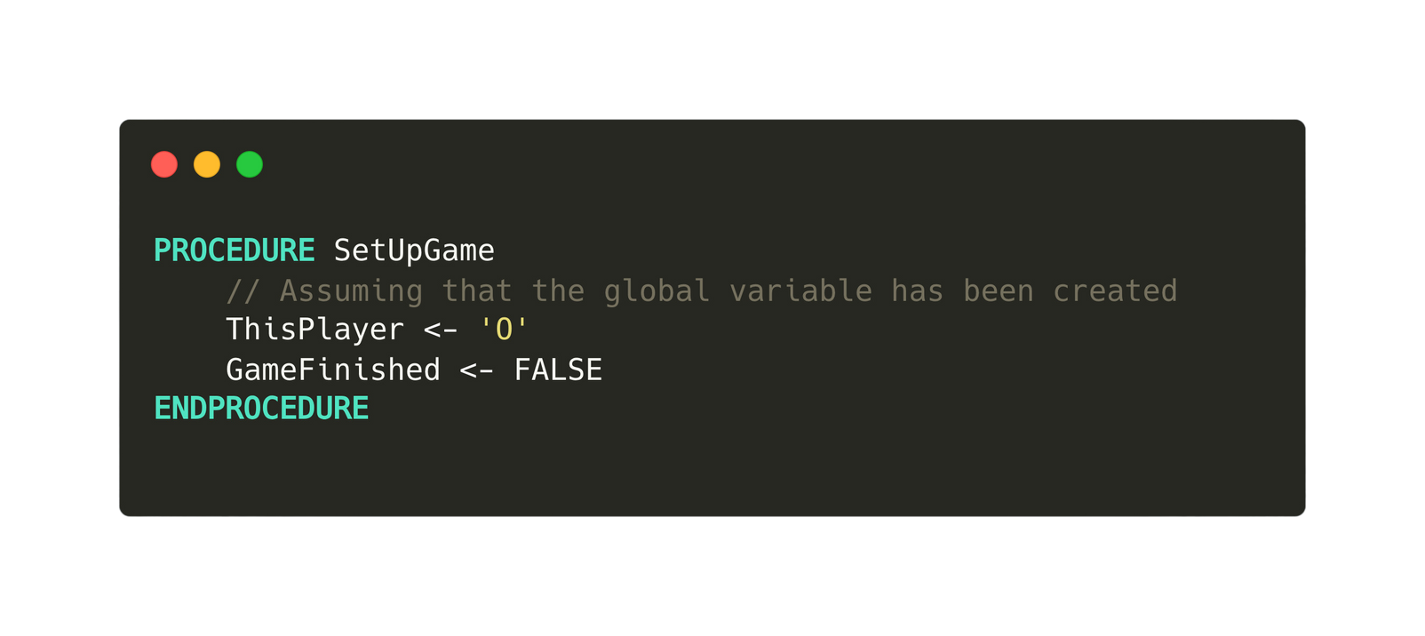
13.5 Two-dimensional array
Working through each procedure
SetUpGame

Slide 43
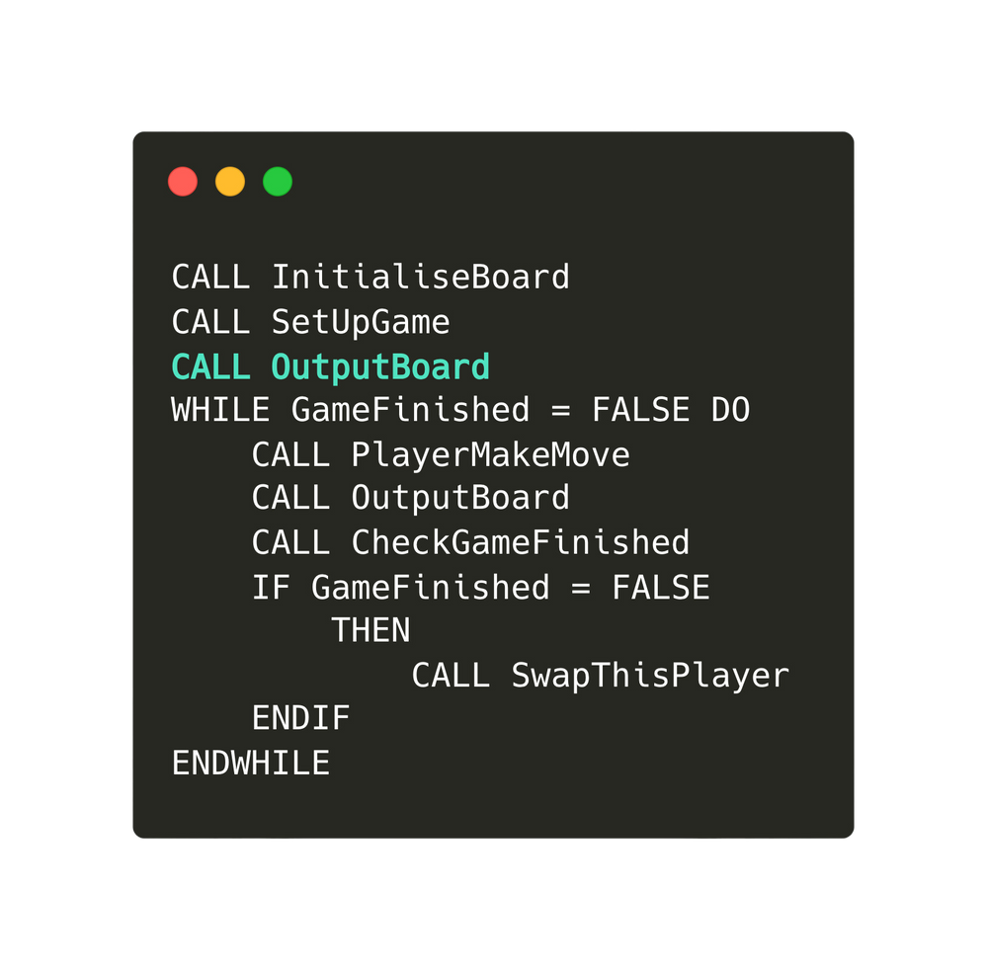
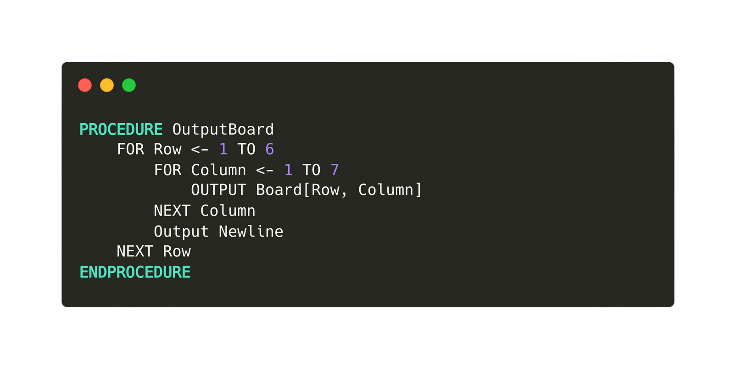
13.5 Two-dimensional array
Working through each procedure
OutputBoard

Slide 44
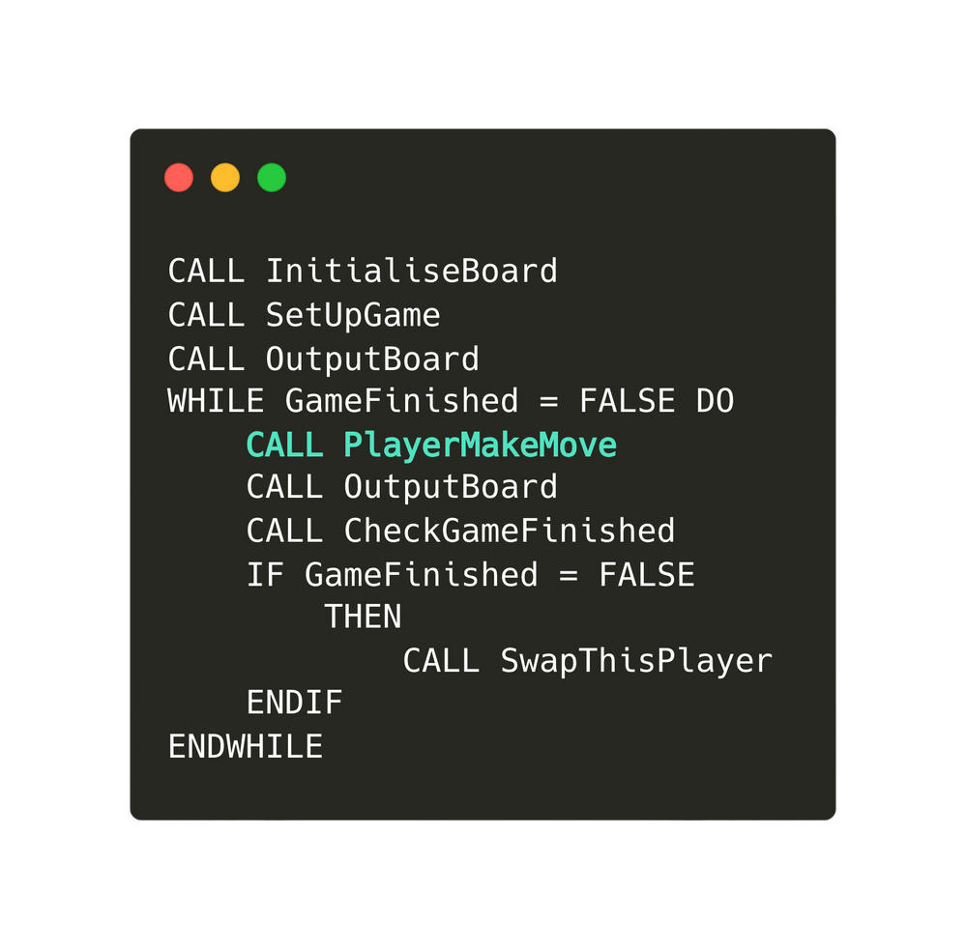

13.5 Two-dimensional array
Working through each procedure
PlayersMakeMove
This module can be further broken down into
  A procedure that let players input a valid column
    A procedure that checks whether an input is valid
  A procedure that finds a free row

Slide 45
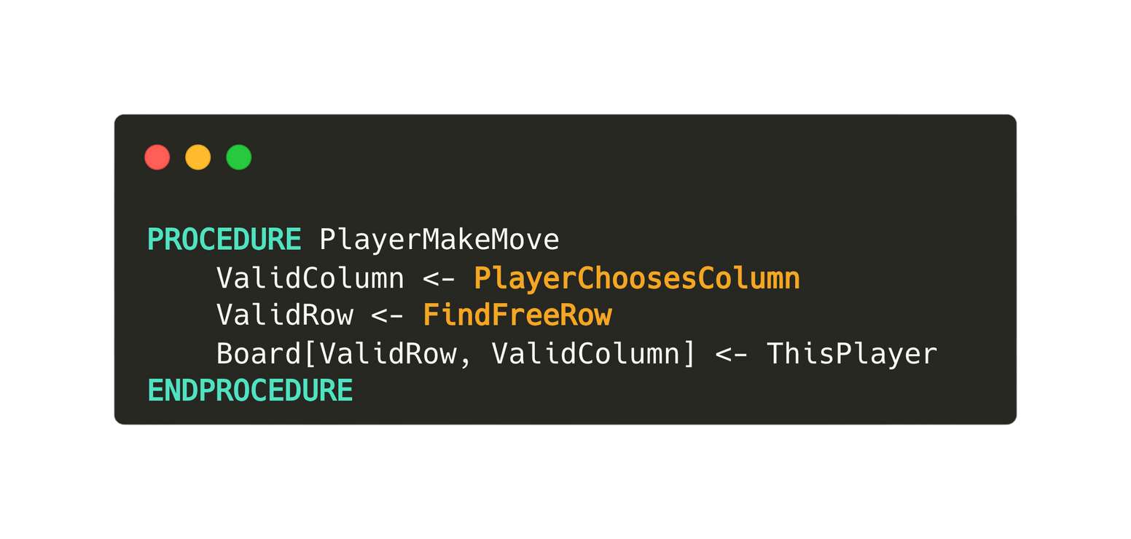

13.5 Two-dimensional array
Working through each procedure
PlayerMakeMove

Slide 46
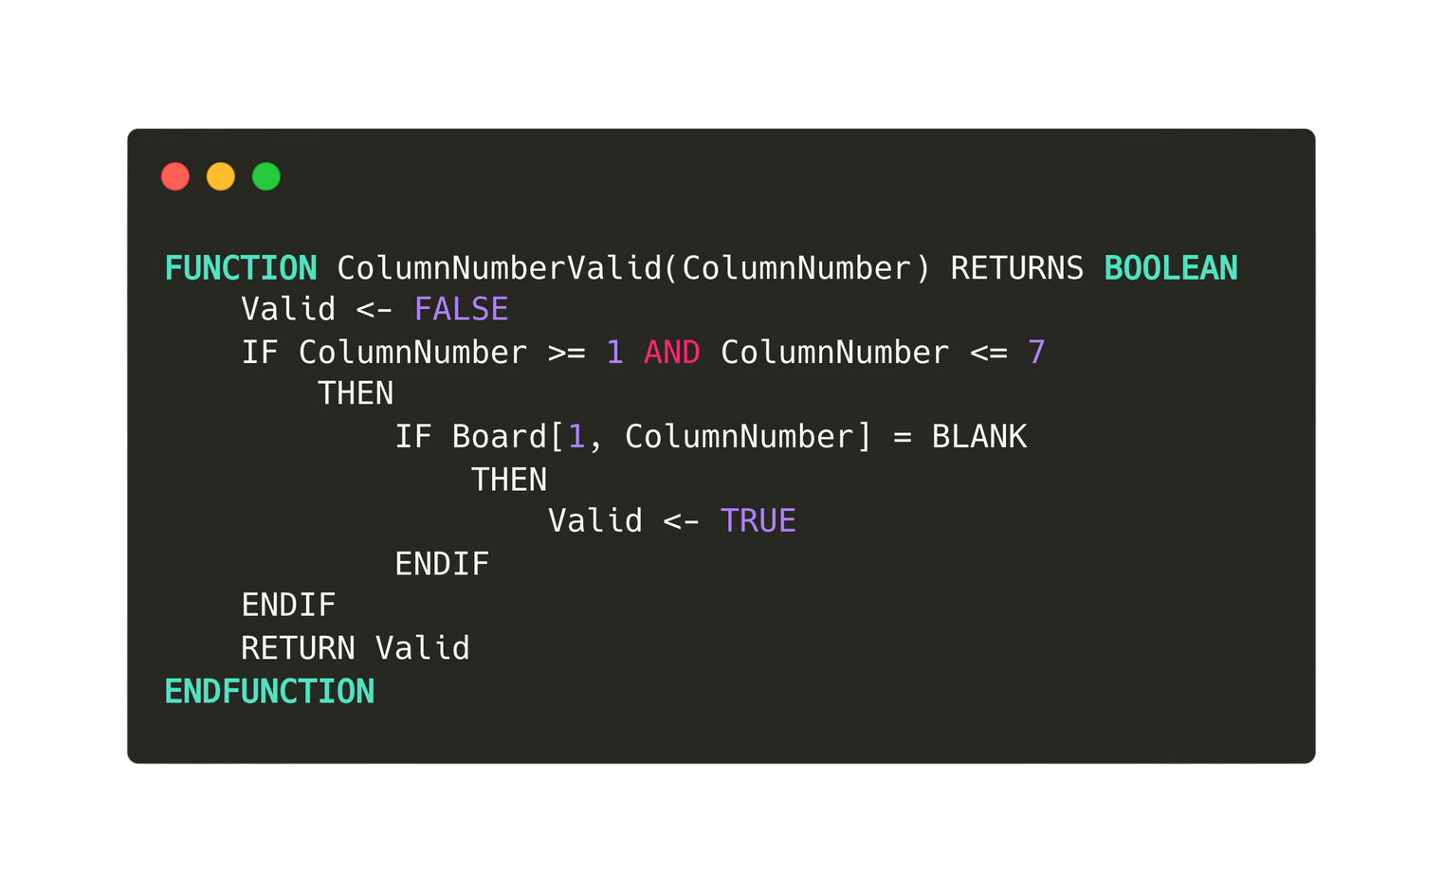
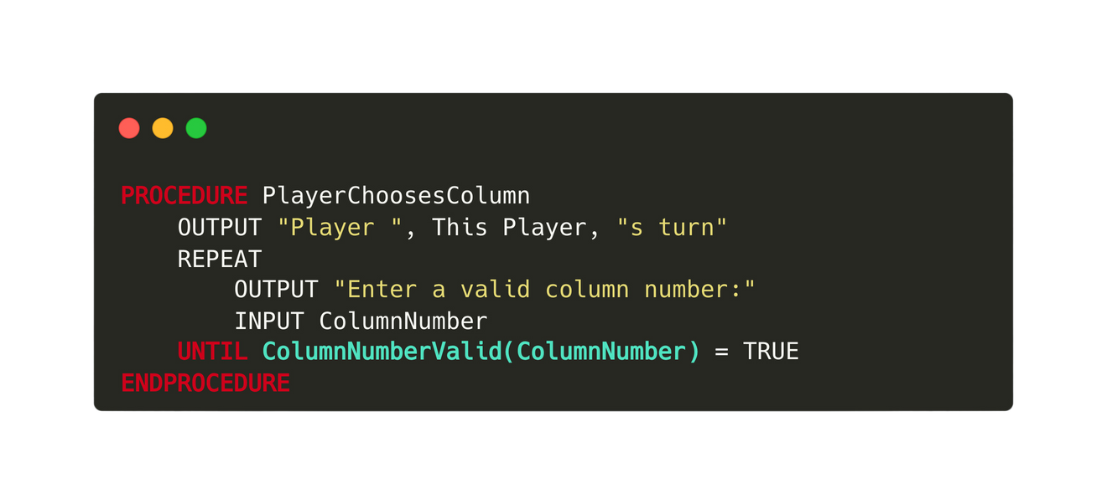

13.5 Two-dimensional array
[1]
[2]
[3]
[4]
[5]
[6]
[7]
[1]
X
Working through each procedure
[2]
PlayerMakeMove
[3]
X
[4]
X
[5]
O
[6]
O

Slide 47
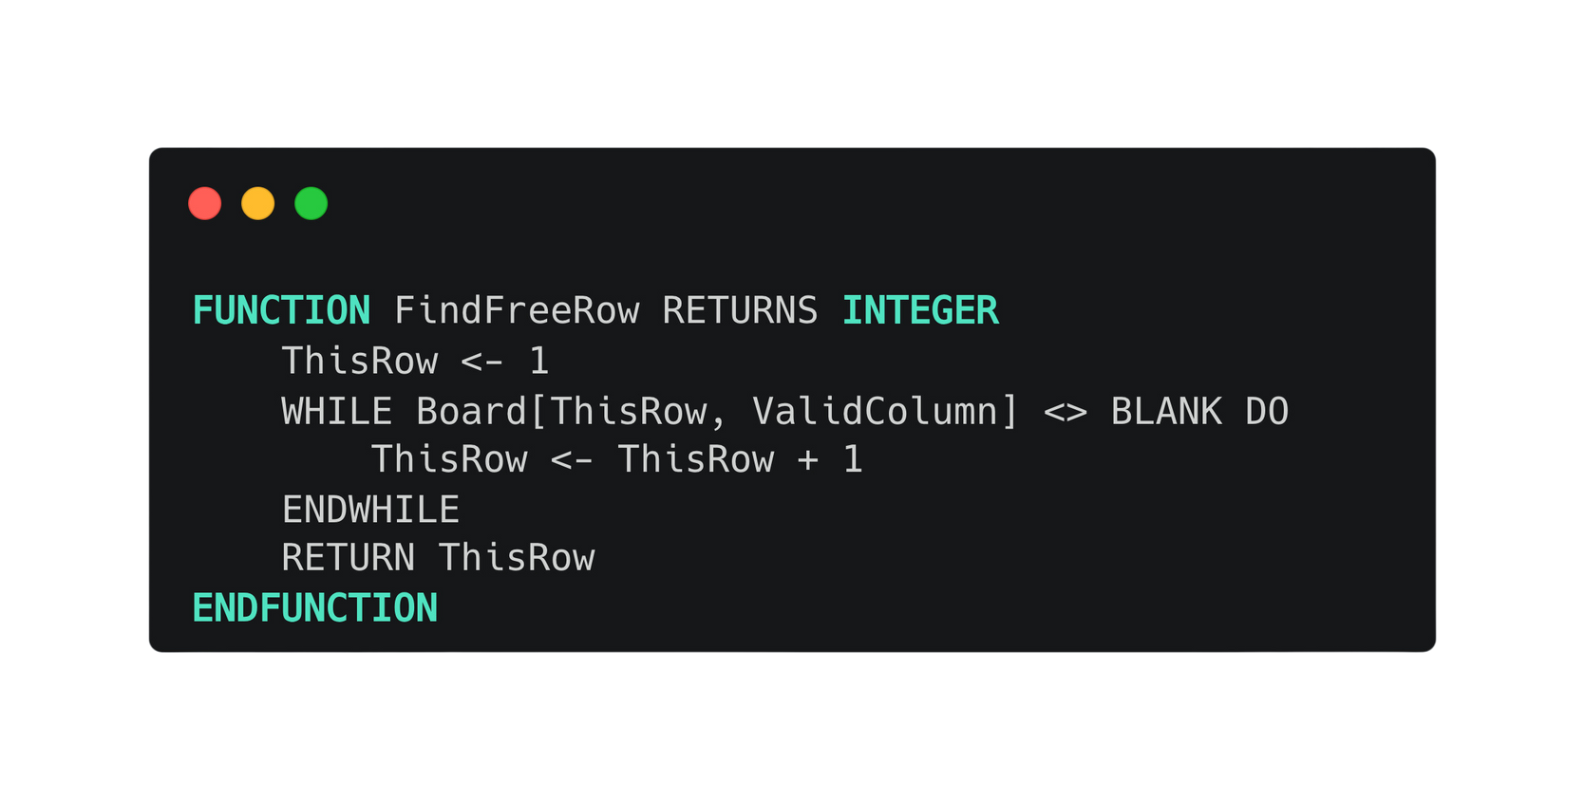
13.5 Two-dimensional array
Working through each procedure
[1]
[2]
[3]
[4]
[5]
[6]
[7]
PlayerMakeMove
[1]
X
[2]
[3]
X
[4]
X
[5]
O
[6]
O

Slide 48
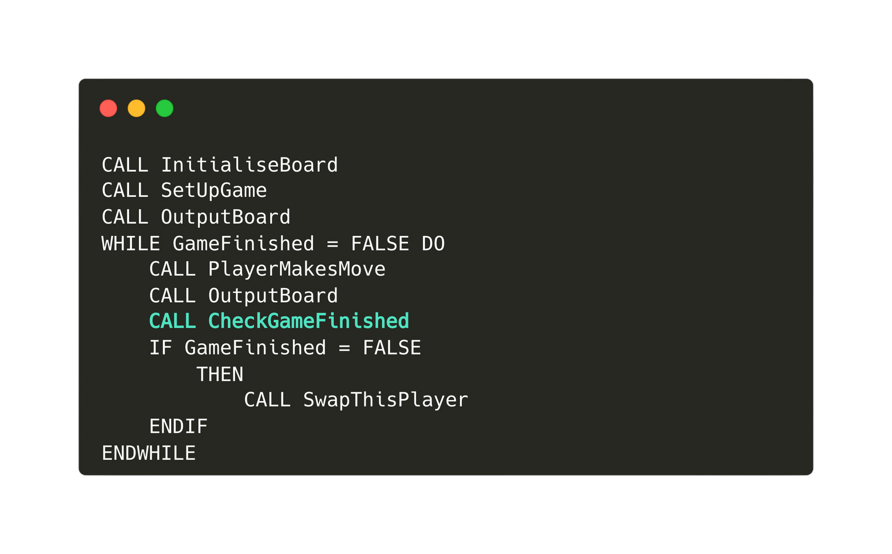
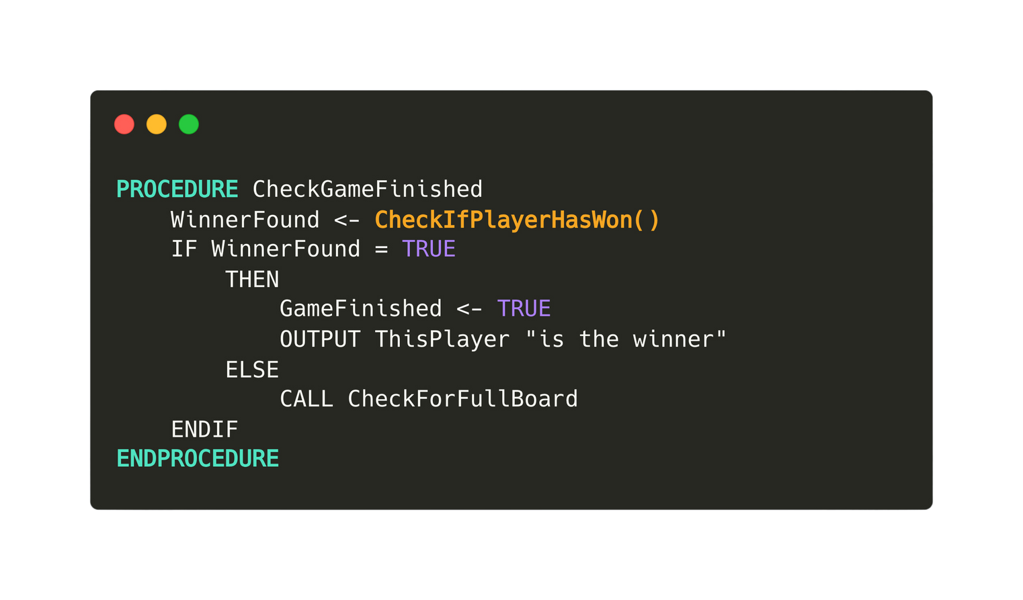
13.5 Two-dimensional array
Working through each procedure
CheckGameFinished

Slide 49
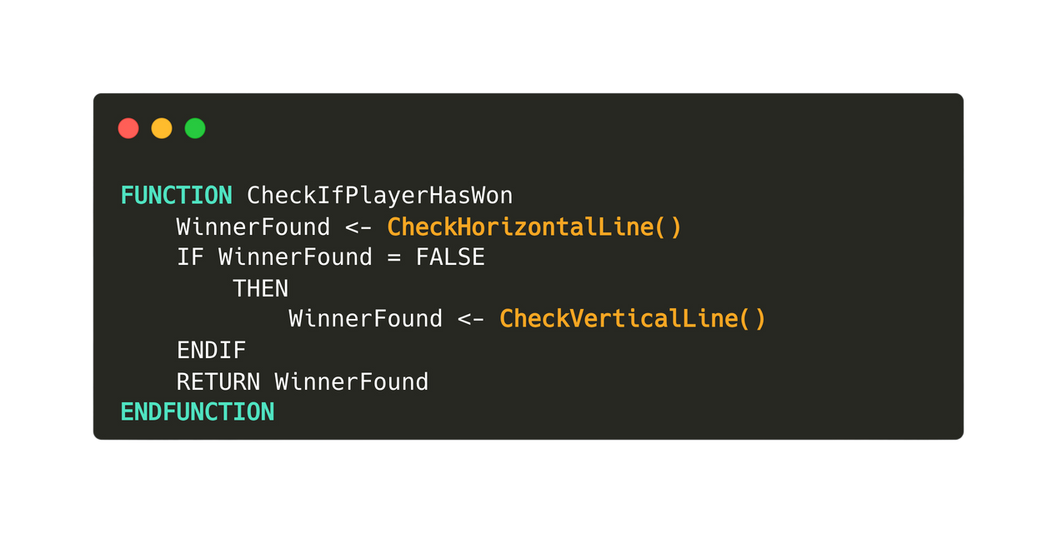
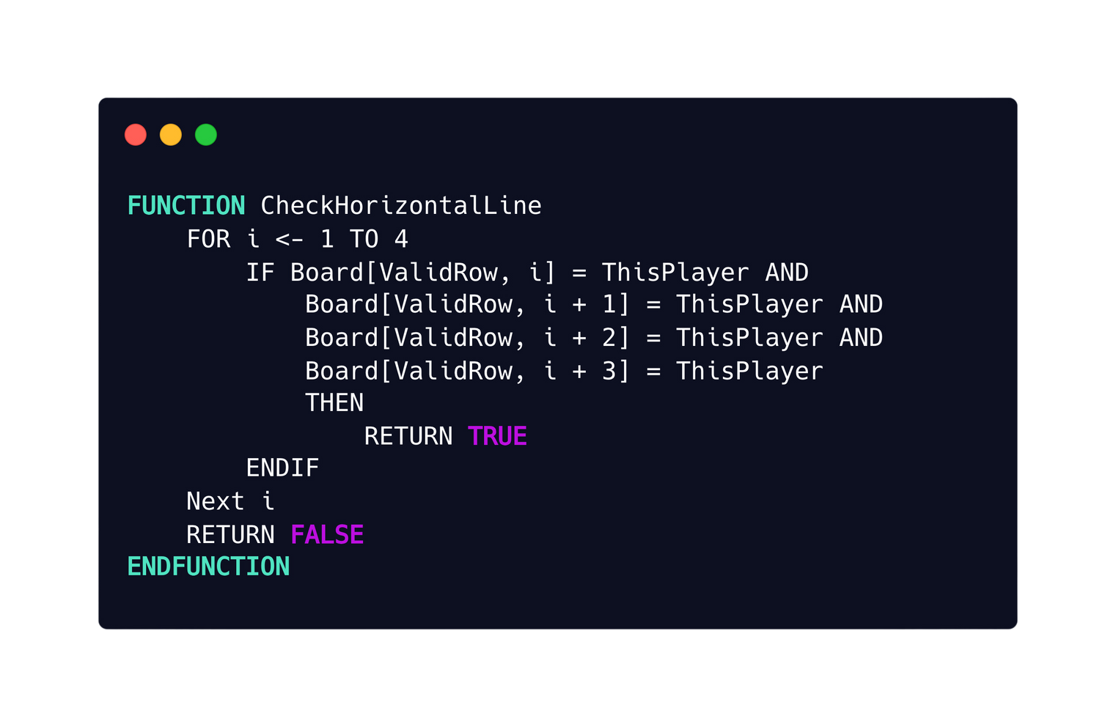
13.5 Two-dimensional array
Working through each procedure
[1]
[2]
[3]
[4]
[5]
[6]
[7]
[1]
X
CheckGameFinished
[2]
X
X
O
X
[3]
X
X
X
O
O
[4]
X
O
O
X
O
[5]
O
O
O
X
X
X
[6]
O
X
X
X
O
X

Slide 50
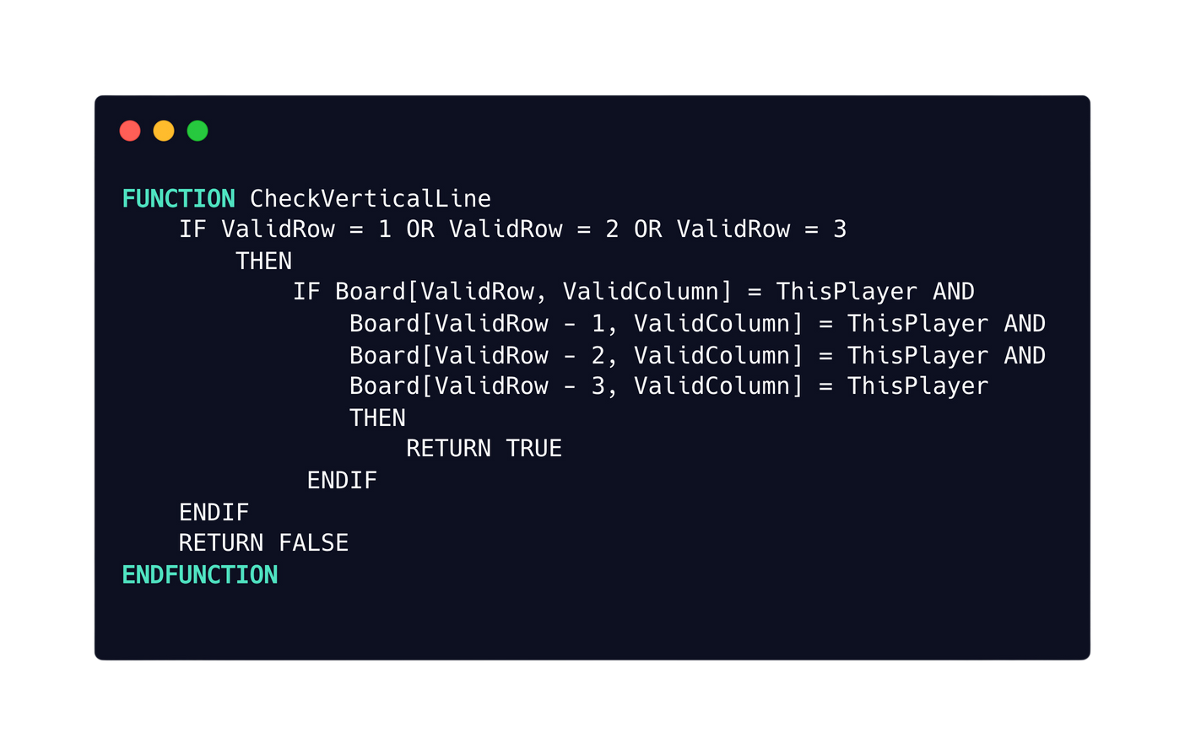
13.5 Two-dimensional array
Working through each procedure
[1]
[2]
[3]
[4]
[5]
[6]
[7]
[1]
X
CheckGameFinished
[2]
X
X
O
X
[3]
X
X
X
O
O
[4]
X
O
O
X
O
[5]
O
O
O
X
X
X
[6]
O
X
X
X
O
X

Slide 51
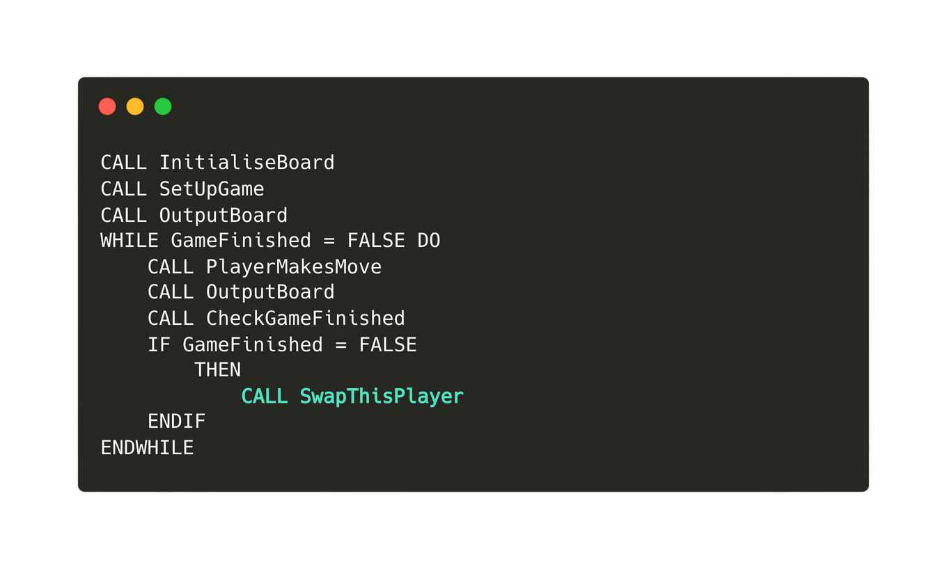
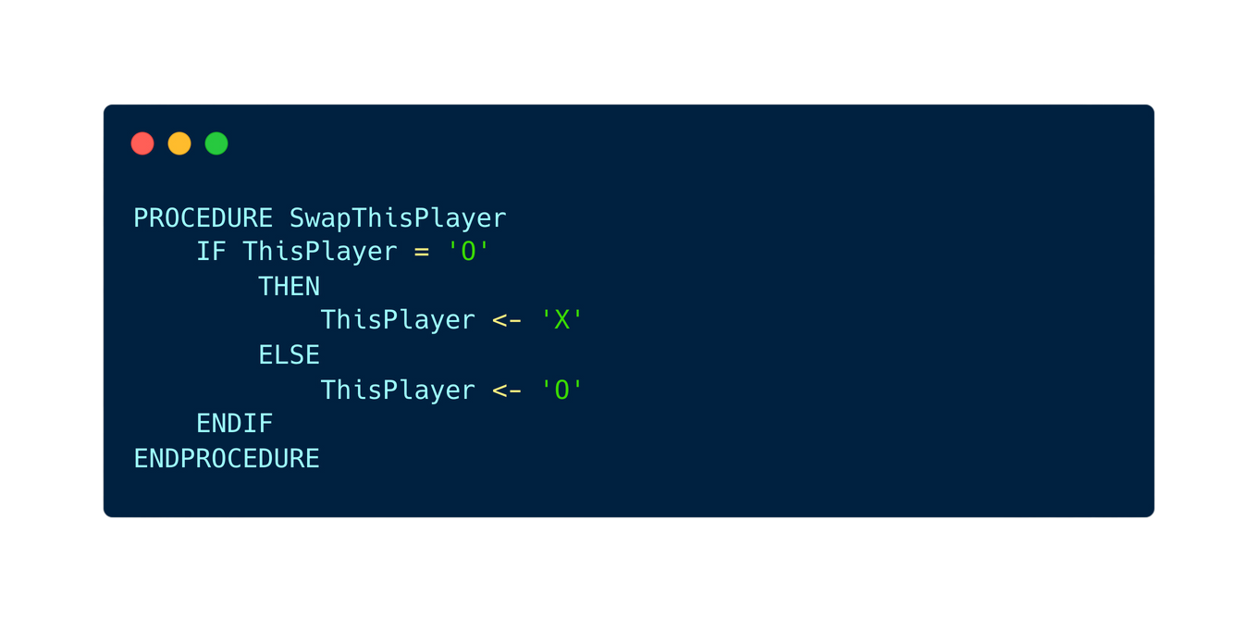
13.5 Two-dimensional array
Working through each procedure
SwapThisPlayer

Slide 52

Subtopic 1
13.6 Text File Handling
Why is text file needed?
Text files are employed in software development to store variables by writing their values into the file, enabling the program to access, modify, or retrieve these values during execution, allowing for persistent data storage across multiple runs of the software.

Slide 53
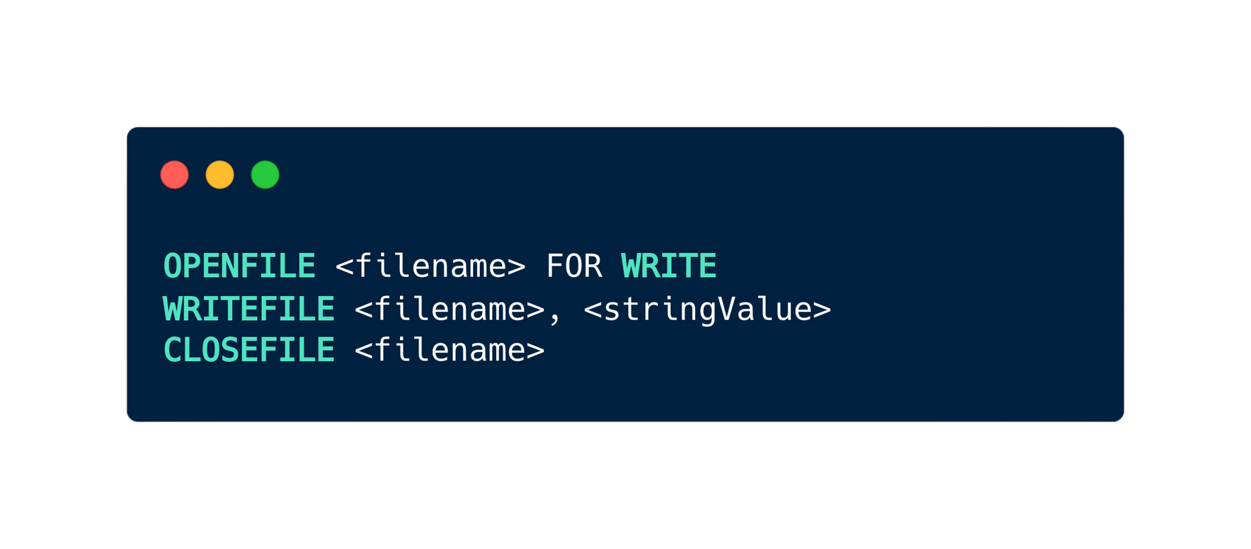
Subtopic 1
13.6 Text File Handling
Writing to a text file
Pseudocode

Slide 54
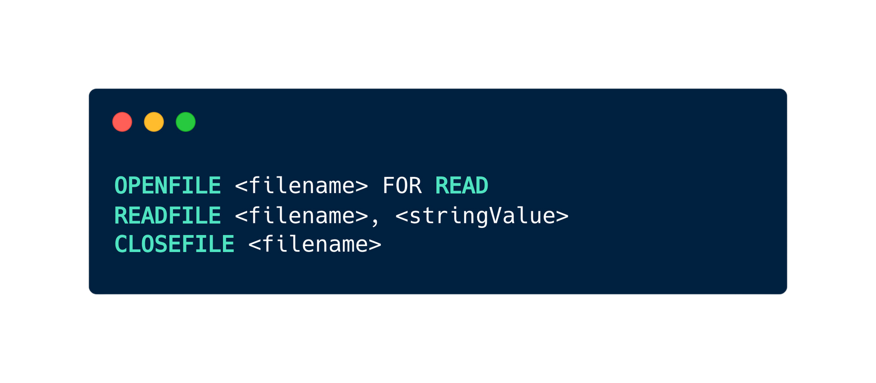
Subtopic 1
13.6 Text File Handling
Reading from a text file
Pseudocode

Slide 55
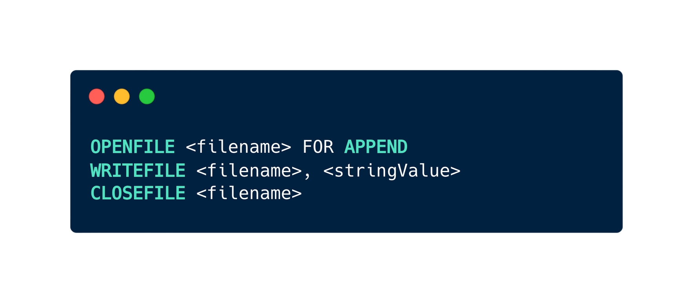
Subtopic 1
13.6 Text File Handling
Appending to a text file
Pseudocode

Slide 56
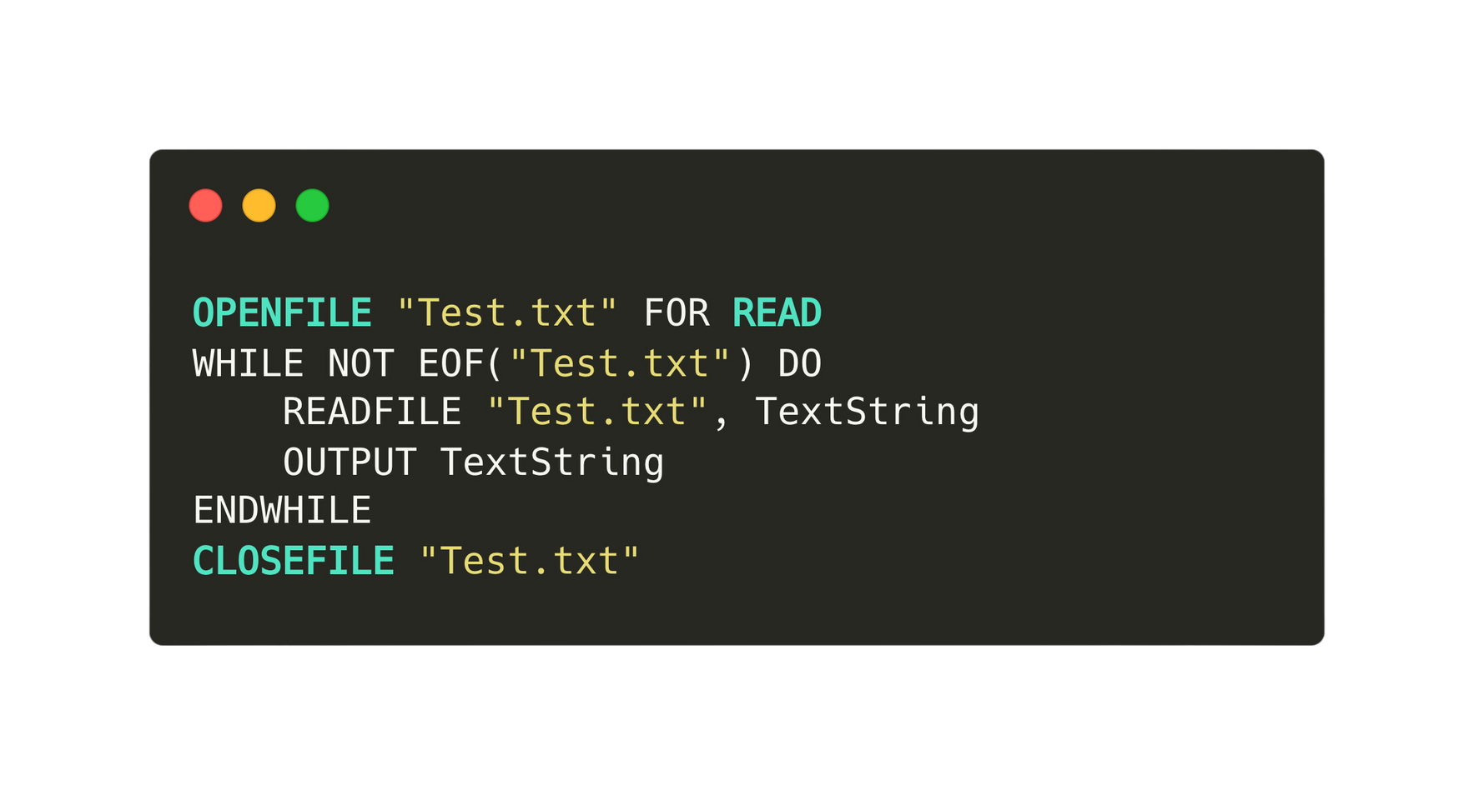
Subtopic 1
13.6 Text File Handling
The end-of-file (EOF) marker
EOF (End-of-File) is a condition or marker used in programming to indicate the end of data in a file, helping programs identify when there is no more content to read from the file.

Slide 57
13.7 Abstract Data Type
Definition
An abstract data type (ADT) is a theoretical model defining a data structure's behavior and operations independently of its implementation details.
Stacks
Queues
Linked List

Slide 58
13.7 Abstract Data Type
Definition
An abstract data type (ADT) is a theoretical model defining a data structure's behavior and operations independently of its implementation details.
Stacks
Queues
Linked List

Slide 59

13.7 Abstract Data Type
Stacks
A stack in programming is a data structure that operates on a last-in, first-out (LIFO) basis, allowing data to be added (pushed) and removed (popped) from the top of the stack.

Slide 60

13.7 Abstract Data Type
Stacks
A stack in programming is a data structure that operates on a last-in, first-out (LIFO) basis, allowing data to be added (pushed) and removed (popped) from the top of the stack.
[5]
[4]
[3]
An empty stack
[2]
[1]
BasePointer
[0]
TopPointer
[-1]

Slide 61
13.7 Abstract Data Type
Stacks
Top pointer (used to point the the item at the top) will be incremented by 1 whenever a new item is added.
[5]
[4]
[3]
[2]
TopPointer
[1]
BasePointer
[0]
a
[-1]

Slide 62
13.7 Abstract Data Type
Stacks
Top pointer (used to point the the item at the top) will be incremented by 1 whenever a new item is added.
[5]
[4]
[3]
[2]
TopPointer
[1]
b
BasePointer
[0]
a
[-1]

Slide 63
13.7 Abstract Data Type
Stacks
Top pointer (used to point the the item at the top) will be incremented by 1 whenever a new item is added.
[5]
[4]
[3]
TopPointer
[2]
c
[1]
b
BasePointer
[0]
a
[-1]

Slide 64
13.7 Abstract Data Type
Stacks
Top pointer (used to point the the item at the top) will be incremented by 1 whenever a new item is added.
[5]
[4]
TopPointer
[3]
d
[2]
c
[1]
b
BasePointer
[0]
a
[-1]

Slide 65
13.7 Abstract Data Type
Stacks
Top pointer (used to point the the item at the top) will be incremented by 1 whenever a new item is added.
[5]
TopPointer
[4]
e
[3]
d
[2]
c
[1]
b
BasePointer
[0]
a
[-1]

Slide 66
13.7 Abstract Data Type
Stacks
When an element is removed, top pointer will be decremented by 1.
[5]
[4]
TopPointer
[3]
d
[2]
c
[1]
b
BasePointer
[0]
a
[-1]

Slide 67
13.7 Abstract Data Type
Stacks
Explaining Last in first out: The last item that is added is ‘e’, and the first item that is removed is also ‘e’.
[5]
[4]
TopPointer
[3]
d
[2]
c
[1]
b
BasePointer
[0]
a
[-1]

Slide 68
13.7 Abstract Data Type
Stacks
Explaining Last in first out: The last item that is added is ‘e’, and the first item that is removed is also ‘e’.
[5]
[4]
TopPointer
[3]
d
[2]
c
[1]
b
BasePointer
[0]
a
[-1]

Slide 69
13.7 Abstract Data Type
Definition
An abstract data type (ADT) is a theoretical model defining a data structure's behavior and operations independently of its implementation details.
Stacks
Queues
Linked List

Slide 70
13.7 Abstract Data Type
Queues
A queue in programming is a data structure that follows the first-in, first-out (FIFO) principle, allowing elements to be added at the rear (enqueue) and removed from the front (dequeue) of the queue.
[-1]
[0]
FrontOfQueuePointer
[1]
EndOfQueuePointer
An empty queue
[2]
[3]
[4]
[5]

Slide 71
13.7 Abstract Data Type
Queues
When one value joins the queue, the EndOfQueuePointer will be incremented before adding the value to the array element where the pointer is pointing to.
[-1]
[0]
a
FrontOfQueuePointer
EndOfQueuePointer
[1]
[2]
[3]
[4]
[5]

Slide 72
13.7 Abstract Data Type
Queues
When one value joins the queue, the EndOfQueuePointer will be incremented before adding the value to the array element where the pointer is pointing to.
[-1]
[0]
a
FrontOfQueuePointer
[1]
b
EndOfQueuePointer
[2]
[3]
[4]
[5]

Slide 73
13.7 Abstract Data Type
Queues
When one value joins the queue, the EndOfQueuePointer will be incremented before adding the value to the array element where the pointer is pointing to.
[-1]
[0]
a
FrontOfQueuePointer
[1]
b
[2]
c
EndOfQueuePointer
[3]
[4]
[5]

Slide 74
13.7 Abstract Data Type
Queues
When one value joins the queue, the EndOfQueuePointer will be incremented before adding the value to the array element where the pointer is pointing to.
[-1]
[0]
a
FrontOfQueuePointer
[1]
b
[2]
c
[3]
d
EndOfQueuePointer
[4]
[5]

Slide 75

13.7 Abstract Data Type
Queues
When the foremost item in the queue is removed, it requires shifting all items one position forward and making necessary adjustments to the EndOfQueuePointer.
[-1]
[0]
[1]
b
FrontOfQueuePointer
[2]
c
EndOfQueuePointer
[3]
d
[4]
[5]

Slide 76
13.7 Abstract Data Type
Queues
While this method works, it is not very efficient as it involves a lot of data shifting.
[-1]
[0]
b
[1]
c
FrontOfQueuePointer
[2]
d
EndOfQueuePointer
[3]
[4]
[5]

Slide 77
13.7 Abstract Data Type
Circular Queue
A circular queue does not involve data shifting. Instead, only the pointers are changed.
[-1]
[0]
a
FrontOfQueuePointer
[1]
b
[2]
c
[3]
d
EndOfQueuePointer
[4]
[5]

Slide 78
13.7 Abstract Data Type
Circular Queue
Let’s say that the item at the front is removed.
[-1]
[0]
FrontOfQueuePointer
[1]
b
[2]
c
[3]
d
EndOfQueuePointer
[4]
[5]

Slide 79
13.7 Abstract Data Type
Circular Queue
No data shifting, only shift the pointer.
[-1]
[0]
[1]
b
FrontOfQueuePointer
[2]
c
[3]
d
EndOfQueuePointer
[4]
[5]

Slide 80
13.7 Abstract Data Type
Circular Queue
Adding items into to the queue.
[-1]
[0]
[1]
b
FrontOfQueuePointer
[2]
c
[3]
d
[4]
e
EndOfQueuePointer
[5]

Slide 81
13.7 Abstract Data Type
Circular Queue
Adding items into to the queue.
[-1]
[0]
[1]
b
FrontOfQueuePointer
[2]
c
[3]
d
[4]
e
[5]
f
EndOfQueuePointer

Slide 82
13.7 Abstract Data Type
Circular Queue
Eventually the queue will wrap around to the beginning.
[-1]
[0]
g
EndOfQueuePointer
[1]
b
FrontOfQueuePointer
[2]
c
[3]
d
[4]
e
[5]
f

Slide 83
13.7 Abstract Data Type
Circular Queue
Eventually the queue will wrap around to the beginning.
[-1]
[0]
g
EndOfQueuePointer
[1]
b
FrontOfQueuePointer
[2]
c
[3]
d
[4]
e
[5]
f

Slide 84
13.7 Abstract Data Type
Definition
An abstract data type (ADT) is a theoretical model defining a data structure's behavior and operations independently of its implementation details.
Stacks
Queues
Linked List

Slide 85
13.7 Abstract Data Type
Linked List
A linked list is a linear data structure where elements, known as nodes, are connected via pointers, each node containing data and a reference to the next node in the sequence.
Node
Node
Node
Data
Reference to the next node

Slide 86

13.7 Abstract Data Type
Linked List
A linked list is a linear data structure where elements, known as nodes, are connected via pointers, each node containing data and a reference to the next node in the sequence.
Node
Node
Node
Start Pointer
Null Pointer
A variable that stores the address of the first element of a linked list
A pointer the does not point at anything.

Slide 87
13.7 Abstract Data Type
Linked List Operations
Node
Node
Node

Slide 88
13.7 Abstract Data Type
Linked List Operations
Insert
Delete
at the beginning of the list
at the beginning of the list
at the end
of the list
at the end
of the list
In between
two nodes
In between
two nodes

Slide 89
13.7 Abstract Data Type
Linked List Operations
Insert
Delete
at the beginning of the list
at the beginning of the list
at the end
of the list
at the end
of the list
In between
two nodes
In between
two nodes

Slide 90
13.7 Abstract Data Type
Linked List Operations
Insert at the beginning of the list.
Start Pointer
Null Pointer
Node
Node
Node
Copy whatever the start pointer is pointing to into the new node’s pointer field...
New Node

Slide 91

13.7 Abstract Data Type
Linked List Operations
Insert at the beginning of the list.
Start Pointer
Null Pointer
Node
Node
Node
Copy whatever the start pointer is pointing to into the new node’s pointer field...
New Node

Slide 92
13.7 Abstract Data Type
Linked List Operations
Insert at the beginning of the list.
Start Pointer
Null Pointer
Node
Node
Node
Set the start pointer to the new node
New Node

Slide 93
13.7 Abstract Data Type
Linked List Operations
Insert at the beginning of the list.
Start Pointer
Null Pointer
New Node
Node
Node
Node

Slide 94
13.7 Abstract Data Type
Linked List Operations
Insert at the end of the list.
Start Pointer
Null Pointer
Node
Node
Node
Connect it to the new node
New Node
Connect it to the null pointer

Slide 95
13.7 Abstract Data Type
Linked List Operations
Insert at the end of the list.
Start Pointer
Null Pointer
Node
Node
Node
New Node

Slide 96
13.7 Abstract Data Type
Linked List Operations
Insert at the middle of the list.
Start Pointer
Null Pointer
Node
Node
Node
A
C
D
Copy whatever Node A is pointing to into the new node’s pointer field...
New Node
B

Slide 97
13.7 Abstract Data Type
Linked List Operations
Insert at the middle of the list.
Start Pointer
Null Pointer
Node
Node
Node
A
C
D
New Node
B

Slide 98
13.7 Abstract Data Type
Linked List Operations
Insert at the middle of the list.
Start Pointer
Null Pointer
Node
Node
Node
A
C
D
Change the pointer field of Node A to point to the new node
New Node
B

Slide 99
13.7 Abstract Data Type
Linked List Operations
Insert at the middle of the list.
Start Pointer
Null Pointer
Node
New Node
Node
Node
A
B
C
D

Slide 100
13.7 Abstract Data Type
Linked List Operations
Insert
Delete
at the beginning of the list
at the beginning of the list
at the end
of the list
at the end
of the list
In between
two nodes
In between
two nodes

Slide 101
13.7 Abstract Data Type
Linked List Operations
Delete at the beginning of the list.
Start Pointer
Null Pointer
Node
Node
Node
A
C
D
Copy whatever Node A is pointing to into starting pointer ...

Slide 102
13.7 Abstract Data Type
Linked List Operations
Delete at the beginning of the list.
Start Pointer
Null Pointer
Node
Node
Node
A
C
D

Slide 103
13.7 Abstract Data Type
Linked List Operations
Delete at the end of the list.
Start Pointer
Null Pointer
Node
Node
Node
A
C
D
Set the Previous Node to null pointer

Slide 104
13.7 Abstract Data Type
Linked List Operations
Delete at the end of the list.
Start Pointer
Null Pointer
Start Pointer
Node
Node
Node
Node
C
A
C
A

Slide 105
13.7 Abstract Data Type
Linked List Operations
Delete at the middle of the list.
Start Pointer
Null Pointer
Node
Node
Node
A
C
D
Copy whatever Node C is pointing to to the pointer field of A ...

Slide 106
13.7 Abstract Data Type
Linked List Operations
Delete at the middle of the list.
Start Pointer
Null Pointer
Node
Node
Node
A
C
D

Slide 107
13.7 Abstract Data Type
Why is linked list preferred?
In a linked list, the utilization of pointers enables efficient insertion and deletion operations by solely adjusting references between nodes, eliminating the necessity for frequent data shifting seen in linear lists like arrays.
One disadvantage of linked list is that we need extra storage to store the pointers.

Slide 108
13.7 Abstract Data Type
Implementing a linked list as an array
We can use two arrays, one to store the data, and the other to store the pointer.
Start
Pointer
Data
Pointer
[0]
[1]
[2]
[3]
[4]
[5]

Slide 109
13.7 Abstract Data Type
Implementing a linked list as an array
Representing a linked list with arrays.
Diagram View
Array View
Start
Pointer
Data
Pointer
Y
[0]
1
2
Z
[1]
-1
Start Pointer
Null Pointer
Node
Node
Node
X
Y
Z
X
[2]
0
[3]
[4]
[5]

Slide 110
13.7 Abstract Data Type
Implementing a linked list as an array
Adding the node W to the beginning of the list.
Diagram View
Array View
Start
Pointer
Data
Pointer
Start Pointer
Null Pointer
Node
Node
Node
[0]
1
X
Y
Z
Y
2
Z
[1]
-1
X
[2]
0
Start Pointer
W
[3]
??
Node
Node
Null Pointer
[4]
New Node
Node
W
X
Y
Z
[5]

Slide 111
13.7 Abstract Data Type
Implementing a linked list as an array
Adding the node W into the beginning of the list.
Diagram View
Array View
Start
Pointer
Data
Pointer
Start Pointer
Null Pointer
Node
Node
Node
[0]
1
X
Y
Z
Y
3
Z
[1]
-1
X
[2]
0
Start Pointer
W
[3]
2
Node
Node
Null Pointer
[4]
New Node
Node
W
X
Y
Z
[5]

Slide 112
13.7 Abstract Data Type
Implementing a linked list as an array
Adding Node AA to the end of the list.
Diagram View
Array View
Start Pointer
Null Pointer
Start
Pointer
Data
Pointer
Node
Node
Node
X
Y
Z
Y
[0]
1
2
Z
[1]
-1
Start Pointer
X
[2]
0
Node
Node
Node
X
Y
Z
AA
[3]
?
New Node
Null Pointer
[4]
AA
[5]

Slide 113
13.7 Abstract Data Type
Implementing a linked list as an array
Adding Node AA to the end of the list.
Diagram View
Array View
Start Pointer
Null Pointer
Start
Pointer
Data
Pointer
Node
Node
Node
X
Y
Z
Y
[0]
1
2
Z
[1]
3
Start Pointer
X
[2]
0
Node
Node
Node
X
Y
Z
AA
[3]
-1
New Node
Null Pointer
[4]
AA
[5]

Slide 114
13.7 Abstract Data Type
Implementing a linked list as an array
Deleting the first element in the linked list.
Diagram View
Array View
Start
Pointer
Data
Pointer
Start Pointer
Null Pointer
Node
Node
Node
[0]
1
X
Y
Z
Y
2
Z
[1]
-1
X
[2]
0
Start Pointer
Null Pointer
Node
Node
Node
X
Y
Z
[3]
[4]
[5]

Slide 115
13.7 Abstract Data Type
Implementing a linked list as an array
Deleting the first element in the linked list.
Diagram View
Array View
Start
Pointer
Data
Pointer
Start Pointer
Null Pointer
Node
Node
Node
[0]
1
X
Y
Z
Y
0
Z
[1]
-1
Old data will still remain in the array, yet they are inaccessible as there is no pointer pointing to them.
X
0
[2]
Start Pointer
Null Pointer
Node
Node
Node
X
Y
Z
[3]
[4]
[5]

Slide 116
13.7 Abstract Data Type
Implementing a linked list as an array
Deleting the last element in the linked list.
Diagram View
Array View
Start
Pointer
Data
Pointer
Start Pointer
Null Pointer
Node
Node
Node
[0]
1
X
Y
Z
Y
2
Z
[1]
-1
X
[2]
0
Start Pointer
Null Pointer
Node
Node
[3]
X
Y
[4]
[5]

Slide 117
13.7 Abstract Data Type
Implementing a linked list as an array
Deleting the last element in the linked list.
Diagram View
Array View
Start
Pointer
Data
Pointer
Start Pointer
Null Pointer
Node
Node
Node
[0]
-1
X
Y
Z
Y
2
Z
[1]
-1
X
[2]
0
Start Pointer
Null Pointer
Node
Node
[3]
X
Y
[4]
[5]

Slide 118
13.7 Abstract Data Type
Free List
A free list pointer is utilized to manage available or unused spaces in the array that can be used to store new nodes.
Node
Node
Node
Node
Node

Slide 119
13.7 Abstract Data Type
Initialising a linked list
Diagram View
Node
Node
Node
Node
Node
Array View
Data
Pointer
StartPointer
-1
[0]
1
[1]
2
FreeListPointer
0
[2]
3
[3]
4
[4]
-1

Slide 120
13.7 Abstract Data Type
Insert Z,X,Y, kept in alphabetical order
Diagram View
Node
Node
Node
X
Y
Z
Node
Node
Array View
Data
Pointer
StartPointer
1
Z
[0]
-1
X
[1]
2
FreeListPointer
3
Y
[2]
0
[3]
4
[4]
-1

Slide 121
13.7 Abstract Data Type
Let’s say X is deleted.
Diagram View
Node
Node
Node
X
Y
Z
Node
Node
Array View
Data
Pointer
StartPointer
2
Z
[0]
-1
X
[1]
3
FreeListPointer
1
Y
[2]
0
[3]
4
[4]
-1

Slide 122
13.7 Abstract Data Type
Let’s say X is deleted.
Diagram View
Node
Node
Y
Z
Node
Node
Node
X
Array View
Data
Pointer
StartPointer
2
Z
[0]
-1
X
[1]
3
FreeListPointer
1
Y
[2]
0
[3]
4
[4]
-1

Slide 123
Subtopic 1
13.2 Record Type
Definition
A record type in programming is a data structure that allows the storage of multiple fields or pieces of information under a single name or identifier. For example: data about a product could contain the following fields:
Product Name: STRING
Product Price: REAL
Expiration Date: DATE
A Dairy Product: BOOLEAN

Slide 124
13.7 Abstract Data Type
Record for a Node
Node
Data: STRING
X
Pointer: Nodes

