Slide 1
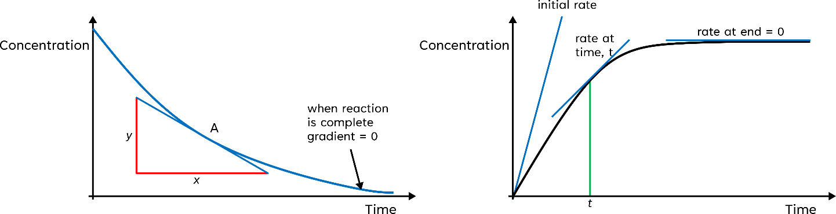
Topic 9
Kinetics I
Collision Theory
Chemical reactions only occur when the reacting particles collide with enough activation energy and the particle orientation is correct.
In order to increase the rate of a reaction one must increase the frequency collisions and/or the energy of the particles, so more successful collisions occur.
This can be done by increasing:
Temperature | It increases the kinetic energy of particles this increases the probability of successful collisions as particles are more likely to have energy levels at or above the activation energy.
Pressure/ Concentration | It increases the density of particles this increasing the frequency of collisions as particles are closer together.
Surface Area | Allows the particles to collided with a greater area this increasing the frequency of collisions.
Catalyst | Lowers activation energy ∴ more successful collisions.
$$Rate of reaction= \frac{amount of reactant used / product formed }{time }$$
On a concentration-time graph, the rate of reaction is equal to the gradient of the curve at a given point. Therefore, the graph can be used to find the rate by drawing a tangent to the curve at a given time.

Slide 2
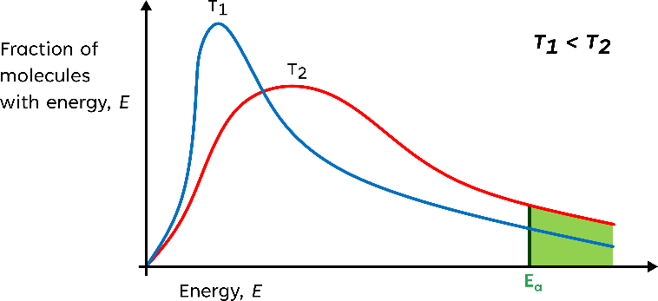
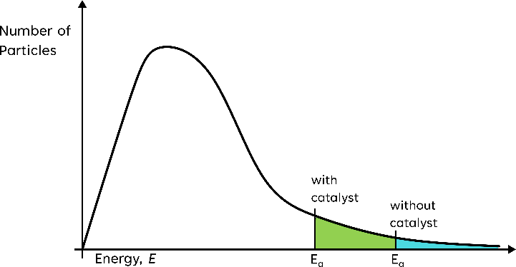
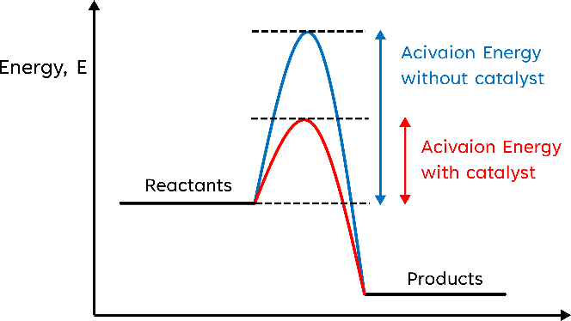
Maxwell-Boltzmann Distribution
The Molecules in a sample of gas have a wide range of energies. To estimate what fraction of collisions will have the required activation energy, we need to know the energy distribution of the molecules. The Maxwell-Boltzmann distribution curve is this.
At a higher temp, T₂ shifts right.
The energy peak decreases and more particles are at or above the activation energy.
Area under the curve is constant - corresponds to the total number of particles.
Catalysts – A substance that increases the rate of reaction but is chemically unchanged at the end of the reaction.
Provides alternative reaction routes, that alternative route having a lower activation energy. The decreasing of the activation energy mean that more particles will have enough energy to overcome the energy barrier and react.
Effect on the Maxwell-Boltzmann Curve
Reaction Profiles for Uncatalysed and Catalysed reactions
Heterogeneous Catalyst in industrial reactions, typically reactions involving gases – Provides are surface for the molecules to absorb and react. The products then reabsorb so that more reactions can take place
Economic benefits of catalysts in industrial reactions
Increase rate of reaction ∴ more products can be made per period time
Lowers the needed temperate ∴ reducing cost

