Slide 1
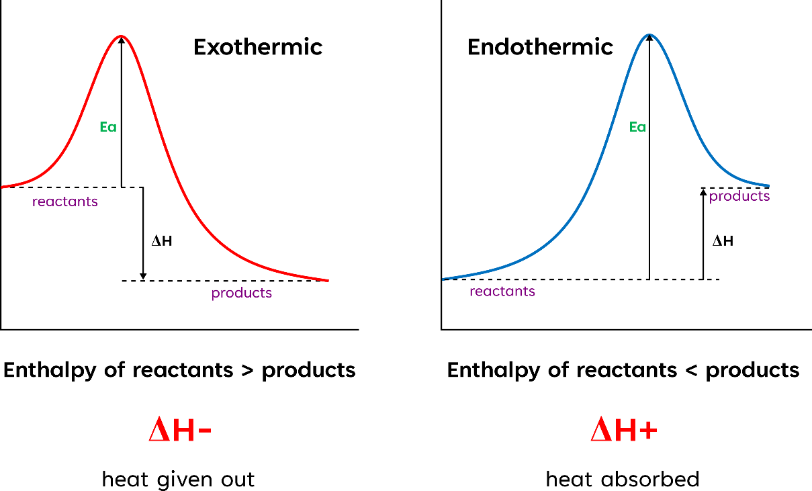
Topic 8
Energetics I
Standard Conditions
100 kPa & 298 K
Enthalpy change – Heat energy change measured at constant pressure
Enthalpy definitions
Formation (ΔH∅_{f})
The energy change when one mole of a substance is formed from elements in their standard states at fixed temperate and pressure
CH₄ = C + 2H₂ → CH₄
(g) (s) (g) (g)
NH₄Cl = ½ N₂+ 2H₂ + ½ Cl₂ → NH₄Cl
(s) (g) (g) (g) (s)
Combustion (ΔH∅_{c})
The energy produced when one mole of a substance is burned in excess oxygen measured at a fixed temperate and pressure
2H₂ = 2H₂ + O₂→ 2H₄O
(l) (g) (g) (l)
C₂H₄ = C₂H₄ + 3O₂ → 2CO₂ + 2H₂O
(g) (g) (g) (g) (l)

Slide 2




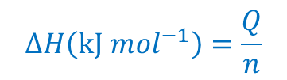
Enthalpy
Enthalpy definitions
Reactions (ΔH∅)
The energy change when quantities of substances react completely in their standard states at fixed temperate and pressure
Neutralisation? (ΔH∅_{n})
The enthalpy change when solutions of acid and alkali react together under standard conditions to produce one mole of water
Calculating Enthalpy
$$Q=m∙c∙∆T$$
$$Energy Transfered=mass∙specific heat capacity ∙ temperature change$$
c of water = 4.18
Calorimetry is an experimental method for finding enthalpy change by measuring temperature change over time. When observed and plotted on a graph, data can be extrapolated to give an accurate value for the change in temperature.
It essentially works by burning a fuel (what you plan to measure) to heat up water, ∆T of the water is how you can then calculate enthalpy.
Thermometer
Water
Copper Can
Spirit Burner
ΔH values found using calorimetry are never completely accurate as energy is easily lost from the system through conduction or convection and inaccuracies in measuring temperatures.
$$∆H\left(\text{kJ} {mol}^{−1}\right)=\frac{Q}{n}$$
$$n=\frac{c}{v}$$

Slide 3
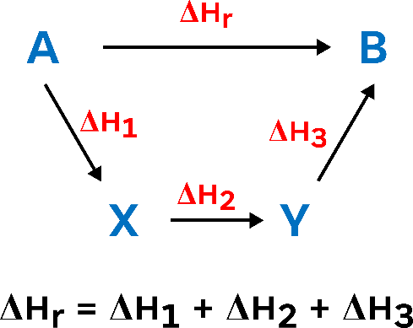
Enthalpy
example
25cm³ of 2.0M HCI was added to 25cm³ of 2.0M NaOH in an insulated beaker. The initial temperature of both solutions was 20°C. The reaction mixture was stirred to ensure mixing, and the highest temperature reached by the solution was 33°C. Calculate the Molar Enthalpy of Neutralisation.
NaOH + HCl → NaCl + H₂O
ΔT = 13
V = 25 + 25 = 50cm³ = 0.05dm³
m = 0.05kg
q = mcΔt = 0.05 × 4.18 × 13 = 2.717kJ
n (of HCl) = 2 × 0.025 = 0.05 mol
n (of NaOH) = 2 × 0.025 = 0.05 mol
n (of H2O) = 0.05
ΔH = -q/n = -(2.717/0.05) = -54.34kJ mol⁻¹
Enthalpy Cycles
Sometimes it may be difficult to measure the enthalpy change of a reaction directly, as:
Reaction may be too slow.
Reaction may be incomplete.
There may be other side reactions occurring simultaneously.
Hess’s Law
Energy in a reaction system must be conserved, as it cannot be created or destroyed ∴ overall enthalpy change for a reaction is the same, regardless of the route taken

Slide 4
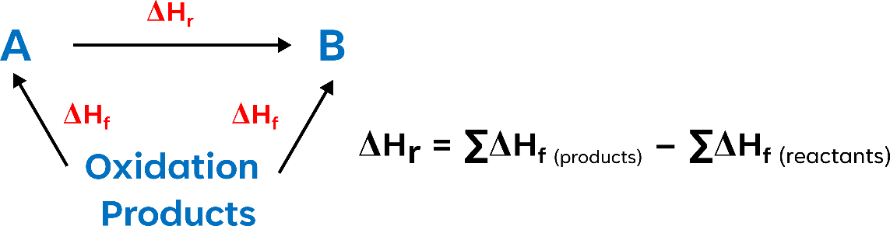

Enthalpy Cycles - calculating enthalpy changes
Formation
example
Calculate the standard enthalpy change for the following reaction, given that the standard enthalpies of formation of water, nitrogen dioxide and nitric acid are -286, +33 and -173 kJmol⁻¹ respectively. [oxygen's value is ZERO as it is an element]
2H₂O + 4NO₂ + O₂ → 4HNO₃
Applying Hess’s Law, ΔH₁ = ΔH₂ – ΔH₃
[(4 × -173)] – [(2 × -286) + (4 × 33)] = -252KJmol⁻¹
Combustion
example
Calculate the standard enthalpy change of formation of methane, given that the standard enthalpies of combustion of carbon, hydrogen and methane are -394, -286 and -890 kJmol⁻¹ respectively.
C + 2H₂ → CH₄
Applying Hess’s Law, ΔH₁ = ΔH₂ – ΔH₃
[(-394) + (2 × -286)] – [-890] = -74 Kjmol⁻¹

Slide 5
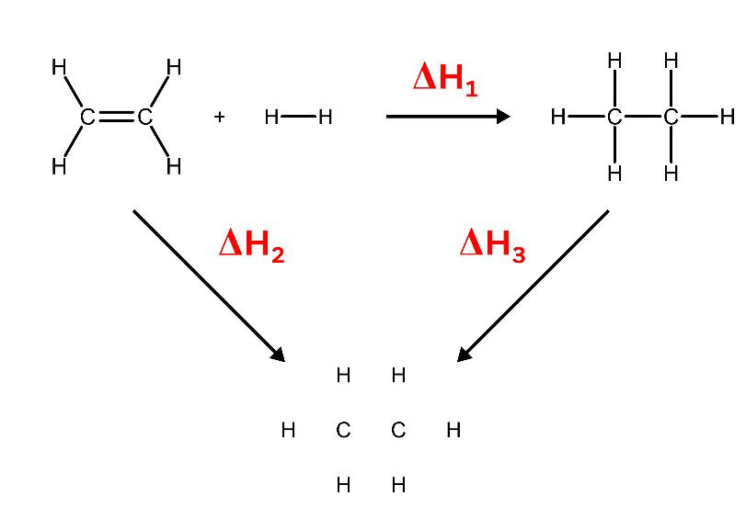
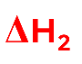

Bond Enthalpy
Bond Enthalpy (∆_{B}H) – The energy required to break one mole of a bond in a gaseous state, under standard conditions.
They can be used alongside Hess’s Law to find the overall enthalpy change for a reaction.
Mean Bond Enthalpy – The averaged, over many different molecules, energy required to break one mole of a bond in a gaseous state, under standard conditions.
Bond enthalpy can vary depending on the environment
Different covalent bonds require different amounts of energy to be broken. Values can be found experimentally using calorimetry methods.
Example
Calculate the enthalpy change for the hydrogenation of ethene
Breaking Bonds
Exothermic
Breaking Bonds
Endothermic
1 x C=C bond (611kJmol⁻¹) = 611
1 x H-H bond (436kJmol⁻¹) = 436
4 x C-H bonds (413kJmol⁻¹) = 1652
+
= 2699 KJmol⁻¹
1 x C-C bond (346kJmol⁻¹) = 346
6 x C-H bonds (413kJmol⁻¹) = 2478
+
= 2824 KJmol⁻¹
Applying Hess’s Law, ΔH₁ = ΔH₂ – ΔH₃
ΔH₁ = 2699 – 2824
= -125 KJmol⁻¹

