Slide 1
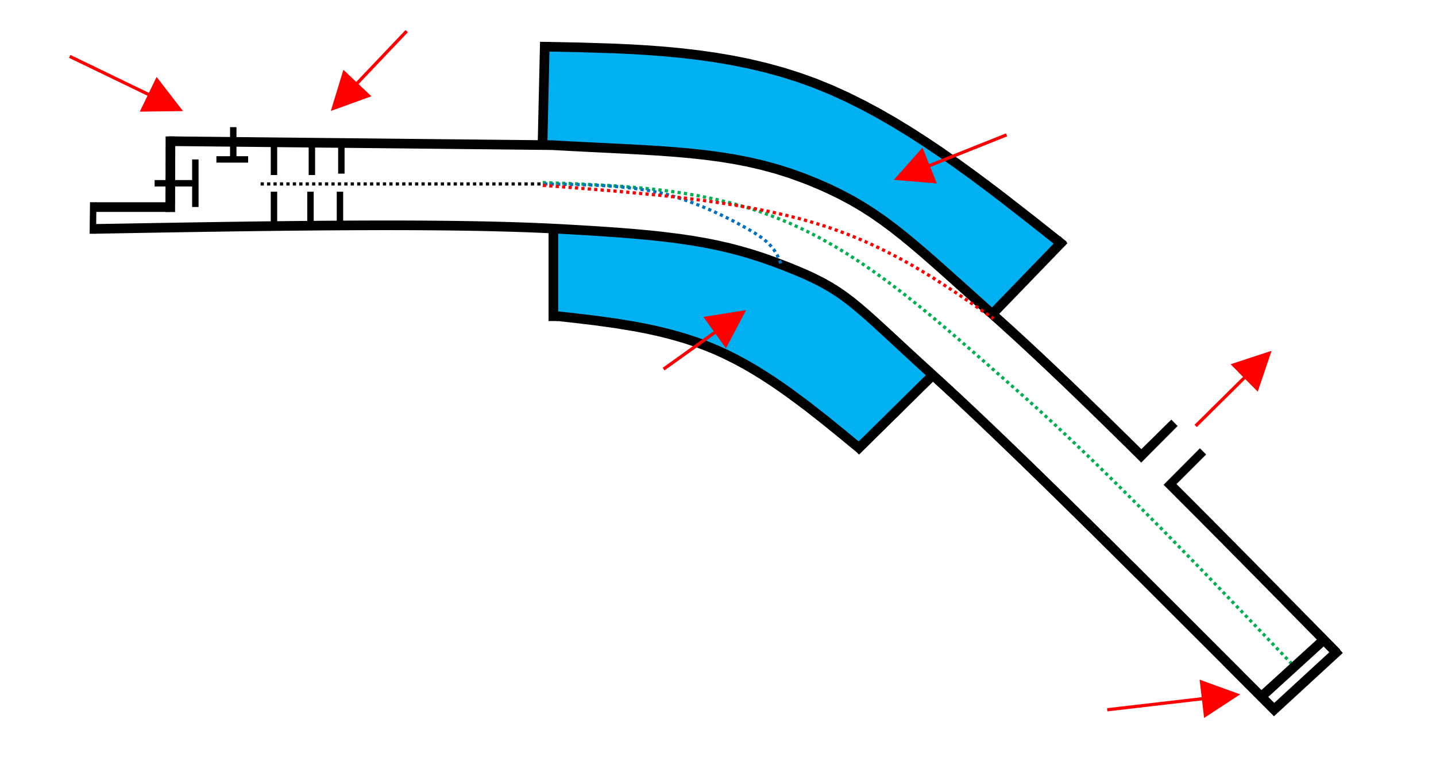
Topic 7
Modern Analytical Techniques I
[7A] Mass spectrometry
Vaporisation – The molecules are made into gases.
Ionisation – A High voltage is passed over the chamber, this bombards the atom making it a +1 changed ion.
Acceleration – The positively charged ions are now accelerated towards a negatively charged detection plate.
ionisation
acceleration
electromagnet
deflection
to vacuum pump
detection
Deflection – The Ions are then deflected by a magnetic field into a curved path. The radius of their path is dependent on the charge & mass of the ion.
Detection – When the positively charged ions hit the negatively charged detection plate, they gain an electron and produce a flow of charge.
In the mass spectrum, the heaviest ion (the one with the greatest m/z value) is likely to be the molecular ion, using this you can find the relative molecular mass of a particular specimen.
Chlorine Mass Spectra
relative
abundance
3:1
molecular Ion
peak
9:6:1
35 – ³⁵Cl
37 – ³⁷Cl
70 – ³⁵Cl₂
72 – ³⁵Cl–³⁷Cl
74 – ³⁷Cl₂
10
20
30
40
50
60
70
m/z
Bromine Mass Spectra
relative
abundance
1:2:1
79 – ⁷⁹Br
81 – ⁸¹Br
158 – ⁷⁹Br₂
160 – ⁷⁹Br – ⁸¹Br
162 – ⁸¹Br₂
1:1
80
100
120
140
160
180
m/z

Slide 2
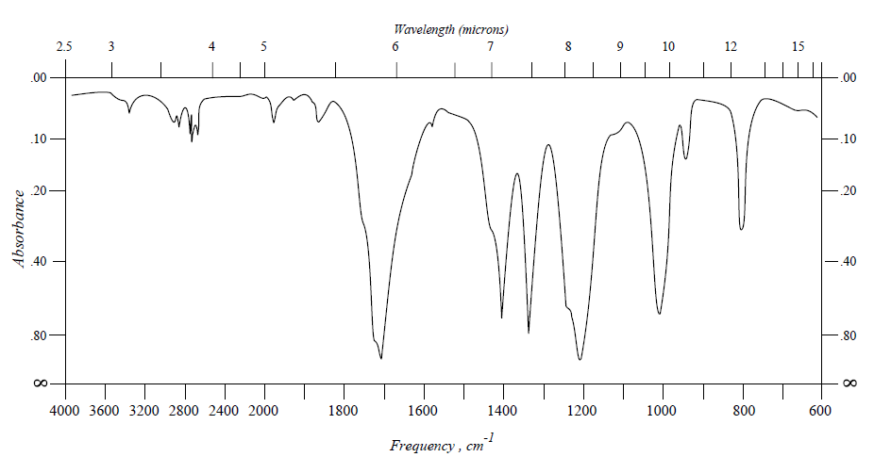
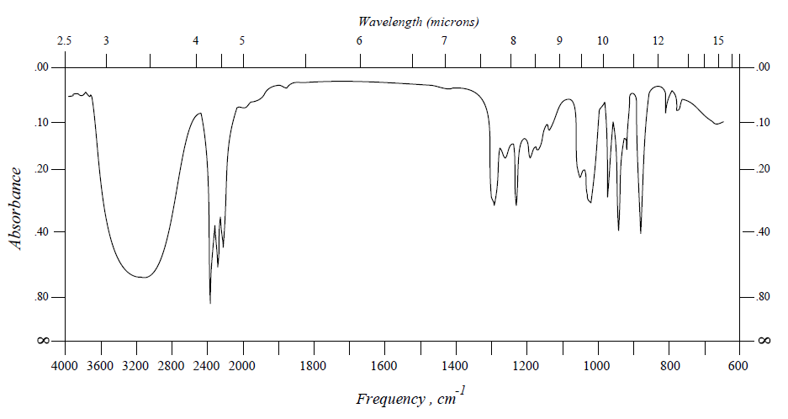
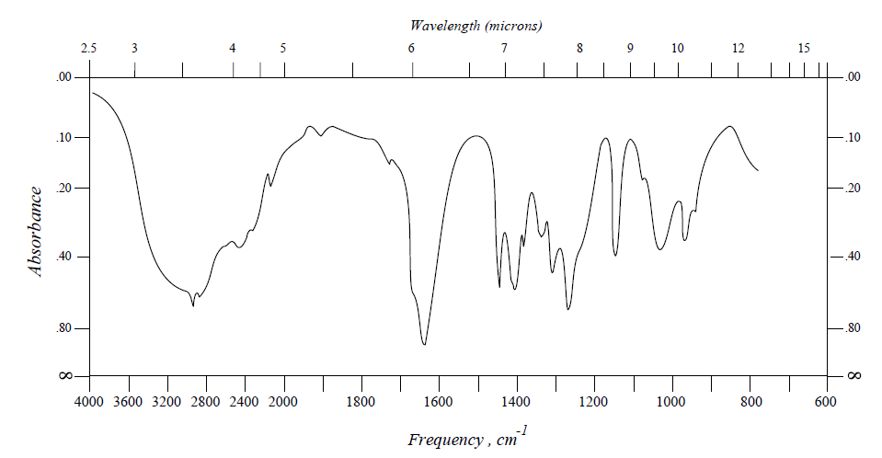
[7B] Infrared (IR) spectroscopy
This analytical technique used infrared (IR) radiation to determine the functional groups present in organic compounds. The IR radiation is passed through a sample where the different types of bonds absorb the radiation in different amounts due to bond length, strength and atomic mass. These varying amounts of absorbance are measured and recorded allowing certain bonds and therefore functional groups to be identified.
C=O | Sharp | ~1700
O-H (Alcohol) | Very Broad | ~3000-3400
O-H (Carboxylic Acid) | Very Broad | ~2500-3000

Slide 3
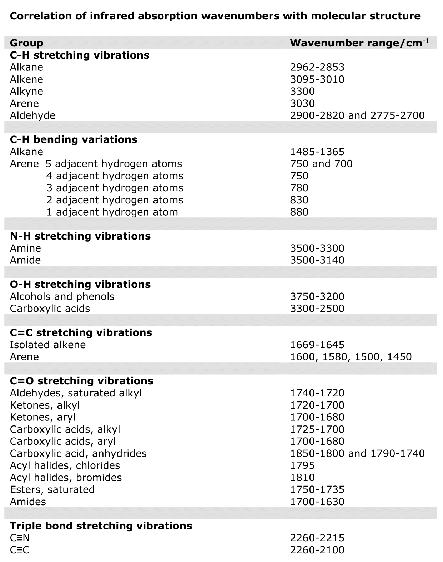
[7B] Infrared (IR) spectroscopy

