Slide 1
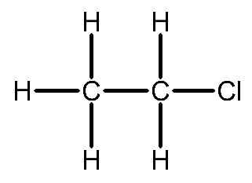
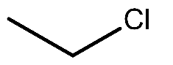
Topic 6
Organic Chemistry I
Hydrocarbon – A compound of hydrogen and carbon only
Organic molecules can be represented in multiple ways, these are the different ways to represent, chloroethane
Empirical Formulae – The simplest whole number ratio of atoms of each element in a compound
C₂H₅Cl
Molecular Formulae – The true number of atoms of each element in a compound.
C₂H₅Cl
General Formulae – All members of a homologous series follow a general formula.
Alkane – C_{n}H_{2n+2}
Structural Formulae – The structural arrangement of atoms within a molecule.
CH₃CH₂Cl
Displayed Formulae – Shows every atom and every bond in an organic compound.
Skeletal Formula:
Shows only the bonds in a compound and any non-carbon atoms.
Vertices are carbon atoms.
Hydrogen is assumed to be bonded to them unless stated otherwise.

Slide 2
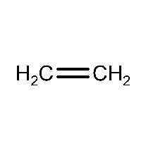
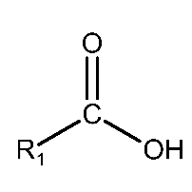
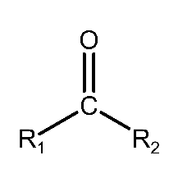
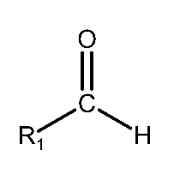
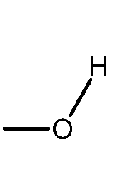
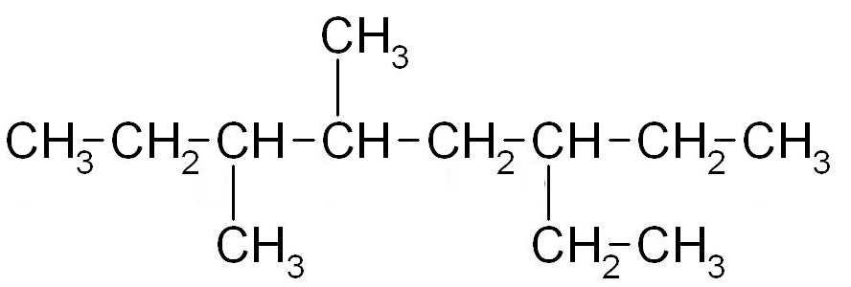
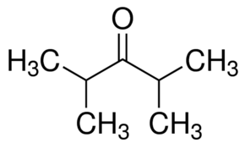
IUPAC Nomenclature (Naming Organic Compounds)
Homologous series – A family of compounds with the same functional group
Functional group – An atom or group of atoms that are responsible for chemical reactions
1 | Meth-
2 | Eth-
3 | Prop-
4 | But-
5 | Pent-
6 | Hex-
7 | Hept-
8 | Oct-
9 | Non-
10 | Dec
CH₃ | Methyl-
CH₂CH₃ | Ethyl-
CH₂CH₂CH₃ | Propyl-
Cl | Chloro-
F | Fluoro-
Br | Bromo-
I | Iodo-
C₆H₅ | Phenyl-
Alkanes | -ane
Alkenes | -ene
Carboxylic Acids | -oic acids
Ketone | -one
Aldehyde | -al
Alcohol | -ol
Naming Rules
Longest carbon chain
Identify attached groups
Designate the location
Assemble the name
Examples:
6-ethyl-3,4-dimethyloctane
2,4-dimethylpentan-3-one

Slide 3
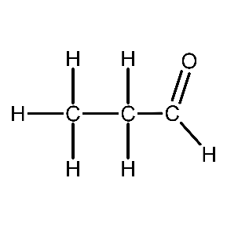
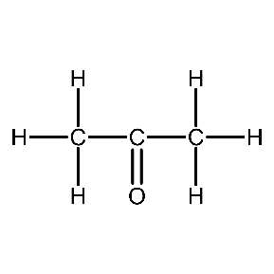
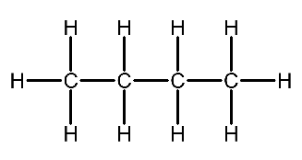
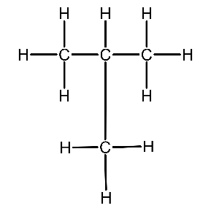
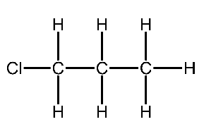
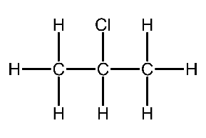
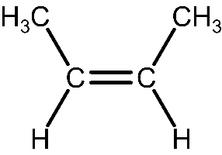
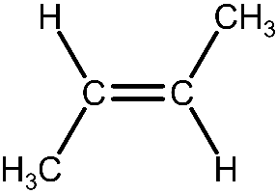
Isomerism
Structural Isomerism
Compounds with the same molecular formula but differing structural formulae
Functional Group Isomerism – Changing the functional group
Chain Isomerism – Changing the length of the longest chain
Point Isomerism – Moving the position of a group
Stereoisomerism
Compounds with the same structural and molecular formula but the atoms/groups are arranged differently in 3D due to the restriction of movement that caused by double bonds
Geometric Isomerism
Z / Cis | Groups are together
E / Trans | Groups are opposite
cis-2-butene
trans-2-butene
cis-trans isomerism, where two of the groups on each of the carbon double bonds are the same

Slide 4
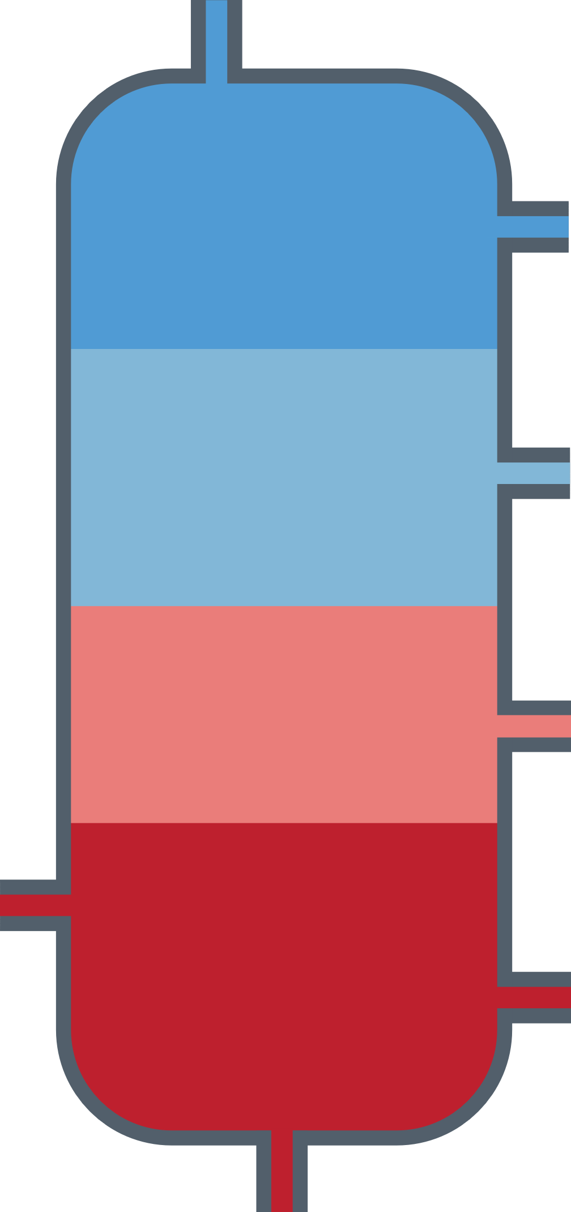
Processing Alkanes
Alkanes & Cycloalkanes are saturated hydrocarbons, they consist of singularly bonded carbon atom bonded to a maximum number of hydrogen atoms
C_{n}H_{2n+2}
Crude oil comes as a large mixture of different hydrocarbons
Alkane fuels are obtained from processing cure oil through:
Fractional distillation
Crude oil is vaporised (made gaseous) and fed into the fractioning column:
Short chains have lower boiling points, they rise higher up the column.
Longer chains have higher boiling points, they condense and are collected at the bottom of the fractionating column.
Gases
Small molecules
Fuel for domestic heating and cooking
Low boiling point
Very volatile
Flows easily
Ignites easily
Petrol
Fuel for cars
Kerosene
Fuel for aircraft
Diesel
crude oil
Fuel for some Cars
and trains
Large molecules
Fuel
High boiling point
Not very volatile
Doesn’t glow easily
Doesn’t Ignite easily
Fuel for ships and
power stations
Bitumen
Bitumen for roads
and roofs
Cracking
Different hydrocarbons are in great demand, with demand exceeding supply in some circumstances, the opposite being true also. Cracking is a way to convert longer chain into smaller more demanded ones. Smaller hydrocarbons are also more useful in the synthesis of polymers.
Thermal Cracking
Catalytic Cracking
This method produces a high proportion of alkanes and alkenes. High temperatures around 1200 K and pressures around 7000 kPa are used to crack the carbon chains.
This method produces aromatic compounds with carbon rings. Lower temperatures around 720 K are used along with normal pressure, but a zeolite catalyst is also used to compensate these less harsh conditions
Reforming
The processing of straight-chain hydrocarbons into branched-chain alkanes and cyclic hydrocarbons for efficient combustion.

Slide 5
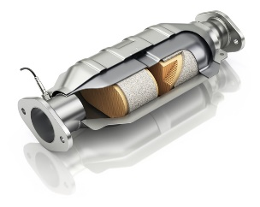
Combustion of Alkanes
Alkanes make good fuels as they release a lot of energy when burned but they often contain pollutants, and the products are environmentally damaging. Additionally, as the Alkanes are derived from crude oil, they are a finite resource.
Pollutants from the burning of alkanes
Incomplete Combustion (Hydrocarbon fuel + oxygen → carbon monoxide + water)
Produces carbon monoxide – a colourless and odourless gas which, if breathed in, prevents haemoglobin fixing oxygen to red blood cells.
Carbon particulates are also released – annoying sot that can damage appliances
Most fuels may also contain some sulfur and nitrogen. When the fuels are burnt in oxygen, the sulfur/nitrogen can react to form sulfur/nitrogen dioxide.
When sulfur/nitrogen dioxide dissolves in rainwater is becomes acid rain which:
Damages buildings and statues (made of limestone)
Reduces the growth of or kill trees and crops
Lowers the pH of water in lakes, killing fish
These gaseous products can be removed from systems using a catalytic converter. This uses a rhodium catalyst to convert harmful products into more stable products such as CO₂ or H₂O.
HC, CO, NO_{x}
N₂,
H₂O, CO₂
Biofuels
Biodiesel – An alternative fuel that can be made from the waste of vegetable oil or from seeds, I can be used in diesel engines either neat or mixed with diesel. During combustion, it releases significantly less CO₂ than diesel and less of the toxins associated with typical fuels (SO₂/NO₂)
Bioethanol – An alternative fuel that can be made from the fermentation of sugars, coming from corn, wheat, straw, and sawdust.
It is a replacement for petrol.

Slide 6
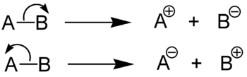

Free radical substitution
Radical – A species with an unpaired electron, formed by the homolytic fission of a covalent bond
Heterolytic fission
Homolytic fission
Free radical substitution
reaction of alkanes with halogens
Alkanes react with halogens in the presence of UV light to produce halogenoalkanes.
CH₄ + Cl₂ → CH₃Cl + HCl
The Mechanism
Initiation – UV breaks down chlorine into chlorine radicals
Cl₂ → 2Cl•
Propagation – These reactions keep the chain going
CH₄ + Cl• → CH₃• + HCl
CH₃• + Cl₂ → CH₃Cl + Cl•
Termination – Free radical are removed from the system
2Cl• → Cl₂
CH₃• → CH₃Cl
CH₃• + CH₃• → CH₃CH₃
Disadvantages
You have no control over the degree of substitution, varying products means lower yield
Required UV light
Substitutions may occur at different positions

Slide 7
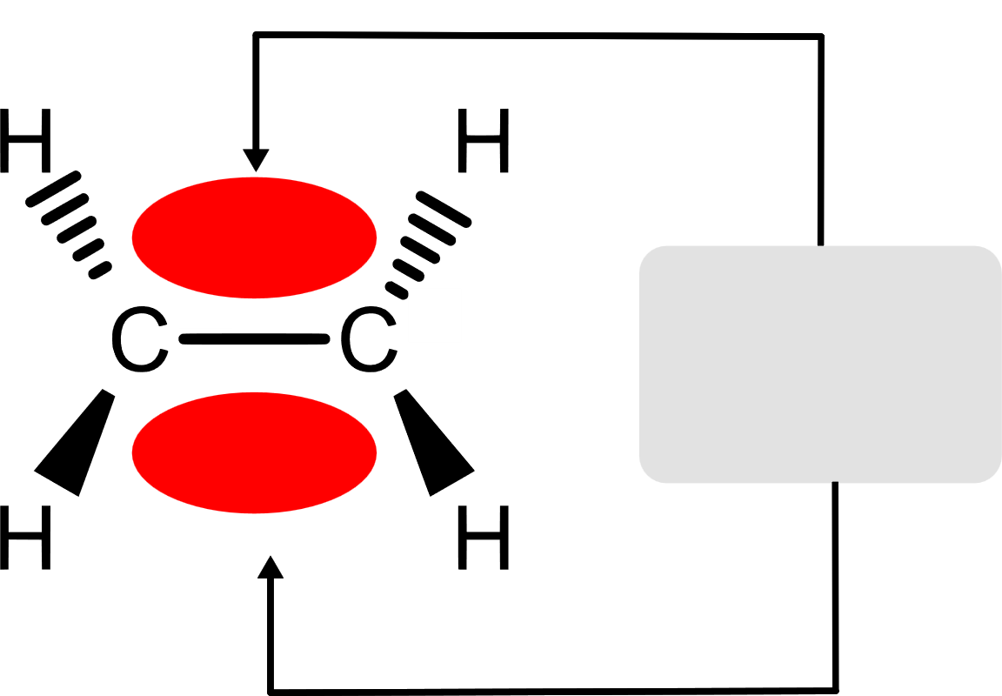
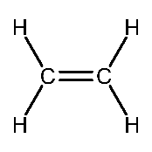
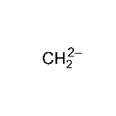
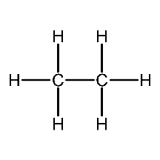
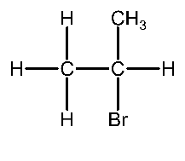
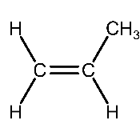
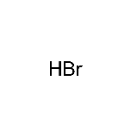
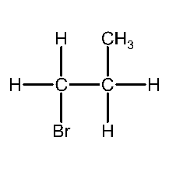
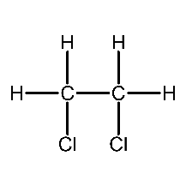

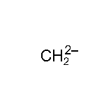
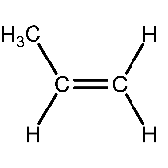
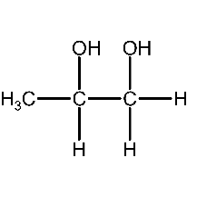
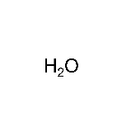
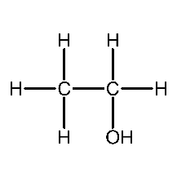
[6C] Alkenes
Alkenes and cycloalkenes are unsaturated hydrocarbons (They have C=C)
C_{n}H_{2n}
A carbon double bond is an area of high electron density making it attract electrophiles.
It’s sigma (σ) bond – head on overlap of orbitals
And a π bond – sideways overlap of p-orbitals
pi bond
(two lobes)
Bromine water is used to identify this double bond and other unsaturated compounds. It turns from orange-brown to colourless if a double bond is present in the substance.
Electrophilic Additions Reactions
Electrophile – Electron pair acceptor
Hydrogenation
Halidation
adding a hydrogen halide
+
nickel catalyst
Halogenation
+
+
Dihydroxylation
Hydration
KMnO₄
cold NaOH
+
+H₂O + [O]
purple colourless

Slide 8
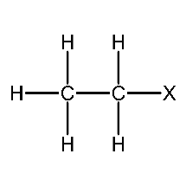
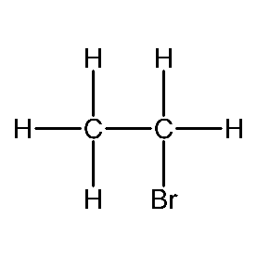
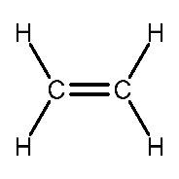
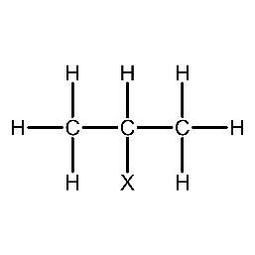
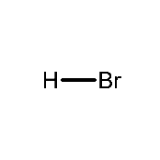
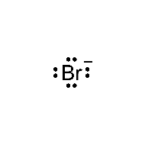
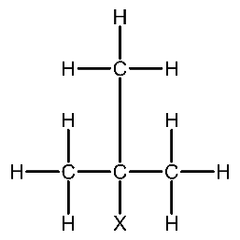
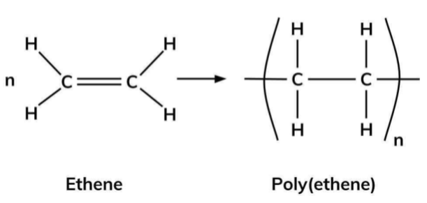
[6C] Alkenes
Electrophilic Additions Mechanism
Primary
+
Secondary
Tertiary
The halogen will prefer the carbon with the most alkyl groups attached as the carbocation is more stable
Addition polymerisation
Waste polymers can be separated into specific types of polymer for:
Recycling
Incineration to release energy
Used as a feedstock for cracking
Chemists limit the problems caused by polymer disposal by:
Developing biodegradable polymers
Removing toxic waste gases caused by incineration of plastics

Slide 9
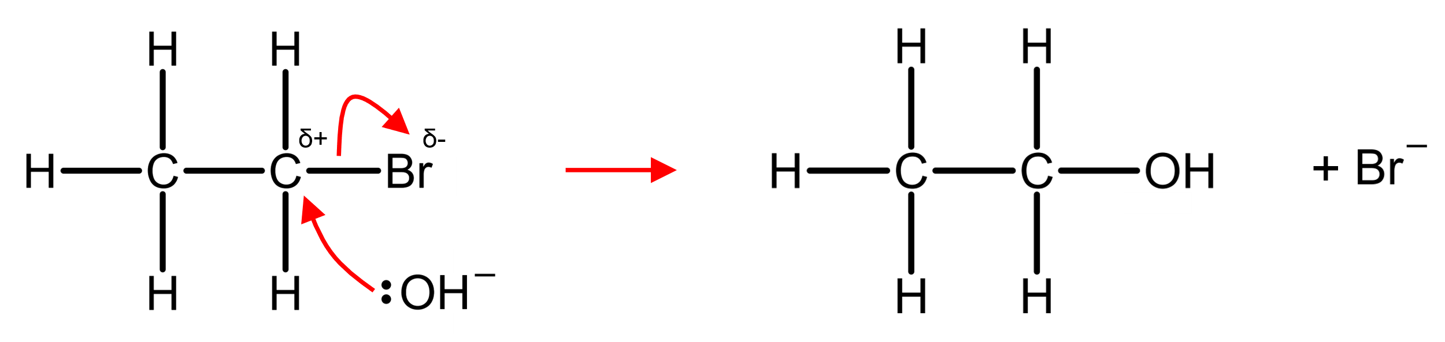
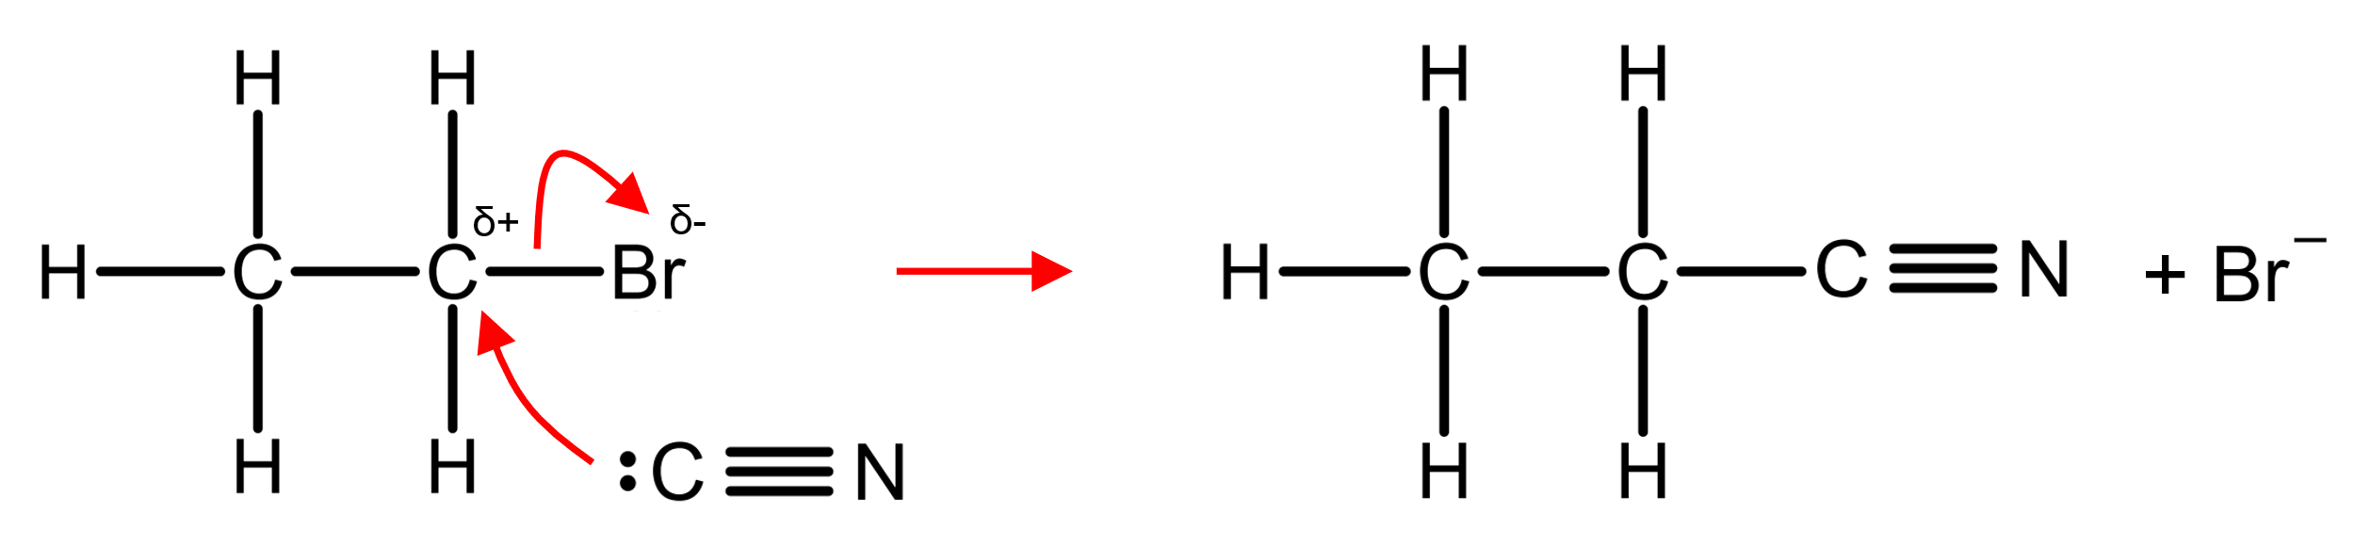
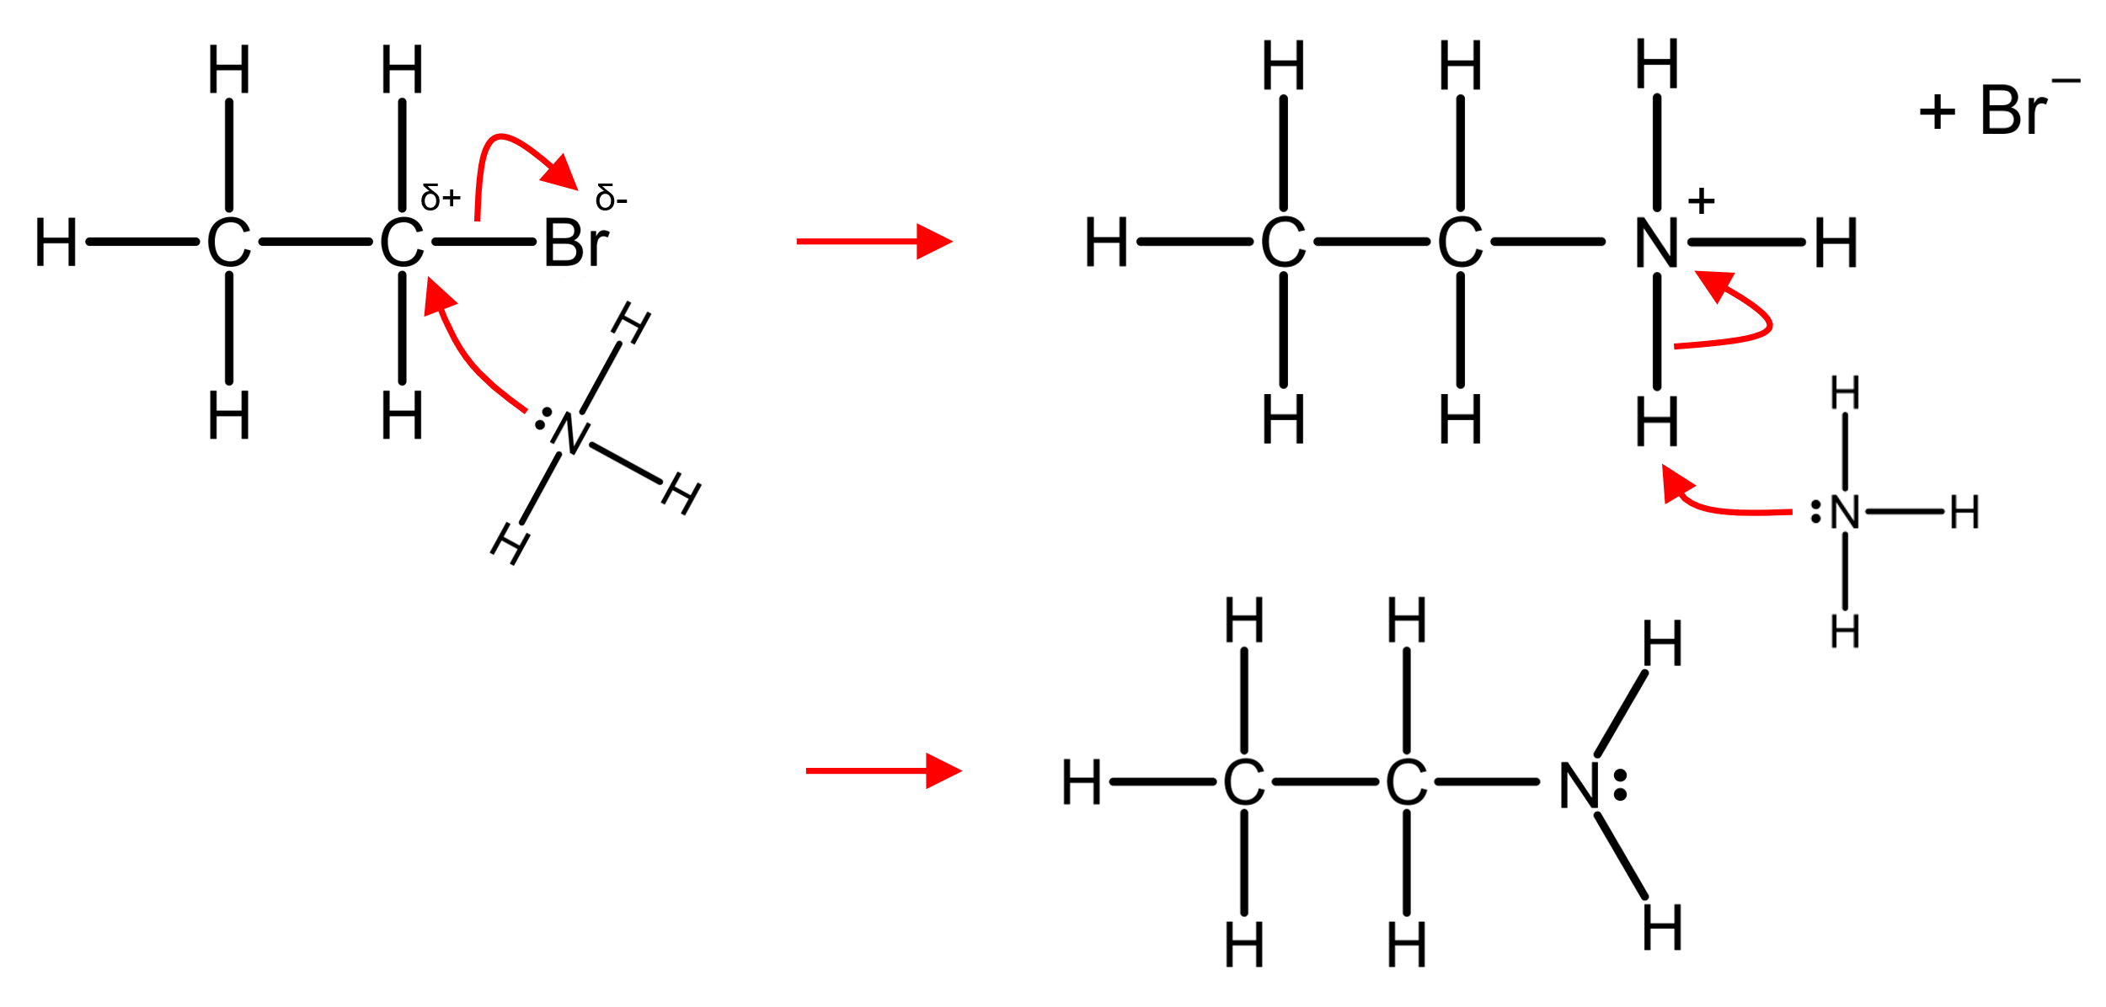
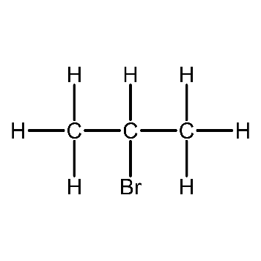
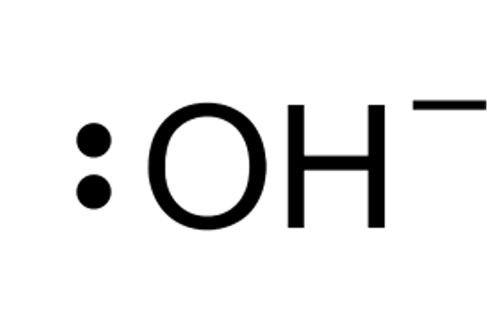
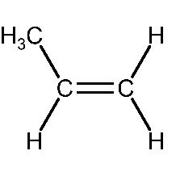
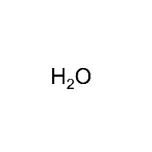
[6D] Halogenoalkanes
Nucleophilic Substitution
Nucleophile – Electron pair donor (OH⁻, CN⁻, NH₃)
Aqueous potassium hydroxide (OH⁻)
Potassium cyanide to produce nitriles (:CN⁻)
Ammonia to produce primary amines (:NH₃)
Nucleophilic Elimination
Elimination – When a halogenoalkane is heated to high temperatures under alcoholic conditions, elimination occurs. The nucleophile acts as a base and accepts a proton, removing a hydrogen atom from the molecule.
Ethanoic potassium hydroxide to produce alkenes (:OH⁻)
+

Slide 10
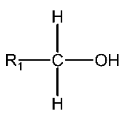






[6E] Alcohols
Combustion
C₂H₅OH + 3O₂ → 2CO₂ + 3H₂O
Alcohol to halogenoalkane
primary
secondary
tertiary
Chlorination
Using PCl₅ (white solid)
It’s a very vigorous reaction at room temp and doesn’t require heat
+ PCl₅
+ POCl₃ + HCl
Bromination
50% Concentrated sulphuric acid (H₂SO₄) is added slowly with lots of shaking and cooling to some ethanol in a flask.
Care must be taken because a great deal of heat is produced when the two are mixed, and there is a real risk of the ethanol boiling and spraying concentrated sulphuric acid around.
Solid potassium bromide (KBr) is then added to the mixture, and the flask is connected to a condenser so that the bromoethane formed can be distilled off.
H₂SO₄ + KBr → KHSO₄ + HBr
+ HBr
+ H₂O
Iodination
Red Phosphorus, Iodine and alcohol is heated under reflux to produce iodoalkanes
2P + 3I₂ → 2PI₃
+ PI₃
+ H₃PO₃
(Phosphorous acid)

Slide 11






Oxidation of Alcohols
potassium dichromate(VI) [K₂Cr₂O₇] in dilute sulfuric acid is the reagent
Aldehydes
When a primary alcohol is oxidised, it becomes an aldehyde.
Reflux is used to ensure that the reaction is incomplete, forming the aldehyde rather than the carboxylic acid.
+ [O]
+ H₂O
Carboxylic Acids
reaction
mixture
When a primary alcohol is oxidised, it becomes an aldehyde.
Heating under reflex is used to ensure that the reaction is complete, forming the carboxylic acid.
alcohol
+ [O]
Secondary Alcohols to Ketones
[O] oxidising agent
When a secondary alcohol is oxidised, it becomes a ketone
aldehyde
+ [O]
Tests For Aldehydes
The presence of hydrogens in aldehydes makes them strong reducing agents
Benedict’s/Fehling’s
Solution
complexed copper(II) ions in an alkaline solution
Ketone: no change
Aldehyde: Blue → Dark Red (ppt)
+ H₂O
If oxidation occurs, the orange solution containing the dichromate(VI) ions is reduced to a green solution containing chromium(III) ions.
1° & 2° alcohols become green
3° remains orange

Slide 12




[6E] Alcohols
Dehydration to alkenes
An alcohol is heated with concentrated phosphoric acid.
The OH⁻ group and the H⁺ group are removed to form water (dehydration) and a C=C is formed adjacent
+ H₂O
or
+ H₂O
The preparation and purification of liquid organic compounds
Heating under reflux
Heating a solution with an attached condenser to prevent reagents from escaping. Any vapor will condense on the cool surface of the attached condenser and flow back into the flask.
Solvent Extraction
reaction
mixture
Using a solvent to remove the desired product from a mixture.
Place the reaction in a separating funnel, then add the solvent (it should form a separate layer)
Place a stopper in the neck of the funnel and shake gently
Allow settlement into 2 layers
Remove the stopper and allow the lower layer to drain into the flask, then pour the upper layer into a separate flask.
Simple distillation can then be used to separate the desired product from the solvent.

Slide 13

The preparation and purification of liquid organic compounds
Distillation
Heating a solution with an attached condenser
The liquid with the lowest temperature will evaporate first, passed into the condenser to cool and is collected as liquid separately.
A thermometer is used to monitor the temperature of the vapour:
  If the temperature remains steady, the one compound is distilling over
  If the temperature begins to rise, a different compound is distilling over.
reaction
mixture
distillate
Drying with an Anhydrous Salt
A liquid organic product can be dissolved in water, so water may be an impurity that needs to be removed by a drying agent.
The drying slat is added to the organic liquid and the mixture is shaken before being left
The drying agent turns form a powder to a crystal after absorbing water
If a bit more drying agent is added, and it remains powdery; the liquid is dry
The drying agent is removed by filtration or decantation (pouring the liquid off the solid drying agent)
Anhydrous salts (Ca/Mg/NaSO₄) are drying salts.
Testing Purity
Boiling temperature determination
The boiling point of pure organic compounds can be carefully measured and are available online. Meaning the boiling point of your organic compound and cross-referencing it with online databases can determine whether a compound is pure.

