Slide 1
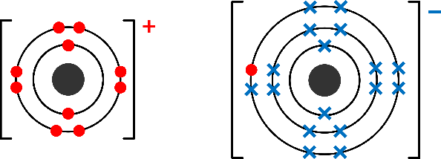
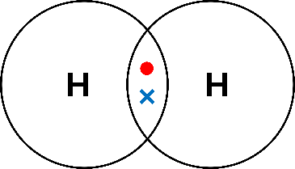
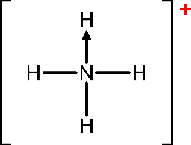
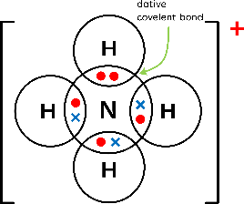
Topic 2
Bonding and Structure
Ionic Bonding
the strong electrostatic attraction between oppositely charged ions
It occurs between a metal and a non-metal. Electrons are transferred from the metal to the non-metal to achieve full outer shells, forming change ions. Oppositely charged ions attract through electrostatic attraction to form an ionic lattice.
Factors that affect the strength of an ionic bond:
Ionic Radius
Ionic Charge
Trends Down a Group – As ionic radii increases and ionic charge decreases, they are also isoelectric as the outermost shell has the same configuration
Trends Across a Row – As ionic charge increases, ionic radii decreases.
Covalent Bonds
the strong electrostatic attraction between two nuclei and the shared pair of electrons between them
Covalent bonds form between two non-metals. Electrons are shared between the two outer shells in order to achieve a full outer shell. Multiple electron pairs can be shared.
Dative (or co-ordinate) bonds form when both electrons in the shared pair are supplied from a single atom. →
As bond length increases, bond strength decreases
Metallic Bonding – The strong electrostatic attraction between metal ions and the delocalised electrons

Slide 2
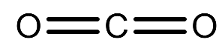
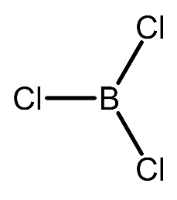
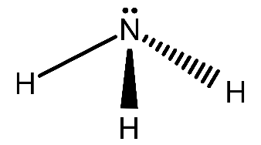
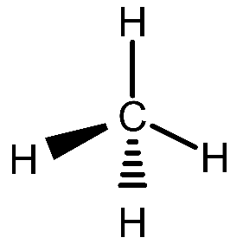
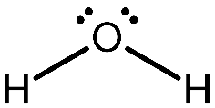
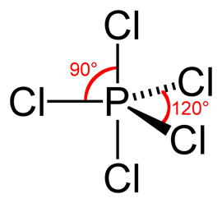
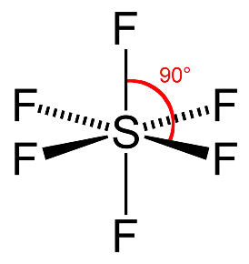
Molecular Shapes
Name | BP | LP | Bond Angle | Example
Linear | 2 | 0 | 180
Trigonal Planar | 3 | 0 | 120
Trigonal Pyramidal | 3 | 1 | 107
Tetrahedral | 4 | 0 | 109.5
Bent | 2 | 2 | 104.5
Trigonal Bipyramid | 5 | 0 | 90 120
Octahedral | 6 | 0 | 90

Slide 3
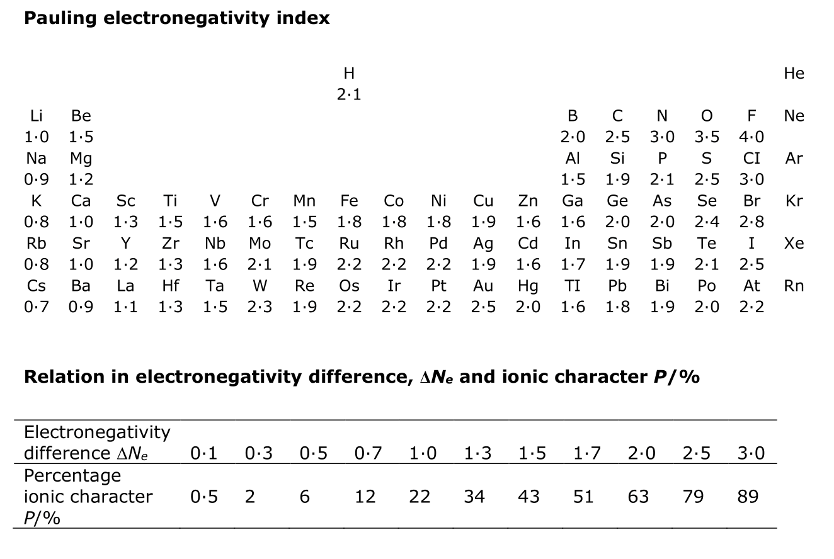
Molecular Shapes
What determines shape
The number of lone pairs
The number of bonding pairs
Molecules try to achieve:
Minimum Repulsion, Maximum Separation
Order of Repulsion Strength
Lone Pair – Lone Pair
Lone Pair – Bonding Pair
Bonding Pair – Bonding Pair
Electronegativity
The ability of an atom to attract the bonding electrons in a covalent bond
Ionic and Covalent bonding are the extremes of a continuum of bonding type and that electronegativity differences lead to bond polarity in bonds and molecules
Molecules are polar or non-polar depending on the electronegativity of the atoms, represented as δ+ or δ-

Slide 4
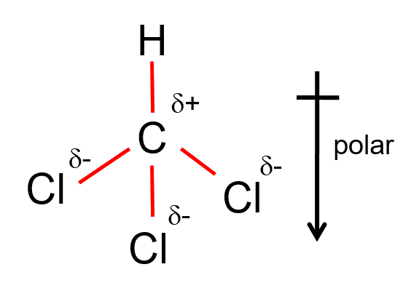
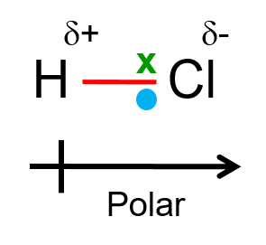
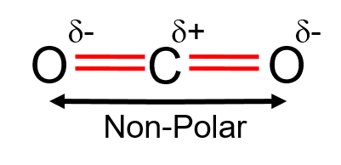
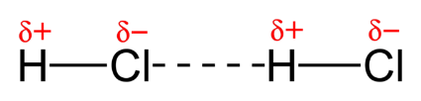
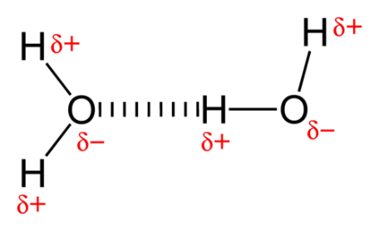
Bonding
Polarity
Molecules are polar or non-polar depending on the electronegativity of the atoms, represented as δ+ or δ-
Whether a molecule has a permanent dipole depends upon its shape and the polarity of its bonds
If the polar bonds point in the same direction (net polarity), then the molecule will be polar
Examples
Intermolecular Forces
Intermolecular forces are weak electrostatic forces of attraction between neighboring molecules. They are all much weaker than covalent, ionic or metallic bonding. There are 3 main forces.
London Dispersion Forces
instantaneous dipole-induced dipole
Every molecule has London dispersion forces (LDF).
As electron number increases LDF increases, therefore boiling point.
Molecules have a random chance of becoming polar forming an instantaneous dipole. This polarity has a knock-on effect causing other molecules to become polar due to charge repulsion, induced dipoles.
Permanent Dipoles
dipole-dipole
If a molecules is polar, dipole-dipole attraction can occur.
As all molecules have LDF, they are in addition to that.
Hydrogen Bonding
H-Bonds on occur if:
  Nitrogen, Oxygen, and Fluorine with a lone pair
  A molecule is polar with
    O-H, N-H, & H-F
Is the strongest of all the intermolecular forces

Slide 5
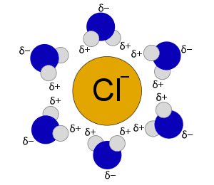
Intermolecular Forces
Water has anomalous properties, all caused by hydrogen bonding
High melting/Boiling point - due to the strong hydrogen bonds
H bonds result in ice having a much lower density than liquid water as they hold the molecules in a rigid structure with lots of air gaps.
Trends in Properties
As the length of an alkane chain increases, the boiling point increases, there are more points of contact with each adjacent molecule, stronger LDF’s.
A straight chain alkane will have a boiling point higher than a branched chain because of the greater surface area in contact with other molecules.
Alcohols can form hydrogen bonds as well as LDF’s, thus higher boiling temperatures as compared to alkanes with a similar number of electrons.
An increase in boiling temperature from HF to HI, as the increasing atomic size means more LDF’s BUT for HCl has dipole-dipole interactions and HF can form hydrogen bonds.
Solvents
Polar things dissolve polar things, non-polar things dissolve non-polar things
Dissolving substances
The solute particles must be separated from each other and surrounded by solvent particles (hydration)
The forces of attraction between the solute and the solvent particles must be stronger than the solute-solute and solvent-solvent particle attraction.
Hydration – The lattice of ions if first broken up, before the polar water molecules surround the ion, forming a ring around it, this is an ion-dipole interaction. Hydration Energy is released.
Alcohols have the O-H group and therefore can form Hydrogen bonds with water. The solubility of alcohols decrease with the increase in chain length.
Compound that cannot form H-Bonds – The attraction between the alkane and the water is not enough to break the hydrogen bonds between the water molecules.
Non-Aqueous Substances – Polar things dissolve polar things; non-polar things dissolve non-polar things.

Slide 6
Structure Summary
Ionic | Simple Molecular
Metals and non-metals Formed by the loss and gain of electrons to produce oppositely charged ions that attract one another Billions of ions held together in a lattice of oppositely charged ions High melting/boiling points The electrostatic forces holding the ionic lattice together are strong Many are soluble in water Water can hydrate the separated ions Conduct electricity when liquid but not when solid The ions are free to move Brittle When the layers of alternating charges are distorted, like charges repel, breaking apart the lattice into fragments | Non-metal molecules Formed when covalent bonds share electrons Held together by LDF and Dipole-Dipole interactions Low melting/Boiling Points The intermolecular forces that hold them together are weak Some are soluble in water Polar molecules attach to water molecules. Nonpolar molecules are repelled by water and do not dissolve Does not conduct electricity There are no charged particles e.g., Iodine (I₂) & Ice (H₂O)
Metallic
In all metals the strong electrostatic attraction between metal ions and the delocalised electrons Billions of ions held together in a giant lattice of cation in sea' of delocalised electrons (the greater the group/ charge, the greater the attraction) High melting/boiling points The electrostatic forces of attraction between the cations and delocalised electrons are very strong Good conductor of electricity The electrons are free to move Malleable The layers of cations can slide over one another. The delocalised electrons prevent fragmentation as they can move around the lattice.
Giant Covalent & Allotropes of Carbon
Graphite Hexagonal layers of carbon atoms, each connected by covalent bonds. Between the layers there are LDF’s. Graphene Just one layer High melting/boiling points Covalent bonds are strong but due to the layers graphite is slightly lower Good conductor of electricity Freely moving electrons | Diamond 3D tetrahedral, where each carbon is covalently bonded to 4 others High melting/boiling points Covalent bonds must be broken Does not conduct electricity There are no electrons free to move and carry charge. Rigid 3D tetrahedral structure

