Slide 1
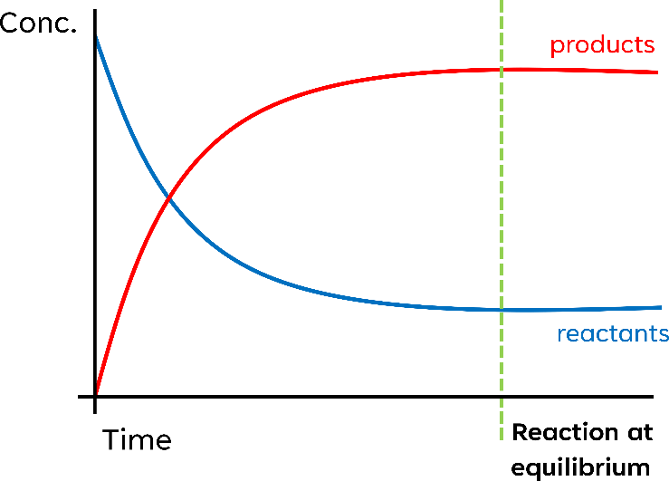
Topic 10
Equilibrium I
Dynamic Equilibrium – ‘A dynamic equilibrium exist in a closed system when the rate of the forward reaction is equal to the rate of reverse reaction and the concentration of the reactants and products do not change.’
Dynamic Equilibrium is reached when the products and reactant’s concentrations are equal
Equilibrium is only achievable if the reaction system is:
Closed
At a constant temperature and pressure
Le Chatelier’s Principle
If a reaction is already at equilibrium and conditions are then changed, the equilibrium position will shift in the direction which opposes the applied change
*equilibrium position moves to the left |  | Endothermic (∆H+) | Exothermic (∆H-)
Temperature | Increase | Moves* to the right | Moves to the left
 | Decrease | Moves to the left | Moves to the right
Reagent/ Concentration | Increase | Moves to the right
 | Decrease | Moves to the left
Pressure (only for gases) | Increase | Moves to the side with fewer gaseous molecules
 | Decrease | Moves to the side with more gaseous molecules
Catalysts | It will not change the equilibrium position but will increase the rate of reaction
1 mole of any gas will occupy the same volume

Slide 2
Industrial Process – The Haber Process
Typical Conditions
250 Atmospheres
450°C
With an iron catalyst
N₂ + 3H₂ ⇌ 2NH₃
Why isn’t a higher temperature used?
As the reaction is exothermic if the temperature is increased the equilibria position will move towards the left, lower yield BUT a greater rate of reaction due to greater energy ⇒ more collision ⇒ greater rate of reaction.
Why isn’t a lower temperature used?
As the reaction is exothermic if the temperature is decreased the equilibria position will move towards the right, higher yield BUT fewer collisions and thus a longer time is needed to react. Less energy ⇒ less collisions ⇒ lower rate of reaction.
Why isn’t a higher pressure used?
As a lot of energy is required to achieve high pressures
Why isn’t a lower pressure used?
As the product has less gaseous molecules, a decrease in pressure will favor the left-hand side, decreased yield.
Why is catalyst is used?
As they lower the activation energy ⇒ more successful collisions ⇒ greater rate of reaction.
Allows milder conditions (less temp/pressure)
A compromise is made in pressure and temperature to ensure high yields with an acceptable rate of reaction.

Slide 3
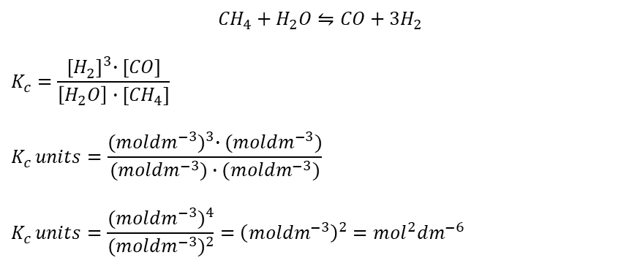
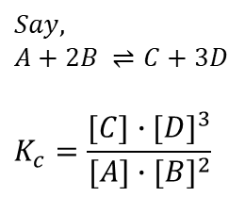
Equilibrium Concentrations
Equilibrium Constant (K_{c}) – indicates the position of equilibrium for a reaction at a certain temperature.
K_{c} for a reaction always has the same value unless the reaction conditions and therefore the position of equilibrium is changed.
aA + bB ⇌ cC + dD
$$Say,$$
$$A+2B ⇌C+3D$$
$$K_{c}=\frac{[C]∙{[D]}^{3}}{[A]∙{[B]}^{2}}$$
[C]^{c} ⋅ [D]^{d}
[ ] Denotes the equilibrium concentration in mol dm⁻³
K_{c} =
[A]ª ⋅ [B]^{b}
K_{c} is only affected by a change of temperature.
In Exothermic reactions – Increasing the temperature decreases the value of the equilibrium constant.
In Endothermic reactions – Increasing the temperature increases the value of the equilibrium constant.
If you increase the temperature, the position of equilibrium will move in such a way as to reduce the temperature again. It will do that by favouring the reaction which absorbs heat.
Example
Concentration, pressure and the addition of a catalyst doesn’t change K_{c}
Deriving the Units
$${CH}_{4}+H_{2}O⇋CO+3H_{2}$$
$$K_{c}=\frac{{[H_{2}^{ }]}^{3}∙[CO]}{\left[H_{2}O\right]∙[{CH}_{4}]}$$
$$K_{c }units=\frac{{({moldm}^{−3})}^{3}∙({moldm}^{−3})}{({moldm}^{−3})∙({moldm}^{−3})}$$
$$K_{c }units=\frac{{({moldm}^{−3})}^{4}}{{({moldm}^{−3})}^{2}}={\left({moldm}^{−3}\right)}^{2}={mol}^{2}{dm}^{−6}$$

Slide 4
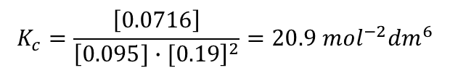
Example
CO(g) + 2H₂(g) ⇌ CH₃OH(g) | ∆H = −91 kJ mol⁻¹
0.200 mol of CO(g) and 0.400 mol of H₂(g) are mixed in a sealed container of volume 1.2 dm³ at a temperature of 500 K and a pressure of 100 atmospheres and allowed to reach equilibrium.
The equilibrium mixture is found to contain 0.086 mol of CH₃OH(g).
Calculate K_{c} for this reaction. Give your answer to an appropriate number of significant figures and state the units.
CO(g) + 2H₂(g) ⇌ CH₃OH(g)
I
0.2
0.4
0
C
-0.086
-0.086 × 2
+0.086
E
0.114
0.228
0.086
n = cv
1.2
1.2
1.2
=
0.095
0.19
~0.0716
$$K_{c}=\frac{\left[0.0716\right]}{{\left[0.095]∙[0.19\right]}^{2}}=20.9 {mol}^{−2}{dm}^{6}$$

