Slide 1
Year 1
AS
Topic 1
Atomic Structure and the Periodic Table
Proton | Neutron | Electron
+1 | 0 | -1
1 | 1 | 1/1800
electron
proton
electron
mass number
23
Na
atomic number
11
Isotopes – Atoms with the same number of protons but differing numbers of neutrons.
Relative Isotopic Mass – The mass of an individual atom of a particular isotope relative to 1/12 of the mass of an atom of carbon-12.
Relative Atomic Mass – The weighted mean mass of an atom of an element compared to 1/12 of the mass of carbon-12.
Relative Formula Mass Calculation
Mg(NO₃)₂
Mg = 24 x 1 = 24
N = 14 x 2 = 28
O = 16 x 6 = 96
= 148

Slide 2
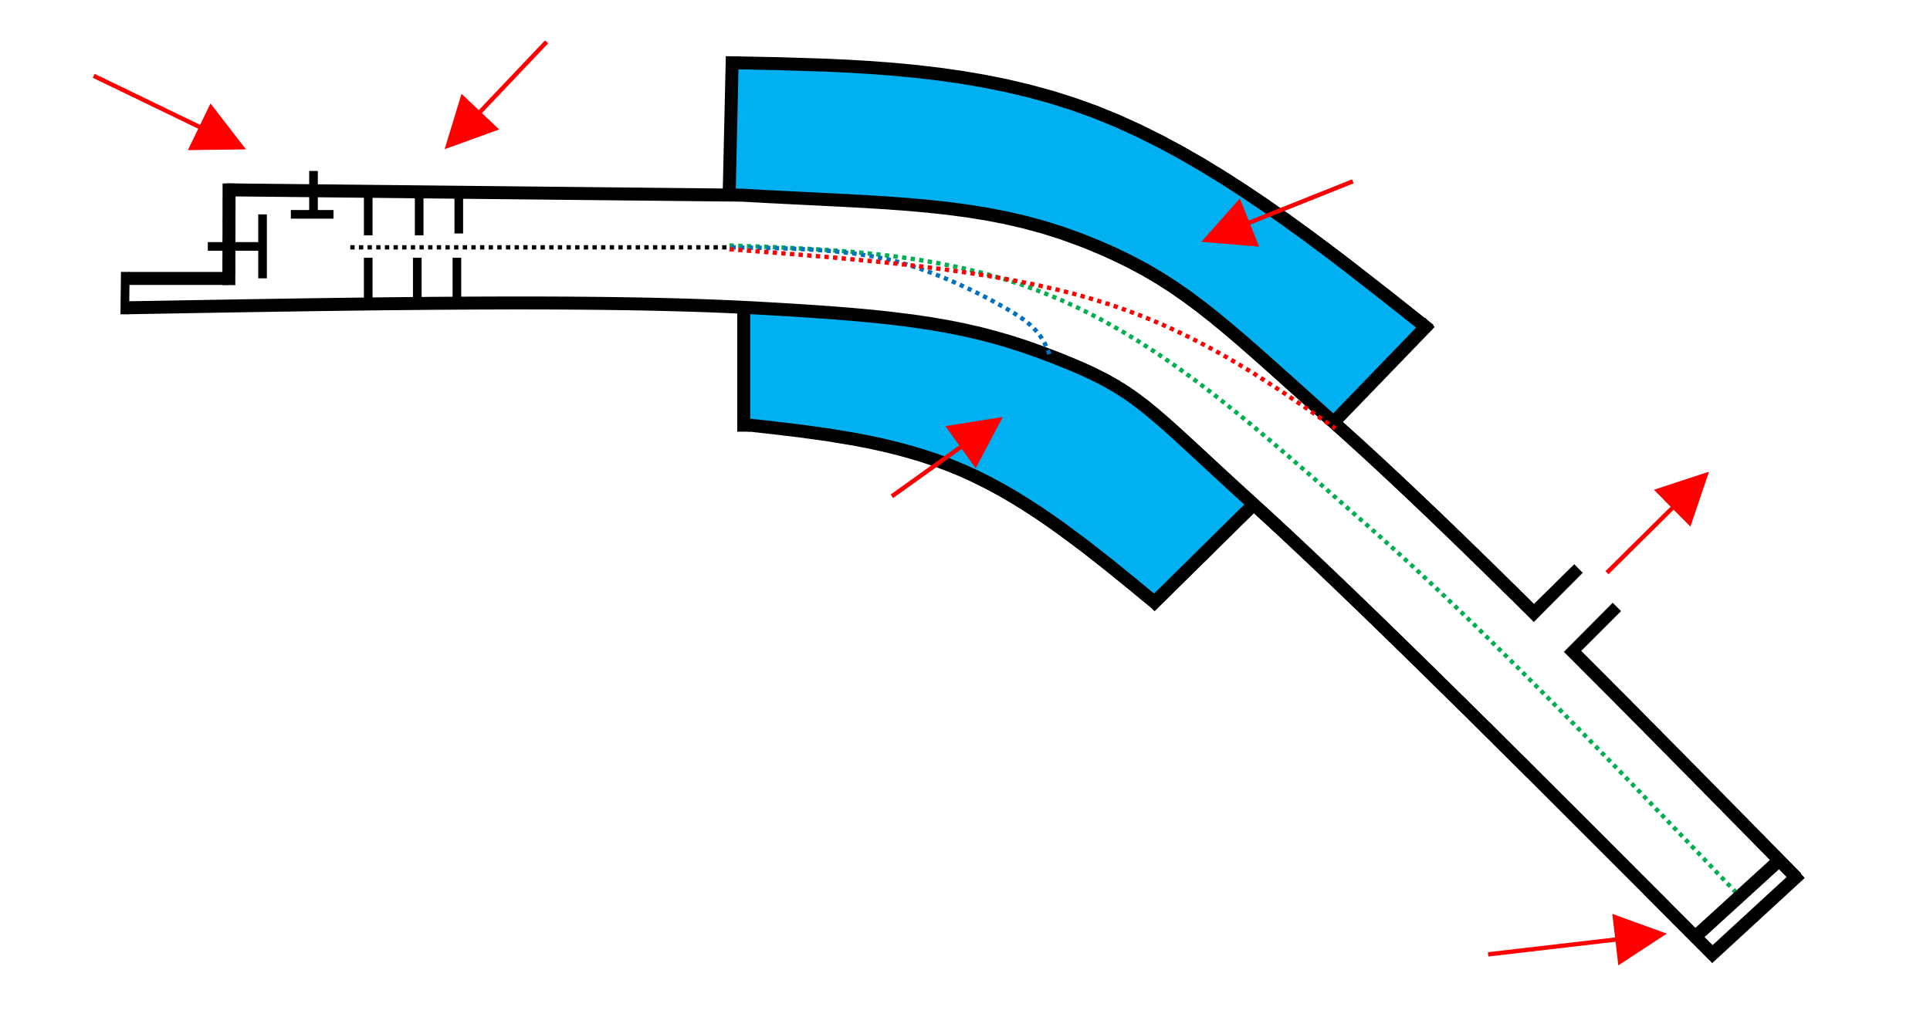
Mass Spectra
Vaporisation – The molecules are made into gases.
Ionisation – A High voltage is passed over the chamber, this bombards the atom making it a +1 changed ion.
Acceleration – The positively charged ions are now accelerated towards a negatively charged detection plate.
ionisation
acceleration
electromagnet
deflection
to vacuum pump
detection
Deflection – The Ions are then deflected by a magnetic field into a curved path. The radius of their path is dependent on the charge & mass of the ion.
Detection – When the positively charged ions hit the negatively charged detection plate, they gain an electron and produce a flow of charge.
Chlorine Mass Spectra
relative
abundance
3:1
molecular Ion
peak
9:6:1
35 – ³⁵Cl
37 – ³⁷Cl
70 – ³⁵Cl₂
72 – ³⁵Cl–³⁷Cl
74 – ³⁷Cl₂
10
20
30
40
50
60
70
m/z
Bromine Mass Spectra
relative
abundance
1:2:1
79 – ⁷⁹Br
81 – ⁸¹Br
158 – ⁷⁹Br₂
160 – ⁷⁹Br – ⁸¹Br
162 – ⁸¹Br₂
1:1
80
100
120
140
160
180
m/z

Slide 3
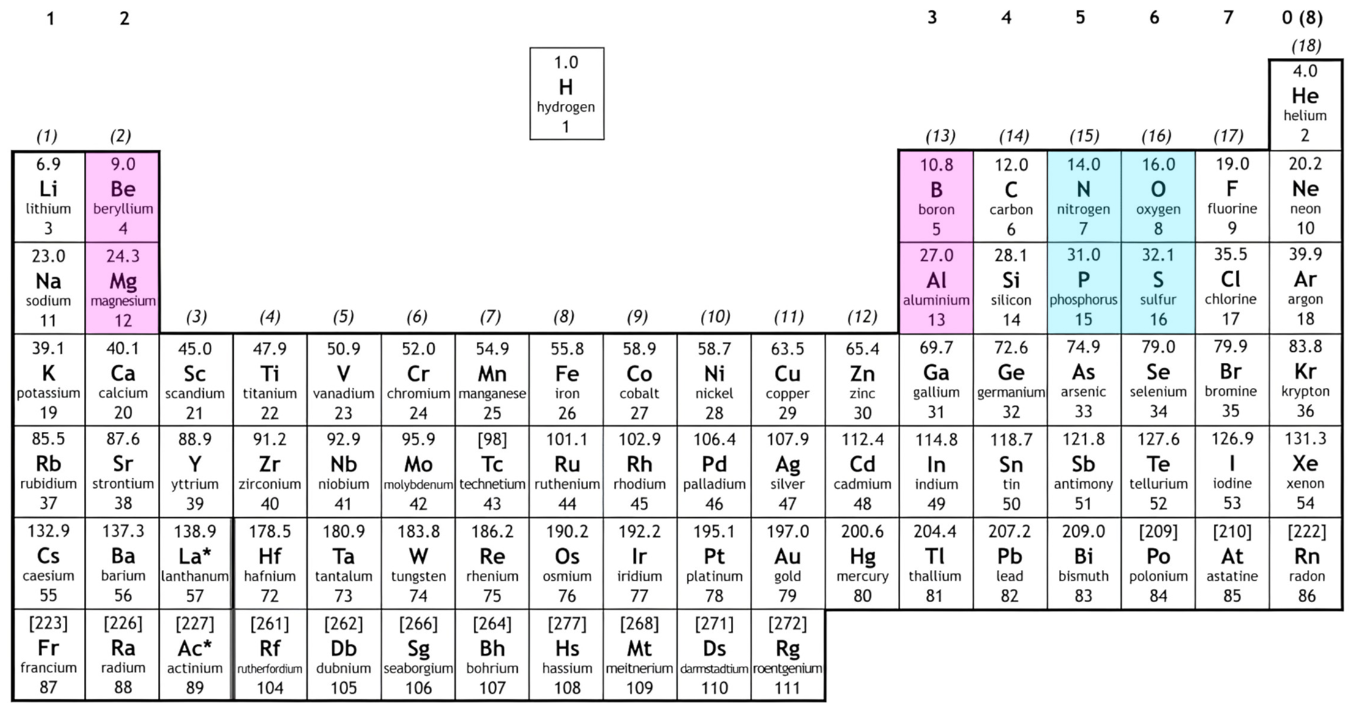
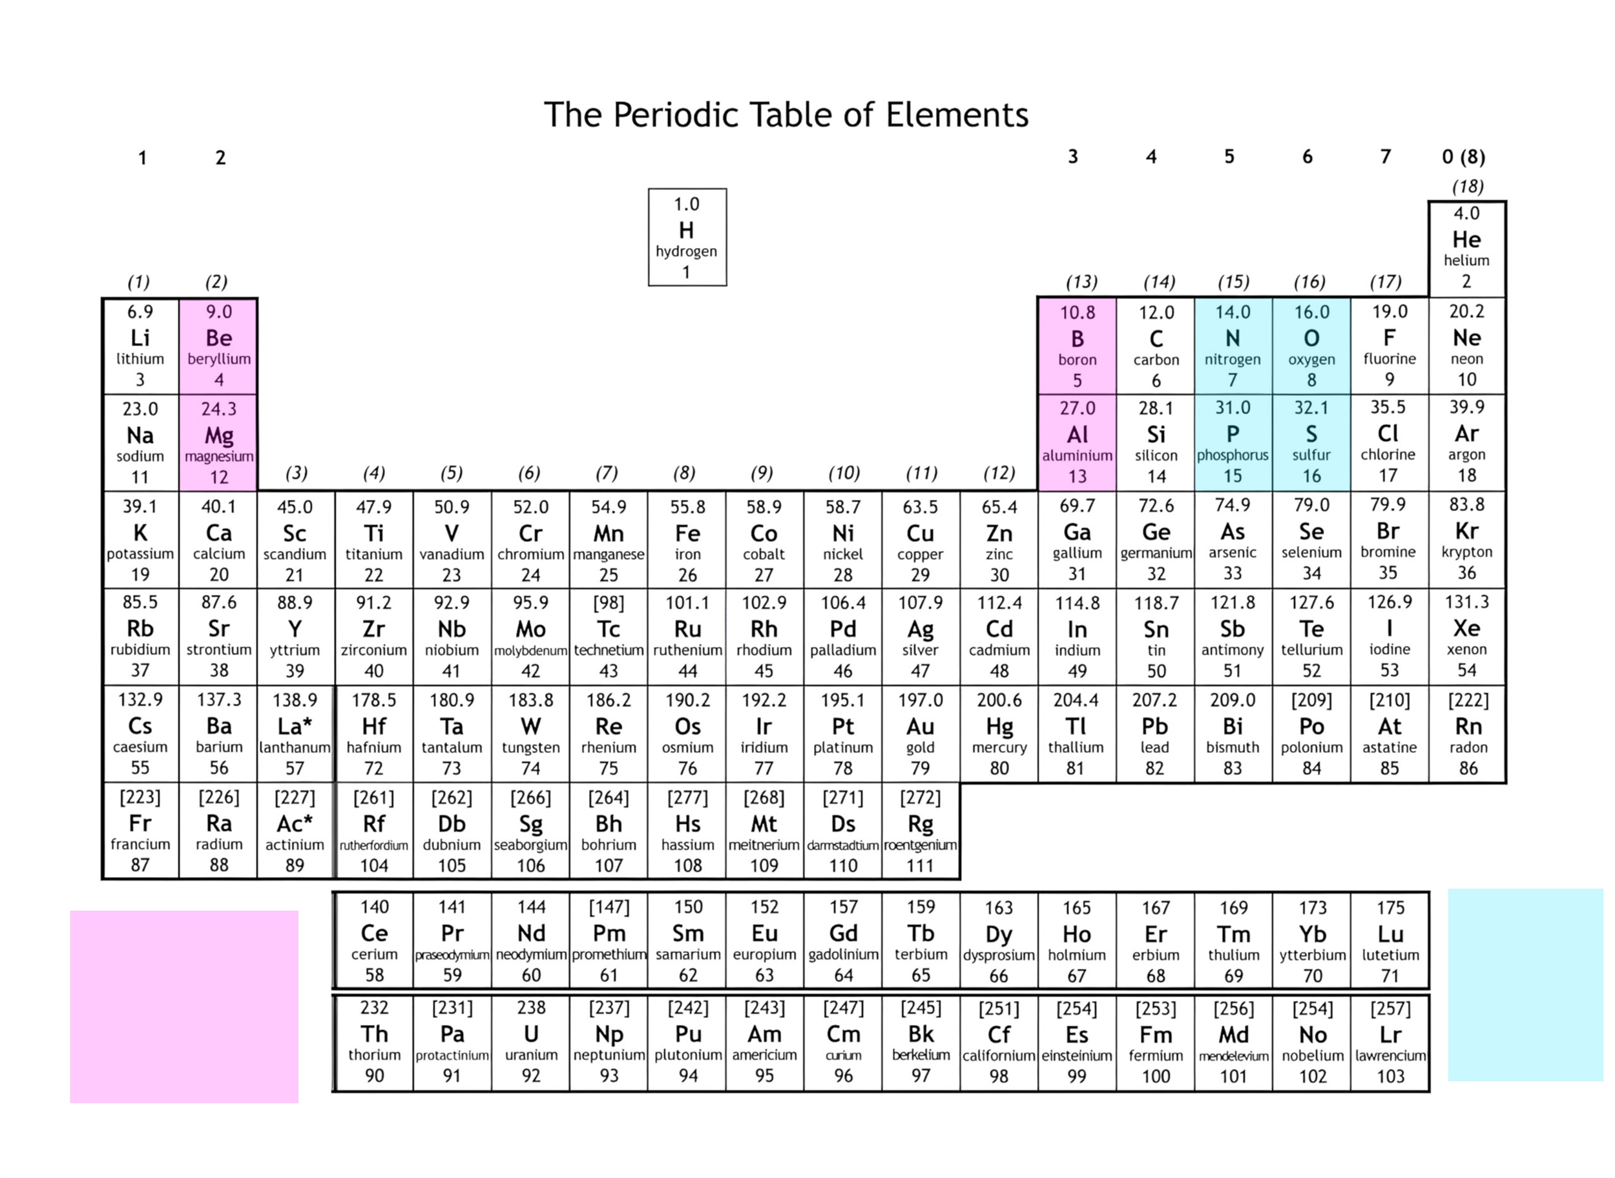
Ionisation Energies
First Ionisation Energy – The energy required to remove an electron from each atom in 1 mole of gaseous atoms to form 1 mole of gaseous 1+ ions
Mg_{(g)} → Mg_{(g)}⁺ + e⁻
Successive Ionisation Energies – The energy required to remove a x amounts of electrons from each atom in 1 mole of atoms in gaseous atoms to form 1 mole of gaseous x+ ions
Shielding:
Al – 1s² 2s² 2p⁶ 3s² 3p¹
It shields
Across a period:
Ionisation energy increases
Atomic Radii decreases
Nuclear charge increases
Shielding/Shells stays the same
Quantum shells/radii increases
Nuclear charge increases
Shielding increases
Down a group:
Ionisation energy decreases
The Trend is broken as from Mg-Al, Al first enters the 3p subshell which is a higher energy level than 3s, gets shielding from the 3s so less energy is needed to ionise
The Trend is broken as from N-O, In O the electrons in the outermost shell are paired, as they repel each other slightly, less energy is required to ionise

Slide 4
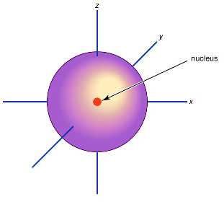
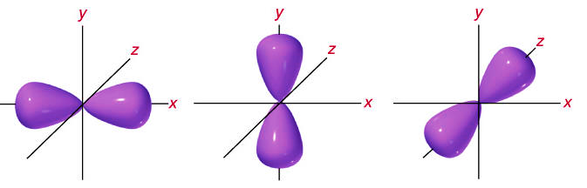
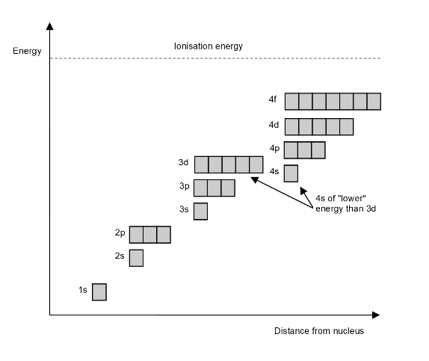
Electronic Configuration
Development of the model
Atomic emission spectra provided evidence for the existence of quantum shells
Successive ionisation energies provided evidence for the existence of quantum shells and the group to which the element belongs
First ionisation energy of successive elements provides evidence for electron sub-shells
Shells
n₁ | 2
n₂ | 8
n₃ | 18
n₄ | 32
Subshells
The grouping of subshells,
e.g., 3 p-orbitals, holding 6 electrons
Atomic
Orbitals
A region within an atom that can hold up to two electrons with opposite spins
s-orbital
p-orbital
Has 1 type, can hold 2 electrons
Has 3 different types, can hold 6 electrons
d-orbital
Has 5 different types, can hold 10 electrons
f-orbital
Has 7 different types, can hold 14 electrons
Hund’s Rule – Electrons fill subshells singly, before pairing up, and two electrons in the same orbital must have opposite spins.
Aufbau’s Principle – Lower energy orbitals are filled first.

Slide 5
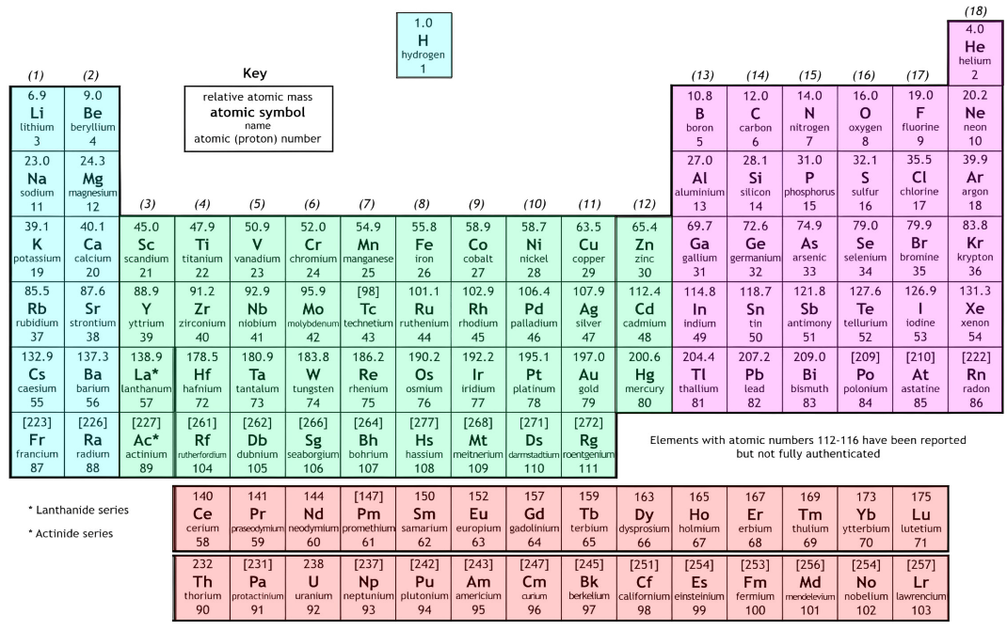
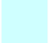



Electronic Configuration
s-Block
d-Block
p-Block
f-Block
Example:
Fe - 1s² 2s² 2p⁶ 3s² 3p⁶ 4s² 3d⁶
↿⇂
↿⇂
↿⇂
↿⇂
↿⇂
↿⇂
↿⇂
↿⇂
↿⇂
↿⇂
↿⇂
↿
↿
↿
↿
Fe³⁺ - 1s² 2s² 2p⁶ 3s² 3p⁶ 3d⁵
↿⇂
↿⇂
↿⇂
↿⇂
↿⇂
↿⇂
↿⇂
↿⇂
↿⇂
↿
↿
↿
↿
↿
The elements within a group have similar properties as they have the same outer electronic configuration.
Periodicity
Recurring trends that are seen in the properties of elements
Atomic Radii | Increasing atomic charge, shells/shielding stays the same
1st Ionisation Energy | Atomic radii decreases while nuclear charge increases, resulting in a general increase. (see page 3)
Electronegativity | Atomic radii decreases while nuclear charge increases, stronger attraction to nucleus
Melting/Boiling Point (Ar, Cl₂, P₄, S₈, Na, Mg, Al, Si) | Na, Mg, Al – Across the period, charge increase so bond strength increases Si – Has a Giant Covalent structure, all covalent bonds must be broken S₈, P₄, Cl₂ Ar – As S has the most electrons, it has the strongest LDF’s

