Slide 1
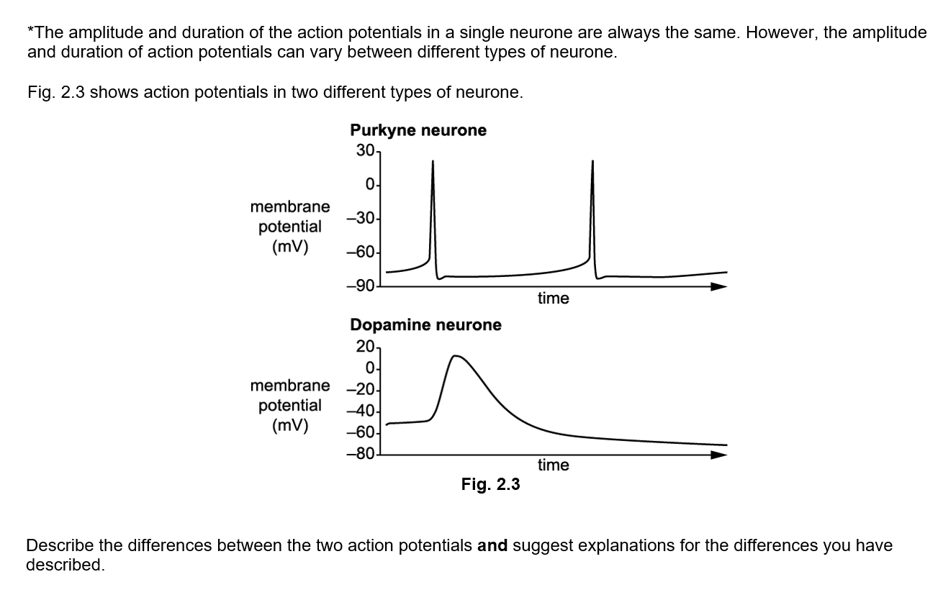
Independent exam question
You have 6 minutes
Start straight away
(6 marks)

Slide 2
Descriptions
Dopamine neurone:
Is less polarised / has a less negative resting potential
Depolarisation shows less change
Action potential peak is lower/less positive
No clear refractory period
Action potential duration is longer
Repolarisation is slower
Independent exam question
Explanations
Resting potential set up by:
Different type/number of sodium/potassium pumps in neuron membrane
Different type/number of sodium / potassium ion channels
Steeper sodium ion gradient in the Purkyne neurone
Steeper potassium ion gradient in the dopamine neurone
More voltage-gated potassium ion channels in the Purkyne neurone

Slide 3
Brain structure and function

Slide 4
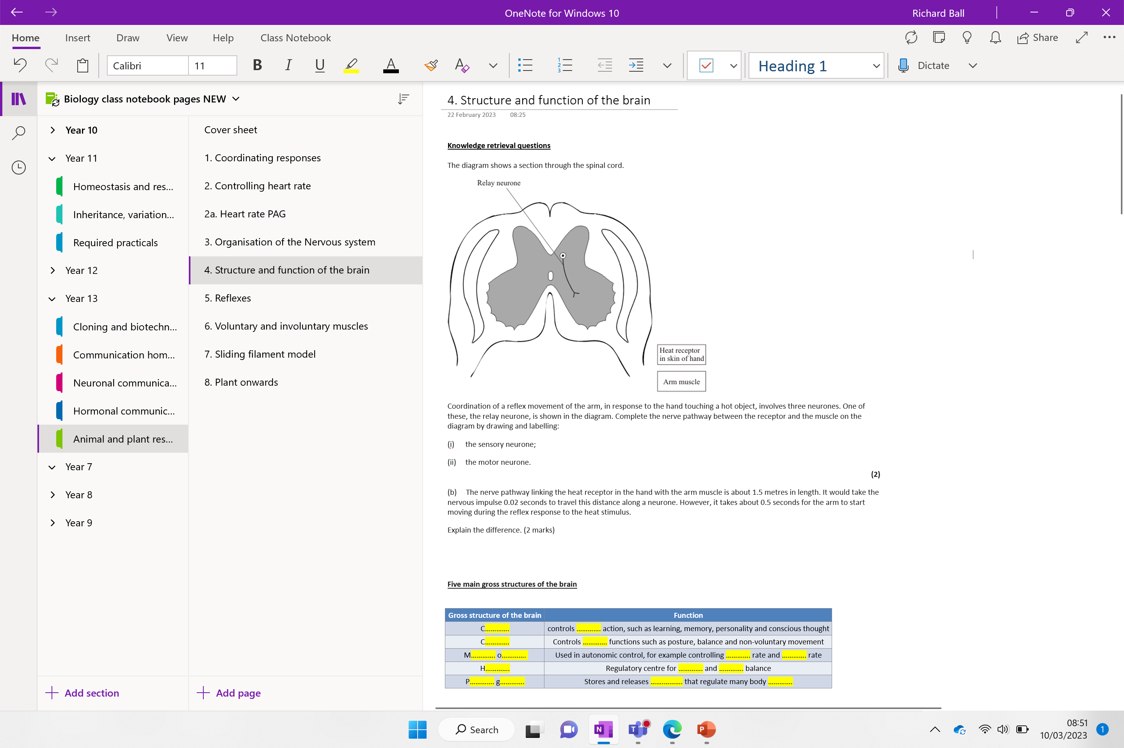

Slide 5
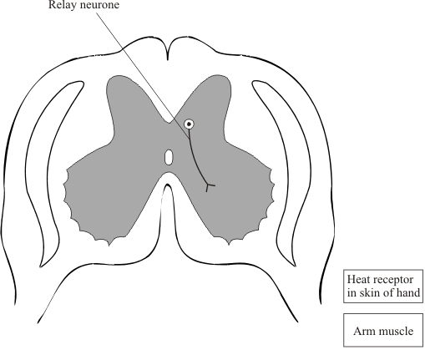
Knowledge retreival questions
The diagram shows a section through the spinal cord.
Coordination of a reflex movement of the arm, in response to the hand touching a hot object, involves three neurones. One of these, the relay neurone, is shown in the diagram. Complete the nerve pathway between the receptor and the muscle on the diagram by drawing and labelling:
(i) the sensory neurone;
(ii) the motor neurone.
(2)
(b) The nerve pathway linking the heat receptor in the hand with the arm muscle is about 1.5 metres in length. It would take the nervous impulse 0.02 seconds to travel this distance along a neurone. However, it takes about 0.5 seconds for the arm to start moving during the reflex response to the heat stimulus.
Explain the difference. (2 marks)
____________________________________________________________________________________________________________________________________________________________________________________________________________

Slide 6
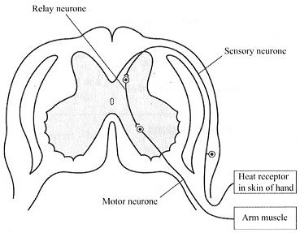
Knowledge retreival questions
The diagram shows a section through the spinal cord.
Coordination of a reflex movement of the arm, in response to the hand touching a hot object, involves three neurones. One of these, the relay neurone, is shown in the diagram. Complete the nerve pathway between the receptor and the muscle on the diagram by drawing and labelling:
(i) the sensory neurone;
(ii) the motor neurone.
(2)
(b) The nerve pathway linking the heat receptor in the hand with the arm muscle is about 1.5 metres in length. It would take the nervous impulse 0.02 seconds to travel this distance along a neurone. However, it takes about 0.5 seconds for the arm to start moving during the reflex response to the heat stimulus.
Explain the difference. (2 marks)
reference to synapses / gaps between neurones
extra time for release / movement of chemical neurotransmitters
extra time for development of muscle ‘tone’ / tension

Slide 7
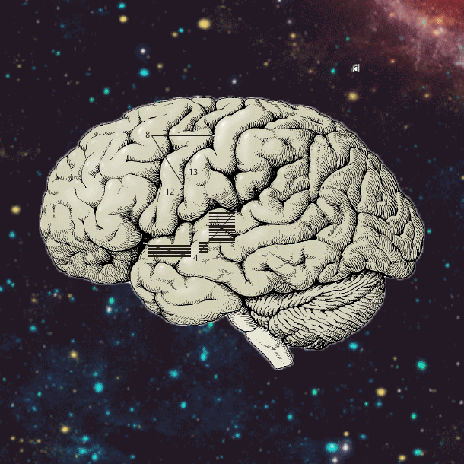

Slide 8
Five main gross structures of the brain
Gross structure of the brain | Function
C…………. | controls …………. action, such as learning, memory, personality and conscious thought
C…………. | Controls …………. functions such as posture, balance and non-voluntary movement
M…………. o…………. | Used in autonomic control, for example controlling …………. rate and …………. rate
H…………. | Regulatory centre for …………. and …………. balance
P…………. g…………. | Stores and releases …….………. that regulate many body ………….

Slide 9
Five main gross structures of the brain
Gross structure of the brain | Function
Cerebrum | controls voluntary action, such as learning, memory, personality and conscious thought
Cerebellum | Controls unconscious functions such as posture, balance and non-voluntary movement
Medulla oblongata | Used in autonomic control, for example controlling heart rate and breathing rate
Hypothalamus | Regulatory centre for temperature and water balance
Pituitary gland | Stores and releases hormones that regulate many body functions

Slide 10
Five main gross structures of the brain
Gross structure of the brain | Function
Cerebrum | controls voluntary action, such as learning, memory, personality and conscious thought
Cerebellum | Controls unconscious functions such as posture, balance and non-voluntary movement
Medulla oblongata | Used in autonomic control, for example controlling heart rate and breathing rate
Hypothalamus | Regulatory centre for temperature and water balance
Pituitary gland | Stores and releases hormones that regulate many body functions

Slide 12
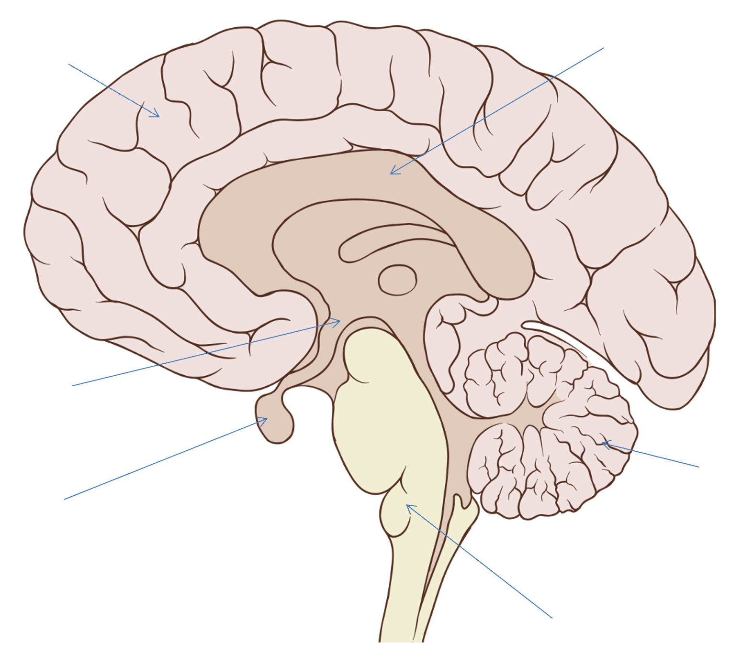
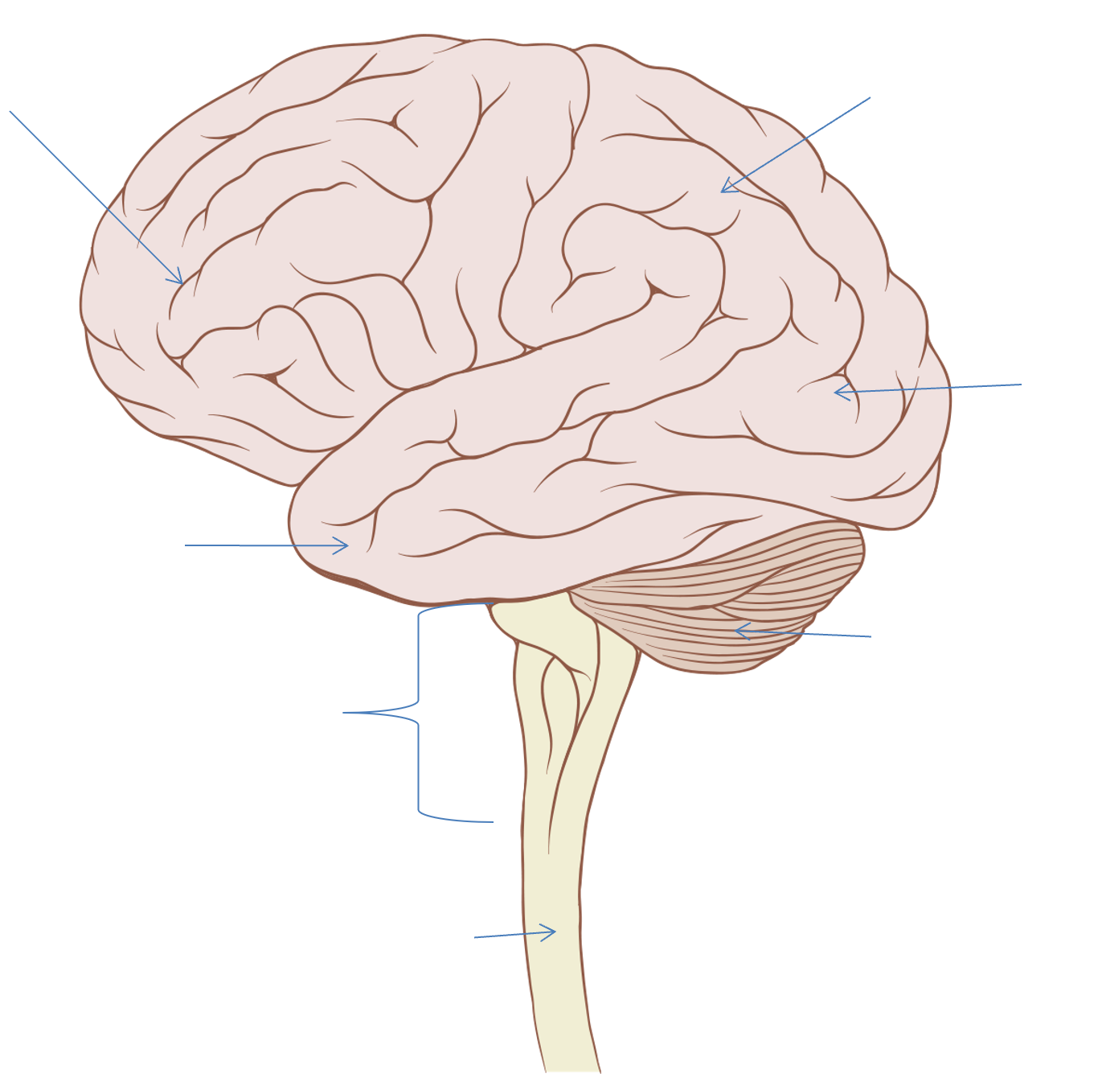
How much can you label from memory?
Internal structure
External (left side)
Label the brain: Use the link to help
Interactive Brain - How Injury Can Affect the Brain | BrainLine

Slide 13
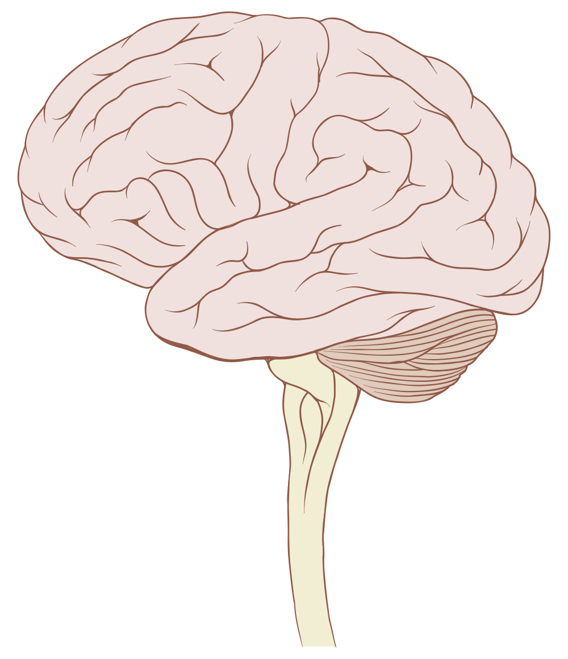
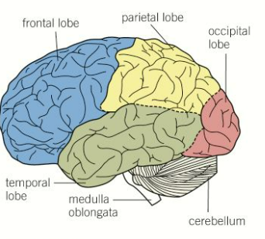
External structure (left side view)
Cerebrum
Frontal lobe
Parietal lobe
Occipital lobe
Temporal lobe
Cerebellum
Brain stem
Spinal cord

Slide 14
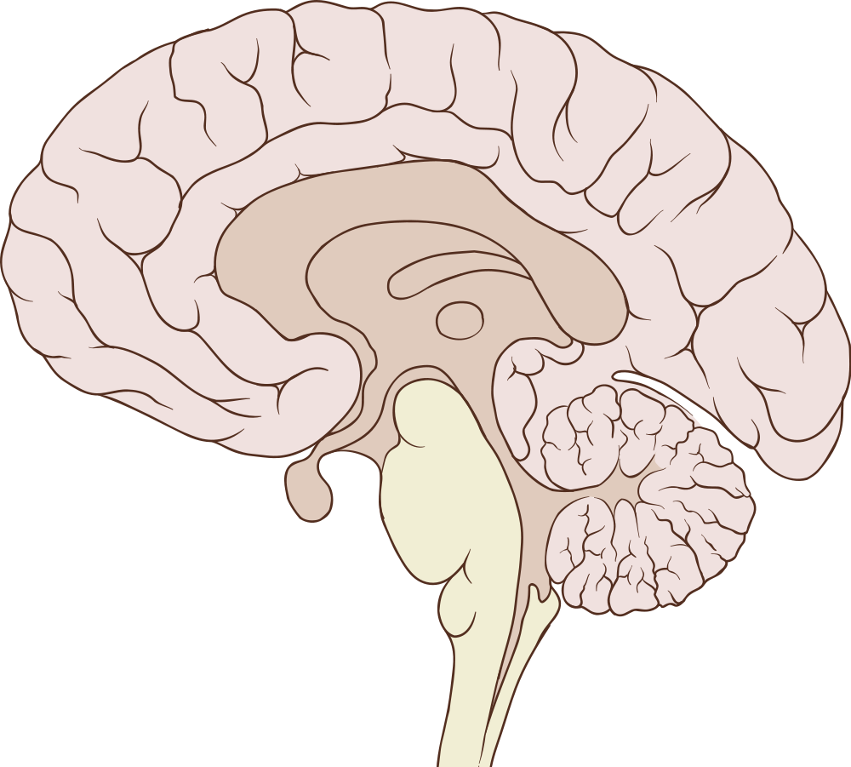
Internal structure of the brain
How the human brain works video
corpus callosum – band of nerve fibres that connect the two hemispheres
cerebral cortex – outer layer of tissue surrounding the cerebrum
hypothalamus
cerebellum
pituitary gland
medulla oblongata

Slide 15
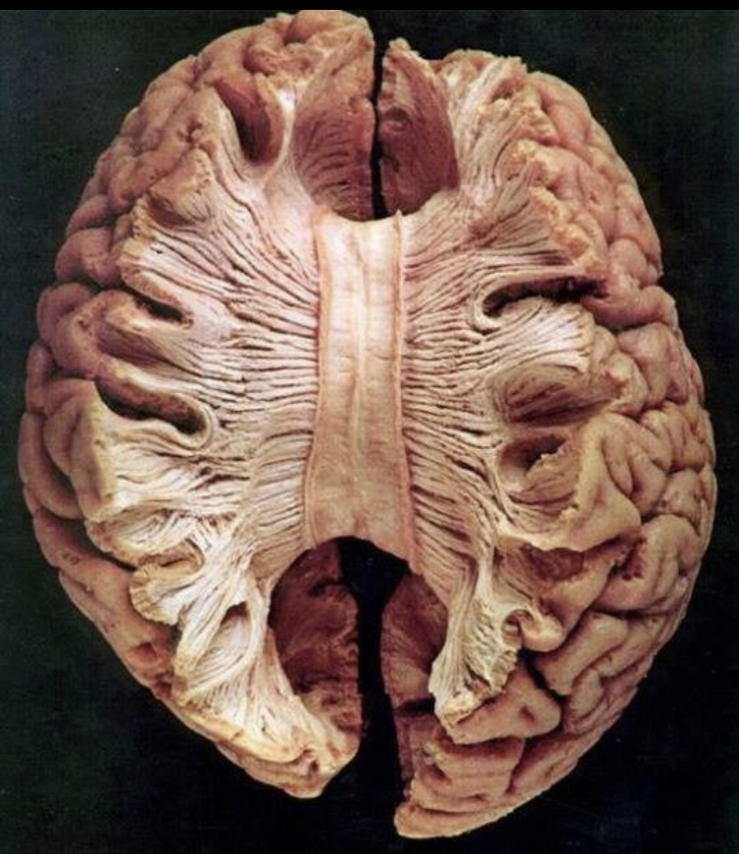
Corpus callosum
Band of nerve fibres that connect the two hemispheres

Slide 16
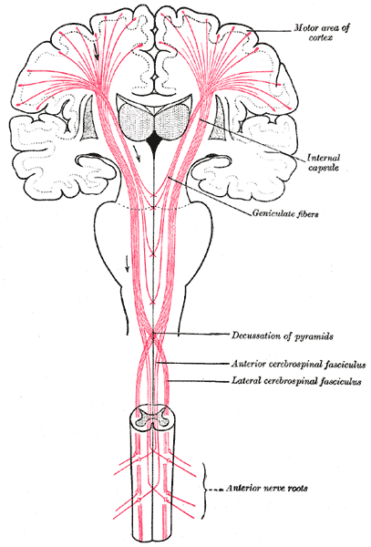
Cerebrum
Split into two hemispheres (left and right) each controlling one side of the body.
High convoluted – increases surface area to help perform complex activities.
Nerve impulses cross over at the base of your brain so your left side of the brain controls the right side of your body.
Careful!
The cerebrum is one of the 5 main regions of the brain, while the cerebral cortex is a thin layer of that covers the surface of the cerebrum. So they can be labelled in the same location!
Notes:
More surface for hormonal receptors – insulin / leptin (regulates body weight)
Twist theories!
Somatic / axel - Embryo twisting during development

Slide 17
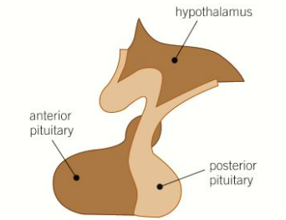
Pituitary
Divided into two sections
Anterior pituitary (front) – Produces six hormones (including FSH)
Posterior pituitary (back) – Stores and releases hormones produced by the hypothalamus (including ADH)
Notes:
More surface for hormonal receptors

Slide 18
Why is performing brain surgery difficult?
How are they usually performed?

Slide 19
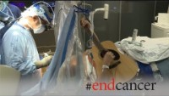
Notes:
Memory , movement, speech

Slide 20
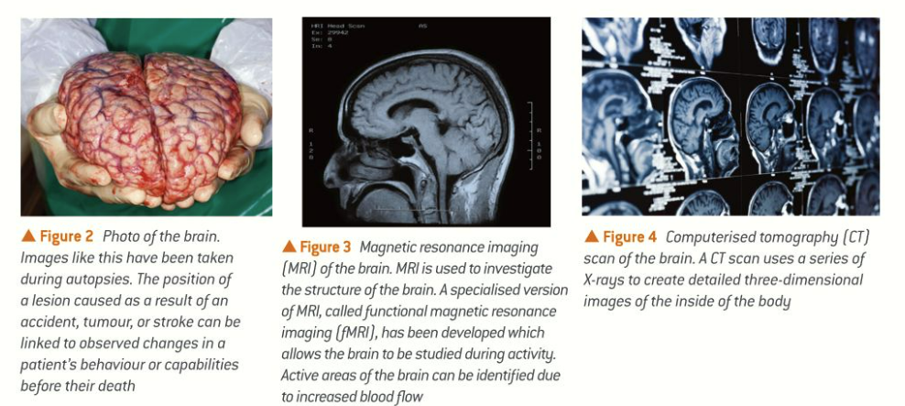
Studying the brain – Read and answer question below
Notes:
Stroke affecting left side
A Stroke on Left Side of Brain Affects Right Side of Body. Each hemisphere of the brain controls the opposite side of the body. Therefore, a left side stroke often impairs the ability to control the right side of the body.
Stokes can affect both sides of the body.

Slide 21
Past paper question
Explain how CT, MRI and fMRI scans enable scientists and doctors to look at the structure and functioning of the brain after a stroke has occurred (3 marks)
CT, MRI, fMRI - Can scan the brain (magnetics or x-rays)
Allowed scientists to pinpoint exactly what parts of the brain have been damaged after a stroke
This can then be linked to changes in behaviour
fMRI allow for movement, which can be linked to cerebellum damage

Slide 22
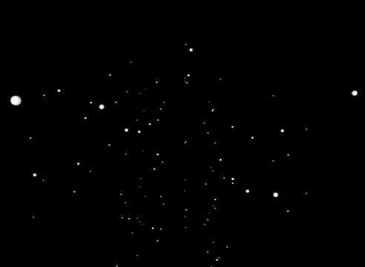

Slide 23

Work down the list – no words – no numbers – pictures only!

Slide 24
Islet of Langerhans
Insulin
Nodes of Ranvier
Thymus
Depolarisation
Schwann cells
Glucagon
Hepatocytes
Pineal gland
Repolarisation
Kupffer cells
Noradrenaline
Myelin sheath
Ion channel
Resting potential

Slide 25
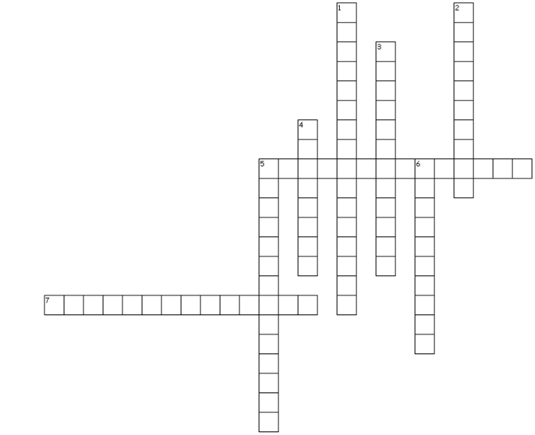
Across
5. Responsible for intelligence, conscious thought and reasoning. Lines the cerebrum.
7. Site of release of ADH.
Down
Regulates heart rate.
2. Term used to describe each half of the cerebrum
3. Site of osmoreceptors that regulate the release of ADH.
4. Largest part of the brain.
5. Connects the left and right cerebral hemispheres.
6. Responsible for balance.

Slide 26
Across
5. Responsible for intelligence, conscious thought and reasoning. Lines the cerebrum Cerebral cortex
7. Site of release of ADH. Pituitary gland
Down
1. Regulates heart rate. Medulla oblongata
2. Term used to describe each half of the cerebrum Hemisphere
3. Site of osmoreceptors that regulate the release of ADH. Hypothalamus
4. Largest part of the brain. Cerebrum
5. Connects the left and right cerebral hemispheres. Corpus callosum
6. Responsible for balance. Cerebellum

Slide 27
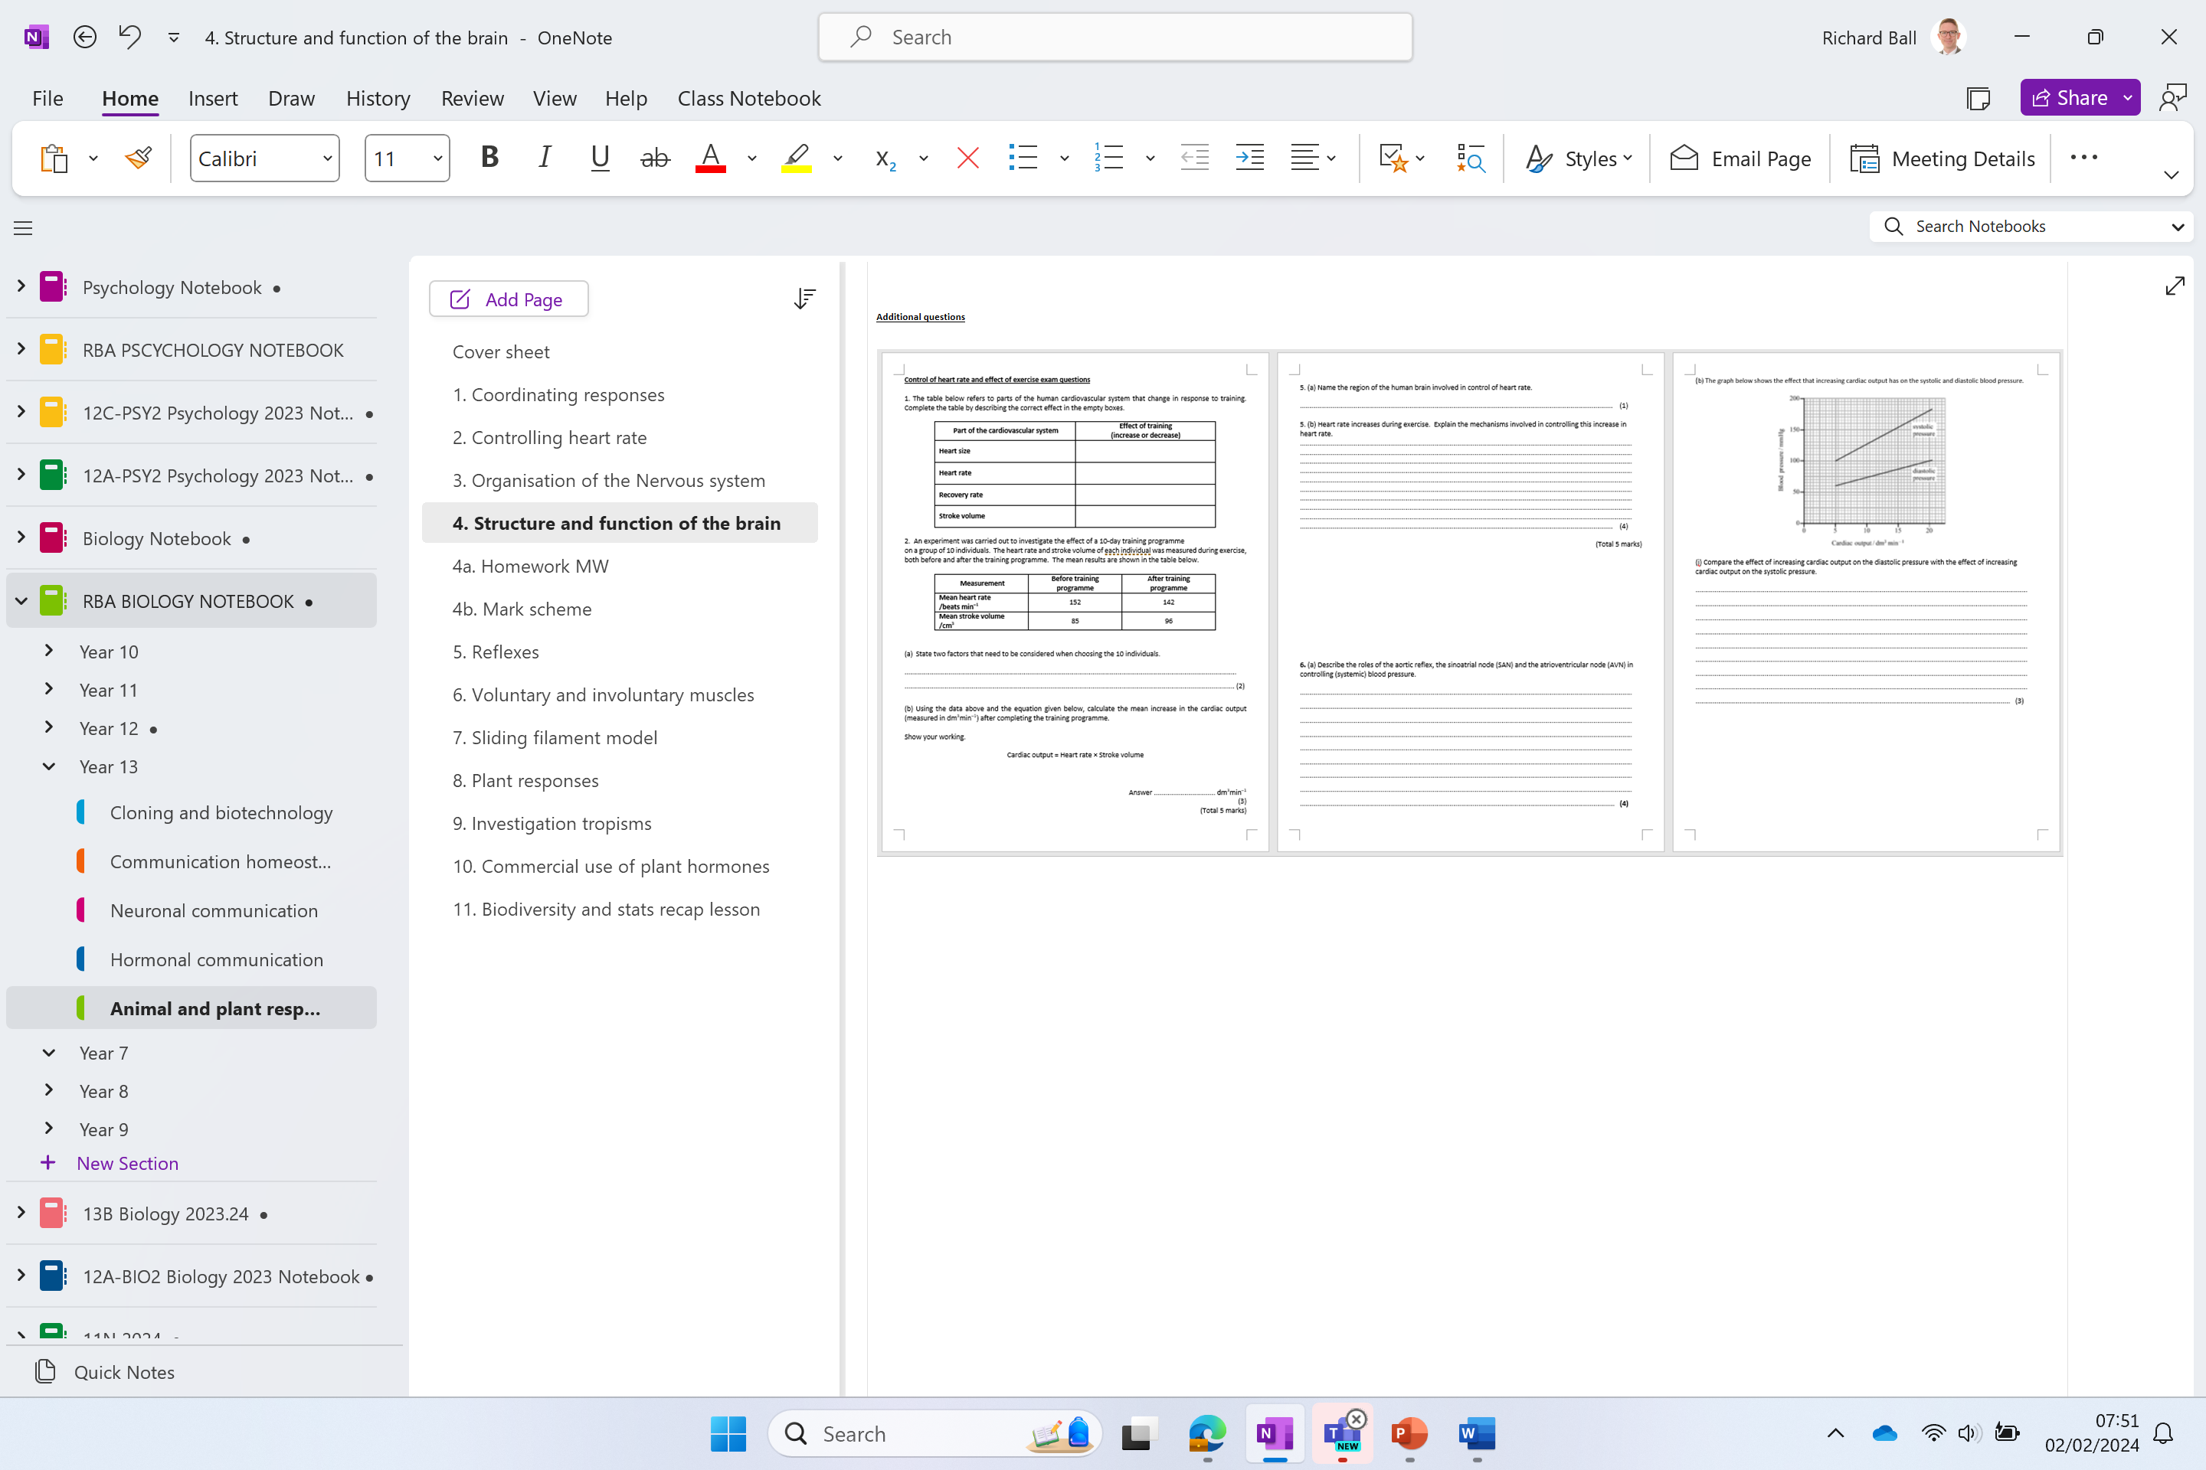
Additional questions

Slide 28
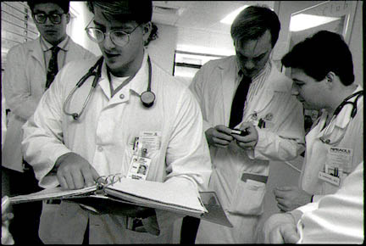
Imagine you are a Doctor on your rounds. Read the descriptions of the symptoms experienced by different patients and decide which area of their brain is affected.

Slide 29
Frontal lobe
Parietal lobe
corpus collosum
Higher brain functions such as decision making, reasoning, planning and consciousness of emotions. Contains primary motor cortex.
Orientation, movement, sensation, calculation and some types of recognition
Connects the left and right hemispheres to coordinate information
Occipital Lobe
Processing information from eyes, including vision, colour, shape recognition and perception
hypothalamus
Homeostasis: control of body temperature and osmoregulation. Secretes hormones.
Temporal Lobe
Processing of auditory information (hearing, sound recognition and speech)
cerebellum
Fine motor control, posture and balance
pituitary gland
pons
Produces hormones that control growth, sexual development and metabolism
Links the medulla with the thalamus
midbrain
medulla oblongata
Involved in control of visual and auditory systems. Also controls body movement
Controls breathing, heart rate and blood pressure; reflex actions such as vomiting and sneezing

