Slide 1
Antibiotics and New Medicines
Wednesday, 23 July 2025

Slide 2
Antibiotics
‘any substance produced by a microorganism which, in dilute solution, harms or kills another microorgansim’
Can be from fungi or mainly from actinobacteria (Streptomyces)
Treat bacterial infections
Penicillin inhibits transpeptidase (an enzyme which catalyses a reaction in the formation of cross links in peptidoglycan)

Slide 3
Antibiotic resistance
What do you remember from GCSE about antibiotic resistance? Big whiteboard activity
What may cause it to increase? (think about how we take a course of antibiotics)
VANCOMYCIN – used as a last resort, but now seeing resistance to this!

Slide 4
What are the two main causes of this?
Population with no antibiotic resistant bacteria
Chance mutation in one bacterium produces gene for antibiotic resistance
Population with ___ antibiotic resistant bacteria
Antibiotic A
Antibiotic A applies strong selection pressure, natural selection for ab resistance
Population with ______ antibiotic resistant bacteria
Antibiotic A
Continued selection pressure allows survival of only resistant bacteria
Population of ___ antibiotic resistant bacteria

Slide 5
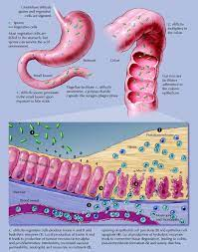
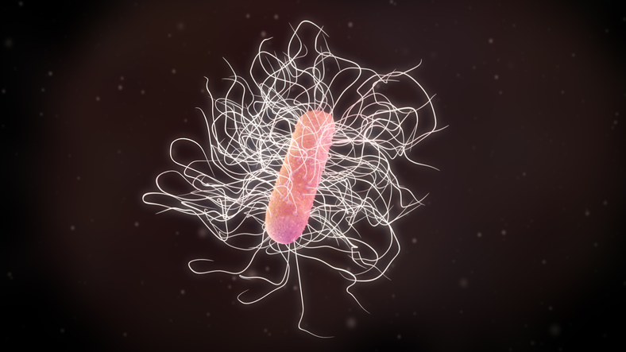
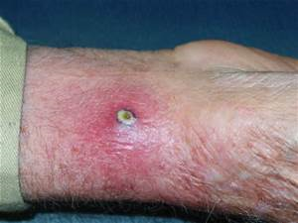
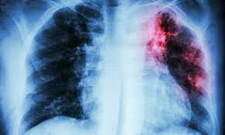
Multi-drug resistant strains
Clostridium difficile
MRSA
Tuberculosis mycobacterium tuberculosis

Slide 6
New medicines
Make notes on bacterial and plant examples as sources for medicines
Why is conservation so important with regard to sources of medicine?
Make notes on PERSONALISED MEDICINES, including why our knowledge of genes and proteins have helped in this area
What is SYNTHETIC BIOLOGY, give a named e.g
Divide into groups. Research one point each make some notes then teach others about your research.

Slide 7
Key term​ | Definition​
Chronic disease​ | ​
Acute disease​ | ​
Opportunistic infection​ | ​
Autoimmune disease​ | ​
Non-communicable disease​ | ​

Slide 8
Q1. Asthma is an inflammatory disease which affects the lungs. It can’t be passed from one person to another and usually affects people for long periods of time. What type of disease is asthma?
Chronic, non-infectious
Q2. Yellow fever is a disease caused by viruses of the Flaviviridae family. Symptoms include fever, headaches and vomiting and last for between three and four days. What type of disease is yellow fever?
Acute, infectious
Q3. AIDS is an immune system disorder caused by the Human Immunodeficiency Virus. The virus infects and destroys T lymphocytes, so the number that work properly gradually falls. AIDS patients often suffer from opportunistic infections, i.e. infections that wouldn’t normally cause too much of a problem in a healthy person. Common ones are tuberculosis, pneumonia and an infection of the brain called toxoplasmosis. Explain why AIDS patients suffer from opportunistic infections.
Q4. Rheumatic fever is a disease where the immune system attacks cells in the heart. It is often triggered by an infection with the bacterium Streptococcus pyogenes. Antigens on the surface of S.pyogenes have a very similar shape to antigens on the surface of heart cells. Suggest why S.pyrogenes infection can lead to rheumatic fever.
Extension – give an example of cell signalling being used during an immune response.

Slide 9
Q3. AIDS is an immune system disorder caused by the Human Immunodeficiency Virus. The virus infects and destroys T lymphocytes, so the number that work properly gradually falls. AIDS patients often suffer from opportunistic infections, i.e. infections that wouldn’t normally cause too much of a problem in a healthy person. Common ones are tuberculosis, pneumonia and an infection of the brain called toxoplasmosis. Explain why AIDS patients suffer from opportunistic infections.
With fewer T lymphocytes, fewer pathogens killed.
With fewer T lymphocytes in the blood, fewer cells available to be activated by the pathogens antigens presented by phagocytes.
Therefore fewer B lymphocytes activated, and so fewer antibodies are produced against the specific pathogen.
With fewer antibodies, pathogens can survive longer in the body, so opportunistic infections can cause a problem.

Slide 10
Q4. Rheumatic fever is a disease where the immune system attacks cells in the heart. It is often triggered by an infection with the bacterium Streptococcus pyogenes. Antigens on the surface of S.pyogenes have a very similar shape to antigens on the surface of heart cells. Suggest why S.pyrogenes infection can lead to rheumatic fever.
Antibodies generated against antigens on the surface of S.pyrogenes.
These antibodies will also bind to the surface of heart cells because the antigens have a similar shape.
The immune system would then attack the heart cells and cause Rheumatic fever.
Extension – give an example of cell signalling being used during an immune response.
Helper T cells release substances that bind to receptors on B lymphocytes.
This activates the B lymphocytes,
As the helper T cells are signalling to the B lymphocytes that there is a pathogen in the body.

Slide 11
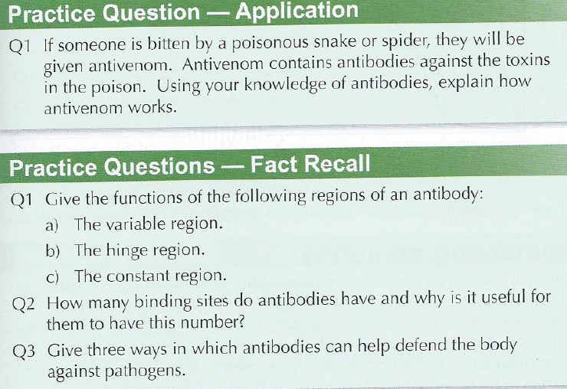

Slide 12
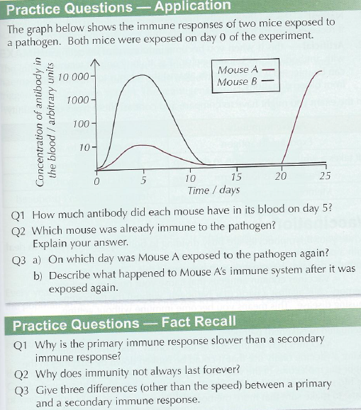

Slide 13
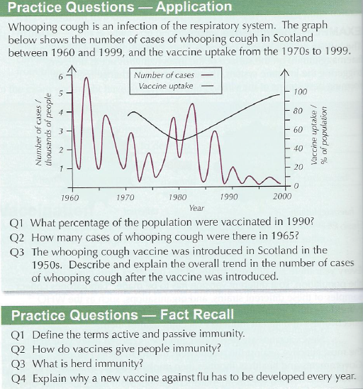

Slide 14
